Slide 1
CSCI 6461: Computer Architecture
Lecture 5
Overcoming Data Hazards with Dynamic Scheduling
Instructor: M. Lancaster
Corresponding to Hennessey and Patterson
Fifth Edition
Sections 3.4 and 3.5

Slide 2
Dynamic Scheduling Using Tomasulo’s Approach
Tomasulo invented the IBM 360/91 floating point unit
  Built before cache memories came into use
  The unit tracks when operands for instructions are available to minimize RAW hazards
  Used register renaming to minimize WAW and RAW hazards
Key concept
  Track instruction dependences to allow execution as soon as operands were available and renaming registers to avoid WAR and WAW hazards
Goal
  Achieve high floating point performance from the instruction set without relying on compiler
September 2012
Fall 2012

Slide 3
Tomasulo’s Approach - Background
IBM 360/91 had only 4 double precision floating point registers
IBM 360/91 had long memory accesses and long floating point delays
IBM 360/91 has register-memory instructions
Tomasulo’s algorithm focuses on the floating point unit and the load-store unit
September 2012
Fall 2012

Slide 4
Tomasulo’s Approach - Background
RAW hazards – avoided by execution of an instruction only when its operands are available
WAR and WAW hazards – eliminated by register renaming
  All destination registers renamed including those with pending read or write for an earlier instruction
  DIV.D F0,F2,F4
  ADD.D F6,F0,F8
  S.D F6,0(R1)
  SUB.D F8,F10,F14
  MUL.D F6,F10,F8
ADD.D & SUB.D has an antidependence
F8 must be used by ADD.D before SUB.D writes it or WAR hazard
ADD.D must finish with R6 before S.D writes
S.D must finish before write-back of MUL.D, WAW if ADD.D finishes later than MUL.D
September 2012
Fall 2012

Slide 5
Tomasulo’s Approach - Background
Assume 2 temporary registers S & T
S allows MUL.D to finish before ADD.D – removes F8
T allows SUB.D to finish before ADD.D
Any subsequent uses of F8 must be replaced by T
  DIV.D F0,F2,F4 DIV.D F0,F2,F4
  ADD.D F6,F0,F8 ADD.D S,F0,F8
  S.D F6,0(R1) S.D S,0(R1)
  SUB.D F8,F10,F14 SUB.D T,F10,F14
  MUL.D F6,F10,F8 MUL.D F6,F10,T
September 2012
Fall 2012

Slide 6
Tomasulo’s Approach - Background
Register renaming is provided by reservation stations
  Buffer operands of instructions waiting to issue
  Fetches and buffers an operand as soon as it is available, eliminating need to get it from a register
  Pending instructions designate the reservation station that will provide their input. As instructions are issued, the register specifiers for pending operands are renamed to the names of the reservation station
  When successive writes to a register overlap in execution, only the last one is used to update the register
  There can be more reservation stations than real registers
September 2012
Fall 2012

Slide 7
Tomasulo’s Approach – Use of reservation stations rather than a centralized register file
Hazard detection and execution control are distributed
  Information held in the reservation stations at each functional unit determine when an instruction can begin execution at that unit
Results are passed directly to functional units from the reservation station where they are buffered
  Common results bus (also called common data bus – CDB) that allows all units waiting for an operand to be loaded at once
  In pipelines with multiple execution units and issuing multiple instructions per clock, more than one results bus will be needed
September 2012
Fall 2012

Slide 8
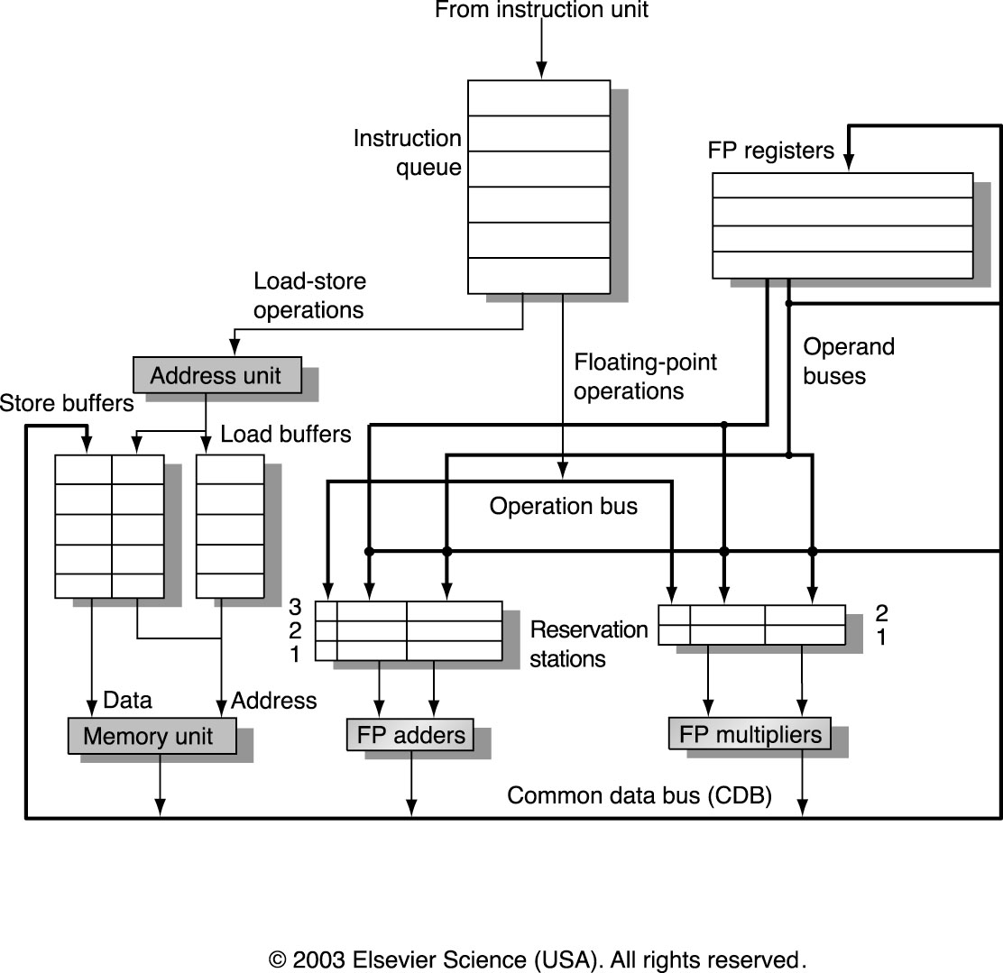
The basic structure of a MIPS floating point unit using Tomasulo’s algorithm
Execution control tables not shown
Each station holds instruction that has been issued and is awaiting execution at a functional unit and either the operand values or the name of a reservation station that will provide the values
Load and store buffers behave similar to reservation stations
Reservation stations have tag fields employed by pipeline control
September 2012
Fall 2012

Slide 9
Instruction Execution in this Pipeline
Issue
  Get the instruction from the head of the instruction queue, which is maintained in FIFO order.
  If there is a matching reservation station that is empty, issue the instruction to the station with the operand values, if they are currently in registers
  If there is not an empty reservation station, then there is a structural hazard and the instruction stalls until a station or buffer is freed. If the operands are not in the registers, keep track of the functional units that will produce the operands
  REGISTERS RENAMED, WAR AND WAW HAZARDS ELIMINATED
September 2012
Fall 2012

Slide 10
Instruction Execution in this Pipeline
(2) Execute
  If not all operands available, monitor the common data bus while waiting for the instruction to be completed. When operand becomes available, it is placed into the corresponding reservation station.
  When all operands are available, operation can be executed at the corresponding functional unit.
  Delaying execution until all operands available, RAW hazards eliminated
  Several instructions could become ready in the same clock cycle for the same functional unit – unit will have to choose
  For floating point unit reservation stations, choice can be arbitrary (we are producing register results here)
September 2012
Fall 2012

Slide 11
Instruction Execution in this Pipeline
(2) Execute - continued
  Load and store ( choosing when multiple instructions are ready) – two steps
    Compute effective address when the base register is available
      Effective address is then placed in the load or store buffer
    Load/Store
      Loads in load buffer execute as soon as memory unit is available
      Stores in the store buffer wait for the value that is to be stored before being sent to the memory unit
  Loads and stores are maintained in program order through the effective address calculation
September 2012
Fall 2012

Slide 12
Instruction Execution in this Pipeline
(2) Execute - continued
  Preservation of exception behavior
    No instruction is allowed to initiate execution until all branches that precede the instruction in program order have completed (this could be relax to say that no instruction will be allowed to cause an exception until all branches that precede the instruction in program order have completed; we will see this later)
    Processor must know that branch prediction was correct
    Exception can be recorded but not actually raise it until appropriate time
September 2012
Fall 2012

Slide 13
Instruction Execution in this Pipeline
(3) Write Result
  When the result of the instruction is available, write it on the Common Data Bus and from there into the destination registers and into any reservation stations (including store buffers) waiting for this result.
  Stores write data to memory during this step.
September 2012
Fall 2012

Slide 14
Hazard Detection and Elimination – The Apparent Effects of the Tomasulo Hardware
Data structures (hardware) used to detect and eliminate hazards are attached to
  Reservation stations
  Register file
  Load – Store buffers
These are tags associated with an extended set of virtual registers used in renaming, that is, the reservation station operand registers
  For this example, the tags are a 4 bit quantity that denotes one of the 5 reservation stations or one of the six load buffers, an equivalent of 11 registers that can be designated as results registers
  The tag field describes which reservation station contains the instruction that will produce a result needed as a source operand
September 2012
Fall 2012

Slide 15
Hazard Detection and Elimination
Once an instruction has been issued and is waiting for a source operand, it refers to the operand by the reservation station number where the instruction that will write the register has been assigned
Unused values, such as 0, indicate that the operand is already available in the registers
September 2012
Fall 2012

Slide 16
Reservation Stations
In the Tomasulo scheme, the tags refer to the buffer or unit that will produce the result. Register names are discarded when an instruction issues to a reservation station
Each reservation station has seven fields
  Op – The operation to perform on source operands S1 and S2
  Qj, Qk – The reservation stations that will produce the corresponding source operand ( a value of 0 indicates that the operand is already available in Vj or Vk or is unnecessary)
  Vj, Vk – The value of the source operands. Only one of the V field or the Q field is valid for each operand. For loads, the Vk field is used to hold the offset field
  A – Used to hold information for the memory address calculation for a load or store – immediate field initially stored here, then EA
  Busy – Indicates that this reservation station and its accompanying functional unit are occupied
September 2012
Fall 2012

Slide 17
Register file & Load-Store Buffers
The register file has one additional field, Qi
  Qi – The number of the reservation station that contains the operation whose result should be stored into this register. If the value is blank (or 0) no currently active instruction is computing a result destined for this register, meaning that the value is simply the register contents
The load and store buffers each have a field, A
  A – holds the result of the effective address once the first step of execution has been completed.
September 2012
Fall 2012

Slide 18
Ex. Show information tables for only first load completion
Refer to page 177, Fig 3.7 – note status of instructions indicate all have been able to issue, both loads in execution and first load finished
Load1, Load2, Add1, Add2, Mult1, Mult2 indicate tag for the reservation station – With load 1 complete, the reservation station (load store buffer in this case) is no longer busy
Load 1 is completed, it provided a result for register F6, which is to be loaded with the value 34(R2). This effective address was completed and when completed, got stored in the Vk for any later instruction that used F6 (note these are both second operands so in Vk vs Vj)
Load 2 has not complete, but has a completed effective address and its reservation station is busy. Note that the SUB.D will need register F2 provided by this load
September 2012
Fall 2012

Slide 19
Ex. Show information tables for only first load completion
Add1 is the reservation station name for the SUB.D instruction (note the SUB in the Op field). The first load has completed and therefore the value for the second operand (F6) passed by the bus when the load-store unit fetched it, and therefore the value can be put in Vk. Now the first operand is F2 which will be there when the second load completes, so Qj gives the reservation station that will contain the result when complete (which is Load2).
The rest is left to the student
September 2012
Fall 2012

Slide 20
Tomasulo’s Algorithm Details
Loads-Stores
Refer to Figure 3.8 Page 179
Loads and stores go through a functional unit for EA computation before going to load or store buffers.
Loads take a second step to access memory and then go to Write Result to send result to register file and/or waiting reservation stations
Stores complete their execution in Write Result which writes the result to memory. (Note that Loads and Stores do writes in Write Result)
September 2012
Fall 2012

Slide 21
Tomasulo’s Algorithm Details
rd is the destination, rs and rt source
imm is sign extended immediate field and r is the reservation station or buffer the instruction is assigned to.
RS is the reservation station data structure.
The value returned by an FP unit or by the load store unit is called result
RegisterStat is the register status data structure
Regs[] is the register file
September 2012
Fall 2012

Slide 22
Tomasulo’s Algorithm Details
Issue for FP operation, using station r (which we waited for)
  If (RegisterStat[rs].Qi ≠0) ;if some active inst is computing a result for rs
  {RS[r].Qj ← RegisterStat[rs].Qi;} ;then place in station r’s Qj field
  ;the number of the reservation
  ;station that will provide result for
  ;rs
  else
  {RS[r].Vj ← Regs[rs] ; RS[r].Qj ←0;} ;else place the value of the register
  ;specified in the rs field into to Vj
  ;field of the reservation station and
  ;set the Qj field = 0 to indicate
  ;that the value is available
  ;Do the same for rt
September 2012
Fall 2012

Slide 23
Tomasulo’s Algorithm Details
Do the Same for Rt
  If (RegisterStat[rt].Qi ≠0) ;if some active inst is computing a result for rs
  {RS[r].Qk ← RegisterStat[rt].Qk;} ;then place in station r’s Qk field
  ;the number of the reservation
  ;station that will provide result for
  ;rt
  else
  {RS[r].Vk ← Regs[rt] ; RS[r].Qk ←0;} ;else place the value of the register
  ;specified in the rt field into to Vk
  ;field of the reservation station and
  ;set the Qk field = 0 to indicate
  ;that the value is available
September 2012
Fall 2012

Slide 24
Tomasulo’s Algorithm Details
Issue for FP operation, using station r –continued
  RS[r].Busy ←yes ;set reservation station as busy
  RegisterStat[rd].Qi=r ;set the status tag of the register in the rd
  ;field to point to this reservation station
  ;indicating that we are producing a result
  ;for rd
September 2012
Fall 2012

Slide 25
Tomasulo’s Algorithm Details
Execute for FP operation, using station r
  Wait until RS[r].Qj=0 and RS[r].Qk = 0 ;wait for both operands available
  compute the result from the operands in Vj and Vk
September 2012
Fall 2012

Slide 26
Tomasulo’s Algorithm Details
Write Result for FP operation (or a load register operation)
  Wait for execution complete at reservation station r & the CDB available
  ∀x (if (RegisterStat[x].Qi = r) ; for all registers waiting on a result
  ; from this station
  { Regs[x] ← result ; place result in register
  RegisterStat[x].Qi ← 0 } ; remove the waiting for tag.
  )
  ∀x (if (RS[x].Qj = r) ; for all reservation stations waiting
  ; on a first source operand from r
  {RS[x].Vj ← result ; store the result in the Vj field
  RS[x].Qj ← 0} ; remove the waiting for tag
  )
September 2012
Fall 2012

Slide 27
Tomasulo’s Algorithm Details
Write Result for FP operation (or a load register operation) - continued
  ∀x (if (RS[x].Qk = r) ; for all reservation stations waiting
  ; on a second source operand from r
  {RS[x].Vk ← result ; store the result in the Vk field
  RS[x].Qk ← 0} ; remove the waiting for tag
  )
  RS[r].Busy ← no;
September 2012
Fall 2012

Slide 28
Tomasulo’s Algorithm Details
The Load Store Operations are left for the student
September 2012
Fall 2012

Slide 29
Tomasulo’s Algorithm Details
Loop Example
An example
  Loop: L.D F0,0(R1)
  MUL.D F4,F0,F2
  S.D F4,0(R1)
  DADDUI R1,R1,-8
  BNE R1,R2,Loop
September 2012
Fall 2012

Slide 30
Tomasulo’s Algorithm Details
Loop Example
If we had adequate hardware to ensure that no instruction causes an exception until prior branches are executed and if the branches are taken, using reservation stations will allow multiple executions of this loop to proceed at once
In effect, the loop is unrolled dynamically
Notes
  A load and store can safely be done in different order, provided they access different addresses
  The processor can check program order and the effective address
  We will look at the hardware that allows the algorithm to proceed across branches later
September 2012
Fall 2012

Slide 31
Tomasulo’s Algorithm Summary
This scheme can lead to very high performance
Tomasulo’s scheme is hardware expensive
  Each reservation station must have
    Associative buffer
    Complex control logic
  Performance limited by single CDB
    If another added, each reservation station must interact with all CDB’s and logic gets more complex
Two techniques combined
  Renaming of registers
  Buffering of source operands from the register file
September 2012
Fall 2012

Slide 32
Tomasulo’s Algorithm Summary
This scheme is a technique for overcoming data hazards
Implements forwarding
Uses out of order execution
September 2012
Fall 2012

