Slide 1
CS 211: Computer Architecture
Lecture 5
Instruction Level Parallelism and Its Dynamic Exploitation
Instructor: M. Lancaster
Corresponding to Hennessey and Patterson
Fifth Edition
Sections 3.6 and Section 3.8

Slide 2
Hardware Based Speculation
For highly parallel machines, maintaining control dependencies is difficult
A processor executing multiple instructions per clock may need to execute a branch instruction every clock.
The processor will speculate (guess) on the outcome of branches and execute the program as if the guesses are correct.
  Fetch, issue and execute instructions as if they are correct; dynamic scheduling only fetches and issues the instructions
  Must handle incorrect speculations
September 2012
Lecture 5 Spring 2012

Slide 3
Hardware Based Speculation
Combination of 3 key activities
  Dynamic branch prediction to choose which instructions to execute
  Speculation to allow the execution of instructions before the control dependencies are resolved
    Must be able to undo effects of an incorrectly speculated sequence
  Dynamic scheduling to deal with scheduling of different combinations of basic blocks
Hardware based speculation follows the predicted flow of data values to choose when to execute instructions
September 2012
Lecture 5 Spring 2012

Slide 4
Hardware Based Speculation Approach
A particular approach is an extension of Tomasulo’s algorithm.
  Extend the hardware to support speculation
  Separate the bypassing of results among instructions from the actual completion of an instruction, allowing an instruction to execute and to bypass its results to other instructions without allowing the instruction to perform any updates that cannot be undone
  When an instruction is no longer speculative, it is committed. (An extra step in the instruction execution sequence allows it to update the register file or memory – “instruction commit”.
September 2012
Lecture 5 Spring 2012

Slide 5
Hardware Based Speculation Approach
Allow instructions to execute out of order but force them to commit in order to prevent irrevocable actions such as updating state or taking an exception
Add a commit phase (to our 5 stage pipeline as an example)
  Requires changes to the sequence and additional set of hardware buffers that hold the results of instructions that have finished but not committed.
  The hardware buffer is called a ReOrder Buffer (ROB)
September 2012
Lecture 5 Spring 2012

Slide 6
Reorder Buffer (ROB)
Provides additional registers in the same way as the reservation stations
Holds result of instruction between the time the operation associated with the instruction completes and the time the instruction commits.
  It therefore is a source of operands for instructions
  With speculation, however, the register file is not updated until the instruction commits
September 2012
Lecture 5 Spring 2012

Slide 7
Reorder Buffer (ROB)
Entries containing four fields
  Instruction Type
    Indicates whether the instruction is a branch, a store or a register operation
  Destination
    Supplies the register number or the memory address where the results should be written
  Value
    Holds the value of the instruction result until the instruction commits
  Ready
    Indicates that the instruction has completed execution and the value is ready
September 2012
Lecture 5 Spring 2012

Slide 8
Reorder Buffer (ROB)
In use with Tomasulo
  ROBs completely replace the store buffers
  Stores occur in two steps with the second step done by instruction commit
  Results now tagged with ROB number rather than reservation station number (in this implementation)
September 2012
Lecture 5 Spring 2012

Slide 9
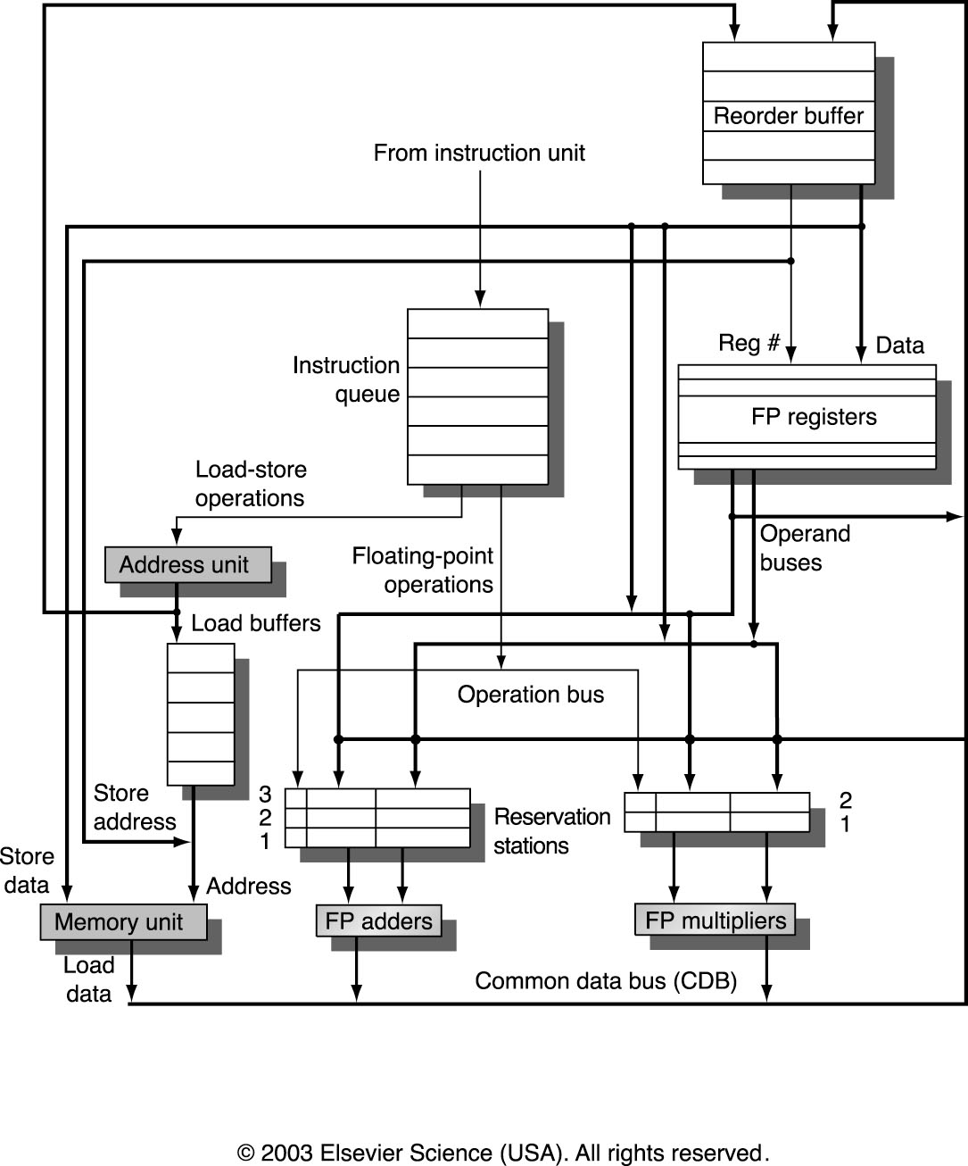
Reorder Buffer and Reservation Stations
September 2012
Lecture 5 Spring 2012

Slide 10
Instruction Execution With ROBs
Issue
  Get an instruction from instruction queue. Issue if there is an empty reservation station and an empty slot in the ROB; send the operands to the reservation station if they are available in either the register or the ROB.
  Update the control entries to indicate the buffers are in use; the number of the ROB allocated for the result being sent to the reservation station so that the number can be used to tag the result when it is placed on the CDB.
  If either all reservation stations or ROB is full, then instruction issue is stalled until both have available entries.
  This stage is also called dispatch in a dynamically scheduled processor
September 2012
Lecture 5 Spring 2012

Slide 11
Instruction Execution With ROBs
Execute
  If one or more operands is not yet available, monitor the CDB while waiting for the register to be computed. (Checks for RAW hazards)
  When both operands are available at a reservation station, execute the operation
  Stores need only have the base register available at this step since execution for a store is the effective address calculation
September 2012
Lecture 5 Spring 2012

Slide 12
Instruction Execution With ROBs
Write Result
  When the result is available, write it on the CDB (with the ROB tag) and from the CDB to the ROB as well as to any reservation stations waiting for this result (they are watching for the tag also)
  Mark the reservation station as available
  If the value to be stored is available, it is written to the value field of the ROB entry for store.
  If the value to be stored is not available, monitor CDB until that value is broadcast, at which time the value of the ROB entry of the store is updated
September 2012
Lecture 5 Spring 2012

Slide 13
Instruction Execution With ROBs
Commit (3 cases)
  Committing instruction is a not a branch with incorrect prediction or a store (normal commit)
    Instruction reaches the head of the ROB and its result is present in the buffer, at this point the processor updates the register with the result and removes the instruction from the ROB
  Committing instruction is a branch with incorrect prediction
    Speculation was wrong, ROB is flushed and execution is restarted at the correct successor of the branch
  Committing instruction is a store
    Same as for normal
Study Pages 187 through 192 to get a better understanding of speculative execution. Also, section 3.8 elaborates.
September 2012
Lecture 5 Spring 2012

Slide 14
ROB Notes
ROBs facilitate managing exception behavior
  If an instruction causes an exception, we wait until it reaches the head of the reorder buffer and was on the branch taken
  Looking at the examples on pages 179, 188 we see that this is more precise than Tomasulo.
ROBs facilitate easy flush of instructions
  When a branch instruction reaches the top of the ROB, the remaining instructions in the ROB can be cleared. No memory or register results will have been overwritten.
September 2012
Lecture 5 Spring 2012

Slide 15
Design Considerations
Register Renaming versus Reorder Buffering
  Use a larger physical set of registers combined with register renaming – replacing the ROB and reservation stations
How much to speculate
  Special events (cache misses)
  Exceptions
  Additional Hardware
Speculating through Multiple Branches
  Probabilities of incorrect speculation add
  Slightly complicates hardware
September 2012
Lecture 5 Spring 2012

Slide 16
Multiple Issue
Goal is to allow multiple instructions to issue in a clock cycle
CPI cannot be reduced below 1 if we issue only one instruction every clock cycle
September 2012
Lecture 5 Spring 2012

Slide 17
Integrated Instruction Fetch Units
Implement a separate autonomous unit that feeds instructions to the rest of the pipeline.
  Integrated branch prediction – branch predictor becomes part of the instruction fetch unit and is constantly predicting branches, so as to drive the fetch pipeline
  Instruction prefetch – to deliver multiple instructions per clock, the instruction fetch unit will likely need to fetch ahead. The unit manages prefetching of instruction
  Instruction memory access and buffering – when fetching multiple instructions per cycle a variety of complexities are encountered, including accessing multiple cache lines (structural hazards)
September 2012
Lecture 5 Spring 2012

Slide 18
Multiple Issue Processors
Superscalar Processors
  Multiple Units
  Static (early processors and embedded processors) and Dynamic Instruction Scheduling
Very Long Instruction Word (VLIW) Processors
  Issue a fixed number of instructions formatted either as one very large instruction or as a fixed instruction packed with the parallelism among instructions explicitly indicated by the instruction (EPIC) Explicitly Parallel Instruction Computers
  Inherently statically scheduled by the compiler
September 2012
Lecture 5 Spring 2012

Slide 19
5 Primary Approaches for Multiple Issue Processors
Common Name | Issue Structure | Hazard Detection | Scheduling | Distinguishing Characteristic | Examples
Superscalar (Static) | Dynamic | Hardware | Static | In-order execution | Sun UltraSparc II/III
Superscalar (Dynamic) | Dynamic | Hardware | Dynamic | Some out-of-order execution | IBM Power2
Superscalar (Speculative) | Dynamic | Hardware | Dynamic with speculation | Out-of-order execution with speculation | Pentium III/4, MIPS R10K, Alpha 21264, HP PA 8500, IBM RS6411
VLIW/LIW | Static | Software | Static | No hazards between packets | Trimedia, i860
EPIC | Mostly static | Mostly Software | Mostly Static | Explicit dependences marked by compiler | Itanium
September 2012
Lecture 5 Spring 2012

Slide 20
Statically Scheduled Superscalar Processors
Hardware may issue from 0 (stalled) to 8 instructions in a clock cycle
Instructions issue in order and all pipeline hazards checked for at issue time among
  Instructions being issued on a given clock cycle
  All those in execution
If some instruction is dependent or will cause structural hazard, only the instructions preceding it in sequence will be issued.
This is in contrast to VLIW processors where the compiler generates a package of instructions that can be simultaneously issued and the hardware makes no dynamic decisions on multiple issue
September 2012
Lecture 5 Spring 2012

Slide 21
Branch Target Buffers are used to keep speculative processor branches going
Refer to page 205 – Figure 3.23 and the example problem.
Penalties arise on first time through the code, and with a mis-prediction,
This example problem has a particular set of statistics for the prediction accuracy.
September 2012
Lecture 5 Spring 2012

Slide 22
Issues with Instruction Issue
Suppose we are given a four-issue static superscalar processor.
  Fetch pipeline receives from 1 to 4 instructions from the instruction fetch unit (the issue packet) which could potentially issue in one clock cycle
  Examined in program order (at least conceptually) and instructions causing a structural or data hazard are not issued
    This examination is done in parallel, although logical order of instructions preserved (must be done in parallel)
  The issue checks are complex and performing them in one cycle could constrain the minimum clock cycle length
    Number of gates/components in the examination logic
As a result, in many statically scheduled and all dynamically scheduled superscalars, the issue stage is split and pipelined so that it can issue instructions on every clock cycle
September 2012
Lecture 5 Spring 2012

Slide 23
Issues with Instruction Issue - Continued
Now the processor must detect any hazards between the two packets of instructions while they are still in the pipeline. One approach is to
  Use first stage to decide how may instructions from the packet can issue simultaneously
  Use the second stage to examine the selected instructions in comparison with those already issued.
In this case, branch penalties are high, now we have several pipelines to reload on incorrect branch choices
Branch prediction takes on more importance
September 2012
Lecture 5 Spring 2012

Slide 24
Issues with Instruction Issue - Continued
To increase the processor’s issue rate, further pipelining of the issue stage becomes necessary, and further breakdowns are more difficult
Instruction issue is one limitation on the clock rate of superscalar processors.
September 2012
Lecture 5 Spring 2012

