Slide 1
CS6461 – Computer Architecture
Spring 2018
Morris Lancaster
Adapted from Professor Stephen Kaisler’s Slides
Lecture 8
Instruction level Parallelism
(continued)

Slide 2
Superscalar Terminology
Superscalar Able to issue > 1 instruction / cycle
Superpipelined Deep, but not superscalar pipeline, e.g.,
MIPS R5000 has 8 stages
Out-of-order Able to issue instructions out of program
order
Speculation Execute instructions beyond branch
points, possibly nullifying later
Register renaming Able to dynamically assign physical
registers to instructions
Retire unit Logic to keep track of instructions as they
complete.
CSCI6461 Computer Architecture

Slide 3
Control Dependencies
Every instruction is control dependent on some set of branches
if p1
S1;
if p2
S2;
S1 is control dependent on p1, and S2 is control dependent on p2 but not on p1.
CSCI6461 Computer Architecture

Slide 4
Control Dependencies - II
Control dependencies must be preserved to preserve program order
Example:
DADDU R2,R3,R4
BEQZ R2,L1
LW R1,0(R2)
L1:
Can’t move LW before BEQZ?
A dynamic execution scheme must produce the same register/memory contents as a sequential execution, any time it is stopped
CSCI6461 Computer Architecture

Slide 5
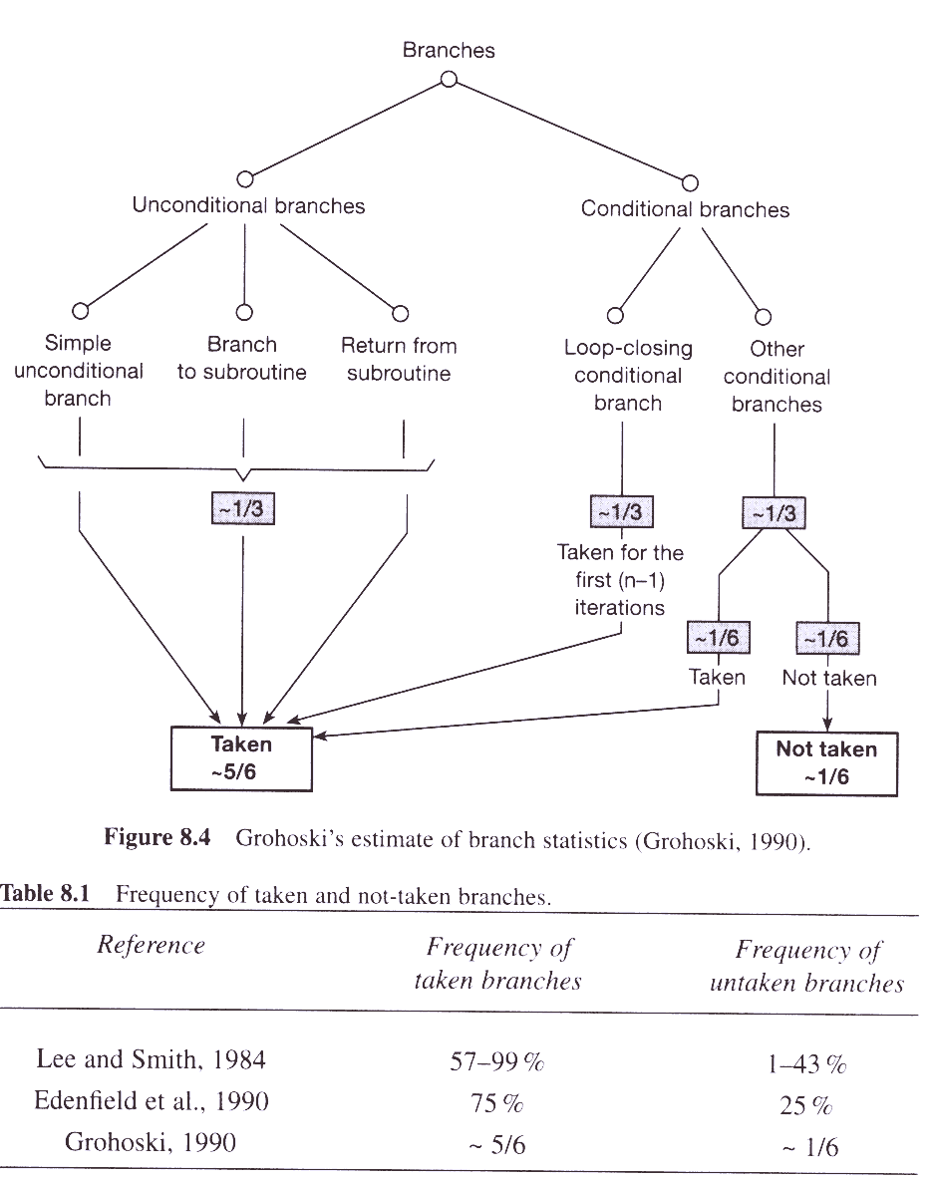
Speculative Execution
Waiting for the outcome of branches significantly affects parallelism
Speculation: fetch, issue, and execute instructions as if branch predictions were always correct
CSCI6461 Computer Architecture

Slide 6
Program Statement Types
Generally, statements and definitions in a program can be divided into three types:
  things which must be run and are mandatory
  things which do not need to be run because they are irrelevant, and
  those statements which cannot be proven to be in either of the first two groups.
The first group does not benefit from speculative execution because they need to run anyway.
The second group can be quietly discarded because they are out of the main stream of execution (branch not taken)
The third group is the target of speculative evaluation, as they can be run concurrently with the mandatory computations until they are needed or shown to be of the second group
  this concurrency means that speculative execution can be parallelized..
CSCI6461 Computer Architecture

Slide 7
Speculative Execution
Speculative execution is a performance optimization.
  It is only useful when early execution consumes less time and space than later execution would, and the savings are enough to compensate, in the long run, for the possible wasted effort of computing a value which is never used.
A conditional branch instruction is encountered
  the processor guesses which way the branch is most likely to go – branch prediction, and immediately starts executing instructions from that point.
If the guess later proves to be incorrect, all computation past the branch point is discarded.
  This early execution is relatively cheap because the pipeline stages involved would otherwise lie dormant until the next instruction was known.
CSCI6461 Computer Architecture

Slide 8
Basic Idea
On a branch, execute both paths and discard one when the value of the branch conditional is known.
Assumes you have the resources to execute both paths.
ALU
Mem
IF
ID
Issue
WB
Fadd
Fmul
CSCI6461 Computer Architecture

Slide 9
Basic Idea - II
Issue stage buffer holds multiple instructions waiting to issue.
Decode adds next instruction to buffer if there is space and the instruction does not cause a WAR or WAW hazard.
  Note: WAR possible again because issue is out-of-order (WAR not possible with in-order issue and latching of input operands at functional unit)
Any instruction in buffer whose RAW hazards are satisfied can be issued
CSCI6461 Computer Architecture

Slide 10
Difference: Branch Prediction vs. Speculative Execution
1 Scalar & 1 FPU Pipeline:
  Guess which branch will be taken and load the pipeline with that stream of instructions
  Guess wrong and you need to flush the pipeline and load the correct stream
  There is a delay incurred in flushing the pipeline and reloading
  Guess right and you have a performance increase because you already have the proper stream of instructions moving through the pipeline.
CSCI6461 Computer Architecture

Slide 11
Difference: Branch Prediction vs. Speculative Execution
2 Scalar and/or 2 FPU Pipelines:
  At a branch, schedule two path streams – one to each pipeline
  When branch conditional result is known, flush the pipeline which corresponds to the failed path
  Allow other pipeline to proceed as normal
Prediction is de-coupled from the decision to execute fetched instructions
Prediction helps boost the issue rate
CSCI6461 Computer Architecture

Slide 12
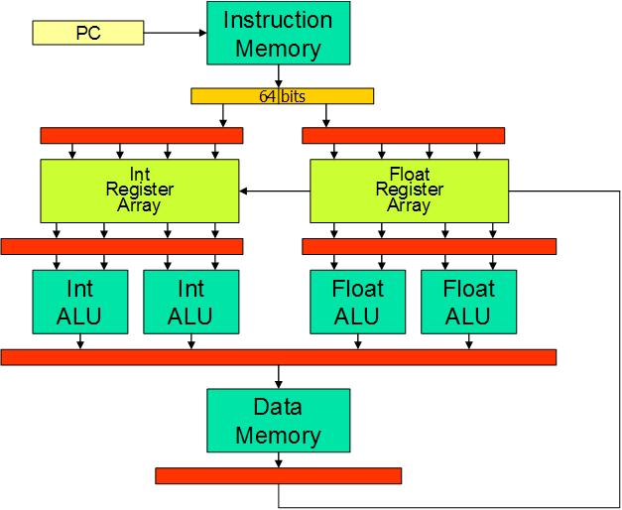
Multiple Instruction Issue
CSCI6461 Computer Architecture

Slide 13
Lack of Register Names
Floating Point pipelines often cannot be kept filled with small number of registers.
  IBM 360 had only 4 floating-point registers
Can a microarchitecture use more registers than specified by the ISA without loss of ISA compatibility ?
  Robert Tomasulo of IBM suggested an ingenious solution in 1967 using on-the-fly register renaming
  (read Tomasulo paper in Files)
CSCI6461 Computer Architecture

Slide 14
Instruction-level Parallelism via Renaming
latency
1 LD F2, 34(R2) 1
2 LD F4, 45(R3) long
3 MULTD F6, F4, F2 3
4 SUBD F8, F2, F2 1
5 DIVD F4’, F2, F8 4
ADDD F10, F6, F4’ 1
Any antidependence can be eliminated by renaming.
Can it be done in hardware? YES!
1
2
4
3
5
6
CSCI6461 Computer Architecture

Slide 15
Renaming & Reorder Buffer
Basic block sizes of instructions are not very large
  Prediction can increase the issue rate but not the completion rate
  Boosting issue rate by itself is insufficient
The completion rate has to be increased to keep up with the issue rate
  Need speculative execution
Key idea: separate instruction execution from instruction commitment
  Compute on a need-to-know basis until speculation outcome is determined
What is commitment?
  Updating the register file!
  Permanent update to the machine state
What should be the criteria?
  Commitment is performed in program order
How to enforce the criteria?
  Reorder instructions that complete out-of-order → Reorder Buffer
CSCI6461 Computer Architecture

Slide 16
Possible Re-order Buffer Entry
Instruction type:
  A branch has no destination
  A store has a memory address destination
  A register operations (ALU or Load) has a register destination
Destination: none or memory address or register
Value: of the instruction result until the instruction commits
Ready: indicates the instruction has completed execution and the value is ready
CSCI6461 Computer Architecture

Slide 17
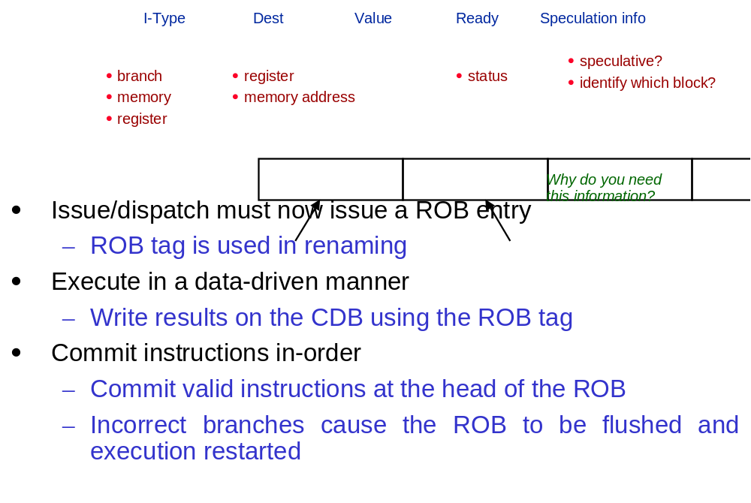
Re-order Buffer Entry
CSCI6461 Computer Architecture

Slide 18
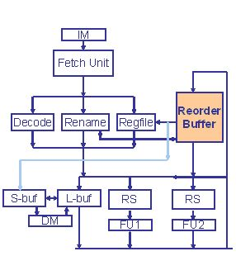
Reorder Buffer (ROB)
If instruction write results in program order, register or memory always gets the correct values
Reorder Buffer (ROB): re-order the out-of-order instructions at the time of writing (commit time) to program order
If the same instruction goes wrong, handle it at the time of commit – just flush the instruction afterwards.
Instruction cannot write register or memory immediately after execution, so ROB also buffers the results
CSCI6461 Computer Architecture

Slide 19
Physical Register Lifetime
Physical register file holds committed and speculative values
Physical registers decoupled from ROB entries (no data in ROB)
ld r1, (r3)
add r3, r1, #4
sub r6, r7, r9
add r3, r3, r6
ld r6, (r1)
add r6, r6, r3
st r6, (r1)
ld r6, (r11)
ld P1, (Px)
add P2, P1, #4
sub P3, Py, Pz
add P4, P2, P3
ld P5, (P1)
add P6, P5, P4
st P6, (P1)
ld P7, (Pw)
Rename
CSCI6461 Computer Architecture

Slide 20
Instruction Buffer: Dataflow Execution
Ins# use exec op p1 src1 p2 src2
ptr₂
next to
deallocate
ptr₁
next
available
Instruction slot is candidate for execution when:
  It holds a valid instruction (“use” bit is set); “use” bit cleared when instruction completes
  It has not already started execution (“exec” bit is clear); “exec” bit set when instruction begins execution
  Both operands are available (p1 and p2 are set)
  ptr2 is incremented only if use bit is clear
CSCI6461 Computer Architecture

Slide 21
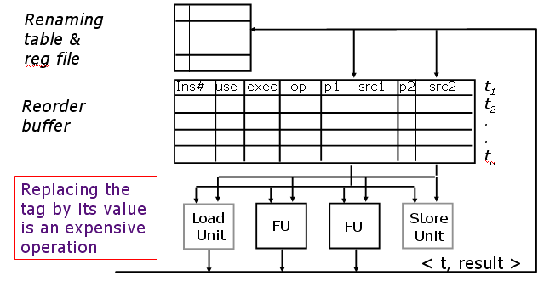
Data-Driven Execution
Instruction template (i.e., tag t) is allocated by the Decode stage, which also associates tag with register in regfile
When an instruction completes, its tag is deallocated
CSCI6461 Computer Architecture

Slide 22
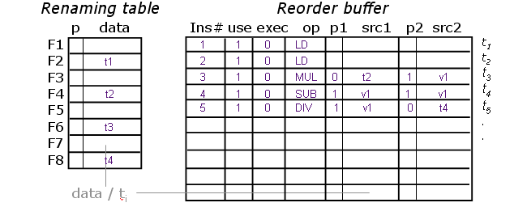
Renaming & Out-of-order Issue
When are tags in sources replaced by data?
  Whenever an FPU produces a result
When can a name be reused?
  When an instruction completes (retires)
See slide 14 for instructions
CSCI6461 Computer Architecture

Slide 23
Physical Register Management - I
Rename Table
Physical Regs
Free List
P0
P0
R0
P1
P1
R1
P8
P2
P3
R2
P3
P2
R3
P7
P4
P4
(LPRd requires third read port on Rename Table for each instruction)
R4
P5
<R6>
p
R5
P6
<R7>
p
R6
P5
P7
<R3>
p
R7
P6
P8
<R1>
p
ROB
Pn
use
ex
op
p1
PR1
p2
PR2
Rd
LPRd
PRd
CSCI6461 Computer Architecture

Slide 24
Physical Register Management - II
Rename Table
Physical Regs
Free List
P0
P0
R0
P1
P1
R1
P0
P2
P3
ld r1, 0(r3)
add r3, r1, #4
sub r6, r7, r6
add r3, r3, r6
ld r6, 0(r1)
P8
R2
P3
P2
R3
P7
P4
P4
R4
P5
<R6>
p
R5
P6
<R7>
p
R6
P5
P7
<R3>
p
R7
P6
P8
<R1>
p
Pn
ROB
use
ex
op
p1
PR1
p2
PR2
Rd
LPRd
PRd
x ld p P7 r1 P0
P8
CSCI6461 Computer Architecture

Slide 25
Physical Register Management - III
Rename Table
Physical Regs
Free List
P0
P0
R0
P1
P1
R1
P0
P2
ld r1, 0(r3)
add r3, r1, #4
sub r6, r7, r6
add r3, r3, r6
ld r6, 0(r1)
P8
P3
R2
P3
P2
R3
P1
P4
P7
P4
R4
P5
<R6>
p
R5
P6
<R7>
p
R6
P5
P7
<R3>
p
R7
P6
P8
<R1>
p
Pn
ROB
use
ex
op
p1
PR1
p2
PR2
Rd
LPRd
PRd
x ld p P7 r1 P0
P8
x add P0 r3 P1
P7
CSCI6461 Computer Architecture

Slide 26
Physical Register Management - IV
Rename Table
Physical Regs
Free List
P0
P0
R0
P1
P1
R1
P0
P2
P8
P3
ld r1, 0(r3)
add r3, r1, #4
sub r6, r7, r6
add r3, r3, r6
ld r6, 0(r1)
R2
P3
P2
R3
P1
P4
P7
P4
R4
P5
<R6>
p
R5
P6
<R7>
p
R6
P3
P7
P5
<R3>
p
R7
P6
P8
<R1>
p
Pn
ROB
use
ex
op
p1
PR1
p2
PR2
Rd
LPRd
PRd
x ld p P7 r1 P0
P8
x add P0 r3 P1
P7
x sub p P6 p P5 r6 P3
P5
CSCI6461 Computer Architecture

Slide 27
Physical Register Management - V
Rename Table
Physical Regs
Free List
P0
P0
R0
P1
P1
R1
P0
P2
P8
P3
R2
P3
P2
ld r1, 0(r3)
add r3, r1, #4
sub r6, r7, r6
add r3, r3, r6
ld r6, 0(r1)
R3
P1
P2
P4
P7
P4
R4
P5
<R6>
p
R5
P6
<R7>
p
R6
P3
P7
P5
<R3>
p
R7
P6
P8
<R1>
p
Pn
ROB
use
ex
op
p1
PR1
p2
PR2
Rd
LPRd
PRd
x ld p P7 r1 P0
P8
x add P0 r3 P1
P7
x sub p P6 p P5 r6 P3
P5
x add P1 P3 r3 P2
P1
CSCI6461 Computer Architecture

Slide 28
Physical Register Management - VI
Rename Table
Physical Regs
Free List
P0
P0
R0
P1
P1
R1
P0
P2
P8
P3
R2
P3
P2
ld r1, 0(r3)
add r3, r1, #4
sub r6, r7, r6
add r3, r3, r6
ld r6, 0(r1)
R3
P1
P2
P4
P7
P4
R4
P5
<R6>
p
R5
P6
<R7>
p
R6
P3
P4
P7
P5
<R3>
p
R7
P6
P8
<R1>
p
Pn
ROB
use
ex
op
p1
PR1
p2
PR2
Rd
LPRd
PRd
x ld p P7 r1 P0
P8
x add P0 r3 P1
P7
x sub p P6 p P5 r6 P3
P5
x add P1 P3 r3 P2
P1
x ld P0 r6 P4
P3
CSCI6461 Computer Architecture

Slide 29
Physical Register Management - VII
Rename Table
Physical Regs
Free List
P0
<R1>
p
P0
R0
P1
P1
R1
P0
P2
ld r1, 0(r3)
add r3, r1, #4
sub r6, r7, r6
add r3, r3, r6
ld r6, 0(r1)
P8
P3
R2
P3
P2
R3
P1
P2
P4
P7
P4
R4
P5
<R6>
p
P8
R5
P6
<R7>
p
R6
P3
P4
P7
P5
<R3>
p
R7
P6
P8
<R1>
p
Pn
ROB
use
ex
op
p1
PR1
p2
PR2
Rd
LPRd
PRd
Execute & Commit
x ld p P7 r1 P0
x ld p P7 r1 P0
x
P8
p
x add P0 r3 P1
P7
x sub p P6 p P5 r6 P3
P5
x add P1 P3 r3 P2
P1
p
x ld P0 r6 P4
P3
CSCI6461 Computer Architecture

Slide 30
Physical Register Management - VIII
Rename Table
Physical Regs
Free List
P0
<R1>
p
P0
R0
P1
<R3>
p
P1
R1
P0
P2
ld r1, 0(r3)
add r3, r1, #4
sub r6, r7, r6
add r3, r3, r6
ld r6, 0(r1)
P8
P3
R2
P3
P2
R3
P1
P2
P4
P7
P4
R4
P5
<R6>
p
P8
R5
P6
<R7>
p
P7
R6
P3
P4
P7
P5
<R3>
p
R7
P6
P8
Pn
ROB
use
ex
op
p1
PR1
p2
PR2
Rd
LPRd
PRd
x x ld p P7 r1 P0
P8
Execute & Commit
p
x add P0 r3 P1
x add P0 r3 P1
x
P7
x sub p P6 p P5 r6 P3
P5
p
x add P1 P3 r3 P2
P1
p
x ld P0 r6 P4
P3
CSCI6461 Computer Architecture

Slide 31
Tomasulo Algorithm: Speculative Execution
First appeared in the IBM 360/91 in the late 1960s
Key Concept:
  Reservation Stations that hold instructions ready for execution (but only one functional unit to execute each class of instructions)
Basic idea:
  Prepare instructions for execution (sometimes) faster than we can execute them, so build up a queue of instructions ready to execute.
  Fetch and buffer operands as soon as available
  NOTE: since operands may come from a previously
  executed instruction can divert operand to make an
  instruction ready to execute at the same time we are
  retiring the results
CSCI6461 Computer Architecture

Slide 32
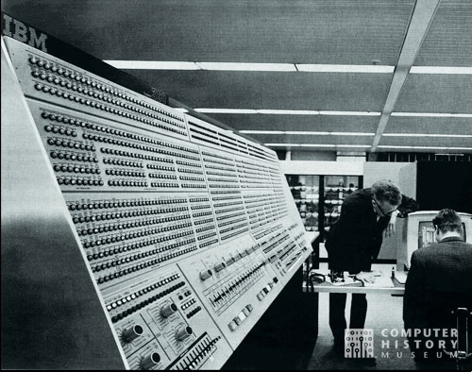
IBM 360/91
CSCI6461 Computer Architecture

Slide 33
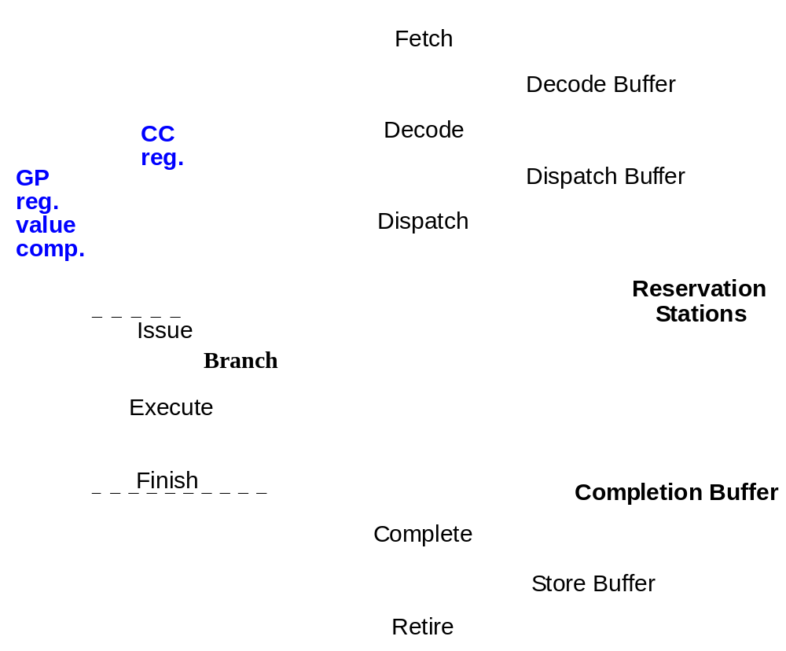
Reservation Stations
CSCI6461 Computer Architecture

Slide 34
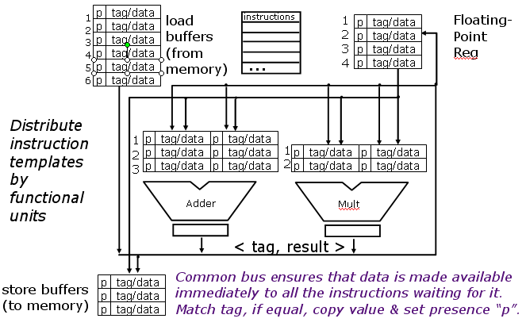
IBM 360/91 Floating-Point Unit
R. M. Tomasulo, 1967
CSCI6461 Computer Architecture

Slide 35
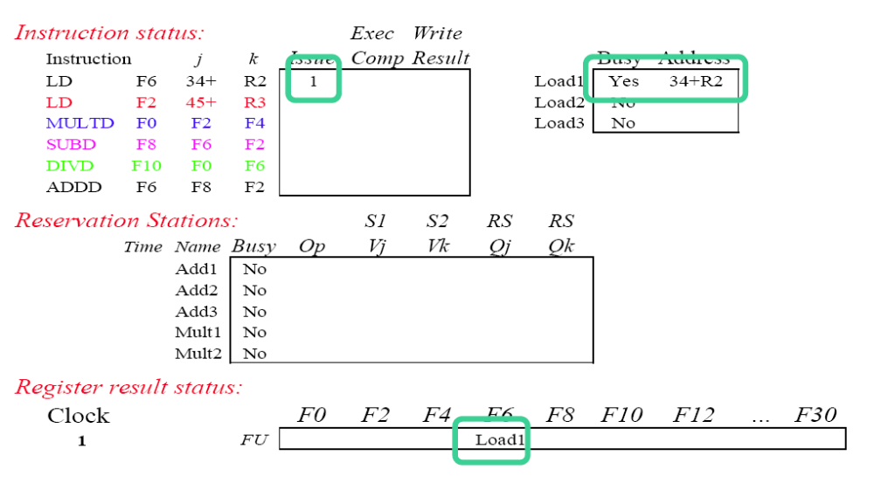
Tomasulo Example – Cycle 1
(Ref: Lecture Notes by David Brooks, Harvard University, CS246)
CSCI6461 Computer Architecture

Slide 36
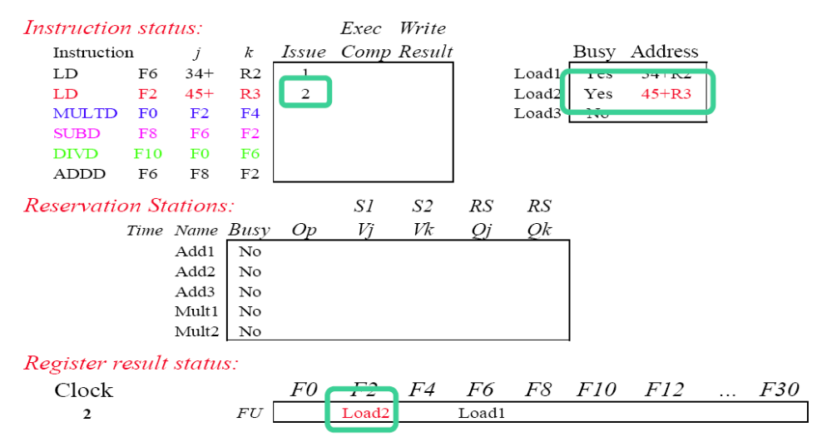
Tomasulo Example – Cycle 2
(Ref: Lecture Notes by David Brooks, Harvard University, CS246)
CSCI6461 Computer Architecture

Slide 37
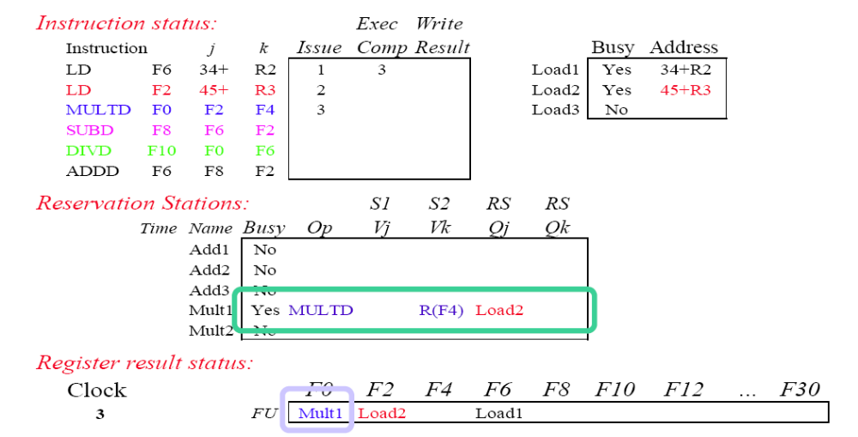
Tomasulo Example – Cycle 3
(Ref: Lecture Notes by David Brooks, Harvard University, CS246)
Load 1 is complete! What is waiting for it?
CSCI6461 Computer Architecture

Slide 38
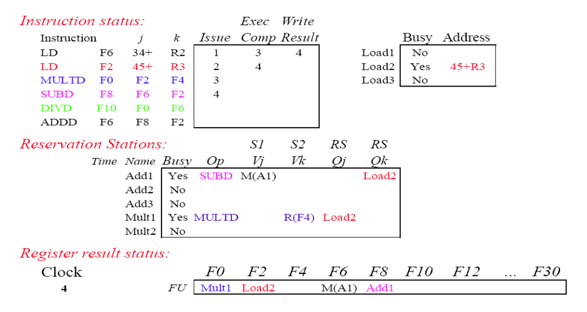
Tomasulo Example – Cycle 4
(Ref: Lecture Notes by David Brooks, Harvard University, CS246)
CSCI6461 Computer Architecture

Slide 39
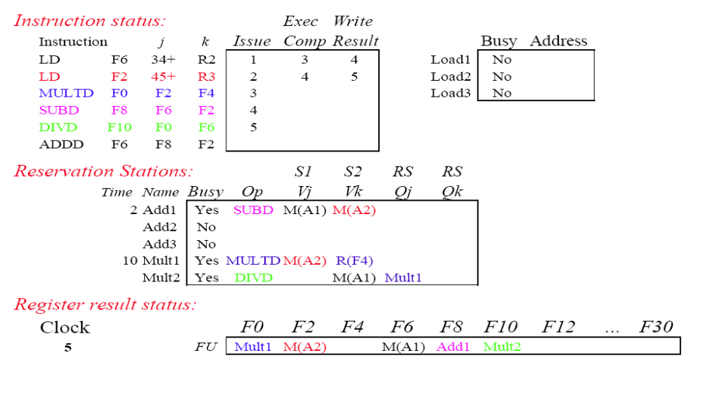
Tomasulo Example – Cycle 5
(Ref: Lecture Notes by David Brooks, Harvard University, CS246)
CSCI6461 Computer Architecture
CSCI6461 Computer Architecture

Slide 40
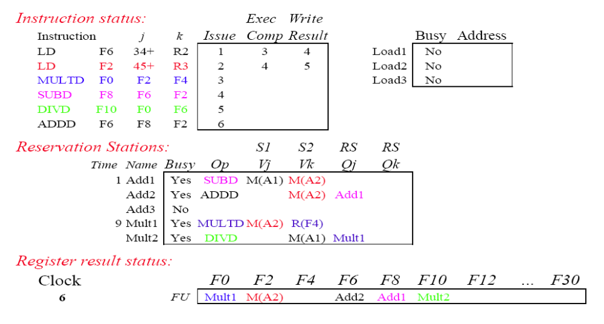
Tomasulo Example – Cycle 6
(Ref: Lecture Notes by David Brooks, Harvard University, CS246)
CSCI6461 Computer Architecture
CSCI6461 Computer Architecture

Slide 41
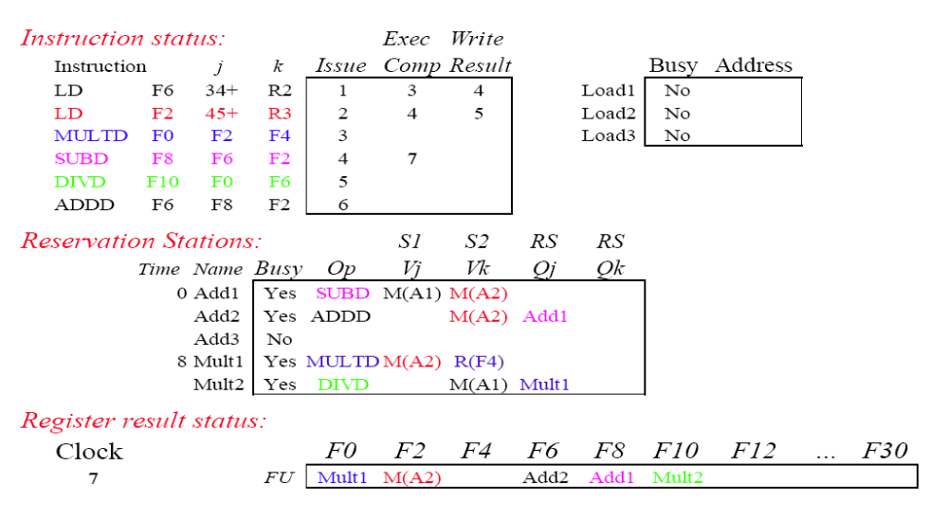
Tomasulo Example – Cycle 7
(Ref: Lecture Notes by David Brooks, Harvard University, CS246)
CSCI6461 Computer Architecture
CSCI6461 Computer Architecture

Slide 42
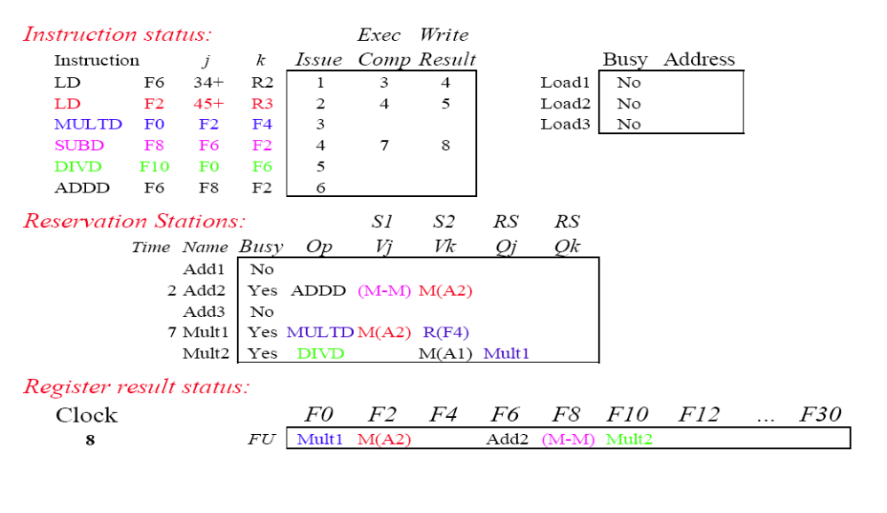
Tomasulo Example – Cycle 8
(Ref: Lecture Notes by David Brooks, Harvard University, CS246)
CSCI6461 Computer Architecture
CSCI6461 Computer Architecture

Slide 43
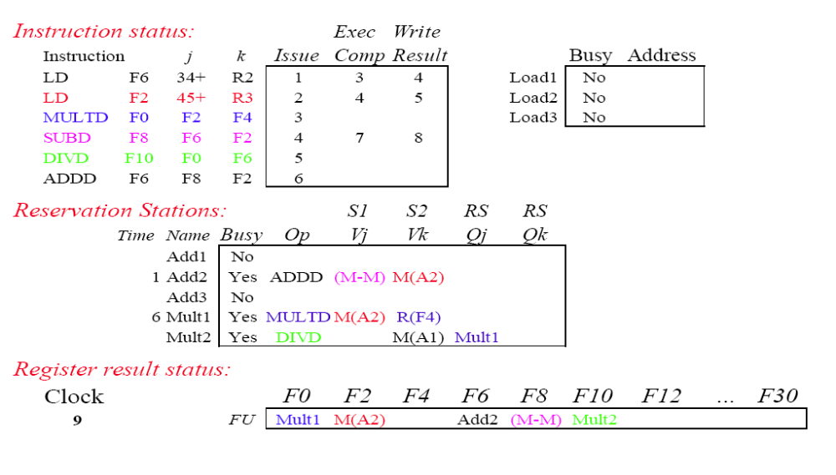
Tomasulo Example – Cycle 9
(Ref: Lecture Notes by David Brooks, Harvard University, CS246)
CSCI6461 Computer Architecture
CSCI6461 Computer Architecture

Slide 44
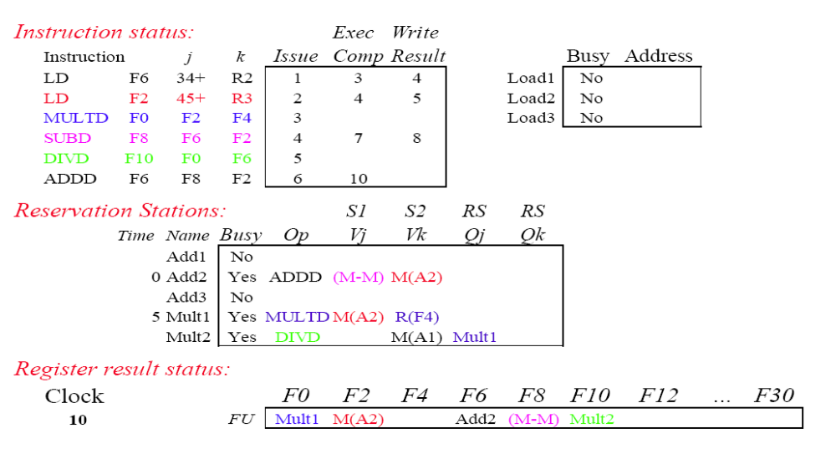
Tomasulo Example – Cycle 10
(Ref: Lecture Notes by David Brooks, Harvard University, CS246)
CSCI6461 Computer Architecture
CSCI6461 Computer Architecture

Slide 45
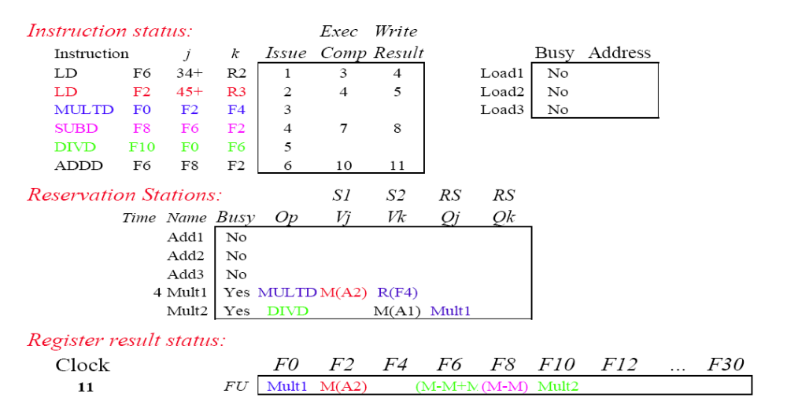
Tomasulo Example – Cycle 11
(Ref: Lecture Notes by David Brooks, Harvard University, CS246)
All instructions complete in this cycle!
CSCI6461 Computer Architecture
CSCI6461 Computer Architecture

Slide 46
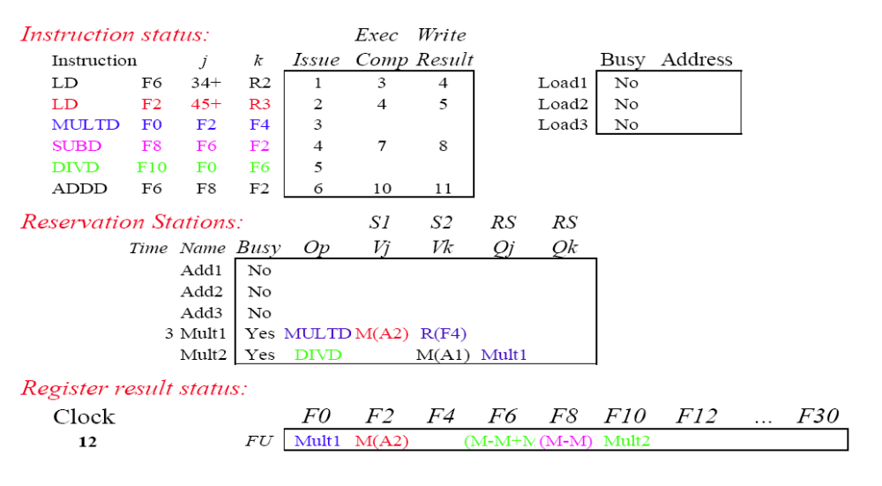
Tomasulo Example – Cycle 12
(Ref: Lecture Notes by David Brooks, Harvard University, CS246)
CSCI6461 Computer Architecture
CSCI6461 Computer Architecture

Slide 47
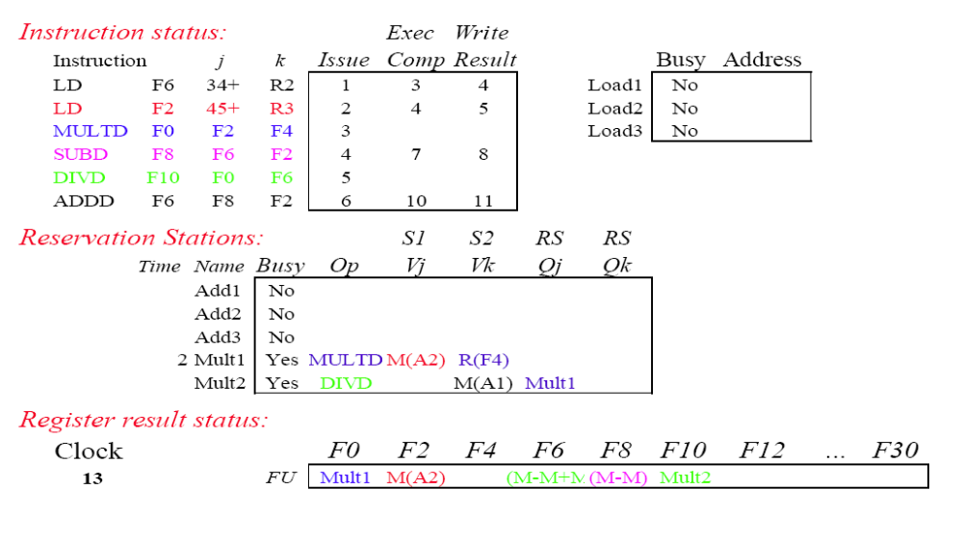
Tomasulo Example – Cycle 13
(Ref: Lecture Notes by David Brooks, Harvard University, CS246)
CSCI6461 Computer Architecture
CSCI6461 Computer Architecture

Slide 48
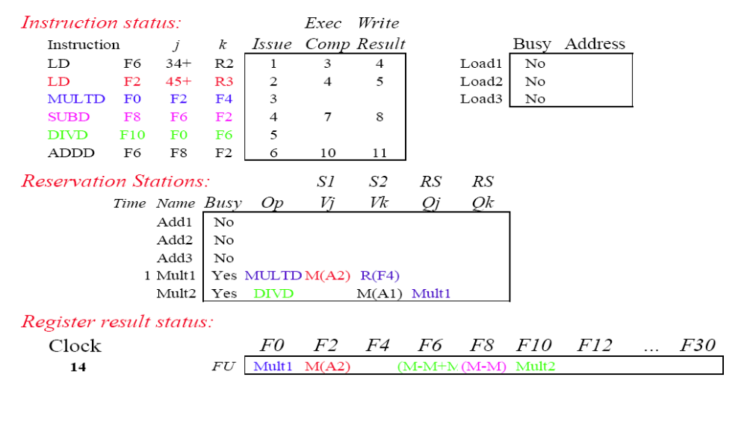
Tomasulo Example – Cycle 14
(Ref: Lecture Notes by David Brooks, Harvard University, CS246)
CSCI6461 Computer Architecture
CSCI6461 Computer Architecture

Slide 49
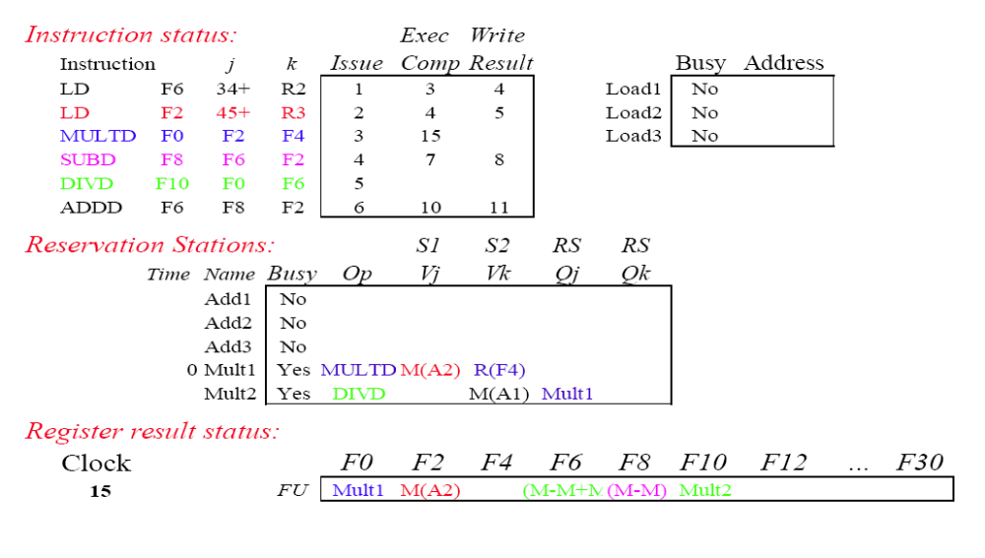
Tomasulo Example – Cycle 15
(Ref: Lecture Notes by David Brooks, Harvard University, CS246)
CSCI6461 Computer Architecture
CSCI6461 Computer Architecture

Slide 50
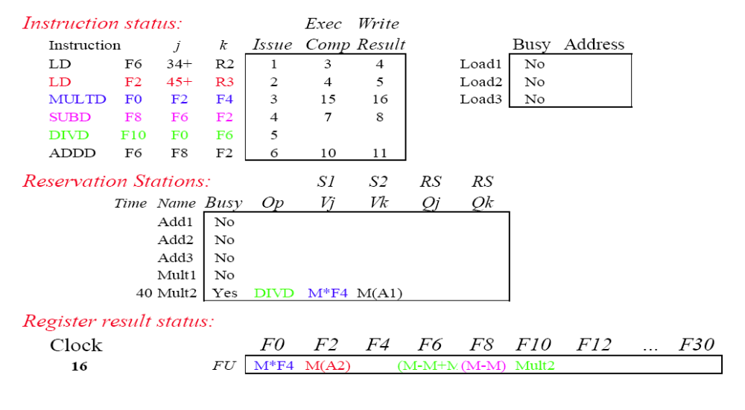
Tomasulo Example – Cycle 16
(Ref: Lecture Notes by David Brooks, Harvard University, CS246)
CSCI6461 Computer Architecture
CSCI6461 Computer Architecture

Slide 51
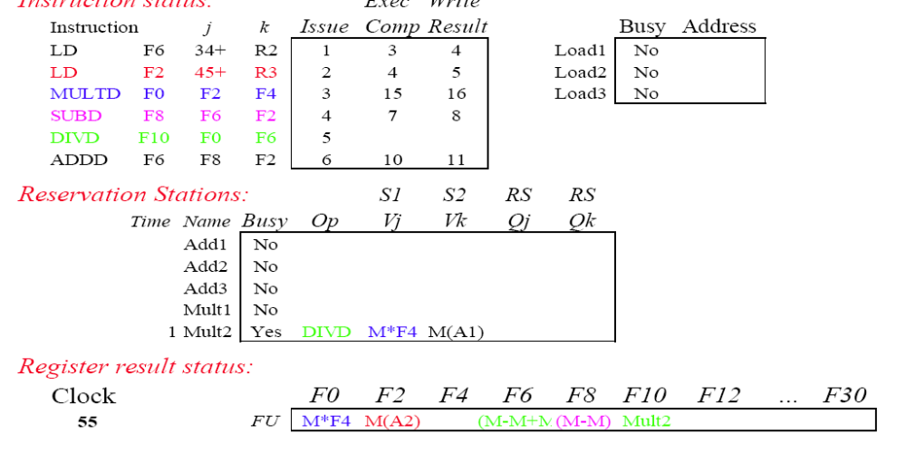
Tomasulo Example – Cycle 55 (Way Later!)
(Ref: Lecture Notes by David Brooks, Harvard University, CS246)
CSCI6461 Computer Architecture
CSCI6461 Computer Architecture

Slide 52
Exception Handling
(In-Order Five-Stage Pipeline)
Commit Point
PC
Inst. Mem
D
Decode
E
M
Data Mem
W
+
Illegal Opcode
Data Addr Except
Kill Writeback
Select Handler PC
Overflow
PC Address Exceptions
Exc
D
Exc
E
Exc
M
Cause
PC
D
PC
E
PC
M
EPC
Kill F Stage
Kill D Stage
Kill E Stage
Asynchronous Interrupts
Hold exception flags in pipeline until commit point (M stage)
Exceptions in earlier pipe stages override later exceptions
Inject external interrupts at commit point (override others)
If exception at commit: update Cause and EPC registers, kill
all stages, inject handler PC into fetch stage
CSCI6461 Computer Architecture
Notes:
CS252 S05

Slide 53
Additional Information
CSCI6461 Computer Architecture

Slide 54
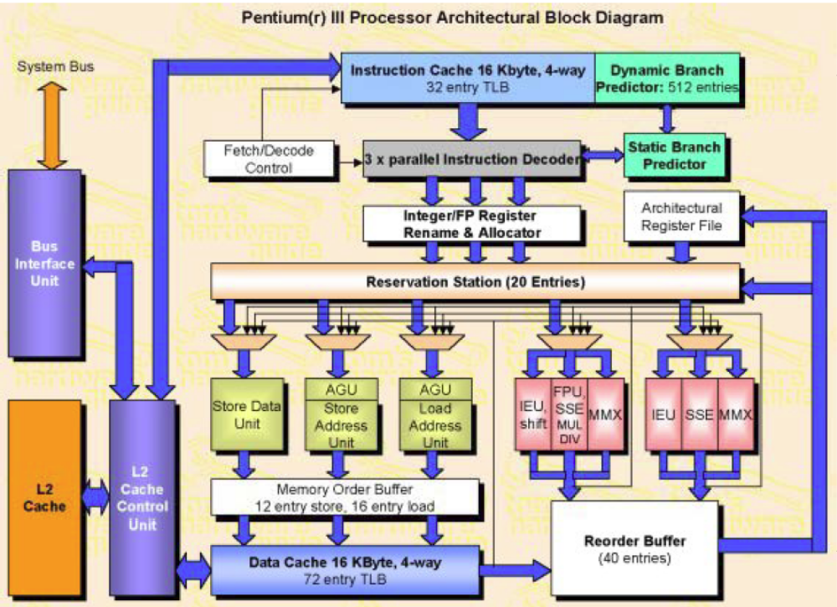
Intel Pentium III
CSCI6461 Computer Architecture

Slide 55
Tomasulo Algorithm: Details - I
At instruction issue, register specifiers (names) for the operand locations are renamed to the exact locations (e.g., physical registers) holding the operands
  Values can exist in reservation stations or register file
  to eliminate WARs, copy register values to reservation stations
Issue—get instruction from FP Op Queue
  Condition: a free RS (Reservation Station) at the required FU (Functional Unit)
  Actions:
(1) decode the instruction
(2) allocate a RS and ROB entry
(3) do source register renaming
(4) do destination register renaming
(5) read register file
(6) dispatch the decoded & renamed instruction to RS and ROB
Execution—operate on operands (EX)
  Condition: At a given FU, At least one instruction is ready
  Action: select a ready instruction and send it to the FU
CSCI6461 Computer Architecture

Slide 56
Tomasulo Algorithm: Details - II
Write result—finish execution (WB = Write Buffer)
  Condition: At a given FU, some instruction finishes FU execution
  Actions:
(1) FU writes to CDB (Cache Data Buffer), broadcast to all RSs & to ROB
(2) FU broadcast tag (ROB index) to all RS
(3) de-allocate the RS
Note: no register status update at this time
Commit—update register with reorder result
  Condition: ROB is not empty and ROB head instruction has finished execution
  Actions if no misprediction/exception:
(1) write result to register/memory
(2) update register status
(3) de-allocate the ROB entry
  Actions if with misprediction/exception: flush the pipeline, e.g.
(1) flush IFQ (Instruction Fetch Queue)
(2) clear register status
(3) flush all RS and reset FU
(4) reset ROB
CSCI6461 Computer Architecture
CSCI6461 Computer Architecture

Slide 57
Tomasulo Algorithm: More Detail - I
Required two data structures:
Register Status Table (RST): For each register, specifies whether or not the register contains valid data; if not, then the RS which contains the valid data is specified. |RST| = # registers. Let r be a register:
  RST(r, value) is the value contained in register r.
  RST(r, valid) is 1 if the value is valid; otherwise, 0.
  RST(r, RS) = s is the s-th RS where a valid value will be found.
Reservation Station Table (ResST): For each FUf, there is a set Sf of reservation stations. Let Inst: opCode, Dest, Src1, Src2 be the instruction which is in RSs for FUf. Then,
  Sf[s, Empty] = = 1indicates that the RS is empty
  Sf[s, InFU] = = 1 indicates that the FUf is executing Inst
  Sf[s, op] = opCode
  Sf[s,Dest] = Dest
  Sf[s,Src1] = Src1
  Sf[s,Src2] = Src2
  Sf[s,vld1] = 0 indicates Sf[s,Src1] is not yet available
  Sf[s,vld2] = 0 indicates Sf[s,Src2] is not yet available
  Sf[s, RS1] = t specifies that the t-th RS will provide the data
  Same for Sf[s, RS2]
CSCI6461 Computer Architecture
CSCI6461 Computer Architecture

Slide 58
Tomasulo Algorithm: More Detail - II
During instruction issue stage, Inst: opCode Dest, Src1,Src2 is issued to an empty RS that belongs to FUf capable of executing opCode.
while Inst not issued yet & previous instruction issued
do
if there exists f, s such that FUf is capable of executing opCode and Sf [s, Empty] = 1
then do in the same cycle
  Choose some pair f, s:
// initialize register status
RST[Dest, RS] = s; RST[Dest, vld] = 0
// initialize reservation station status
Sf [s, Empty] = 0; Sf [s, InFU] = 0; Sf [s, Op] = opCode; Sf [s, Dest] = Dest
  if RST[Src1,vld] = 1
then
Sf [s,Src1] = RST[Src1.Value]
endif
Sf [s,vld1] = RST[Src1,vld]; Sf [s,RS1] = RST[Src1,RS]
if RST[Src2,vld] = 1
then
Sf [s,Src2] = RST[Src2,Value]
endif
Sf [s,vld2] = RST[Src2,vld]; Sf [s,RS2] = RST[Src2,RS]
endif
enddo
CSCI6461 Computer Architecture

Slide 59
Tomasulo Algorithm: More Detail - III
2. In the execution stage, FUf can start executing instruction Inst on the s-th RS if Inst has not been started yet
Sf [s,InFU] = = 0 and Inst has both operands available, e.g.,
Sf [s,vld1] = 1 and Sf [s,vld2] = 1.
while Sf [s,Empty] = 0 and Sf [s,InFu] = = 0
do
if Sf [s,vld1] = = 1 and Sf [s,vld2] = = 1
then
if FUf can start executing another instruction
then do in the same cycle
Sf [s,InFU] = 1
FUf gets s, Sf [s,op], Sf [s,Src1], Sf [s,Src2]
endif
endif
enddo
CSCI6461 Computer Architecture

Slide 60
Tomasulo Algorithm: More Detail - IV
3. In the write back stage, after completion of instruction inst,
the result is written to register Dest.
while FUf completed Inst from RSs
do
if FUf can gain control of CDB
then do in the same cycle
Token.tag = s;
Token.data = result
Sf [s,Empty] = 1
RST[Dest, Value] = token.data
RST[Dest, vld] = 1
RST[Dest, RS] = 0
endif
enddo
CSCI6461 Computer Architecture

Slide 61
Tomasulo Algorithm: More Detail - V
Snooping on the Common Data Bus allowed all units that were waiting for an operand, which happened to be the result, to simultaneously load it into the appropriate RS.
Tomasulo’s algorithm eliminates WAW and WAR hazards and allows results to be forwarded to RSes awaiting them.
CSCI6461 Computer Architecture

