Slide 1
CS6461 – Computer Architecture
Spring 2018
Adapted from Professor Stephen H. Kaisler’s Slides
Lecture 9 – Vector Operations
(Partially based on notes from David Patterson, UC Berkeley)
“Anyone can build a fast CPU. The trick is to build a fast computer.”
- Seymour Cray -

Slide 2
Improving Performance
Many scientific programs compute using collections of like numbers – either integer or floating point - e.g., vectors
Performance can be improved if we structure hardware to efficiently deal with such collections
Vector processors have high-level operations that work on linear arrays of numbers, e.g., vectors
  Vector instructions access memory with a known pattern
  No data caches required
  Single vector instruction implies a lot of work
CSCI 6461 Computer Architecture

Slide 3
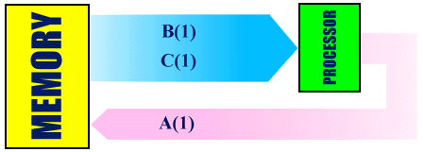
Conventional Computer
  Initialize I = 0
20 Read B(I)
Read C(I)
Store A(I) = B(I) + C(I)
Increment I = I + 1
If I <= 100 Go to 20
B(1) will be fetched from memory.
C(1) will be fetched from memory.
A scalar add instruction will operate on B(1) and C(1).
A(1) will be stored back to memory
Step (1) to (4) will be repeated 100 times.
CSCI 6461 Computer Architecture

Slide 4
General Purpose Computer
General purpose computer: A(i) = B(i) * C(i) ; i =1, ... ,N
Cycle:
1
2
3
4
5
6
...
N*5
Operation
Separate
mant. / exp.
B(1)
C(1)
B(2)
C(2)
...
Multiply
mantissa
B(1)
C(1)
...
Add
exponents
B(1)
C(1)
...
Normal.
result
A(1)
...
Put
sign
A(1)
...
A(N)
CSCI 6461 Computer Architecture

Slide 5
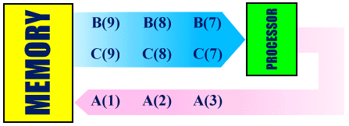
Vector Computer
A(1:100) = B(1:100) + C(1:100)
Fetch vectors of values B(I) and C(I) into memory
Use ‘vector integer add’ instruction to operate on B(I), C(I) pairs
Stream of A(I) values will be stored back to memory, one value every clock cycle
CSCI 6461 Computer Architecture

Slide 6
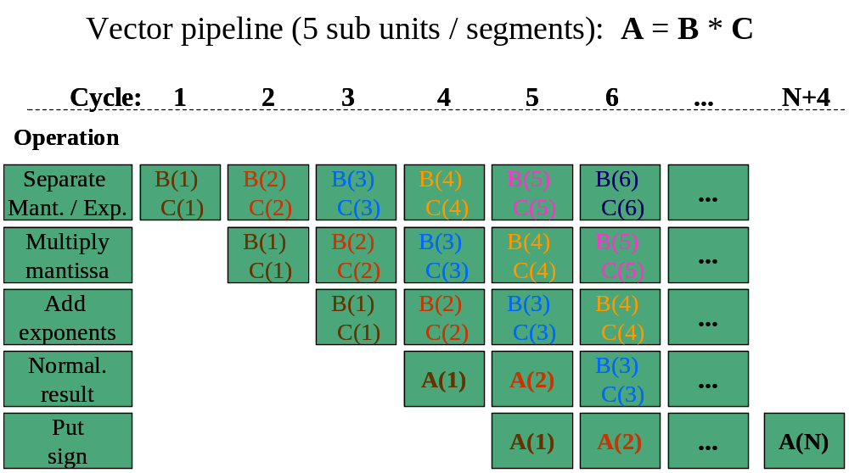
Vector Computer
CSCI 6461 Computer Architecture

Slide 7
Basic Ideas
Vector registers: Each vector register is a fixed-length bank holding a single vector.
  Usually comprised of normal general-purpose registers and floating-point registers.
  They can provide data as input to the vector functional units, as well as compute addresses.
Vector functional units: Fully pipelined and can start a new operation on every clock cycle.
Vector load-store unit: loads or stores a vector to or from memory.
Vector Length Control: A vector has a natural length determined by the length of the vector registers.
CSCI 6461 Computer Architecture

Slide 8
Two Types of Vector Processors
Vector-Register Processors:
  All vector operations (except load and store) occur in the vector registers.
  Vector counterpart of a load-store architecture
  All major vector computers (Cray machines, NEC SX/2 ~ SX/5, Fujitsu VP200, etc.)
Memory-Memory Processors:
  All vector operations are memory to memory.
  CDC vector computers: CDC 203, CDC 205, TI ASC
  All are obsolete!
CSCI 6461 Computer Architecture

Slide 9
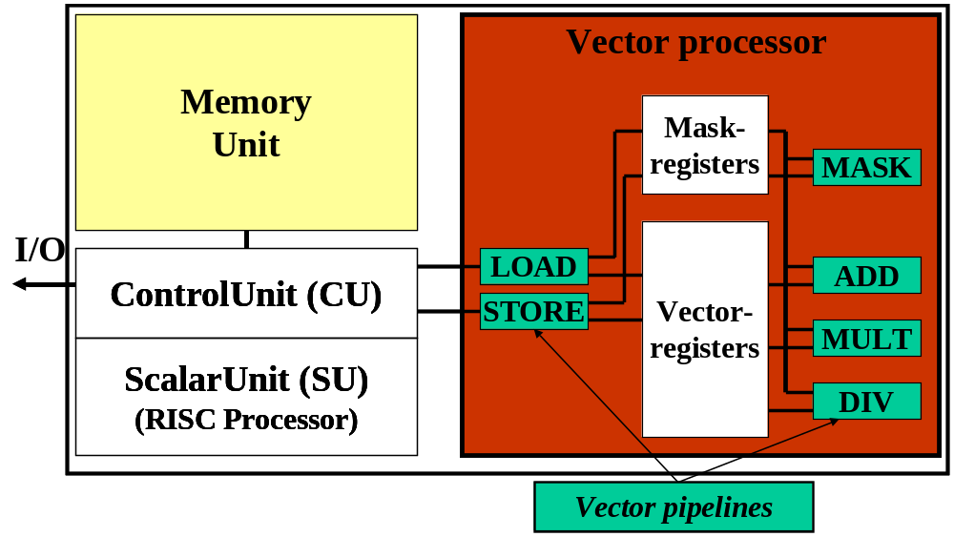
Properties of Vector Processors
Vector instructions access memory with known pattern
  Highly interleaved memory
  Amortize memory latency over multiple elements
  No (data) caches required! (Do use instruction cache)
  Single vector instruction implies lots of work (­ loop)
  => fewer instruction fetches
CSCI 6461 Computer Architecture

Slide 10
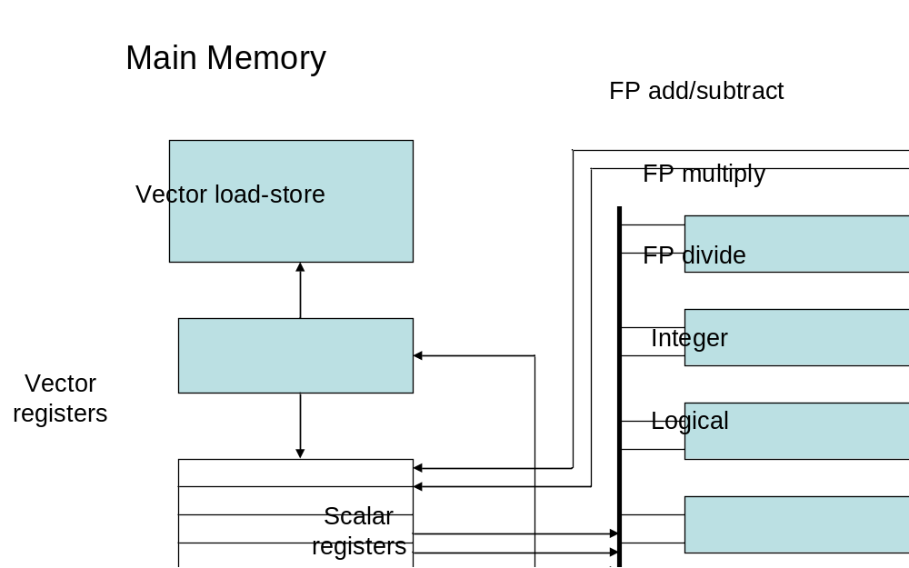
Basic Vector-Register Processor Architecture
8 64-element vector registers
5 Functional Units; each unit is fully pipelined,
can start a new operation on every clock cycle
Load/store unit - fully pipelined
Scalar registers
CSCI 6461 Computer Architecture

Slide 11
What’s in a Vector Processor
A scalar processor
  Scalar register file
  Scalar functional units (arithmetic, load/store, etc)
A vector register file (a 2D register array)
  Each register is an array of elements, e.g. 32 registers with 32 64-bit elements per register
  MVL = maximum vector length = max # of elements per register
A set of pipelined vector functional units: Integer, FP, load/store, etc
  Sometimes vector and scalar units are combined (share ALUs)
Three types of addressing
  Unit stride
    Contiguous block of information in memory
    Fastest: always possible to optimize this
  Non-unit (constant) stride
    Harder to optimize memory system for all possible strides
    Prime number of data banks makes it easier to support different strides at full bandwidth
  Indexed (gather-scatter)
    Vector equivalent of register indirect
    Good for sparse arrays of data
    Increases number of programs that vectorize
CSCI 6461 Computer Architecture

Slide 12
How a Vector Pipeline Works
Consider the steps involved in a floating-point addition on a vector machine with IEEE Arithmetic hardware
  The exponents of the two floating-point numbers to be added are compared to find the number with the smallest magnitude.
  The significands of the number with the smaller magnitude is shifted so that the exponents of the two numbers agree.
  The significands are added.
  The result of the addition is normalized.
  Checks are made to see if any floating-point exceptions occurred during the addition, such as overflow.
  Rounding occurs.
CSCI 6461 Computer Architecture

Slide 13
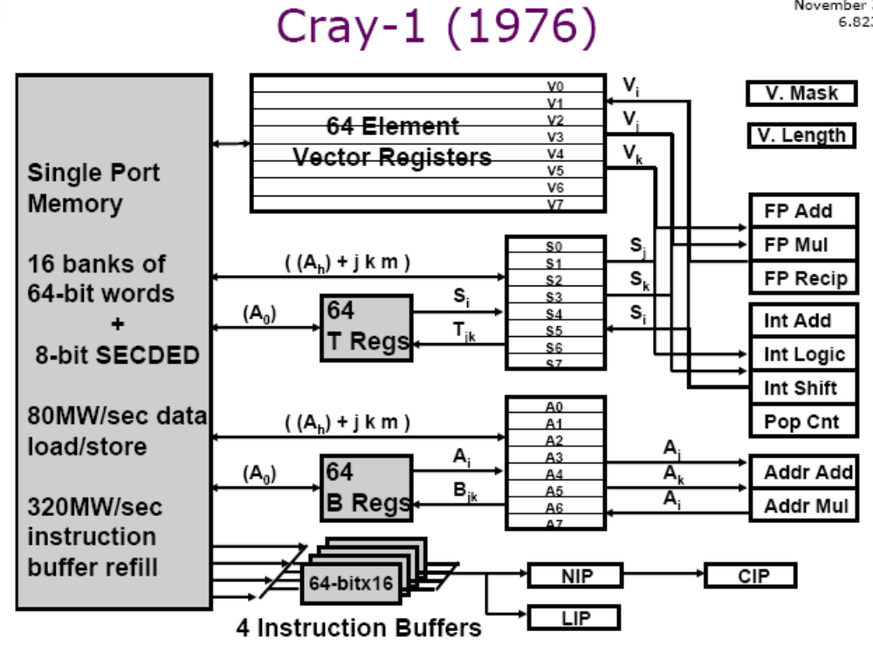
Cray-1 Vector Computer
CSCI 6461 Computer Architecture

Slide 14
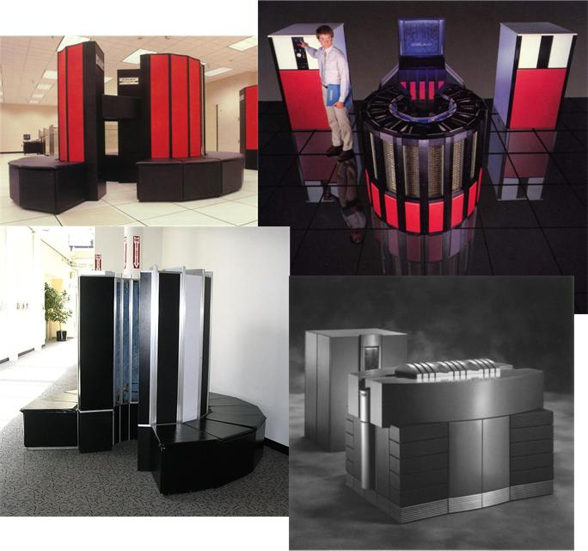
Cray Processors
From Bottom Left: Cray-1,
Cray-XMP,
Cray-2,
Cray-T916
Cray Research built aestheticallly pleasing supercomputers.
For over two decades they were the fastest machines on earth.
CSCI 6461 Computer Architecture

Slide 15
Vector Instructions
Instruction Operands Operation Comment
VADD.VV V1,V2,V3 V1=V2+V3 vector + vector
VADD.SV V1,R0,V2 V1=R0+V2 scalar + vector
VMUL.VV V1,V2,V3 V1=V2*V3 vector x vector
VMUL.SV V1,R0,V2 V1=R0*V2 scalar x vector
VLD V1,R1 V1=M[R1...R1+63] load, stride=1
VLDS V1,R1,R2 V1=M[R1…R1+63*R2] load, stride=R2
VLDX V1,R1,V2 V1=M[R1+V2i,i=0..63] indexed("gather")
VST V1,R1 M[R1...R1+63]=V1 store, stride=1
VSTS V1,R1,R2 V1=M[R1...R1+63*R2] store, stride=R2
VSTX V1,R1,V2 V1=M[R1+V2i,i=0..63] indexed(“scatter")
CSCI 6461 Computer Architecture

Slide 16
SAXPY: A Common Equation
32 element SAXPY: scalar
LD F0, a
ADDI R4, Rx,#256
Loop:
LD F2, 0(Rx)
MUL.D F2, F0, F2
LD F4, 0(Ry)
ADD.D F4, F2, F4
SD F4, 0(Ry)
ADDI Rx, Rx, 8
ADDI Ry, Ry, 8
SUB R20,R4,Rx
BNZ R20,loop
SAXPY: S = aX + Y
X,Y are vectors (of same length);
a is a scalar
One of the most common vector operations found in all arithmetic systems.
All transformations in linear algebra can be expressed in this basic triad.
Now, 32 element SAXPY: vector
LD F0,a #load a
VLD V1,Rx #load X[0:31]
VMULD.SV V2,F0,V1 #vector mult
VLD V3,Ry #load Y[0:31]
VADDD.VV V4,V2,V3 #vector add
VST Ry,V4 #store Y[0:31]
CSCI 6461 Computer Architecture

Slide 17
Terminology
Vector Start-up Time: A measure of the latency in starting up the vector pipeline.
  The number of clock cycles required prior to the generation of the first result.
The start-up time adds a considerable overhead for small value of N.
The effect of start-up time is negligible for large value of N.
To maintain an initiation rate of one word fetched/store per clock, the memory must be able to meet this rate.
  Usually done by interleaving memory in banks.
CSCI 6461 Computer Architecture

Slide 18
Issues
What to do when the application vector length is not exactly maximum vector length (MVL)?
  Vector-length (VL) register controls the length of any vector operation, including a vector load or store
    Set it before performing any vector operation
  VADD.VV with VL=10 is equivalent to
  for (i=0; i<10; i++)
  V1[i] = V2[i]+V3[i]
  VL can be anything from 0 to MVL
CSCI 6461 Computer Architecture

Slide 19
Issues
Problem: Vector registers have finite length
Solution: Break loops into pieces that fit in registers, “Stripmining”
  Vector Length modulo VL /= 0!!
  So, do short piece first, then do rest with length VL
  EX: Suppose VL = 64. We have a vector that is 264, which is mod 8.
  So, process a vector length 8, then four vectors of length 64.
Problem: All computations have some scalar components, e.g., non-vectorizable
Solution: Separate scale from vector computations (by hand; but maybe automatically)
CSCI 6461 Computer Architecture

Slide 20
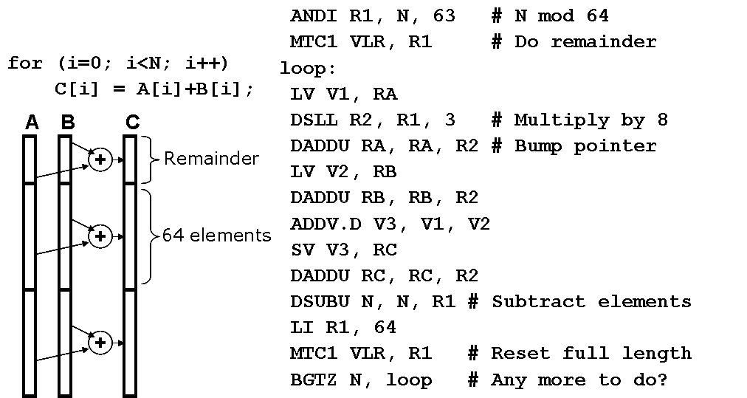
Ex: Vector Code
Note: Fast processing rates do not always translate directly into
Fast processing of loops.
CSCI 6461 Computer Architecture

Slide 21
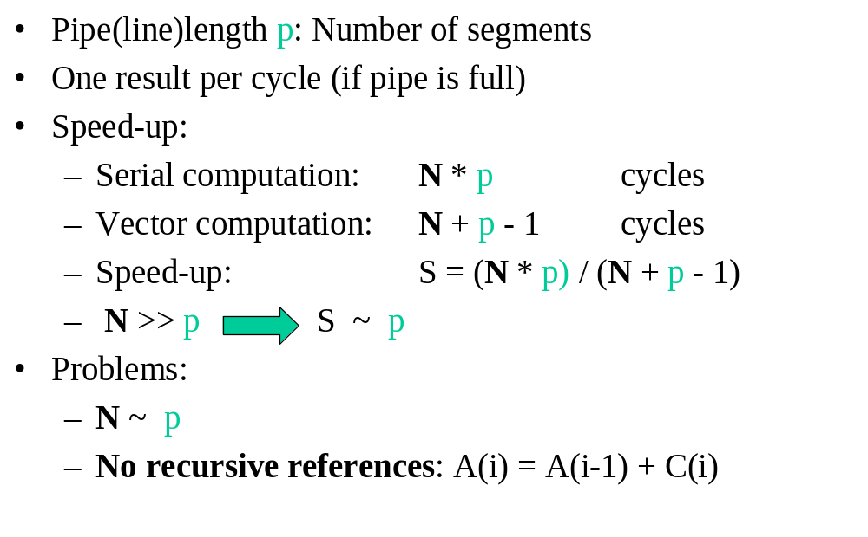
Assessing Performance
Number of stages in pipeline = N
CSCI 6461 Computer Architecture

Slide 22
Characteristics of Vectorizable Code - I
Vectorization can only be done within a DO/FOR loop; it must be the innermost loop.
It is crucial to ensure that there are sufficient iterations in the DO loop to offset the start-up time overhead.
Put as much work as possible into a vectorizable statement to provide more opportunities for concurrent operations.
There is a limit to vectorization because a compiler may not vectorize the code if it is too complicated.
Exercise: How do you vectorize a WHILE loop??
CSCI 6461 Computer Architecture

Slide 23
Characteristics of Vectorizable Code - II
The existence of certain operations in the DO loop may prevent the compiler from converting the entire, or part of the DO loop for vector processing:
  vectorization inhibitors include subroutine calls, recursion, references to external functions, and any input/output statements (which are actually system calls)
These types of vector inhibitors can be removed by:
  expanding the function
  in-lining subroutines at the point of reference.
CSCI 6461 Computer Architecture

Slide 24
Vector Code Example
Vector Processing Example:
/* Multiply a[m][k] * b[k][n] to get c[m][n] */
for (i = 1; i < m; i++)
{
for (j =1; j < n; j++)
{
sum = 0;
for (t =1; t <k; t++)
{
sum = sum + a[i][t] * b[t][j]; //// This is a dependency!!!
}
c[i][j] = sum;
}
}
CSCI 6461 Computer Architecture

Slide 25
Optimized Vector Code
/* Multiply a[m][k] * b[k][n] to get c[m][n] */
for (i = 1; i < m; i++)
{
for (j = 1; j < n; j += 32) /* Step j by 32 at a time. */
{
sum[0:31] = 0; /* Initialize a vector register to zeros. */
for (t = 1; t < k; t++)
{
a_scalar = a[i][t];
b_vector[0:31] = b[t][j:j+31];
/* Do a vector-scalar multiply. */
prod[0:31] = b_vector[0:31] * a_scalar;
/* Vector-vector add into results. */
sum[0:31] += prod[0:31];
}
/* Unit-stride store of vector of results. */
c[i][j:j+31] = sum[0:31];
}
}
It's actually better to interchange the i and j loops, so that you only change
vector length once during the whole matrix multiply
CSCI 6461 Computer Architecture

Slide 26
Vector Stride
Suppose adjacent elements of the vector are not sequential in memory
do 10 i = 1,100
do 10 j = 1,100
A(i,j) = 0.0
do 10 k = 1,100
A(i,j) = A(i,j)+B(i,k)*C(k,j)
Either B or C accesses not adjacent (800 bytes between)
stride: distance separating elements that are to be merged into a single vector (caches do unit stride)
=> LVWS (load vector with stride) instruction
Strides => can cause bank conflicts
(e.g., stride = 32 and 16 banks)
CSCI 6461 Computer Architecture

Slide 27
Vector Chaining
Suppose:
MULV V1,V2,V3
ADDV V4,V1,V5
chaining: vector register (V1) is not as a single entity but as a group of individual registers, then pipeline forwarding can work on individual elements of a vector
Flexible chaining: allow vector to chain to any other active vector operation => more read/write ports, e.g. pass the result from one vector operation to another vector operation
As long as enough HW, increases convoy size
CSCI 6461 Computer Architecture

Slide 28
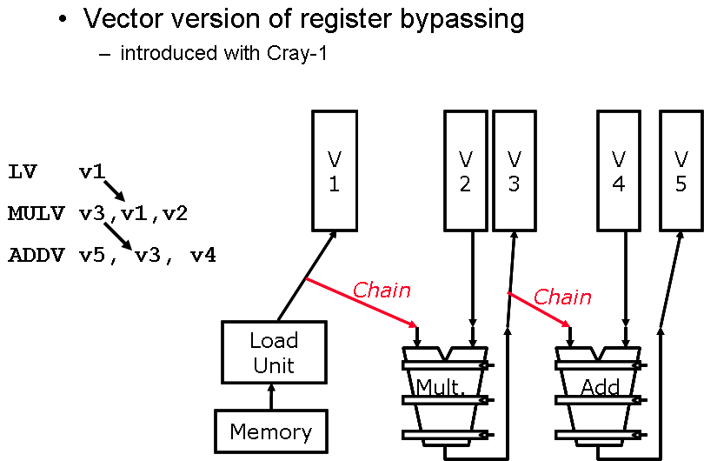
Vector Register Bypassing
CSCI 6461 Computer Architecture

Slide 29
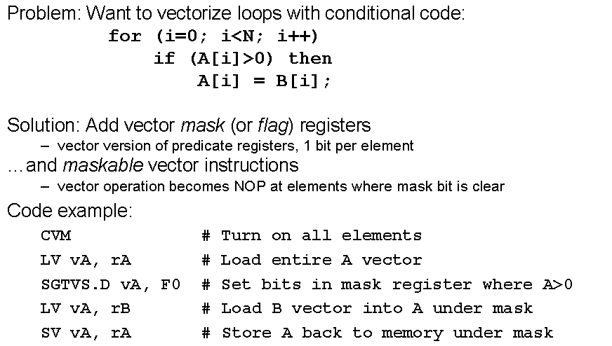
Vector Conditional Execution
CSCI 6461 Computer Architecture

Slide 30
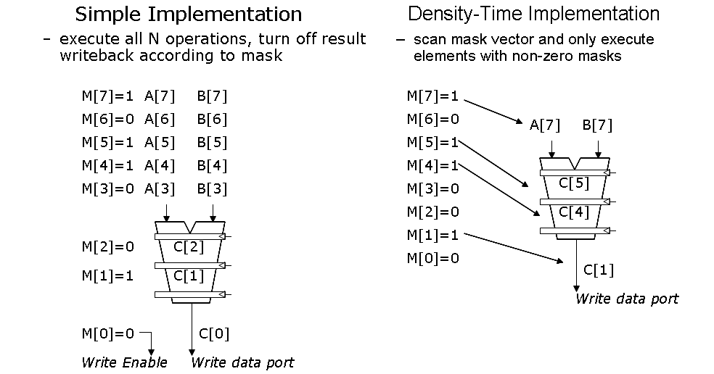
Two Approaches
CSCI 6461 Computer Architecture

Slide 31
Vectors w/ Sparse Matrices
Suppose:
do 100 i = 1,n
A(K(i)) = A(K(i)) + C(M(i))
gather (LVI) operation takes an index vector and fetches data from each address in the index vector
This produces a “dense” vector in the vector registers
After these elements are operated on in dense form, the sparse vector can be stored in expanded form by a scatter store (SVI), using the same index vector
Can't be figured out by a compiler since it can't know elements distinct, no dependencies
Use CVI to create index 0, 1xm, 2xm, ..., 63xm
CSCI 6461 Computer Architecture

Slide 32
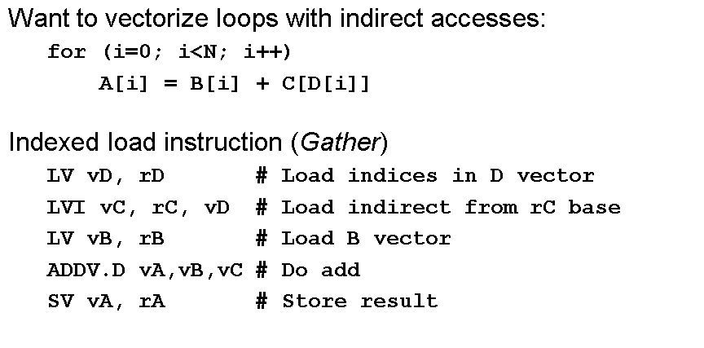
Gather Example
CSCI 6461 Computer Architecture

Slide 33
Vector Issues
Pitfall: Concentrating on peak performance and ignoring start-up overhead:
NV (length faster than scalar) > 100!
Pitfall: Increasing vector performance, without comparable increases in scalar performance (Amdahl's Law)
  problems of Cray competitor (ETA)
Pitfall: Good processor vector performance without providing good memory bandwidth
  MMX?
CSCI 6461 Computer Architecture

Slide 34
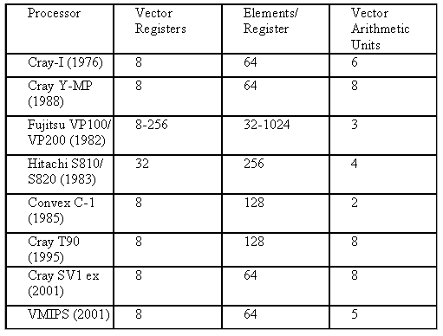
Some Previous Vector Processors
CSCI 6461 Computer Architecture

Slide 35
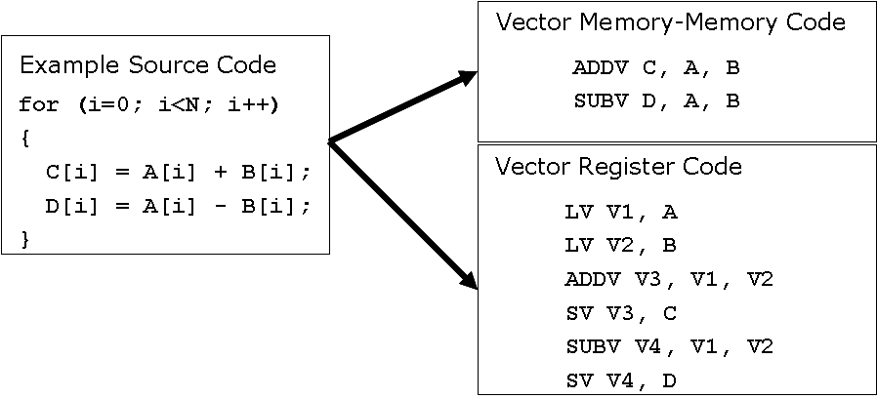
Vector Memory-Memory vs Register Machines
Vector memory-memory instructions hold all vector operands in main memory
The first vector machines, CDC Star-100 (‘73) and TI ASC (‘71), were memory-memory machines
Cray-1 (’76) was first vector register machine
CSCI 6461 Computer Architecture

Slide 36
Vector Memory-Memory vs Register Machines
Vector memory-memory architectures (VMMA) require greater main memory bandwidth, why?
  All operands must be read in and out of memory
VMMAs make if difficult to overlap execution of multiple vector operations, why?
  Must check dependencies on memory addresses
VMMAs incur greater startup latency
  Scalar code was faster on CDC Star-100 for vectors < 100 elements
  For Cray-1, vector/scalar breakeven point was around 2 elements
Apart from CDC follow-ons (Cyber-205, ETA-10) all major vector machines since Cray-1 have had vector register architectures
CSCI 6461 Computer Architecture

Slide 37
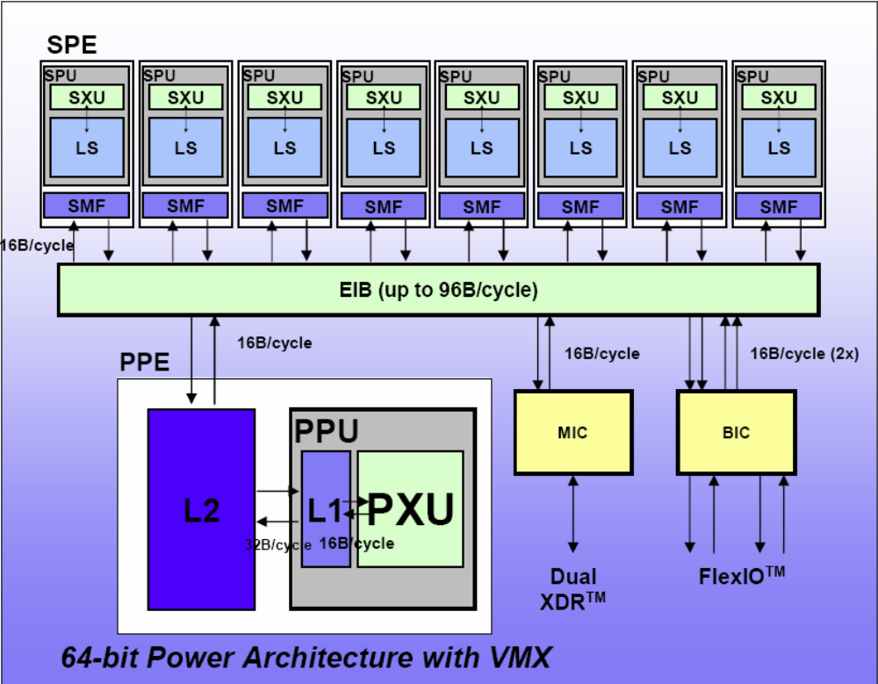
The Cell Processor
Observed clock speed: > 4 GHz
Peak performance (single precision): > 256 GFlops
Peak performance (double precision): >26 GFlops
Local storage size per SPU: 256KB
Total number of transistors: 234M
CSCI 6461 Computer Architecture

Slide 38
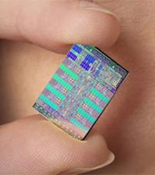
The Cell Processor
Sony Playstation 3
  Partnership between Sony, Toshiba, IBM
  Power PC-based main core (PPE)
  Multiple SPEs
  On die memory controller
  Inter-core transport bus
  High speed IO
  Clocked at 3-4ghz
  256GFLOPS Single Precision @ 4ghz
Offload a large amount of work onto compiler / software.
CSCI 6461 Computer Architecture

Slide 39
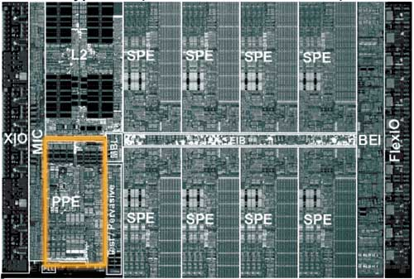
Cell Processor Die Layout
CSCI 6461 Computer Architecture

Slide 40
Power Processing Element (PPE)
PowerPC instruction set with AltiVec VMX instructions
  Slow, but power-efficient
Used for general purpose computing and controlling SPE’s
Simultaneous Multithreading
Separate 32 KB L1 Caches for instructions and data
Unified 512 KB L2 Cache
Two issue in-order instruction fetch
Conspicuous lack of instruction window
PPE’s and SPE’s use different instruction sets.
CSCI 6461 Computer Architecture

Slide 41
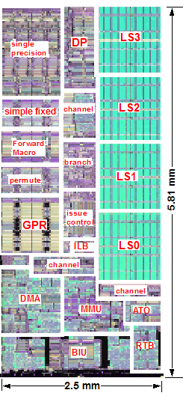
Synergistic Processing Element (SPE)
SPE’s are vector processors:
  Not efficient for general-purpose computation.
  Meant to be used in parallel
  (7 on PS3 implementation)
Instructions based on VMX
  In-order execution w/ dual issue
  Modified for 128 registers
  Instructions assumed to be 4x 32 bits
128 registers (each 128 bits wide)
Vector logic
8 single precision operations per cycle
Significant performance hit for double precision
CSCI 6461 Computer Architecture

Slide 42
SPE Local Storage
On chip local storage (256KB)
  NOT a cache
  Completely private to each SPE
  Directly addressable by software
Software controlled DMA to and from main memory
Request queue handles 16 simultaneous requests
  Up to 16 KB transfer each
  Priority: DMA, L/S, Fetch
Fetch / execute parallelism
CSCI 6461 Computer Architecture

Slide 43
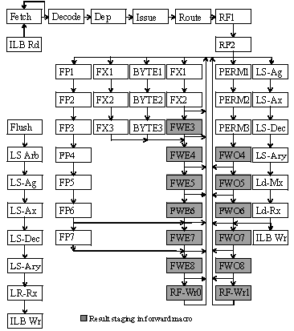
SPE Control Logic/Pipeline
Little ILP, and thus little control logic ➔ faster execution
No hardware branch prediction
  Software branch prediction
  Loop unrolling
  18 cycle penalty
Simple commit unit
  no reorder buffer or other complexities
Same execution unit for FP/int
Instruction Scheduling a HUGE problem
  Done primarily in software
  IBM predicted 80-90% usage ideally
CSCI 6461 Computer Architecture

Slide 44
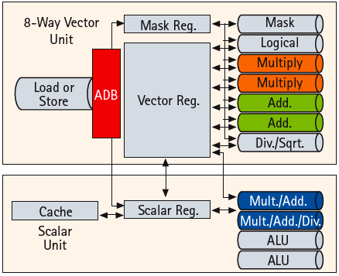
Modern Vector Supercomputer
65nm CMOS technology
Vector unit (3.2 GHz)
  8 foreground VRegs + 64 background VRegs (256x64-bit elements/VReg)
  64-bit functional units: 2 multiply, 2 add, 1 divide/sqrt, 1 logical, 1 mask unit
  8 lanes (32+ FLOPS/cycle, 100+ GFLOPS peak per CPU)
  1 load or store unit (8 x 8-byte accesses/cycle)
Scalar unit (1.6 GHz)
  4-way superscalar with out-of-order and speculative execution
  64KB I-cache and 64KB data cache
Memory system provides 256GB/s DRAM bandwidth per CPU
Up to 16 CPUs and up to 1TB DRAM form shared-memory node
  total of 4TB/s bandwidth to shared DRAM memory
Up to 512 nodes connected via 128GB/s network links (message passing between nodes)
CSCI 6461 Computer Architecture

Slide 45
Vector Advantages
Easy to get high performance: N operations
  are independent
  use same functional unit
  access disjoint registers
  access registers in same order as previous instructions
  access contiguous memory words or known pattern
  can exploit large memory bandwidth
  hide memory latency (and any other latency)
Scalable: (get higher performance by adding HW resources)
Compact: Describe N operations with 1 short instruction
Predictable: performance vs. statistical performance (cache)
Multimedia ready: N * 64b, 2N * 32b, 4N * 16b, 8N * 8b
Mature, developed compiler technology
CSCI 6461 Computer Architecture

Slide 46
Vector Disadvantages
Vector Disadvantage: Out of Fashion?
  Hard to say. Many irregular loop structures seem to still
  be hard to vectorize automatically.
Not as fast with scalar instructions
Complexity of the multi-ported Vector Register File
Difficulties implementing precise exceptions
High price of on-chip vector memory systems
Increased code complexity
CSCI 6461 Computer Architecture

Slide 47

Cray and NEC
The
Last
(Vector)
Samurais
CSCI 6461 Computer Architecture

