Slide 1
Medical Image
Detection & Diagnosis

Slide 2
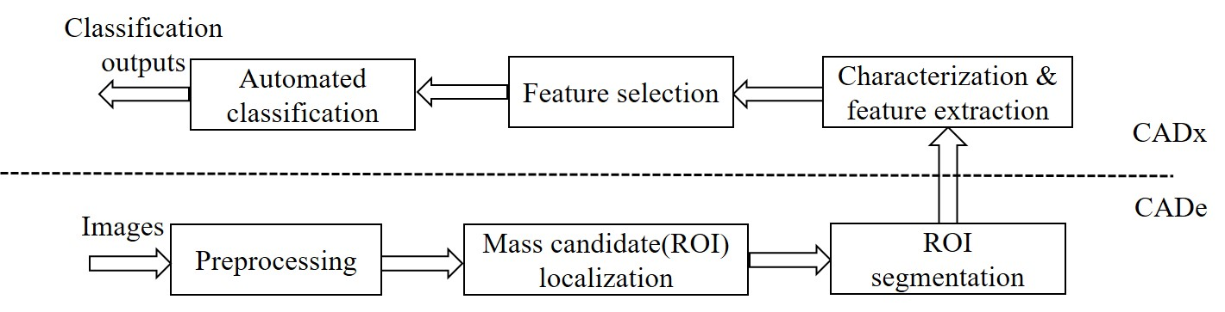
System structure
Image preprocessing: Getting high quality images
CAD
Image segmentation: Getting ROIs
Mass detection & diagnosis: FP reduction

Slide 3
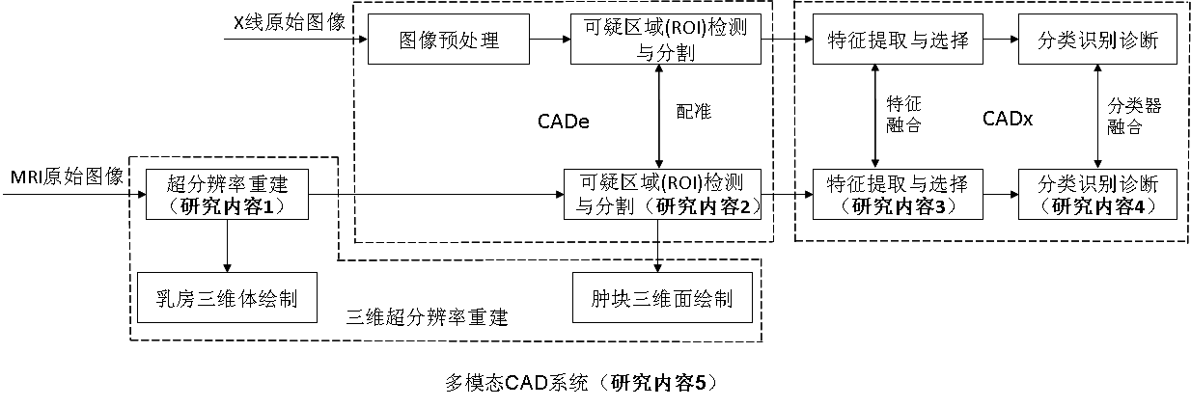
Overall Design

Slide 4
Image preprocessing
Super-resolution reconstruction (sparse representation, PCA…)
Border enhancement ( LoG, Canny, …)
Morphology operations
Image filtering

Slide 5
Image Segmentation
Threshold techniques (OTSU, Watershed Algorithm)
Active Contour Model (Snake, C-V, level-set)
Graph-based (Graph-cut)
Superpixel (SLIC)

Slide 7
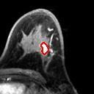
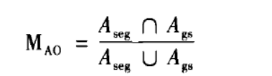
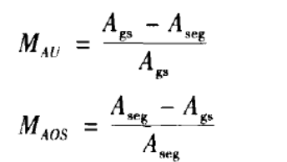
Segmentation evaluation
Area Overlapping Measurement (AOM)
Under / Over Segmentation Measurement

Slide 8

Segmentation evaluation

Slide 9
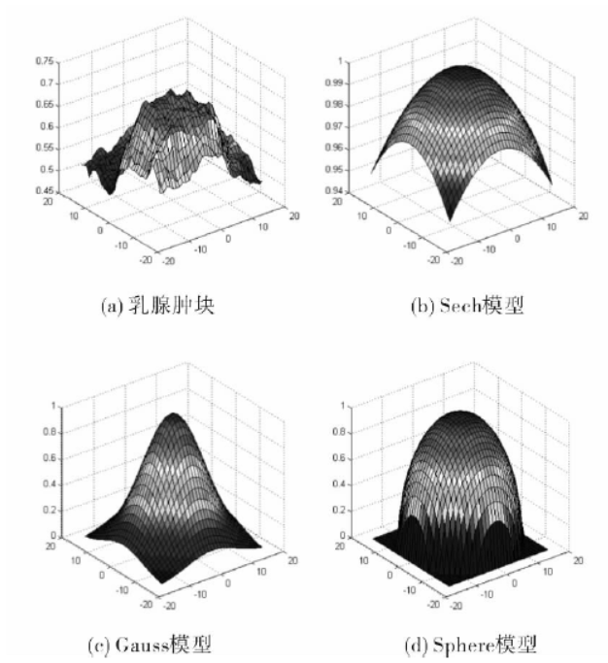
Mass Detection & Diagnosis
Template Matching (NCC)

Slide 10

Mass Detection & Diagnosis

Slide 11
Mass Diagnosis
Feature extraction(shape, texture, wavelet…)
Feature selection (wrapper, filter)
Imbalanced data processing (sampling, boosting, bagging, cost-sensitive…)
Further work (deep learning)

Slide 12
Mass Diagnosis
Shape: circularity, entropy of the intensity distribution, area, …
Feature extraction
texture: Haralick (GLCM), GLDM, GGLCM, GLRLM
wavelet: gabor, haar, …

Slide 13
Mass Diagnosis
Wrapper: Classifier dependent
SFS, SBS, SFFS, SFBS, plus-l-remove-r
slower, sensitive to classifier
Feature selection
Filter: Classifier independent
Relief, ReliefF

Slide 14
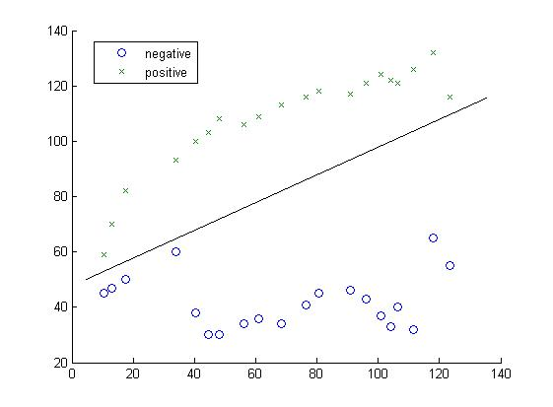
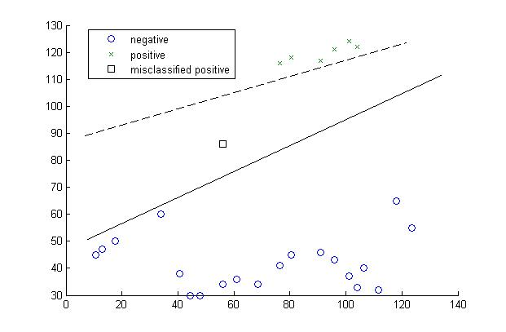
Mass diagnosis
Imbalanced data processing
Origin: Many medical information has this problem, because most samples are normal and only a little part samples are abnormal and of higher value.

Slide 15
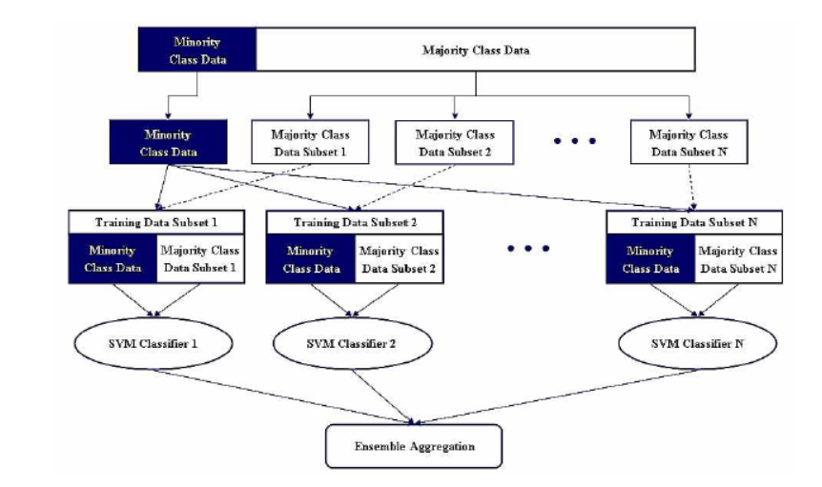
Mass diagnosis

