Slide 1

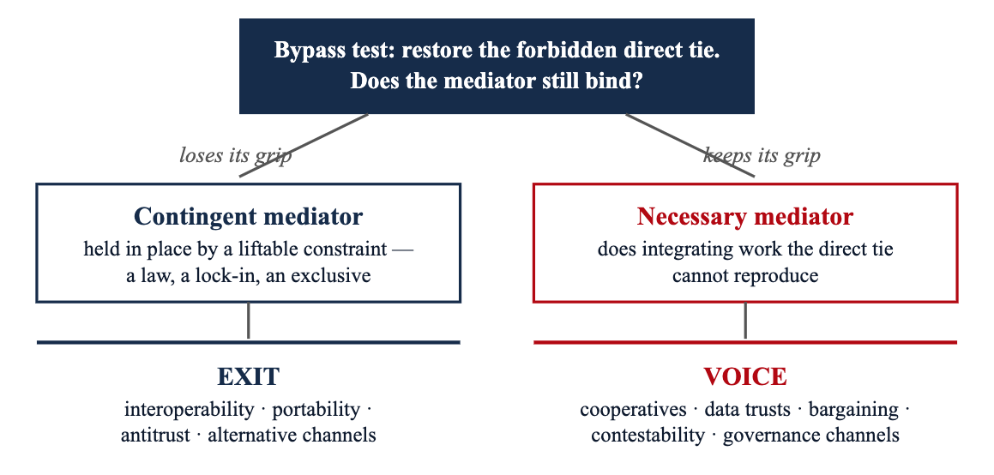
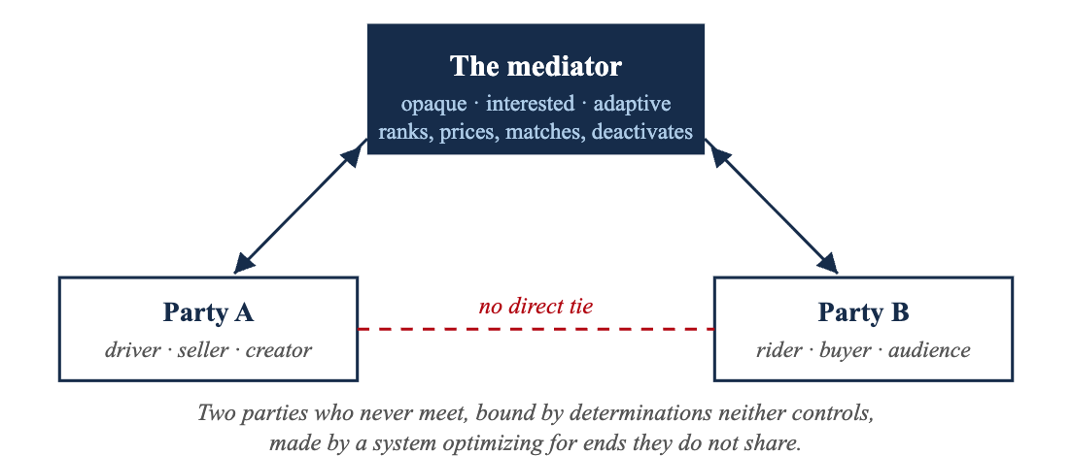
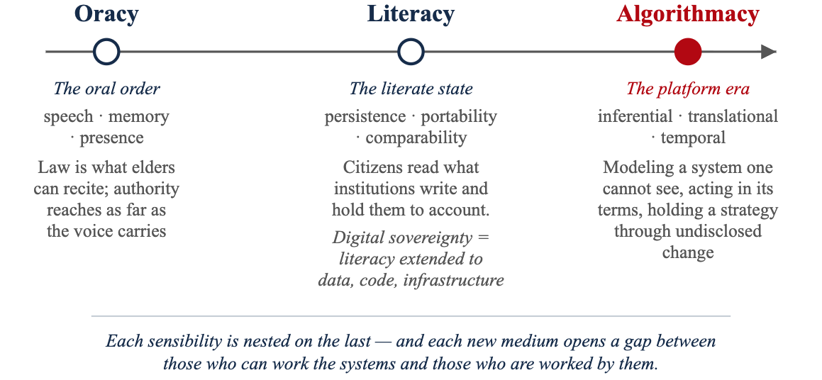
SOCIETY OF BUSINESS ETHICS · ANNUAL MEETING 2026
Algorithmacy and Sovereignty: Toward a Coordinative Sovereignty for the Platform Era
Full paper & companion work
www.algorithmacy.org
Roger Hunt · Bentley University · rhunt@bentley.edu
1. Sovereignty has never stood alone
2. The platform turn: the mediated triad
3. Exit, voice, and coordinative sovereignty
The gap. A firm can satisfy every requirement of Europe's digital regulation — GDPR, AI Act, DMA, DSA, NIS2 — and remain strategically helpless. A compliant marketplace seller still watches sales collapse when the ranking changes; a developer in full compliance cannot see, predict, or contest the store decisions that determine its access to customers. Compliance governs how actors handle data; their market positions are determined inside algorithmic systems that decide what to surface and what to bury.
The coordination logic (price, authority, trust) is old. The topology — a broker between parties — is old. What is new is the conjunction of two features of the mediator: it is opaque (high-dimensional systems that resist interpretation) and interested and adaptive (it pursues its own objectives and revises its rules to achieve them). The coordinated actor is co-opted : enrolled without delegated authority and without negotiated terms.
FIGURE 3 · THE BYPASS TEST DECIDES WHICH SOVEREIGNTY IS AVAILABLE
The pattern. Every historical form of sovereignty was paired with a communicative sensibility — a competence for handling the medium through which authority is exercised and contested. Without the competence, sovereignty can be neither exercised nor held to account.
FIGURE 2 · COORDINATION THROUGH AN OPAQUE, INTERESTED MEDIATOR
FIGURE 1 · THREE SENSIBILITIES, THREE SOVEREIGNTIES
A platform is a portfolio of mediators — necessary in one function, contingent in another. Treating a necessary mediator as contingent wastes effort on an exit that cannot be had; treating a contingent one as necessary concedes a bypass that could be opened.
Why literacy cannot reach it
DEFINITION
Coordinative sovereignty
i.
The object resists reading — machine-learning opacity survives the release of source code (Burrell 2016).
is the autonomy proper to being irreducibly coordinated: the power to shape the terms on which one is mediated, to contest the mediator's arbitrary power, and to hold a share in the governance of an arrangement one cannot leave. Its currency is
. It rests on non-domination (Pettit), relational autonomy (Nedelsky), involvement (Markell), and commons governance (Ostrom).
ii.
Reading without a channel to act yields no accountability — a disclosure no one can contest is a fact without a consequence (Ananny & Crawford 2018).
effective voice
Digital sovereignty is extended literacy. Its instruments — classification, documentation, disclosure, data-subject rights — govern by rendering the digital object legible and attaching consequences to what it reveals. Faced with platform coordination, the literate response is to demand more disclosure, more rights to read. That addresses the layer the sensibility can grasp and leaves untouched the layer it cannot.
iii.
The actors who most need to contest the system have no leverage — the "invisible cage" of platform dependence (Rahman 2021; Cutolo & Kenney 2021).
iv.
Text-driven law confronts code- and data-driven coordination and stops short of the layer where the platform decides (Hildebrandt 2015).
Implications
Scholars
Digital sovereignty (a literacy construct) and coordinative sovereignty (an algorithmacy construct) vary independently and call for separate measurement.
Algorithmacy is the sensibility equal to this medium: inferential (model an unseen system from its outputs), translational (render conduct into the terms the system reads), temporal (hold a strategy through undisclosed change). It is what algorithmic literacy becomes when your own conduct is a variable the system optimizes. The competence is unevenly held — and opacity is a rent-preserving strategy of the mediator itself.
Managers
Compliance investment does not close the algorithmic gap. Diagnose each platform function: exit against contingent gates, voice against necessary ones. Algorithmacy can be trained, budgeted, and audited.
Claim. Platform coordination is a further change in kind: a situation that reading, however extended, cannot govern — and therefore a sovereignty that literacy cannot supply.
Policymakers
Build standing, not just legibility: contestation rights, collective-organization rights, and channels that turn disclosure into accountability.
Takeaway. Sovereignty in the age of AI rests on the standing of the coordinated to govern the coordinations that govern them — and on the diffusion of the competence that standing requires. Neither reading nor control secures it.

