Slide 1

SOCIETY OF BUSINESS ETHICS · ANNUAL MEETING 2026
Algorithmacy and Sovereignty: Toward a Coordinative Sovereignty for the Platform Era
Roger Hunt · Bentley University · rhunt@bentley.edu
www.algorithmacy.org
Notes:
Introduce the paper: compliance with Europe's digital regulation does not secure a firm's strategic position on platforms. The chapter proposes a new competence, algorithmacy, and a new form of autonomy, coordinative sovereignty.

Slide 2
1. The gap: compliant, yet strategically helpless
A firm can satisfy every requirement of Europe's digital regulation — GDPR, AI Act, DMA, DSA, NIS2 — and remain strategically helpless.
·
A compliant marketplace seller watches sales collapse when the ranking changes.
·
A developer in full compliance cannot see, predict, or contest the store decisions that determine its customer access.
·
A creator obeys every policy and loses an audience to a recommendation change announced nowhere.
Compliance governs how actors handle data. Their market positions are determined inside algorithmic systems that decide what to surface and what to bury.
Notes:
A firm can meet every requirement of GDPR, the AI Act, the DMA, the DSA, and NIS2 and still be strategically helpless. Compliance governs data handling; market position is determined inside algorithmic systems.

Slide 3
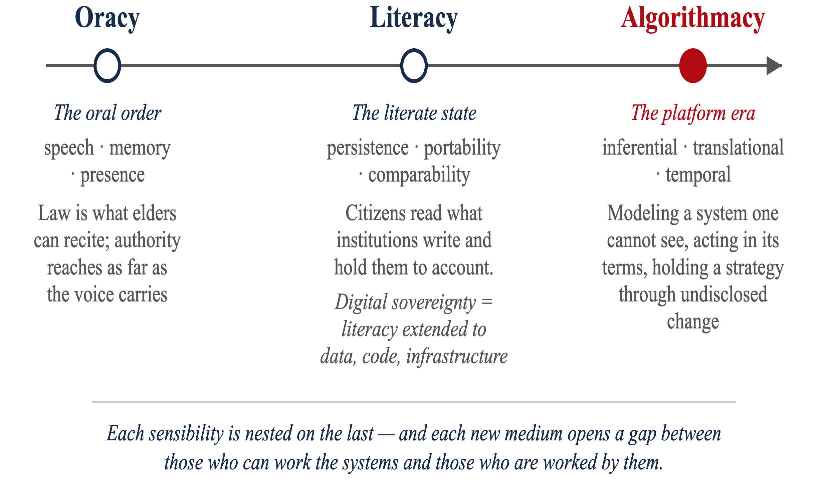
Three sensibilities, three sovereignties
Every historical form of sovereignty was paired with a communicative sensibility — a competence for handling the medium through which authority is exercised and contested.
Notes:
Every historical form of sovereignty was paired with a communicative sensibility. Oracy for the oral order, literacy for the literate state, and now algorithmacy for the platform era. Each sensibility is nested on the last.

Slide 4
Digital sovereignty is extended literacy
Its instruments — classification, documentation, disclosure, data-subject rights — govern by rendering the digital object legible and attaching consequences to what it reveals.
Faced with platform coordination, the literate response is to demand more disclosure, more rights to read. That addresses the layer the sensibility can grasp — and leaves untouched the layer it cannot.
Claim. Platform coordination is a further change in kind: a situation that reading, however extended, cannot govern — and therefore a sovereignty that literacy cannot supply.
Notes:
Digital sovereignty is the literate sensibility carried into the digital domain. Its instruments render objects legible. The chapter's claim: platform coordination is a change in kind that reading cannot govern.

Slide 5
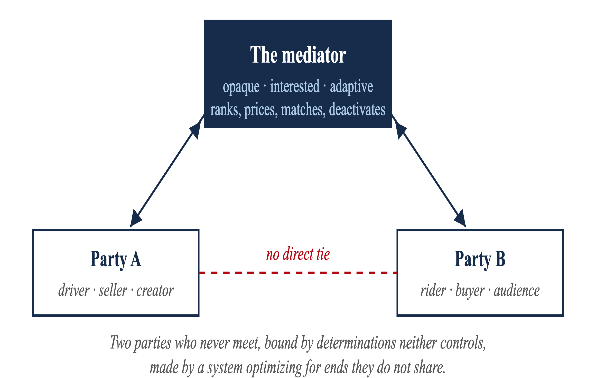
2. The platform turn: the mediated triad
What is new is a conjunction: the mediator is opaque (high-dimensional systems that resist interpretation) and interested and adaptive (it pursues its own objectives and revises its rules to achieve them). The coordinated actor is co-opted.
Notes:
The coordination logic is old, the topology is old. What is new is the conjunction: the mediator is opaque, and it is interested and adaptive. The coordinated actor is co-opted — enrolled without delegated authority or negotiated terms.

Slide 6
Why literacy cannot reach it
i.
The object resists reading — machine-learning opacity survives the release of source code (Burrell 2016).
ii.
Reading without a channel to act yields no accountability — a disclosure no one can contest is a fact without a consequence (Ananny & Crawford 2018).
iii.
The actors who most need to contest the system have no leverage — the "invisible cage" of platform dependence (Rahman 2021; Cutolo & Kenney 2021).
iv.
Text-driven law confronts code- and data-driven coordination and stops short of the layer where the platform decides (Hildebrandt 2015).
Notes:
Four structural reasons: opacity survives disclosure; transparency without standing produces no accountability; the dependent actors have no leverage; and text-driven law stops short of the layer where the platform decides.

Slide 7
Algorithmacy: the sensibility for the platform era
Inferential
model the behavior of a system one cannot see, from its outputs.
Translational
render one's conduct into the terms the system reads, and read its determinations back into consequences.
Temporal
hold a strategy together across a system whose rules shift without notice.
It is what algorithmic literacy becomes when your own conduct is a variable the system optimizes. The competence is unevenly held — and opacity is a rent-preserving strategy of the mediator itself.
Notes:
Algorithmacy has three parts: inferential, translational, temporal. It is what algorithmic literacy becomes when your own conduct is a variable the system optimizes. The competence is unevenly held, and opacity is a rent-preserving strategy.

Slide 8
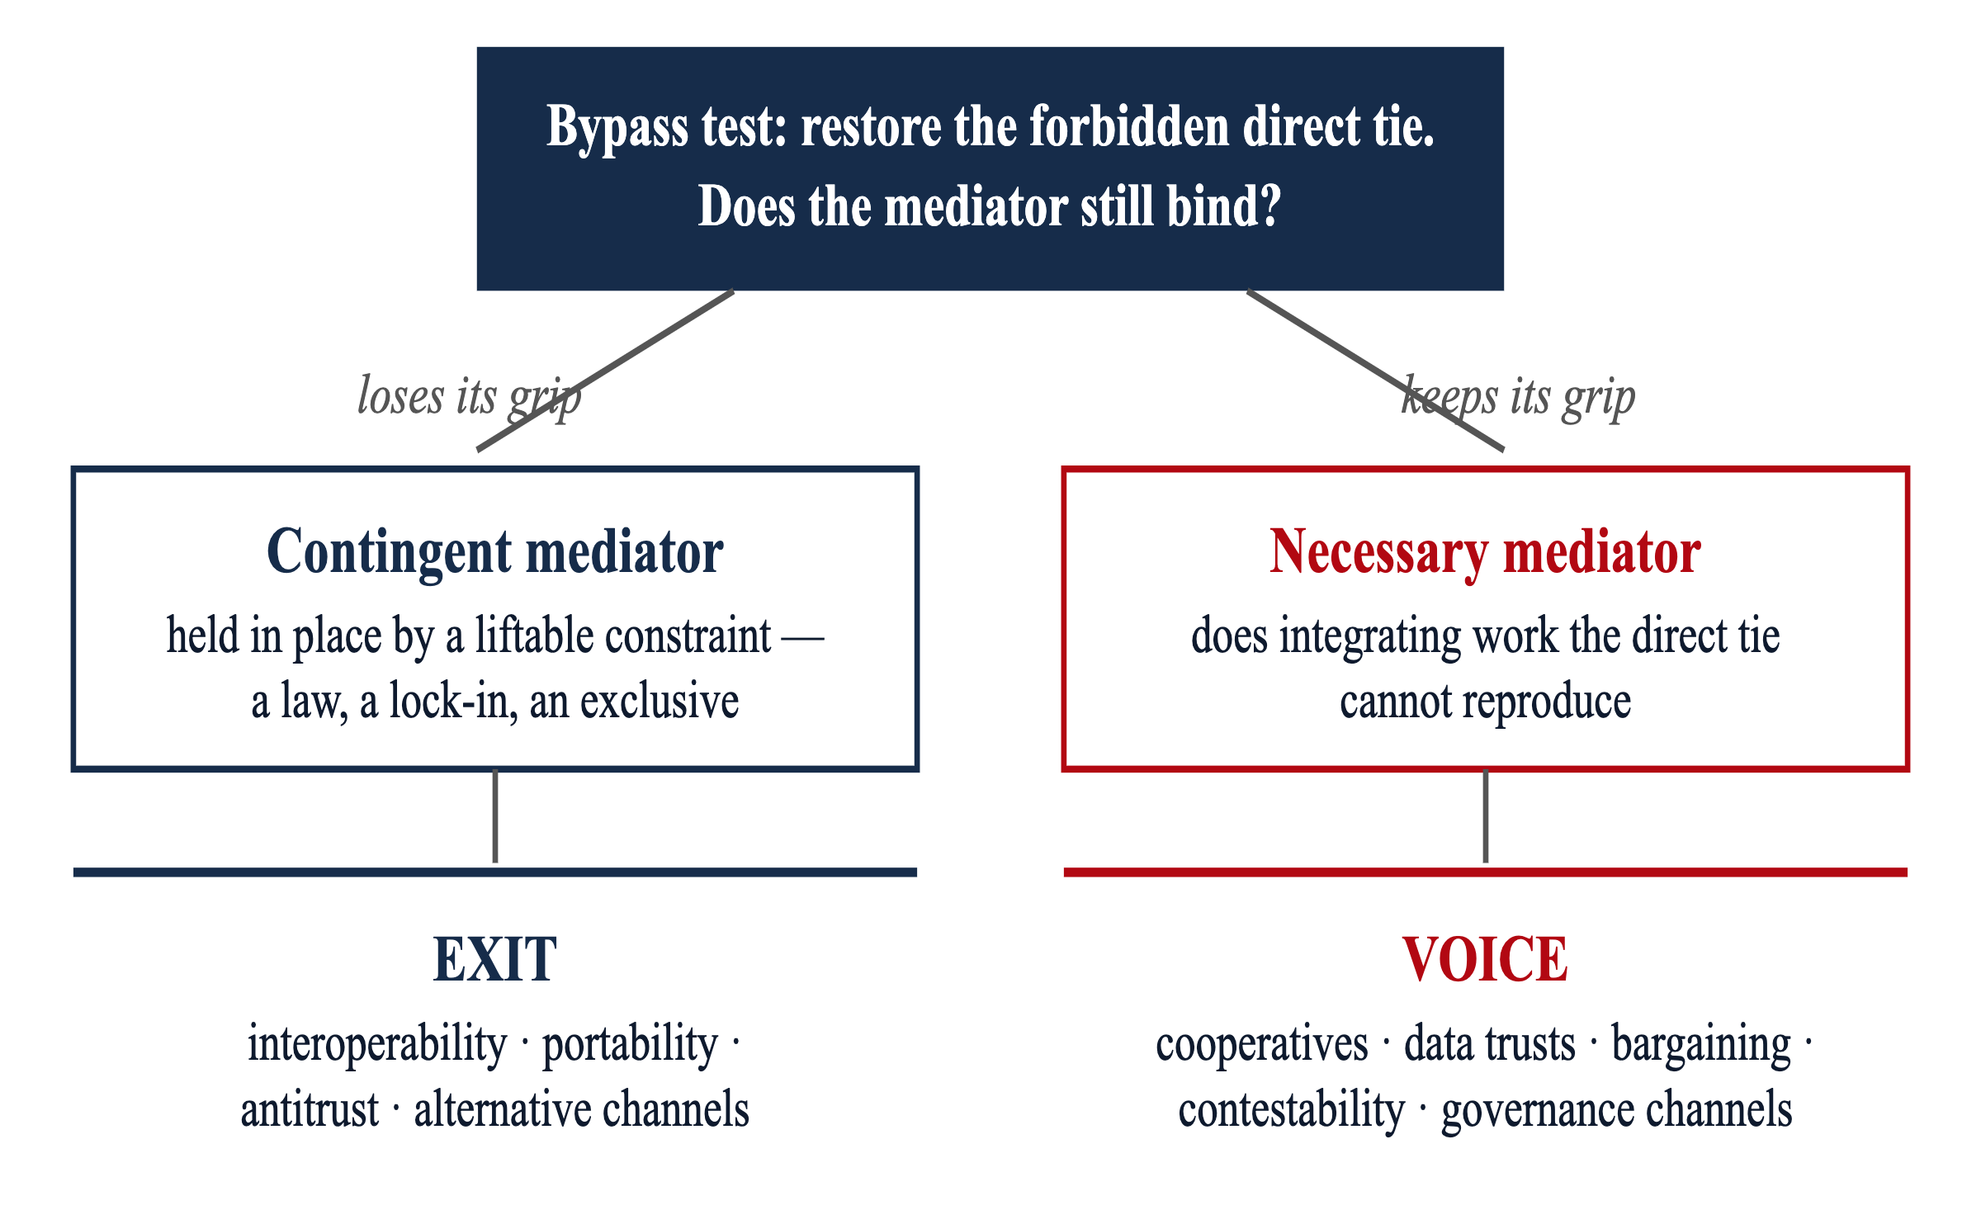
3. The bypass test: exit or voice
A platform is a portfolio of mediators — necessary in one function, contingent in another. Treating a necessary mediator as contingent wastes effort on an exit that cannot be had; treating a contingent one as necessary concedes a bypass that could be opened.
Notes:
Restore the forbidden direct tie and recompute. A mediator that loses its grip is contingent — exit is available. One that keeps its grip is necessary — only voice remains. A platform is a portfolio of both kinds at once.

Slide 9
DEFINITION
Coordinative sovereignty is the autonomy proper to being irreducibly coordinated: the power to shape the terms on which one is mediated, to contest the mediator's arbitrary power, and to hold a share in the governance of an arrangement one cannot leave.
Its currency is effective voice . It rests on non-domination (Pettit), relational autonomy (Nedelsky), involvement (Markell), and commons governance (Ostrom).
Notes:
The definition: coordinative sovereignty is the autonomy proper to being irreducibly coordinated. Its currency is effective voice. It rests on non-domination, relational autonomy, involvement, and commons governance.

Slide 10
Implications
Scholars
Digital sovereignty (a literacy construct) and coordinative sovereignty (an algorithmacy construct) vary independently and call for separate measurement.
Managers
Compliance investment does not close the algorithmic gap. Diagnose each platform function: exit against contingent gates, voice against necessary ones. Algorithmacy can be trained, budgeted, and audited.
Policymakers
Build standing, not just legibility: contestation rights, collective-organization rights, and channels that turn disclosure into accountability.
Notes:
For scholars: two constructs, measured separately. For managers: diagnose each platform function — exit against contingent gates, voice against necessary ones. For policymakers: build standing, not just legibility.

Slide 11

Sovereignty in the age of AI rests on the standing of the coordinated to govern the coordinations that govern them — and on the diffusion of the competence that standing requires. Neither reading nor control secures it.
Roger Hunt · Bentley University
rhunt@bentley.edu · www.algorithmacy.org
Notes:
Close on the framing question: whether algorithmacy can be democratized as literacy was, or stays concentrated among a new constitutive priesthood. Point the audience to the full paper at www.algorithmacy.org.

