Slide 1
Roger Hunt · Algorithmacy Lab · 2026
_ DXD · 2026 _
DECISION EXPERIENCE DESIGN · HUMAN FACTORS
-2026-
Spaces in the Stream
How word spaces changed reading—and why AI streams need decision marks.
Notes:
Spaces in the Stream. Roger Hunt, Algorithmacy Lab, 2026.
The big idea: about 1,300 years ago, putting blank spaces between words changed how people read. Today, AI tools pour out text in one long stream, and they need a similar kind of mark to show readers where the decisions are.
Source: submissions/phd1750_spaces_in_stream/paper/gdoc_full_2026-10-22d.md

Slide 2
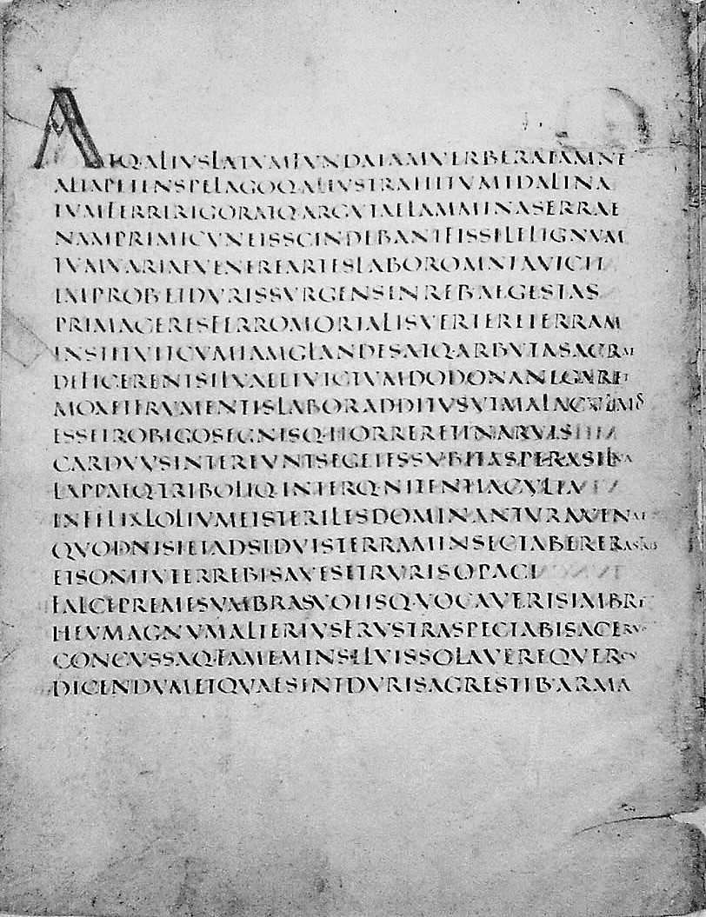
Scriptura Continua:
When Reading Relied on Speaking Aloud
IN PRINCIPIO ERAT VERBVM
→
INPRINCIPIOERATVERBVM
With no spaces to show where words started or ended, readers usually sounded the letters out, aloud or under the breath, to hear the words. Skilled readers could also read silently (Knox, 1968).
Left: Vergilius Augusteus (probably 4th century CE), in square capitals. The letters run on with no spaces.
By Roman imperial times, most Greek and Latin books ran the letters together, with no spaces and little punctuation.
Without spaces on the page, the voice usually did the work that the layout did not.
Saenger 1997 · Johnson 2000 · Knox 1968
Image: Vergilius Augusteus (Virgil, Georgics 141 ff.), Vatican Library, Vat. lat. 3256, probably 4th c. Wikimedia Commons, public domain.
1. Scan
Look at an unbroken wall of letters on the page
2. Sound Out
Say the syllables aloud or under the breath
3. Hear Words
Recognize where words begin and end by ear
SCAN
SOUND
OUT
HEAR
WORDS
Notes:
By Roman imperial times, most Greek and Latin books ran the letters together: no spaces between words and very little punctuation. (Early Latin texts used dots between words, but scribes later dropped them to copy the Greek style.)
Readers could not see where one word ended and the next began. So they usually sounded the letters out, often aloud, and listened for the words. Skilled readers could read silently when they needed to (Knox 1968; Johnson 2000), but reading was mostly done out loud (Saenger 1997).
Sources: Saenger, P. (1997) Space Between Words; Johnson, W. A. (2000) Toward a sociology of reading in classical antiquity; Knox, B. M. W. (1968) Silent reading in antiquity.
Image (pulled, not AI-generated): Vergilius Augusteus, page with Virgil, Georgics, lines 141 ff. (as labeled on Wikimedia Commons), written in Roman square capitals with no spaces. Vatican Library (Biblioteca Apostolica Vaticana), MS Vat. lat. 3256 (three other leaves: Staatsbibliothek zu Berlin, Lat. fol. 416). Late antiquity, probably 4th century. Public domain (PD-Art). Converted to grayscale for this deck.
Source URL: https://commons.wikimedia.org/wiki/File:Vergilius_Augusteus,_Georgica_141.jpg
Holding and shelfmark: https://en.wikipedia.org/wiki/Vergilius_Augusteus ; https://commons.wikimedia.org/wiki/Category:Vergilius_Augusteus

Slide 3
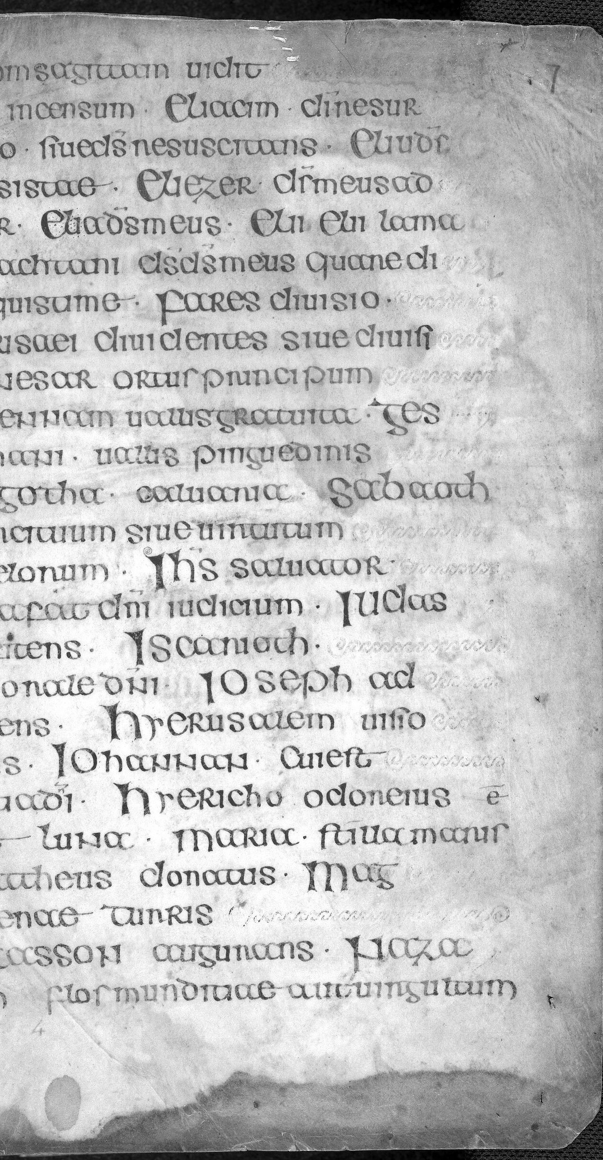
How Spaces Between
Words Changed Reading
Blank spaces moved the work of finding words from the voice to the eye.
In the 7th and 8th centuries, Irish and then Anglo-Saxon scribes began putting spaces between words, which made Latin, a foreign language to them, easier to read (Saenger, 1997).
Unspaced Latin. Image: Vergilius Augusteus, Vatican Library, Vat. lat. 3256, probably 4th c. Wikimedia Commons, public domain.
Slower Reading Without Spaces
How much skilled adults slowed down reading English with the spaces taken out.
From sounding out to seeing
44–58%
That simple gap changed the work of reading. The eye could find each word, and see where the next one began, without sounding out the letters. That made fast, silent reading much easier.
Nearly Double the Backtracking
Without spaces, the eyes miss their usual landing spot and jump backward almost twice as often.
9.7% → 17.3%
Both figures: Rayner, Fischer & Pollatsek, 1998
After: Insular word spacing. Image: Book of Durrow, fol. 7r, Trinity College Dublin, MS 57, c. 700. © The Board of Trinity College Dublin, CC BY 4.0, via Wikimedia Commons; cropped, grayscale.
Notes:
In the 7th and 8th centuries, Irish and then Anglo-Saxon scribes started leaving blank spaces between words. Latin was a foreign language to them, and the spaces made it easier to read. The habit reached the rest of Europe only in the late 10th century (Saenger, 1997).
That small change let the eye find each word without sounding it out. Silent reading existed before, but spacing made fast, silent reading much easier.
The numbers: take the spaces out of English text and skilled adults read 44–58% slower (54% for sentences and 44% for passages in Experiment 1; 58% in Experiment 2). In sentences, the share of eye movements that jump backward rises from 9.7% to 17.3%, and the eyes land near the start of words instead of just left of the middle (Rayner, Fischer & Pollatsek, 1998, Table 1, pp. 1132, 1138).
Sources: Parkes, M. B. (1992) Pause and Effect: An Introduction to the History of Punctuation in the West, Scolar Press; Saenger, P. (1997) Space Between Words: The Origins of Silent Reading, Stanford University Press, https://www.sup.org/books/literary-studies-and-literature/space-between-words ; Rayner, Fischer & Pollatsek (1998), Unspaced text interferes with both word identification and eye movement control, Vision Research 38(8), 1129–1144: https://doi.org/10.1016/s0042-6989(97)00274-5 ; Drieghe, Fitzsimmons & Liversedge (2017).
Image 1 (pulled, not AI-generated): Vergilius Augusteus, Georgics 1.141 ff., Vatican Library, MS Vat. lat. 3256, probably 4th century. Public domain. Grayscale. Source URL: https://commons.wikimedia.org/wiki/File:Vergilius_Augusteus,_Georgica_141.jpg
Image 2 (pulled, not AI-generated): Book of Durrow, folio 7r, Trinity College Dublin Library, IE TCD MS 57, made c. 700 (where it was made, Ireland, Iona or Northumbria, is debated, so the caption says Insular). Photo by Trinity College Dublin Library, Digital Collections. License: CC BY 4.0 (https://creativecommons.org/licenses/by/4.0/), credit: The Board of Trinity College Dublin. Cropped and converted to grayscale for this deck. Source URL: https://commons.wikimedia.org/wiki/File:IE_TCD_MS_57_fol.7r.jpg ; TCD record: https://doi.org/10.48495/wm117t53k

Slide 4
Reading was sold as a path to a better life. But in 19th-century Canadian cities, being able to read did little to lift workers out of their class; ethnicity, class and gender mattered more (Graff, 1991).
Experts treated one school-based kind of reading as the only real kind, and cast people with other ways of reading and knowing as backward (Street, 1984).
The promise that reading makes people smarter did not hold up. Among the Vai of Liberia, learning a script outside school helped with the tasks people used it for, not with thinking in general (Scribner & Cole, 1981).
In England between 1066 and 1307, written records slowly took over from memory and spoken witness as the proof that counted (Clanchy, 2013).
Print broke the church’s hold on knowledge, but it did not end control by a few. New monopolies grew up around print (Innis, 1951).
Printed books were not trusted just because they were printed. Their authority came from the printers, sellers, and readers around the press (Johns, 2002).
In ancient Greece, the alphabet arrived around 700 BCE, but schooling made reading common only near 400 BCE. Until then, writing served a skilled few (Havelock, 1963).
Ethical Failures
of the Expansion
of Literacy
Spaces on the page made reading easier—but as literacy spread, societies did not fix the unequal power that came with the written word.
Notes:
Speaker notes: This slide is only about the history of reading and writing. Spaces between words made reading easier, but as more people learned to read, these problems went unfixed.
1) In 19th-century Canadian cities (Hamilton, Kingston, London, Ontario), literacy did little to lift workers out of their class; ethnicity, class and gender shaped their lives more (Graff, 1991). 2) One school-based kind of literacy was treated as the only real kind, the “autonomous model” (Street, 1984). 3) Reading alone did not make people better thinkers in general; among the Vai of Liberia, who learned their script outside school, its effects were tied to specific uses (Scribner & Cole, 1981). 4) In England from 1066 to 1307, trust slowly moved from memory and spoken witness to written records (Clanchy, 2013). 5) Print broke the church’s monopoly of knowledge, but new monopolies formed around it (Innis, 1951). 6) The authority of print came from the people and institutions around it, not the machine (Johns, 2002). 7) In Greece the alphabet came about 700 BCE, but only a skilled few used it (“craft literacy”) until schooling spread reading near the end of the 5th century BCE (Havelock, 1963).
References:
Clanchy, M. T. (2013). From Memory to Written Record: England 1066–1307 (3rd ed.). Wiley-Blackwell. (Released Sept. 2012; title page 2013.) https://www.wiley.com/en-us/From+Memory+to+Written+Record%3A+England+1066+-+1307%2C+3rd+Edition-p-9781405157919
Graff, H. J. (1991). The Literacy Myth: Cultural Integration and Social Structure in the Nineteenth Century. Transaction Publishers. (Orig. Academic Press, 1979.) https://wacclearinghouse.org/books/landmarks/literacy-myth/
Havelock, E. A. (1963). Preface to Plato. Belknap Press of Harvard University Press.
Innis, H. A. (1951). The Bias of Communication. University of Toronto Press.
Johns, A. (2002). How to acknowledge a revolution. American Historical Review, 107(1), 106–125. https://doi.org/10.1086/532099
Scribner, S., & Cole, M. (1981). The Psychology of Literacy. Harvard University Press.
Street, B. V. (1984). Literacy in Theory and Practice. Cambridge University Press.

Slide 5
The AI Scroll Is Today's Scriptura Continua
AI chat tools pour out an unbroken stream of words without marking where the real decisions happen.
Like ancient unspaced manuscripts, a fast-scrolling wall of AI text can hide the forks in the road inside smooth, confident prose, so you have to read line by line to spot what the machine decided.
~45 w/s
Eyes Pulled
Off-Screen
Too Fast to Judge in Real Time
Your Eyes Get Pulled by the Moving Cursor
Auto-Scroll Pushes Earlier Text Out of View
GPT-4o’s API streams about 45 words per second (Xiao & Yang, 2025). Adults read silently at about 4 words per second, or 238 a minute (Brysbaert, 2019).
New words appearing at the bottom of the screen can act like a moving lure, pulling your eyes down so you keep following the stream instead of questioning earlier claims.
As the window scrolls up on its own, earlier assumptions move off-screen—making it hard for your eyes to jump back and catch mistakes before the AI moves on.
Notes:
Speaker notes: Old manuscripts ran words together with no spaces, so readers had to work line by line to find where one word ended. AI chat output does something similar with decisions: it streams one smooth block of text and does not mark where the real choices are. Card 1: GPT-4o’s API streams about 45 words per second (Xiao & Yang, 2025). Adults read English non-fiction silently at about 238 words a minute, about 4 per second (Brysbaert, 2019). In Xiao & Yang’s study, even the 99th-percentile comfortable streaming speed was about 12 words per second for hard text and 21 for easy text. Card 2: Each new word popping up at the bottom can grab attention, so your eyes follow the cursor instead of going back to check. This is the paper’s proposal, built on Yantis & Jonides (1984) and Wolfe (2021); it has not been tested on AI streams yet. Card 3: When the window scrolls by itself, earlier text slides out of view. In a lab study that turned words into x’s once the eyes passed them, so readers could not look back, comprehension fell from 78% to 71% (Schotter, Tran & Rayner, 2014). Sources: Brysbaert, M. (2019) How many words do we read per minute? Journal of Memory and Language 109, 104047, https://doi.org/10.1016/j.jml.2019.104047 ; Xiao, C. & Yang, B. (2025) Streaming, fast and slow, UIST ’25, https://doi.org/10.1145/3746059.3747721 ; Liu et al. (2024); Yantis & Jonides (1984); Wolfe (2021); Schotter, Tran & Rayner (2014), https://doi.org/10.1177/0956797614531148 ; Booth & Weger (2013).

Slide 6
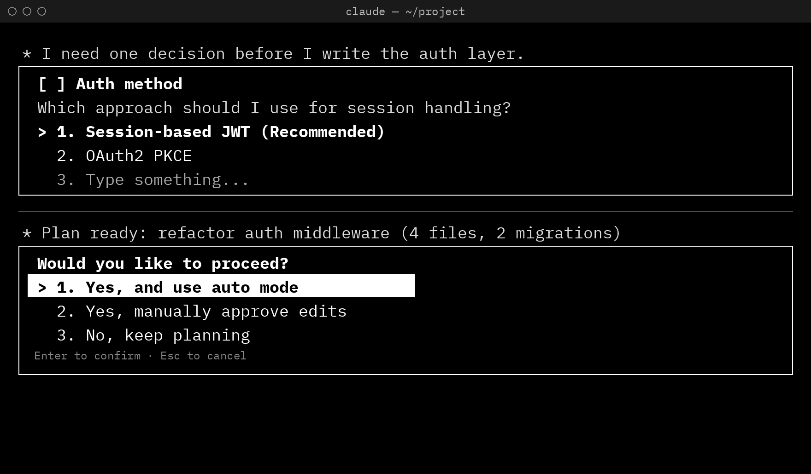
Now the AI Prompts You:
The Role Reversal
RE-CREATED VIEW, NOT A SCREENSHOT Drawn for this talk; plan menu per Anthropic’s docs
Instead of showing where decisions happen in the text, tools like Claude Code pause to quiz the human—turning the AI into the prompter.
01 · Hides the Other Options (Dec 2025)
As of December 2025, Claude Code’s Plan Mode told the AI to “include only your recommended approach, not all alternatives.”
02 · Turns the Human Into the One Answering Prompts (October 2025)
The AI writes its own multiple-choice questions for you (AskUserQuestion). Until July 2026, an unanswered question timed out by default and the agent went on without you.
03 · Nudges You Toward Auto Mode (2026)
The first choice on the plan menu is “Yes, and use auto mode.” Since September 2026, Claude Code starts in auto mode by default.
Claude Code prompting the user: the AI writes the question menu, and the plan menu puts “use auto mode” first.
Notes:
The normal picture is that people prompt the AI. In today’s coding tools it often runs the other way: the AI writes the questions and the plan, and the person picks an answer.
01: Plan mode appears in the Claude Code changelog by June 2025 (v1.0.33). As of December 2025, its instructions told the AI to “Include only your recommended approach, not all alternatives” (Ronacher, 2025). 02 (October 2025): v2.0.21 added an interactive question tool (now AskUserQuestion) that lets the AI write multiple-choice questions for the user. Until July 2026 (v2.1.200), these questions auto-continued by default if the user did not answer; now they stay open unless you set a timeout. Permission prompts and plan approval never auto-resolve. 03: “Yes, and use auto mode” is the first option on the plan approval menu (Anthropic docs). In August 2026 (v2.1.247), Bash permission prompts gained a “Yes, and switch to auto mode” option, and from September 2026 (v2.1.283–2.1.284) auto mode became the starting mode on every plan and provider (earlier it was the default only on Pro, Max and Team). Anthropic’s docs list auto mode as being for “reducing prompt fatigue.”
Image (made by script for this talk, not AI-generated, not a screenshot): a re-created black-and-white terminal view drawn with Python (PIL) in IBM Plex Mono. The plan-menu wording “Yes, and use auto mode / Yes, manually approve edits / No, keep planning” follows Anthropic’s Claude Code docs; the session-handling question and its options are made-up examples.
Sources: Anthropic, Claude Code docs, Choose a permission mode: https://code.claude.com/docs/en/permission-modes ; Tools reference (AskUserQuestion): https://code.claude.com/docs/en/tools-reference ; Claude Code changelog: https://github.com/anthropics/claude-code/blob/main/CHANGELOG.md ; Ronacher, A. (2025, Dec. 17) What actually is Claude Code’s plan mode? https://lucumr.pocoo.org/2025/12/17/what-is-plan-mode/

Slide 7
Why AI-Written Menus Weaken Your Control
When the AI writes the questions and the multiple-choice options, you steer less—you mostly approve its plan.
01 · Who Decides When to Pause?
02 · How Are the Choices Shown?
03 · What Role Does the Human Play?
01
Mostly to get a yes
The tool pauses mainly for permission, plan approval, or a question the AI wrote.
One plan, rest hidden
The AI shows one recommended plan, leaves out the alternatives, and puts “Yes, and use auto mode” first on the menu.
Rubber-Stamper
You click through menus the machine wrote, and auto mode is pitched as the cure for “prompt fatigue.”
Today’s AI Agents
The AI prompts the human.
02
At every real decision
The interface pauses automatically whenever the stream hits a real commitment, assumption, or fork in the road.
Real options, no default
No pre-selected default—the interface lays out the real alternatives and trade-offs side by side.
Decision-Maker
You see where the paths split, check the facts on a still page, and choose the direction.
Decision Experience Design
The human is in the driver’s seat.
Notes:
Today’s AI agents write the questions they ask you and the answers you get to pick from. That means you steer less. Mostly you say yes to a plan the AI already made.
Top row: the tool pauses mainly for permission, plan approval, or a question the AI wrote. The plan shows one approach, leaves out the others, and the menu puts “use auto mode” first. Anthropic’s docs pitch auto mode as a way of “reducing prompt fatigue.”
Bottom row (a proposal, not a shipped product): with Decision Experience Design, the interface pauses at every real decision, shows the real options side by side with no default picked, and lets you choose.
Sources: Spaces in the Stream, Table 3.1 and sections 3.1, 3.5, 4.1; Stark & Vanden Broeck (2024); Johnson (2000); Kim et al. (2025); Steyvers et al. (2025); Anthropic (2026a) on “prompt fatigue.”

Slide 8
Algorithmacy: Seeing
Where the Decisions Are
[COMMIT]
Point of No Return
[BRANCH]
Fork in the Road
To steer an AI system, you have to be able to see the moments where it is making choices for you.
Right before the AI changes a file, runs code, calls an external tool, or sends a message you can’t easily undo.
A moment where two or three reasonable paths exist, and the AI would otherwise quietly pick one without telling you.
FROM ORACY TO ALGORITHMACY
Oracy lets us speak and listen well
Literacy lets us read and write
Numeracy lets us work with numbers
Algorithmacy lets us steer AI without giving up our judgment
[ASSERT]
Key Assumption
[SHIFT]
Change of Step or Topic
Real Control = Seeing the Decision × Knowing How the Tool Fails
If the interface hides the decision points, knowing about AI doesn’t help—and if you don’t know how AI fails, a pause button isn’t enough.
An important fact, number, or premise stated in the text that the rest of the plan depends on being true.
Where the AI finishes one part of the job and moves to a new goal, giving you a clean break to review what just happened.
Notes:
Each of these is a basic skill for a different kind of material: oracy for speech, literacy for writing, numeracy for numbers. Algorithmacy is the one the paper proposes for AI: steering an AI system without handing over your judgment. (The term “oracy” was coined by Wilkinson in 1965.)
Real control needs two things at once. You have to see where the decision is, and you have to know how the tool works and fails. The paper proposes that if either one is missing, you lose control.
There are four places in an AI’s output where decisions hide: right before something can’t be undone, at a fork in the road, at a key assumption, and when the AI moves on to a new step.
Sources: Spaces in the Stream, Table 4.1, Proposition 1, sections 4.2–4.5; the formula is adapted from Hoover & Gough (1990); Ronacher (2025); Zacks et al. (2009); Kumar et al. (2023).

Slide 9
Putting the Human Back in the Driver’s Seat
Just as blank spaces let the eye see words on a page, Decision Marks are meant to make choices visible inside an AI stream.
01
02
03
Stop the Moving Stream
Mark Clean Breaks
Hold the Page Still
Pause at Real Choices
Break Up the Wall of Text
Look Back Before You Decide
When the AI hits a fork in the road or an action it can’t undo, the stream stops automatically—breaking the pull of the moving cursor so you aren’t rushed.
Clear visual dividers separate each step and highlight key assumptions—so you can take in one section at a time instead of drowning in a single scroll.
Auto-scroll locks while you review a decision, keeping earlier claims on screen so your eyes can jump back and check the facts before anything runs.
Word spaces didn’t ask readers for permission—they changed the page so the eye could work. Decision Marks aim to do the same for AI.
Notes:
Say: When blank spaces came into writing, readers could finally see where one word ended and the next began. Decision Marks are meant to do the same job for AI output. This is a design proposal; it has not been tested yet. First, the stream stops on its own when the AI reaches a real choice or something it can’t undo, so nobody is rushed. Second, clear breaks split the long scroll into sections and point out key assumptions. Third, the page stops scrolling while you decide, so you can look back up and check earlier facts. Sources: Spaces in the Stream §4.6–4.8; Rayner, Fischer & Pollatsek (1998); Zacks, Speer & Reynolds (2009); Schotter, Tran & Rayner (2014).

Slide 10
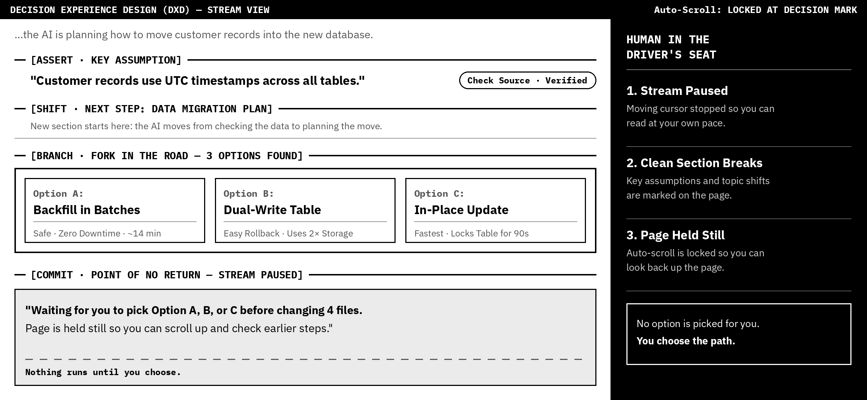
What Decision Marks Look Like in Practice
Inline marks break up the AI stream, show the options the AI considered, and hold the page still until you choose a path.
Illustration made for this talk (drawn by script). Not a real product; sample data.
Notes:
Say: This is a mock-up of a chat with Decision Marks. The first mark points out a key assumption and lets you check its source. The second mark shows where a new step starts. The third mark shows three options side by side, with none picked for you. The last mark stops the stream before any files change, and the page stays still so you can scroll up. The panel on the right sums up the three ideas. The options, times, and file count are made-up examples, not measured results.
Image (made by script for this talk, not AI-generated, not a screenshot): drawn with Python (PIL) in IBM Plex fonts (draw_g4.py).
Source: Spaces in the Stream §4.5, §4.9, §5.2.

