Slide 1

Proto.Actor
Roger Johansson
Proto.Actor Founder Twitter: @rogeralsing
Github: rogeralsing
Mail: rogeralsing@gmail.com
Github.com/rogeralsing/presentations

Slide 2
Actor Model
Three axioms:
Send – an actor can send messages to other actors
Create – an actor can create new actors
Become – an actor can decide how to handle it’s next message
”An island of consistency in a sea of concurrency”
”Shared nothing”, ”Black box”
”Location transparent”, ”Distributable by design”

Slide 3
OOP vs. Actor Model
OOP
Actor Model
Behavior
Behavior
Stateful
Stateful
Synchronous method calls
Asynchronous message passing
Why Actors?? The synchronous model has worked nicely for 60 years!?

Slide 4
Moore’s Law
We can no longer build faster processors Instead, we stack them next to eachother and call them ”cores”

Slide 5
CPU

Slide 6
Core
Core
Core
Core

Slide 7
The invocation will run on a single core
Code
Invocation

Slide 8
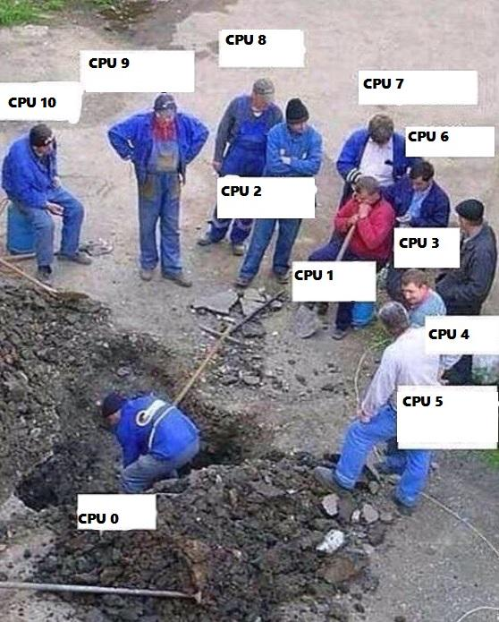
Buying a larger CPU will not change this
Code
Invocation

Slide 9
Code
Invocation
Multithreading Multithreaded systems let us utilize more than one core

Slide 10
Code
Invocation
Multithreading Multithreaded systems let us utilize more than one core

Slide 11
Scale out When one CPU is no longer enough

Slide 12

Standard Technologies
Scale up:
Threads
Promises/Futures
Scale out:
RPC
HTTP
Queues
Elasticity:

Slide 13


Scale up:
”actor” package ”router” package
Scale out:
”remote” package
Elasticity:
”cluster” package

Slide 14

Scale up and out are essentially the same
That is; we want to execute code ”somewhere”, on a core, on a machine, in a cluster.
Why should we have to resort to different technologies to accomplish the same thing?

Slide 15
Scale up and out are essentially the same
That is; we want to execute code ”somewhere”, on a core, on a machine, in a cluster.
Why should we have to resort to different technologies to accomplish the same thing?

Slide 16
Event-driven thread
Actor
PID
Mailbox
Transport
ActorRef
Behavior
State
Supervision
Children

Slide 17
Multiplex Scheduling
Actor1
Actor1
Actor2
Actor3
Actor4
Actor1
Thread Pool
Actor2
Actor3
Actor1
Actor2
Actor2
Actor4
Actor4
Actor3
Time
Cheaper than threads, no context switching

Slide 18

”actor” package

Slide 19
Demo – Create your first actor

Slide 20
”remote” package

Slide 21
Demo – Build a chat

Slide 22

”router” package

Slide 23
Routers
A router delegates messages to other ”routee” actors
Group routers – delegate messages to your existing actors
Pool routers – delegate messages to a dedicated pool of actors

Slide 24
BroadcastRouter
Notifies all ”routees”
2
1
Routee1
2
1
Router
2
1
Routee2
2
1
Routee3

Slide 25
RoundRobinRouter
4
1
Routee1
Scale up!
4
3
2
1
Router
2
Routee2
.. Or down!
3
Routee3

Slide 26
RoundRobinRouter
Routee1
Scale out!
Remote1
Router
Routee2
Scale up!
Routee3
Routee1
Router
Remote2
Router
Routee2
Routee3
Routee1
Remote3
Router
Routee2
Routee3

Slide 27
ConsistentHashRouter
Affinity between hash index and routee
A
M
Routee1
X
A
Y
M
Router
Y
Routee2
X
Routee3

Slide 28
ConsistentHashRouter
Id: 789
Id: 123
Id:456
Id: 123
Payment
Stop
Router
Create
Create
…
…
…
…

Slide 29
ConsistentHashRouter
Maps hash of 123 to routee1
Id: 123
Id: 123
Stop
Create
Routee1
…
…
Id: 789
Id: 123
Id:456
Id: 123
Id:456
Router
Routee2
Payment
Stop
Create
Create
Create
…
…
…
…
…
Id: 789
Payment
Routee3
…

Slide 30
Demo – Use routers
RoundRobin

Slide 31

/
/a1
/a2
/b1
/b1
/b2
/b3
/c1
/c2
/c3
/c4
/c5
Fault tolerance

Slide 32
Bulkheads

Slide 33
Consumer 1
Consumer 2
Component

Slide 34
Website
Businesslogic
Component

Slide 35
Service guy
Out of beans
Refill beans
Insert coins
Me
Vendor machine
Need more coins
Out of beans!
Gets coffee

Slide 36
Supervisor
Application error
Manage failures
Request
Client
Service
Validation error
Response

Slide 37
Supervision
Every actor is being supervised by another actor that dictates how failures should be handled
A supervisor can decide to:
Force a restart
Terminate
Ignore and resume
Escalate up to it’s own supervisor

Slide 38
Error Kernel
/
99.9999999% uptime ~0.03 sekunder downtime per år
OneForOne supervisor
/a1
/a2
AllForOne supervisor
/b1
/b1
/b2
/b3
/b3
/c1
/c2
/c3
/c4
/c5

Slide 39
Exponential Backoff
parent
Delay
child
Attempts

Slide 40
Circuit Breaker
DB Actor
DB Query
DB Up
DB Result
DB Query
DB Down
DB Error
Poll DB Status

Slide 41
Active Passive Consumers
Node 1
Primary
Queue
Node 2
Secondary

Slide 42
Consistent Hash Pairs
Hash Slot 1
Queue
Hash Slot 2
Hash Slot 3

Slide 43
Fan out and quickest reply
Fan out
?
Worker 1
Consumer
?
Router
?
Worker 2
?
Worker 3

Slide 44
Fan out and quickest reply
Return first reply
!
Worker 1
Consumer
!
Router
!
Worker 2
!
Worker 3

Slide 45
N-Modular Redundancy
Require same reply from at least N workers
!
Worker 1
Consumer
!
Router
!
Worker 2
!
Worker 3

Slide 46
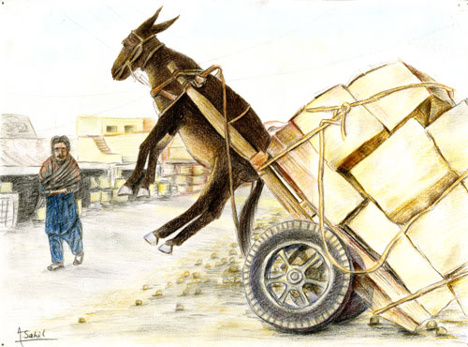
Dealing with load

Slide 47
Throttling
Add a delay after each message

Slide 48
Throttling
Limit messages per time slice

Slide 49
Bounded Mailboxes
Mailbox
Actor

Slide 50
Bounded Mailboxes
Mailbox
Actor

Slide 51
Limit Concurrency
Limit concurrent access to a resource
4
1
Worker 1
4
3
2
1
Router
2
Worker 2
3
Worker 3

Slide 52
Work Pulling
Producer
Send work
Worker 1
Work to be done
Work Done
Send work
Worker 2
Work to be done
Work Done

Slide 53
Scaling Microservices
A microservice architecture puts
each element of functionality into a
separate service…
…and scales by distributing these services
across servers, replicating as needed
-Martin Fowler, James Lewis

Slide 54
Scaling Microservices
Where are you guys!?
I’m over here!

Slide 55
Scaling Microservices

Slide 56
Service Discovery
Service Registry
Publish ”I am A”
@1.2.4.6:4040
Publish ”I am B”
@1.2.3.4:5000
Service A
Service B

Slide 57
Service Discovery
Service Registry
Lookup ”Where is B?”
B is at address 1.2.3.4:5000
Service A
Service B

Slide 58
Service Discovery
Service Registry
Service A
Call 1.2.3.4:5000
Service B

Slide 59
Redundancy
Service A1
Service B1
Service Registry
Service A2
Service B2
Service A3
Service B3

Slide 60
Health Checks
Service Registry
Are you Alive?
Yes!
Service A
Service B

Slide 61

Virtual Actors

Slide 62



Slide 64
Node A
433
Node F
987234
Hash:
989123
Names: Roger
Grain Id:
Roger
Node E
943772
Node B
24345
Names: Roger
Actors:
Roger : User
Node D
612344
Node C
82327

Slide 65
The End

Slide 66
Proto.Actor
Roger Johansson
Proto.Actor Founder Twitter: @rogeralsing
Github: rogeralsing
Mail: rogeralsing@gmail.com
Github.com/rogeralsing/presentations

