Slide 1
Millions of Transactions per Second on a Single Machine Case for a Virtualized Database and Scale-In
Roger Johansson

Slide 2

Millions of Transactions per Second on a Single Machine
Case for a Virtualized Database and Scale-In

Slide 3
Who am I?
Roger Johansson
Senior Solution Architect – Starcounter http://StarCounter.io Akka.NET and Proto.Actor Founder http://GetAkka.net, http://Proto.Actor
Twitter: @rogeralsing
Github: rogeralsing
Mail: roger@starcounter.com
http://Github.com/rogeralsing/presentations
Actor Model, Scalability, Distributed Systems, C#, Go, Kotlin
6

Slide 4
Agenda
Setting the stage - Why we need in memory computing:
Application Platform
Micro-Apps
The Starcounter information operating system:
Our approach to in memory computing
The future of hardware
The Mars project

Slide 5
Application Platform

Slide 6
Front-end Framework React, Polymer
Starcounter
Communication Palindrom - REST, Web Sockets
Application View Models, Entities, App Logic
In Memory App Platform
Mapping, Persistence, Queries

Slide 7
Traditional Stack
Starcounter
Front-end Framework
Front-end Framework
Client Side Code
Network
Network
Services + Contracts
View Models
Application Code
Application
O/R Mapper
Network
Database
In Memory App Platform

Slide 8
Micro-Applications

Slide 9
UI A
UI B
UI C
Starcounter
App A
App B
App C
Model A
Model B
Model C

Slide 10
Client Side Blending
UI A
UI B
UI C
UI A
UI B
UI C
Starcounter
App A
App B
App C
Model A
Model B
Model C

Slide 11
Demo People App

Slide 12
Client Side Blending
UI A
UI B
UI C
UI A
UI B
UI C
Starcounter
App A
App B
App C
Model A
Model B
Model C
Mapper

Slide 13
Data Flow Programming

Slide 14
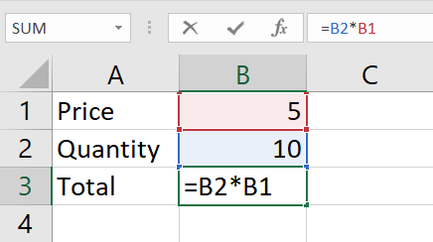
UI A
UI B
UI C
Starcounter
App A
App B
App C
Model A
Model B
Model C
Mapper

Slide 15
In Memory, For Real

Slide 16
Application Process
Object
Offline copy of database data
ObjectId
123
FirstName
Alan
LastName
Turing
Age
41
Map to and from Object / Storage model
Object Mapper
Transfer Data over network
Database Process
Network / IPC
Disk
Data is stored on disk, optimized for spinning disks and moving arms
ObjectId
FirstName
LastName
Age
123
Alan
Turing
41
124
Ada
Lovelace
36
125
Grace
Hopper
86

Slide 17
Application Process
Object
Offline copy of database data
ObjectId
123
FirstName
Alan
LastName
Turing
Age
41
Map to and from Object / Relational model
Object Mapper
Transfer Data over network
Database Process
Network / IPC
Memory
Data is mainly kept in memory, enabling faster reads and writes
ObjectId
FirstName
LastName
Age
123
Alan
Turing
41
124
Ada
Lovelace
36
125
Grace
Hopper
86

Slide 18
Application Process
Object
Stateless Entity maps directly to shared memory
ObjectId
123
Shared Memory
Database Process
Data is kept in memory and shared across processes
ObjectId
FirstName
LastName
Age
123
Alan
Turing
41
124
Ada
Lovelace
36
125
Grace
Hopper
86

Slide 19
C#
Node.JS
Object
Object
Multiple processes can read the same data
ObjectId
123
ObjectId
123
Shared Memory
Database Process
ObjectId
FirstName
LastName
Age
123
Alan
Turing
41
124
Ada
Lovelace
36
125
Grace
Hopper
86

Slide 20
C# Source Code
public class Person
{
public string FirstName
{
get;
set;
}

Slide 21
C# Compiler Output
public class Person
{ private string _firstName;
public string FirstName
{
get => _firstName;
set value => _firstName = value;
}

Slide 22
Starcounter Weaver Output
public class Person
{ private string _firstName;
private ulong _id;
public string FirstName
{
get => DbState.GetString(_id, FirstNameId);
set value => DbState.SetString(_id, FirstNameId, value)
}

Slide 23
Enabling the impossible

Slide 24
O/R mapper – Object Graphs
Customer
Order
OrderDetail
Product
Lazy Load Execute SQL Query per traversed relation
Eager Load
Carefully defining load boundaries
Ripple load,
Hundreds/Thousands of queries per view
Hard to maintain, inefficient joined queries

Slide 25
Starcounter – Object Graphs
Customer
Order
OrderDetail
Product
Chasing Pointers Traversing relations are simple pointer traversals

Slide 26
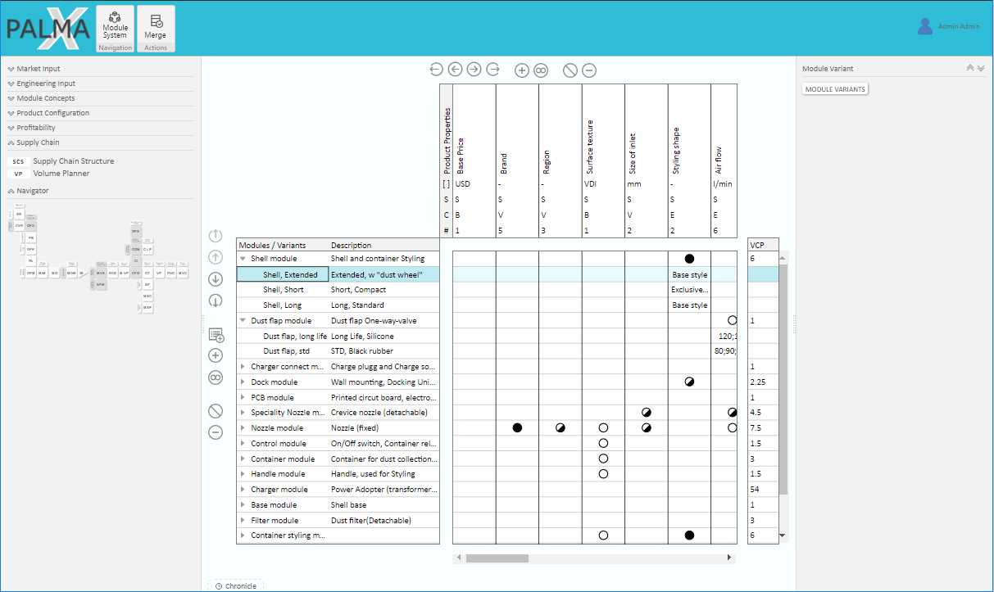

Slide 27
The Future of Hardware

Slide 29
Current
Future
Registers
Registers
Cache
Cache
Main Memory
Main Memory
Solid State Disk
Non Volatile Memory
Magnetic Disk
Solid State Disk
Magnetic Disk

Slide 30
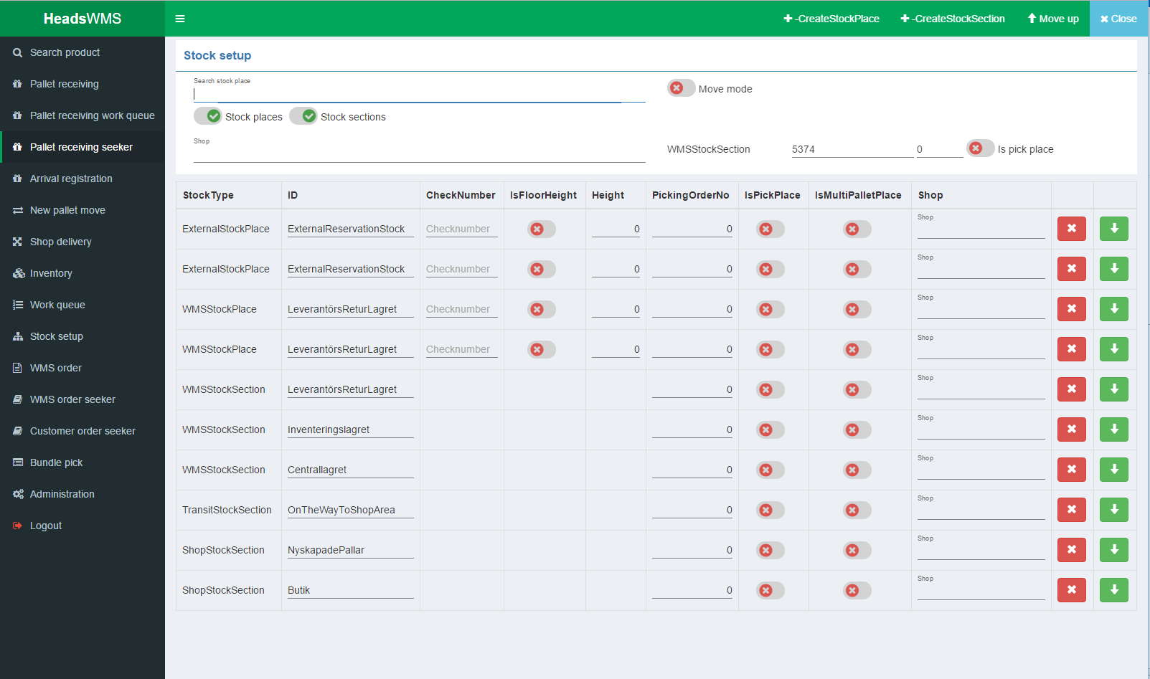

Slide 31
Q & A

Slide 32
Micro-Services
Reusable graphics, ignore this..
Bounded Contexts
Login
Customer
Registration
Customer Data

Slide 33
C#
Node.JS
Shared Memory
Database Process
Non Volatile Memory
Column Store
Row Store
Column Store

