Slide 1
Service Discovery

Slide 2
Scaling Microservices
A microservice architecture puts
each element of functionality into a
separate service…
…and scales by distributing these services
across servers, replicating as needed
-Martin Fowler, James Lewis

Slide 3
Service Discovery
Where are you guys!?
I’m over here!

Slide 4
Service Discovery

Slide 5
Service Discovery
Service Registry
Publish ”I am A”
Publish ”I am B”
Service A
Service B

Slide 6
Service Discovery
Service Registry
Lookup ”Where is B?”
Service A
Service B
Call

Slide 7
Service Discovery
Service Discovery
Service Discovery
Service A1
Service B1
Service Registry
Service A2
Service B2
Service A3
Service B3

Slide 8
Consul

Slide 9

Consul
Demo https://demo.consul.io/ui/

Slide 10

Consul
Server
Server
Server
Agent
Agent
Agent
Agent
Agent

Slide 11
Consul enables
Scalability – Locate service instances
Availability – Find healthy instances
Circuit Breaker’ish
Distributed Configuration
Cross Data Center support
Network latency optimization

Slide 12
Docker

Slide 13

Server
Login
Registration
Customer Data

Slide 14
Isolating services from eachother
Server
Docker
Login
Registration
Customer Data

Slide 15
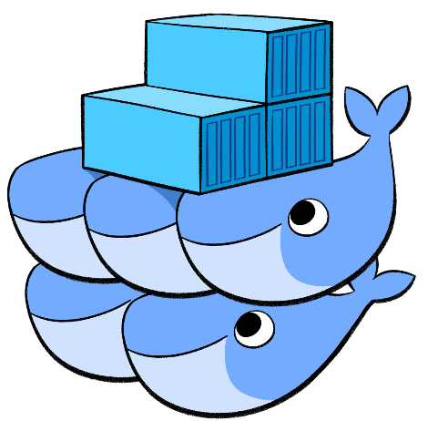


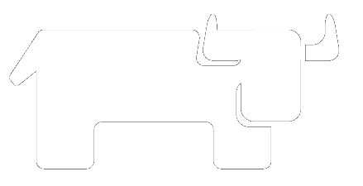
Cluster Schedulers

Slide 16
Cluster Schedulers
Server 1
Server 2
Server 3
Docker
Docker
Docker
Registration
Login
Login
Registration
Registration
….
….
Customer Data
….

Slide 17
Tracing

Slide 18
