Slide 1
actor
Scale up and out with Proto.Actor
Roger Johansson
Proto.Actor Founder Twitter: @rogeralsing
Github: rogeralsing
Mail: roger.johansson@betsson.com
Github.com/rogeralsing/presentations

Slide 2
Actor Model
Three axioms:
Send – an actor can send messages to other actors
Create – an actor can create new actors
Become – an actor can decide how to handle it’s next message
”An island of consistency in a sea of concurrency”
”Shared nothing”, ”Black box”
”Location transparent”, ”Distributable by design”

Slide 3
OOP vs. Actor Model
OOP
Actor Model
Behavior
Behavior
Stateful
Stateful
Synchronous method calls
Asynchronous message passing
Why Actors?? The synchronous model has worked nicely for 60 years!?

Slide 4
Moore’s Law
We can no longer build faster processors Instead, we stack them next to eachother and call them ”cores”

Slide 5
CPU

Slide 6
Core
Core
Core
Core

Slide 7
The invocation will run on a single core
Code
Invocation

Slide 8
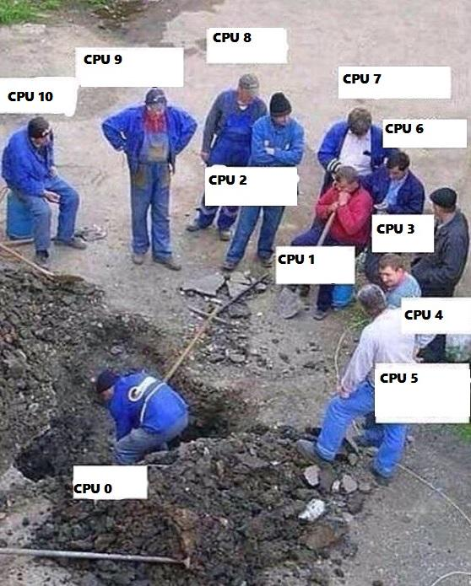
Buying a larger CPU will not change this
Code
Invocation

Slide 9
Code
Invocation
Multithreading Multithreaded systems let us utilize more than one core

Slide 10
Code
Request
Multithreading Multithreaded systems let us utilize more than one core

Slide 11
Scale out When one CPU is no longer enough

Slide 12

Standard Go technologies
Scale up:
Go routines
Channels
Scale out:
net/http
rpc
Elasticity:

Slide 13
actor
Scale up:
”actor” package ”router” package
Scale out:
”remote” package
Elasticity:
”cluster” package

Slide 14
Scale up and out are essentially the same
That is; we want to execute code ”somewhere”, on a core, on a machine, in a cluster.
Why should we have to resort to different technologies to accomplish the same thing?

Slide 15
Scale up and out are essentially the same
That is; we want to execute code ”somewhere”, on a core, on a machine, in a cluster.
Why should we have to resort to different technologies to accomplish the same thing?

Slide 16

Location Transparency, Distributed by default
Event-driven thread
Actor
ActorRef
Mailbox
Transport
ActorRef
Behavior
State
Shared Nothing, Black box
Supervision
Children
An island of consistency in a sea of concurrency

Slide 17
Multiplex Scheduling
Actor1
Actor1
Actor2
Actor3
Actor4
Actor1
Thread Pool
Actor2
Actor3
Actor1
Actor2
Actor2
Actor4
Actor4
Actor3
Time
Cheaper than threads, no context switching

Slide 18
”actor” package

Slide 19
Demo – Create your first actor

Slide 20
”remote” package

Slide 22
System 1
System 2
System 3

Slide 23
Demo – Build a chat

Slide 24
”router” package

Slide 25
Routers
A router delegates messages to other ”routee” actors
Group routers – delegate messages to your existing actors
Pool routers – delegate messages to a dedicated pool of actors

Slide 26
BroadcastRouter
Notifies all ”routees”
2
1
Routee1
2
1
Router
2
1
Routee2
2
1
Routee3

Slide 27
RoundRobinRouter
4
1
Routee1
Scale up!
4
3
2
1
Router
2
Routee2
3
Routee3
.. Or down!

Slide 28
RoundRobinRouter
Routee1
Scale out!
Remote1
Router
Routee2
Scale up!
Routee3
Routee1
Router
Remote2
Router
Routee2
Routee3
Routee1
Remote3
Router
Routee2
Routee3

Slide 29
ConsistentHashRouter
A
M
Routee1
X
A
Y
M
Router
Y
Routee2
X
Routee3
Affinity between hash index and routee

Slide 30
ConsistentHashRouter
Id: 789
Id: 123
Id:456
Id: 123
Payment
Stop
Router
Create
Create
…
…
…
…

Slide 31
ConsistentHashRouter
Prevents race conditions
Id: 123
Id: 123
Stop
Create
Routee1
…
…
Id: 789
Id: 123
Id:456
Id: 123
Id:456
Router
Routee2
Payment
Stop
Create
Create
Create
…
…
…
…
…
Id: 789
Payment
Routee3
…

Slide 32
Demo – Use routers
RoundRobin

Slide 33
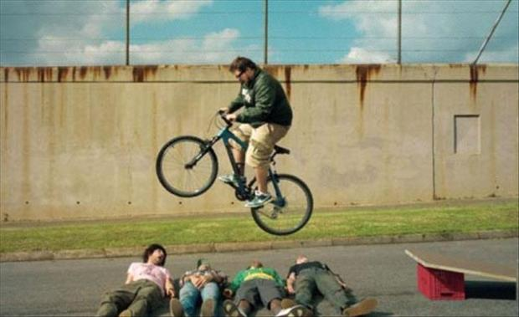
Error handling in Java, C# and C

Slide 34
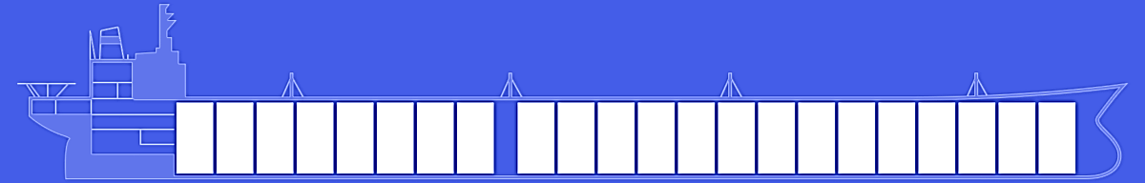
Fault tolerance – fail gracefully
actor
Isolate failures in bulkheads

Slide 35
Consumer 1
Consumer 2
Component

Slide 36
Website
Businesslogic
Component

Slide 37
Service guy
Out of beans
Refill beans
Insert coins
Me
Vendor machine
Need more coins
Out of beans!
Gets coffee

Slide 38
Supervisor
Application error
Manage failures
Request
Client
Service
Validation error
Response

Slide 39
Supervision
Every actor is being supervised by another actor that dictates how failures should be handled
A supervisor can decide to:
Force a restart
Terminate
Ignore and resume
Escalate up to it’s own supervisor

Slide 40
Error Kernel
/
”Guardian”
User actor
Hierarchy

Slide 41
Error Kernel
/
99.9999999% uptime ~0.03 sekunder downtime per år
OneForOne supervisor
/a1
/a2
AllForOne supervisor
/b1
/b1
/b2
/b3
/b3
/c1
/c2
/c3
/c4
/c5

Slide 42
Become
Become or hotswap means that an actor can decide how it should process the next incoming message.
In Akka.NET this is handled by the .Become and .Unbecome methods.
Very useful for creating state machines

Slide 43

Private void Alive(){
…//other code
if (this.hitpoints <= 0)
this.Become(Dead);
…
}
private void Dead(){
Receive<Resurrect>(_ => {
this.hitpoints = this.maxHitpoints;
this.Become(Alive);
});
}

Slide 44
Other features
Persistence
Cluster
Cluster Sharding
Dependency Injection
Finite State Machines
F# API
Reactive Streams

Slide 45
The End

Slide 46
actor
Scale up and out with Proto.Actor
Roger Johansson
Proto.Actor Founder Twitter: @rogeralsing
Github: rogeralsing
Mail: roger.johansson@betsson.com
Github.com/rogeralsing/presentations

