Slide 1
Roger Johansson
Akka.NET Co-Founder Twitter: @rogeralsing
Github: rogeralsing
Mail: roger.alsing@nethouse.se
akka.nethouse.se

Slide 2


akka.net

Slide 3
Service
Classic .NET system
BLL
Component/Object
DAO
EF
Entitet

Slide 4
Server

Slide 5
CPU

Slide 6
Core
Core
Core
Core

Slide 7
Moore’s Law
We can no longer build faster processors Instead, we stack them next to eachother and call them ”cores”

Slide 8
The service request will run on a single core
Code
Invocation

Slide 9
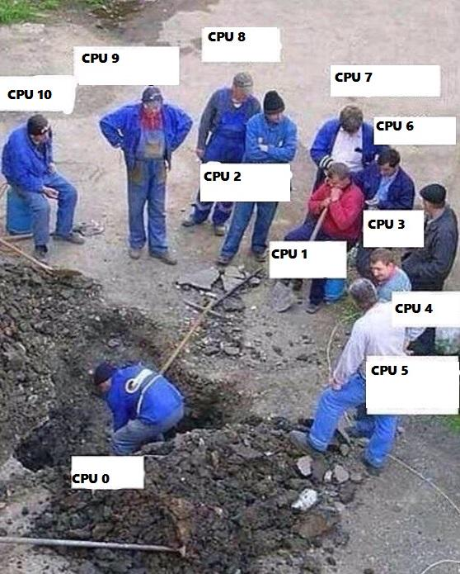
Buying a larger CPU will not change this
Code
Invocation

Slide 10
Code
Invocation
Multithreading Multithreaded systems let us utilize more than one core

Slide 11
Service
Request
Multithreading Flertrådade system låter oss nyttja fler än en kärna samtidigt

Slide 12
Scale out When one CPU is no longer enough

Slide 13
Classic .NET technologies
Scale up:
Parallel Linq TPL – async await
Threads
Scale out:
WCF Web API
MSMQ
Elasticity:
Complex, Slow and Annoying

Slide 14


akka.net
Scale up:
Akka.Actor
Scale out:
Akka.Remote
Elasticity:
Akka.Cluster

Slide 15

Scale up and out are essentially the same
That is; we want to execute code ”somewhere”, on a core, on a machine, in a cluster.
Why should we have to resort to different technologies to accomplish the same thing?

Slide 16
Scale up and out are essentially the same
That is; we want to execute code ”somewhere”, on a core, on a machine, in a cluster.
Why should we have to resort to different technologies to accomplish the same thing?

Slide 17
Actor Model
Three axioms:
Send – an actor can send messages to other actors
Create – an actor can create new actors
Become – an actor can decide how to handle it’s next message
”An island of consistency in a sea of concurrency”
”Shared nothing”, ”Black box”
”Location transparent”, ”Distributable by design”

Slide 18
OOP vs. Actor Model
OOP
Actor Model
Behavior
Behavior
Stateful
Stateful
Synchronous method calls
Asynchronous message passing
Why Actors?? The synchronous model has worked nicely for 60 years!?

Slide 19
Moore’s Law
We can no longer build faster processors Instead, we stack them next to eachother and call them ”cores”

Slide 20

Event-driven thread
Actor
ActorRef
Mailbox
Transport
ActorRef
Behavior
State
Supervision
Children

Slide 21
Actor Model
Actor1
Actor1
Actor2
Actor3
Actor4
Actor1
Thread Pool
Actor2
Actor3
Actor1
Actor2
Actor2
Actor4
Actor4
Actor3
Time
Cheaper than threads, not the same context switching

Slide 22
Footprint?
An actor only consumes CPU-time when it is processing a message, just like an object only consume CPU-time when it is executing a method.
Memory footprint varies between implementations, but actors are in general very cheap.
Ca 2.5 mil actors per gigabyte on JVM.
(Not quite there yet on the .NET side of things)

Slide 23
Actor Model
What can a good use case for actors?
Alternative to threading
As an object or component
As a service or singleton
Message routing, e.g. round robin or consistent hash.
Entity or aggregate root a´la CQRS / Domain driven design
State machines

Slide 24
Actor Model
Products basered on the actor model:
Erlang
Facebook WhatsApp (Erlang)
RabbitMQ (Erlang)
CouchDB (Erlang)
LinkedIn.com (JVM Akka)
Walmart.com (JVM Akka)
Azure Service Fabric alternative backend (Akka.NET)

Slide 25
Akka.Actor

Slide 26
Demo – Create your first actor
ActorSystem
ReceiveActor
Props
ActorRef

Slide 27
Akka.Remote

Slide 29
System 1
System 2
System 3

Slide 30
Demo – Build a chat
RemoteActorRefProvider
ActorSelection

Slide 31
Demo – Remote Deployment
Deployment configuration
RemoteDaemon

Slide 32
Akka.Routing

Slide 33
Routers
A router delegates messages to other ”routee” actors
Group routers, Pool routers
BroadcastRouter
RoundRobinRouter
ConsistentHashRouter
ScatterGatherFirstCompletedRouter
SmallestMailboxRouter
TailChoppingRouter

Slide 34
BroadcastRouter
Notifies all ”routees”
2
1
Routee1
2
1
Router
2
1
Routee2
2
1
Routee3

Slide 35
RoundRobinRouter
4
1
Routee1
Scale up!
4
3
2
1
Router
2
Routee2
3
Routee3
.. Or down!

Slide 36
RoundRobinRouter
Routee1
Scale out!
Remote1
Router
Routee2
Scale up!
Routee3
Routee1
Router
Remote2
Router
Routee2
Routee3
Routee1
Remote3
Router
Routee2
Routee3

Slide 37
ConsistentHashRouter
A
M
Routee1
X
A
Y
M
Router
Y
Routee2
X
Routee3
Affinity between hash index and routee

Slide 38
ConsistentHashRouter
OCR: 789
OCR: 123
OCR:456
OCR: 123
Betalning
Stoppa
Router
Skapa
Skapa
…
…
…
…

Slide 39
ConsistentHashRouter
Prevents race conditions
OCR: 123
OCR: 123
Stoppa
Skapa
Routee1
…
…
OCR: 789
OCR: 123
OCR:456
OCR: 123
OCR:456
Router
Routee2
Betalning
Stoppa
Skapa
Skapa
Skapa
…
…
…
…
…
OCR: 789
Betalning
Routee3
…

Slide 40
ScatterGatherFirstCompletedRouter
?
Routee1
Sender
?
Router
?
Routee2
!
?
Routee3
Similar to broadcast, forwards the first reply to the original sender

Slide 41
Demo – Use routers
RoundRobin
Deployment configuration

Slide 42
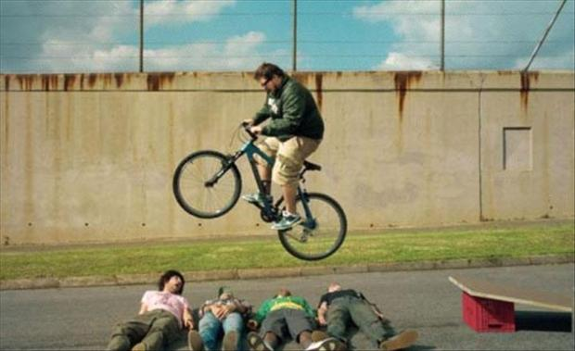
Error handling in Java, C# and C

Slide 43
Consumer 1
Consumer 2
Component

Slide 44
Website
Businesslogic
Component

Slide 45
Service guy
Out of beans
Refill beans
Insert coins
Me
Vendor machine
Need more coins
Out of beans!
Gets coffee

Slide 46
Supervisor
Application error
Manage failures
Request
Client
Service
Validation error
Response

Slide 47
Supervision
Every actor is being supervised by another actor that dictates how failures should be handled
A supervisor can decide to:
Force a restart
Terminate
Ignore and resume
Escalate up to it’s own supervisor

Slide 48
/
”Root Guardian”
Error Kernel
/user
/system
”Guardian”
”System Guardian”
User actor
Hierarchy
System actor
Hierarchy

Slide 49
/
Error Kernel
/user
/system
99.9999999% uptime ~0.03 sekunder downtime per år
OneForOne supervisor
/a1
/a2
AllForOne supervisor
/b1
/b1
/b2
/b3
/b3
/c1
/c2
/c3
/c4
/c5

Slide 50
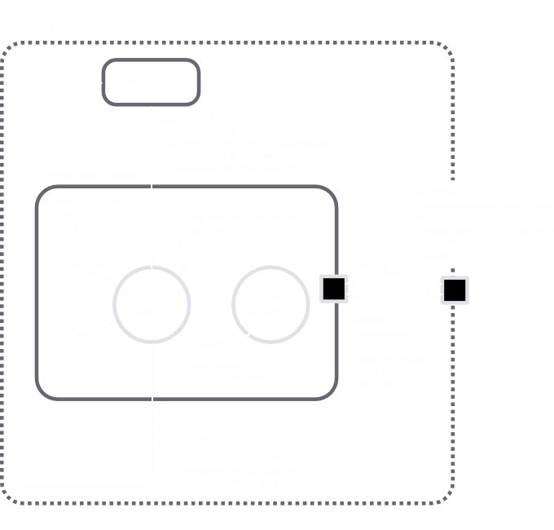

Slide 51
Become
Become or hotswap means that an actor can decide how it should process the next incoming message.
In Akka.NET this is handled by the .Become and .Unbecome methods.
Very useful for creating state machines

Slide 52
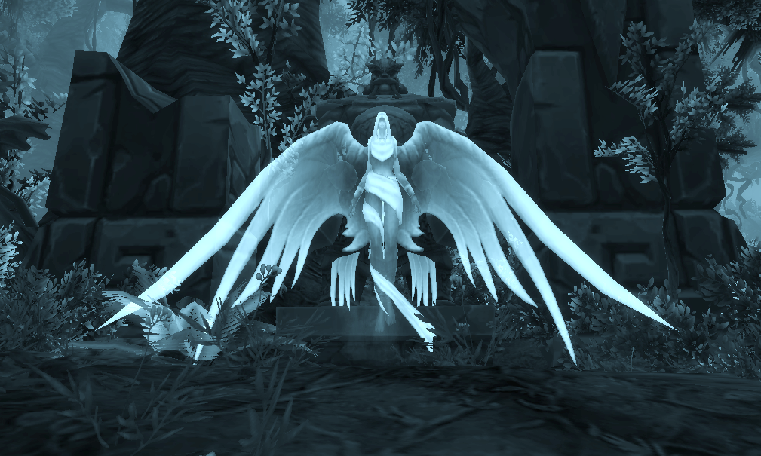
Private void Alive(){
…//other code
if (this.hitpoints <= 0)
this.Become(Dead);
…
}
private void Dead(){
Receive<Resurrect>(_ => {
this.hitpoints = this.maxHitpoints;
this.Become(Alive);
});
}

Slide 53
Other features
Cluster
Cluster Sharding
Dependency Injection
Persistence
Finite State Machines
F# API

Slide 54

Before Akka.NET
200-300 Simulated Excel workbooks.
Aprox 7000 Excel cells.
Excel compatible formulas.
Single user system, one user per workbook.

Slide 55
With Akka.NET
800 000 Excel cells.
Multiuser, manu users can edit the same workbook
– google docs style.
Two devs rewrote/adapted the current system in two weeks.

Slide 56

Before Akka.NET
Legacy system, written around year 2000.
One customer per server, SPOF.
Huge amounts of synchronization code.

Slide 57
With Akka.NET
85% less code, The code only focus on business value, Akka.NET handles the infrastructure.
High Availability - Failover using Akka.Cluster.

Slide 58
Q & A

Slide 59
Roger Johansson
Akka.NET Co-Founder Twitter: @rogeralsing
Github: rogeralsing
Mail: roger.alsing@nethouse.se
akka.nethouse.se

Slide 60
The End

