Slide 1

Scaling the gaming platform @Betsson Journey of the monolith Roger Johansson
All material from this presentation
Akka.NET Co-Founder Twitter: @rogeralsing
Github: rogeralsing
Mail: roger.johansson@betsson.com
Github.com/rogeralsing/presentations

Slide 2

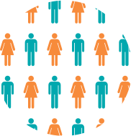
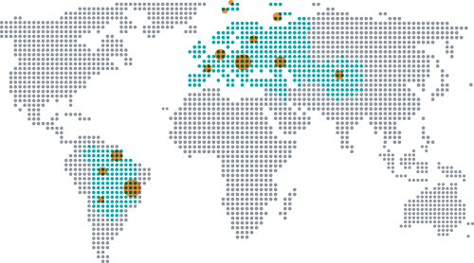



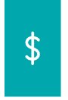
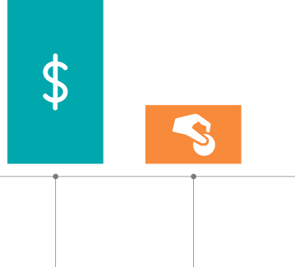


About Betsson group
1963
1766
21
Company founded
21 different brands
Across Europe, Central Asia & Latin America
Listed on Nasdaq Large Cap
2014
Employees (Q2 2016)
+ 500 tech employees
+ 40 nationalities
563,247
Active players (Q2 2016)
Mobile
41%
Share of revenue
(Q2 2016)
19.1%
Top line CAGR of 19.1% (2012-2015)
Share of revenue
2015
73%
Casino
24%
Sportsbook
Revenue SEK 3,722 m
EBIT SEK 886 m
Notes:
Founded in 1963
-strong history
-we know what we’re doing
Strong growth of approx 10% annually
and strong EBIT margins at around 25%. Q2 was a disappointment, but we have taken action and Q3 has started well.
Despite Q2 revenue was less than we hoped for, we have a strong underlying activity with an all time high of active players during Q2.
Betsson is listed at Nasdaq Stockholm large cap. Betsson’s board believes in return to shareholders and the direct yield is 5-5.5%.
We employ close to 1800 people across Europe. Our largest site, where I am based, is Malta with some 800 employees

Slide 3
What to expect from this talk
A bit of history on where we came from in terms of architecture
Geekery about microservices, service discovery, Docker and .NET Core
I will not talk about Akka.NET
I am not an Ops guy

Slide 4
The Past

Slide 5
One Brand, One System
Bets10
The Monolith

Slide 6
We acquired more brands
Betsafe
Bets10
NordicBet
?
The Monolith
?

Slide 7
Scaling the monolith
A monolithic application puts all its
functionality into a single process…
…and scales by replicating the
monolith on multiple servers
-Martin Fowler, James Lewis

Slide 8
Scaling by Instance
Instance 1
Instance 2
Instance 3
Brand A, B
Brand C
Brand D

Slide 9
Introducing SOA
Still pretty darn big services
Instance 1
Instance 2
Instance 3
Customer
Customer
Customer
Gaming
Gaming
Gaming
Campaigns
Campaigns
Campaigns
…
…
…

Slide 10
Challenges?

Slide 11
Point to point communication
Single Message Producer
Single Message Consumer
No Redundancy
Doesn’t Scale

Slide 12


Shared Servers, Noisy Neighbours
Instance
Customer
Gaming
Campaigns
…

Slide 13

Single point of failure…
Instance
Customer
Gaming
Campaigns
…

Slide 14
…Same issue with deployment
Down during deployment
Instance
Customer
Gaming
Campaigns
…

Slide 15
Challenges!
Scalability, Elasticity
Isolation
Availability
Deployment

Slide 16
The Current

Slide 17
Adopting Microservices
Customer

Slide 18
Adopting Microservices
Bounded Contexts
Login
Customer
Registration
Customer Data

Slide 19
Scaling Microservices
A microservice architecture puts
each element of functionality into a
separate service…
…and scales by distributing these services
across servers, replicating as needed
-Martin Fowler, James Lewis

Slide 20
Scaling Microservices
Where are you guys!?
I’m over here!

Slide 21
Scaling Microservices

Slide 22
Service Discovery
Service Registry
Publish ”I am A”
Publish ”I am B”
Service A
Service B

Slide 23
Service Discovery
Service Registry
Lookup ”Where is B?”
Service A
Service B
Call

Slide 24
Service Discovery
Service A1
Service B1
Service Registry
Service A2
Service B2
Service A3
Service B3

Slide 25
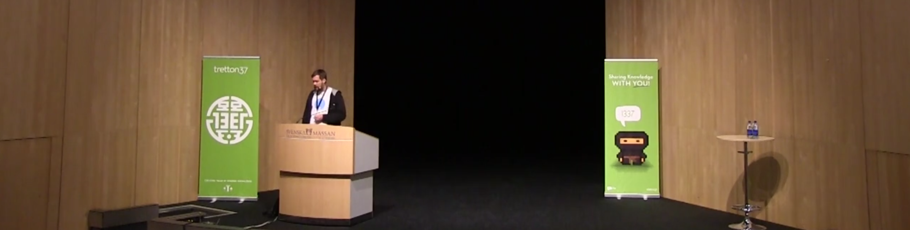
Leetspeak 2014, Niklas Gustavsson/Spotify
Service Discovery using DNS

Slide 26

Consul
Demo https://demo.consul.io/ui/

Slide 27

Microphone
.NET Consul

Slide 28

Microphone
Consul
Are you alive?
I am A
Where is X?
.NET Service A
Microphone

Slide 29
Consul enables
Scalability – Locate service instances
Availability – Find healthy instances
Circuit Breaker’ish
(Distributed Configuration)

Slide 30
Asp.NET Core
Demo Show Asp.NET Core with Microphone

Slide 31
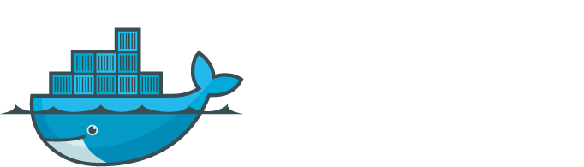
?

Slide 32
Server
Login
Registration
Customer Data

Slide 33
Isolating services from eachother
Server
Docker
Login
Registration
Customer Data

Slide 34
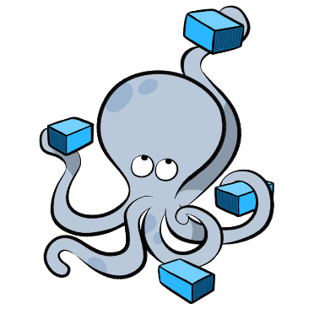
Docker Compose
Demo Docker Compose

Slide 35
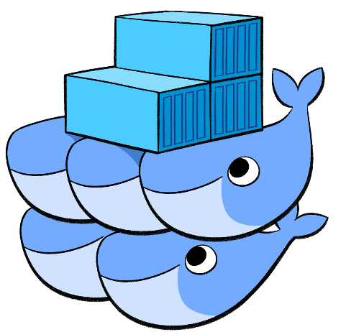


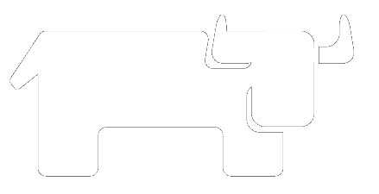
Cluster Schedulers

Slide 36
Cluster Schedulers
Server 1
Server 2
Server 3
Docker
Docker
Docker
Registration
Login
Login
Registration
Registration
….
….
Customer Data
….

Slide 37
Putting it all together
Show Rancher UI
Install Consul – Docker Compose
Install Asp.NET Core services
Show Consul UI
Scale Services
Redeploy Services
Integrate with legacy services

Slide 38
Out of scope but still nice ☺

Slide 39
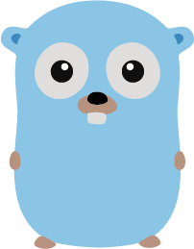



Selecting a proper tech stack

Slide 40
Why Go or Elixir?
Built for Concurrency
Built for Distributed Systems
A different culture

Slide 41
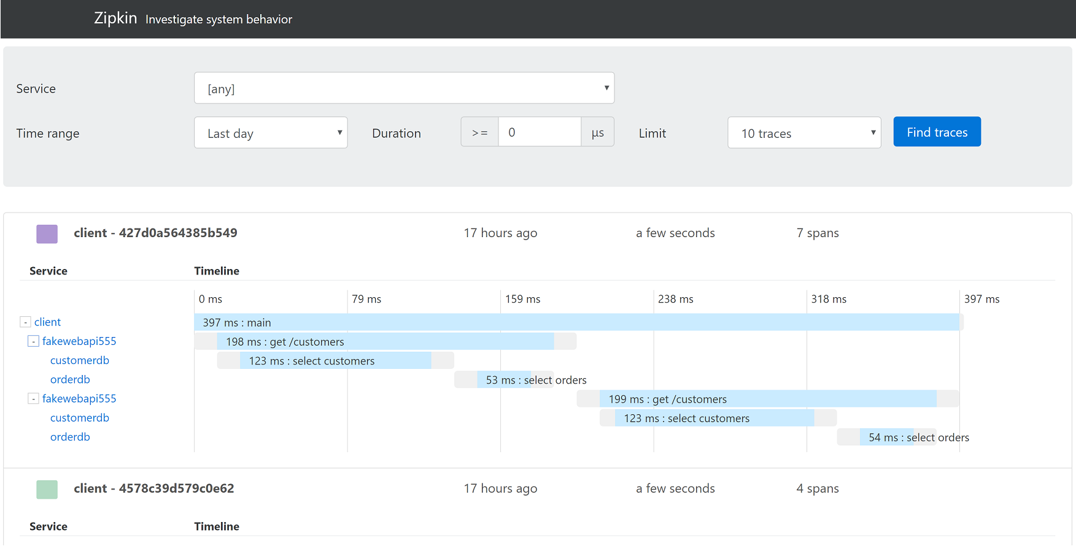

Slide 42


Slide 47
Techsson Verticals and Components
Control Panel
Verticals
Utility Components
Customer
Currency Converter
Gaming
Fraud
Communications
Bonus/Wallet
Communications
Loyalty
Campaign
Customer
Rewards
Gaming
Rules Engine
Campaign
Rewards
Statistics/Models
Loyalty
Bonus/Wallet
AL/CL integration
Infrastructure Components
Control Panel Framework
Configuration
Caching
Migration

