Slide 1
Micro services
Important aspects when building microservices:
Elasticity
Resilience
Platform independent
Version tolerance
Concurrency
Performance

Slide 2

Platform-independent, resilient, and stateful microservices
Roger Johansson
Proto.Actor Founder Twitter: @rogeralsing
Github: rogeralsing
Mail: roger.johansson@betsson.com
Github.com/rogeralsing/presentations

Slide 3
What is Proto.Actor?
Next Generation Actor Model:
Built on standards
Platform independent
Actors and Virtual Actors
Ultra fast

Slide 4
What is Proto.Actor?
Next Generation Actor Model:
Built on standards – Protobuf, gRPC, Consul
Platform independent – C#, Go, Python, Javascript, Kotlin
Actors and Virtual Actors – Akka, Microsoft Orleans
Ultra fast – 65 times faster than Akka.NET over network

Slide 5
Actor Model
Three axioms:
Send – an actor can send messages to other actors
Create – an actor can create new actors
Become – an actor can decide how to handle it’s next message
”An island of consistency in a sea of concurrency”
”Shared nothing”, ”Black box”
”Location transparent”, ”Distributable by design”

Slide 6
Moore’s Law
We can no longer build faster processors Instead, we stack them next to eachother and call them ”cores”

Slide 7
CPU

Slide 8
Core
Core
Core
Core

Slide 9
The invocation will run on a single core
Code
Invocation

Slide 10
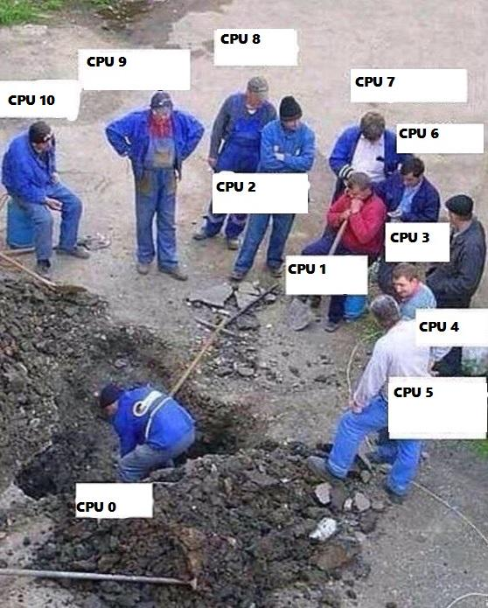
Buying a larger CPU will not change this
Code
Invocation

Slide 11
Code
Invocation
Vertical Scalability

Slide 12
Code
Invocation
Vertical Scalability

Slide 13

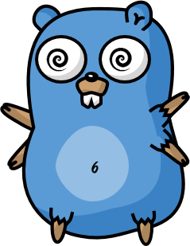
Code
Invocation

Slide 14
Horizontal Scalability

Slide 15


Slide 16


Slide 17

Standard technologies
Scale up:
Threads
Promises/Futures
Scale out:
HTTP
Message queues
Elasticity:

Slide 18

Scale up:
”actor” package ”router” package
Scale out:
”remote” package
Elasticity:
”cluster” package

Slide 19
Scale up and out are essentially the same
That is; we want to execute code ”somewhere”, on a core, on a machine, in a cluster.
Why should we have to resort to different technologies to accomplish the same thing?

Slide 20
Event-driven thread
Actor
Transport
PID
Mailbox
Behavior
State
Supervision
Children

Slide 21
Multiplex Scheduling
Actor1
Actor1
Actor2
Actor3
Actor4
Actor1
Thread Pool
Actor2
Actor3
Actor1
Actor2
Actor2
Actor4
Actor4
Actor3
Time
Cheaper than threads, no context switching

Slide 22
”actor” package

Slide 23
Demo – Create your first actor

Slide 24
”remote” package

Slide 25
Demo – Build a chat

Slide 26
”router” package

Slide 27
Routers
A router delegates messages to other ”routee” actors
Group routers – delegate messages to your existing actors
Pool routers – delegate messages to a dedicated pool of actors

Slide 28
BroadcastRouter
Notifies all ”routees”
2
1
Routee1
2
1
Router
2
1
Routee2
2
1
Routee3

Slide 29
RoundRobinRouter
4
1
Routee1
Scale up!
4
3
2
1
Router
2
Routee2
.. Or down!
3
Routee3

Slide 30
RoundRobinRouter
Routee1
Scale out!
Remote1
Router
Routee2
Scale up!
Routee3
Routee1
Router
Remote2
Router
Routee2
Routee3
Routee1
Remote3
Router
Routee2
Routee3

Slide 31
ConsistentHashRouter
Affinity between hash index and routee
A
M
Routee1
X
A
Y
M
Router
Y
Routee2
X
Routee3

Slide 32
ConsistentHashRouter
Id: 789
Id: 123
Id:456
Id: 123
Payment
Stop
Router
Create
Create
…
…
…
…

Slide 33
ConsistentHashRouter
Maps hash of 123 to routee1
Id: 123
Id: 123
Stop
Create
Routee1
…
…
Id: 789
Id: 123
Id:456
Id: 123
Id:456
Router
Routee2
Payment
Stop
Create
Create
Create
…
…
…
…
…
Id: 789
Payment
Routee3
…

Slide 34
Demo – Use routers

Slide 35
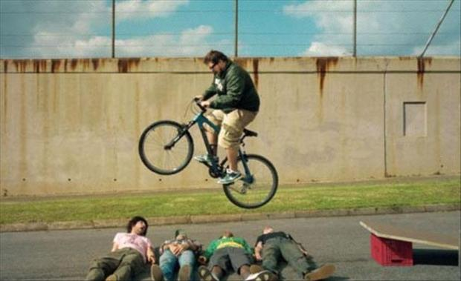
Error handling in Java, C# and C

Slide 36
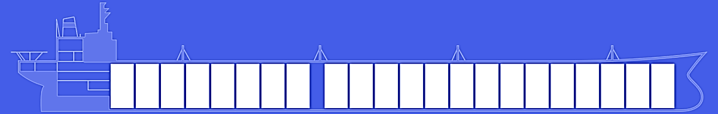
Fault tolerance – fail gracefully
Isolate failures in bulkheads

Slide 37
Consumer 1
Consumer 2
Component

Slide 38
Website
Businesslogic
Component

Slide 39
Service guy
Out of beans
Refill beans
Insert coins
Me
Vendor machine
Need more coins
Out of beans!
Gets coffee

Slide 40
Supervisor
Application error
Manage failures
Request
Client
Service
Validation error
Response

Slide 41
Supervision
Every actor is being supervised by another actor that dictates how failures should be handled
A supervisor can decide to:
Force a restart
Terminate
Ignore and resume
Escalate up to it’s own supervisor

Slide 42
Error Kernel
/
”Guardian”
User actor
Hierarchy

Slide 43
Error Kernel
/
99.9999999% uptime ~0.03 sekunder downtime per år
OneForOne supervisor
/a1
/a2
AllForOne supervisor
/b1
/b1
/b2
/b3
/b3
/c1
/c2
/c3
/c4
/c5

Slide 44
The End

Slide 45
Platform-independent, resilient, and stateful microservices
Roger Johansson
Proto.Actor Founder Twitter: @rogeralsing
Github: rogeralsing
Mail: roger.johansson@betsson.com
Github.com/rogeralsing/presentations

