Slide 1

Failing gracefully
With the actor model
Roger Johansson
Akka.NET and Proto.Actor Founder
Asynkron AB
Twitter: @rogeralsing
Github: rogeralsing
Mail: roger@asynkron.se
Github.com/rogeralsing/presentations
http://Proto.Actor

Slide 2
Design for failure
Dealing with, mitigating and preventing failures.
In the small, and at scale.

Slide 3

An escalator can never break: it can only become stairs. You should never see an Escalator Temporarily Out Of Order sign, just Escalator Temporarily Stairs. Sorry for the convenience. -Mitch Hedberg

Slide 4
Bulkheads

Slide 5

Actors

Slide 6
Actor Model
Three axioms:
Send – an actor can send messages to other actors
Create – an actor can create new actors
Become – an actor can decide how to handle it’s next message

Slide 7
Actor Model
”An island of consistency in a sea of concurrency”
”Shared nothing”, ”Black box”
”Location transparent”, ”Distributable by design”

Slide 8
Actor Model
BEAM – Erlang, Elixir, LFE
JVM – Akka, Orbit
.NET – Akka.NET, Proto.Actor, Microsoft Orleans
Go – Proto.Actor

Slide 9
Event-driven thread
Actor
Mailbox
Transport
PID
Behavior
State
Supervision
Children

Slide 10

/
/a1
/a2
/b1
/b1
/b2
/b3
/c1
/c2
/c3
/c4
/c5
Supervision

Slide 11
Classic Error Handling
Consumer 1
Consumer 2
Component

Slide 12
Classic Error Handling
Website
Businesslogic
Data Access

Slide 13
Service person
Out of beans
Refill beans
Insert coins
Me
Vendor machine
Need more coins
Out of beans!
Gets coffee

Slide 14
Supervisor
Application error
Manage failures
Request
Client
Service
Validation error
Response

Slide 15
Error Kernel
/
99.9999999% uptime ~0.03 sekunder downtime per år
OneForOne supervisor
/a1
/a2
AllForOne supervisor
/b1
/b1
/b2
/b3
/b3
/c1
/c2
/c3
/c4
/c5

Slide 16
Let it crash
Protect state by delegating work
parent
Performs work, can be restarted
child

Slide 17
Consistent Hash Pairs
Hash Slot 1
Queue
Hash Slot 2
Hash Slot 3

Slide 18
Fan out and quickest reply
Fan out
?
Worker 1
Consumer
?
Router
?
Worker 2
?
Worker 3

Slide 19
Fan out and quickest reply
Return first reply
!
Worker 1
Consumer
!
Router
!
Worker 2
!
Worker 3

Slide 20
N-Modular Redundancy
Require same reply from at least N workers
!
Worker 1
Consumer
!
Router
!
Worker 2
!
Worker 3

Slide 21
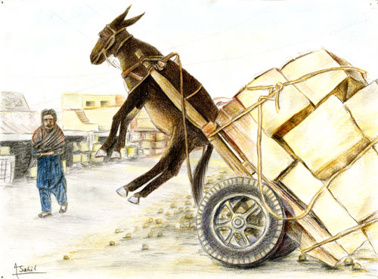
Dealing with load

Slide 22
Throttling
Add a delay after each message

Slide 23
Throttling
Limit messages per time slice

Slide 24
Bounded Mailboxes
Mailbox
Actor

Slide 25
Bounded Mailboxes
Mailbox
Actor

Slide 26
Limit Concurrency
Limit concurrent access to a resource
4
1
Worker 1
4
3
2
1
Router
2
Worker 2
3
Worker 3

Slide 27
Work Pulling
Producer
Send work
Worker 1
Work to be done
Work Done
Send work
Worker 2
Work to be done
Work Done

Slide 28

Virtual Actors
Always Exists, Never Fails

Slide 29




Slide 30
Virtual Actors

Slide 31
Virtual Actors

Slide 32
The End
Roger Johansson
Twitter: @rogeralsing
Github: rogeralsing
Mail: roger@asynkron.se
Github.com/rogeralsing/presentations
http://Proto.Actor

