Slide 1
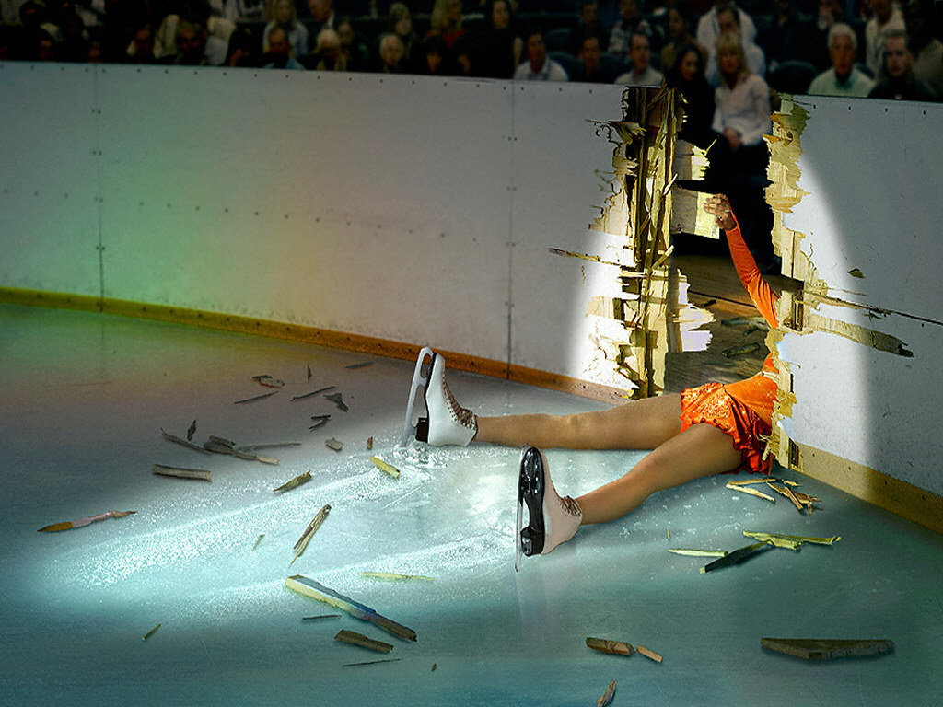
Failing gracefully
With the actor model
Roger Johansson
Akka.NET and Proto.Actor Founder
Solution Architect - Betsson Group
Twitter: @rogeralsing
Github: rogeralsing
Mail: rogeralsing@gmail.com
Github.com/rogeralsing/presentations
http://Proto.Actor

Slide 2
Design for failure
Dealing with, mitigating and preventing failures.
In the small, and at scale.

Slide 3

An escalator can never break: it can only become stairs. You should never see an Escalator Temporarily Out Of Order sign, just Escalator Temporarily Stairs. Sorry for the convenience. -Mitch Hedberg

Slide 4
Bulkheads

Slide 5

Actors

Slide 6
Actor Model
Three axioms:
Send – an actor can send messages to other actors
Create – an actor can create new actors
Become – an actor can decide how to handle it’s next message

Slide 7
Actor Model
”An island of consistency in a sea of concurrency”
”Shared nothing”, ”Black box”
”Location transparent”, ”Distributable by design”

Slide 8
Actor Model
Implementations:
BEAM – Erlang, Elixir, LFE
JVM – Akka, Orbit
.NET – Akka.NET, Proto.Actor, Microsoft Orleans
Go – Proto.Actor

Slide 9
Event-driven thread
Actor
Mailbox
Transport
PID
Behavior
State
Supervision
Children

Slide 10

/
/a1
/a2
/b1
/b1
/b2
/b3
/c1
/c2
/c3
/c4
/c5
Supervision

Slide 11
Consumer 1
Consumer 2
Component

Slide 12
Website
Businesslogic
Data Access

Slide 13
Insert coins
Me
Vendor machine
Need more coins
Gets coffee

Slide 14
Service guy
Out of beans
Refill beans
Insert coins
Me
Vendor machine
Gets coffee

Slide 15
Supervisor
Application error
Manage failures
Request
Client
Service
Validation error
Response

Slide 16
Error Kernel
/
99.9999999% uptime ~0.03 sekunder downtime per år
OneForOne supervisor
/a1
/a2
AllForOne supervisor
/b1
/b1
/b2
/b3
/b3
/c1
/c2
/c3
/c4
/c5

Slide 17
Let it crash
Protect state by delegating work
parent
Performs work, can be restarted
child

Slide 18

Mitigating Failures

Slide 19
Exponential Backoff
parent
Delay
child
Attempts

Slide 20
Circuit Breaker
DB Actor
DB Query
DB Up
DB Result
DB Query
DB Down
DB Error

Slide 21
Akka Remote Associations
Idle
Active
Quarantined
Gated

Slide 22
Active Passive Consumers
Node 1
Primary
Queue
Node 2
Secondary

Slide 23
Consistent Hash Pairs
Hash Slot 1
Queue
Hash Slot 2
Hash Slot 3

Slide 24
Fan out and quickest reply
Fan out
?
Worker 1
Consumer
?
Router
?
Worker 2
?
Worker 3

Slide 25
Fan out and quickest reply
Return first reply
!
Worker 1
Consumer
!
Router
!
Worker 2
!
Worker 3

Slide 26
N-Modular Redundancy
Require same reply from at least N workers
!
Worker 1
Consumer
!
Router
!
Worker 2
!
Worker 3

Slide 27
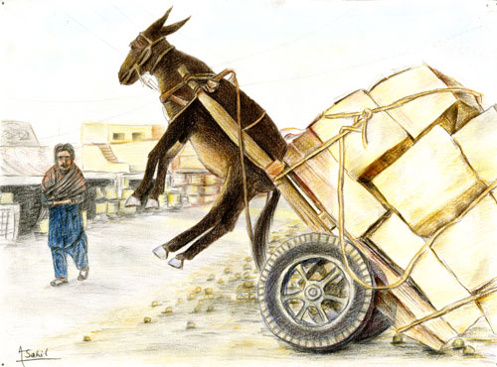
Dealing with load

Slide 28
Throttling
Add a delay after each message

Slide 29
Throttling
Limit messages per time slice

Slide 30
Bounded Mailboxes
Mailbox
Actor

Slide 31
Bounded Mailboxes
Mailbox
Actor

Slide 32
Limit Concurrency
Limit concurrent access to a resource
4
1
Worker 1
4
3
2
1
Router
2
Worker 2
3
Worker 3

Slide 33
Work Pulling
Producer
Send work
Worker 1
Work to be done
Work Done
Send work
Worker 2
Work to be done
Work Done

Slide 34

Virtual Actors
Always Exists, Never Fails

Slide 35




Slide 36
Virtual Actors

Slide 37
Virtual Actors
Node A
433
Hash:
989123
Grain Id:
Roger
Node E
943772
Node B
24345
Names: Roger
Actors:
Roger : User
Node C
82327

Slide 38
Virtual Actors
Node A
433
Node F
987234
Hash:
989123
Names: Roger
Grain Id:
Roger
Node E
943772
Node B
24345
Actors:
Roger : User
Node C
82327

Slide 39
Akka Cluster Sharding
Coordinator

Slide 40
The End
Roger Johansson
Twitter: @rogeralsing
Github: rogeralsing
Mail: rogeralsing@gmail.com
Github.com/rogeralsing/presentations
http://Proto.Actor

