Slide 1

Platform-independent, resilient, and stateful microservices
Roger Johansson
Proto.Actor Founder Twitter: @rogeralsing
Github: rogeralsing
Mail: roger.johansson@betsson.com
Github.com/rogeralsing/presentations

Slide 2
Microservices
Important aspects when building microservices:
Platform independent
How to deal with versions?
How do you handle errors?
How do you scale up?
How do you scale out?
How do services find eachother?
Throughput, Latency

Slide 3
What is Proto.Actor?
Next Generation Actor Model:
Built on standards
Platform independent
Actors and Virtual Actors
Ultra fast

Slide 4
What is Proto.Actor?
Next Generation Actor Model:
Built on standards – Protobuf, HTTP/2 Streams, Consul
Platform independent – C#, Go, Python, Javascript, Kotlin
Actors and Virtual Actors – Akka, Microsoft Orleans
Ultra fast – 65 times faster than Akka.NET over network

Slide 5

Actor Model
Three axioms:
Send – an actor can send messages to other actors
Create – an actor can create new actors
Become – an actor can decide how to handle it’s next message

Slide 6
”An island of consistency in a sea of concurrency”
”Shared nothing”, ”Black box”
”Location transparent”, ”Distributable by design”

Slide 7
Event-driven thread
Actor
Mailbox
Transport
PID
Behavior
State
Supervision
Children

Slide 8
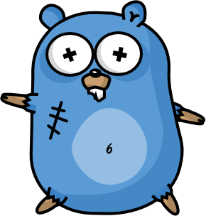
/
/a1
/a2
/b1
/b1
/b2
/b3
/c1
/c2
/c3
/c4
/c5
Fault tolerance

Slide 9
Error Kernel
/
99.9999999% uptime ~0.03 sekunder downtime per år
OneForOne supervisor
/a1
/a2
AllForOne supervisor
/b1
/b1
/b2
/b3
/b3
/c1
/c2
/c3
/c4
/c5

Slide 10
Consumer 1
Consumer 2
Component

Slide 11
Website
Businesslogic
Component

Slide 12
Service guy
Out of beans
Refill beans
Insert coins
Me
Vendor machine
Need more coins
Out of beans!
Gets coffee

Slide 13
Supervisor
Application error
Manage failures
Request
Client
Service
Validation error
Response

Slide 14
Moore’s Law
We can no longer build faster processors Instead, we stack them next to eachother and call them ”cores”

Slide 15
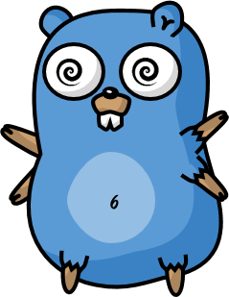
Scale up

Slide 16

Scale out

Slide 17
Scale up and out are essentially the same
That is; we want to execute code ”somewhere”, on a core, on a machine, in a cluster.
Why should we have to resort to different technologies to accomplish the same thing?

Slide 18
Multiplex Scheduling
Actor1
Actor1
Actor2
Actor3
Actor4
Actor1
Thread Pool
Actor2
Actor3
Actor1
Actor2
Actor2
Actor4
Actor4
Actor3
Time
Cheaper than threads, no context switching

Slide 19
”actor” package

Slide 20
”remote” package

Slide 21
”router” package

Slide 22
Routers
A router delegates messages to other ”routee” actors
Group routers – delegate messages to your existing actors
Pool routers – delegate messages to a dedicated pool of actors

Slide 23
BroadcastRouter
Notifies all ”routees”
2
1
Routee1
2
1
Router
2
1
Routee2
2
1
Routee3

Slide 24
RoundRobinRouter
4
1
Routee1
Scale up!
4
3
2
1
Router
2
Routee2
.. Or down!
3
Routee3

Slide 25
RoundRobinRouter
Routee1
Scale out!
Remote1
Router
Routee2
Scale up!
Routee3
Routee1
Router
Remote2
Router
Routee2
Routee3
Routee1
Remote3
Router
Routee2
Routee3

Slide 26
ConsistentHashRouter
Affinity between hash index and routee
A
M
Routee1
X
A
Y
M
Router
Y
Routee2
X
Routee3

Slide 27
ConsistentHashRouter
Id: 789
Id: 123
Id:456
Id: 123
Payment
Stop
Router
Create
Create
…
…
…
…

Slide 28
ConsistentHashRouter
Maps hash of 123 to routee1
Id: 123
Id: 123
Stop
Create
Routee1
…
…
Id: 789
Id: 123
Id:456
Id: 123
Id:456
Router
Routee2
Payment
Stop
Create
Create
Create
…
…
…
…
…
Id: 789
Payment
Routee3
…

Slide 29
Demo – Use routers

Slide 30
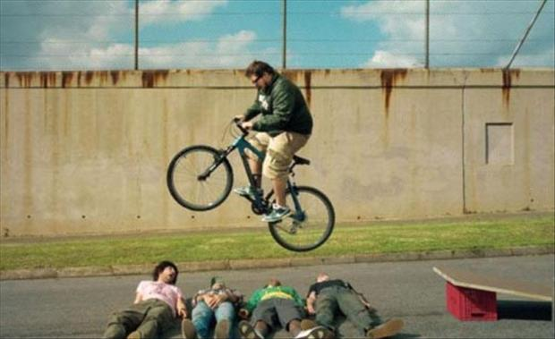
Error handling in Java, C# and C

Slide 31
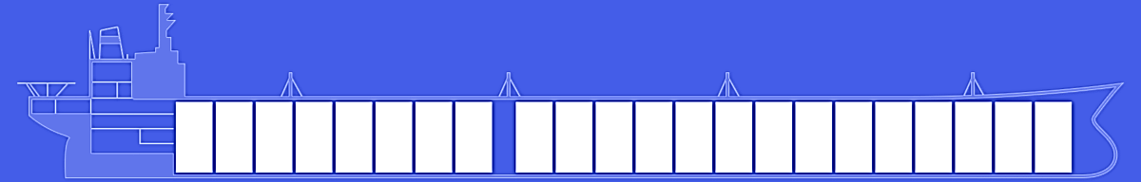
Fault tolerance – fail gracefully
Isolate failures in bulkheads

Slide 32
Supervision
Every actor is being supervised by another actor that dictates how failures should be handled
A supervisor can decide to:
Force a restart
Terminate
Ignore and resume
Escalate up to it’s own supervisor

Slide 33
The End

Slide 34
Platform-independent, resilient, and stateful microservices
Roger Johansson
Proto.Actor Founder Twitter: @rogeralsing
Github: rogeralsing
Mail: roger.johansson@betsson.com
Github.com/rogeralsing/presentations

