Slide 1
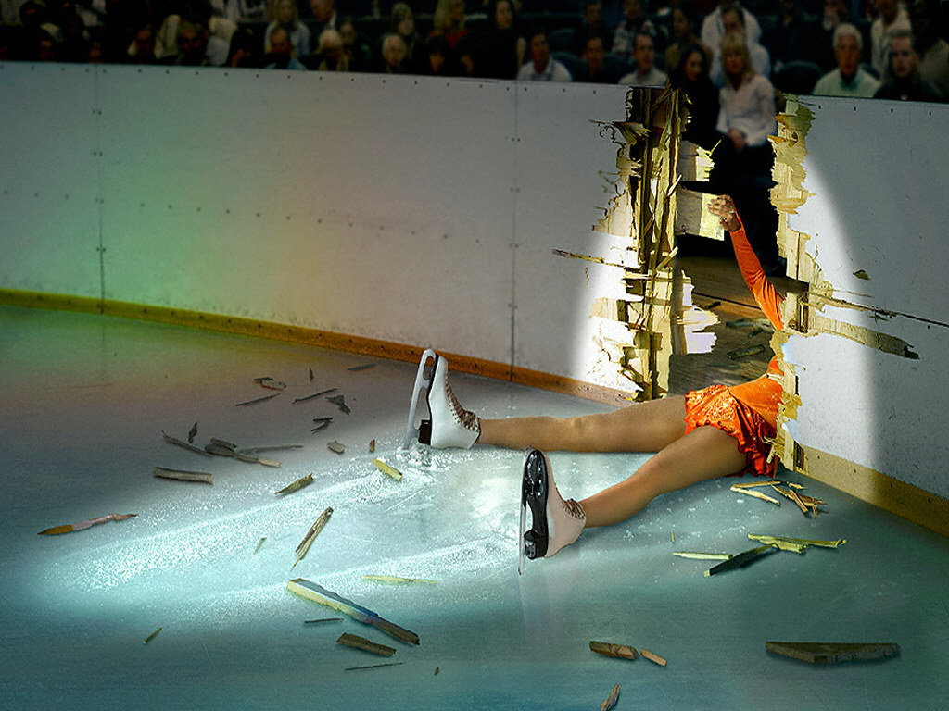
Failing gracefully
With the actor model
Roger Johansson
Akka.NET and Proto.Actor Founder
Twitter: @rogeralsing
Github: rogeralsing
Mail: rogeralsing@gmail.com
Github.com/rogeralsing/presentations

Slide 2
Design for failure
Dealing with, mitigating and preventing failures.
In the small, and at scale.

Slide 3
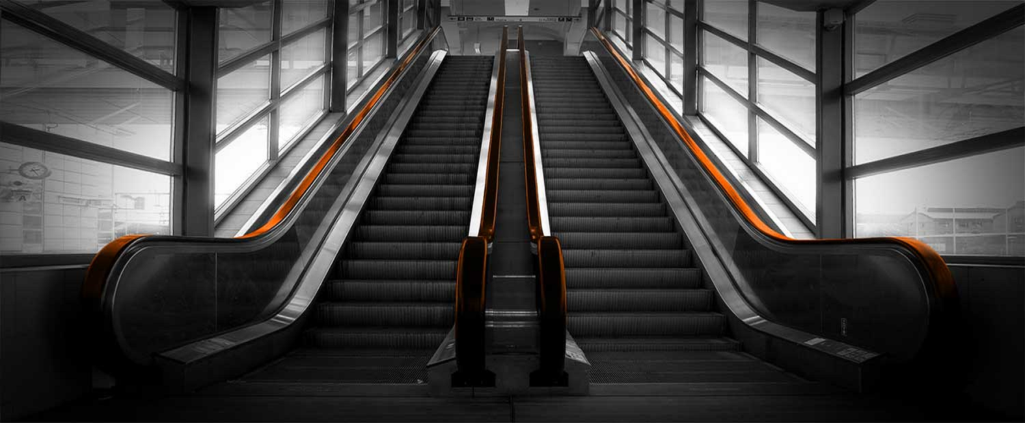
An escalator can never break: it can only become stairs. You should never see an Escalator Temporarily Out Of Order sign, just Escalator Temporarily Stairs. Sorry for the convenience. -Mitch Hedberg

Slide 4
Bulkheads

Slide 5
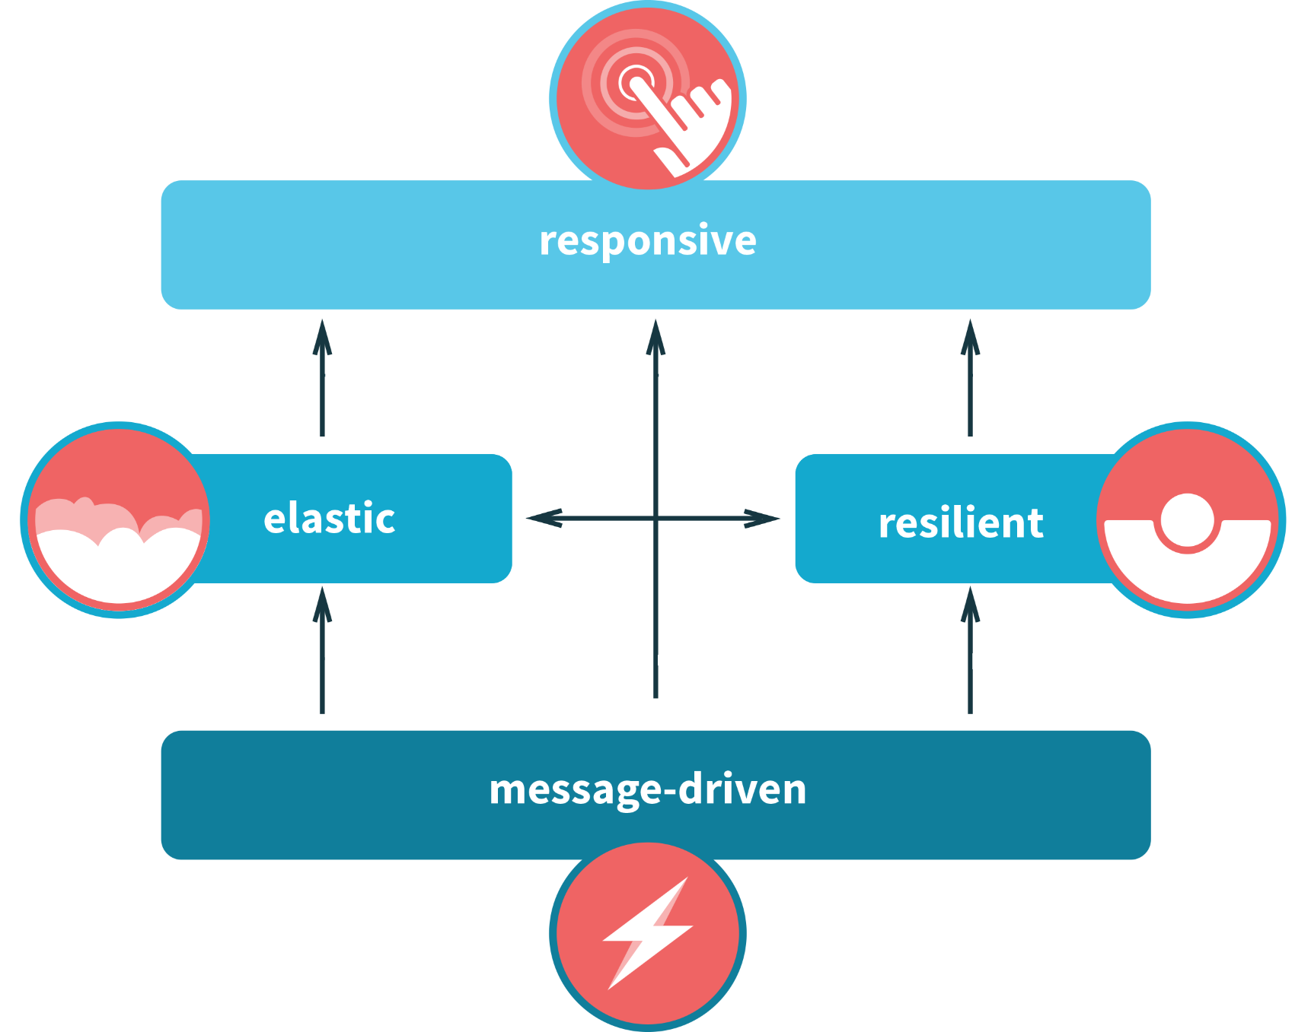

Slide 6
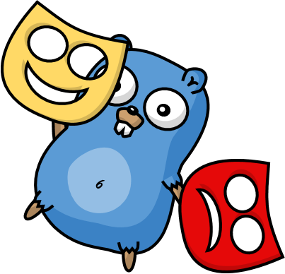
Actors

Slide 7
Actor Model
Three axioms:
Send – an actor can send messages to other actors
Create – an actor can create new actors
Become – an actor can decide how to handle it’s next message

Slide 8
Actor Model
”An island of consistency in a sea of concurrency”
”Shared nothing”, ”Black box”
”Location transparent”, ”Distributable by design”

Slide 9
Event-driven thread
Actor
Mailbox
Transport
PID
Behavior
State
Supervision
Children

Slide 10
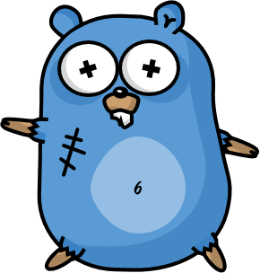
/
/a1
/a2
/b1
/b1
/b2
/b3
/c1
/c2
/c3
/c4
/c5
Supervision

Slide 11
Consumer 1
Consumer 2
Component

Slide 12
Website
Businesslogic
Data Access

Slide 13
Service guy
Out of beans
Refill beans
Insert coins
Me
Vendor machine
Need more coins
Out of beans!
Gets coffee

Slide 14
Supervisor
Application error
Manage failures
Request
Client
Service
Validation error
Response

Slide 15
Error Kernel
/
99.9999999% uptime ~0.03 sekunder downtime per år
OneForOne supervisor
/a1
/a2
AllForOne supervisor
/b1
/b1
/b2
/b3
/b3
/c1
/c2
/c3
/c4
/c5

Slide 16
Redshirt - Character Actor
Protect state by delegating work
parent
Performs work, can be restarted
child

Slide 17
Exponential Backoff
parent
Delay
child
Attempts

Slide 18
Circuit Breaker
DB Actor
DB Query
DB Up
DB Result
DB Query
DB Down
DB Error
Poll DB Status

Slide 19
Limit Concurrency
Limit concurrent access to a resource
4
1
Routee1
4
3
2
1
Router
2
Routee2
3
Routee3

Slide 20
Fan out and quickest reply
Fan out, return first reply
?
Routee1
Consumer
?
Router
Routee2
?
!
?
Routee3

Slide 21
Examples,Protocols, e.g. Akka Remote Endpoint states

Slide 22
Active Passive consumers

Slide 23
Actor lifecycle

Slide 24
Deathwatch

Slide 25
Distributed failures
Lost nodes
Network problems
How do you handle this?

Slide 26
Persistencec. Rehydrate actors on a new node

Slide 27
Virtual Actors

Slide 28
Never fail, always exists

Slide 29

Virtual Actors

Slide 30




Slide 32
Node A
433
Node F
987234
Hash:
989123
Names: Roger
Grain Id:
Roger
Node E
943772
Node B
24345
Names: Roger
Actors:
Roger : User
Node D
612344
Node C
82327

Slide 33
Coordinator

Slide 34
The End

Slide 35
Platform-independent, resilient, and stateful microservices
Roger Johansson
Proto.Actor Founder Twitter: @rogeralsing
Github: rogeralsing
Mail: roger.johansson@betsson.com
Github.com/rogeralsing/presentations

