Slide 1
Millions of Transactions per Second on a Single Machine Case for a Virtualized Database and Scale-In
Roger Johansson

Slide 2
Who am I?
Roger Johansson
Senior Solution Architect – Starcounter http://StarCounter.io Akka.NET and Proto.Actor Founder http://GetAkka.net, http://Proto.Actor
Twitter: @rogeralsing
Github: rogeralsing
Mail: roger@starcounter.com
http://Github.com/rogeralsing/presentations
Actor Model, Scalability, Distributed Systems, C#, Go, Kotlin
6

Slide 3
Agenda
Setting the stage - Why we need in memory computing:
Application Platform
Micro-Apps
The Starcounter information operating system:
Our approach to in memory computing
The future of hardware
The Mars project

Slide 4
Application Platform

Slide 5
Front-end Framework React, Polymer
Starcounter
Communication Palindrom - REST, Web Sockets
Application View Models, Entities, App Logic
In Memory App Platform
Mapping, Persistence, Queries

Slide 6
Traditional Stack
Starcounter
Front-end Framework
Front-end Framework
Client Side Code
Network
Network
Services + Contracts
View Models
Application Code
Application
O/R Mapper
Network
Database
In Memory App Platform

Slide 7
Micro-Applications

Slide 8
UI A
UI B
UI C
Starcounter
App A
App B
App C
Model A
Model B
Model C

Slide 9
Client Side Blending
UI A
UI B
UI C
UI A
UI B
UI C
Starcounter
App A
App B
App C
Model A
Model B
Model C

Slide 10
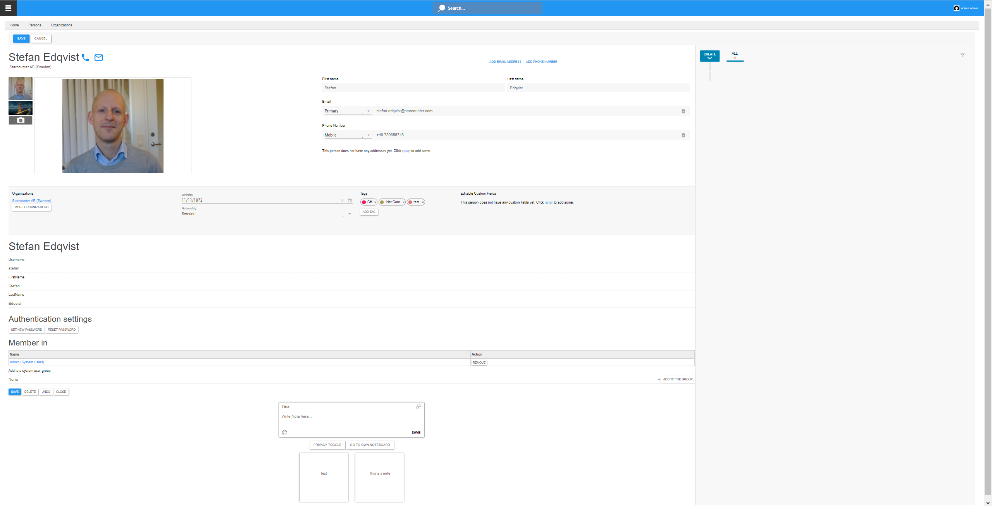

Slide 12
Profile
ObjectId
789
FirstName
Stefan
LastName
Edqvist
User
ObjectId
123
FirstName
Stefan
LastName
Edqvist

Slide 13
Client Side Blending
UI A
UI B
UI C
UI A
UI B
UI C
Starcounter
App A
App B
App C
Model A
Model B
Model C
ACID, Snapshot Isolation
Mapper

Slide 14
Data Flow Programming

Slide 15
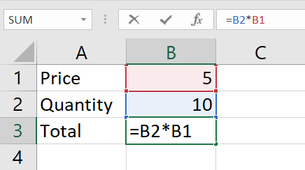
UI A
UI B
UI C
Starcounter
App A
App B
App C
Model A
Model B
Model C
Mapper

Slide 16
Demo Dataflow

Slide 17
In Memory, For Real

Slide 18
Application Process
Object
Offline copy of database data
ObjectId
123
FirstName
Alan
LastName
Turing
Age
41
Map to and from Object / Storage model
Object Mapper
Transfer Data over network
Database Process
Network / IPC
Disk
Data is stored on disk, optimized for spinning disks and moving arms
ObjectId
FirstName
LastName
Age
123
Alan
Turing
41
124
Ada
Lovelace
36
125
Grace
Hopper
86

Slide 19
Application Process
Object
Offline copy of database data
ObjectId
123
FirstName
Alan
LastName
Turing
Age
41
Map to and from Object / Relational model
Object Mapper
Transfer Data over network
Database Process
Network / IPC
Memory
Data is mainly kept in memory, enabling faster reads and writes
ObjectId
FirstName
LastName
Age
123
Alan
Turing
41
124
Ada
Lovelace
36
125
Grace
Hopper
86

Slide 20
Application Process
Object
Stateless Entity maps directly to shared memory
ObjectId
123
Shared Memory
Database Process
Data is kept in memory and shared across processes
ObjectId
FirstName
LastName
Age
123
Alan
Turing
41
124
Ada
Lovelace
36
125
Grace
Hopper
86

Slide 21
C#
Node.JS
Object
Object
Multiple processes can read the same data
ObjectId
123
ObjectId
123
Shared Memory
Database Process
ObjectId
FirstName
LastName
Age
123
Alan
Turing
41
124
Ada
Lovelace
36
125
Grace
Hopper
86

Slide 22
C# Source Code
public class Person
{
public string FirstName
{
get;
set;
}

Slide 23
C# Compiler Output
public class Person
{ private string _firstName;
public string FirstName
{
get => _firstName;
set value => _firstName = value;
}

Slide 24
Starcounter Weaver Output
public class Person
{ private string _firstName;
private ulong _id;
public string FirstName
{
get => DbState.GetString(_id, FirstNameId);
set value => DbState.SetString(_id, FirstNameId, value)
}

Slide 25
Millions of operations per second

Slide 26
O/R mapper – Object Graphs
Customer
Order
OrderDetail
Product
Lazy Load Execute SQL Query per traversed relation
Eager Load
Carefully defining load boundaries
Ripple load,
Hundreds/Thousands of queries per view
Hard to maintain, inefficient joined queries

Slide 27
Starcounter – Object Graphs
Customer
Order
OrderDetail
Product
Chasing Pointers Traversing relations are simple pointer traversals

Slide 28
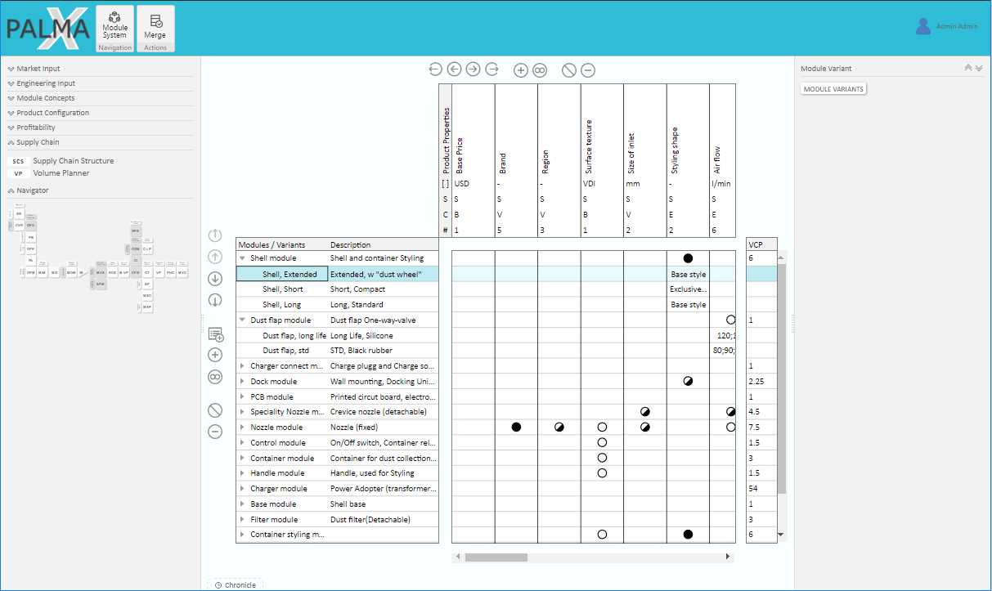

Slide 29
Demo - Write 1 mil transactions

Slide 30
Demo - Write 1 mil transactions
In this demo we provided:
ACID Transactions
Snapshot Isolation
Guaranteed disk persistency
Can we go even faster?
We are capped by disk IO
The Mars project

Slide 31
The Future of Hardware

Slide 33
Current
Future
Registers
Registers
Cache
Cache
Main Memory
Main Memory
Solid State Disk
Non Volatile Memory
Magnetic Disk
Solid State Disk
Magnetic Disk

Slide 34
Starcounter on the CPUs of 2018
Write
Delta Store
(incremental updates)
Volatile DRAM
Read
Merge
CPU
Main Store
(batch update)
Non Volatile DRAM

Slide 35
Few Big Servers, not many small
Server
Server

Slide 36
Few Big Servers, not many small
Server
Server

Slide 37
Q & A

