Slide 1
Design for failure

Slide 2
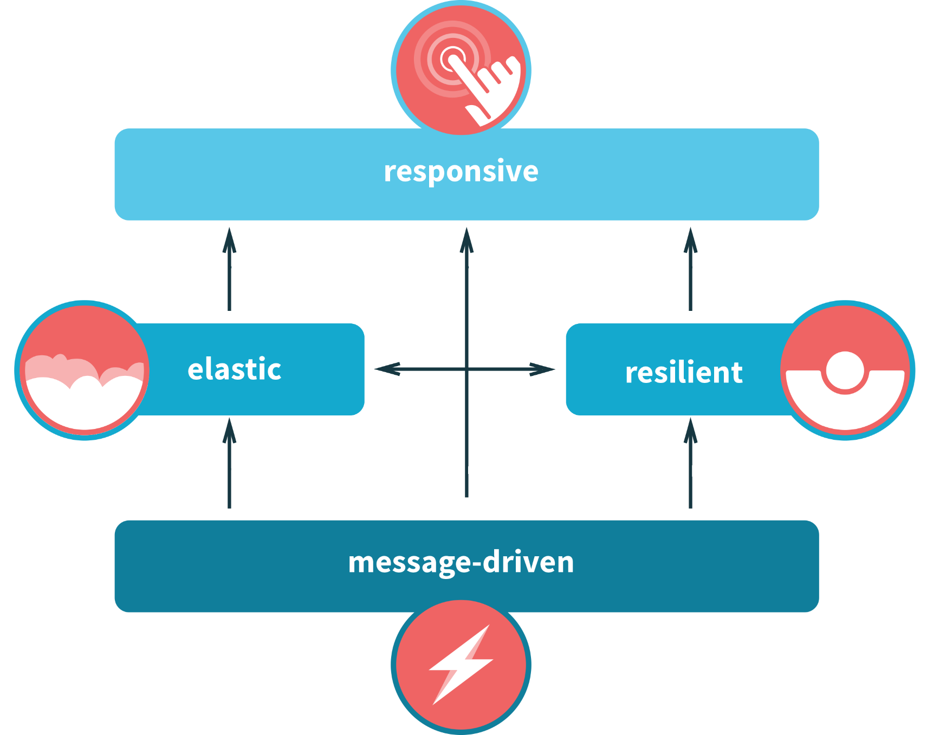

Slide 3
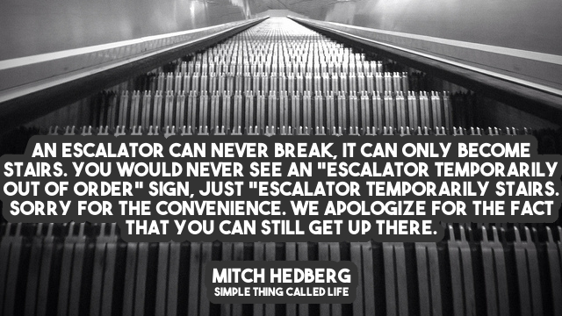

Slide 4
Bulkhead

Slide 5
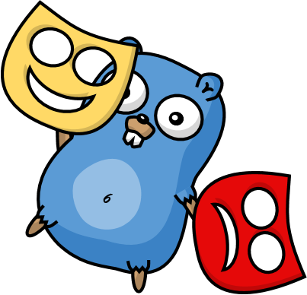
Actors

Slide 6
Actor Model
Three axioms:
Send – an actor can send messages to other actors
Create – an actor can create new actors
Become – an actor can decide how to handle it’s next message

Slide 7
Actor Model
”An island of consistency in a sea of concurrency”
”Shared nothing”, ”Black box”
”Location transparent”, ”Distributable by design”

Slide 8
Event-driven thread
Actor
Mailbox
Transport
PID
Behavior
State
Supervision
Children

Slide 9
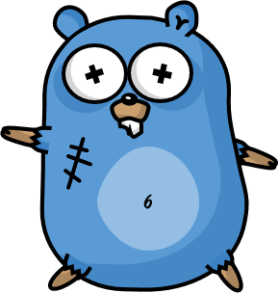
/
/a1
/a2
/b1
/b1
/b2
/b3
/c1
/c2
/c3
/c4
/c5
Fault tolerance

Slide 10
Consumer 1
Consumer 2
Component

Slide 11
Website
Businesslogic
Component

Slide 12
Service guy
Service guy
Out of beans
Refill beans
Insert coins
Me
Vendor machine
Need more coins
Out of beans!
Gets coffee

Slide 13
Supervisor
Application error
Manage failures
Request
Client
Service
Validation error
Response

Slide 14
Error Kernel
/
99.9999999% uptime ~0.03 sekunder downtime per år
OneForOne supervisor
/a1
/a2
AllForOne supervisor
/b1
/b1
/b2
/b3
/b3
/c1
/c2
/c3
/c4
/c5

Slide 15
Exponential Backoff Demo

Slide 16
DB Query
DB Query
DB Result
DB Error
DB Actor
Up
Down
Poll DB Status

Slide 17
Examples,Protocols, e.g. Akka Remote Endpoint states

Slide 18
Actor lifecycle

Slide 19
Deathwatch

Slide 20
Distributed failures
Lost nodes
Network problems
How do you handle this?

Slide 21
Persistencec. Rehydrate actors on a new node

Slide 22
Virtual Actors

Slide 23
Never fail, always exists

Slide 24
Node Foo
433
Node Gnu
987234
Hash:
989123
Names: Roger
Grain Id:
Roger
Node Fob
943772
Node Bar
24345
Names: Roger
Actors:
Roger
Node Pew
612344
Node Baz
82327

Slide 25
Akka has Cluster Sharding

Slide 26
The End

Slide 27

Platform-independent, resilient, and stateful microservices
Roger Johansson
Proto.Actor Founder Twitter: @rogeralsing
Github: rogeralsing
Mail: roger.johansson@betsson.com
Github.com/rogeralsing/presentations

