Slide 1
Why Techsson wants Docker

Slide 2
The Past

Slide 3
One Brand, One System
Bets10
The Monolith

Slide 4
We acquired more brands
Betsafe
Bets10
NordicBet
?
The Monolith
?

Slide 5
Scaling the monolith
A monolithic application puts all its
functionality into a single process…
…and scales by replicating the
monolith on multiple servers
-Martin Fowler, James Lewis

Slide 6
Scaling by Instance
Instance 1
Instance 2
Instance 3
Brand A, B
Brand C
Brand D

Slide 7
Introducing SOA
Still pretty darn big services
Instance 1
Instance 2
Instance 3
Customer
Customer
Customer
Gaming
Gaming
Gaming
Campaigns
Campaigns
Campaigns
…
…
…

Slide 8
Challenges?

Slide 9
Point to point communication
Single Message Producer
Single Message Consumer
No Redundancy
Doesn’t Scale

Slide 10
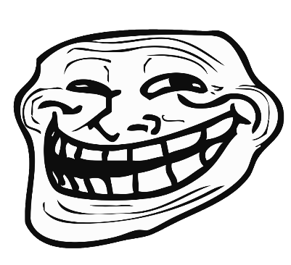

Shared Servers, Noisy Neighbours
Instance
Customer
Gaming
Campaigns
…

Slide 11

Single point of failure…
Instance
Customer
Gaming
Campaigns
…

Slide 12
…Same issue with deployment
Down during deployment
Instance
Customer
Gaming
Campaigns
…

Slide 13
Challenges!
Scalability, Elasticity
Isolation
Availability
Deployment

Slide 14
The Current

Slide 15
Adopting Microservices
Customer

Slide 16
Adopting Microservices
Bounded Contexts
Login
Customer
Registration
Customer Data

Slide 17
Scaling Microservices
A microservice architecture puts
each element of functionality into a
separate service…
…and scales by distributing these services
across servers, replicating as needed
-Martin Fowler, James Lewis

Slide 18
Scaling Microservices
Where are you guys!?
I’m over here!

Slide 19
Scaling Microservices

Slide 20
Service Discovery
Service Registry
Publish ”I am A”
Publish ”I am B”
Service A
Service B

Slide 21
Service Discovery
Service Registry
Lookup ”Where is B?”
Service A
Service B
Call

Slide 22
Service Discovery
Service A1
Service B1
Service Registry
Service A2
Service B2
Service A3
Service B3

Slide 23


Consul
Server
Server
Server
Agent
Agent
Agent
Agent
Agent

Slide 24
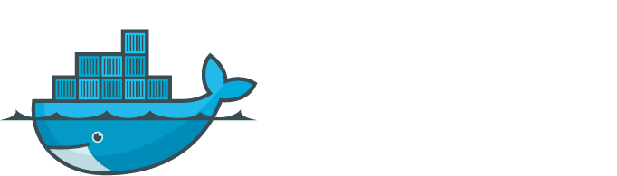
?

Slide 25
Server
Login
Registration
Customer Data

Slide 26
Isolating services from eachother
Server
Docker
Login
Registration
Customer Data

Slide 27
Can we isolate using VMs?

Slide 28
App A
App A
App A
Bin/Libs
Bin/Libs
Bin/Libs
Guest OS
Guest OS
Guest OS
Waste / Cost
App A
App A
App A
Bin/Libs
Bin/Libs
Bin/Libs
Hypervisor
Container Engine
Host OS
Host OS
Infrastructure
Infrastructure

Slide 29
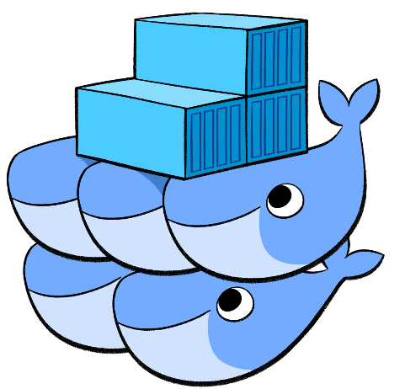
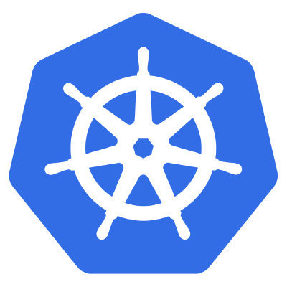
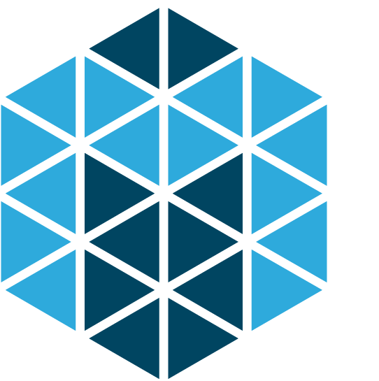
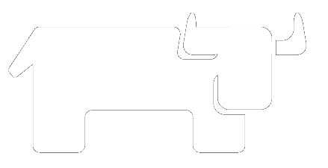
Cluster Schedulers

Slide 30
Why Cluster Schedulers?
Server 1
Server 2
Server 3
Docker
Docker
Docker
Registration
Login
Login
Registration
Registration
….
….
Customer Data
….

Slide 31
Cluster Schedulers
Shared pool of resources
Docker
Docker
Docker
Registration
Login
Login
Registration
Registration
….
….
Customer Data
….

Slide 32
Service Discovery inside a cluster
Service Discovery
Shared pool of resources
Docker
Docker
Docker
Registration
Login
Login
Registration
Registration
….
….
Customer Data
….

Slide 33
Hybrid Environment
Service Discovery
Shared pool of resources
Server 3
Docker
Docker
Registration
Login
Legacy Service
Registration
Registration
….
….
Customer Data
….

Slide 34
Context Aware Services
Bets10 – VIP
Bets10 – Default
Shared pool of resources
Docker
Docker
Docker
Registration
Login
Login
Registration
Registration
….
….
Customer Data
….

Slide 35
Aspects to consider
Organizational decisions
Cluster Schedulers, Kubernetes, Mesos, Swarm, Cattle etc?
Containers for legacy apps, Windows Containers?
The RFC process, can we do better?
Private Registry, access to Docker Hub?

Slide 36
Aspects to consider
Techops / Devops
Monitoring. Appdynamics vs Promethius etc.
Security
Networking
Filesystems

Slide 37
Aspects to consider
Architecture
Communication and discovery between container and non-container based services
Context aware services
Footprint. .NET gives huge images
Automated development environments

Slide 38
Way forward – Build a MVP
In order to not take a bigger bite than we can handle.
We suggest that we start small, let’s start with simple microservices in .NET core.
Deploy them in containers, possibly using a low friction scheduler like Swarm or Cattle.
This will give us some time to learn and familiarize with the ecosystem around Docker before we take
And major strategical decissions.
Once we have successfully hosted such services for e.g. 2 months in prod without container related issues,
then we move on to the next step.

Slide 39
Eyes on the future?

Slide 40
Function as a Service
This will become mainstream in a few years
IaaS
CaaS
PaaS
FaaS
Functions
Functions
Functions
Functions
Customer Managed
Application
Application
Application
-
Abstracted by Vendor
Runtime
Runtime
Runtime
Runtime
-
Containers
Containers
Containers
Operating System
Operating System
Operating System
Operating System
Virtualization
Virtualization
Virtualization
Virtualization
Hardware
Hardware
Hardware
Hardware

