Slide 1


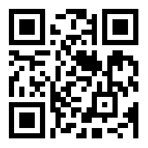
akka.net
Scale up and out with Akka.NET
Roger Johansson
Akka.NET Co-Founder Twitter: @rogeralsing
Github: rogeralsing
Mail: roger.johansson@betsson.com

Slide 2
Actor Model
Three axioms:
Send – an actor can send messages to other actors
Create – an actor can create new actors
Become – an actor can decide how to handle it’s next message
”An island of consistency in a sea of concurrency”
”Shared nothing”, ”Black box”
”Location transparent”, ”Distributable by design”

Slide 3
OOP vs. Actor Model
OOP
Actor Model
Behavior
Behavior
Stateful
Stateful
Synchronous method calls
Asynchronous message passing
Why Actors?? The synchronous model has worked nicely for 60 years!?

Slide 4
Moore’s Law
We can no longer build faster processors Instead, we stack them next to eachother and call them ”cores”

Slide 5
CPU

Slide 6
Core
Core
Core
Core

Slide 7
The invocation will run on a single core
Code
Invocation

Slide 8
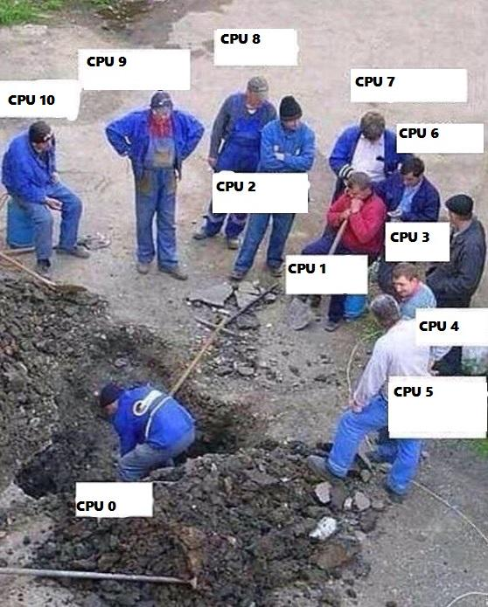
Buying a larger CPU will not change this
Code
Invocation

Slide 9
Code
Invocation
Multithreading Multithreaded systems let us utilize more than one core

Slide 10
Code
Request
Multithreading Multithreaded systems let us utilize more than one core

Slide 11
Scale out When one CPU is no longer enough

Slide 12

Classic .NET technologies
Scale up:
Parallel Linq TPL – async await
Threads
Scale out:
WCF Web API
MSMQ
Elasticity:
OMG-WTF-Difficult

Slide 13


akka.net
Scale up:
Akka.Actor
Scale out:
Akka.Remote
Elasticity:
Akka.Cluster

Slide 14

Scale up and out are essentially the same
That is; we want to execute code ”somewhere”, on a core, on a machine, in a cluster.
Why should we have to resort to different technologies to accomplish the same thing?

Slide 15
Scale up and out are essentially the same
That is; we want to execute code ”somewhere”, on a core, on a machine, in a cluster.
Why should we have to resort to different technologies to accomplish the same thing?

Slide 16

Location Transparency, Distributed by default
Event-driven thread
Actor
ActorRef
Mailbox
Transport
ActorRef
Behavior
State
Shared Nothing, Black box
Supervision
Children
An island of consistency in a sea of concurrency

Slide 17
Multiplex Scheduling
Actor1
Actor1
Actor2
Actor3
Actor4
Actor1
Thread Pool
Actor2
Actor3
Actor1
Actor2
Actor2
Actor4
Actor4
Actor3
Time
Cheaper than threads, no context switching

Slide 18
Actor Model
Products basered on the actor model:
Facebook WhatsApp (Erlang)
RabbitMQ (Erlang)
CouchDB (Erlang)
LinkedIn.com (JVM Akka)
Walmart.com (JVM Akka)
Azure Service Fabric alternative backend (Akka.NET)

Slide 19
Akka.Actor

Slide 20
Demo – Create your first actor
ActorSystem
ReceiveActor
Props
ActorRef

Slide 21
Akka.Remote

Slide 23
System 1
System 2
System 3

Slide 24
Demo – Build a chat
RemoteActorRefProvider
ActorSelection

Slide 25
Demo – Remote Deployment
Deployment configuration
RemoteDaemon

Slide 26
Akka.Routing

Slide 27
Routers
A router delegates messages to other ”routee” actors
Group routers – delegate messages to your existing actors
Pool routers – delegate messages to a dedicated pool of actors

Slide 28
BroadcastRouter
Notifies all ”routees”
2
1
Routee1
2
1
Router
2
1
Routee2
2
1
Routee3

Slide 29
RoundRobinRouter
4
1
Routee1
Scale up!
4
3
2
1
Router
2
Routee2
3
Routee3
.. Or down!

Slide 30
RoundRobinRouter
Routee1
Scale out!
Remote1
Router
Routee2
Scale up!
Routee3
Routee1
Router
Remote2
Router
Routee2
Routee3
Routee1
Remote3
Router
Routee2
Routee3

Slide 31
ConsistentHashRouter
A
M
Routee1
X
A
Y
M
Router
Y
Routee2
X
Routee3
Affinity between hash index and routee

Slide 32
ConsistentHashRouter
Id: 789
Id: 123
Id:456
Id: 123
Payment
Stop
Router
Create
Create
…
…
…
…

Slide 33
ConsistentHashRouter
Prevents race conditions
Id: 123
Id: 123
Stop
Create
Routee1
…
…
Id: 789
Id: 123
Id:456
Id: 123
Id:456
Router
Routee2
Payment
Stop
Create
Create
Create
…
…
…
…
…
Id: 789
Payment
Routee3
…

Slide 34
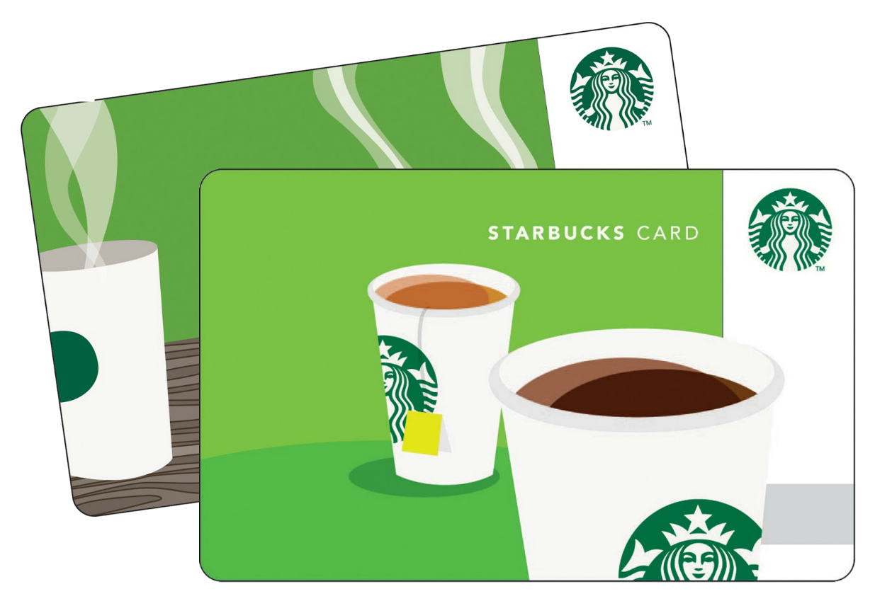
Concurrency
akka.net
Coordinate access to shared resources
”Hacking Starbucks for unlimited coffee”

Slide 35
ScatterGatherFirstCompletedRouter
?
Routee1
Sender
?
Router
?
Routee2
!
?
Routee3
Similar to broadcast, forwards the first reply to the original sender

Slide 36
Demo – Use routers
RoundRobin
Deployment configuration

Slide 37
Demo – Scale up and out
RoundRobin
Remote Deployment
Executing actors on a GUI Thread

Slide 38
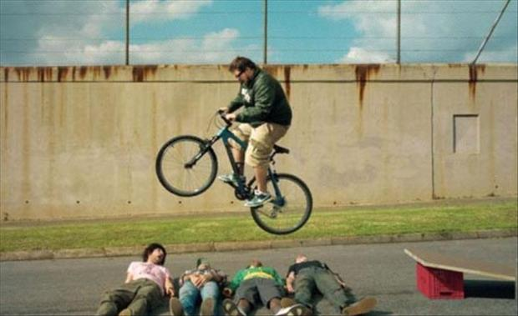
Error handling in Java, C# and C

Slide 39
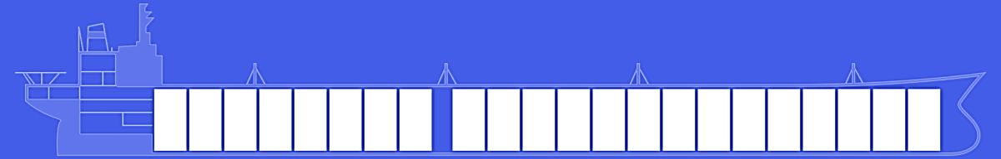
Fault tolerance – fail gracefully
akka.net
Isolate failures in bulkheads

Slide 40
Consumer 1
Consumer 2
Component

Slide 41
Website
Businesslogic
Component

Slide 42
Service guy
Out of beans
Refill beans
Insert coins
Me
Vendor machine
Need more coins
Out of beans!
Gets coffee

Slide 43
Supervisor
Application error
Manage failures
Request
Client
Service
Validation error
Response

Slide 44
Supervision
Every actor is being supervised by another actor that dictates how failures should be handled
A supervisor can decide to:
Force a restart
Terminate
Ignore and resume
Escalate up to it’s own supervisor

Slide 45
/
”Root Guardian”
Error Kernel
/user
/system
”Guardian”
”System Guardian”
User actor
Hierarchy
System actor
Hierarchy

Slide 46
/
Error Kernel
/user
/system
99.9999999% uptime ~0.03 sekunder downtime per år
OneForOne supervisor
/a1
/a2
AllForOne supervisor
/b1
/b1
/b2
/b3
/b3
/c1
/c2
/c3
/c4
/c5

Slide 47
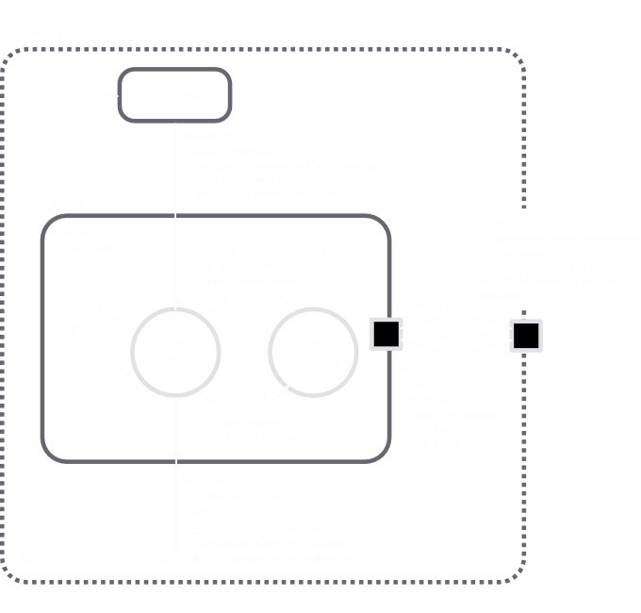

Slide 48
Become
Become or hotswap means that an actor can decide how it should process the next incoming message.
In Akka.NET this is handled by the .Become and .Unbecome methods.
Very useful for creating state machines

Slide 49
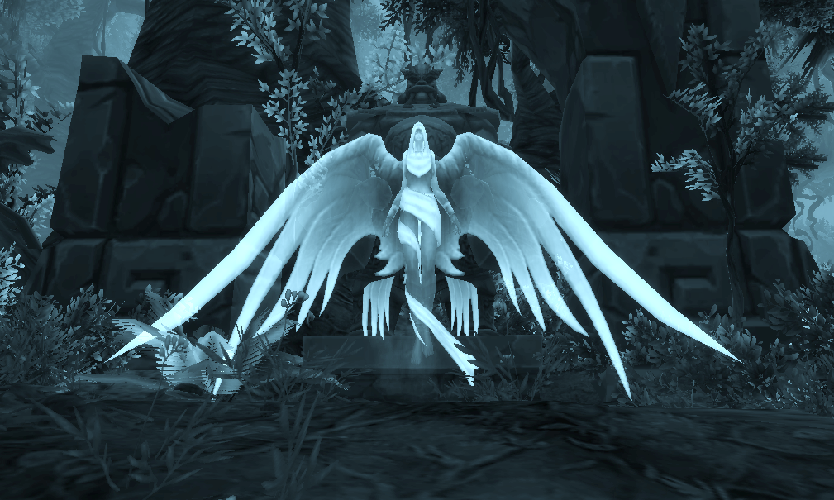
Private void Alive(){
…//other code
if (this.hitpoints <= 0)
this.Become(Dead);
…
}
private void Dead(){
Receive<Resurrect>(_ => {
this.hitpoints = this.maxHitpoints;
this.Become(Alive);
});
}

Slide 50
Other features
Persistence
Cluster
Cluster Sharding
Dependency Injection
Finite State Machines
F# API
Reactive Streams

Slide 51

Before Akka.NET
200-300 simulated Excel workbooks.
Aprox. 7000 Excel celles.
Excel compatible formulas.
Single user per worksheet.

Slide 52
With Akka.NET
800 000 Excel cells.
Multiuser, multiple users editing worksheets – google docs style.
Two devs rewrote the entire system in two weeks.

Slide 53

Before Akka.NET
Legacy system, written around 2000.
One customer per server, SPOF.
Huge amount of synchronization/locking code.

Slide 54
With Akka.NET
85% smaller codebase, code focuses on business logic, Akka.NET handles infrastructure.
High Availability - Failover with Akka.Cluster.

Slide 55
Q & A

Slide 56
FAQ
Akka/NET vs. Project Orleans
http://bit.ly/25KAuzC
Akka/NET vs. Message Queues, e.g. NServiceBus
http://stackoverflow.com/a/13018198
OT, but how did you get the strange arrows and symbols in the code?
https://github.com/tonsky/FiraCode

Slide 57
akka.net
Scale up and out with Akka.NET
Roger Johansson
Akka.NET Co-Founder Twitter: @rogeralsing
Github: rogeralsing
Mail: roger.johansson@betsson.com

