Slide 1
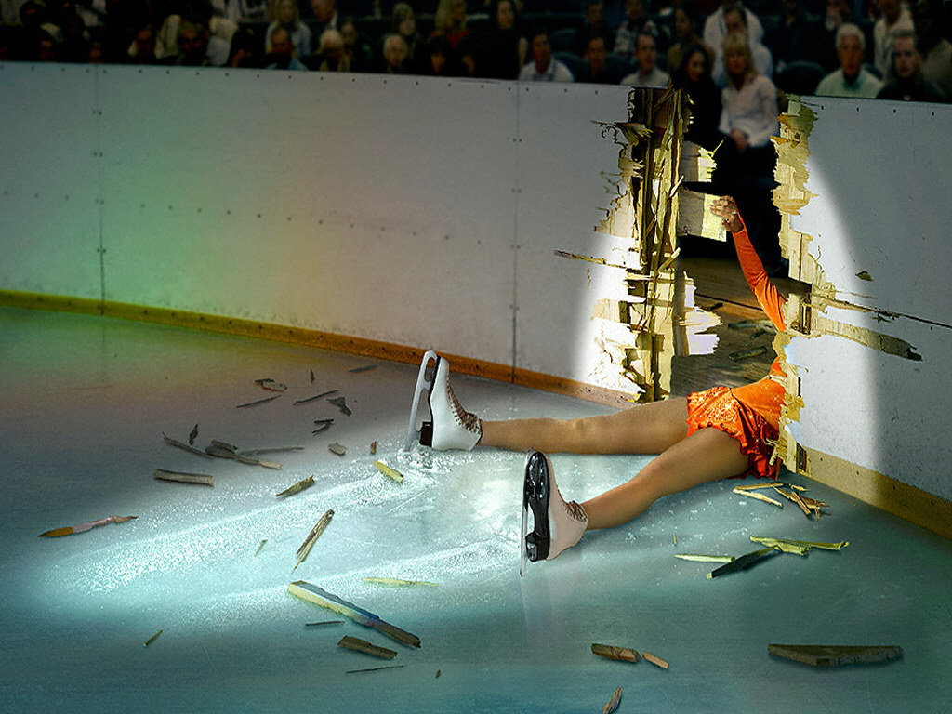
Failing gracefully
With the actor model
Roger Johansson
Akka.NET and Proto.Actor Founder
Solution Architect - Betsson Group
Twitter: @rogeralsing
Github: rogeralsing
Mail: rogeralsing@gmail.com
Github.com/rogeralsing/presentations
http://Proto.Actor

Slide 2
Design for failure
Dealing with, mitigating and preventing failures.
In the small, and at scale.

Slide 3

An escalator can never break: it can only become stairs. You should never see an Escalator Temporarily Out Of Order sign, just Escalator Temporarily Stairs. Sorry for the convenience. -Mitch Hedberg

Slide 4
Bulkheads

Slide 5

Actors

Slide 6
Actor Model
Three axioms:
Send – an actor can send messages to other actors
Create – an actor can create new actors
Become – an actor can decide how to handle it’s next message

Slide 7
Actor Model
”An island of consistency in a sea of concurrency”
”Shared nothing”, ”Black box”
”Location transparent”, ”Distributable by design”

Slide 8
Actor Model
Implementations:
BEAM – Erlang, Elixir, LFE
JVM – Akka, Orbit
.NET – Akka.NET, Proto.Actor, Microsoft Orleans
Go – Proto.Actor

Slide 9
Event-driven thread
Actor
Mailbox
Transport
PID
Behavior
State
Supervision
Children

Slide 10

/
/a1
/a2
/b1
/b1
/b2
/b3
/c1
/c2
/c3
/c4
/c5
Supervision

Slide 11
Consumer 1
Consumer 2
Component

Slide 12
Website
Businesslogic
Data Access

Slide 13
Service guy
Out of beans
Refill beans
Insert coins
Me
Vendor machine
Need more coins
Out of beans!
Gets coffee

Slide 14
Supervisor
Application error
Manage failures
Request
Client
Service
Validation error
Response

Slide 15
Error Kernel
/
99.9999999% uptime ~0.03 sekunder downtime per år
OneForOne supervisor
/a1
/a2
AllForOne supervisor
/b1
/b1
/b2
/b3
/b3
/c1
/c2
/c3
/c4
/c5

Slide 16
Let it crash
Protect state by delegating work
parent
Performs work, can be restarted
child

Slide 17

Mitigating Failures

Slide 18
Exponential Backoff
parent
Delay
child
Attempts

Slide 19
Circuit Breaker
DB Actor
DB Query
DB Up
DB Result
DB Query
DB Down
DB Error

Slide 20
Akka Remote Associations
Idle
Active
Quarantined
Gated

Slide 21
Active Passive Consumers
Node 1
Primary
Queue
Node 2
Secondary

Slide 22
Consistent Hash Pairs
Hash Slot 1
Queue
Hash Slot 2
Hash Slot 3

Slide 23
Fan out and quickest reply
Fan out
?
Worker 1
Consumer
?
Router
?
Worker 2
?
Worker 3

Slide 24
Fan out and quickest reply
Return first reply
!
Worker 1
Consumer
!
Router
!
Worker 2
!
Worker 3

Slide 25
N-Modular Redundancy
Require same reply from at least N workers
!
Worker 1
Consumer
!
Router
!
Worker 2
!
Worker 3

Slide 26
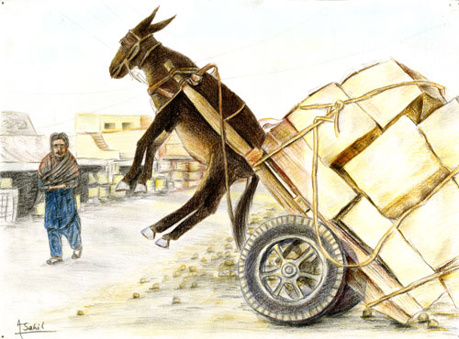
Dealing with load

Slide 27
Throttling
Add a delay after each message

Slide 28
Throttling
Limit messages per time slice

Slide 29
Bounded Mailboxes
Mailbox
Actor

Slide 30
Bounded Mailboxes
Mailbox
Actor

Slide 31
Limit Concurrency
Limit concurrent access to a resource
4
1
Worker 1
4
3
2
1
Router
2
Worker 2
3
Worker 3

Slide 32
Work Pulling
Producer
Send work
Worker 1
Work to be done
Work Done
Send work
Worker 2
Work to be done
Work Done

Slide 33

Virtual Actors
Always Exists, Never Fails

Slide 34




Slide 35
Virtual Actors

Slide 36
Node A
433
Hash:
989123
Grain Id:
Roger
Node E
943772
Node B
24345
Node C
82327

Slide 37
Node A
433
Hash:
989123
Grain Id:
Roger
Node E
943772
Node B
24345
Names: Roger
Node C
82327

Slide 38
Node A
433
Hash:
989123
Grain Id:
Roger
Node E
943772
Node B
24345
Names: Roger
Actors:
Roger : User
Node D
612344
Node C
82327

Slide 39
Node A
433
Node F
987234
Hash:
989123
Names: Roger
Grain Id:
Roger
Node E
943772
Node B
24345
Actors:
Roger : User
Node D
612344
Node C
82327

Slide 40
Node F
987234
Hash:
989123
Names: Roger
Grain Id:
Roger
Node B
24345
Actors:
Roger : User

Slide 41
Virtual Actors
Node A
433
Node F
987234
Hash:
989123
Names: Roger
Grain Id:
Roger
Node E
943772
Node B
24345
Names: Roger
Actors:
Roger : User
Node D
612344
Node C
82327

Slide 42
Consul A
Consul F
Consul E
Consul B
Consul D
Consul C

Slide 43
Node A
433
Consul
Node F
987234
Consul
Node E
943772
Node B
24345
Consul
Consul
Node D
612344
Consul
Node C
82327
Consul

Slide 44
Akka Cluster Sharding
Coordinator

Slide 45
The End
Roger Johansson
Twitter: @rogeralsing
Github: rogeralsing
Mail: rogeralsing@gmail.com
Github.com/rogeralsing/presentations
http://Proto.Actor

