Slide 1
OS & CN PROJECT · PRODUCT 8 · GROUP VIII
Industrial Machine
Log Integrity Checker
ONE BIT, ONE DIFFERENT READING
'0' · ASCII 48
Detecting corrupted or tampered machine logs with a hand-written CRC-32 built on modulo-2 division.
0
0
1
1
0
0
0
0
SR University · Operating Systems & Computer Networks
'1' · ASCII 49
0
0
1
1
0
0
0
1
TEAM RESPONSIBILITY & DEMONSTRATION ROLES:
— Project Lead & Architecture: Problem statement, product overview & dataset management (Slides 1 & 2)
— Algorithm Lead: Galois field GF(2) math, Modulo-2 XOR logic & CRC-32 division (Slides 3 & 4)
— Data Ingestion Lead: ASCII-to-binary mapping, file upload parsing & UI integration (Slides 4 & 5)
— Backend & Telemetry Lead: Flask REST API, session divisor & live step telemetry (Slides 5 & 6)
— QA & Verification Lead: Testing matrix (TC-01..TC-05), error simulation & summary (Slides 7 & 8)
RPM:3450 → RPM:3451
Flip the last bit of one character and the log reports a different value.
github.com/rogeralukka/OS-CN-Product-8
Notes:
Introduce the project: a checker that detects whether a machine log was corrupted or tampered with in transit. The card on the right is the whole idea in one picture: one flipped bit turns a 0 into a 1.

Slide 2



01 · THE PROBLEM
A single flipped bit can change a sensor reading
Electrical noise
Motors, drives and long cable runs inject interference that flips bits in transit.
WHY IT MATTERS
TEMP:82.4C
↓
Hardware faults
TEMP:92.4C
A failing buffer or memory cell silently alters a log that was stored correctly.
Flipping one bit of '8' makes it '9'. A normal reading becomes a false shutdown, or a real fault goes unseen.
In-flight tampering
Plaintext logs can be edited between the machine and the gateway without anyone noticing.
OUR APPROACH
Send a 32-bit CRC with every log. The receiver recomputes it and flags any mismatch.
Industrial Machine Log Integrity Checker
2
Notes:
Industrial links are noisy. '8' and '9' differ by one bit, so one bit flip changes 82.4C to 92.4C. We need a cheap way to detect that.

Slide 3
02 · HOW IT WORKS
The sender computes a CRC; the receiver re-divides to check it
Log text
one machine log line
ASCII → binary
8 bits per character
Pad with 32 zeros
M · 2³²
Divide by G(x)
modulo-2 XOR division
CRC = remainder
32 bits sent with the log
SENDER
computes the CRC
Log + CRC arrive
received M′ and R′
Build codeword
bits(M′) + R′
Divide by same G(x)
shared session divisor
Remainder = 0?
check all 32 bits
✓ ACCEPT
remainder = 0…0
RECEIVER
verifies the log
✗ REJECT
remainder ≠ 0
Both sides use the same 33-bit divisor G(x), fixed for the whole session.
Industrial Machine Log Integrity Checker
3
Notes:
Walk the top lane left to right, then the bottom lane. The receiver never needs the original log: it only needs the received log, the received CRC and the shared divisor.

Slide 4
03 · THE MATH
Modulo-2 arithmetic makes the check exact
XOR rules in GF(2)
Why the receiver expects a zero remainder
a | b | a ⊕ b
0 | 0 | 0
0 | 1 | 1
1 | 0 | 1
1 | 1 | 0
SENDER DIVIDES
M(x)·x³² = Q(x)·G(x) ⊕ R(x)
CODEWORD SENT
T(x) = M(x)·x³² ⊕ R(x)
SUBSTITUTE
T(x) = Q(x)·G(x) ⊕ R(x) ⊕ R(x)
CANCEL
R ⊕ R = 0, so T(x) = Q(x)·G(x)
Addition and subtraction are the same operation. No carries, no borrows, so long division reduces to repeated XOR.
RESULT
T(x) mod G(x) = 0
Industrial Machine Log Integrity Checker
4
Notes:
This is the proof examiners like. Key move: R XOR R = 0, so the codeword is an exact multiple of G(x).

Slide 5



04 · THE DIVISOR
One 33-bit divisor, fixed for the whole session
G(x): example session divisor, 33 bits
1
0
0
0
0
1
0
1
0
1
0
0
1
1
0
0
0
1
1
0
1
1
1
1
1
0
1
0
0
0
1
1
1
always 1
31 random bits, chosen once by crcgen()
always 1
Why 33 bits?
Generated once
Not the IEEE polynomial
A degree-32 polynomial has 33 coefficients. Dividing by it leaves at most 32 bits, and that remainder is the CRC.
The divisor is created on first use and stored in GENERATOR. Sender and receiver share it for the whole session.
The project spec uses a random divisor. That is fine for a demo; real systems use a standard, well-studied polynomial.
Industrial Machine Log Integrity Checker
5
Notes:
The first and last bits are always 1. That guarantees a real degree-32 polynomial with a constant term, which is what gives the burst-error guarantee later.

Slide 6
05 · IMPLEMENTATION
crc_checker.py: the whole algorithm in about 25 lines
ascii2binary
compute_crc and verify
def ascii2binary(text):
result = ""
for ch in text:
result += f"{ord(ch):08b}"
return result
def compute_crc(text):
bits = ascii2binary(text)
padded = bits + '0' * 32
return xordiv(padded, get_divisor())
def verify(text, received_crc):
bits = ascii2binary(text)
codeword = bits + received_crc
remainder = xordiv(codeword, get_divisor())
return remainder == '0' * 32
xordiv: modulo-2 long division
def xordiv(dividend, divisor):
d = list(dividend)
m = len(divisor) # 33
for i in range(len(d) - m + 1):
if d[i] == '1':
for j in range(m):
d[i+j] = '1' if d[i+j] != divisor[j] else '0'
return ''.join(d[-(m-1):]) # last 32 bits
Say this in the viva
xordiv flips bits in place; no zlib, no libraries
The remainder is the last 32 bits after division
Sender and receiver call the same get_divisor()
Industrial Machine Log Integrity Checker
6
Notes:
Read xordiv aloud: whenever the current leading bit is 1, XOR the divisor into the window. When the loop ends, the last 32 bits are the remainder.

Slide 7
06 · WHY CRC
Why CRC-32 beats parity bits and checksums
WEAK
BASIC
STRONG
Parity bit
Additive checksum
CRC-32 (this project)
CATCHES
Any odd number of flipped bits
MISSES
Any even number: two flips cancel out
OVERHEAD
1 bit per byte
CATCHES
Many random errors
MISSES
Compensating changes and reordered bytes
OVERHEAD
16 to 32 bits
1 in 4.3 billion
chance that a long random error goes unnoticed (1 / 2³²)
ALWAYS CATCHES
Every single-bit error
Every burst up to 32 bits
OVERHEAD
32 bits per message
Bursts of exactly 33 bits slip through with probability 2⁻³¹, longer ones with 2⁻³². Extra guarantees, such as every double-bit or every odd-count error, depend on the polynomial chosen, and a random divisor does not provide them.
Industrial Machine Log Integrity Checker
7
Notes:
Be honest about the limits: the guarantees listed on the CRC card hold for any divisor whose first and last bits are 1. Double-bit and odd-count guarantees are properties of specific polynomials.

Slide 8
07 · BACKEND API
Two JSON endpoints drive the whole UI
POST
/api/compute
POST
/api/verify
// request
{ "log": "TURBINE_01 RPM:3450" }
// response
{
"crc": "00110110011110110100011100100100",
"divisor": "100001010100110001101111101000111",
"steps": {
"binary": "0101010001010101...",
"padded": "...00000000000000000000000000000000",
"remainder": "00110110011110110100011100100100",
"hex": "367B4724"
}
}
// request
{
"log": "TURBINE_01 RPM:3450",
"crc": "00110110011110110100011100100100"
}
// response
{
"accepted": true,
"divisor": "100001010100110001101111101000111",
"steps": {
"codeword": "...00110110011110110100011100100100",
"remainder": "00000000000000000000000000000000"
}
}
GET /api/divisor returns the session divisor, so the UI can show it in STEP 4.
Industrial Machine Log Integrity Checker
8
Notes:
The steps object is what the frontend uses to fill in the Process Steps panels. Every value on this slide was produced by running the same xordiv logic.

Slide 9
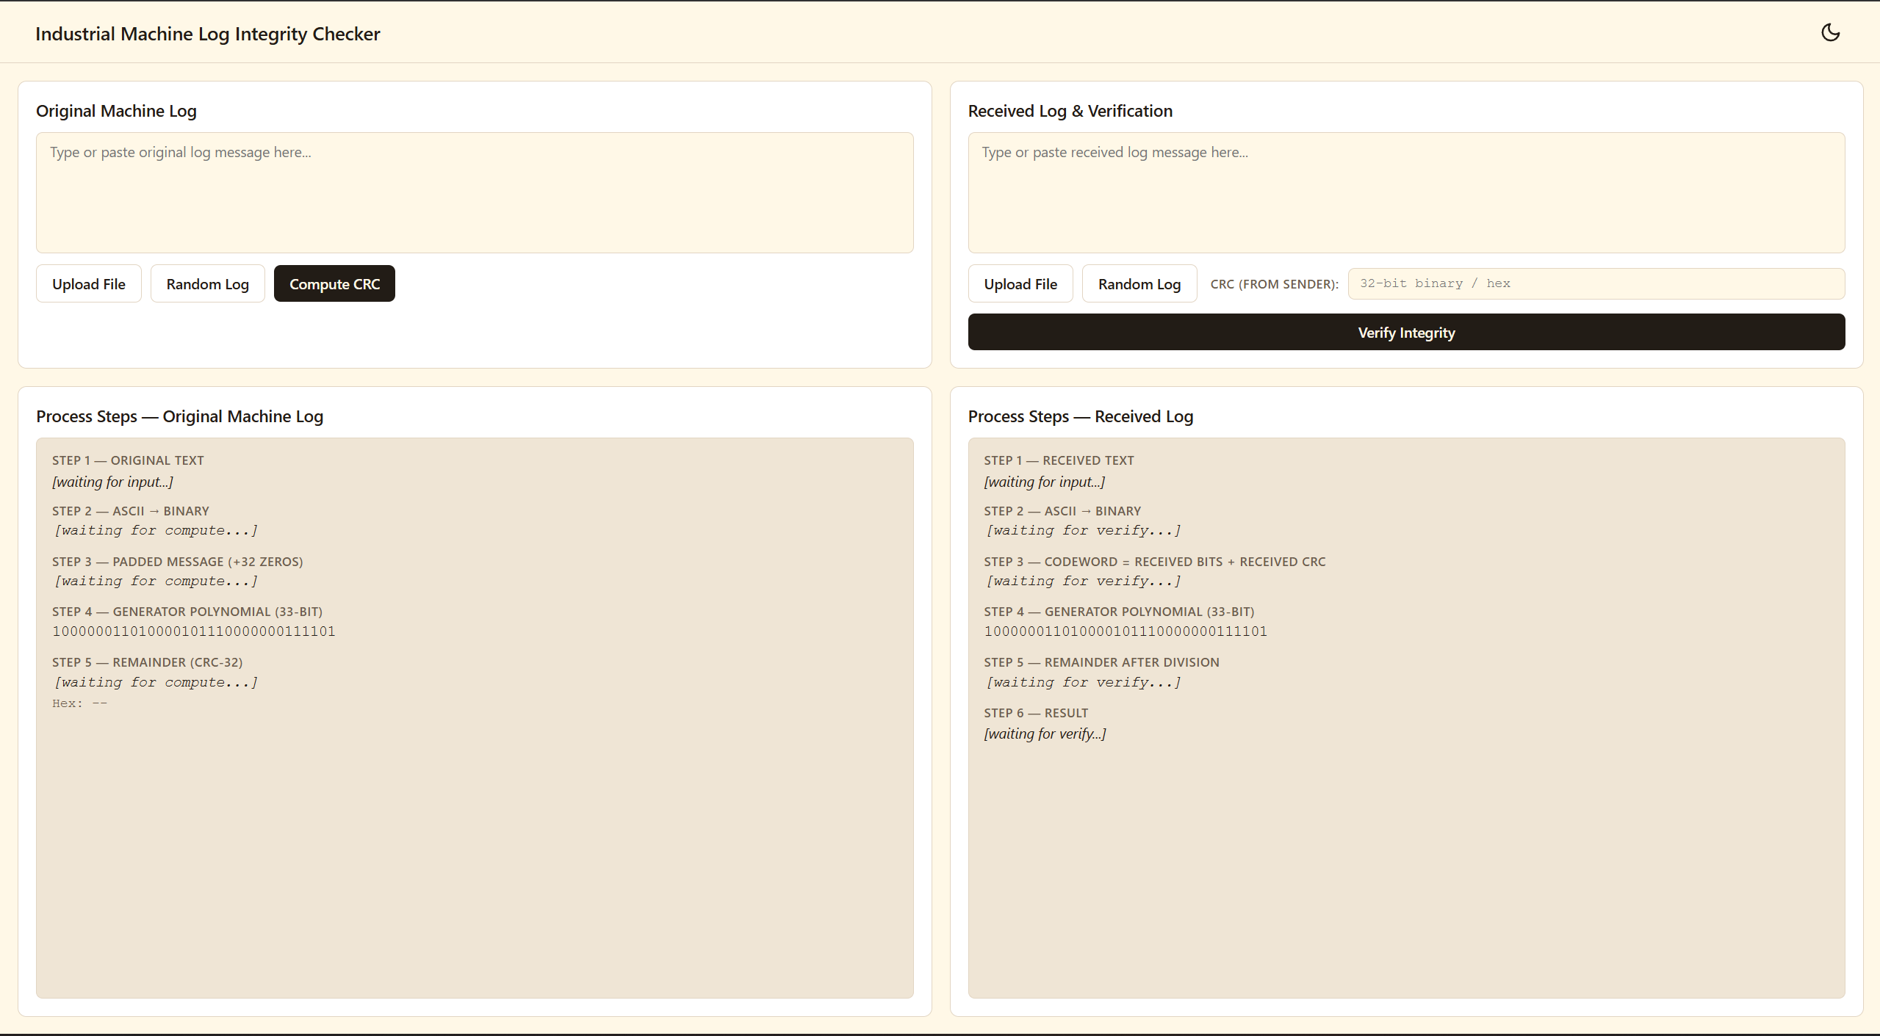




08 · FRONTEND
One-screen dashboard: inputs on top, workings below
Two-row layout
Inputs on top, live process steps below. Fits one screen with no page scroll.
Every step visible
ASCII to binary, padding, divisor, remainder and hex, shown as they happen.
Files and random logs
Upload .txt, .log or .md with FileReader, or generate a random machine log.
Light and dark theme
CSS variables and one toggle; the choice is saved in localStorage.
Industrial Machine Log Integrity Checker
9
Notes:
Sketch of the final layout. The compact ACCEPT/REJECT chip sits under the received-side steps.

Slide 10
09 · RESULTS
Tested: intact, mutated, and forged-checksum logs
CASE 1
CASE 2
CASE 3
Authentic log
One-bit mutation
Tampered checksum
Nothing changed in transit.
One character flipped: '0' → '1' (a single bit).
The log is intact; 8 bits of the CRC were flipped.
RECEIVED LOG
RECEIVED LOG
RECEIVED LOG
TURBINE_01 RPM:3450
TURBINE_01 RPM:3451
TURBINE_01 RPM:3450
CRC RECEIVED
CRC RECEIVED
CRC RECEIVED
00110110 01111011 01000111 00100100
00110110 01111011 01000111 00100100
11001001 01111011 01000111 00100100
REMAINDER
REMAINDER
REMAINDER
00000000 00000000 00000000 00000000
00001010 10011000 11011111 01000111
11111111 00000000 00000000 00000000
✓ ACCEPT
✗ REJECT
✗ REJECT
Values produced with the same ascii2binary and xordiv code, using the example divisor from slide 5.
Industrial Machine Log Integrity Checker
10
Notes:
Case 2 flips one bit of one character. Case 3 leaves the log alone and corrupts the CRC. Both leave a non-zero remainder, so both are rejected.

