Slide 1
Bayesian Inference
MsC in Data Science – University of Barcelona

Slide 2
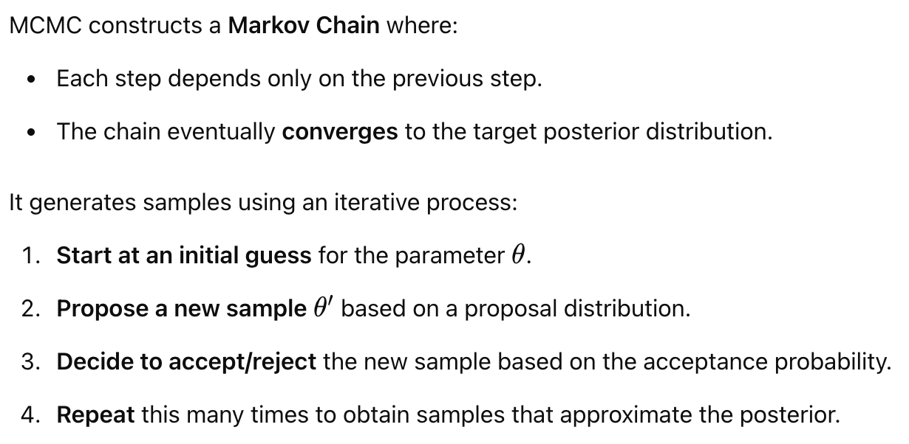
The MCMC Algorithm

Slide 3
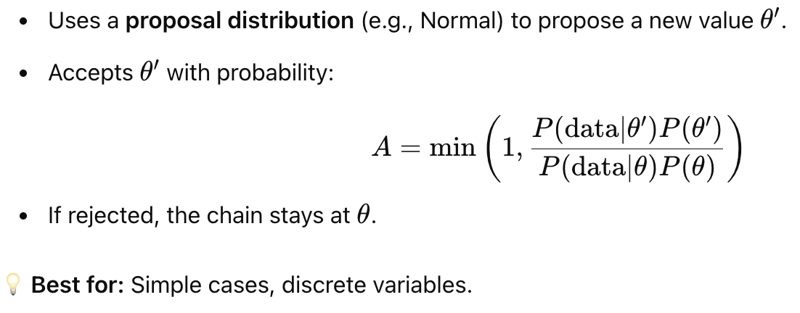
Metropolis-Hastings Algorithm

Slide 4
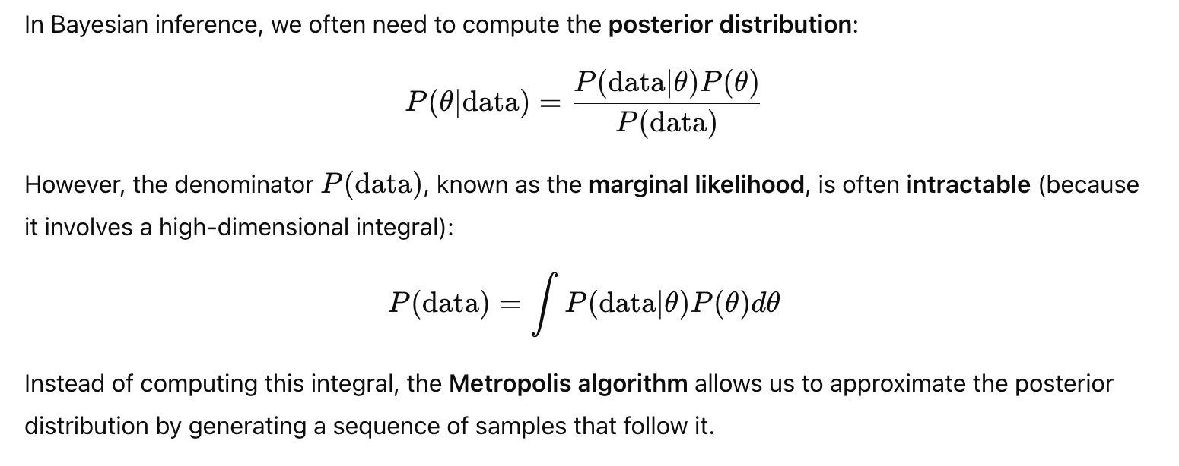
Deep Dive into Metropolis Algorithm

Slide 5
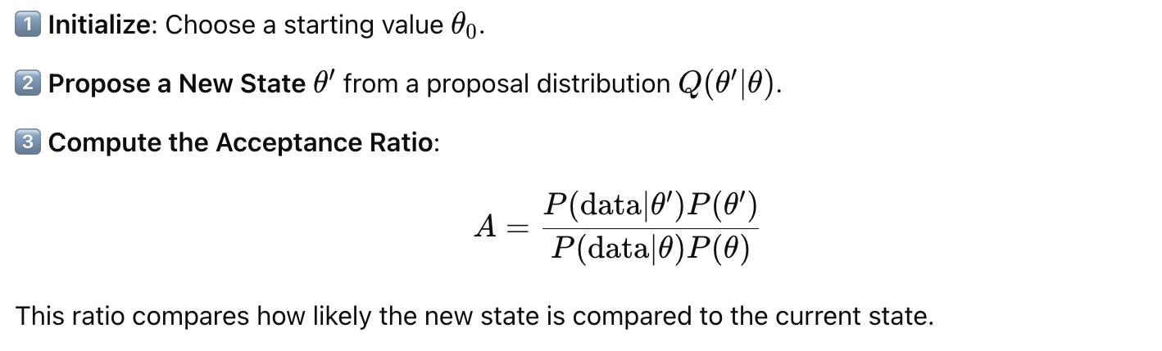
How does it work? (I)

Slide 6
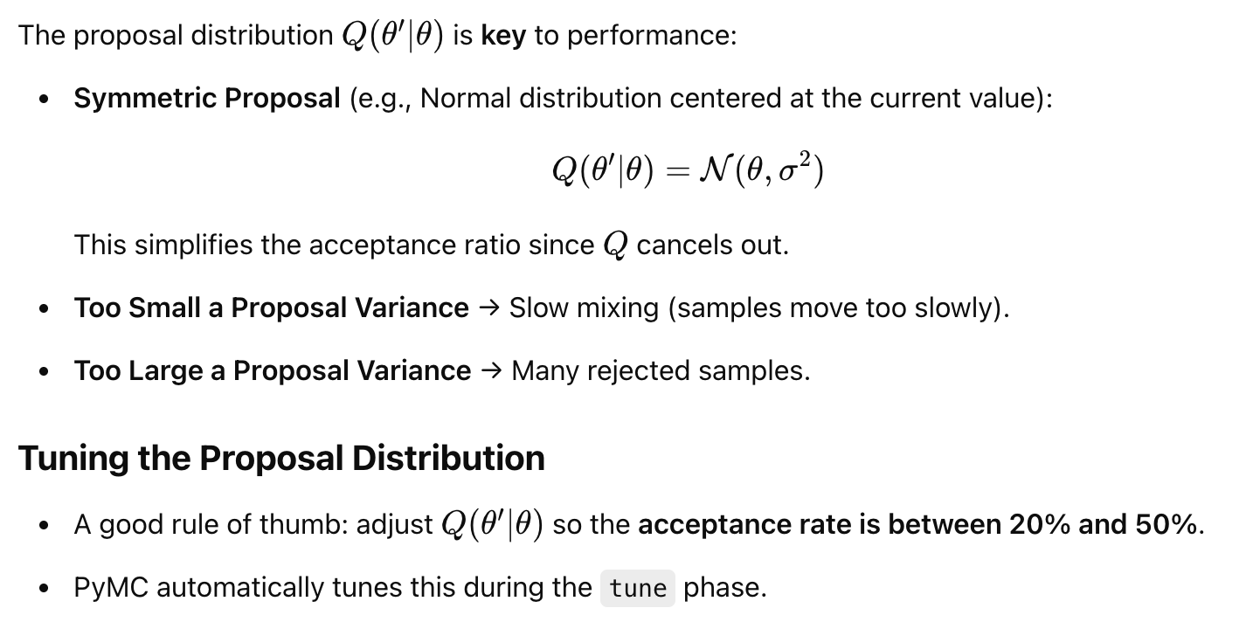
Choosing the Q distribution

Slide 7
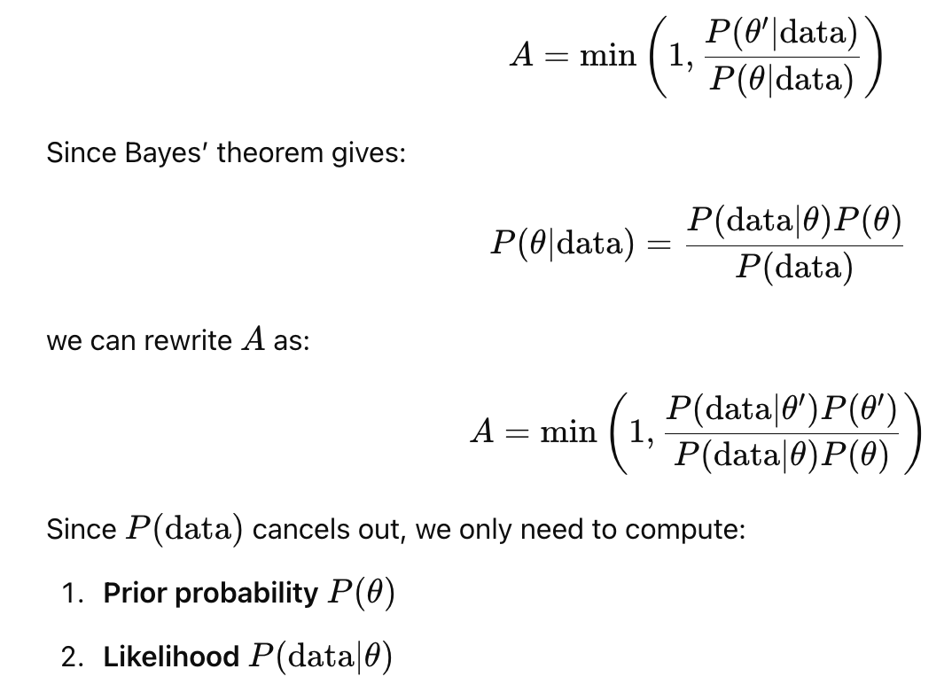
How to calculate the A?

Slide 8
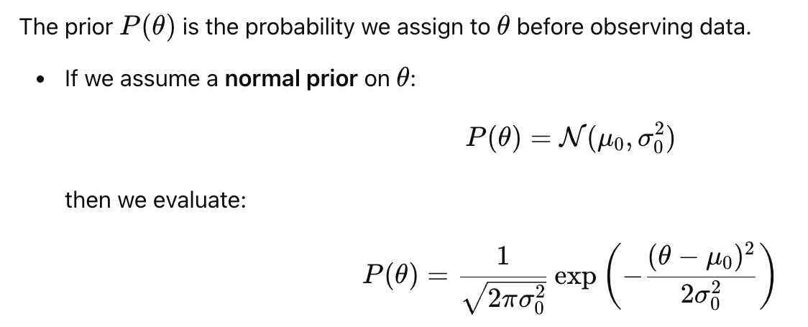
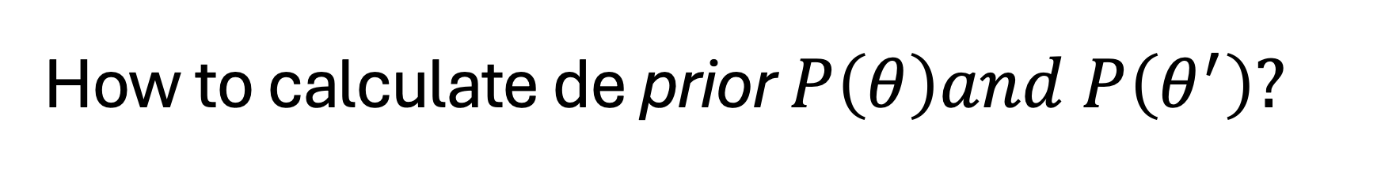
How to calculate de prior $P\left(θ\right)and P\left(θ^{′}\right)?$

Slide 9
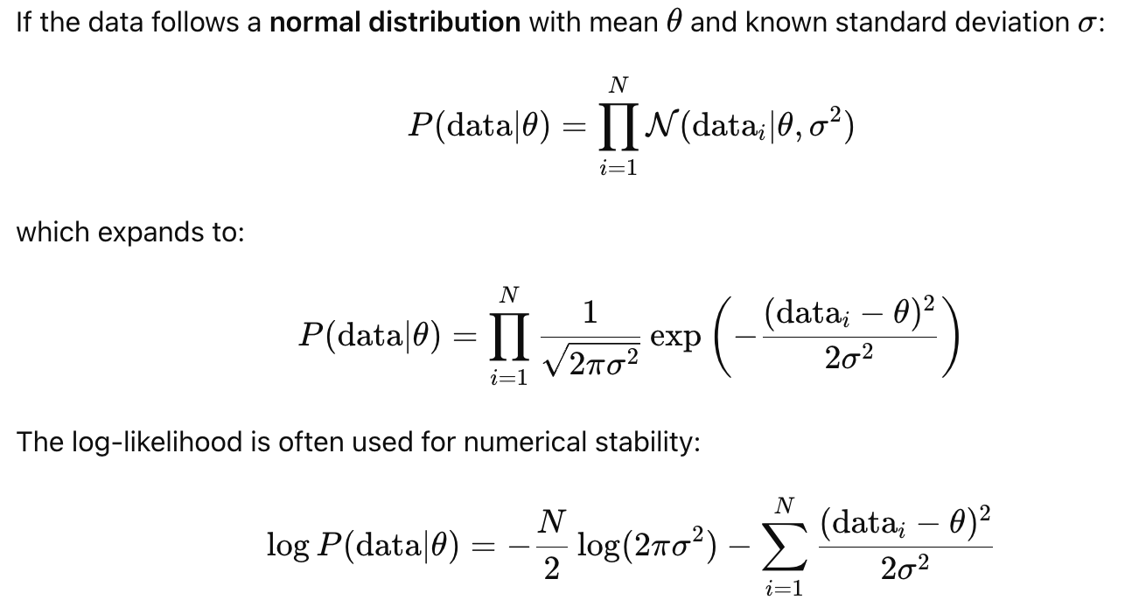
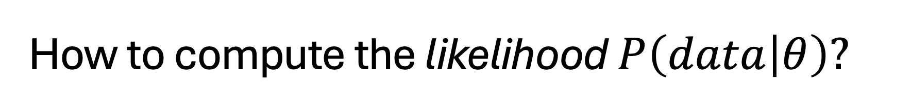
How to compute the likelihood $P\left(data | θ\right)?$

Slide 10
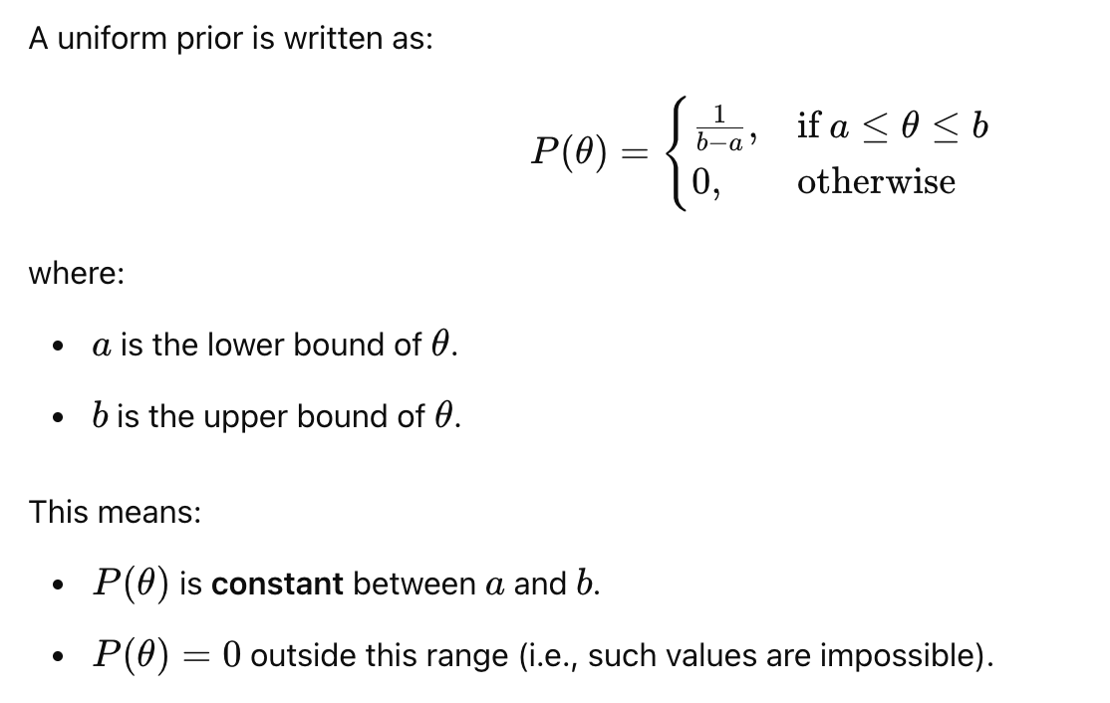
If the prior is a Uniform…

Slide 11
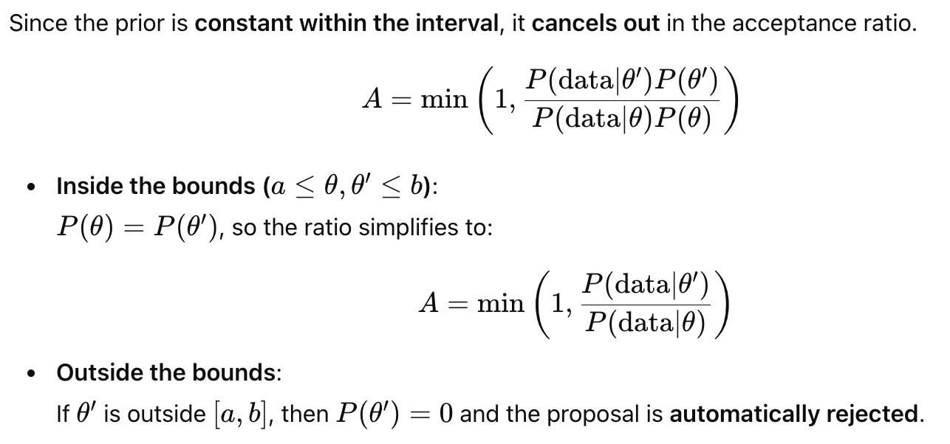
If the prior is a Uniform…

Slide 12
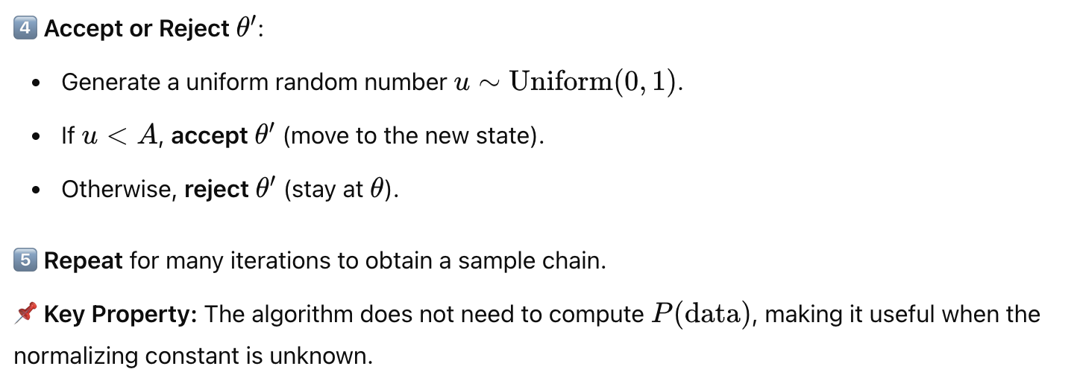
How does it work? (II)

Slide 13
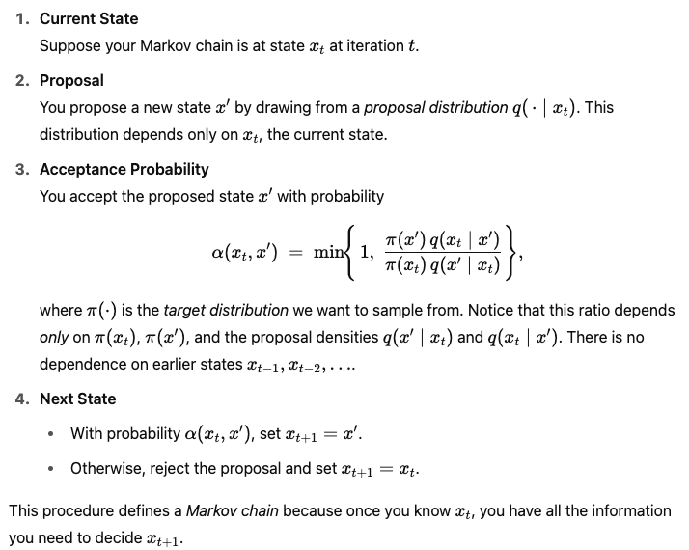
Why the Markov Property is important?
In the Metropolis-Hastings (MH) algorithm, the Markov property ensures that the next sample in your chain depends only on the current sample, not on the full history of how you got there

Slide 14
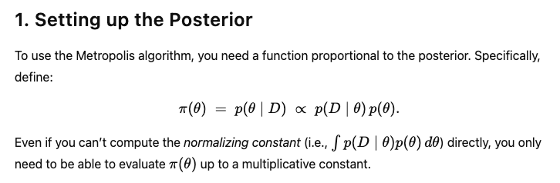
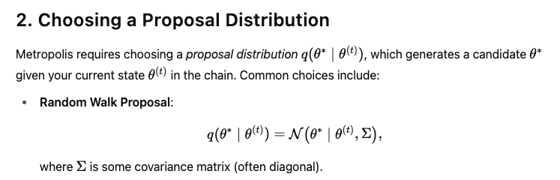

How does it apply to Bayesian Inference?

Slide 15
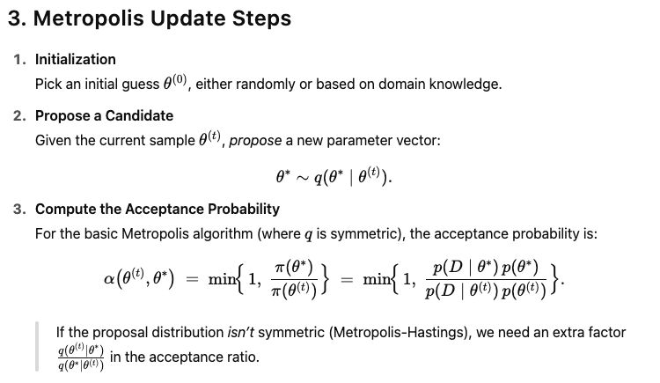
How does it apply to Bayesian Inference?

Slide 16
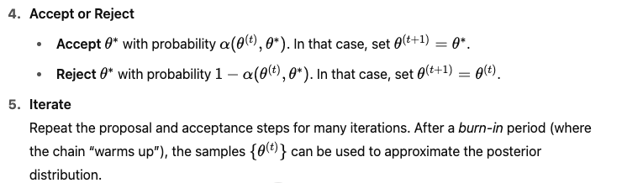
How does it apply to Bayesian Inference?

Slide 17
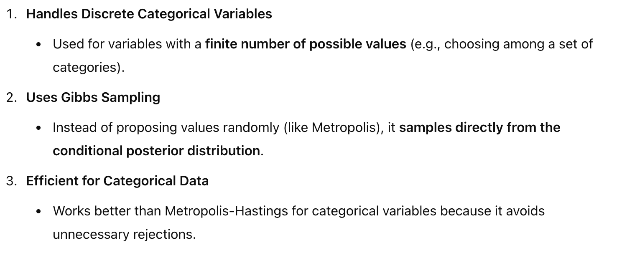
Categorical Gibbs Metropolis Algorithm

