Slide 1
Bayesian Inference
MsC in Data Science – University of Barcelona

Slide 2

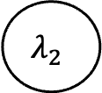

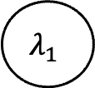



$$λ_{1}$$
$$λ_{2}$$
$$Unif(0,5)\sim$$
$$\sim Unif(0,5)$$
or
or
$$Exp(10)\sim$$
$$\sim Exp(3)$$
Observed data
$$\sim Poiss(λ_{1},λ_{2})$$

Slide 3




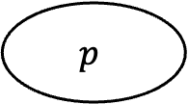

$$p$$
$$\sim Uniform(0,1)$$
$$Cluster_{0}$$
$$Cluster_{1}$$
$$Normal(μ_{0},σ_{0})\sim$$
$$\sim Normal(μ_{1},σ_{1})$$
Observed data

Slide 4





$$p$$
$$\sim Uniform(0,1)$$
$$Centers$$
$$Taus$$
$$Normal([120,190],[10,10])\sim$$
$$\sim Uniform(0,100)$$
$$Normal\left({(μ}_{0},μ_{1}\right),{(σ}_{0},σ_{1}))\sim$$
Observed data

Slide 5
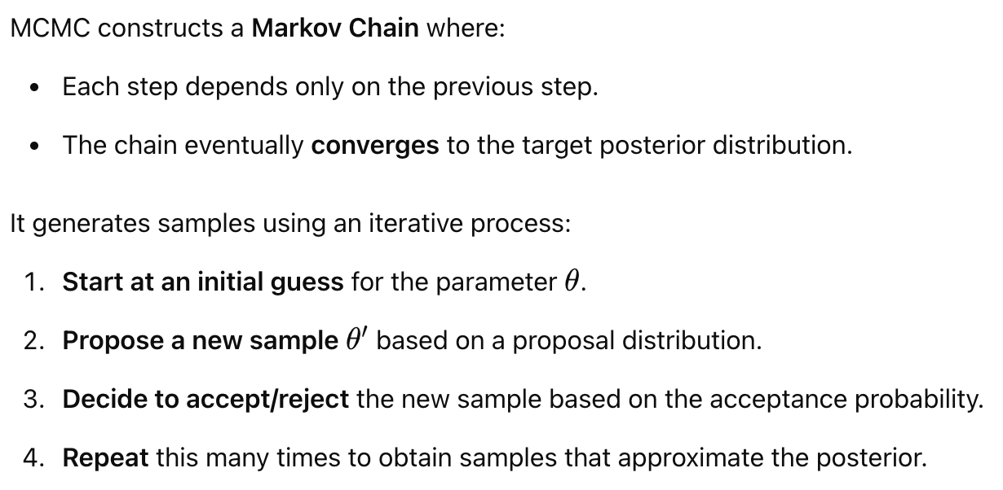
The MCMC Algorithm

Slide 6
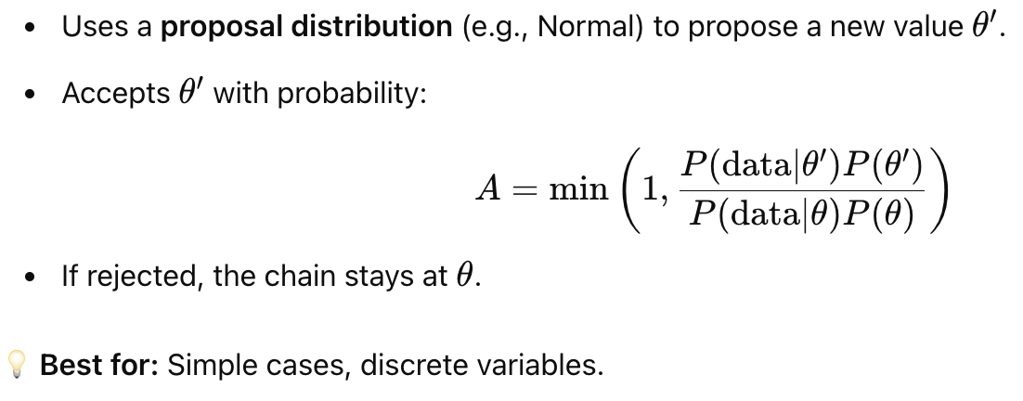
Metropolis-Hastings Algorithm

Slide 7
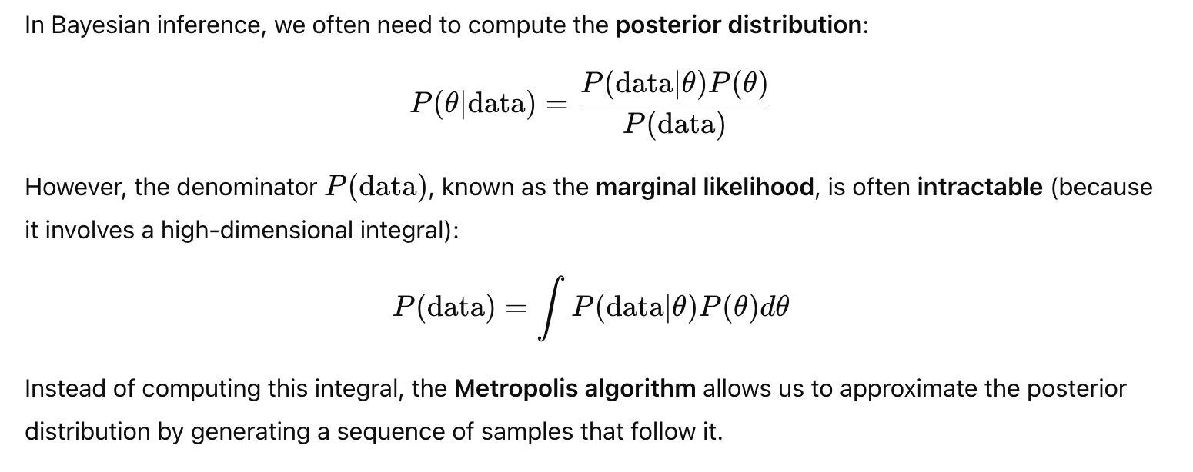
Deep Dive into Metropolis Algorithm

Slide 8
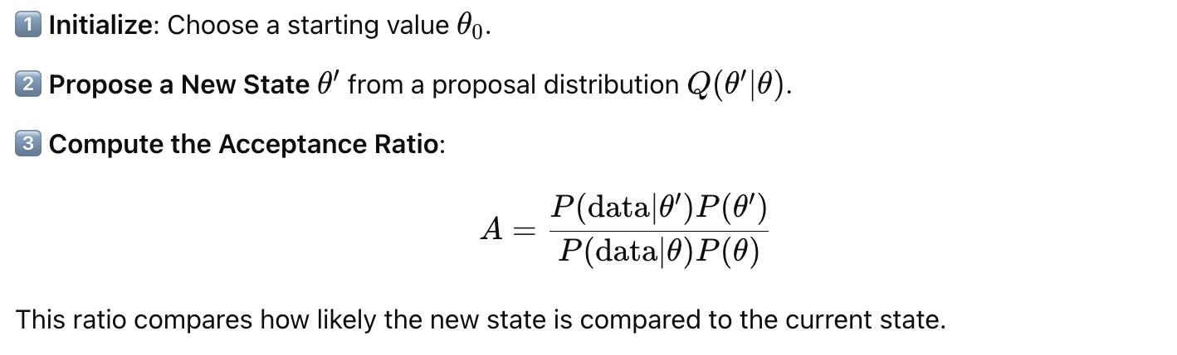
How does it work? (I)

Slide 9
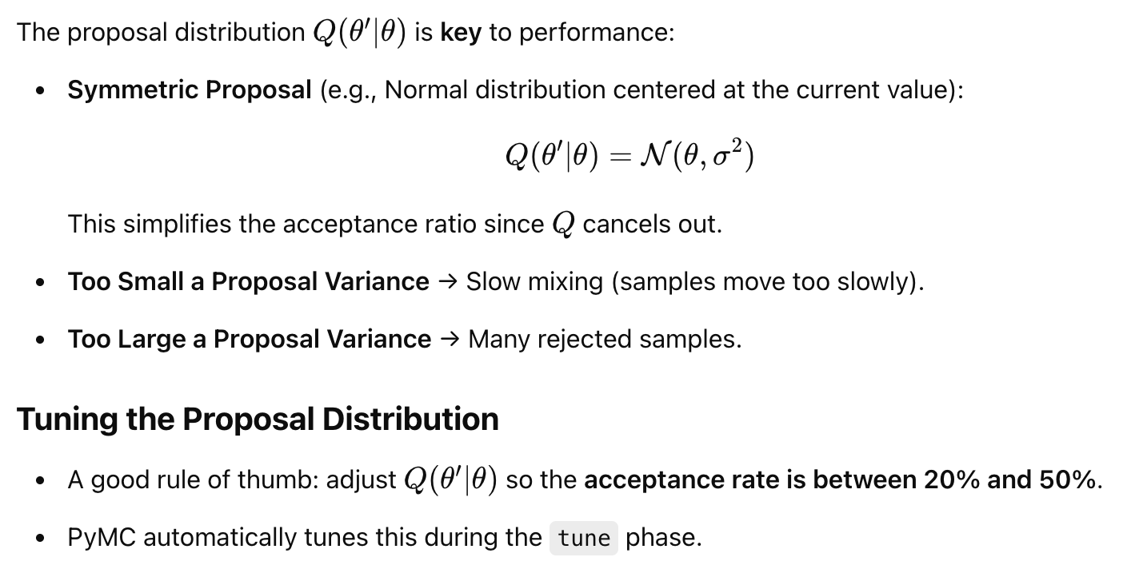
Choosing the Q distribution

Slide 10
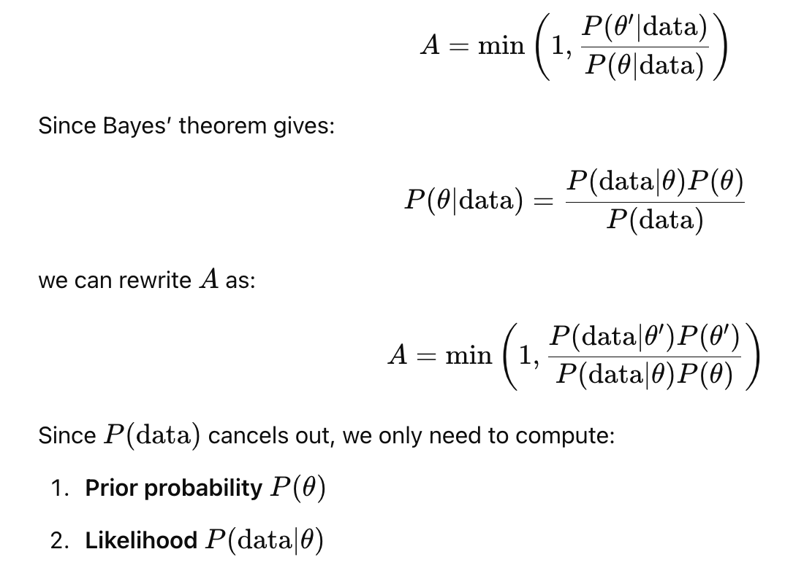
How to calculate the A?

Slide 11
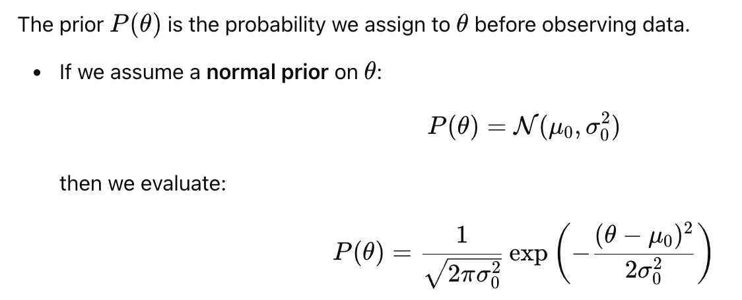

How to calculate de prior $P\left(θ\right)and P\left(θ^{′}\right)?$

Slide 12
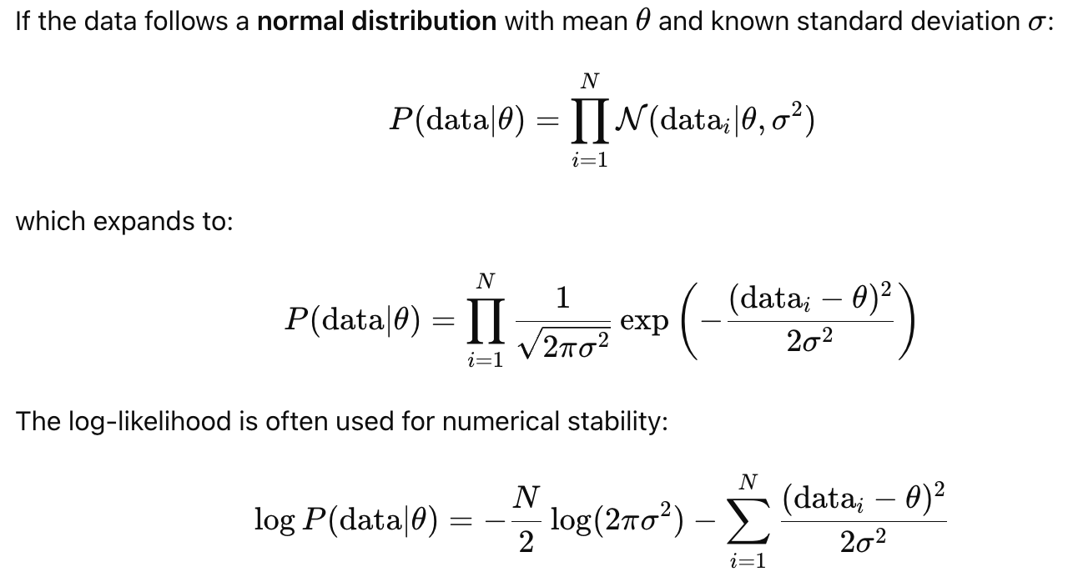

How to compute the likelihood $P\left(data | θ\right)?$

Slide 13
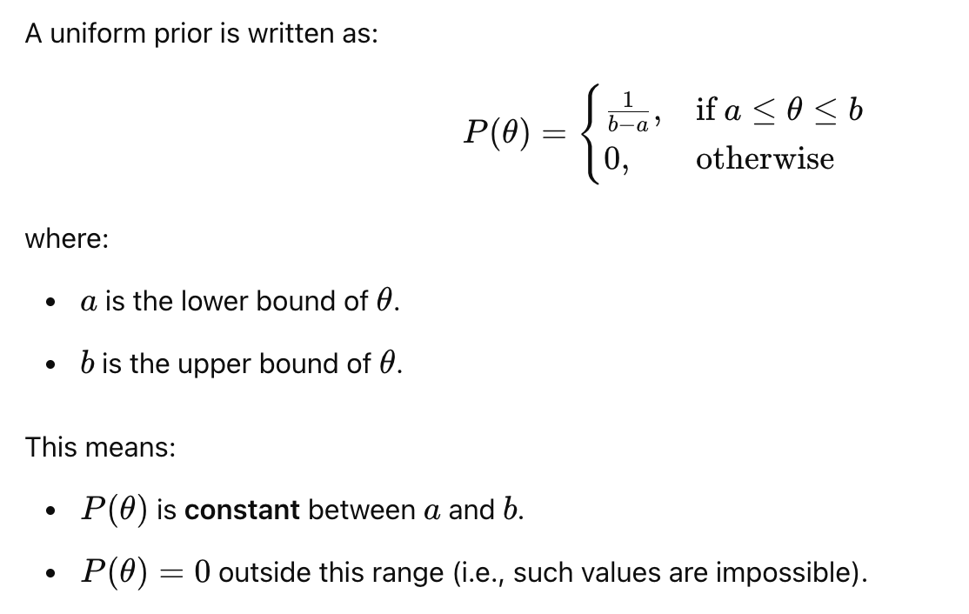
If the prior is a Uniform…

Slide 14
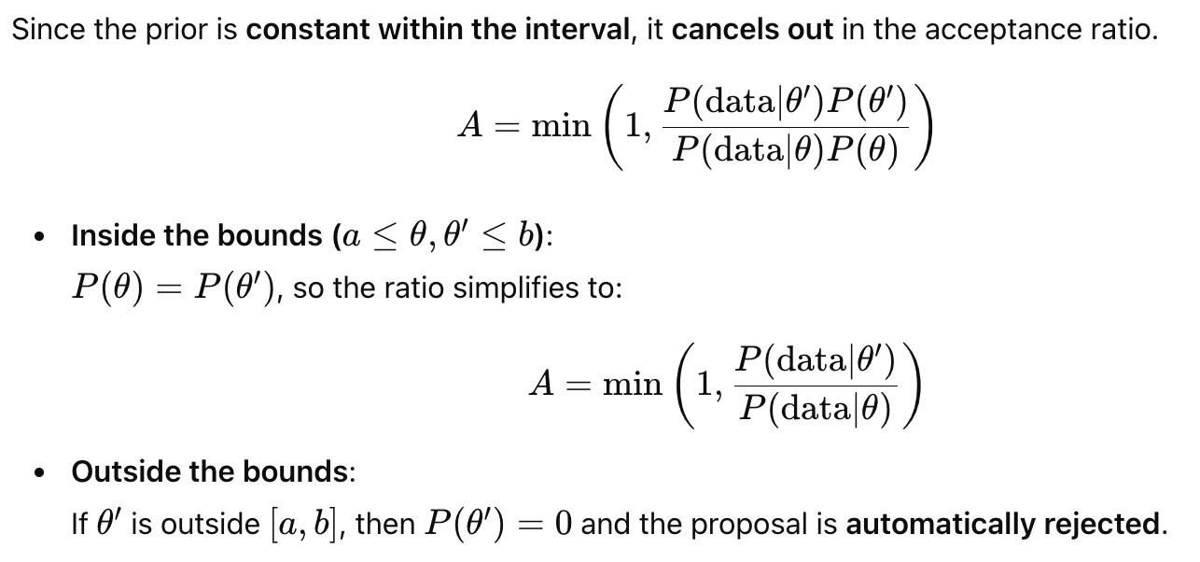
If the prior is a Uniform…

Slide 15
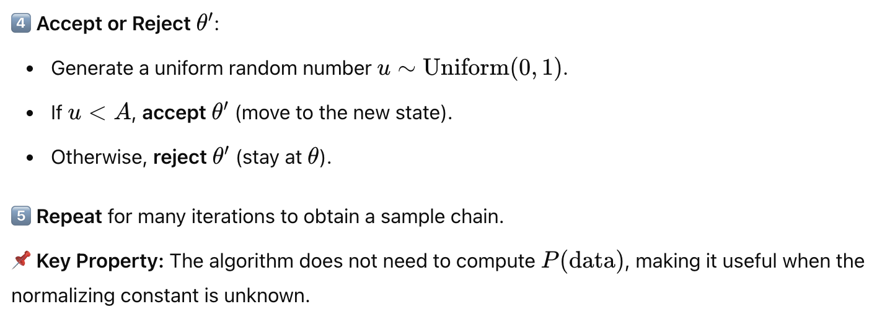
How does it work? (II)

Slide 16
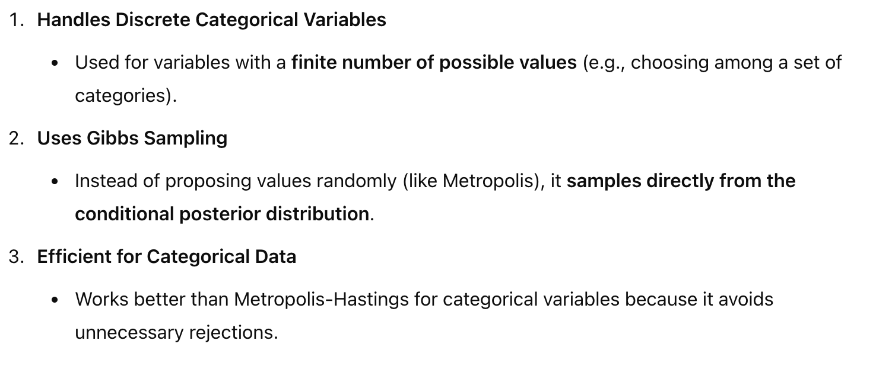
Categorical Gibbs Metropolis Algorithm

