Slide 1

UX: Ian Dodson UI: Roger Benjume Back End: Alex Moomaw Kevin Nguyen Project Manager: Amy Washington
http 418

Slide 2

The Tea Spot
A blog about
Not much else
Teapots
Tea

Slide 3

Tools:
Figma Graphics editng and user interface design
Adobe Creative Cloud Logo and custom icons

Slide 4






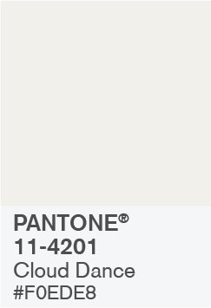

color scheme

Slide 5

FRONTEND Development
The JQuery library will be used to facilitate more complex user behavior such as pagination, etc
JavaScript and CSS will be used to handle small page animations and styling

Slide 6

Backend development
Tools:
JavaScript for interactivity
Data storage using Laragon and MySQL
React for simplifying the development process

