Slide 1
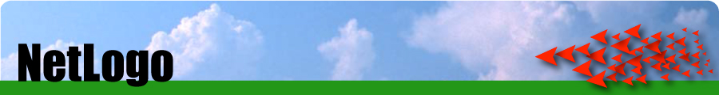
NetLogo
Free!
Uses Java in the background
Multi platform
Can be converted into applets (and embedded in websites)
Great for quickly putting a model together and thinking through ideas
Easy to build
Easy to interact with models
East to extract data and create plots
Excellent documentation: http://ccl.northwestern.edu/netlogo/docs/

Slide 2
NetLogo Web
No need to download the app (though some advanced functions are not available)
Google ‘NetLogo home page’
Netlogo home page > NetLogo Web
https://www.netlogoweb.org/launch#https://www.netlogoweb.org/assets/modelslib/Sample%20Models/Social%20Science/Traffic%20Basic.nlogo
Make sure the mode is ‘interactive’

Slide 3
Useful resources
‘Netlogo programming guide’: https://ccl.northwestern.edu/netlogo/docs/programming.html
‘NetLogo Dictionary’ (for code syntax): https://ccl.northwestern.edu/netlogo/docs/dictionary.html

Slide 4
NetLogo
Components of a NetLogo model
Interface (direct interact with the model using control knobs)
Command centre (direct interact with the model using command)
Code
Model Info (description, metadata, etc)

Slide 5
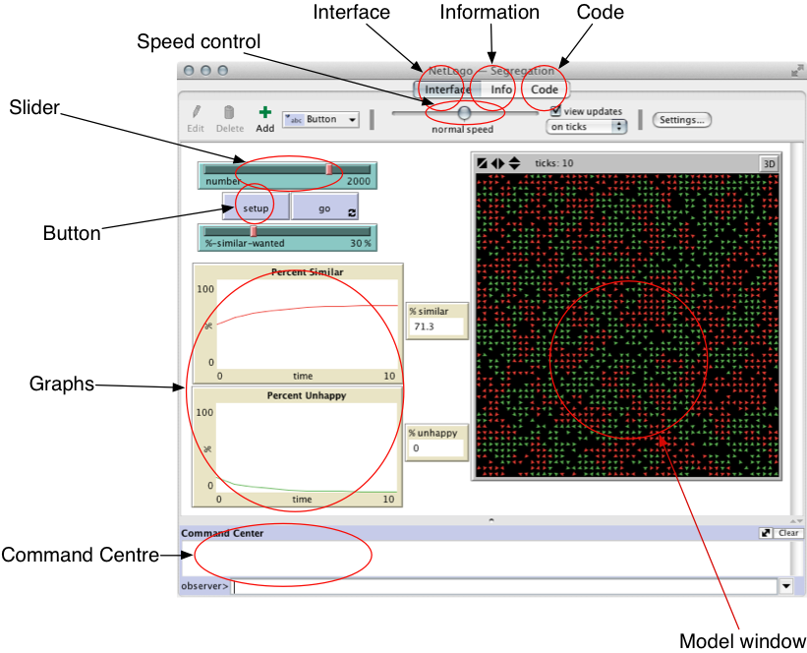
Interface and Command Centre
There are two parts:
the top part shows outputs from the model
the bottom part (command centre) allows you to enter commands that are sent to the model.

Slide 6
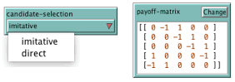
Interface Components
These controls are used to interact with the model and understand what it is doing. You add them yourself, depending on which ones are needed for the particular application
Chooser
Input

Slide 7
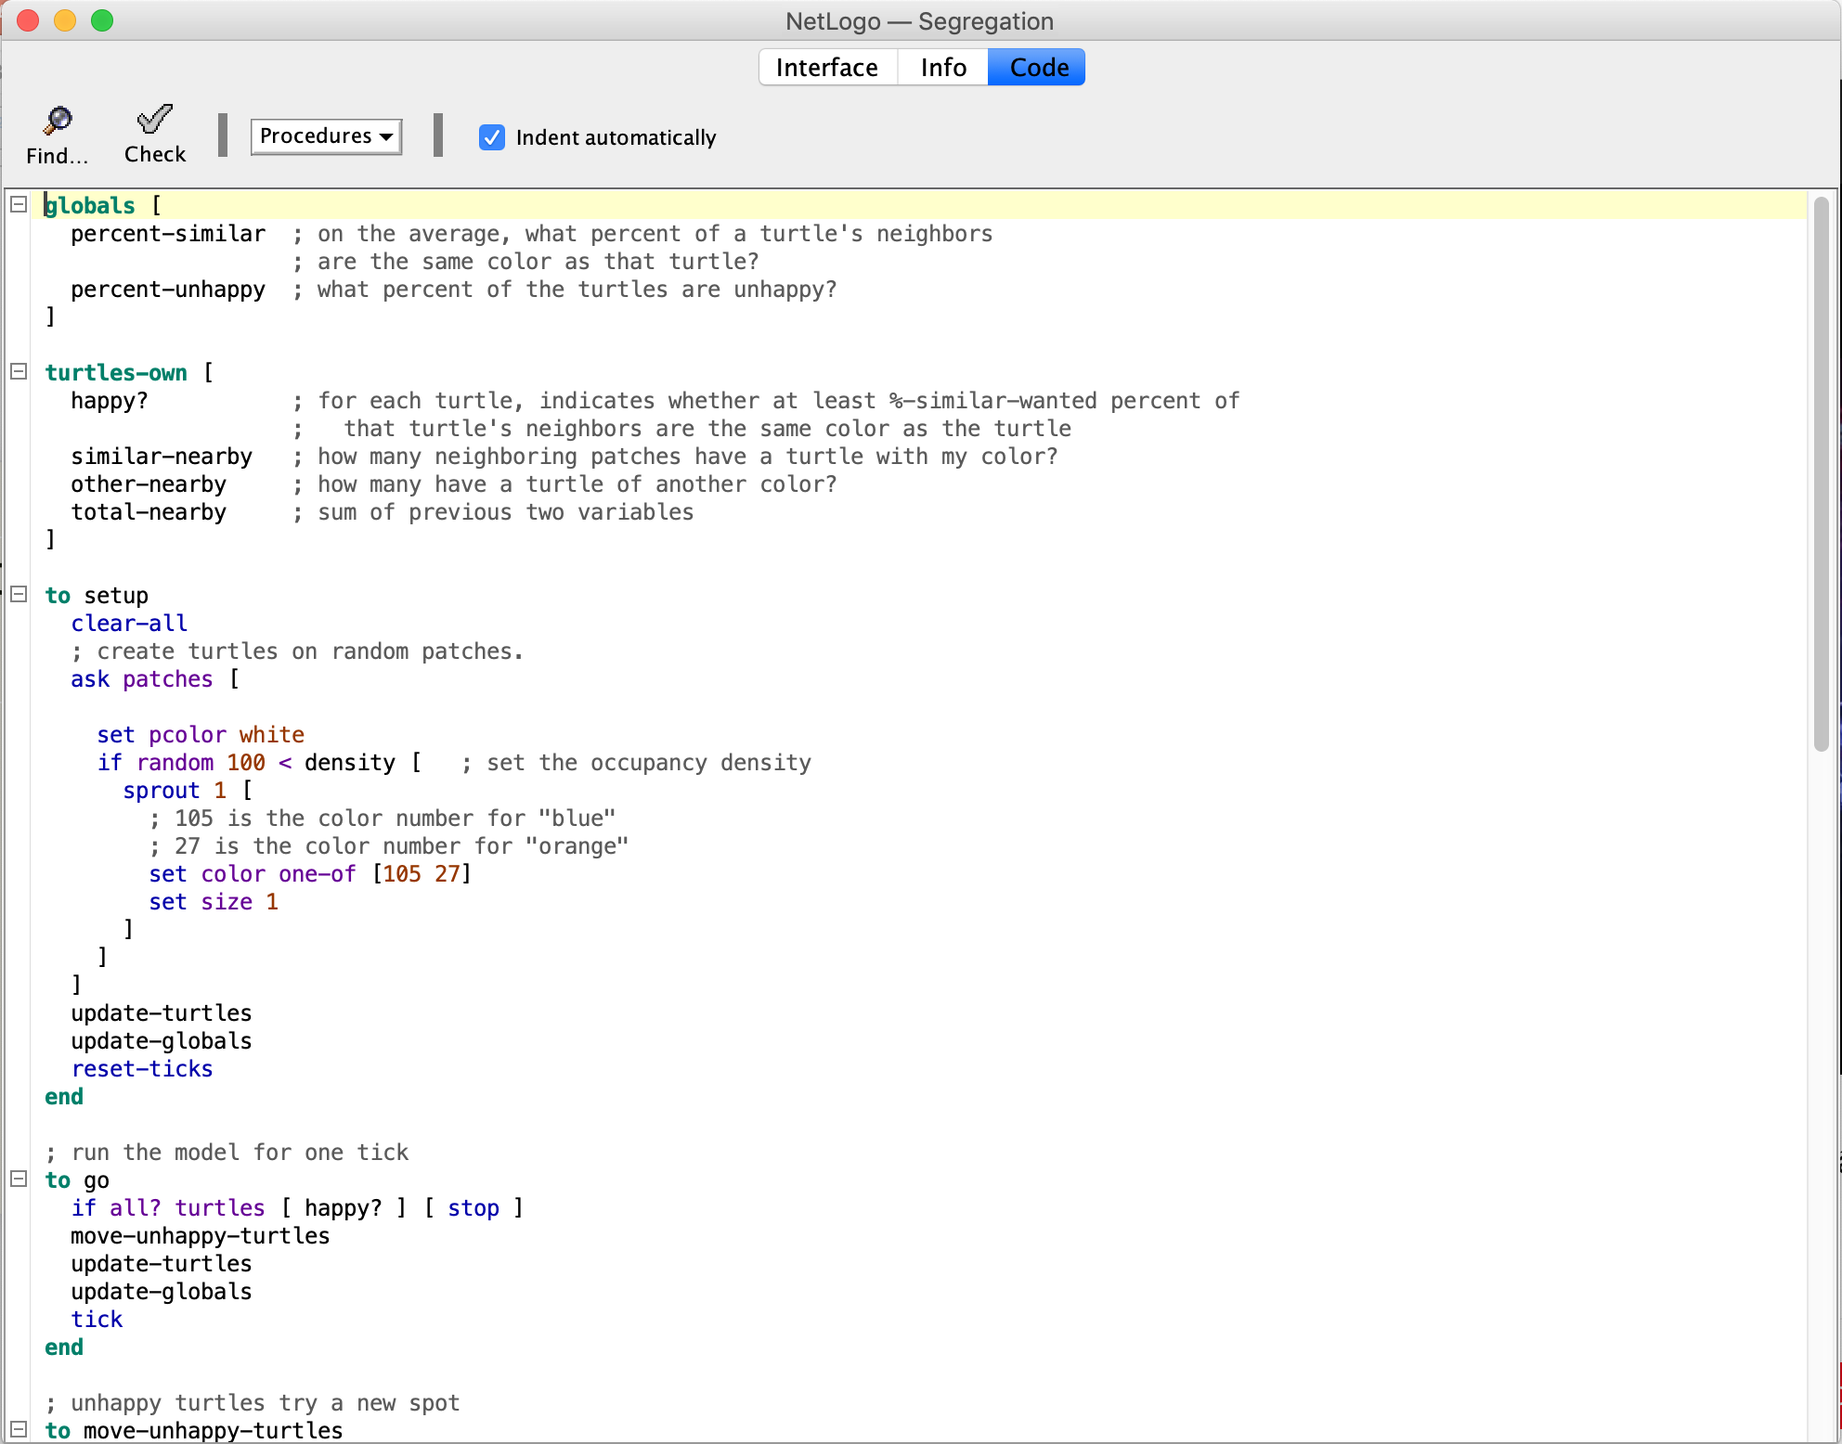
Model code Define global variables (globals []) Define agent types (turtles-own []) ‘setup’ command/function –initialise model ‘go’ command/function – run model You can write any other functions as you like, such as ‘move-unhappy-turtles’

Slide 8
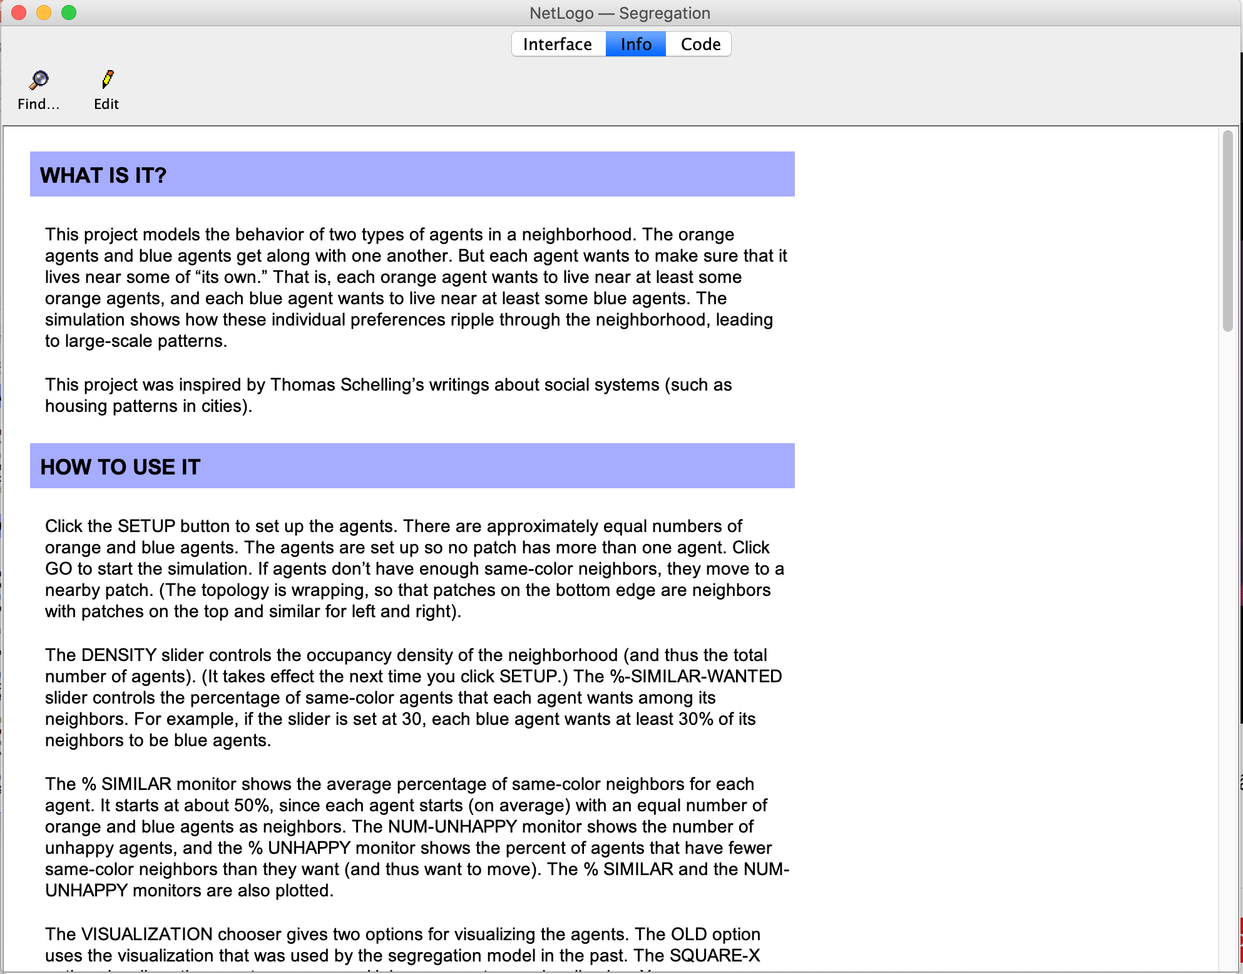
Model info To help others (and your future self) understand the model Documentation is very important!

Slide 9
NetLogo programming
So what you will mostly do for this practical is
change some of the agent behaviour parameters
examine the effects
The interested amongst you may want to play with the code!
So let’s have a look at the interface of a typical NetLogo programme

Slide 10
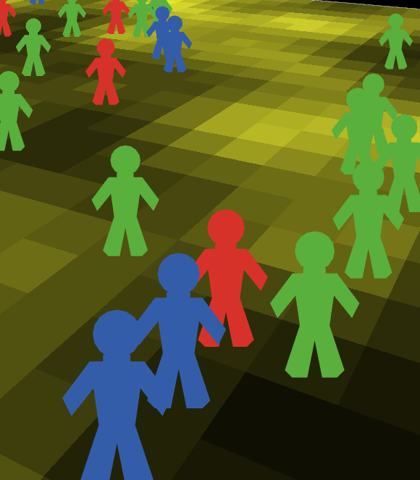
Turtles and Patches
Both are agents
They have attributes
They have rules that determine their behaviour
They can interact with other agents
Main differences:
Patches cannot move
You can create different types of 'turtle' (e.g. person, dog, cat, car, etc.)
Why called turtles?
'Logo' language originally used to control robot turtles. It seems that the name 'turtle' has stuck.

Slide 11
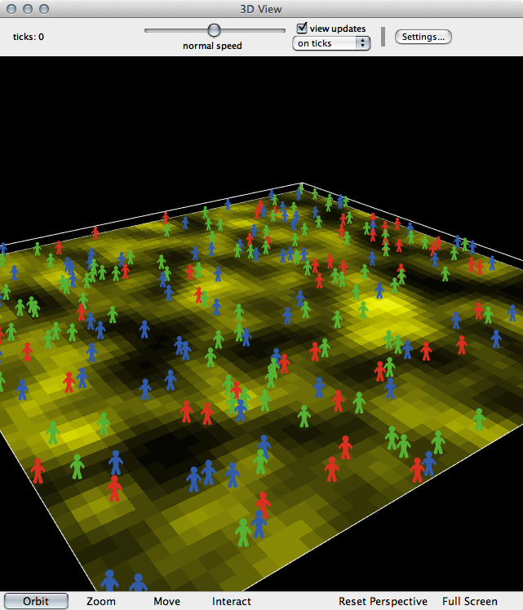
Observer (global)
The 'god' of a model
Oversea everything that happens, give orders to turtles or patches, control other things like data input/output, virtual time, etc.
Global variables

Slide 12
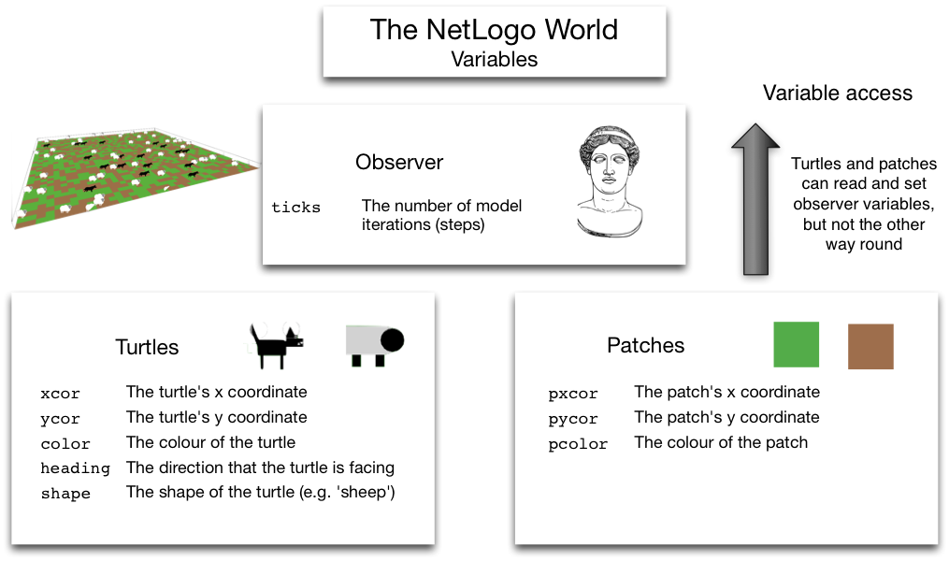
Built-In Variables
There are some variables that NetLogo uses by default

Slide 13
NetLogo variables
In programming, variables are a way of storing information. E.g.
my-name = ”Lex"
seconds-per-minute = 60
pi = 3.142
infected = True
Variables (or attributes) can belong to different objects in the model.
Examples:
Turtle variables: e.g. name, age, occupation, wealth, energy
Patch variables: e.g. height-above-sea, amount-of-grain, building-security, deprivation
Observer variables: e.g. total-wealth, weather, time-of-day, pi
Different objects can have different variable values

Slide 14
NetLogo commands
Some examples
show "Hello World" Prints something to the screen
set my-age 13 Sets the value of a variable
ask turtles [ ... ] Ask the turtles to do something
ask turtles [ set color blue ] Asks the turtles to turn blue

Slide 15
Model Concepts: Brackets
NetLogo uses both square [ ] and round ( ) brackets.
Round brackets are used to set the order of operations. E.g.:
2 + 3 × 4 = 14
(2 + 3) × 4 = 20
Square brackets are used to split up commands. E.g.:
ask turtles [ ... ]
the ask command expects to find some more commands inside the brackets.

Slide 16
Flow Control and Logic in NetLogo
Usually, NetLogo will run through your code, one line after the other
But! Sometimes there are two or more possibilities for what to do next
if statements are one example:
... start here ...
if ( age < 18 )
[ .. do something .. ]
if ( age > 18 )
[ .. do something else .. ]
... now continue …

Slide 17
Flow Control Quiz
The code below has been taken from the rules that drive the behaviour of a virtual person (or 'agent’).
What will the person do when the age variable has the values of 10, 50, or 18?
Age | Actions
10 | ?
50 | ?
18 | ?
if ( age < 18 ) [ .. go to the cinema .. ] if ( age > 18 ) [ .. go to the pub .. ] .. go to my friend's house ..

Slide 18
Wolf Sheep Predation model
Sample Models>Biology>Wolf Sheep Predation
Press the setup button to initialise the model. You should see some sheep, wolves and green grass
Choose model version to be ‘sheep-wolves-grass’
The first command that we will experiment with is show. Type the following into the command centre:
show "Hello World"
Try this again with some other text (don't forget to put quotes around the text).

Slide 19
Wolf Sheep Predation – Model info
Explores the stability of predator-prey ecosystems
An ecosystem is unstable if it tends to result in extinction for one or more species involved;
It is stable if it tends to maintain itself over time, despite fluctuations in population sizes
Sheep wander randomly around the landscape
Wolves look for sheep to prey on

Slide 20
Wolf Sheep Predation – Model info cont’d
Each step costs the wolves and sheep energy
Wolves must eat sheep in order to replenish their energy - when they run out of energy they die
The sheep must eat grass in order to maintain their energy - when they run out of energy they die
Each wolf or sheep has a fixed probability of reproducing at each time step
Once grass is eaten it will only regrow after a fixed amount of time

Slide 21
Count the number of sheep and wolves
Now combine two commands: show and count as follows:
Show count wolves
Show count sheep
What does this show you? Try this as well:
show count patches
What does that tell you?

Slide 22
Count agents with certain attributes
The with command: Try the following:
show count patches with [pcolor = green]
show count patches with [pcolor = brown]
What is happening with those two commands?
Now run the model for a few seconds (press 'Go' to start it, then press it again to stop). Repeat the two commands above. What result do you get now?
The with command actually needs two pieces of information. It needs a group of agents or patches on the left, and a test on the right (in this case we test the colour of the patches).
You can find more information about all the commands available in 'NetLogo Dictionary' (look for the 'with' command)

Slide 23
Global/observer variables
In NetLogo, it is possible to save values in things called 'variables' (for info, see the documentation on variables). Different parts of the model can check the values of the variables to decide what they should do.
For example, in the Wolf Sheep Predation model, each of the sliders changes the value of a variable. So, if you move the wolf-gain-from-food slider from 20 to 40, that will change the value of a variable called wolf-gain-from-food.
Each time a wolf eats a sheep it checks the value of that variable to decide how much new 'energy' it will gain. In this case, it will now get 40 units rather than only 20.
Now change the values of wolf-gain-from-food from to 40, and run the model again. How are the result different? Change the value of some other variables using the sliders. How are the result different?

Slide 24
Turtle and patch variable
Individual turtles and patches can also have their own variables; this is one of the ways that models can account for heterogeneity (we'll cover this in more detail in later lectures).
For example, in the Wolf Sheep Predation model, the wolves and sheep have a variable called energy. This records how much energy each individual wolf or sheep will have at any given time. If this reaches zero, then they will die.
Select ‘show-energy?’ to see the energy value of individual sheep and wolf

Slide 25
Set variable values (the set command)
Try the following command each at a time, and press setup. Then let the model run for 10-20 seconds. What do you observe? Does the results change after setting the variable values?
set sheep-gain-from-food 12
set sheep-gain-from-food 50
set initial-number-wolves 100
set wolf-reproduce 10
Now set different variable values yourself, and run the model for 10-20 seconds. How are the result different?

Slide 26
Think about the Wolf Sheep Predation model
Notice that increases and decreases in the sizes of each population are related. In what way are they related?
What is the explanation for this?
What eventually happens?
Why do you suppose that some variations of the model might be stable while others are not?

Slide 27
Virus model
Sample Models>Biology/Virus
This model simulates the transmission and perpetuation of a virus in a human population.
In the beginning, there are 150 people, of which 10 are infected
People move randomly about
People have three states:
Healthy but susceptible to infection (green)
Sick and infectious (red)
Healthy and immune (grey)
People may get infected when they come into contact with each other

Slide 28
Virus model – cont’d
How likely does a person get infected when come into contact with an infected person?
Controlled by the (global variable) infectiousness slider
What is the chance that a person will die from the virus?
Controlled by the (global variable) chance-recover slider
How long is a person infected before they either recover or die?
Controlled by the (global variable) duration slider

Slide 29
The ‘ask’ command
Use the ask command to send commands to turtles or patches directly
In the command centre, write: ask patches [ set pcolor blue ]
The ask command expects two inputs.
The first input is the turtles or patches that we want to do something to.
The second input is a command, or a number of commands, that will be sent to those turtles or patches.

Slide 30
Virus model – ask command
Now try this command: ask turtles [ set color brown ]
Now try two commands to set the x and y coordinates of the turtles:
ask turtles [ set xcor 1 set ycor 5]
Where have all the turtles moved to? Try this as well
ask turtles [ set xcor -10 set ycor -5]

Slide 31
Using ask and with
First reset the model by pressing setup
Execute the following command, that will have an affect only on the people that have been infected by a virus
ask turtles with [ sick? = true ] [ set color brown ]
Here, instead of giving all the turtles to the ask command, we give it the group of turtles who have a value of true stored in their variable called ‘sick’ (this is a special variable created specifically for the 'virus' model)

Slide 32
Using ask and with
Now try it again, but change the colour of those who aren't ill
ask turtles with [ sick? = false ] [ set color blue ]
Each person also has a variable that is their age. So we can use ask to run commands on people of different ages:
ask turtles with [ age > 20 ] [ set color yellow ]
You can also ask to run commands on people who are older than 20 AND sick
ask turtles with [ age > 20 and sick? = false] [ set color orange ]
Try some other ask command yourself

Slide 33
Move people’s location using ask
Move the 'people' slider from 150 down to 10. This will reduce the number of people in the model and make it easier to see the impact that the following commands will have.
Setup the model again. You should now see only a few (10) people in the world.
issue the following command:
ask turtles [ forward 1 ]
What is happening? What happens if a negative number is sent to the forward command?
ask turtles [ forward -1 ]

Slide 34
Move people’s location using ask
Now try these commands and see what happens (they have to be entered into the Command Centre one by one):
ask turtles [ facexy 0 0 ]
ask turtles [ forward 1 ]
ask turtles [ forward 1 ]
ask turtles [ forward 5 ]
Now make the turtles move around as you wish

Slide 35
Think about the Virus model
Did you notice the initial outbreak?
Often there will initially be an explosion of infection since no one in the population is immune
What makes a ‘successful’ virus?
Viruses that are too successful (high infectiousness) at first (infecting almost everyone) may not survive in the long term. Since everyone infected generally dies or becomes immune as a result
Ebola has a very short duration, a very high infectiousness value, and an extremely low recovery rate. How successful is it? Set the sliders appropriately and watch what happens.
The HIV AIDS virus, has an extremely long duration, an extremely low recovery rate, but an extremely low infectiousness value. How successful is it?

Slide 36
Exercise: Virus model
Write a command to change the colour of all of the patches to brown.
Write a command that will ask all agents to move forward one step.
Write a command that will ask all blue turtles to move forward five steps. (Hint: use a combination of ask and with).
Write a command that will ask the turtles to change the colour of the patch that they are standing on to blue. (Hint: ‘patch-here’ reports the patch under the turtle)
Write a command that will ask all of the red turtles to change the colour of the patch that they are standing on to orange. Hint: remember that turtle colour is stored in a variable called ‘color’ and patch colour is stored in a variable called ‘pcolor’.

