Slide 1
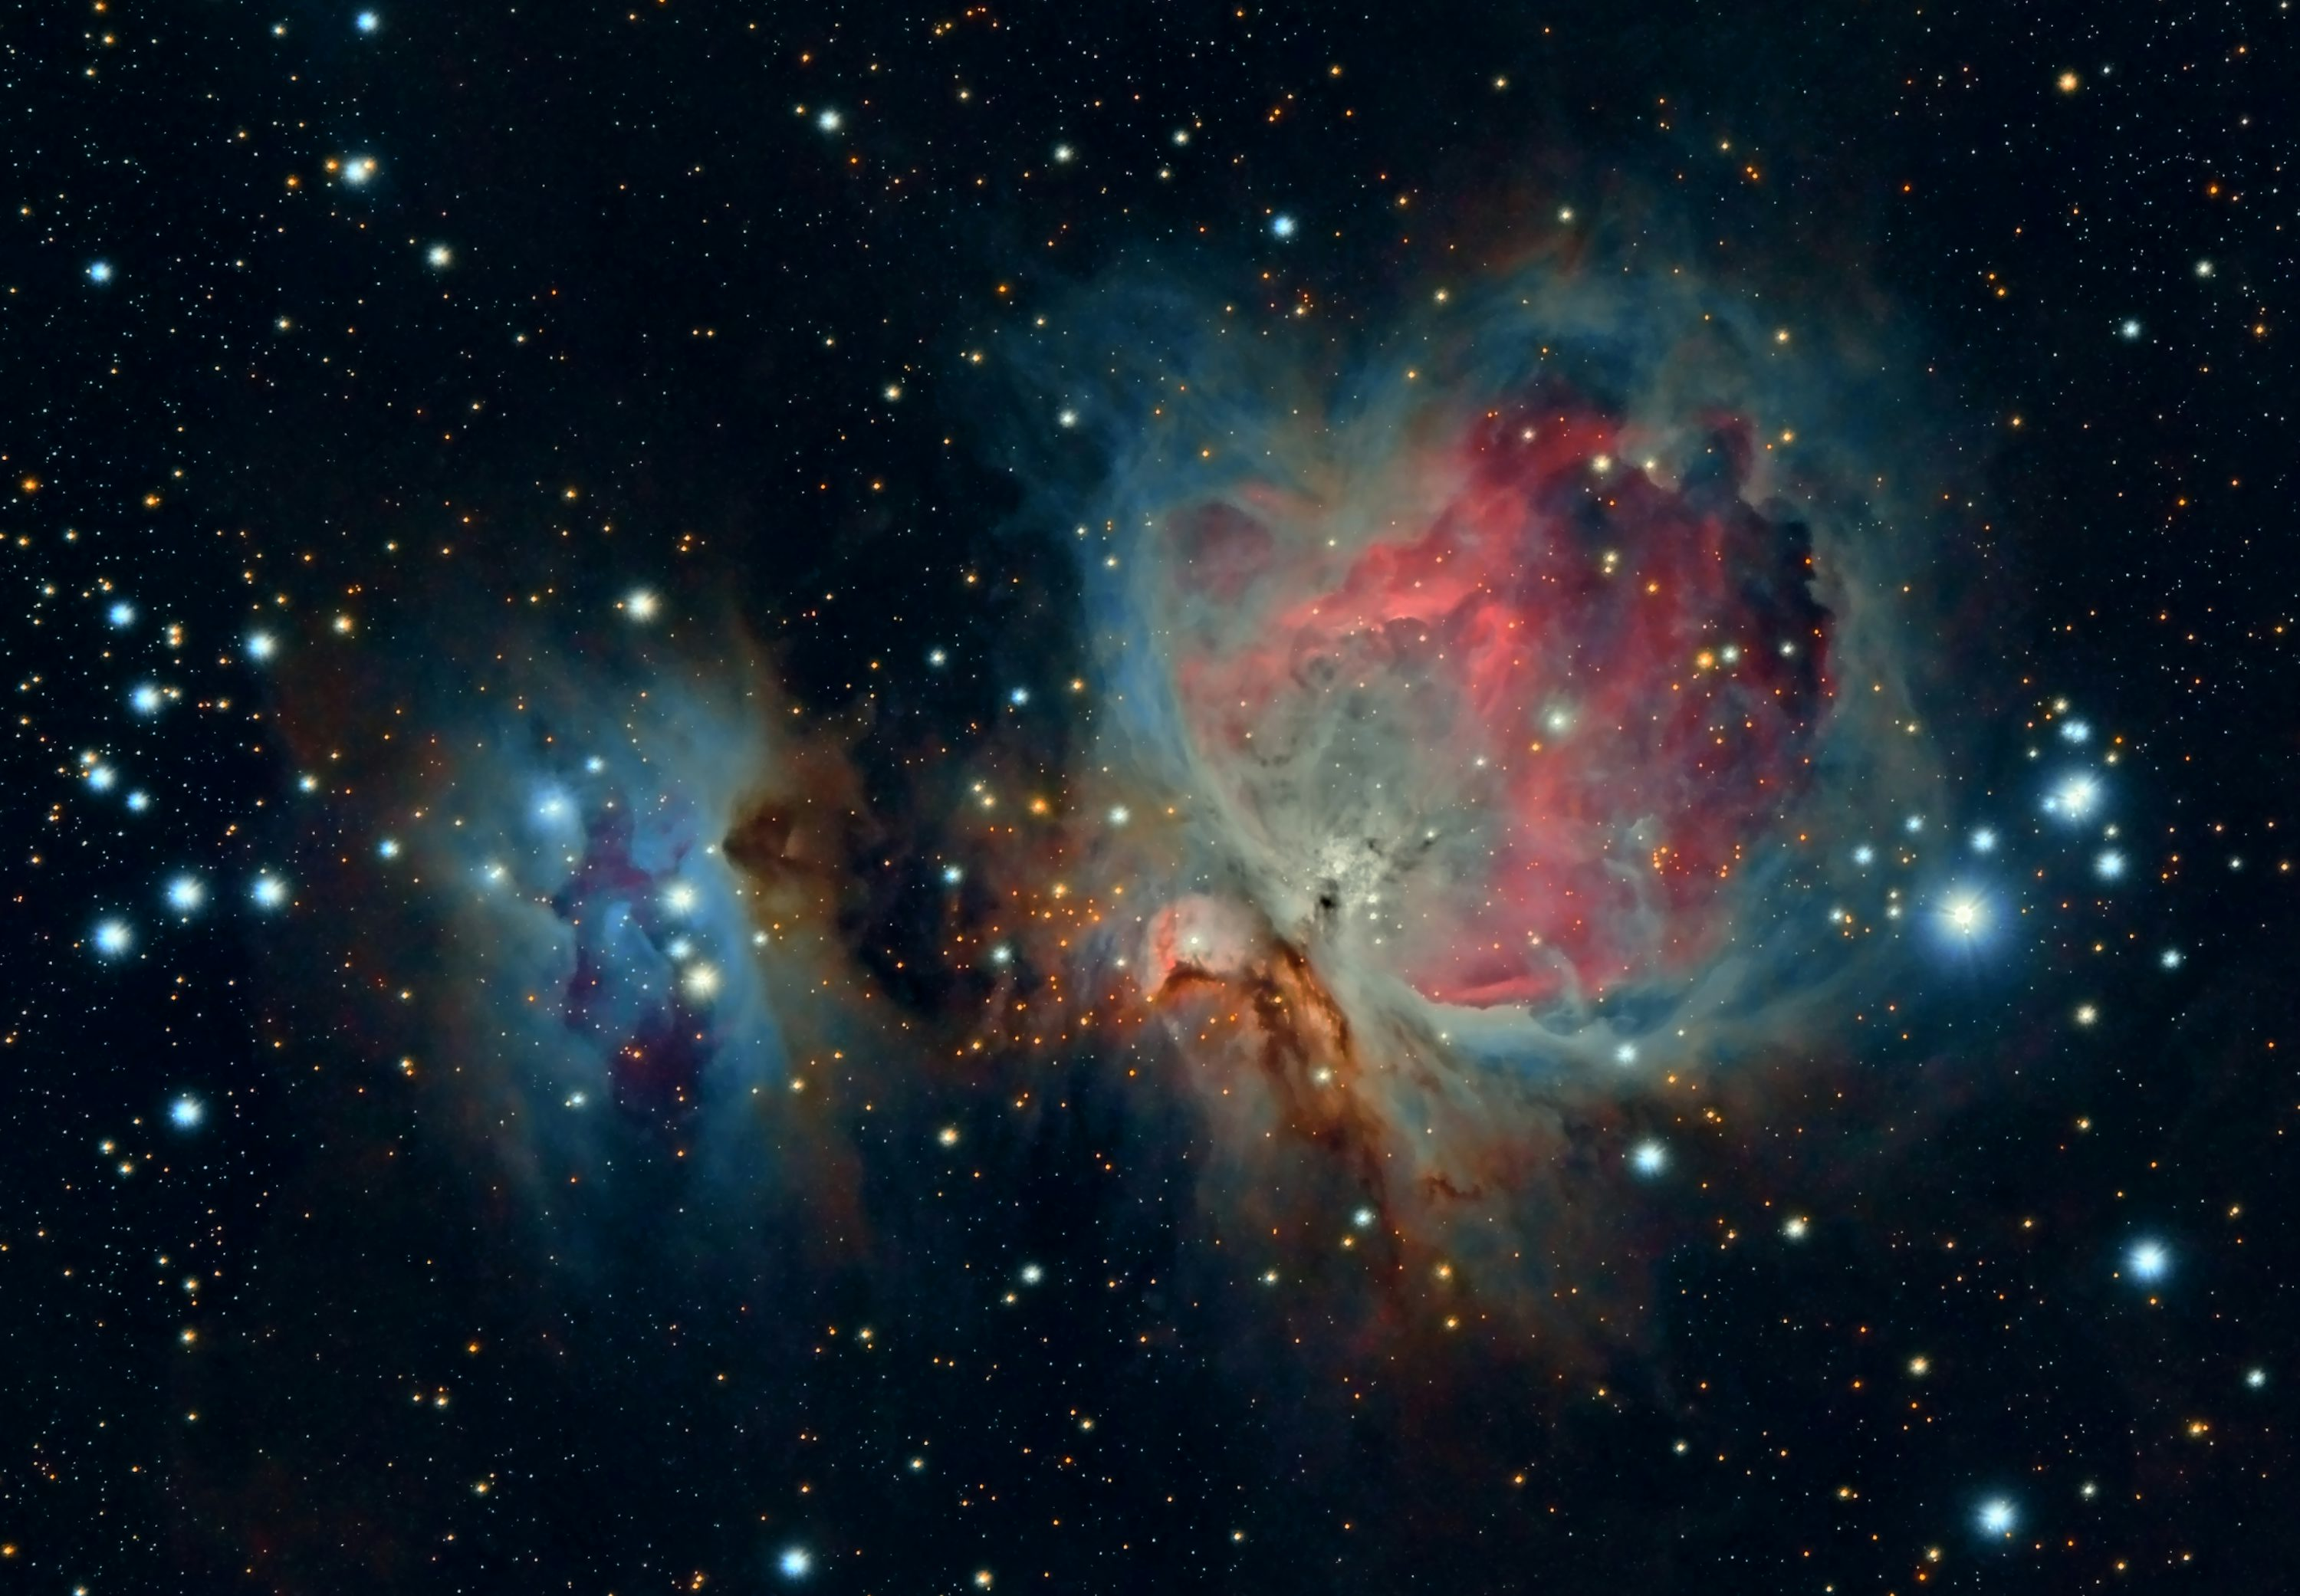

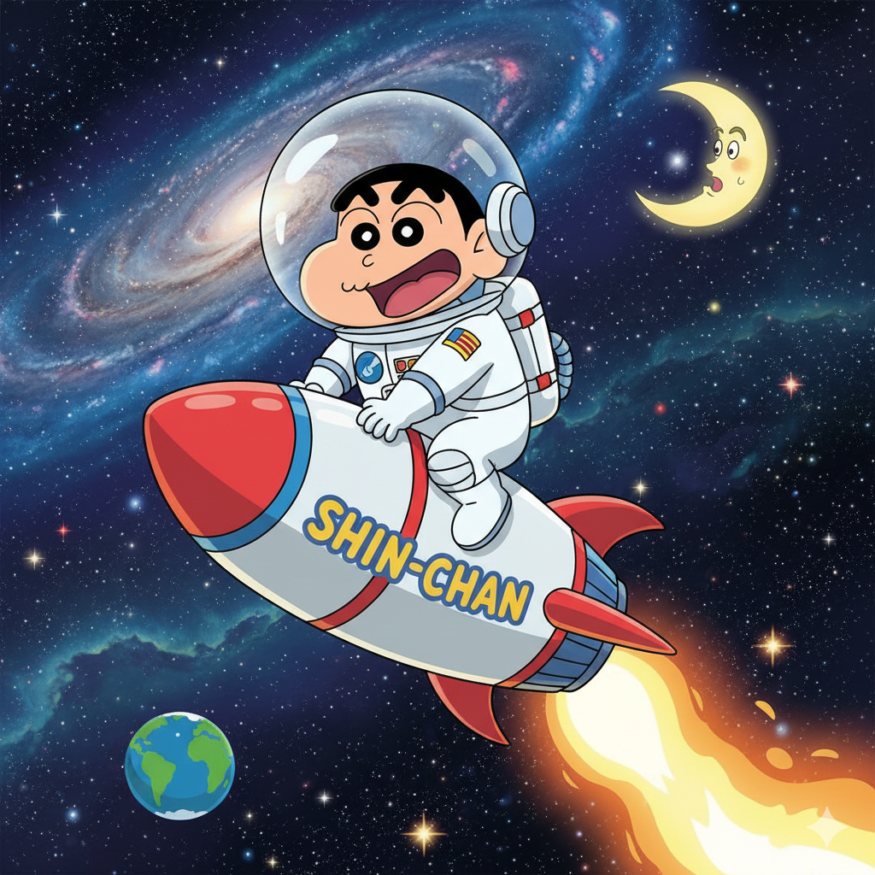
Team CosmoToys
Rocket's
Assemble – Launch - Explore
Crew Members
Roger Marrero
Jair Stick
Ricardo Dellazari

Slide 2
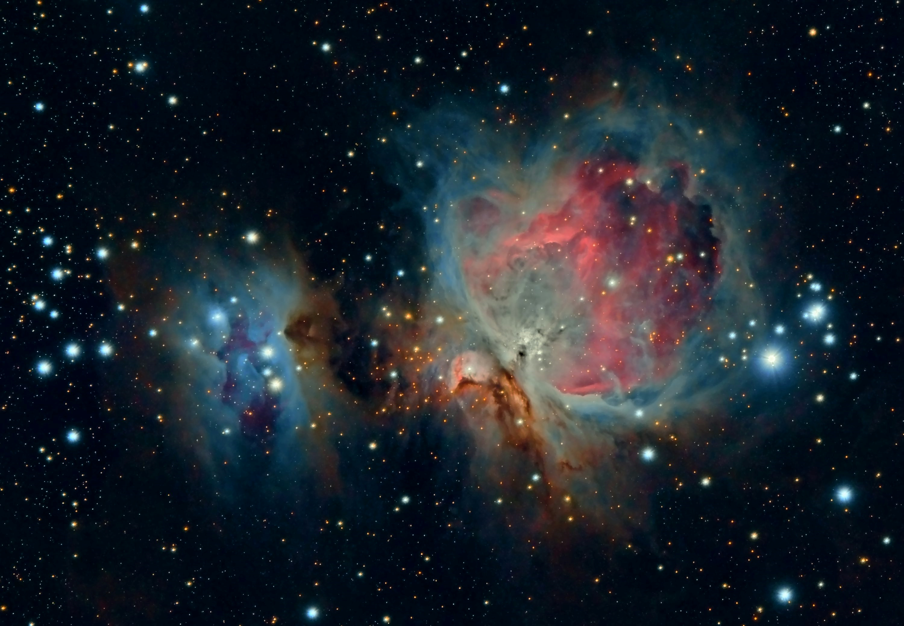
The Project
What it does?
“Assemble rockets, launch them, and explore space missions.”
How it works?
“Choose rocket sections based on mission objectives: payload, engine, fuel.”
Benefits?
“Encourages learning about space, science, and engineering through play.”
Objective?
“Enhance children’s curiosity and understanding of Science Technology, Enginering and Math subjects.”
Tools, programming langs, software?
"React, Typescript, Css, HTML5, JavaScript, Node.Js"

Slide 3

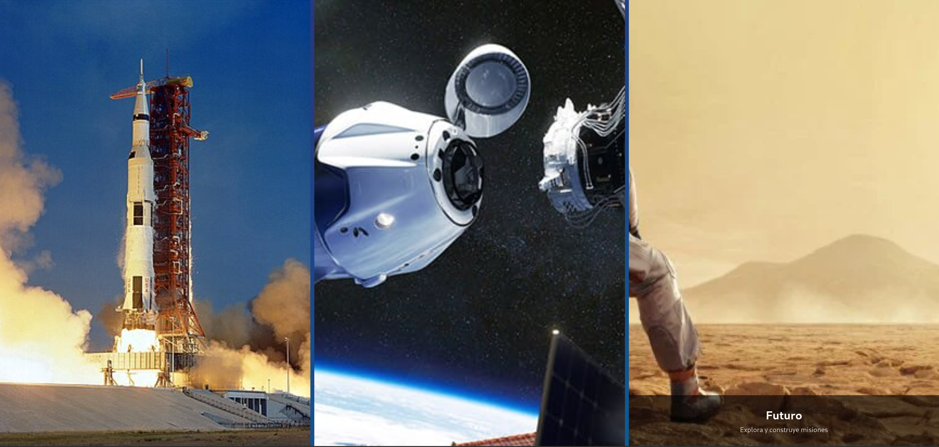
Modes
History
Present
Future

Slide 4
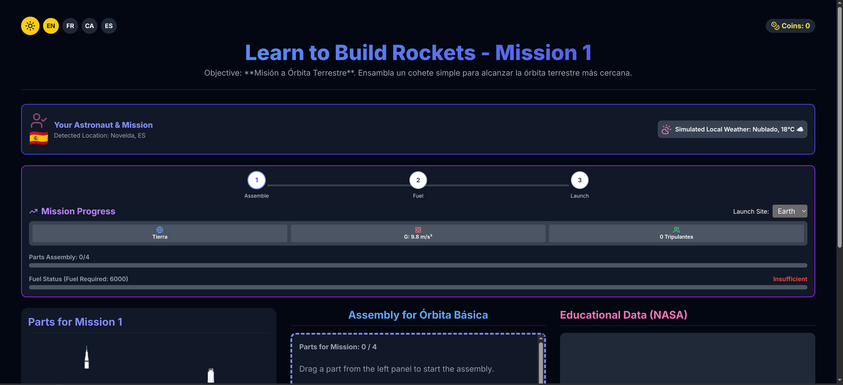
Stages
Step-by-step guided advancement
Mission-based condition selection
Actual progress.

Slide 5
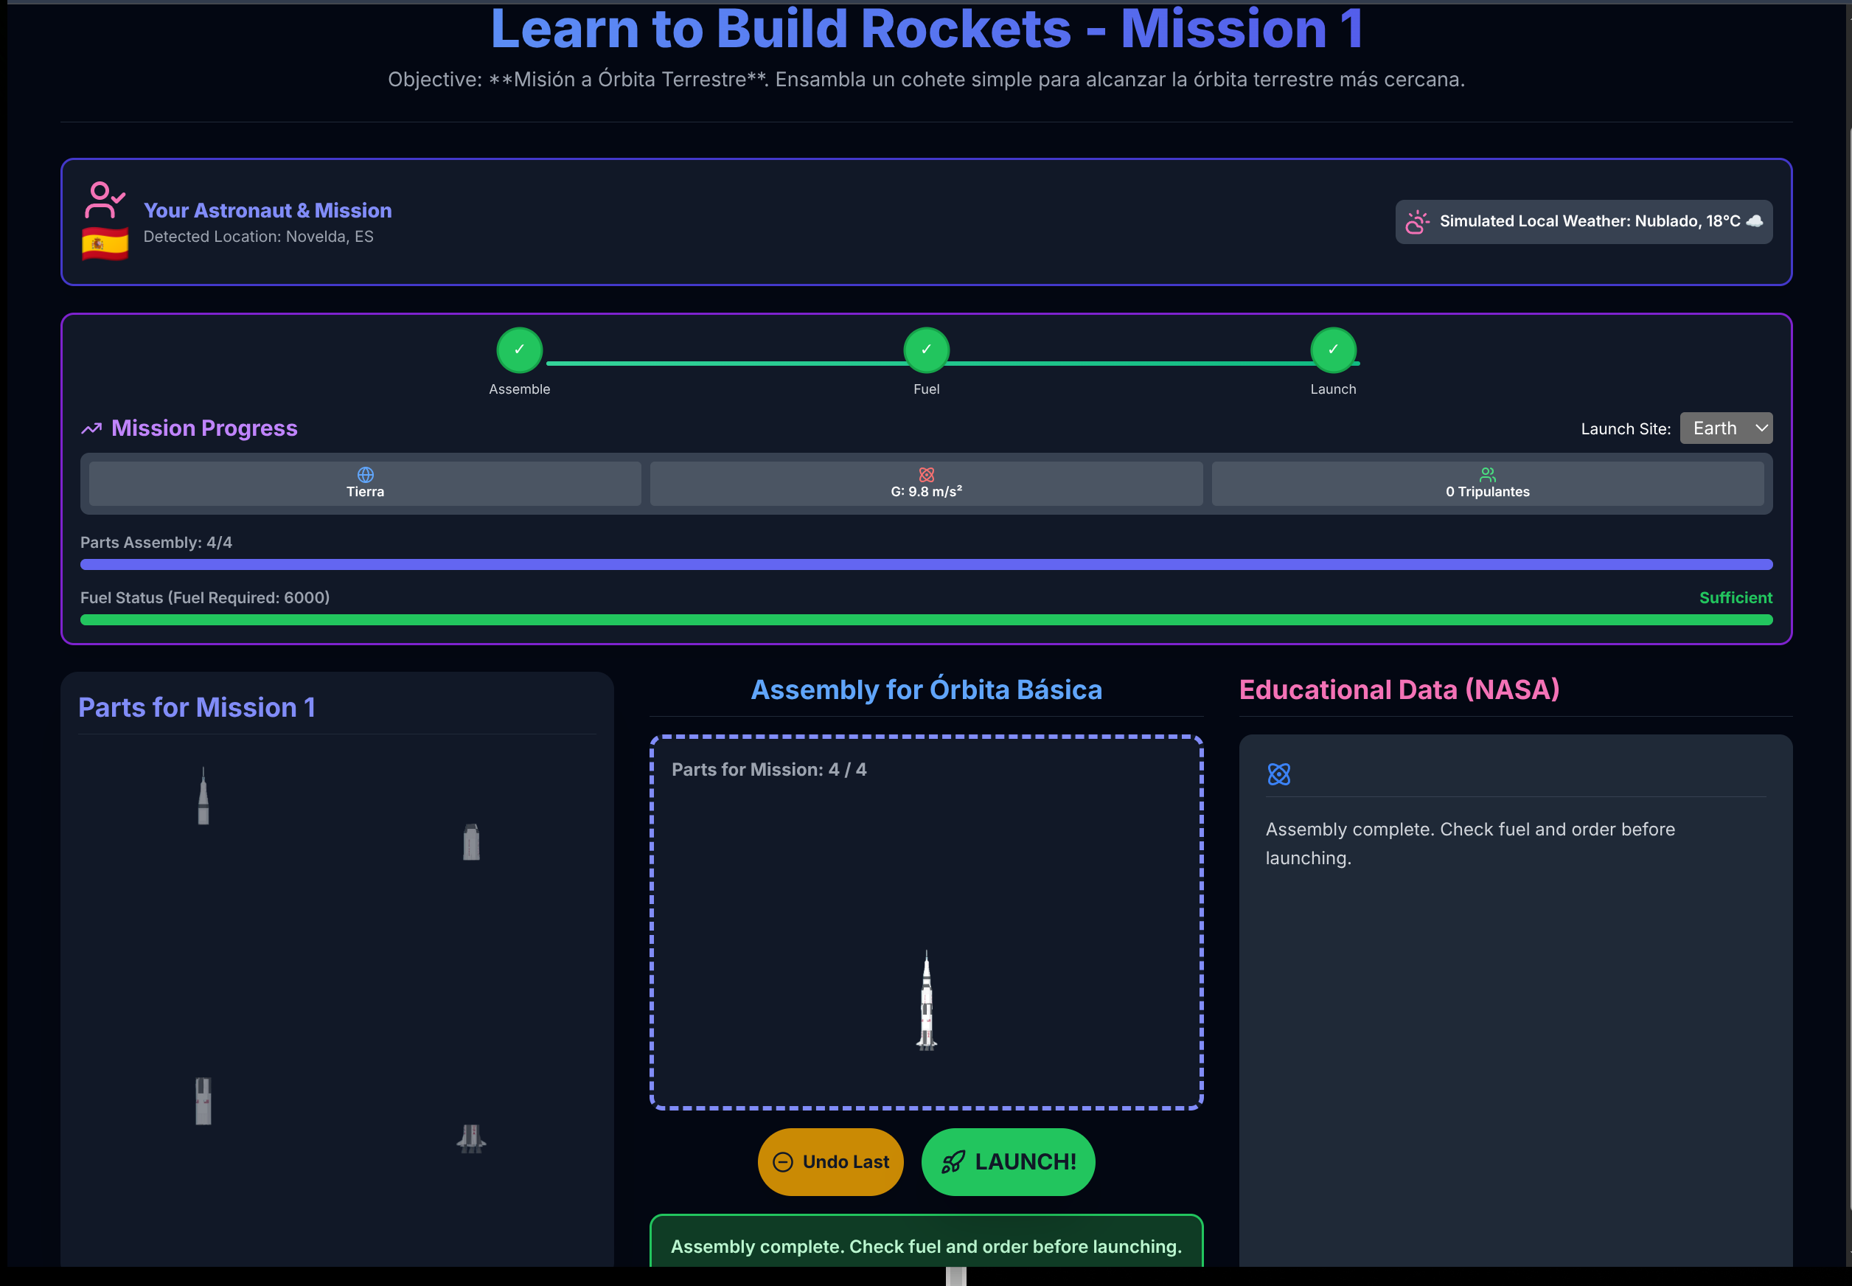
Guided learning process.
Interactive
Dynamic
Focused learning
Gamified
Error-based learning

Slide 6
Bibliography.
https://spaceplace.nasa.gov/launch-windows/en/
https://www.esa.int/Applications/Observing_the_Earth/FutureEO/FLEX/Launch
https://www.spacex.com/vehicles/falcon-9
https://airandspace.si.edu/collection-objects/rocket-engine-liquid-fuel-merlin-1d/nasm_A20220606000
https://www.eoportal.org/other-space-activities/rocket-lab#design-parameters
https://www.nasa.gov/reference/space-launch-system-rl10-engine/
https://ariane.group/en/equipment-services/for-launchers/propulsion-systems-for-launchers/
https://www.ulalaunch.com/docs/default-source/rockets/delta-iv-heavy-cutaway.pdf
https://api.nasa.gov/DONKI/WSAEnlilSimulations?startDate=2011-09-19&endDate=2011-09-20&api_key=DEMO_KEY

Slide 7


Inspire the next generation of explorers
Every big mission starts with a spark of curiosity
THANK YOU
TH

