Slide 1
SimpleChess
Rohan Kumar, Michael Terekhov, Roger Finnerty, Joshua Caban, Harlan Jones

Slide 2
Idea
The idea for this project is an app that allows a user to play games of chess. It will feature :
user vs user capability
pieces obeying laws of chess
proper timing for moves
a bot player to play against if there is only one player
Potential features include :
customizable pieces/themes/backgrounds
sound effects for piece movements and takes as well as animations for moves
predictive move feature
ranking play histories
different bot player difficulties and tactics

Slide 3
Basic Requirements
Local device user vs user gameplay
Local device user vs computer gameplay
Chess pieces follow traditional movement rules
Game recognizes whose turn it is
Game recognizes when a checkmate or stalemate is reached
Game prompts user to keep playing, quit playing, or change modes upon game ending

Slide 4
Implementation
Created class called Piece, which has several subclasses (Rook, Queen, etc)
In main activity, creates 8x8 matrix of Pieces, as well as two 8x8 matrices of TextViews, layered on top of each other (one for background tiles and one for pieces)
Logic is done on the Piece matrix, and then reflected on the TextView matrices
Each click program checks whose turn, whether a win has happened, or whether the king is in check
Bot can be supplemented after each player turn if mode is set to Bot

Slide 5
Additional Features
Predictive move feature (able to see possible moves)
Sound effects/animation
Customizable UI (pieces, board colors, etc)
Leaderboard ranking system
Different levels of bot strength/playing types

Slide 6
Implementation
Predictive move feature is found by finding all possible moves and displaying on board
Animation done by moving piece square by square over time
speed will be able to be set, etc
Leaderboard is a count of how many wins a certain user has

Slide 7
Bots
Random bot
finds all possible moves, randomly selects one
still can maneuver out of a check
Aggressive bot
prioritizes moves that take pieces, higher value pieces are worth more
If time permits:
Location bot
ranks each spot on board according to how effective piece is there (e.g.. King is not effective in the middle, but a Queen might be)
using coefficient matrix for each piece

Slide 8
Design Decision
Players should not be able to move in a way that puts them in check
Leaderboard is propagated by users putting in their name before matches begin
Being able to return to menu after a game and start another round
how to save Leaderboard/Settings
SharedPreference vs Room (internal storage)

Slide 9
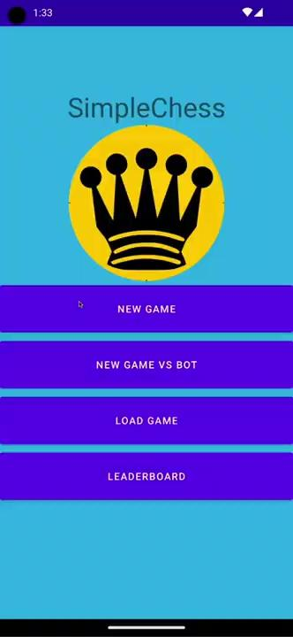
Video Demo if Needed

