Slide 1
OpenTelemetry Starter Pack

Slide 2
https://github.com/rogerhmar/OTEL-NDC-2024

Slide 3
Goal of this workshop
Your own local setup for OpenTelemetry
Better understanding of what OpenTelemetry is
An example of how to add OpenTelemetry to a .NET application

Slide 4
Shape of the workshop
Follow your own pace
I will go through some solutiuons in plenium, if needed/requested. You can choose to listen or not
Help each other and colaborate

Slide 5
Agenda
Clone repo, and run «docker compose up» as soon as possible
Intro to observability and OpenTelemetry
Self paced tasks

Slide 6
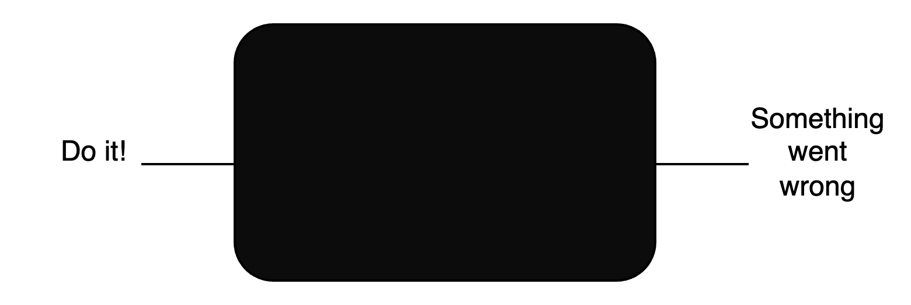
Observability
Observability of a system – How easy is it to observe the internal state of the system (from its outputs)?
Typically we need to instrument our application
Symptom => Root cause

Slide 7
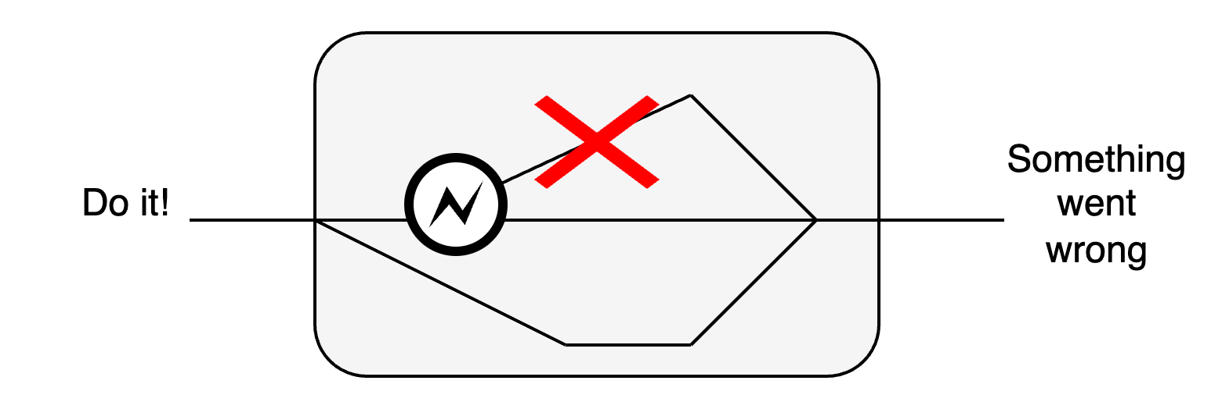
What we want
Notes:
Trace the flow
Statistics on failures
Log statements linked to traces

Slide 8
OpenTelemetry
High-quality, ubiquitous, and portable telemetry to enable effective observability
A collection of APIs, SDKs, and tools. Use it to instrument, generate, collect, and export telemetry data (metrics, logs and traces) to help you analyze your software's performance and behavior.
https://github.com/open-telemetry
Notes:
Sometimes – Standardize to increase inovation.
It works, it works across technologies and is found “everywhere”

Slide 9
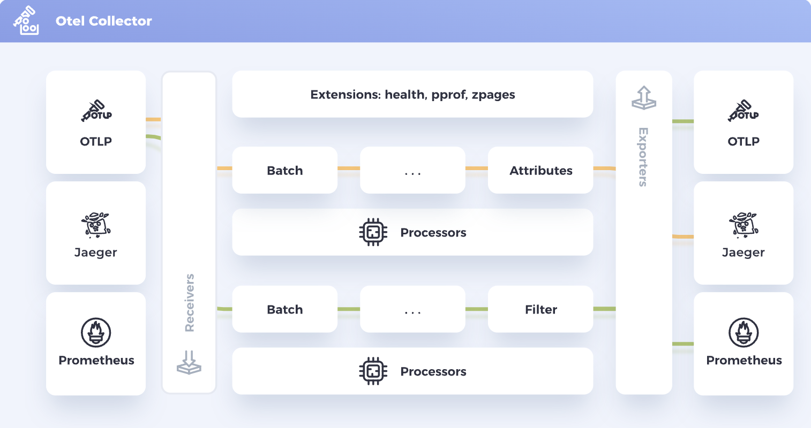
Notes:
OTLP OpenTelemetry Wire Protocol
Backpressure signaling
Low CPU serial/deserial
loadbalanser friendly
Minimal memory pressure
Pipelines
Receive -> Process -> Export
Receive:
OTLP from .NET app
Processors:
Limiters – Memory limiters
Samplers –
Batch - The batch processor accepts spans, metrics, or logs and places them into batches. Batching helps better compress the data and reduce the number of outgoing connections required to transmit the data
Attributes
Export:
More and more OTLP

Slide 10
Signals
Traces –> Connect the components
Metrics -> Quantify and show statistics
Logs -> Tell a story
And OTEL links it together; Logs -> Traces

Slide 11
Docs
https://github.com/rogerhmar/OTEL-NDC-2024
https://opentelemetry.io/docs
https://opentelemetry.io/docs/specs/otlp/
https://grpc.io/docs/what-is-grpc/introduction/
https://grpc.io/docs/what-is-grpc/core-concepts/
https://devblogs.microsoft.com/dotnet/azure-monitor-opentelemetry-distro/
https://learn.microsoft.com/en-us/azure/azure-monitor/app/opentelemetry-configuration?tabs=aspnetcore#why-is-microsoft-azure-monitor-investing-in-opentelemetry

