Slide 1
OpenTelemetry Starter Pack

Slide 2
Goal of this workshop
Your own local setup for OpenTelemetry
Better understanding of what OpenTelemetry is
An example of how to add OpenTelemetry to a .NET application

Slide 3
Shape of the workshop
Follow your own pace
I will go through some solutiuons in plenium, if needed/requested. You can choose to listen or not
Help each other and colaborate

Slide 4
Agenda
Clone repo, and run «docker compose up» as soon as possible
Intro to observability and OpenTelemetry
Self paced tasks

Slide 5
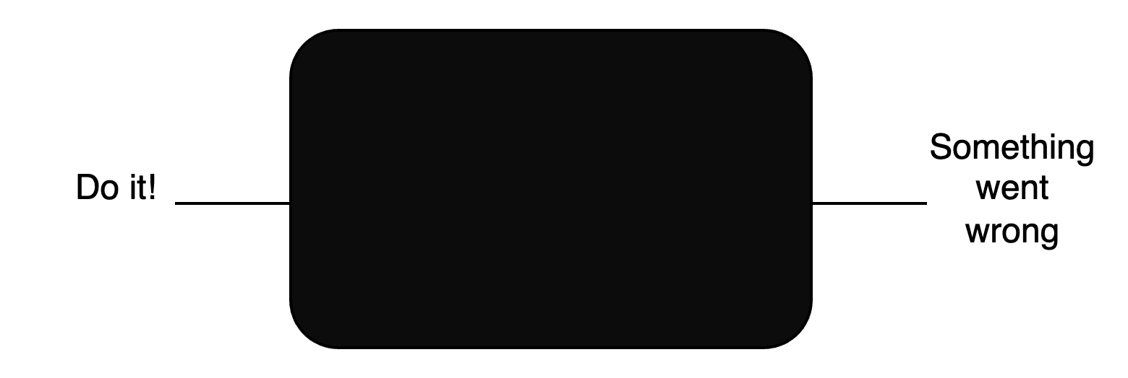
Observability
Observability of a system – How easy is it to observe the internal state of the system (from its outputs)?
Typically we need to instrument our application
Symptom => Root cause

Slide 6
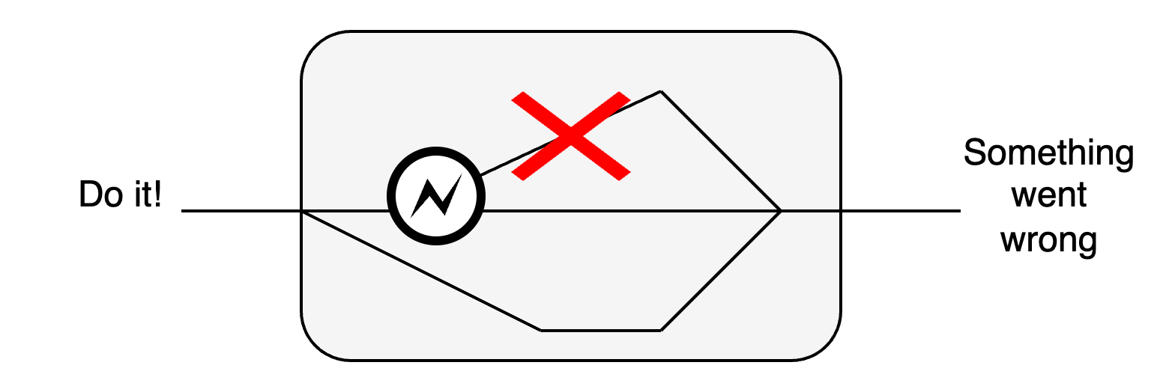

Slide 7
OpenTelemetry
High-quality, ubiquitous, and portable telemetry to enable effective observability
A collection of APIs, SDKs, and tools. Use it to instrument, generate, collect, and export telemetry data (metrics, logs and traces) to help you analyze your software's performance and behavior.
https://github.com/open-telemetry
Notes:
It works, it works across technologies and is found “everywhere”

Slide 8
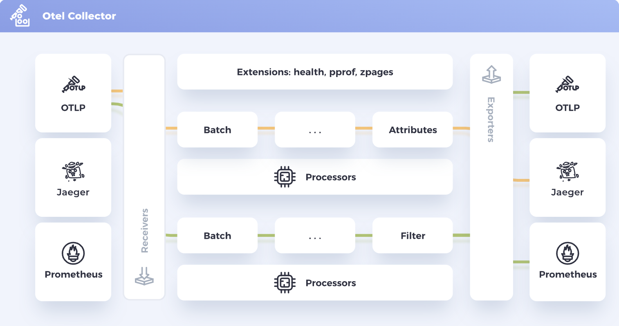

Slide 9
Signals
Traces –> Connect the components
Metrics -> Quantify and show statistics
Logs -> Tell a story

Slide 10
Docs
https://opentelemetry.io/docs
https://github.com/rogerhmar/OTEL-NDC-2024
https://devblogs.microsoft.com/dotnet/azure-monitor-opentelemetry-distro/
https://learn.microsoft.com/en-us/azure/azure-monitor/app/opentelemetry-configuration?tabs=aspnetcore#why-is-microsoft-azure-monitor-investing-in-opentelemetry

