Slide 1
OpenTelemetry Starter Pack

Slide 2
Agenda
Clone repo, and run «docker compose up» as soon as possible
Intro to observabiltiy and OpenTelemetry
Self paced tasks

Slide 3
Observability
Observability of a system – How easy is it to observe the inner state of the system?
Typically we need to instrument our application
Symtom => Root cause

Slide 4
OpenTelemetry
High-quality, ubiquitous, and portable telemetry to enable effective observability
A collection of APIs, SDKs, and tools. Use it to instrument, generate, collect, and export telemetry data (metrics, logs and traces) to help you analyze your software's performance and behavior.
https://github.com/open-telemetry
Notes:
It works, it works across technologies and is found “everywhere”

Slide 5
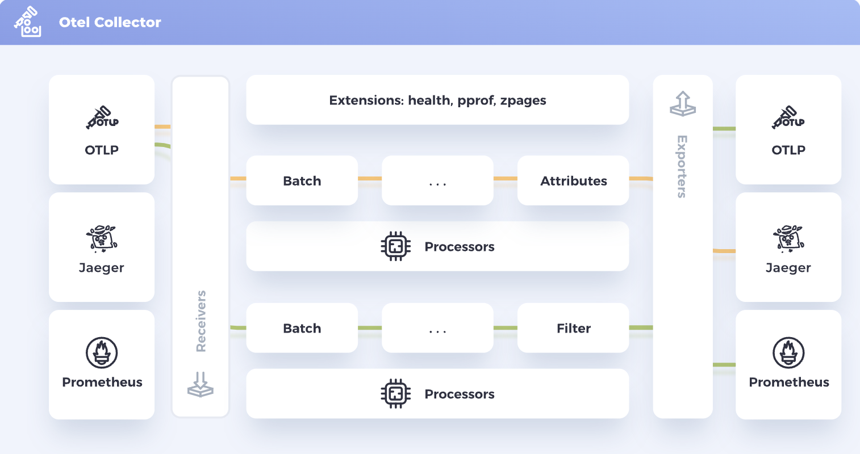

Slide 6
Signals
Traces –> Connect the components
Metrics -> Quantify and show statistics
Logs -> Tell a story

Slide 7
Docs
https://opentelemetry.io/docs
https://github.com/rogerhmar/OTEL-NDC-2024
https://devblogs.microsoft.com/dotnet/azure-monitor-opentelemetry-distro/
https://learn.microsoft.com/en-us/azure/azure-monitor/app/opentelemetry-configuration?tabs=aspnetcore#why-is-microsoft-azure-monitor-investing-in-opentelemetry

