Slide 1
Music BPM Detection
2020270619 형정현
컴퓨터융합소프트웨어학과
FINAL Presentation

Slide 2
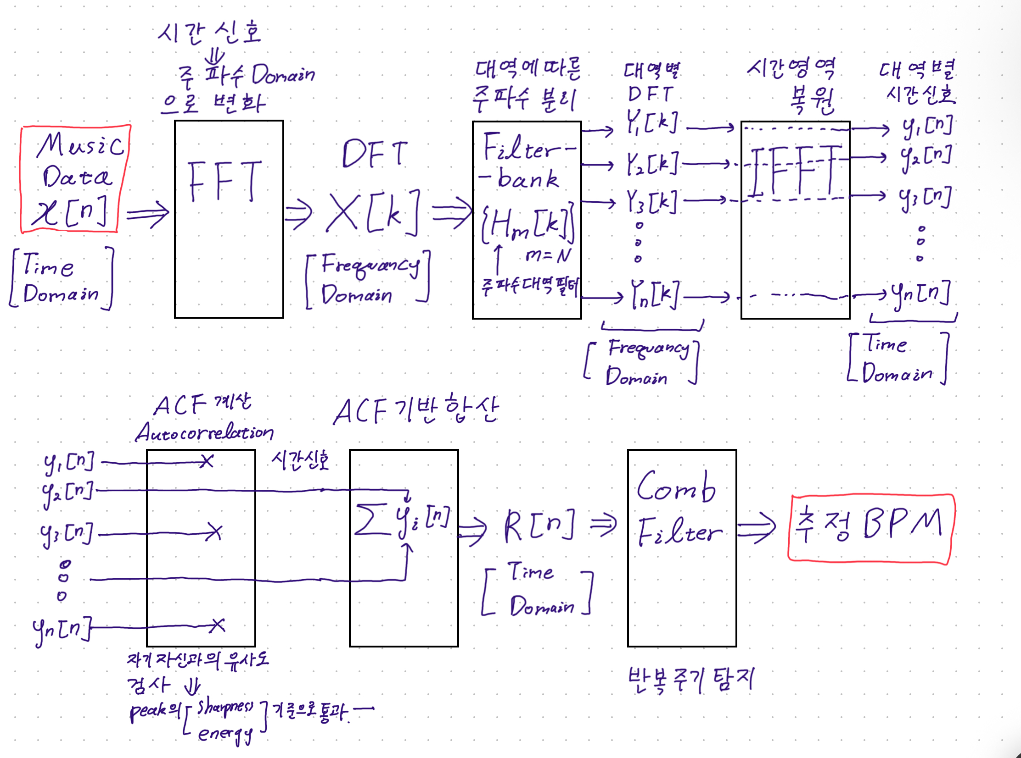
Mono channel transition
Using
Butterworth Bandpass filter

Slide 3
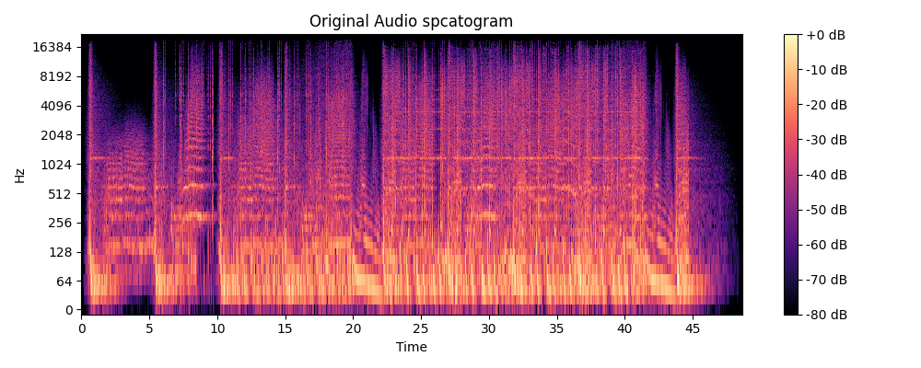

Slide 4
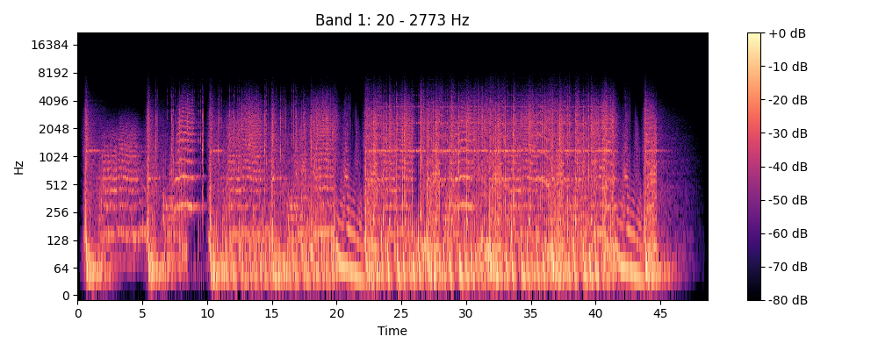
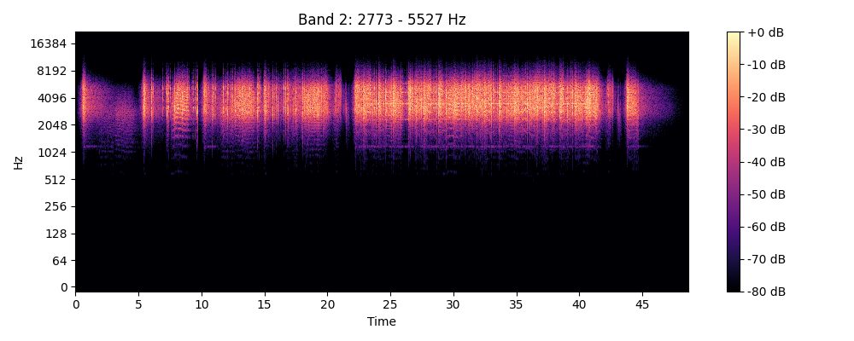
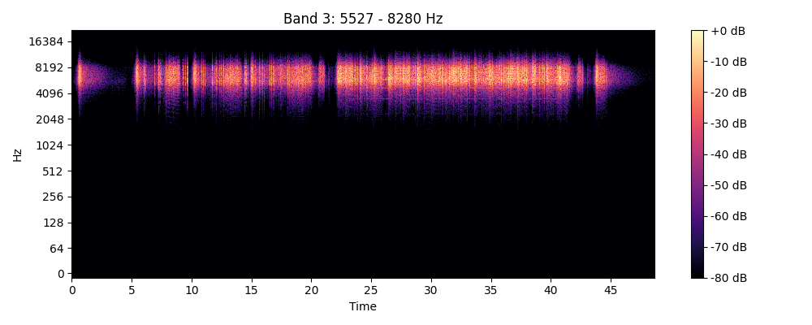
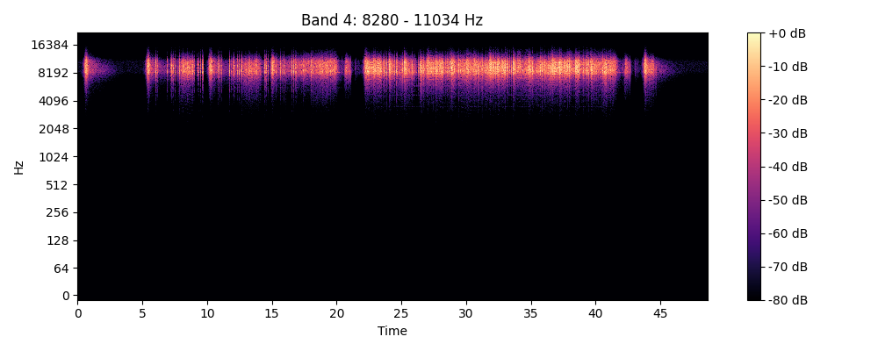
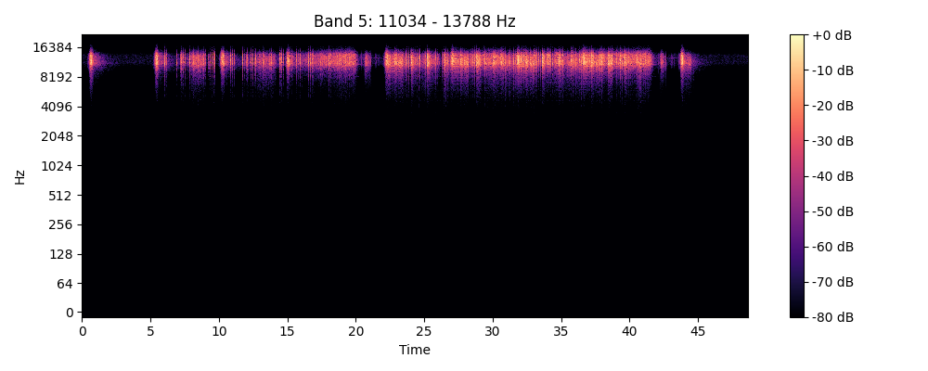
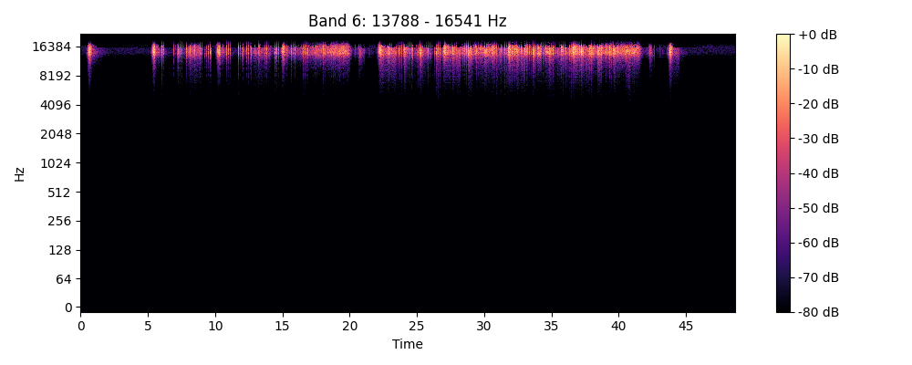
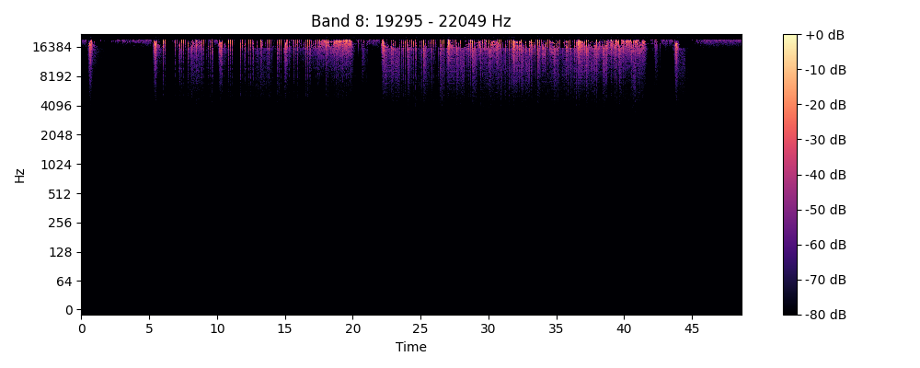
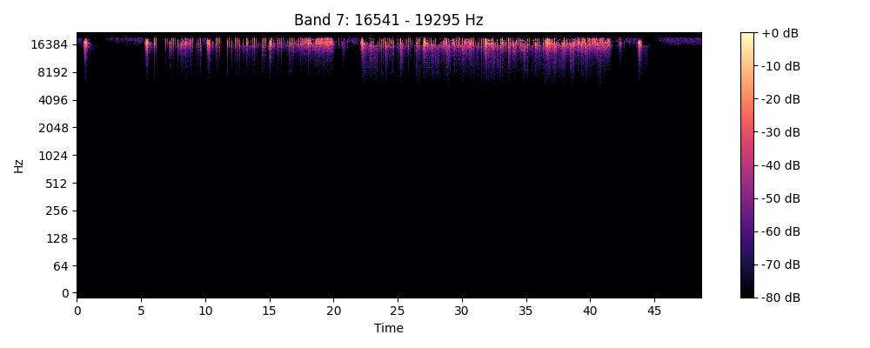

Slide 5
Envelope 추출

Slide 6


Slide 7








Slide 8

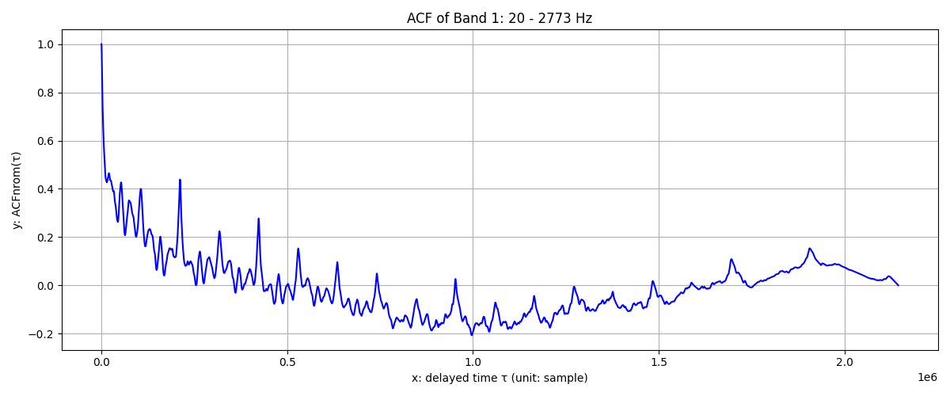
ACF

Slide 9
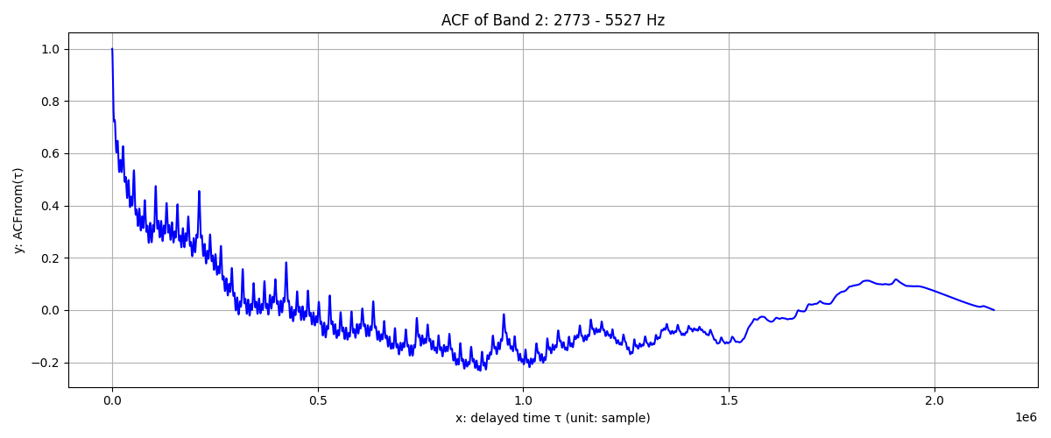
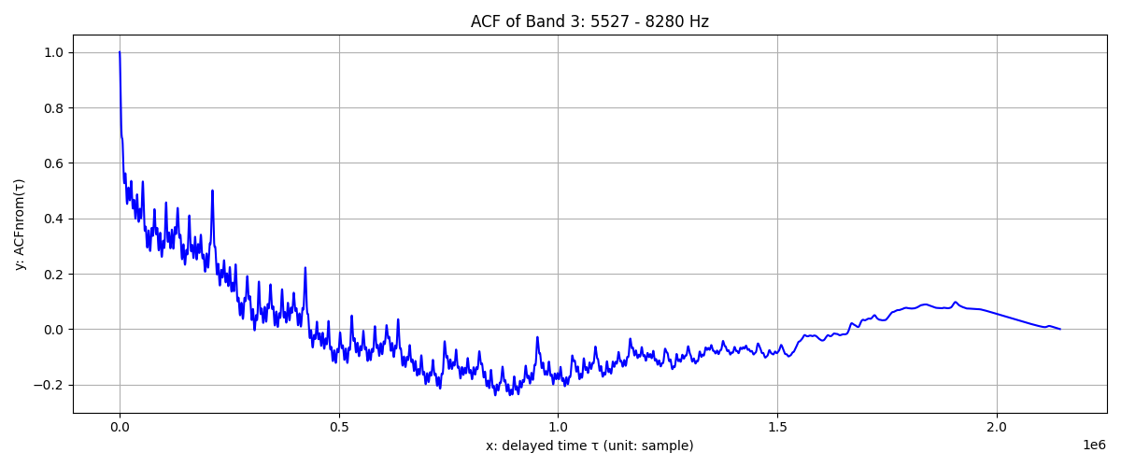
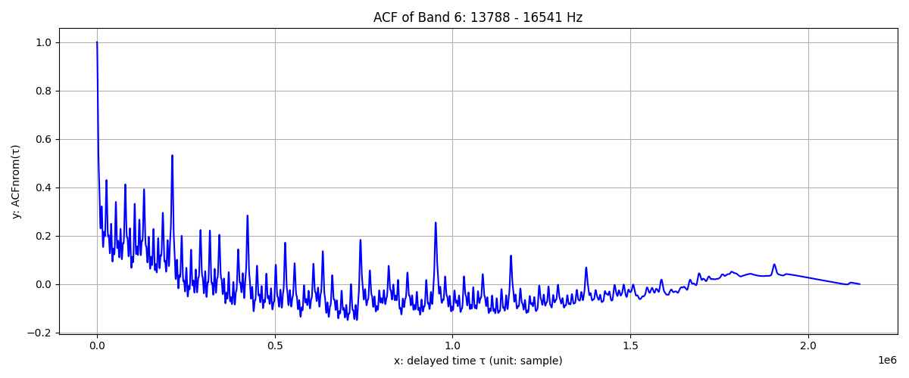
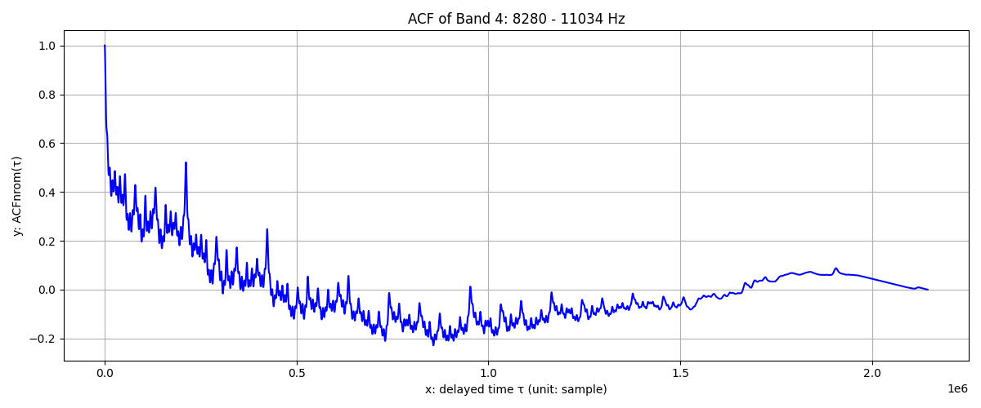
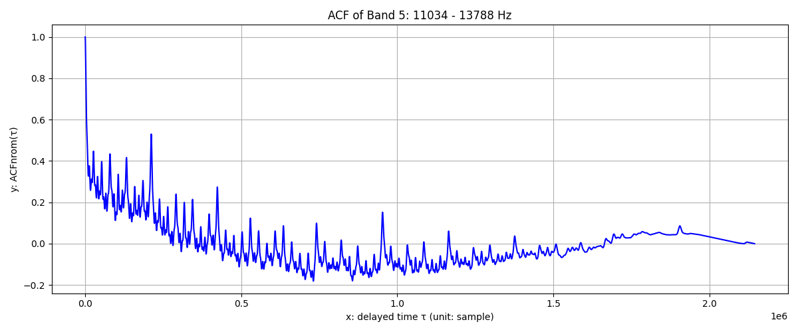
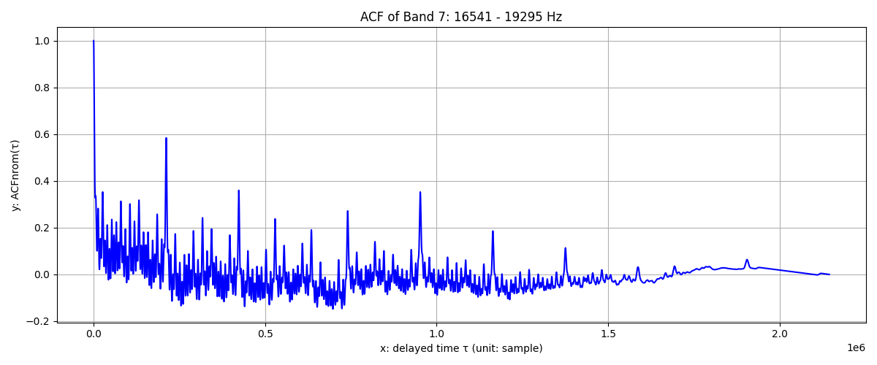
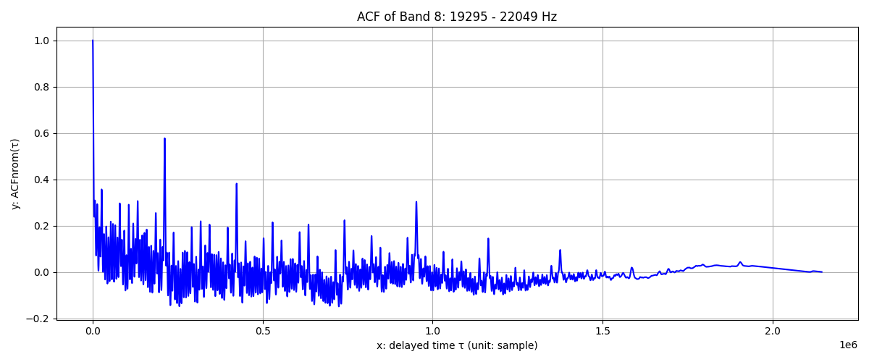

Slide 10
https://github.com/rogerhyung/BPM_DETECTION/tree/main

Slide 11
1 | Detect periodic peaks in the ACF
2 | Compute intervals between peaks
3 | Convert intervals to BPM values
4 | Keep only BPMs in valid range
5 | Count frequency of each BPM
6 | Return the most common estimate

Slide 12
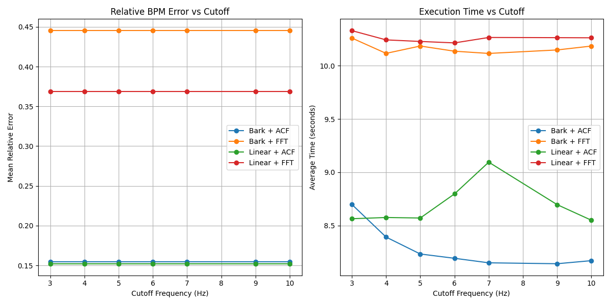
결과

Slide 13
후기
去去去中知 行行行裏覺
거거거중지 행행행리각

