Slide 1

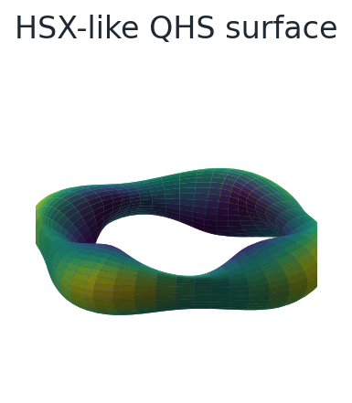
Can we design a stellarator by following gradients?
Lecture 1: what the optimizer actually sees
Equilibrium, Boozer spectrum, and metrics become the design language
Docs: https://sos2026-rjorge-stellarator-optimization.readthedocs.io/
CEA-IRFM / Renaissance Fusion School on Stellarators
Rogerio Jorge, University of Wisconsin-Madison
Aix-en-Provence, 2026
Docs: sos2026-rjorge-stellarator-optimization.readthedocs.io
Repo: github.com/rogeriojorge/sos2026-rjorge-stellarator-optimization
Slide 01

Slide 2
Lecture 1
PART 1. From field lines to hidden symmetry
Goal: turn confinement physics into computable objectives
Caveat: geometry freedom creates an inverse problem
Slide 02
sos2026-rjorge-stellarator-optimization.readthedocs.io
optimization workflow
SOS 2026 Stellarator Optimization, Rogerio Jorge, UW-Madison

Slide 3
Metrics are compressed physics
They are useful only when we know what was compressed
Slide 03
sos2026-rjorge-stellarator-optimization.readthedocs.io
optimization workflow
SOS 2026 Stellarator Optimization, Rogerio Jorge, UW-Madison

Slide 4
What is rotational transform?
Physical meaning
Rotational transform, iota
Iota controls field-line pitch and where rational surfaces can appear.
The number of poloidal turns a magnetic field line makes per toroidal turn on a flux surface.
What the optimizer sees
The optimizer can shape the radial iota profile or avoid low-order rationals in sensitive regions.
iota = Delta theta / Delta zeta
Failure mode
A good scalar score can still land near a rational surface that creates islands.
A stellarator is designed by shaping both the surface and the field-line pitch.
Refs: VMEC equilibrium conventions; Landreman et al., Phys. Plasmas 28, 092505 (2021).
Slide 04
sos2026-rjorge-stellarator-optimization.readthedocs.io
optimization workflow
SOS 2026 Stellarator Optimization, Rogerio Jorge, UW-Madison

Slide 5
Three literature gates shape the workflow
Design question
Optimization interpretation
Precise quasisymmetry
make the Boozer spectrum sparse, then test what remains
Good magnetic surfaces
compare surface-based objectives with island and chaos diagnostics
W7-X validation
reduced neoclassical transport is real progress, but it is one gate in the loop
Refs: Landreman & Paul PRL 128, 035001 (2022); Landreman et al. Phys. Plasmas 28, 092505 (2021); Beidler et al. Nature 596, 221-226 (2021).
Slide 05
sos2026-rjorge-stellarator-optimization.readthedocs.io
optimization workflow
SOS 2026 Stellarator Optimization, Rogerio Jorge, UW-Madison

Slide 6
The optimizer sees artifacts with provenance
Equilibrium
>
Neoclassical
>
Turbulence
>
Pareto
Boozer spectrum
>
Coils
>
Profiles
>
Boundary and profiles create an equilibrium
Spectra and scalars turn physics into objectives
Every scalar needs a validation gate
Slide 06
sos2026-rjorge-stellarator-optimization.readthedocs.io
optimization workflow
SOS 2026 Stellarator Optimization, Rogerio Jorge, UW-Madison

Slide 7
The first object is a surface
A visible surface is a design variable, not yet a validated device.
VMEC background: Hirshman & Whitson, Phys. Fluids 26, 3553 (1983); public cases from landreman/vmec_equilibria.
Slide 07
sos2026-rjorge-stellarator-optimization.readthedocs.io
optimization workflow
SOS 2026 Stellarator Optimization, Rogerio Jorge, UW-Madison

Slide 8
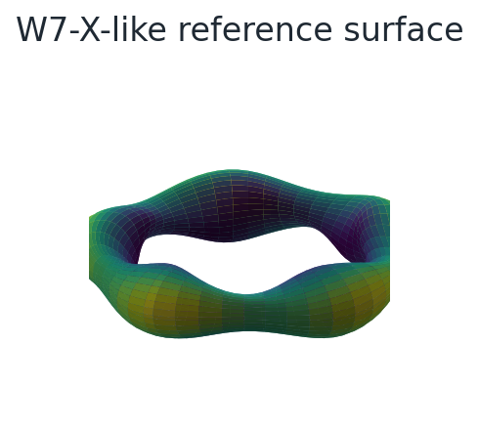
W7-X is the reference case to keep in mind
The reference case anchors the design discussion without duplicating geometry lectures.
Ref: Beidler et al., Nature 596, 221-226 (2021), reduced neoclassical energy transport in W7-X.
Slide 08
sos2026-rjorge-stellarator-optimization.readthedocs.io
optimization workflow
SOS 2026 Stellarator Optimization, Rogerio Jorge, UW-Madison

Slide 9
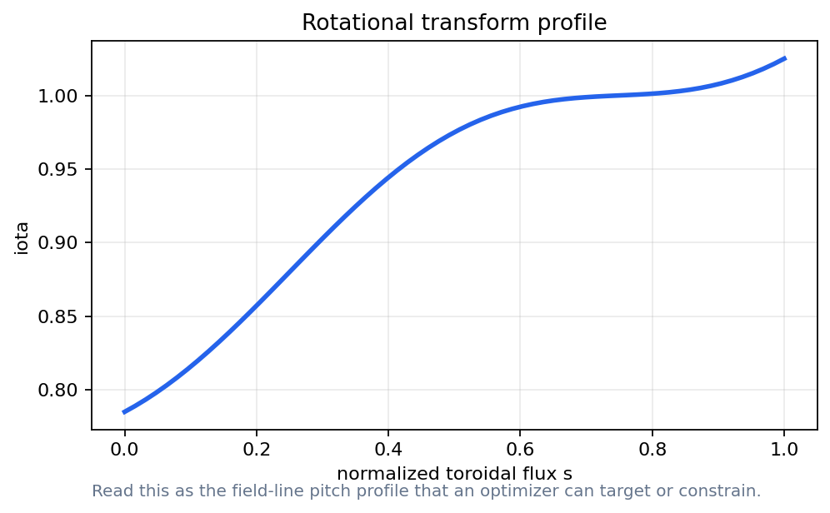
Rotational transform is an optimization target
How to read it
Plot pitch before optimizing spectra
Watch low-order rational surfaces
A profile can be a constraint, an objective, or a diagnostic.
Ref: Landreman, Medasani & Zhu, Phys. Plasmas 28, 092505 (2021), good surfaces and quasisymmetry together.
Slide 09
sos2026-rjorge-stellarator-optimization.readthedocs.io
optimization workflow
SOS 2026 Stellarator Optimization, Rogerio Jorge, UW-Madison

Slide 10
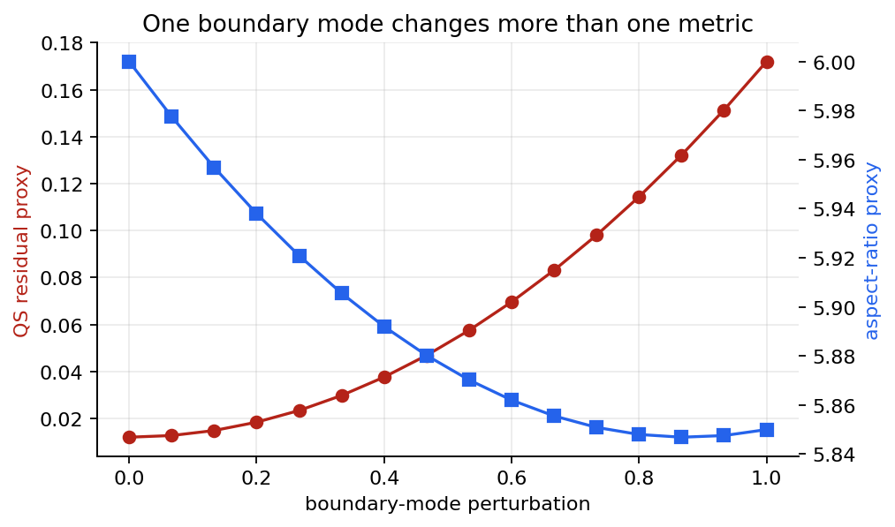
A small boundary mode can move the objective
How to read it
One knob changes QS residual and aspect ratio
This is the gradient intuition for stage 1
The optimizer needs knobs whose effects can be measured.
Slide 10
sos2026-rjorge-stellarator-optimization.readthedocs.io
optimization workflow
SOS 2026 Stellarator Optimization, Rogerio Jorge, UW-Madison

Slide 11
Equilibrium convergence is part of the result
Validation check
Record resolution and residuals
Do not compare designs before the solve is trustworthy
Keep a reliable lecture path alongside research runs
Validation rule: state the assumption, identify the metric, and explain what would change your mind.
Slide 11
sos2026-rjorge-stellarator-optimization.readthedocs.io
optimization workflow
SOS 2026 Stellarator Optimization, Rogerio Jorge, UW-Madison

Slide 12
The wout file is the first checked artifact
command surface
Inspect dimensions, surfaces, and mode counts
$ python scripts/run_smoke_tests.py
$ python scripts/execute_all_notebooks.py
$ python scripts/build_powerpoint_decks.mjs
$ python scripts/check_release_ready.py
Use public HSX/W7-X files when present
Record what was actually read
Slide 12
sos2026-rjorge-stellarator-optimization.readthedocs.io
optimization workflow
SOS 2026 Stellarator Optimization, Rogerio Jorge, UW-Madison

Slide 13
Demo break: first equilibrium object
Notebook break
Notebook: Vmec Jax First Equilibrium
Locate the HSX wout file
Plot surface and iota
Change one boundary-mode proxy
Notebook path: notebooks/01_vmec_jax_first_equilibrium.ipynb
Slide 13
sos2026-rjorge-stellarator-optimization.readthedocs.io
optimization workflow
SOS 2026 Stellarator Optimization, Rogerio Jorge, UW-Madison

Slide 14
Lecture 1
PART 2. Boozer coordinates make symmetry measurable
The spectrum turns geometry into a table
Bad modes become penalties
Slide 14
sos2026-rjorge-stellarator-optimization.readthedocs.io
optimization workflow
SOS 2026 Stellarator Optimization, Rogerio Jorge, UW-Madison

Slide 15
What is a Boozer spectrum?
Physical meaning
Boozer spectrum
Quasisymmetry appears when most off-symmetry coefficients are small.
A Fourier representation of |B| in magnetic coordinates where guiding-center physics has a simple form.
What the optimizer sees
The objective penalizes the modes that break the target symmetry line.
B(theta,zeta)=sum B_mn cos(m theta - n zeta)
Failure mode
A sparse spectrum is not enough if the equilibrium, coils, or transport gates fail.
Boozer coordinates turn hidden symmetry into a plot and a penalty.
Ref: Landreman & Paul, Phys. Rev. Lett. 128, 035001 (2022).
Slide 15
sos2026-rjorge-stellarator-optimization.readthedocs.io
optimization workflow
SOS 2026 Stellarator Optimization, Rogerio Jorge, UW-Madison

Slide 16
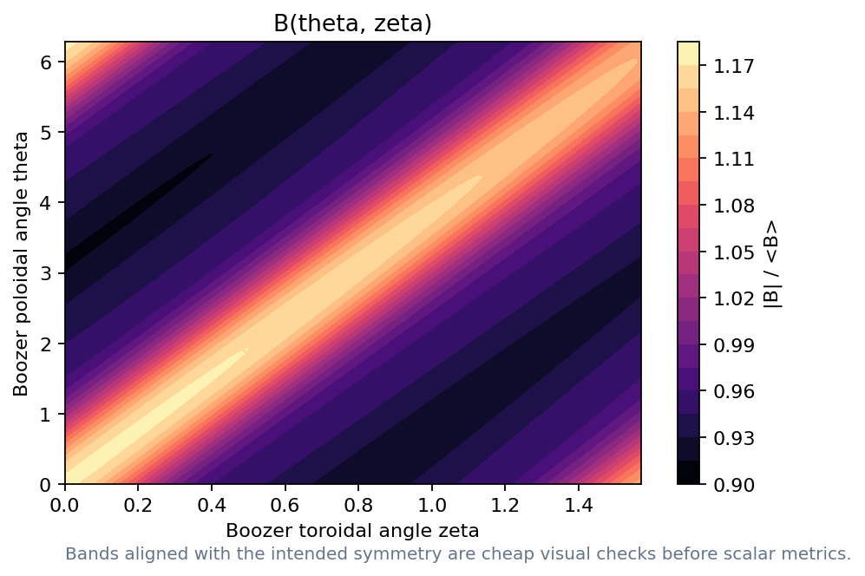
Boozer coordinates make symmetry visible
How to read it
Clean bands suggest the intended symmetry
Broken bands warn before the scalar metric
Use the contour to connect symmetry intuition to the spectrum.
Slide 16
sos2026-rjorge-stellarator-optimization.readthedocs.io
optimization workflow
SOS 2026 Stellarator Optimization, Rogerio Jorge, UW-Madison

Slide 17
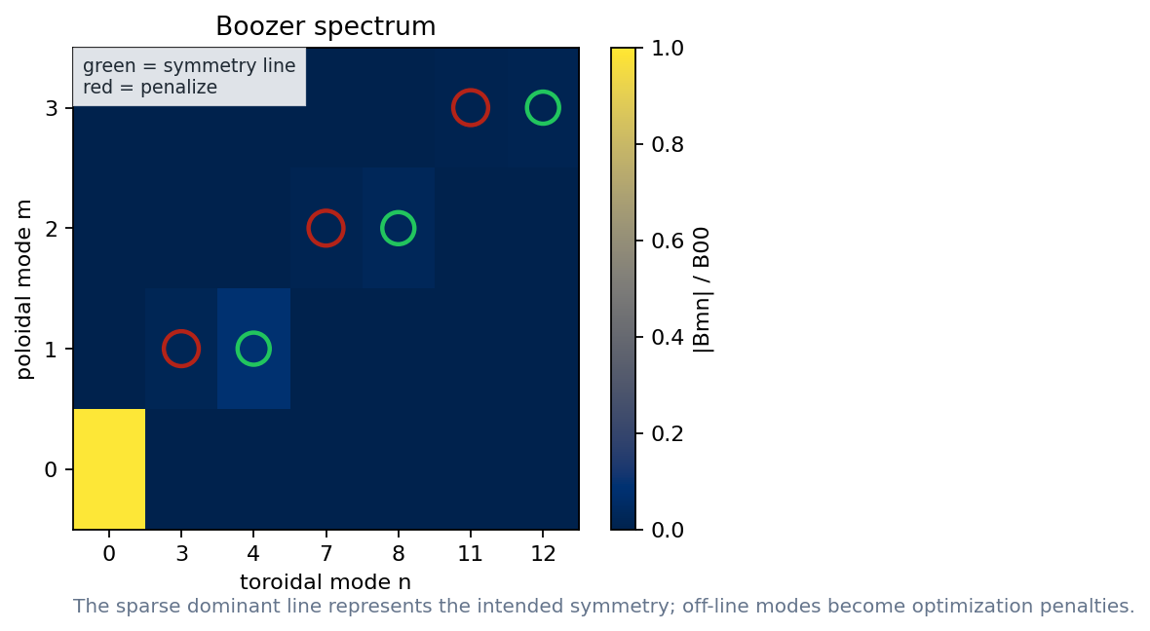
The spectrum tells the optimizer what to penalize
How to read it
Green modes preserve the intended line
Red modes are symmetry-breaking targets
Symmetry-preserving and symmetry-breaking modes are marked explicitly.
Ref: Landreman & Paul, Phys. Rev. Lett. 128, 035001 (2022), precise quasisymmetry.
Slide 17
sos2026-rjorge-stellarator-optimization.readthedocs.io
optimization workflow
SOS 2026 Stellarator Optimization, Rogerio Jorge, UW-Madison

Slide 18
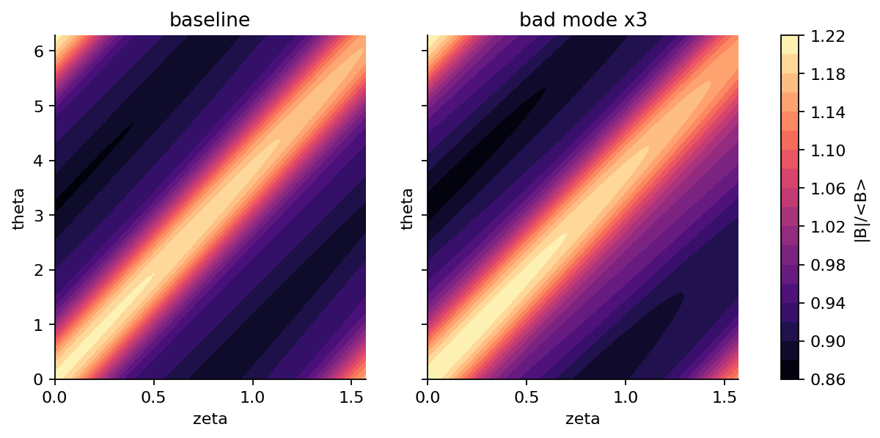
A bad mode changes the picture immediately
How to read it
Perturb one coefficient
Regenerate contour and residual
The exercise is to connect a table entry to a visible field-strength change.
Slide 18
sos2026-rjorge-stellarator-optimization.readthedocs.io
optimization workflow
SOS 2026 Stellarator Optimization, Rogerio Jorge, UW-Madison

Slide 19
Several symmetry targets use the same workflow
Design question
Optimization interpretation
Quasi-axisymmetry
penalize modes off the QA line
Quasi-helical symmetry
keep the QH ridge clean
Quasi-isodynamic
use different metrics but the same artifact discipline
Slide 19
sos2026-rjorge-stellarator-optimization.readthedocs.io
optimization workflow
SOS 2026 Stellarator Optimization, Rogerio Jorge, UW-Madison

Slide 20
What is effective ripple?
Physical meaning
Effective ripple, epsilon_eff
Lower effective ripple usually means lower 1/nu neoclassical losses.
A scalar proxy for ripple-driven trapped-particle radial transport in the low-collisionality neoclassical regime.
What the optimizer sees
Use it as an early screen before expensive drift-kinetic validation.
D_11 ~ epsilon_eff^(3/2) / nu
Failure mode
It does not include every transport channel, electric-field branch, or turbulence effect.
Effective ripple is a fast warning light, not the whole transport model.
Ref: Beidler et al., Nature 596, 221-226 (2021).
Slide 20
sos2026-rjorge-stellarator-optimization.readthedocs.io
optimization workflow
SOS 2026 Stellarator Optimization, Rogerio Jorge, UW-Madison

Slide 21
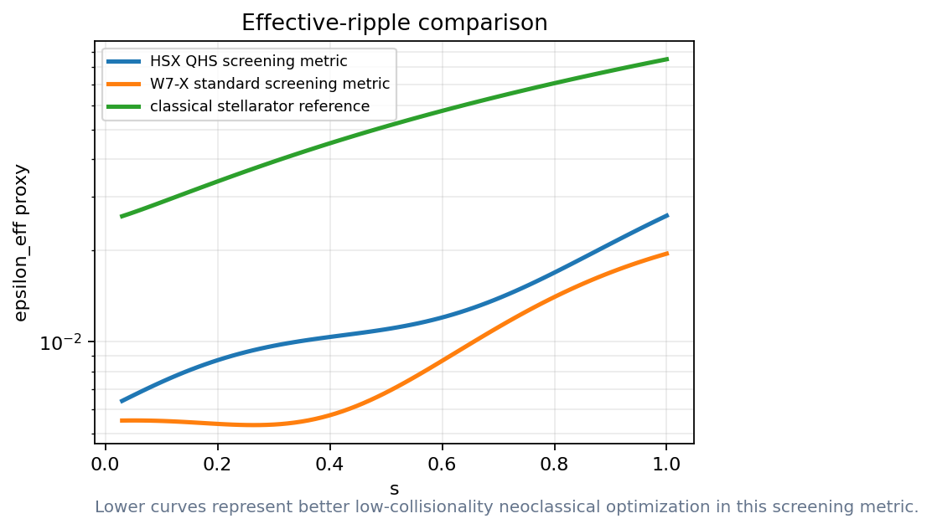
Effective ripple is an early transport warning
How to read it
Lower is better for this screen
Use it before expensive validation
Read the radial trend: lower effective ripple points to lower 1/nu neoclassical loss.
Ref: Beidler et al., Nature 596, 221-226 (2021), effective ripple as a W7-X optimization target.
Slide 21
sos2026-rjorge-stellarator-optimization.readthedocs.io
optimization workflow
SOS 2026 Stellarator Optimization, Rogerio Jorge, UW-Madison

Slide 22
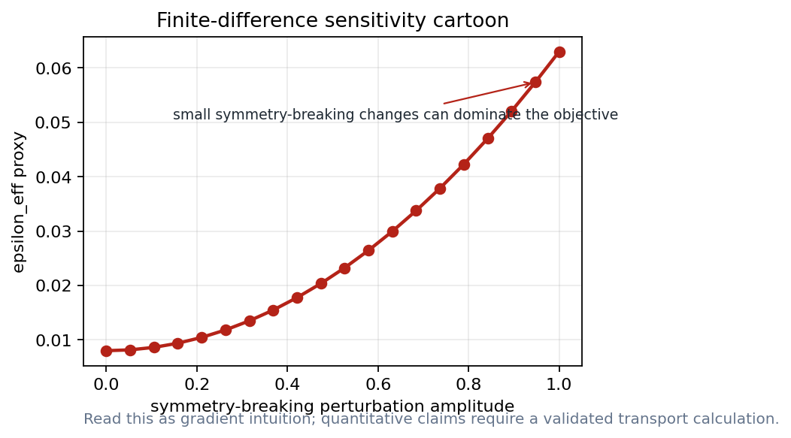
Gradients tell us which knobs matter
How to read it
Finite differences make the sensitivity visible
Autodiff becomes important at scale
The point is sensitivity ranking, not a production derivative.
Slide 22
sos2026-rjorge-stellarator-optimization.readthedocs.io
optimization workflow
SOS 2026 Stellarator Optimization, Rogerio Jorge, UW-Madison

Slide 23
The scalar objective is a negotiation
Weights encode scientific and engineering priorities
Slide 23
sos2026-rjorge-stellarator-optimization.readthedocs.io
optimization workflow
SOS 2026 Stellarator Optimization, Rogerio Jorge, UW-Madison

Slide 24
Demo break: spectrum and ripple
Notebook break
Notebook: Effective Ripple Neo Jax
Circle bad modes
Change one scalar
Explain what the plot proves
Notebook path: notebooks/02_boozer_spectrum.ipynb + notebooks/03_effective_ripple_neo_jax.ipynb
Slide 24
sos2026-rjorge-stellarator-optimization.readthedocs.io
optimization workflow
SOS 2026 Stellarator Optimization, Rogerio Jorge, UW-Madison

Slide 25
Failure mode: optimizing a beautiful plot
Validation check
A clean surface is not a validated design
A scalar can hide the wrong physics
A diagnostic figure must state its assumptions
Validation rule: state the assumption, identify the metric, and explain what would change your mind.
Slide 25
sos2026-rjorge-stellarator-optimization.readthedocs.io
optimization workflow
SOS 2026 Stellarator Optimization, Rogerio Jorge, UW-Madison

Slide 26
Lecture 1 what to remember
Optimization starts with a parameterization
A wout file is a scientific artifact
Boozer spectra turn symmetry into penalties
Metrics must stay connected to validation
A good optimization result is a design argument that survives new metrics.
Slide 26
sos2026-rjorge-stellarator-optimization.readthedocs.io
optimization workflow
SOS 2026 Stellarator Optimization, Rogerio Jorge, UW-Madison

Slide 27
A design loop starts when the artifact can be rerun
Repo and docs are part of the scientific object
Slide 27
sos2026-rjorge-stellarator-optimization.readthedocs.io
optimization workflow
SOS 2026 Stellarator Optimization, Rogerio Jorge, UW-Madison

Slide 28
Lecture 1
APPENDIX. Lecture 1 checks and replacements
Use this section when a live package succeeds
Keep the reference demo path ready for timing
Slide 28
sos2026-rjorge-stellarator-optimization.readthedocs.io
optimization workflow
SOS 2026 Stellarator Optimization, Rogerio Jorge, UW-Madison

Slide 29
VMEC file review
Design question
Optimization interpretation
Dimensions
surfaces, modes, field periods
Variables
iota, pressure, boundary coefficients
Provenance
public repo path and hash
Slide 29
sos2026-rjorge-stellarator-optimization.readthedocs.io
optimization workflow
SOS 2026 Stellarator Optimization, Rogerio Jorge, UW-Madison

Slide 30
Boozer file review
Design question
Optimization interpretation
Surface labels
choose the same radial grid
Mode truncation
report m/n limits
Residual
separate symmetry-preserving from breaking modes
Slide 30
sos2026-rjorge-stellarator-optimization.readthedocs.io
optimization workflow
SOS 2026 Stellarator Optimization, Rogerio Jorge, UW-Madison

Slide 31
When a reference demo is enough
Validation check
Following the design-loop structure
Testing plotting and data plumbing
Preparing exercises with defensible qualitative answers
Validation rule: state the assumption, identify the metric, and explain what would change your mind.
Slide 31
sos2026-rjorge-stellarator-optimization.readthedocs.io
optimization workflow
SOS 2026 Stellarator Optimization, Rogerio Jorge, UW-Madison

Slide 32
When research mode is needed
Validation check
Reporting a numerical value
Comparing HSX and W7-X quantitatively
Changing VMEC or Boozer resolution
Validation rule: state the assumption, identify the metric, and explain what would change your mind.
Slide 32
sos2026-rjorge-stellarator-optimization.readthedocs.io
optimization workflow
SOS 2026 Stellarator Optimization, Rogerio Jorge, UW-Madison

Slide 33
Research path: VMEC_JAX to Boozer transform
command surface
Start from a verified input or wout file
$ python scripts/run_smoke_tests.py
$ python scripts/execute_all_notebooks.py
$ python scripts/build_powerpoint_decks.mjs
$ python scripts/check_release_ready.py
Run a short equilibrium on the lecture machine
Replace screening arrays with documented solver outputs
Slide 33
sos2026-rjorge-stellarator-optimization.readthedocs.io
optimization workflow
SOS 2026 Stellarator Optimization, Rogerio Jorge, UW-Madison

Slide 34
Metric acceptance checklist
Design question
Optimization interpretation
Reference figure
use for trends and discussion
Real-code run
use for numerical claim after provenance check
STATUS.md record
package, data source, and validation domain
Slide 34
sos2026-rjorge-stellarator-optimization.readthedocs.io
optimization workflow
SOS 2026 Stellarator Optimization, Rogerio Jorge, UW-Madison

Slide 35
Reference figure: HSX surface
Reference image for the surface discussion.
Slide 35
sos2026-rjorge-stellarator-optimization.readthedocs.io
optimization workflow
SOS 2026 Stellarator Optimization, Rogerio Jorge, UW-Madison

Slide 36
Reference figure: Boozer contour
How to read it
Use to read the expected symmetry pattern
Discuss the expected symmetry pattern
Reference image for reading the contour before scalarizing.
Slide 36
sos2026-rjorge-stellarator-optimization.readthedocs.io
optimization workflow
SOS 2026 Stellarator Optimization, Rogerio Jorge, UW-Madison

Slide 37
Discussion: what did the optimizer see?
Design question
Optimization interpretation
Design variable
boundary modes and profiles
Computed object
equilibrium, spectra, scalar metrics
Decision variable
which scalar deserves trust
Slide 37
sos2026-rjorge-stellarator-optimization.readthedocs.io
optimization workflow
SOS 2026 Stellarator Optimization, Rogerio Jorge, UW-Madison

Slide 38
Lecture 1
What to remember
Keep the scientific object and the computed artifact together
Rerun, perturb, compare, and explain before trusting the optimum
Docs: https://sos2026-rjorge-stellarator-optimization.readthedocs.io/
github.com/rogeriojorge/sos2026-rjorge-stellarator-optimization
sos2026-rjorge-stellarator-optimization.readthedocs.io
Repo lab handoff: rerun, perturb, compare, explain.
Slide 38

