Slide 1

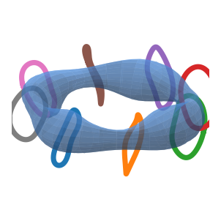
Can we build the field that we optimized?
Lecture 2: coils, quadratic flux, and single-stage design
A plasma boundary is a wish; coils are the contract
Docs: https://sos2026-rjorge-stellarator-optimization.readthedocs.io/
CEA-IRFM / Renaissance Fusion School on Stellarators
Rogerio Jorge, University of Wisconsin-Madison
Aix-en-Provence, 2026
Docs: sos2026-rjorge-stellarator-optimization.readthedocs.io
Repo: github.com/rogeriojorge/sos2026-rjorge-stellarator-optimization
Slide 01

Slide 2
Lecture 2
PART 1. The coil inverse problem
Stage 1 gives a target surface
Stage 2 asks hardware to reproduce it
Slide 02
sos2026-rjorge-stellarator-optimization.readthedocs.io
optimization workflow
SOS 2026 Stellarator Optimization, Rogerio Jorge, UW-Madison

Slide 3
Never show a beautiful plasma without its coils
The engineering contract starts at B dot n
Slide 03
sos2026-rjorge-stellarator-optimization.readthedocs.io
optimization workflow
SOS 2026 Stellarator Optimization, Rogerio Jorge, UW-Madison

Slide 4
Stage 1, stage 2, single stage
Design question
Optimization interpretation
Stage 1
optimize the plasma target
Stage 2
fit coils to that target
Single stage
move plasma and coils together
Slide 04
sos2026-rjorge-stellarator-optimization.readthedocs.io
optimization workflow
SOS 2026 Stellarator Optimization, Rogerio Jorge, UW-Madison

Slide 5
What is a modular coil set?
Physical meaning
Modular coils
The loops are hardware objects: length, curvature, separation, ports, and tolerance matter.
A set of separate closed coils placed around the torus, each shaped to reproduce the target magnetic surface.
What the optimizer sees
Move coil control points while measuring normal-field error and engineering regularization.
min ∫ |B · n|^2 dA + engineering penalties
Failure mode
A coil set can reproduce the surface mathematically while being too complex or too close to the plasma.
The field is credible only when the coil geometry is credible.
Refs: SIMSOPT JOSS 6, 3525 (2021); Giuliani et al., JCP 459, 111147 (2022).
Slide 05
sos2026-rjorge-stellarator-optimization.readthedocs.io
optimization workflow
SOS 2026 Stellarator Optimization, Rogerio Jorge, UW-Madison

Slide 6
Single-stage changed the controlled object
Design question
Optimization interpretation
Two-stage
choose a plasma boundary first, then ask coils to reproduce it
Fixed-boundary single-stage
boundary and coils move together through a quadratic-flux penalty
Simplified coils
few-coil designs become searchable, but engineering gates still decide viability
Refs: Jorge et al., PPCF 65, 074003 (2023); Jorge, Giuliani & Loizu, arXiv:2406.07830 (2024); Giuliani et al., JCP 459, 111147 (2022).
Slide 06
sos2026-rjorge-stellarator-optimization.readthedocs.io
optimization workflow
SOS 2026 Stellarator Optimization, Rogerio Jorge, UW-Madison

Slide 7

Initial coils define the first mismatch
The first coil set shows the inverse problem before regularization.
Slide 07
sos2026-rjorge-stellarator-optimization.readthedocs.io
optimization workflow
SOS 2026 Stellarator Optimization, Rogerio Jorge, UW-Madison

Slide 8
Final coils reduce the obvious mismatch
A better coil picture is still not a manufacturability proof.
Ref: SIMSOPT, Landreman et al., JOSS 6, 3525 (2021).
Slide 08
sos2026-rjorge-stellarator-optimization.readthedocs.io
optimization workflow
SOS 2026 Stellarator Optimization, Rogerio Jorge, UW-Madison

Slide 9
What does B dot n measure?
Physical meaning
Normal-field error
If B dot n is large, field lines pierce the intended boundary instead of staying tangent to it.
The component of the coil-produced magnetic field that crosses the target plasma boundary.
What the optimizer sees
Stage-2 optimization drives the normal-field error down while respecting coil complexity.
B · n = 0 on the target surface
Failure mode
A small B dot n can still hide current, clearance, tolerance, or maintenance problems.
B dot n is the first coil score; it is not the last engineering score.
Ref: SIMSOPT stage-two coil optimization workflow.
Slide 09
sos2026-rjorge-stellarator-optimization.readthedocs.io
optimization workflow
SOS 2026 Stellarator Optimization, Rogerio Jorge, UW-Madison

Slide 10
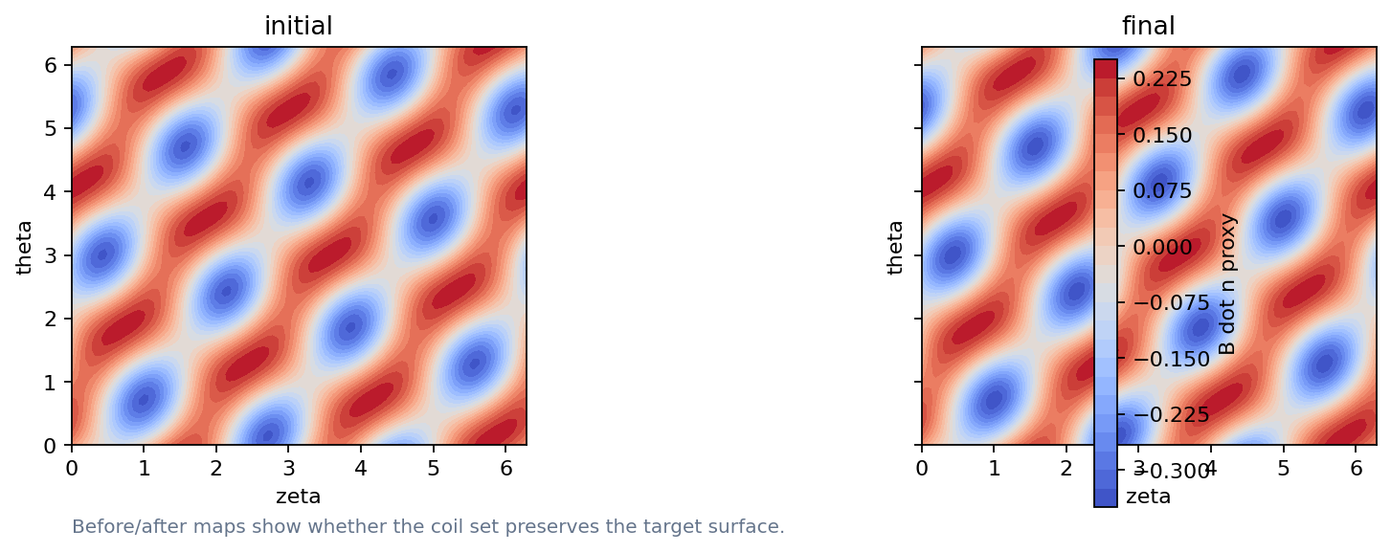
B dot n is the basic stage-2 score
How to read it
Blue/red patches show normal-field error
The target surface is damaged when patches remain
Quadratic flux measures whether coils reproduce the requested boundary.
Ref: SIMSOPT docs stage-two coil optimization example.
Slide 10
sos2026-rjorge-stellarator-optimization.readthedocs.io
optimization workflow
SOS 2026 Stellarator Optimization, Rogerio Jorge, UW-Madison

Slide 11
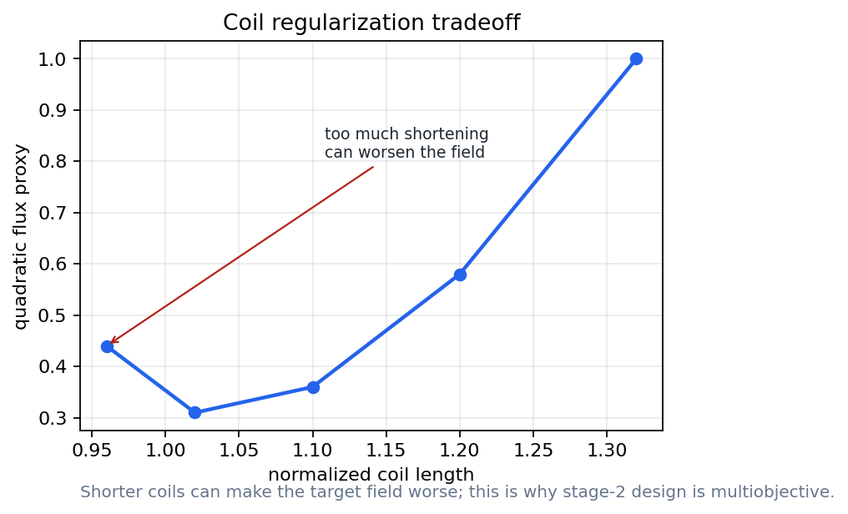
Regularization trades field quality for hardware
How to read it
Shorter coils can make B dot n worse
A single optimum hides the engineering choice
The annotation marks what gets worse when coils are pushed too hard.
Slide 11
sos2026-rjorge-stellarator-optimization.readthedocs.io
optimization workflow
SOS 2026 Stellarator Optimization, Rogerio Jorge, UW-Madison

Slide 12
Coil complexity has multiple dimensions
Design question
Optimization interpretation
Length
cost, maintenance, and access
Curvature
force and strain risk
Separation
ports and assembly constraints
Slide 12
sos2026-rjorge-stellarator-optimization.readthedocs.io
optimization workflow
SOS 2026 Stellarator Optimization, Rogerio Jorge, UW-Madison

Slide 13
Ports and maintenance enter early
Validation check
Access can invalidate attractive coil sets
Use engineering constraints as penalties or hard gates
Validation rule: state the assumption, identify the metric, and explain what would change your mind.
Slide 13
sos2026-rjorge-stellarator-optimization.readthedocs.io
optimization workflow
SOS 2026 Stellarator Optimization, Rogerio Jorge, UW-Madison

Slide 14
Demo break: SIMSOPT stage-2 coils
Notebook break
Notebook: Simsopt Stage2 Coils
Compare initial and final coils
Plot B dot n maps
Name the tradeoff
Notebook path: notebooks/04_simsopt_stage2_coils.ipynb
Slide 14
sos2026-rjorge-stellarator-optimization.readthedocs.io
optimization workflow
SOS 2026 Stellarator Optimization, Rogerio Jorge, UW-Madison

Slide 15
Lecture 2
PART 2. Direct optimization
Move field, particles, and coils in the same loop
Use differentiable codes where the gradient is meaningful
Slide 15
sos2026-rjorge-stellarator-optimization.readthedocs.io
optimization workflow
SOS 2026 Stellarator Optimization, Rogerio Jorge, UW-Madison

Slide 16
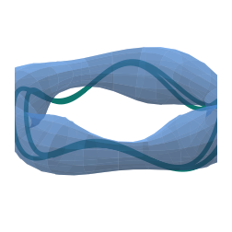
Fieldlines diagnose topology
The fieldline is a topology diagnostic; particle confinement needs a separate check.
Slide 16
sos2026-rjorge-stellarator-optimization.readthedocs.io
optimization workflow
SOS 2026 Stellarator Optimization, Rogerio Jorge, UW-Madison

Slide 17
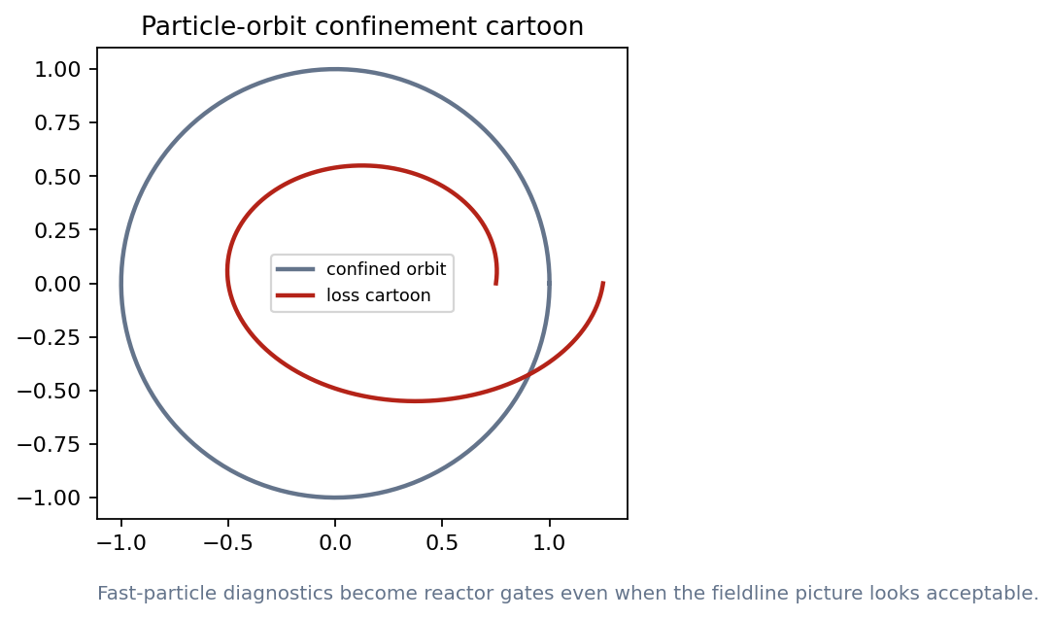
Particles answer a different question
How to read it
Fieldlines do not guarantee confinement
Fast-particle gates matter for reactors
Orbit cartoons teach why particle objectives can enter directly.
Slide 17
sos2026-rjorge-stellarator-optimization.readthedocs.io
optimization workflow
SOS 2026 Stellarator Optimization, Rogerio Jorge, UW-Madison

Slide 18
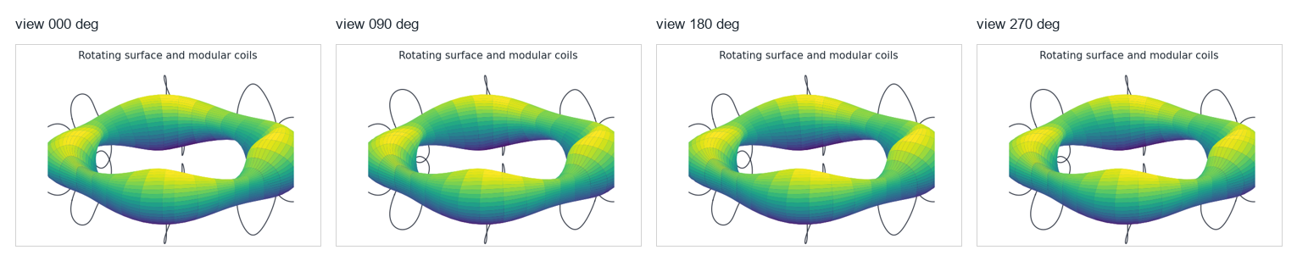
Animation storyboard: rotating surface and modular coils
Use the four views to explain modular-coil clearance
Emphasize that coils and surface must be judged together
Static storyboard for reliable projection; the movie file remains in the repo.
Slide 18
sos2026-rjorge-stellarator-optimization.readthedocs.io
optimization workflow
SOS 2026 Stellarator Optimization, Rogerio Jorge, UW-Madison

Slide 19
Single-stage design keeps coils in the loop
Equilibrium
>
Neoclassical
>
Turbulence
>
Pareto
Boozer spectrum
>
Coils
>
Profiles
>
Boundary variables and coil variables move together
The objective includes plasma metrics, flux error, and coil metrics
Ref: Jorge et al., PPCF 65, 074003 (2023), single-stage fixed-boundary/coils workflow.
Slide 19
sos2026-rjorge-stellarator-optimization.readthedocs.io
optimization workflow
SOS 2026 Stellarator Optimization, Rogerio Jorge, UW-Madison

Slide 20
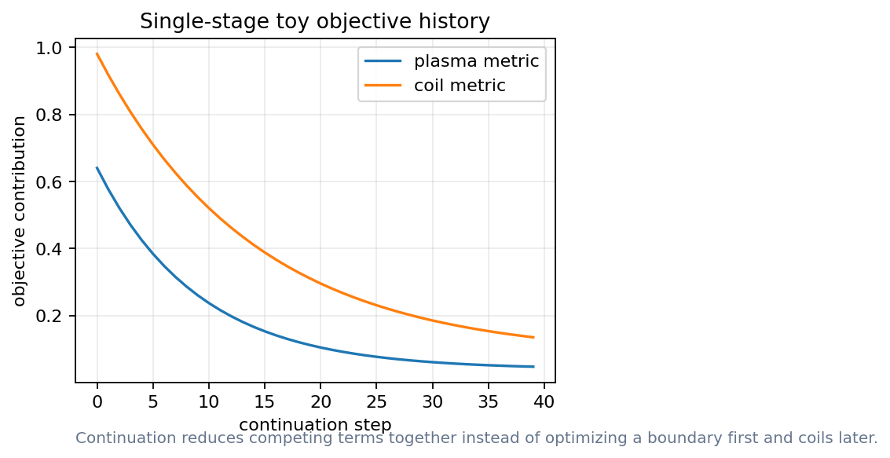
Continuation makes the negotiation visible
How to read it
Watch objective terms decrease together
Stop when one term dominates the story
A coupled objective is a trace, not just a final number.
Slide 20
sos2026-rjorge-stellarator-optimization.readthedocs.io
optimization workflow
SOS 2026 Stellarator Optimization, Rogerio Jorge, UW-Madison

Slide 21
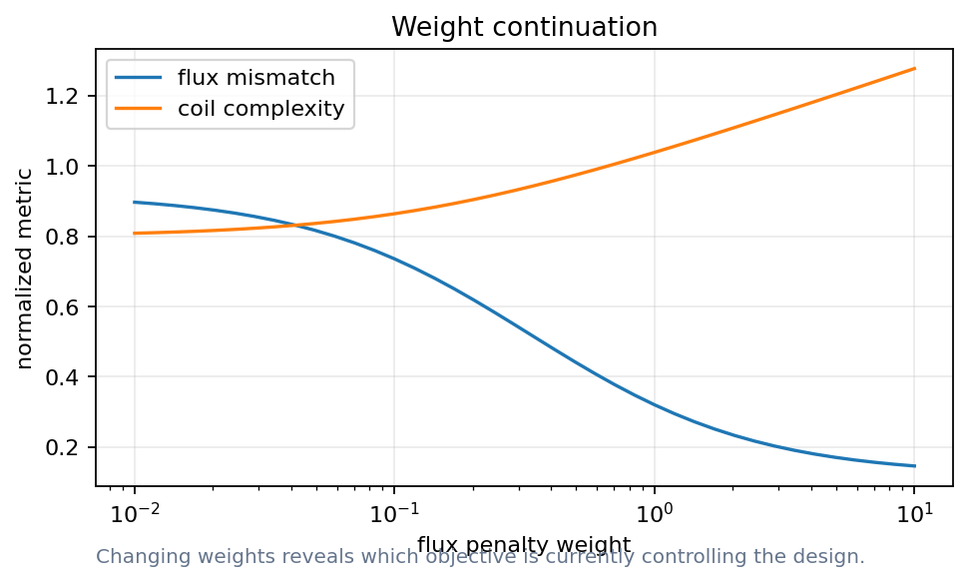
Weights reveal which constraint is active
How to read it
Increasing one weight can improve one metric and hurt another
This is the classroom Pareto intuition
Weight scans are design arguments.
Slide 21
sos2026-rjorge-stellarator-optimization.readthedocs.io
optimization workflow
SOS 2026 Stellarator Optimization, Rogerio Jorge, UW-Madison

Slide 22
Demo break: fieldlines and single-stage toy
Notebook break
Notebook: Essos Fieldlines Particles
Change one weight
Run the reference diagnostics
Defend the result
Notebook path: notebooks/05_single_stage_toy.ipynb + notebooks/06_essos_fieldlines_particles.ipynb
Slide 22
sos2026-rjorge-stellarator-optimization.readthedocs.io
optimization workflow
SOS 2026 Stellarator Optimization, Rogerio Jorge, UW-Madison

Slide 23
Autodiff still needs validation
Validation check
A gradient is a derivative of the implemented model
The implemented model still has a validity domain
Finite differences remain a check
Validation rule: state the assumption, identify the metric, and explain what would change your mind.
Slide 23
sos2026-rjorge-stellarator-optimization.readthedocs.io
optimization workflow
SOS 2026 Stellarator Optimization, Rogerio Jorge, UW-Madison

Slide 24
Robustness is a stage-2 metric
Design question
Optimization interpretation
Manufacturing errors
sensitivity to shape perturbations
Current perturbations
sensitivity to power-supply changes
Maintenance tolerance
clearance, curvature, and access
Slide 24
sos2026-rjorge-stellarator-optimization.readthedocs.io
optimization workflow
SOS 2026 Stellarator Optimization, Rogerio Jorge, UW-Madison

Slide 25
Lecture 2 what to remember
Stage 2 turns a field design into hardware
Coil regularization is part of the objective
Single-stage optimization changes the tradeoff surface
Test engineering as a gate
A good optimization result is a design argument that survives new metrics.
Slide 25
sos2026-rjorge-stellarator-optimization.readthedocs.io
optimization workflow
SOS 2026 Stellarator Optimization, Rogerio Jorge, UW-Madison

Slide 26
Simple coils far away from the plasma are difficult to find
That sentence is an optimization problem
Slide 26
sos2026-rjorge-stellarator-optimization.readthedocs.io
optimization workflow
SOS 2026 Stellarator Optimization, Rogerio Jorge, UW-Madison

Slide 27
Lecture 2
APPENDIX. Lecture 2 checks and replacements
Use this section when SIMSOPT or ESSOS is available
Keep reference figures for lecture timing
Slide 27
sos2026-rjorge-stellarator-optimization.readthedocs.io
optimization workflow
SOS 2026 Stellarator Optimization, Rogerio Jorge, UW-Madison

Slide 28
Stage-2 objective terms
Design question
Optimization interpretation
Normal-field error
does the coil set reproduce the target?
Length and curvature
can the coil be built and maintained?
Separation and access
can the device be assembled and diagnosed?
Slide 28
sos2026-rjorge-stellarator-optimization.readthedocs.io
optimization workflow
SOS 2026 Stellarator Optimization, Rogerio Jorge, UW-Madison

Slide 29
SIMSOPT research path
command surface
Load the public QA target
$ python scripts/run_smoke_tests.py
$ python scripts/execute_all_notebooks.py
$ python scripts/build_powerpoint_decks.mjs
$ python scripts/check_release_ready.py
Build curves and Biot-Savart fields
Run a short optimization before class
Slide 29
sos2026-rjorge-stellarator-optimization.readthedocs.io
optimization workflow
SOS 2026 Stellarator Optimization, Rogerio Jorge, UW-Madison

Slide 30
Fieldlines and particles answer different questions
Design question
Optimization interpretation
Fieldlines
topology and stochasticity
Particles
alpha-loss and orbit width
Both
rerun after coil changes
Slide 30
sos2026-rjorge-stellarator-optimization.readthedocs.io
optimization workflow
SOS 2026 Stellarator Optimization, Rogerio Jorge, UW-Madison

Slide 31
Single-stage acceptance checks
Validation check
The plasma metric improves without hiding coil complexity
The coil metric improves without destroying confinement metrics
The combined gradient passes a finite-difference check
Validation rule: state the assumption, identify the metric, and explain what would change your mind.
Slide 31
sos2026-rjorge-stellarator-optimization.readthedocs.io
optimization workflow
SOS 2026 Stellarator Optimization, Rogerio Jorge, UW-Madison

Slide 32
Reference figure: initial coils
Slide 32
sos2026-rjorge-stellarator-optimization.readthedocs.io
optimization workflow
SOS 2026 Stellarator Optimization, Rogerio Jorge, UW-Madison

Slide 33
Reference figure: final coils
Slide 33
sos2026-rjorge-stellarator-optimization.readthedocs.io
optimization workflow
SOS 2026 Stellarator Optimization, Rogerio Jorge, UW-Madison

Slide 34
Reference figure: particle orbit
How to read it
Use if a particle trace is unavailable
Connect orbit loss to reactor gates
Read the plot as a diagnostic, not as a new validated result.
Slide 34
sos2026-rjorge-stellarator-optimization.readthedocs.io
optimization workflow
SOS 2026 Stellarator Optimization, Rogerio Jorge, UW-Madison

Slide 35
Coil robustness outputs to track
Design question
Optimization interpretation
Shape perturbations
sensitivity of B dot n
Current errors
sensitivity of flux surfaces
Mechanical tolerance
clearance, curvature, access
Slide 35
sos2026-rjorge-stellarator-optimization.readthedocs.io
optimization workflow
SOS 2026 Stellarator Optimization, Rogerio Jorge, UW-Madison

Slide 36
Discussion: can a coil set win with the wrong metric?
Design question
Optimization interpretation
Lower B dot n
can come with high curvature
Smoother coils
can miss the target boundary
First experiment
needs both magnetic accuracy and engineering margin
Slide 36
sos2026-rjorge-stellarator-optimization.readthedocs.io
optimization workflow
SOS 2026 Stellarator Optimization, Rogerio Jorge, UW-Madison

Slide 37
Lecture 2
What to remember
Keep the scientific object and the computed artifact together
Rerun, perturb, compare, and explain before trusting the optimum
Docs: https://sos2026-rjorge-stellarator-optimization.readthedocs.io/
github.com/rogeriojorge/sos2026-rjorge-stellarator-optimization
sos2026-rjorge-stellarator-optimization.readthedocs.io
Repo lab handoff: rerun, perturb, compare, explain.
Slide 37

