Slide 1

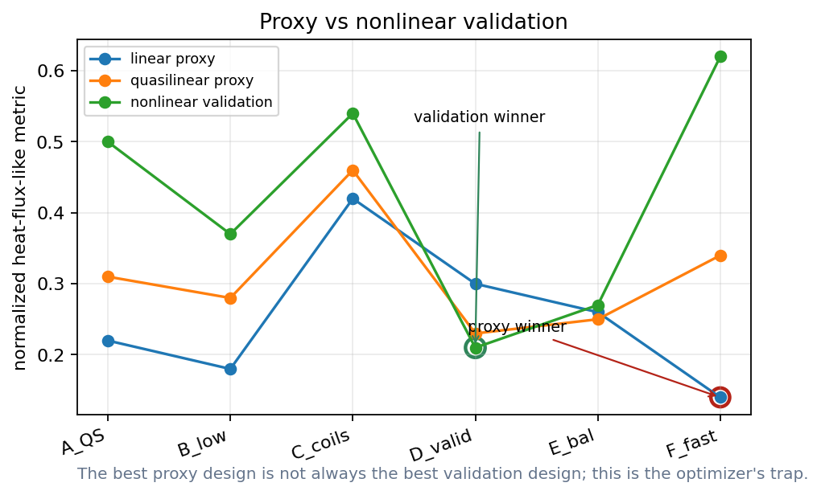
What should go into the objective function?
Lecture 3: neoclassical, turbulence, and fast-particle gates
Can transport physics become an optimization metric?
Docs: https://sos2026-rjorge-stellarator-optimization.readthedocs.io/
CEA-IRFM / Renaissance Fusion School on Stellarators
Rogerio Jorge, University of Wisconsin-Madison
Aix-en-Provence, 2026
Docs: sos2026-rjorge-stellarator-optimization.readthedocs.io
Repo: github.com/rogeriojorge/sos2026-rjorge-stellarator-optimization
Slide 01

Slide 2
Lecture 3
PART 1. A hierarchy of transport calculations
Cheap screens move many designs
Expensive calculations validate finalists
Slide 02
sos2026-rjorge-stellarator-optimization.readthedocs.io
optimization workflow
SOS 2026 Stellarator Optimization, Rogerio Jorge, UW-Madison

Slide 3
What is neoclassical transport?
Physical meaning
Neoclassical transport
It is geometry sensitive, especially in stellarators, and can be reduced by optimization.
Collisional transport caused by guiding-center drifts in a toroidal magnetic field with trapped particles.
What the optimizer sees
Use cheap geometry metrics first, then drift-kinetic validation for finalists.
Gamma, Q = functions(geometry, nu, E_r, profiles)
Failure mode
The result depends on collisionality, radial electric field, species, and profiles.
Neoclassical metrics are geometry gates with plasma-state assumptions.
Refs: Helander RPP 77, 087001 (2014); Beidler et al., Nature 596, 221-226 (2021).
Slide 03
sos2026-rjorge-stellarator-optimization.readthedocs.io
optimization workflow
SOS 2026 Stellarator Optimization, Rogerio Jorge, UW-Madison

Slide 4
The optimizer follows the metric we choose
Metric design is part of physics
Slide 04
sos2026-rjorge-stellarator-optimization.readthedocs.io
optimization workflow
SOS 2026 Stellarator Optimization, Rogerio Jorge, UW-Madison

Slide 5
Cost hierarchy for transport metrics
Design question
Optimization interpretation
Geometry metrics
fastest screens
Effective ripple and Boozer metrics
early transport warnings
DKE, gyrokinetics, particles, profiles
validation gates
Slide 05
sos2026-rjorge-stellarator-optimization.readthedocs.io
optimization workflow
SOS 2026 Stellarator Optimization, Rogerio Jorge, UW-Madison

Slide 6
Transport literature says: validate the winner
Design question
Optimization interpretation
W7-X
neoclassical optimization reduced the geometry-driven loss channel
SFINCS
drift-kinetic validation depends on trajectory, electric-field, and collision modeling choices
Nonlinear turbulence
heat-flux objectives can be noisy enough to need stochastic or staged optimization
Refs: Beidler et al., Nature 596, 221-226 (2021); Landreman et al., Phys. Plasmas 21, 042503 (2014); Kim et al., JPP 90, 905900203 (2024).
Slide 06
sos2026-rjorge-stellarator-optimization.readthedocs.io
optimization workflow
SOS 2026 Stellarator Optimization, Rogerio Jorge, UW-Madison

Slide 7
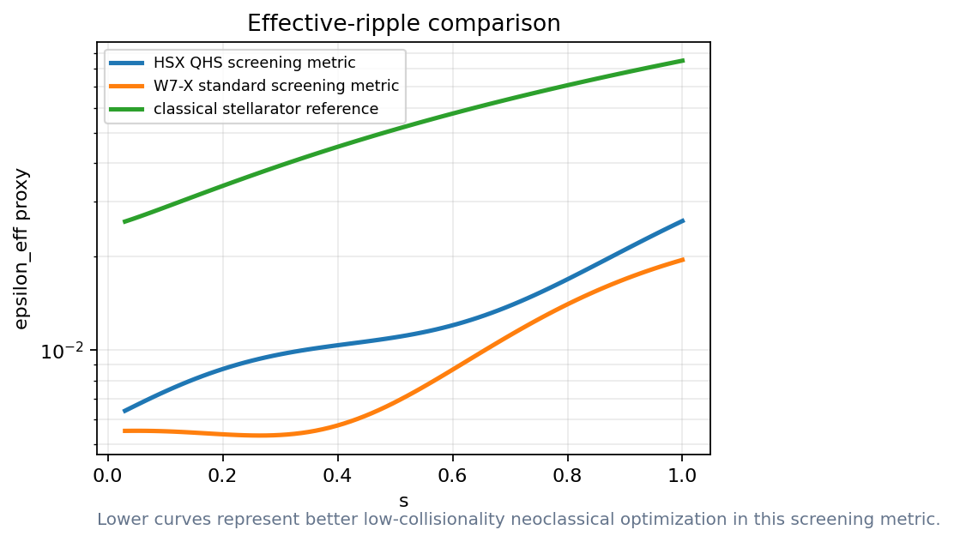
Effective ripple is a neoclassical screen
How to read it
Rank candidates before expensive runs
Do not treat the scalar as the whole transport story
These curves show how the screen should be read; full transport validation remains a separate step.
Slide 07
sos2026-rjorge-stellarator-optimization.readthedocs.io
optimization workflow
SOS 2026 Stellarator Optimization, Rogerio Jorge, UW-Madison

Slide 8
What is D11?
Physical meaning
D11 transport coefficient
It tells how strongly particles diffuse radially for a given thermodynamic drive.
A radial particle-transport coefficient from the drift-kinetic response, often scanned versus collisionality.
What the optimizer sees
Use D11 scans to test whether a low-ripple design remains good under richer kinetic physics.
Gamma_1 = - n D_11 (d ln n / dr + ...)
Failure mode
A single D11 curve is not a full flux prediction without Er, sources, profiles, and species choices.
D11 is a validation coefficient, not a universal confinement number.
Ref: Landreman et al., Phys. Plasmas 21, 042503 (2014).
Slide 08
sos2026-rjorge-stellarator-optimization.readthedocs.io
optimization workflow
SOS 2026 Stellarator Optimization, Rogerio Jorge, UW-Madison

Slide 9
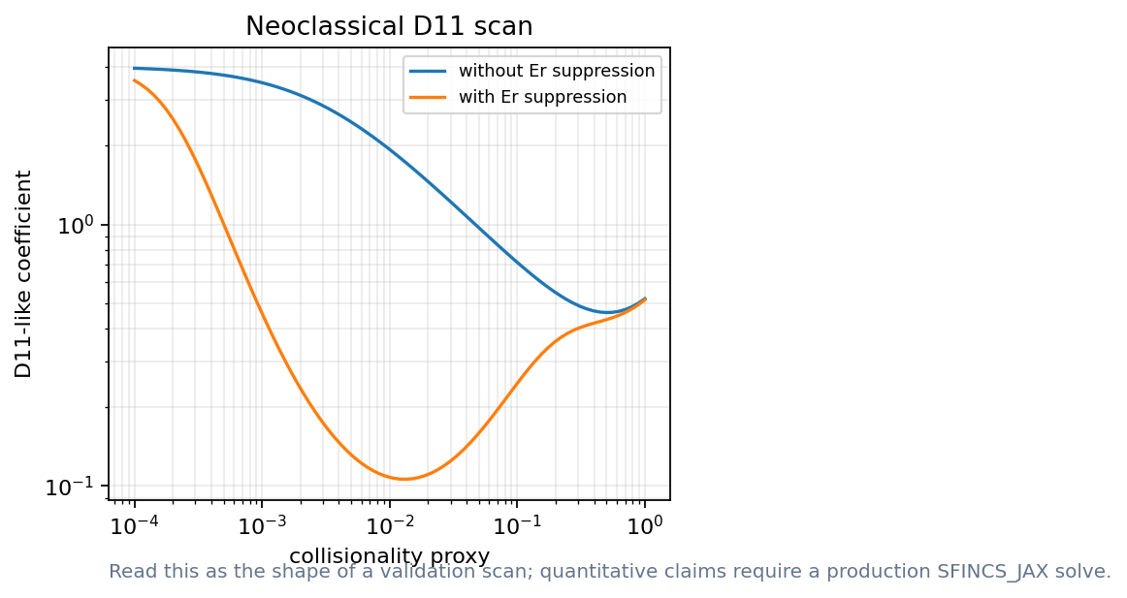
D11 scans add richer validation
How to read it
Collisionality changes the answer
Er suppression changes the interpretation
Read the slope, the electric-field suppression, and the collisionality window.
Ref: Landreman et al., Phys. Plasmas 21, 042503 (2014), SFINCS drift-kinetic solver.
Slide 09
sos2026-rjorge-stellarator-optimization.readthedocs.io
optimization workflow
SOS 2026 Stellarator Optimization, Rogerio Jorge, UW-Madison

Slide 10
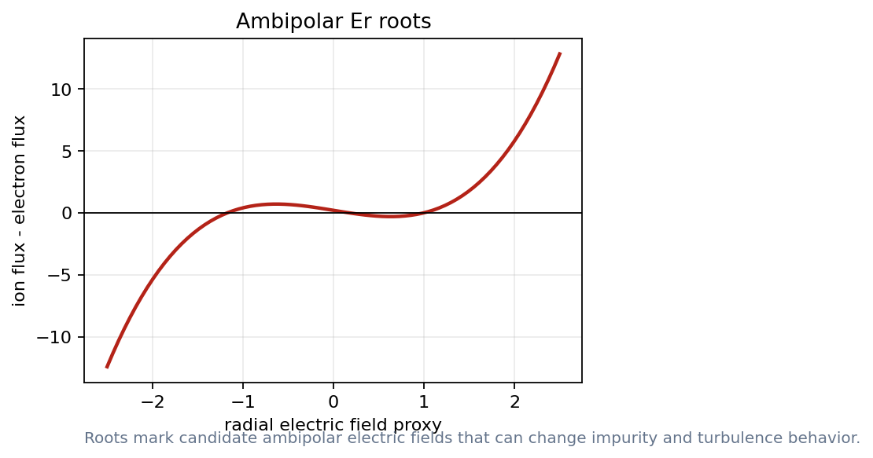
Ambipolar roots are not always unique
How to read it
Multiple roots imply multiple regimes
Optimization needs a root-choice rule
The root structure is the lesson; the numbers are not a live SFINCS result.
Slide 10
sos2026-rjorge-stellarator-optimization.readthedocs.io
optimization workflow
SOS 2026 Stellarator Optimization, Rogerio Jorge, UW-Madison

Slide 11
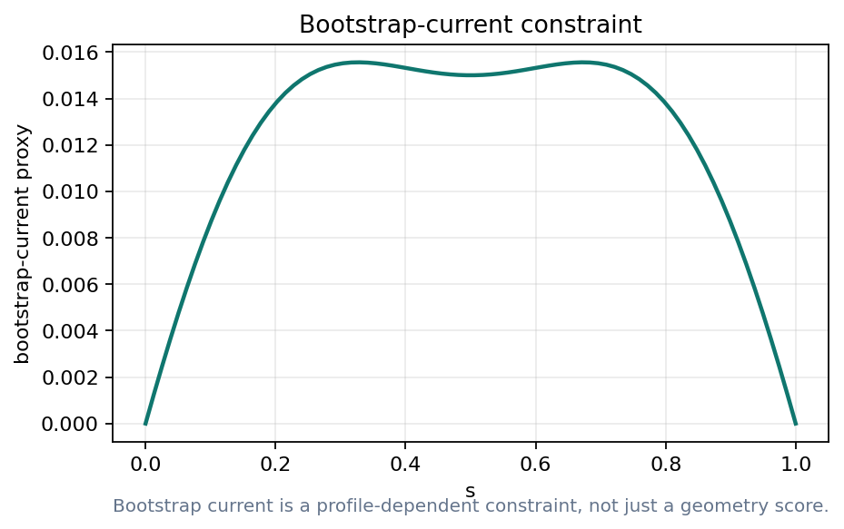
Bootstrap current feeds back on equilibrium
How to read it
Bootstrap current can alter transform and islands
Profile dependence enters early
Transport outputs become equilibrium inputs.
Slide 11
sos2026-rjorge-stellarator-optimization.readthedocs.io
optimization workflow
SOS 2026 Stellarator Optimization, Rogerio Jorge, UW-Madison

Slide 12
W7-X lesson for optimizers
Design question
Optimization interpretation
Neoclassical optimization
reduced radial losses
Ion-temperature clamping
turbulence bottleneck
Profiles
decide whether the metric matters experimentally
Slide 12
sos2026-rjorge-stellarator-optimization.readthedocs.io
optimization workflow
SOS 2026 Stellarator Optimization, Rogerio Jorge, UW-Madison

Slide 13
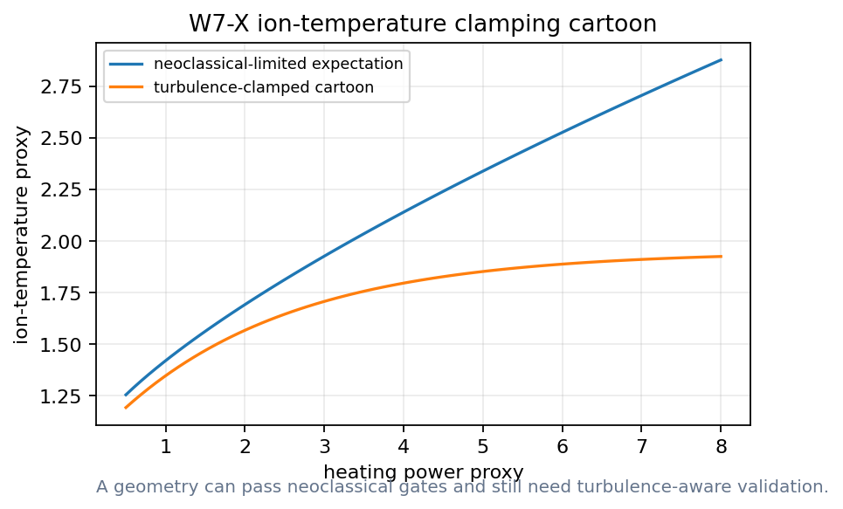
Neoclassical success can expose turbulence
How to read it
The blue expectation keeps rising
The orange curve saturates
The cartoon motivates turbulence-aware validation without rederiving transport theory.
Ref: Beidler et al., Nature 596, 221-226 (2021); W7-X ion-temperature clamping literature.
Slide 13
sos2026-rjorge-stellarator-optimization.readthedocs.io
optimization workflow
SOS 2026 Stellarator Optimization, Rogerio Jorge, UW-Madison

Slide 14
Demo break: neoclassical validation
Notebook break
Notebook: Sfincs Jax Neoclassical Validation
Read a collisionality scan
Inspect Er roots
Plot bootstrap feedback
Notebook 07: SFINCS-style neoclassical validation.
Slide 14
sos2026-rjorge-stellarator-optimization.readthedocs.io
optimization workflow
SOS 2026 Stellarator Optimization, Rogerio Jorge, UW-Madison

Slide 15
Lecture 3
PART 2. Turbulence metrics
Linear calculations are early screens
Nonlinear validation changes rankings
Slide 15
sos2026-rjorge-stellarator-optimization.readthedocs.io
optimization workflow
SOS 2026 Stellarator Optimization, Rogerio Jorge, UW-Madison

Slide 16
What is turbulent transport?
Physical meaning
Turbulent transport
It can dominate after neoclassical losses are reduced, as seen in W7-X temperature-clamping discussions.
Radial heat and particle transport driven by microinstabilities and nonlinear fluctuations.
What the optimizer sees
Start with linear or proxy metrics, then validate finalists with nonlinear heat-flux calculations.
Q_turb ~ <delta v_E · delta p>
Failure mode
Linear growth rates can rank designs differently from nonlinear heat flux.
A transport optimizer must survive both neoclassical and turbulence gates.
Ref: Kim et al., J. Plasma Phys. 90, 905900203 (2024).
Slide 16
sos2026-rjorge-stellarator-optimization.readthedocs.io
optimization workflow
SOS 2026 Stellarator Optimization, Rogerio Jorge, UW-Madison

Slide 17
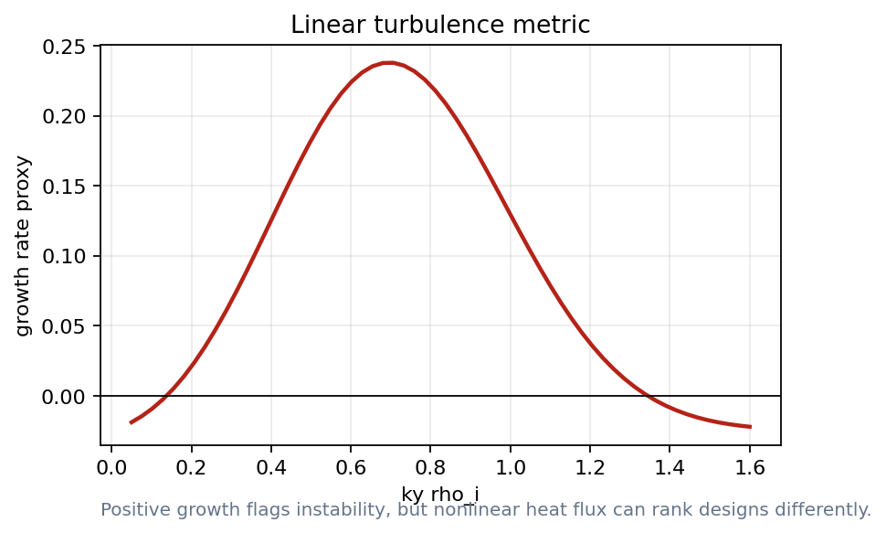
Linear growth is a fast warning
How to read it
Positive growth marks unstable branches
The peak is not the heat flux
Use growth rate as a screen, not as the final objective.
Ref: SPECTRAX-GK PyPI/docs, JAX-native gyrokinetic solver for stellarator optimization workflows.
Slide 17
sos2026-rjorge-stellarator-optimization.readthedocs.io
optimization workflow
SOS 2026 Stellarator Optimization, Rogerio Jorge, UW-Madison

Slide 18
What are growth rate and frequency?
Physical meaning
Linear gyrokinetic spectrum
Positive gamma marks an unstable mode, but the nonlinear saturated flux is a separate result.
The growth rate says whether a mode amplifies; the frequency helps identify the branch.
What the optimizer sees
Use spectra as fast screens and branch diagnostics before nonlinear validation.
omega = omega_r + i gamma
Failure mode
A design with a lower peak gamma can still have worse nonlinear heat flux.
Linear spectra are warning lights; nonlinear flux is the stronger gate.
Ref: SPECTRAX-GK public package notes and nonlinear turbulence optimization literature.
Slide 18
sos2026-rjorge-stellarator-optimization.readthedocs.io
optimization workflow
SOS 2026 Stellarator Optimization, Rogerio Jorge, UW-Madison

Slide 19
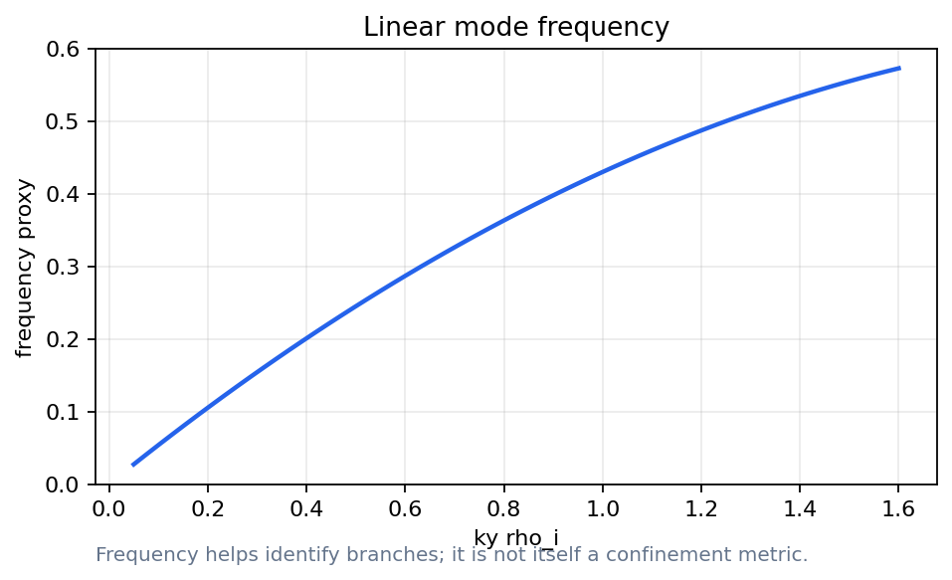
Frequency helps identify the branch
How to read it
Growth and frequency belong together
The sign and trend help classify modes
Frequency is diagnostic context, not the scalar objective.
Slide 19
sos2026-rjorge-stellarator-optimization.readthedocs.io
optimization workflow
SOS 2026 Stellarator Optimization, Rogerio Jorge, UW-Madison

Slide 20
A proxy can pick the wrong winner
How to read it
Red circle: proxy winner
Green circle: validation winner
The ranking failure is the point of the plot.
Ref: Kim et al., J. Plasma Phys. 90, 905900203 (2024), nonlinear turbulence optimization with noisy heat fluxes.
Slide 20
sos2026-rjorge-stellarator-optimization.readthedocs.io
optimization workflow
SOS 2026 Stellarator Optimization, Rogerio Jorge, UW-Madison

Slide 21
Demo break: turbulence proxy versus validation
Notebook break
Notebook: Turbulence Metric Surrogate
Choose the proxy winner
Compare validation ranking
Explain the failure mode
Notebook path: notebooks/08_spectrax_gk_linear_metric.ipynb + notebooks/09_turbulence_metric_surrogate.ipynb
Slide 21
sos2026-rjorge-stellarator-optimization.readthedocs.io
optimization workflow
SOS 2026 Stellarator Optimization, Rogerio Jorge, UW-Madison

Slide 22
Lecture 3
PART 3. Fast particles are reactor gates
Alpha confinement, wall loads, and orbit classes matter
Particle metrics must rerun after coil changes
Slide 22
sos2026-rjorge-stellarator-optimization.readthedocs.io
optimization workflow
SOS 2026 Stellarator Optimization, Rogerio Jorge, UW-Madison

Slide 23
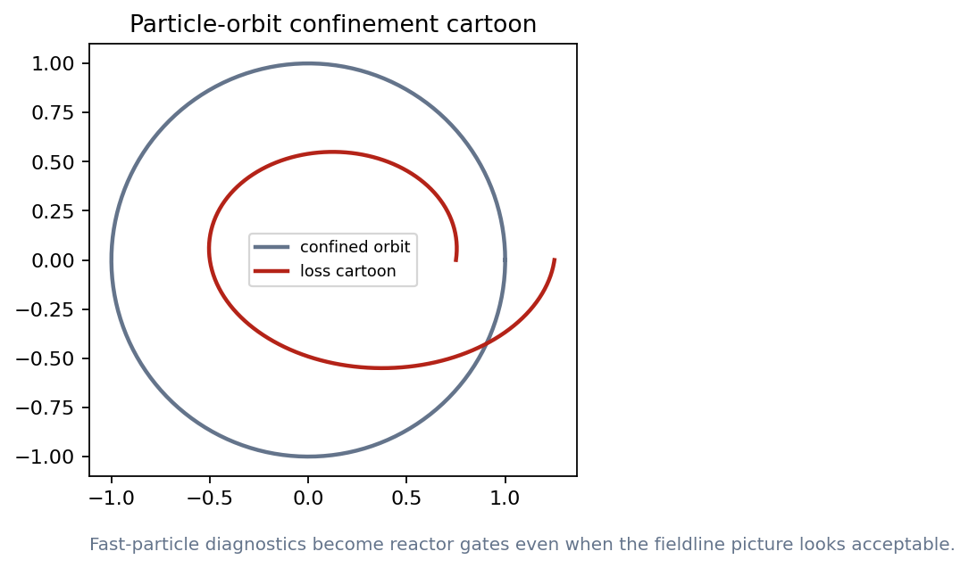
Particle metrics connect back to coils
How to read it
A fieldline picture can look acceptable
An orbit diagnostic can still fail
Fast-particle checks belong in the validation ladder.
Slide 23
sos2026-rjorge-stellarator-optimization.readthedocs.io
optimization workflow
SOS 2026 Stellarator Optimization, Rogerio Jorge, UW-Madison

Slide 24
Validation compares failure modes
Validation check
Does the metric fail on a known bad design?
Does it rank a known good design correctly?
Does it change smoothly under perturbations?
Validation rule: state the assumption, identify the metric, and explain what would change your mind.
Slide 24
sos2026-rjorge-stellarator-optimization.readthedocs.io
optimization workflow
SOS 2026 Stellarator Optimization, Rogerio Jorge, UW-Madison

Slide 25
Metric trust ladder
Design question
Optimization interpretation
Screen
reduced model trend
Ranking hypothesis
fast or quasilinear run
Validation
expensive run or experimental comparison
Slide 25
sos2026-rjorge-stellarator-optimization.readthedocs.io
optimization workflow
SOS 2026 Stellarator Optimization, Rogerio Jorge, UW-Madison

Slide 26
Lecture 3 what to remember
Use cheap metrics to steer the search
Use expensive metrics to challenge finalists
Plot profiles and regimes
Never hide proxy failure
A good optimization result is a design argument that survives new metrics.
Slide 26
sos2026-rjorge-stellarator-optimization.readthedocs.io
optimization workflow
SOS 2026 Stellarator Optimization, Rogerio Jorge, UW-Madison

Slide 27
Transport metrics are validation gates
A good design survives a stronger metric
Slide 27
sos2026-rjorge-stellarator-optimization.readthedocs.io
optimization workflow
SOS 2026 Stellarator Optimization, Rogerio Jorge, UW-Madison

Slide 28
Lecture 3
APPENDIX. Lecture 3 checks and replacements
Use this section when SFINCS, SPECTRAX, or particle tools are live
Keep reference ranking plots ready
Slide 28
sos2026-rjorge-stellarator-optimization.readthedocs.io
optimization workflow
SOS 2026 Stellarator Optimization, Rogerio Jorge, UW-Madison

Slide 29
Neoclassical outputs to track
Design question
Optimization interpretation
Effective ripple
low-collisionality screen
Ambipolar roots
radial electric-field validation
Bootstrap current
profile-dependent equilibrium feedback
Slide 29
sos2026-rjorge-stellarator-optimization.readthedocs.io
optimization workflow
SOS 2026 Stellarator Optimization, Rogerio Jorge, UW-Madison

Slide 30
Turbulence outputs to track
Design question
Optimization interpretation
Linear growth rate
fast instability screen
Quasilinear weight
ranking hypothesis
Nonlinear heat flux
validation for finalists
Slide 30
sos2026-rjorge-stellarator-optimization.readthedocs.io
optimization workflow
SOS 2026 Stellarator Optimization, Rogerio Jorge, UW-Madison

Slide 31
Research path: NEO_JAX and SFINCS_JAX
command surface
Choose the same equilibrium and flux surface
$ python scripts/run_smoke_tests.py
$ python scripts/execute_all_notebooks.py
$ python scripts/build_powerpoint_decks.mjs
$ python scripts/check_release_ready.py
Scan collisionality and radial electric field
Compare compact metrics before detailed validation
Slide 31
sos2026-rjorge-stellarator-optimization.readthedocs.io
optimization workflow
SOS 2026 Stellarator Optimization, Rogerio Jorge, UW-Madison

Slide 32
Research path: SPECTRAX-GK
command surface
Start with a short linear calculation
$ python scripts/run_smoke_tests.py
$ python scripts/execute_all_notebooks.py
$ python scripts/build_powerpoint_decks.mjs
$ python scripts/check_release_ready.py
Plot growth rate and frequency versus ky
Keep nonlinear validation gate explicit
Slide 32
sos2026-rjorge-stellarator-optimization.readthedocs.io
optimization workflow
SOS 2026 Stellarator Optimization, Rogerio Jorge, UW-Madison

Slide 33
How to read a fast metric
Validation check
Growth rate screens instability before heat-flux validation
A scalar ripple value should point back to where losses occur
A profile proxy should lead to a solved discharge model
Validation rule: state the assumption, identify the metric, and explain what would change your mind.
Slide 33
sos2026-rjorge-stellarator-optimization.readthedocs.io
optimization workflow
SOS 2026 Stellarator Optimization, Rogerio Jorge, UW-Madison

Slide 34
Reference figure: growth-rate spectrum
How to read it
Use if a live linear run is slow
Ask what the scalar should be
Read the plot as a diagnostic, not as a new validated result.
Slide 34
sos2026-rjorge-stellarator-optimization.readthedocs.io
optimization workflow
SOS 2026 Stellarator Optimization, Rogerio Jorge, UW-Madison

Slide 35
Reference figure: W7-X clamping cartoon
How to read it
Use to motivate turbulence after neoclassical success
Keep the cartoon label visible
Read the plot as a diagnostic, not as a new validated result.
Slide 35
sos2026-rjorge-stellarator-optimization.readthedocs.io
optimization workflow
SOS 2026 Stellarator Optimization, Rogerio Jorge, UW-Madison

Slide 36
Before showing a transport number
Design question
Optimization interpretation
Equilibrium
which surface and assumptions?
Kinetics
which species and collisionality?
Validation
which expensive calculation confirms it?
Slide 36
sos2026-rjorge-stellarator-optimization.readthedocs.io
optimization workflow
SOS 2026 Stellarator Optimization, Rogerio Jorge, UW-Madison

Slide 37
Discussion: what can reverse the ranking?
Design question
Optimization interpretation
Neoclassical winner
can lose on turbulence
Turbulence winner
can fail alpha confinement
Profile change
can move both metrics together
Slide 37
sos2026-rjorge-stellarator-optimization.readthedocs.io
optimization workflow
SOS 2026 Stellarator Optimization, Rogerio Jorge, UW-Madison

Slide 38
Lecture 3
What to remember
Keep the scientific object and the computed artifact together
Rerun, perturb, compare, and explain before trusting the optimum
Docs: https://sos2026-rjorge-stellarator-optimization.readthedocs.io/
github.com/rogeriojorge/sos2026-rjorge-stellarator-optimization
sos2026-rjorge-stellarator-optimization.readthedocs.io
Repo lab handoff: rerun, perturb, compare, explain.
Slide 38

