Slide 1
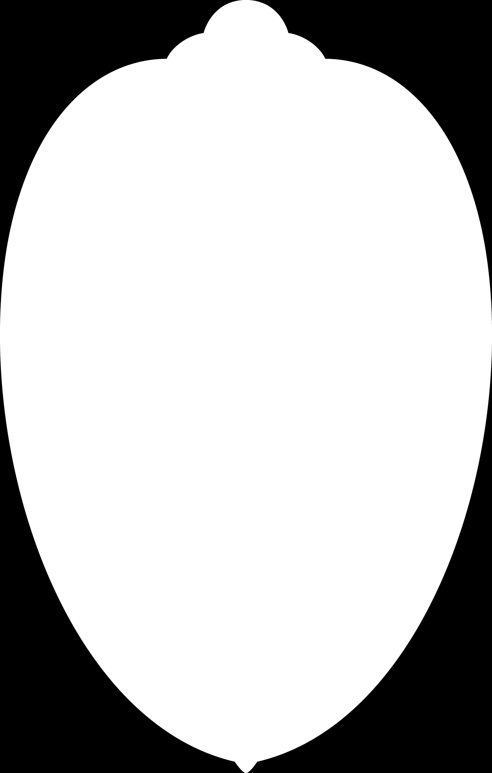
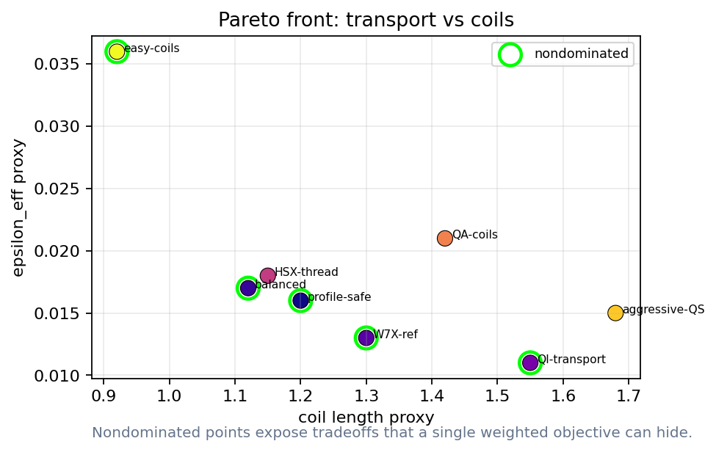
When does an optimized field become a reactor design?
Lecture 4: profiles, Pareto decisions, and the repo lab
A design becomes credible when the workflow is validated
Docs: https://sos2026-rjorge-stellarator-optimization.readthedocs.io/
CEA-IRFM / Renaissance Fusion School on Stellarators
Rogerio Jorge, University of Wisconsin-Madison
Aix-en-Provence, 2026
Docs: sos2026-rjorge-stellarator-optimization.readthedocs.io
Repo: github.com/rogeriojorge/sos2026-rjorge-stellarator-optimization
Slide 01

Slide 2
The full loop has memory
Equilibrium
>
Neoclassical
>
Turbulence
>
Pareto
Boozer spectrum
>
Coils
>
Profiles
>
Geometry changes transport
Transport changes profiles
Profiles change objectives
Slide 02
sos2026-rjorge-stellarator-optimization.readthedocs.io
optimization workflow
SOS 2026 Stellarator Optimization, Rogerio Jorge, UW-Madison

Slide 3
What is profile closure?
Physical meaning
Profile closure
The same magnetic geometry can look different once profiles and heating are allowed to respond.
Solving whether sources, sinks, transport coefficients, and radial gradients produce consistent temperature and density profiles.
What the optimizer sees
Use profile closure near the end of the loop to test the design scenario, not only the vacuum field.
source - div(Q_neo + Q_turb) = 0
Failure mode
A geometry-only winner can lose when profile stiffness or power balance is included.
A reactor design is a field plus a self-consistent plasma scenario.
Refs: nonlinear turbulence optimization and integrated transport validation workflows.
Slide 03
sos2026-rjorge-stellarator-optimization.readthedocs.io
optimization workflow
SOS 2026 Stellarator Optimization, Rogerio Jorge, UW-Madison

Slide 4
Modern workflows are multi-fidelity by design
Design question
Optimization interpretation
SIMSOPT
objective terms, geometry objects, and coils live in one optimization framework
JAX transport tools
differentiable metrics are useful only inside a documented claim scope
Profile closure
sources and turbulence can reverse a geometry-only ranking
Refs: Landreman et al., JOSS 6, 3525 (2021); sfincs-jax and SPECTRAX-GK public docs; Kim et al., JPP 90, 905900203 (2024).
Slide 04
sos2026-rjorge-stellarator-optimization.readthedocs.io
optimization workflow
SOS 2026 Stellarator Optimization, Rogerio Jorge, UW-Madison

Slide 5
Lecture 4
PART 1. Close the loop with profiles
Field optimization changes transport
Transport changes pressure and current
Slide 05
sos2026-rjorge-stellarator-optimization.readthedocs.io
optimization workflow
SOS 2026 Stellarator Optimization, Rogerio Jorge, UW-Madison

Slide 6
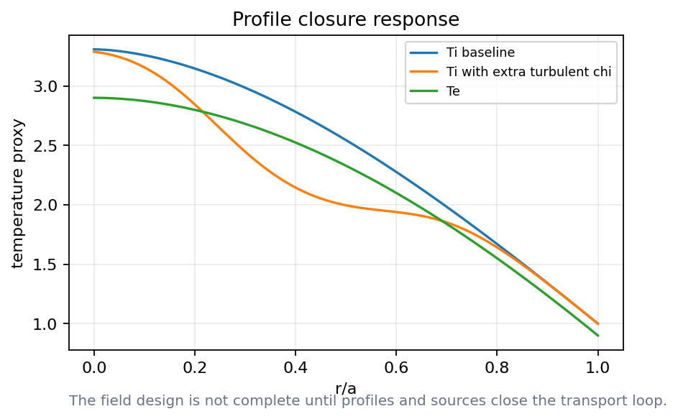
Profiles turn a field optimum into a scenario
How to read it
Temperature and density gradients drive transport
A good field metric can underperform after closure
Read how profile feedback changes the temperature response.
Ref: transport/profile closure logic in nonlinear turbulence optimization and T3D validation literature.
Slide 06
sos2026-rjorge-stellarator-optimization.readthedocs.io
optimization workflow
SOS 2026 Stellarator Optimization, Rogerio Jorge, UW-Madison

Slide 7
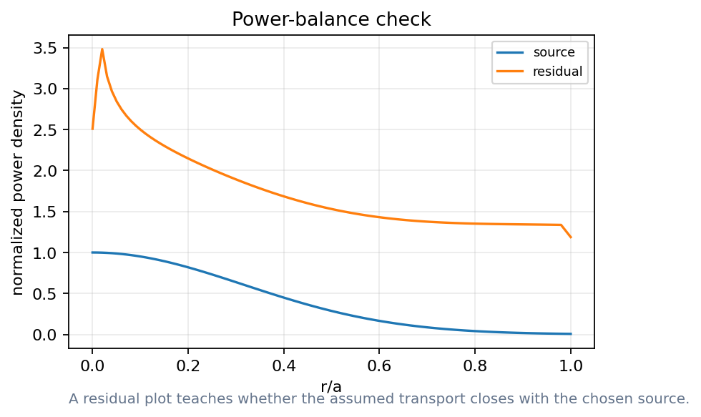
Power balance is a credibility check
How to read it
Sources, fluxes, and residuals must match
A post-hoc residual is weak evidence
A design claim needs a solved balance, not only a field metric.
Slide 07
sos2026-rjorge-stellarator-optimization.readthedocs.io
optimization workflow
SOS 2026 Stellarator Optimization, Rogerio Jorge, UW-Madison

Slide 8
Integrated objectives should be staged
Design question
Optimization interpretation
Early
cheap geometry and Boozer screens
Middle
coils and neoclassical metrics
Late
turbulence, particles, profiles, engineering
Slide 08
sos2026-rjorge-stellarator-optimization.readthedocs.io
optimization workflow
SOS 2026 Stellarator Optimization, Rogerio Jorge, UW-Madison

Slide 9
Demo break: profile closure
Notebook break
Notebook: Neopax Profile Closure
Plot temperature response
Inspect power balance
State which quantities are screened and which are validated
Notebook path: notebooks/10_neopax_profile_closure.ipynb
Slide 09
sos2026-rjorge-stellarator-optimization.readthedocs.io
optimization workflow
SOS 2026 Stellarator Optimization, Rogerio Jorge, UW-Madison

Slide 10
Lecture 4
PART 2. Pareto decisions
Many designs can be defensible
The decision weights must be explicit
Slide 10
sos2026-rjorge-stellarator-optimization.readthedocs.io
optimization workflow
SOS 2026 Stellarator Optimization, Rogerio Jorge, UW-Madison

Slide 11
Reactor constraints enter as gates
Design question
Optimization interpretation
Alpha heating and losses
reactor-relevant loss gate
Wall loads and blankets
engineering and material constraint
Maintenance and access
device availability constraint
Slide 11
sos2026-rjorge-stellarator-optimization.readthedocs.io
optimization workflow
SOS 2026 Stellarator Optimization, Rogerio Jorge, UW-Madison

Slide 12
What is a Pareto front?
Physical meaning
Pareto front
It separates physics tradeoffs from preference choices.
The set of designs where improving one objective requires worsening at least one other objective.
What the optimizer sees
Use it to decide which weights and hard gates are steering the final selection.
no design improves all objectives at once
Failure mode
A point on the front can still fail a validation gate that was not included in the objective.
Pareto analysis makes the design decision explicit.
Ref: multiobjective SIMSOPT and single-stage stellarator optimization workflows.
Slide 12
sos2026-rjorge-stellarator-optimization.readthedocs.io
optimization workflow
SOS 2026 Stellarator Optimization, Rogerio Jorge, UW-Madison

Slide 13
Pareto fronts need interpretation
How to read it
Nondominated points still require priorities
Final choice needs context and validation
A Pareto front is an argument surface, not an automatic answer.
Ref: SIMSOPT objective composition and multiobjective stellarator optimization workflows.
Slide 13
sos2026-rjorge-stellarator-optimization.readthedocs.io
optimization workflow
SOS 2026 Stellarator Optimization, Rogerio Jorge, UW-Madison

Slide 14
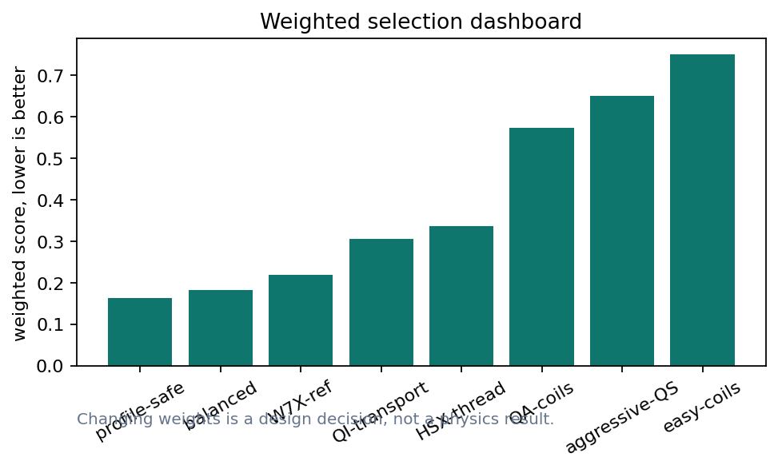
Weights expose the design decision
How to read it
Changing weights changes the winner
Record weights beside every selected design
A weighted score is a value judgment with units and provenance.
Slide 14
sos2026-rjorge-stellarator-optimization.readthedocs.io
optimization workflow
SOS 2026 Stellarator Optimization, Rogerio Jorge, UW-Madison

Slide 15
Demo break: Pareto dashboard
Notebook break
Notebook: Pareto Design Dashboard
Change one metric weight
Regenerate the chart
Defend the selected design
Notebook path: notebooks/11_pareto_design_dashboard.ipynb
Slide 15
sos2026-rjorge-stellarator-optimization.readthedocs.io
optimization workflow
SOS 2026 Stellarator Optimization, Rogerio Jorge, UW-Madison

Slide 16
Validation gates prevent metric gaming
Validation check
Equilibrium, Boozer, neoclassical, turbulence, particles, profiles, coils, engineering
A design can pass one gate and fail the next
Validation rule: state the assumption, identify the metric, and explain what would change your mind.
Slide 16
sos2026-rjorge-stellarator-optimization.readthedocs.io
optimization workflow
SOS 2026 Stellarator Optimization, Rogerio Jorge, UW-Madison

Slide 17
Lecture 4
PART 3. The GitHub repo is the lab manual
Slides explain concepts
Notebooks execute projects
Scripts regenerate figures, movies, and status
Slide 17
sos2026-rjorge-stellarator-optimization.readthedocs.io
optimization workflow
SOS 2026 Stellarator Optimization, Rogerio Jorge, UW-Madison

Slide 18
A design is a validated workflow
The repo is the audit trail
Slide 18
sos2026-rjorge-stellarator-optimization.readthedocs.io
optimization workflow
SOS 2026 Stellarator Optimization, Rogerio Jorge, UW-Madison

Slide 19
Repo lab flow
command surface
python scripts/check_release_ready.py
$ python scripts/run_smoke_tests.py
$ python scripts/execute_all_notebooks.py
$ python scripts/build_powerpoint_decks.mjs
$ python scripts/check_release_ready.py
python scripts/make_lecture_bundle.py
python scripts/audit_notebook_outputs.py
Slide 19
sos2026-rjorge-stellarator-optimization.readthedocs.io
optimization workflow
SOS 2026 Stellarator Optimization, Rogerio Jorge, UW-Madison

Slide 20
Live demos and research runs have different roles
Design question
Optimization interpretation
reference examples
student reliability
short live run
instructor timing
research run
documented solver output after timing
Slide 20
sos2026-rjorge-stellarator-optimization.readthedocs.io
optimization workflow
SOS 2026 Stellarator Optimization, Rogerio Jorge, UW-Madison

Slide 21
ReadTheDocs is the canonical guide
Design question
Optimization interpretation
Docs
https://sos2026-rjorge-stellarator-optimization.readthedocs.io/
Repo
github.com/rogeriojorge/sos2026-rjorge-stellarator-optimization
Use the live demo matrix during class
Use it as a metric, constraint, or validation gate.
Slide 21
sos2026-rjorge-stellarator-optimization.readthedocs.io
optimization workflow
SOS 2026 Stellarator Optimization, Rogerio Jorge, UW-Madison

Slide 22
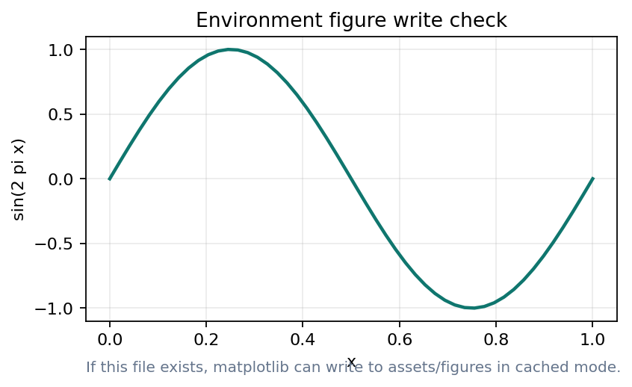
Repo lab: full reference run
Notebook break
scripts/check_release_ready.py
Run acceptance checks
Review STATUS.md
Open rendered docs
Start with the reference run. Repo: https://github.com/rogeriojorge/sos2026-rjorge-stellarator-optimization | Docs: https://sos2026-rjorge-stellarator-optimization.readthedocs.io/
Slide 22
sos2026-rjorge-stellarator-optimization.readthedocs.io
optimization workflow
SOS 2026 Stellarator Optimization, Rogerio Jorge, UW-Madison

Slide 23
Coil robustness returns in the final workflow
Design question
Optimization interpretation
Manufacturing tolerance
can the design survive perturbations?
Current errors
can operations maintain the target field?
Thermal and mechanical deformation
does the coil story remain true?
Slide 23
sos2026-rjorge-stellarator-optimization.readthedocs.io
optimization workflow
SOS 2026 Stellarator Optimization, Rogerio Jorge, UW-Madison

Slide 24
There is no single best stellarator
There are only defensible choices with stated priorities
Slide 24
sos2026-rjorge-stellarator-optimization.readthedocs.io
optimization workflow
SOS 2026 Stellarator Optimization, Rogerio Jorge, UW-Madison

Slide 25
Exercise: change the weights and defend a design
Notebook break
Notebook: Pareto Design Dashboard
Move one weight
Identify the new winner
Say which validation gate you now trust less
Notebook path: notebooks/11_pareto_design_dashboard.ipynb
Slide 25
sos2026-rjorge-stellarator-optimization.readthedocs.io
optimization workflow
SOS 2026 Stellarator Optimization, Rogerio Jorge, UW-Madison

Slide 26
Documentation is part of reproducibility
Design question
Optimization interpretation
README
how a student starts
ReadTheDocs
the rendered guide during class
STATUS.md
data provenance and claim scope
Slide 26
sos2026-rjorge-stellarator-optimization.readthedocs.io
optimization workflow
SOS 2026 Stellarator Optimization, Rogerio Jorge, UW-Madison

Slide 27
Lecture 4
APPENDIX. Lecture 4 checks and replacements
Use this section before distributing the school bundle
Keep claim scope visible
Slide 27
sos2026-rjorge-stellarator-optimization.readthedocs.io
optimization workflow
SOS 2026 Stellarator Optimization, Rogerio Jorge, UW-Madison

Slide 28
What belongs in git
Design question
Optimization interpretation
Small inputs
versioned and documented
Small inputs
versioned and documented
Large outputs
regenerated by scripts and ignored
Slide 28
sos2026-rjorge-stellarator-optimization.readthedocs.io
optimization workflow
SOS 2026 Stellarator Optimization, Rogerio Jorge, UW-Madison

Slide 29
What stays out of git
Validation check
Original package PDFs and PPTX files
Private screenshots and huge generated media
Local environments and secrets
Validation rule: state the assumption, identify the metric, and explain what would change your mind.
Slide 29
sos2026-rjorge-stellarator-optimization.readthedocs.io
optimization workflow
SOS 2026 Stellarator Optimization, Rogerio Jorge, UW-Madison

Slide 30
STATUS.md anatomy
Design question
Optimization interpretation
Package status
what imported and what was skipped
Data status
source, hash, and provenance
Notebook status
what ran and saved outputs
Slide 30
sos2026-rjorge-stellarator-optimization.readthedocs.io
optimization workflow
SOS 2026 Stellarator Optimization, Rogerio Jorge, UW-Madison

Slide 31
Live-demo abort criteria
Validation check
A package starts compiling during class
A notebook loses its reference data path
A result is numerical but the validation path is missing
Validation rule: state the assumption, identify the metric, and explain what would change your mind.
Slide 31
sos2026-rjorge-stellarator-optimization.readthedocs.io
optimization workflow
SOS 2026 Stellarator Optimization, Rogerio Jorge, UW-Madison

Slide 32
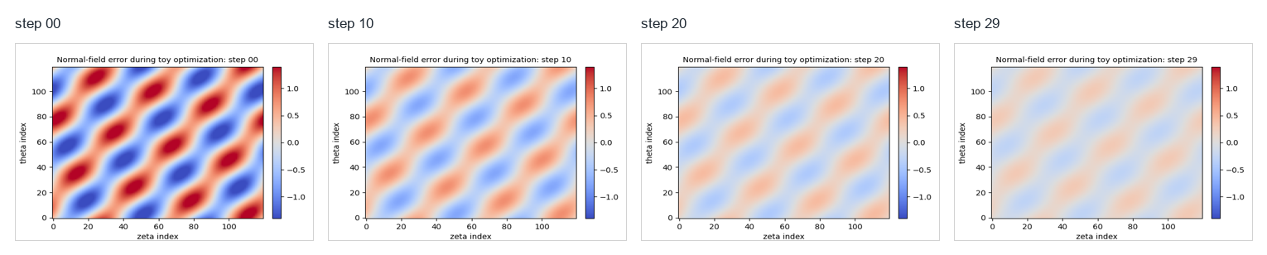
Animation storyboard: optimization history
Read the sequence as objective residual decreasing
Discuss when a live animation adds value
Static storyboard for reliable projection; the movie file remains in the repo.
Slide 32
sos2026-rjorge-stellarator-optimization.readthedocs.io
optimization workflow
SOS 2026 Stellarator Optimization, Rogerio Jorge, UW-Madison

Slide 33
Manual steps before the school
Design question
Optimization interpretation
Choose the lecture machine and environment
Use it as a metric, constraint, or validation gate.
Pre-fetch equilibria and verify notebooks render
Use it as a metric, constraint, or validation gate.
Freeze the branch or tag used for the school
Use it as a metric, constraint, or validation gate.
Slide 33
sos2026-rjorge-stellarator-optimization.readthedocs.io
optimization workflow
SOS 2026 Stellarator Optimization, Rogerio Jorge, UW-Madison

Slide 34
How students should use the repo after school
Design question
Optimization interpretation
Start with reference results
reproduce every figure
Change one notebook at a time
Use it as a metric, constraint, or validation gate.
Keep generated outputs small and documented
Use it as a metric, constraint, or validation gate.
Slide 34
sos2026-rjorge-stellarator-optimization.readthedocs.io
optimization workflow
SOS 2026 Stellarator Optimization, Rogerio Jorge, UW-Madison

Slide 35
Reference figure: profile closure
How to read it
Use to discuss profile-closure behavior
Keep the limitation explicit
Reference plot for profile closure discussion.
Slide 35
sos2026-rjorge-stellarator-optimization.readthedocs.io
optimization workflow
SOS 2026 Stellarator Optimization, Rogerio Jorge, UW-Madison

Slide 36
Reference figure: Pareto front
How to read it
Use to discuss the final design choice
Ask which design the room would defend
Reference plot for design-decision discussion.
Slide 36
sos2026-rjorge-stellarator-optimization.readthedocs.io
optimization workflow
SOS 2026 Stellarator Optimization, Rogerio Jorge, UW-Madison

Slide 37
Final design commandments
Show every boundary with its coil story
State the validation domain for every metric
Pair each proxy with its failure mode
Show the weights behind each Pareto choice
A good optimization result is a design argument that survives new metrics.
Slide 37
sos2026-rjorge-stellarator-optimization.readthedocs.io
optimization workflow
SOS 2026 Stellarator Optimization, Rogerio Jorge, UW-Madison

Slide 38
Coupled, differentiable, reproducible stellarator design
Field, coils, transport, profiles, and decisions in one auditable loop
Slide 38
sos2026-rjorge-stellarator-optimization.readthedocs.io
optimization workflow
SOS 2026 Stellarator Optimization, Rogerio Jorge, UW-Madison

Slide 39
Lecture 4
What to remember
Keep the scientific object and the computed artifact together
Rerun, perturb, compare, and explain before trusting the optimum
Docs: https://sos2026-rjorge-stellarator-optimization.readthedocs.io/
github.com/rogeriojorge/sos2026-rjorge-stellarator-optimization
sos2026-rjorge-stellarator-optimization.readthedocs.io
Repo lab handoff: rerun, perturb, compare, explain.
Slide 39

