Slide 1
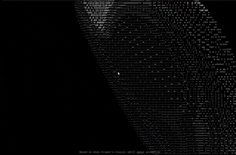
Ascii Torus in VisuAlg
Rogerio O. Ferraz (rogerio.o.ferraz@gmail.com)
01

Slide 2
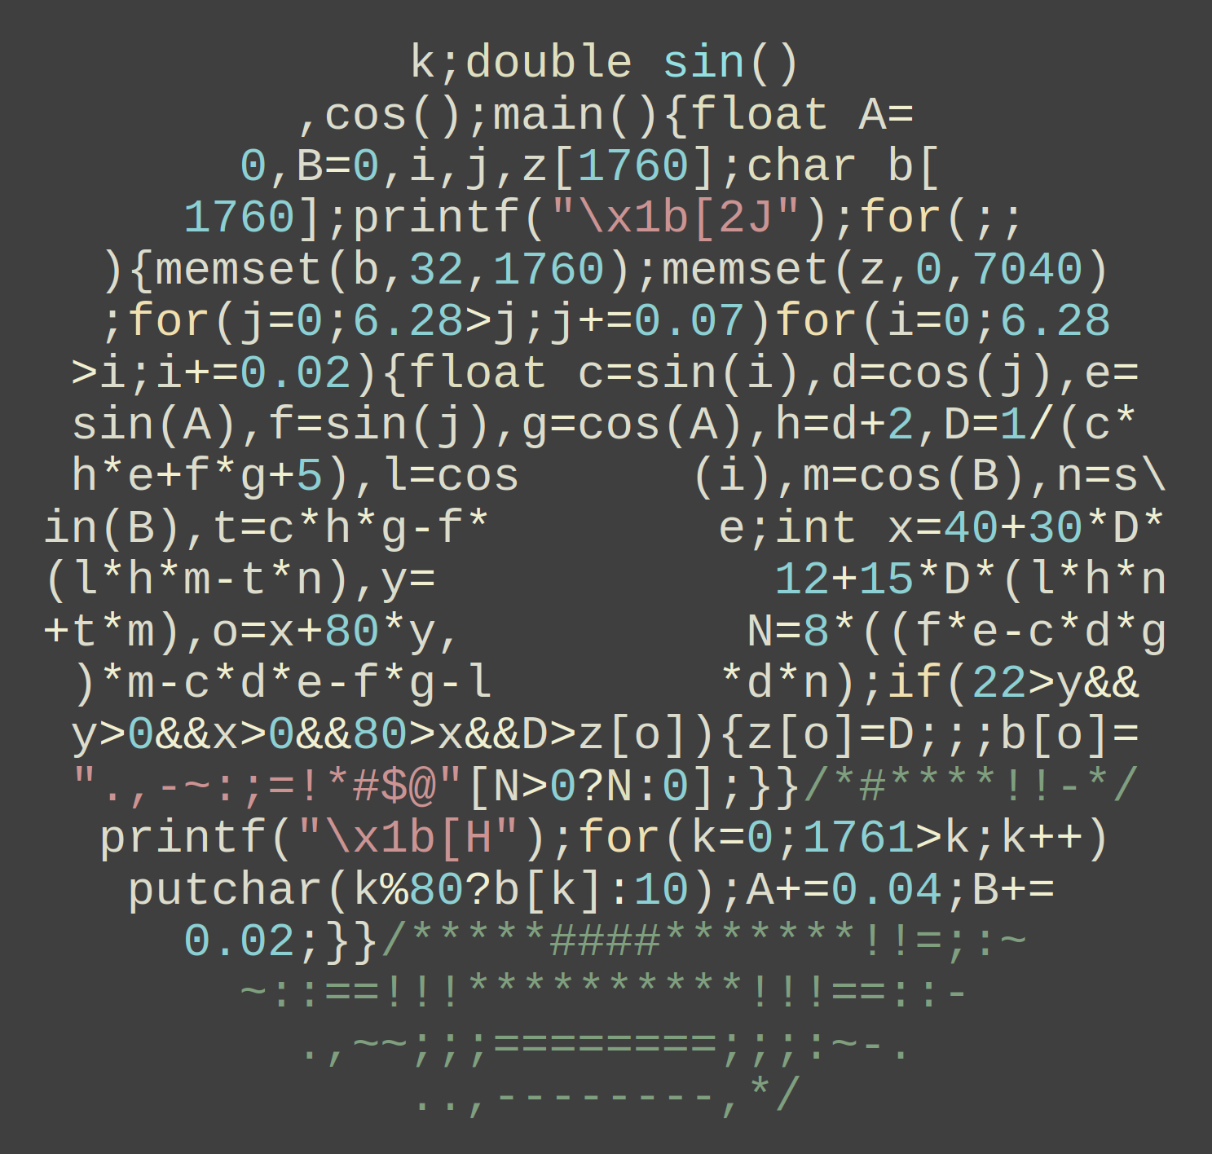

1. The classic: Have a donut (2006)
Andy Sloane’s classic donut blends obfuscated C, ASCII animation, and visual math.
Obfuscated C Donut
Animation
Source: “How donut.c works” (Sloane, 2011)
The original donut and this VisuAlg torus share the same core idea: two rotation angles, text projection, and an ASCII brightness ramp.
Credits: Andy Sloane —
“Have a donut.” (2006) and “Donut math: how donut.c works” (2011)
Source: “Have a donut.” (Sloane, 2006)
02

Slide 3
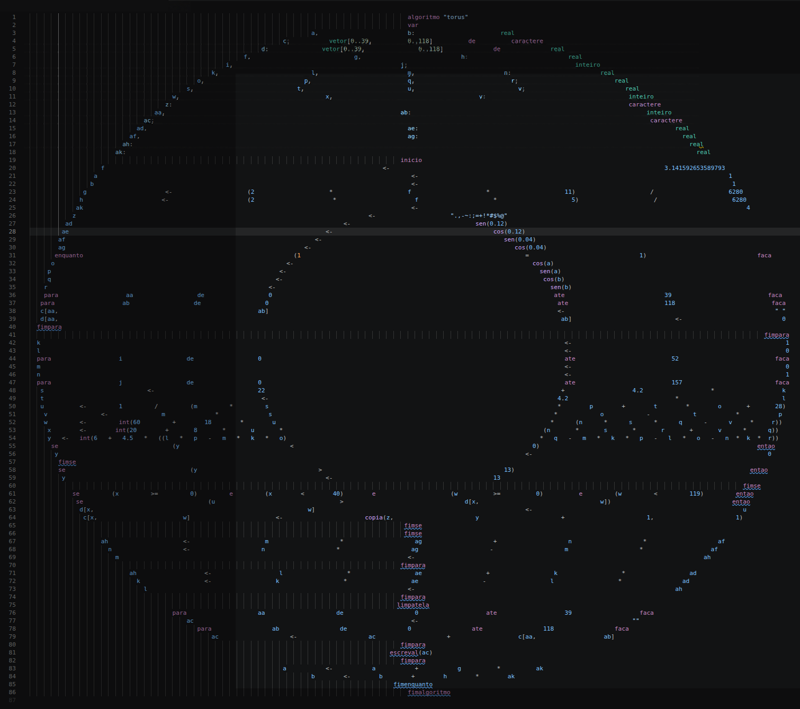
2. ASCII Torus in VisuAlg
What changed
VisuAlg syntax replaces C so the demo can run in the Windows GUI.
Short variable names preserve the donut-shaped layout, echoing the original obfuscated style.
Next, we unpack the geometry and motion behind the image.
Quick map
a, b → global angles
g, h → per-frame increments
c, d → character + depth buffers
w, x → column + row
y, z → brightness + ASCII ramp
Open the readable version
Source: author with IA assistance (ChatGPT)
03

Slide 4
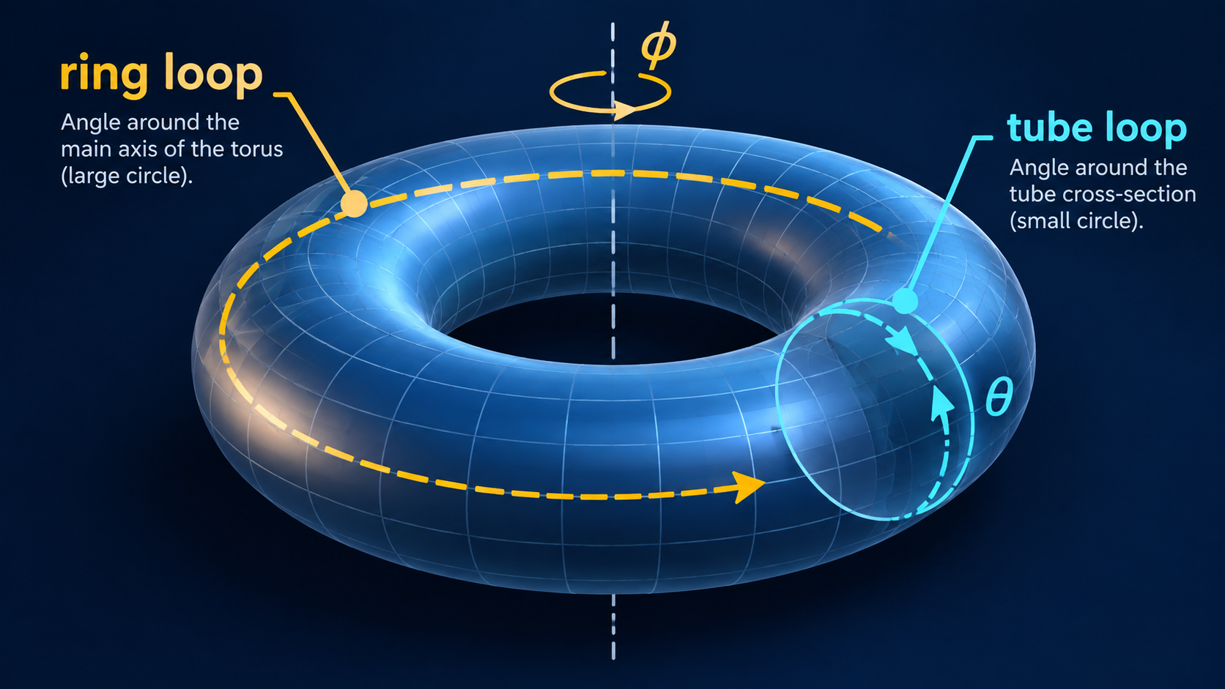
3. What is a torus?
A torus is a circular tube wrapped into a ring.
Core idea
Two local loops define the surface.
One loop moves around the tube cross-section.
The other loop moves around the main ring.
Together, they generate the full torus surface.
ringDistance = R + r × cos(tubeAngle)
tubeYOffset = r × sin(tubeAngle)
Source: author with IA assistance (ChatGPT)
04

Slide 5
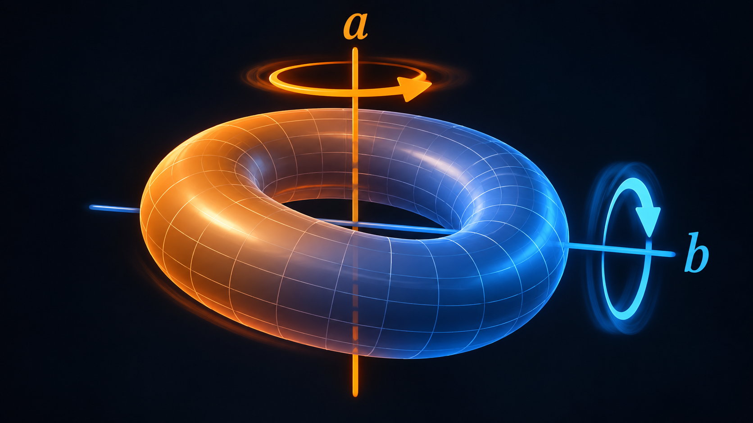
4. How does the torus move?
The loops draw the shape; the visible motion comes from rotating the whole torus around two axes.
Two global angles
angleAxial: spin around the main axis
angleElevation: tilt that changes the screen view
Both values update once per frame.
Without those updates, the donut stays still.
angleAxial <- angleAxial + axialStep * speedMultiplier
angleElevation <- angleElevation + elevationStep * speedMultiplier
Source: author with IA assistance (ChatGPT)
05

Slide 6
5. Motion parameters and core formulas
Focus on what each parameter controls—not on memorizing the formulas.
What controls the motion
angleAxial
current axial spin
angleElevation
current elevation tilt
axialStep
axial spin per frame
elevationStep
elevation tilt per frame
speedMultiplier
speeds up VisuAlg redraws
axialStep <- (2 * piValue * 11) / 6280
elevationStep <- (2 * piValue * 5) / 6280
speedMultiplier <- 4
Source: author with IA assistance (ChatGPT)
06

Slide 7
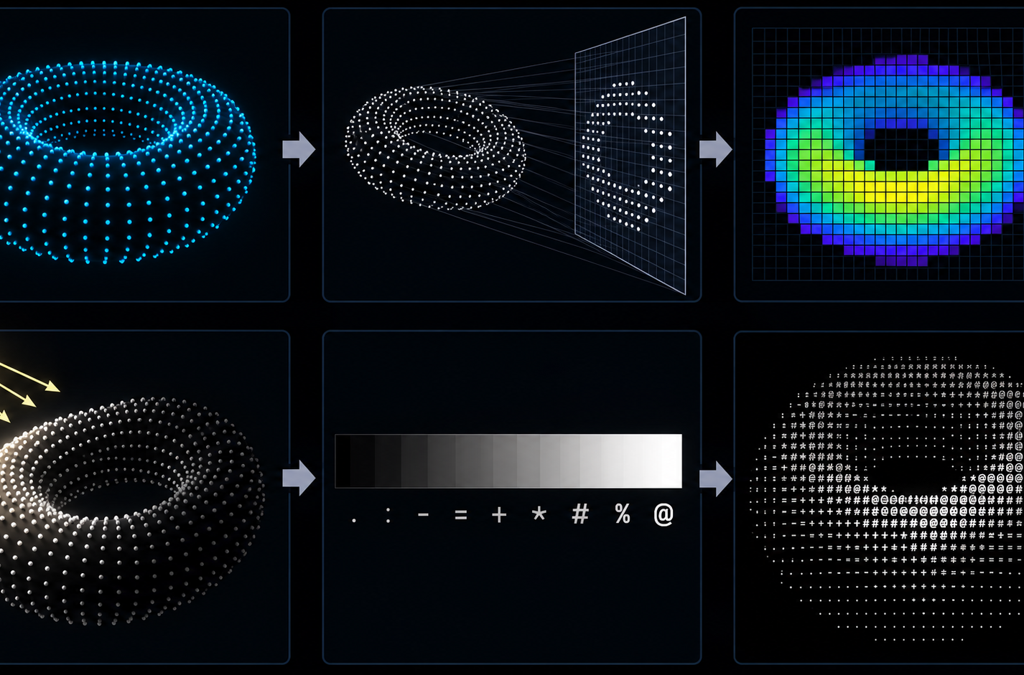
6. How each frame is drawn
Every frame follows the same pipeline: clear, sample, rotate, project, shade, and draw.
1. Clear the character and z-buffers
2. Sample points on the torus surface
3. Apply the two global rotations
4. Project each point to a screen cell
5. Use depth and lighting to choose the character
6. Advance the motion angles
while true
clear buffers
sample and project points
draw text rows
advance angles
end while
Source: author with IA assistance (ChatGPT)
07

Slide 8
7. How the torus surface is generated
Two local angles generate every 3D point before animation is applied.
Local angles
θ = tube angle: moves around the small cross-section
φ = ring angle: moves around the main loop
R = major radius; r = tube radius
Local point before animation
x₀ = (R + r·cos(θ)) · cos(φ)
y₀ = (R + r·cos(θ)) · sin(φ)
Source: author with IA assistance (ChatGPT)
z₀ = r · sin(θ)
ringDistance <- 22 + 4.2 * cosTube
tubeYOffset <- 4.2 * sinTube
// R = 22, r = 4.2
08

Slide 9
8. Rotation, projection, and lighting
The global angles drive the sin() and cos() terms.
Global rotations
A = angleAxial B = angleElevation
y₁ = y₀·cos(A) − z₀·sin(A)
z₁ = y₀·sin(A) + z₀·cos(A)
x₂ = x₀·cos(B) − y₁·sin(B)
y₂ = x₀·sin(B) + y₁·cos(B)
Source: author with IA assistance (ChatGPT)
Screen projection
light = lightDirection · surfaceNormal
shadeIndex <- int(6 + 4.5 * light)
D = 1 / (z₁ + cameraDistance)
col = centerX + scaleX·D·x₂
row = centerY + scaleY·D·y₂
Lighting maps surface direction to a dim, medium, or bright ASCII character.
09

Slide 10
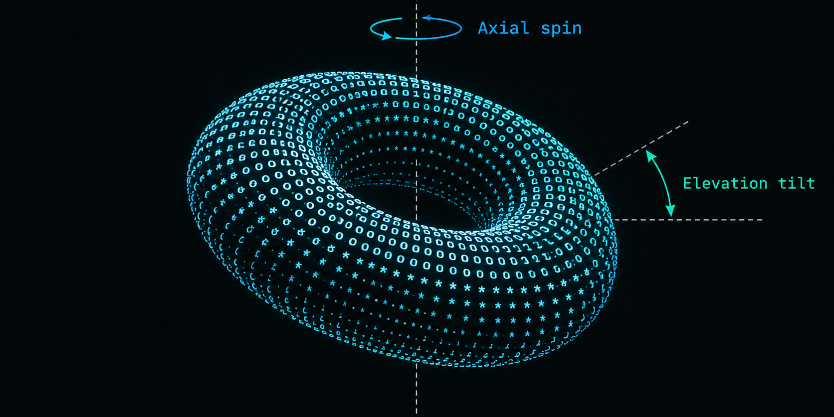
9. From 3D geometry to the text screen
Important
if inverseDepth > depthBuffer[row, col] then
depthBuffer[row, col] = inverseDepth
charBuffer[row, col] = shadeRamp[shadeIndex]
end if
Closer points are projected larger.
Each point becomes one screen column and row.
If two points land in the same cell, the closer point wins.
inverseDepth = 1 / (rotatedZ + distanceFromCamera)
screenCol = centerX + scaleX × inverseDepth × rotatedX
screenRow = centerY + scaleY × inverseDepth × rotatedY
Source: author with IA assistance (ChatGPT)
10

Slide 11
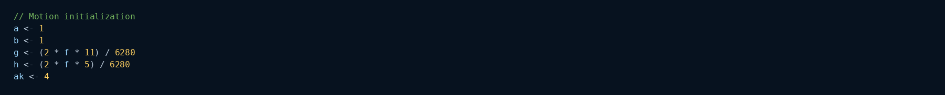
10. Where it appears in the code
These excerpts connect motion, projection, and drawing in the VisuAlg console.
Source: author with IA assistance (ChatGPT)
11

Slide 12
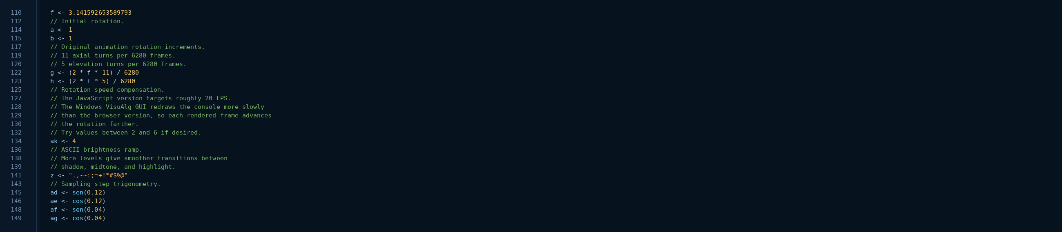
Animation parameters
← Back
110
f <- 3.141592653589793
112
// Initial rotation.
114
a <- 1
115
b <- 1
117
// Original animation rotation increments.
119
Initial values of the
two global angles.
// 11 axial turns per 6280 frames.
120
// 5 elevation turns per 6280 frames.
122
g <- (2 * f * 11) / 6280
123
h <- (2 * f * 5) / 6280
125
// Rotation speed compensation.
127
11:5 ratio between
the two motions.
// The JavaScript version targets roughly 20 FPS.
128
// The Windows VisuAlg GUI redraws the console more slowly
129
// than the browser version, so each rendered frame advances
130
// the rotation farther.
132
// Try values between 2 and 6 if desired.
134
Compensates for the
VisuAlg GUI, which redraws
more slowly.
ak <- 4
136
// ASCII brightness ramp.
138
// More levels give smoother transitions between
139
// shadow, midtone, and highlight.
141
z <- ".,-~:;=+!*#$%@"
143
// Sampling-step trigonometry.
145
ad <- sen(0.12)
146
ae <- cos(0.12)
148
af <- sen(0.04)
149
ag <- cos(0.04)
12

Slide 13
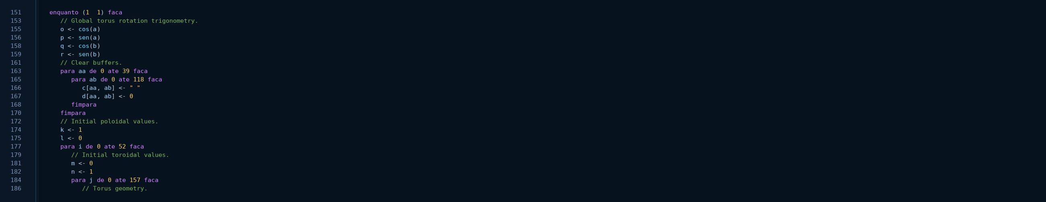
Global rotation calculation
← Back
151
enquanto (1 = 1) faca
153
// Global torus rotation trigonometry.
155
Recomputes sin() and cos()
for the two global angles.
o <- cos(a)
156
p <- sen(a)
158
q <- cos(b)
159
r <- sen(b)
161
// Clear buffers.
163
para aa de 0 ate 39 faca
165
para ab de 0 ate 118 faca
Clears the logical screen
and the depth buffer.
166
c[aa, ab] <- " "
167
d[aa, ab] <- 0
168
fimpara
170
fimpara
172
// Initial poloidal values.
174
k <- 1
175
l <- 0
177
para i de 0 ate 52 faca
179
Starts the two loops
that scan the torus
surface.
// Initial toroidal values.
181
m <- 0
182
n <- 1
184
para j de 0 ate 157 faca
186
// Torus geometry.
13

Slide 14
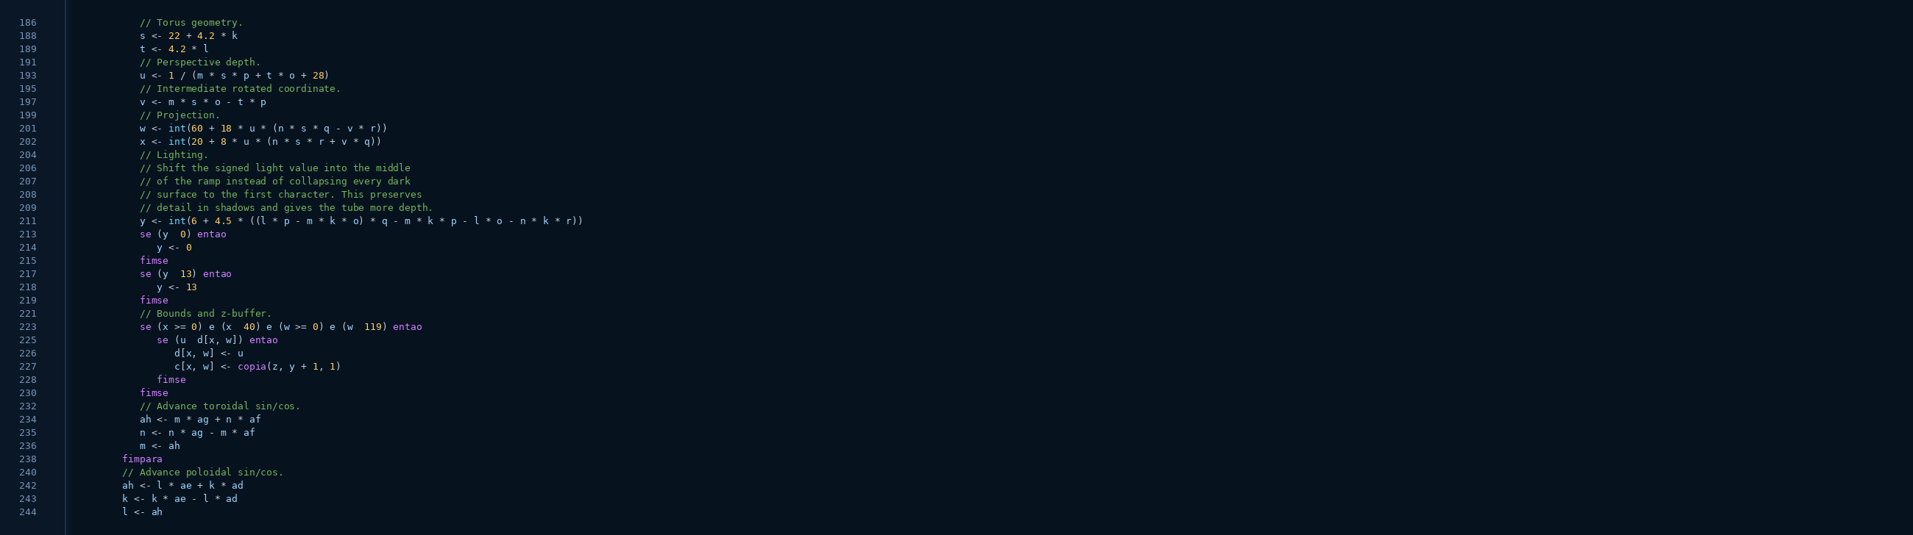
Geometry, projection, and light
← Back
This is the core of the algorithm: form the 3D point, project it, and decide the character brightness.
186
// Torus geometry.
188
Torus geometry and
depth.
189
s <- 22 + 4.2 * k
191
t <- 4.2 * l
193
// Perspective depth.
195
u <- 1 / (m * s * p + t * o + 28)
197
// Intermediate rotated coordinate.
199
v <- m * s * o - t * p
201
// Projection.
w <- int(60 + 18 * u * (n * s * q - v * r))
202
Converts the 3D point
into a screen column and row.
204
x <- int(20 + 8 * u * (n * s * r + v * q))
206
// Lighting.
207
// Shift the signed light value into the middle
208
// of the ramp instead of collapsing every dark
209
// surface to the first character. This preserves
211
// detail in shadows and gives the tube more depth.
213
y <- int(6 + 4.5 * ((l * p - m * k * o) * q - m * k * p - l * o - n * k * r))
214
se (y < 0) entao
215
y <- 0
217
fimse
se (y > 13) entao
218
Lighting: chooses which
ASCII ramp character
will be used.
219
y <- 13
221
fimse
223
// Bounds and z-buffer.
225
se (x >= 0) e (x < 40) e (w >= 0) e (w < 119) entao
226
se (u > d[x, w]) entao
227
d[x, w] <- u
228
c[x, w] <- copia(z, y + 1, 1)
230
fimse
232
fimse
234
// Advance toroidal sin/cos.
235
ah <- m * ag + n * af
n <- n * ag - m * af
236
Trigonometric stepping
without calling sin/cos
at every point.
238
m <- ah
240
fimpara
242
// Advance poloidal sin/cos.
243
ah <- l * ae + k * ad
244
k <- k * ae - l * ad
l <- ah
14

Slide 15
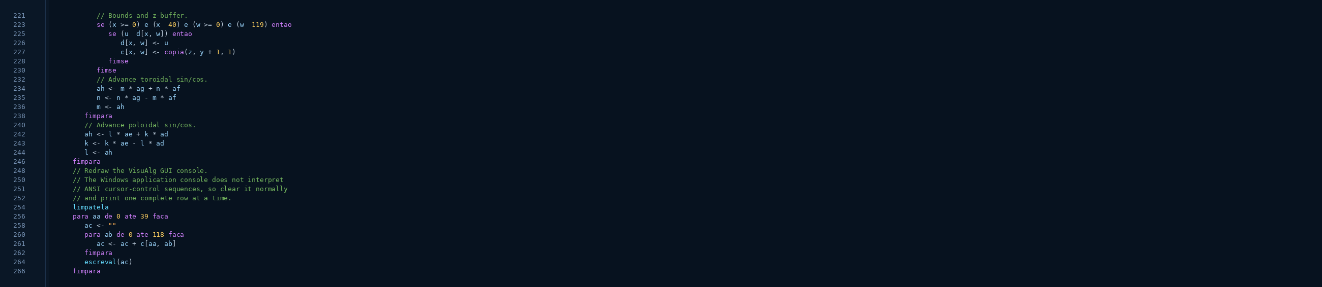
Drawing in the console
← Back
The Windows version clears the screen and reprints every line of the frame.
221
// Bounds and z-buffer.
223
Z-buffer: only the
closest point occupies
the cell.
se (x >= 0) e (x < 40) e (w >= 0) e (w < 119) entao
225
se (u > d[x, w]) entao
226
d[x, w] <- u
227
c[x, w] <- copia(z, y + 1, 1)
228
fimse
230
fimse
232
// Advance toroidal sin/cos.
234
ah <- m * ag + n * af
235
n <- n * ag - m * af
236
m <- ah
238
fimpara
240
// Advance poloidal sin/cos.
242
ah <- l * ae + k * ad
243
k <- k * ae - l * ad
244
l <- ah
246
fimpara
248
// Redraw the VisuAlg GUI console.
250
// The Windows application console does not interpret
251
// ANSI cursor-control sequences, so clear it normally
252
// and print one complete row at a time.
254
limpatela
256
VisuAlg GUI strategy:
build the line and use
escreval to redraw.
para aa de 0 ate 39 faca
258
ac <- ""
260
para ab de 0 ate 118 faca
261
ac <- ac + c[aa, ab]
262
fimpara
264
escreval(ac)
266
fimpara
15

Slide 16
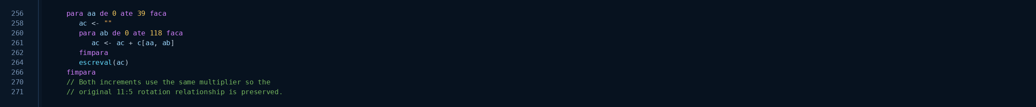
Where the motion happens
← Back
The two most important lines
These two lines advance
the angles and create the
frame-by-frame animation.
b <- b + h * ak
Summary
• The redraw prints the frame.
• Lines 273–274 advance the global angles.
• That is what makes the torus spin.
16

Slide 17
16. Variable map
Obfuscated name
Readable name
Purpose
a
angleAxial
global axial angle
b
angleElevation
global elevation angle
g
axialStep
axial-spin step per frame
h
elevationStep
elevation step per frame
ak
speedMultiplier
animation speed multiplier
c
charBuffer
character buffer
d
depthBuffer
z-buffer / depth buffer
w / x
screenCol / screenRow
projected screen position
y
shadeIndex
index in the ASCII brightness ramp
z
shadeRamp
ASCII ramp from shadow to highlight
17

Slide 18
Spin and lighting
Watch the spin and the shifting highlights
• The torus spins because the global angles change every frame.
• The ASCII ramp changes characters as the simulated lighting shifts.
angleAxial <- angleAxial + axialStep * speedMultiplier
angleElevation <- angleElevation + elevationStep * speedMultiplier
Source: author with IA assistance (ChatGPT)
18

Slide 19
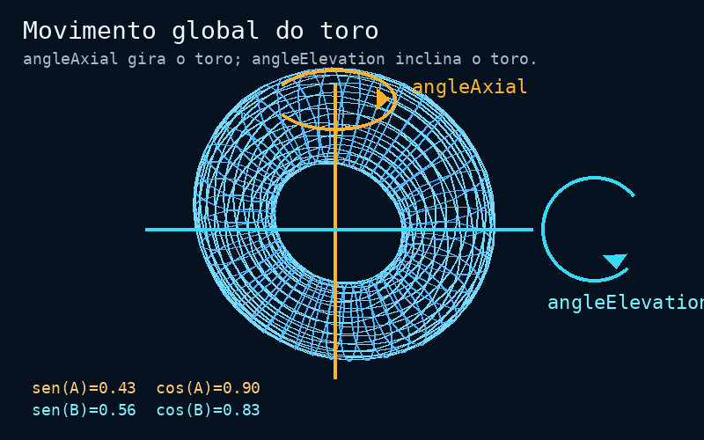
Global angles
Sine and cosine values used by the animation
Each frame computes:
cos(angleAxial)
sin(angleAxial)
cos(angleElevation)
sin(angleElevation)
These values feed the 3D rotations.
cosAxial = cos(angleAxial)
sinAxial = sin(angleAxial)
cosElevation = cos(angleElevation)
sinElevation = sin(angleElevation)
Source: author with IA assistance (ChatGPT)
19

Slide 20
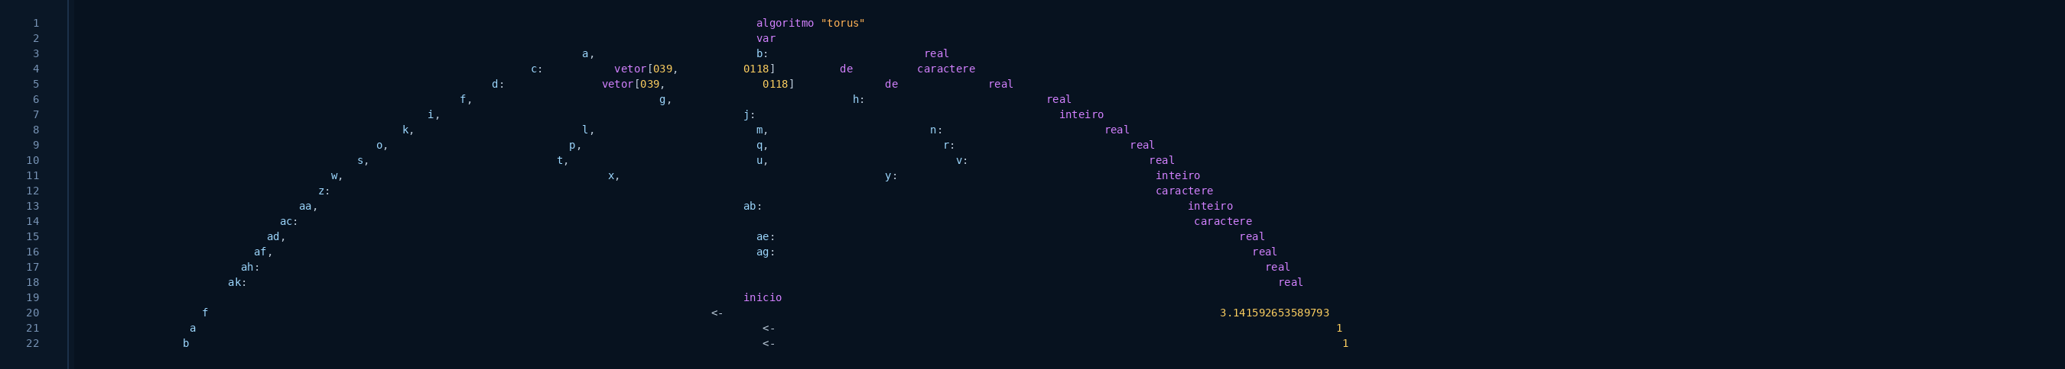
ASCII Torus in VisuAlg
Lines 1–22
Excerpt 1/4 — lines 1–22
20

Slide 21
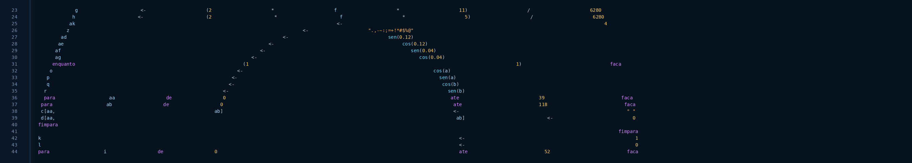
ASCII Torus in VisuAlg
Lines 23–44
Next
Excerpt 2/4 — lines 23–44
21

Slide 22
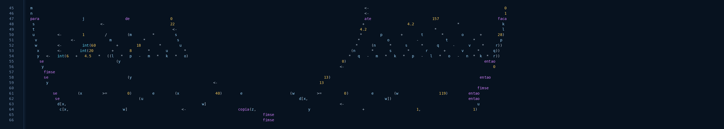
ASCII Torus in VisuAlg
Lines 45–66
Next
Excerpt 3/4 — lines 45–66
22

Slide 23

ASCII Torus in VisuAlg
Lines 67–86
Back
Excerpt 4/4 — lines 67–86
23

Slide 24
Q&A
Questions, comments, and discussion
20

Slide 25
Thank you!
Many thanks for your attention and participation!!!
21

Slide 26
Torus source code
The next slides show the Torus for Windows source code (readable version)

Slide 27

Next
Back
Torus for Windows
Lines 1–40
27

Slide 28
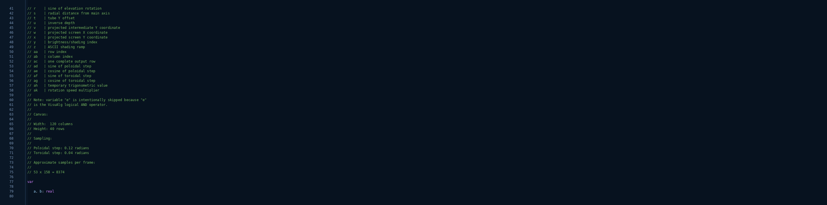
Previous
Next
Back
Torus for Windows
Lines 41–80
28

Slide 29
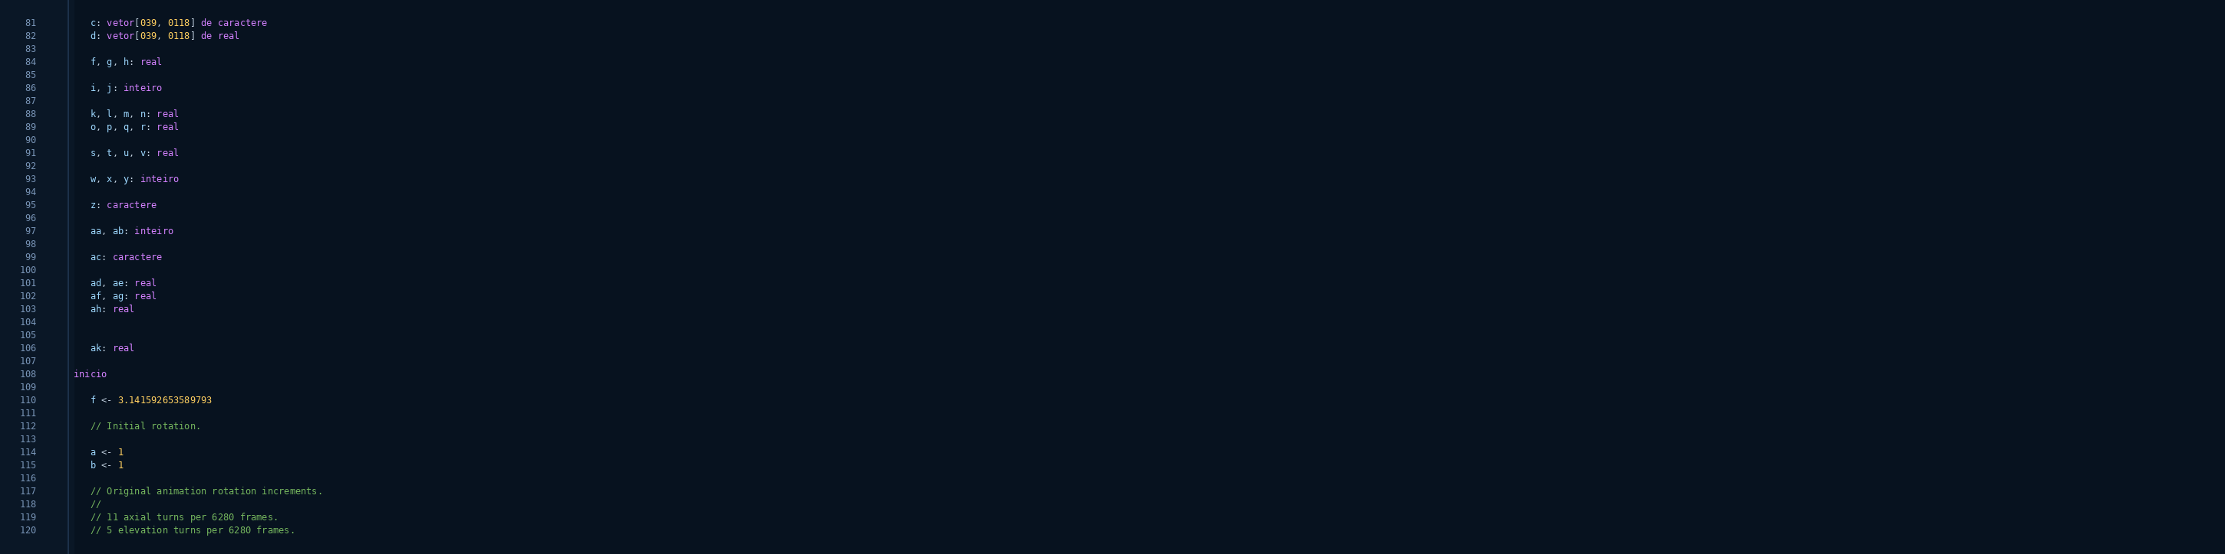
Previous
Next
Back
Torus for Windows
Lines 81–120
29

Slide 30
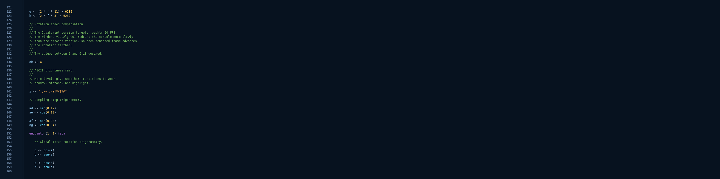
Previous
Next
Back
Torus for Windows
Lines 121–160
30

Slide 31
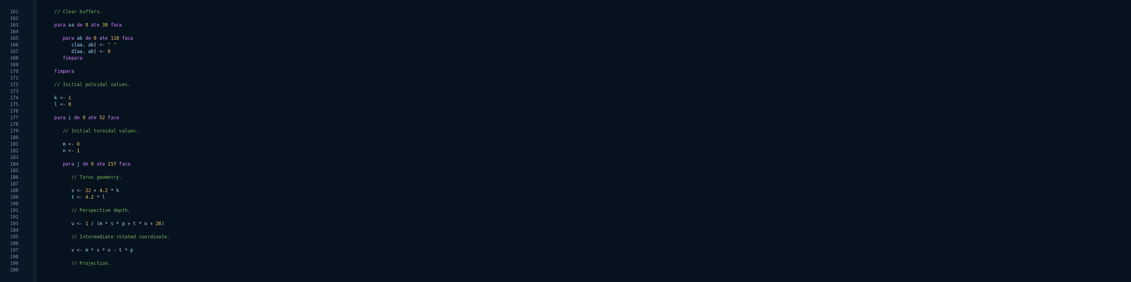
Previous
Next
Back
Torus for Windows
Lines 161–200
31

Slide 32
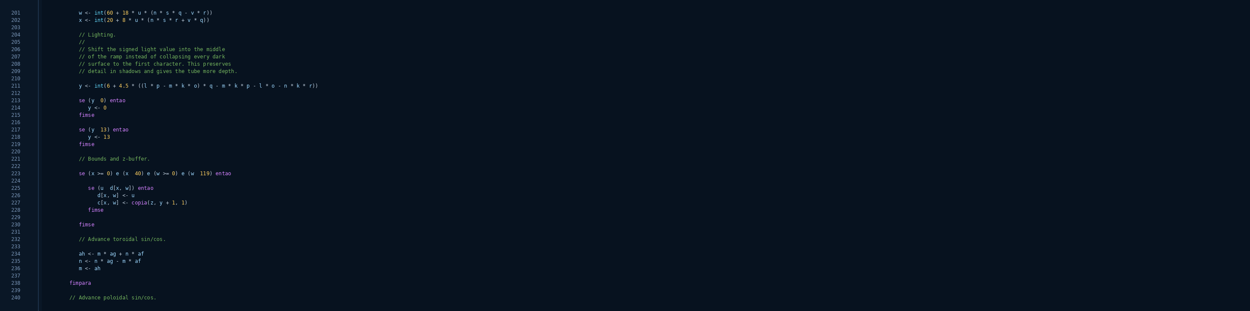
Previous
Next
Back
Torus for Windows
Lines 201–240
32

Slide 33
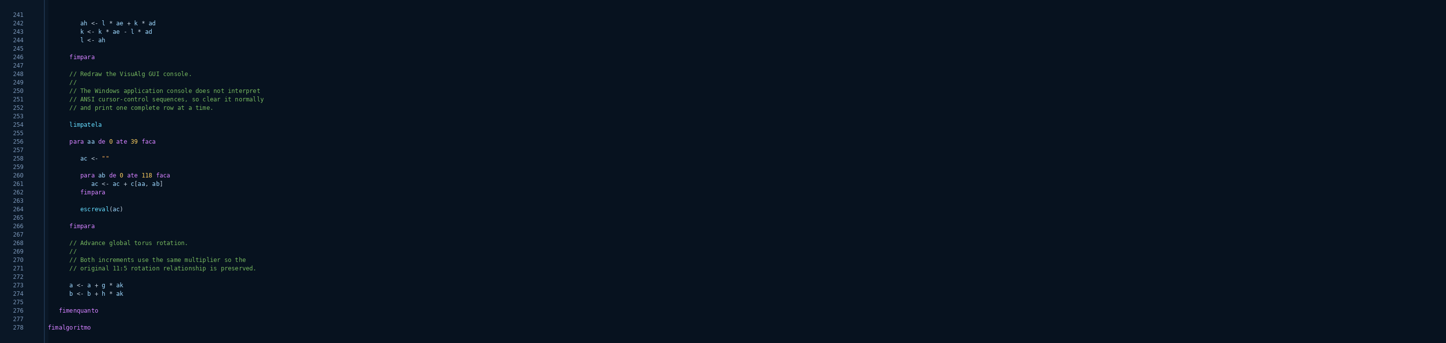
Previous
Back
Torus for Windows
Lines 241–278
33

