Slide 1
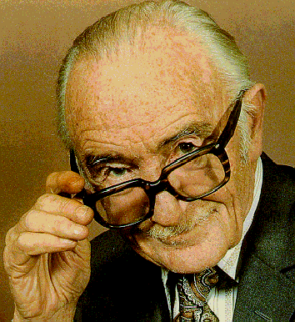
Meta-Analysis of
Binary Outcomes
For Rare Adverse Event Data
Source: http://www.cochrane.org/cochrane/archieco.htm

Slide 2
Agenda
Historical Background
Why not use the CMA package
Treatment effect in 2x2 contingency tables
Publication bias
Fixed and Random effect models
Heterogeneity
Examples
List of SAS+R, R-meta and R-rmeta tools
Maintaining 14 significant digits to and from R
Simultaneous multiuser support between R and SAS
Documentation

Slide 3
Historical Background
  R. A. Fisher (1944)
    “When a number of quite independent tests of significance have been made, it sometimes happens that although few or none can be claimed individually as significant, yet the aggregate gives an impression that the probabilities are on the whole lower than would often have been obtained by chance” (p. 99).
    Source of the idea of cumulating probability values
  W. G. Cochran (1953)
    Discusses a method of averaging means across independent studies
    Laid-out much of the statistical foundation that modern meta-analysis is built upon (e.g., inverse variance weighting and homogeneity testing)

Slide 4
Why not use CMA
Commercial Package $1295 per user
Only available at one workstation
Windows only
Does not have options for cross arm continuity corrections, empirical corrections or arcsine transformations.
Does not support general file input, manual entry only
Not reproducible and very labor intensive
Not compliant with AMGEN style guide
* www.biomedcentral.com/1471-2288/7/40

Slide 5
Comparing Binary Outcomes Between Two Groups
Group | Event | No Event | Total
Treatment | a | b | a+b
Control | c | d | c+d
Total | a+c | b + d | n
The measure of treatment effect usually takes the form of
with a link function g

Slide 6
Publication Bias

Slide 7
Publication Bias
Studies with significant positive results are easier to find than those with non-significant or 'negative' results.
The subsequent over-representation of positive studies in systematic reviews may mean that our reviews are biased toward a positive result.

Slide 8
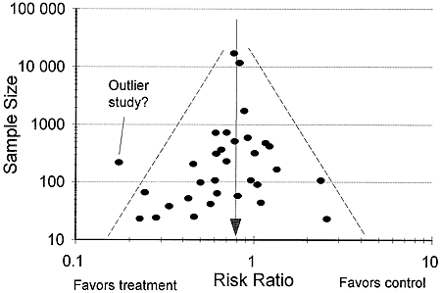
R funnel plot to detect publication bias

Slide 9
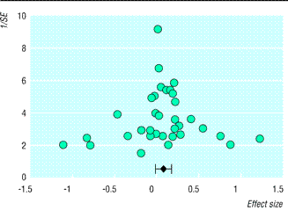
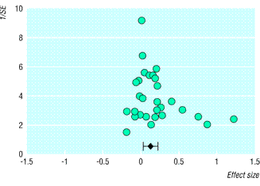
Funnel plots and publication bias
The graph typically resembles an inverted funnel.
Publication bias
is suggested
if review finds no small and negative studies.
Sutton, A.J., Duval, S.J., Tweedie, R.L., Abrams, K.R., & Jones, D.R. (2000). Empirical assessment of effect of publication bias on meta-analyses. BMJ,320:1574-1577.

Slide 10
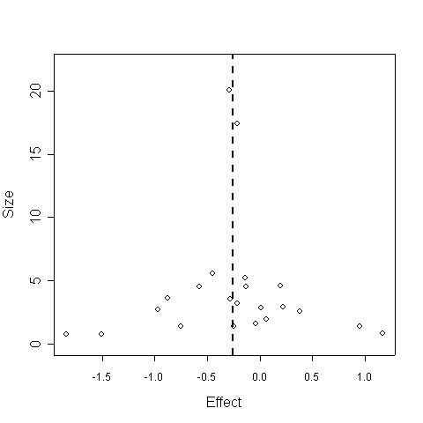
R funnel plot most critical area
Effect size vs sample size
To study a funnel plot, look at its LOWER LEFT corner, that’s where negative or null studies are most likely
If lower left is empty then we may have support for publication bias
Not empty here

Slide 11
Flip funnel plot to run Eggers test
.6
.4
.2
0
Risk Difference\SE
-.2
-.4
-.6
-.8
0
1
2
.3
4
5
6
1 \ Standard Error

Slide 12
Egger test
A test of funnel plot asymmetry
tests the null hypothesis that y-intercept (β₀)=0
in a linear regression model: y = β₀ + β₀ x
where y is the estimate (or effect size)
divided by its standard error
X is precision (reciprocal of the standard error of the estimate).
If β₀≠0, there is evidence of bias
Test’s power to detect bias depends on number of studies (data points in funnel plot)
Egger M, et al. (1997). Bias in meta-analysis detected by a simple, graphical test. British Medical Journal, 315, 629-634.

Slide 13
Test for funnel plot asymmetry metabias.R
> metabias(meta1,method="linreg",plotit=TRUE)
Linear regression test of funnel plot asymmetry
data: meta1
t = -0.9844, df = 5, p-value = 0.3701
alternative hypothesis: true is 0
sample estimates:
bias se.bias slope
-0.73099606 0.74257667 -0.05010411

Slide 14
Publication bias – trimfill.R
The trim and fill method uses the funnel plot to try to estimate the missing unpublished studies. In this approach, studies that are asymmetrically distributed (that have no matching study on the opposite side of the funnel plot) are removed from the plot. Then the funnel plot is filled in using symmetric pairs from the trimmed study. This produces a funnel plot with extra imputed studies that make the plot symmetric. The trim and fill method is quite controversial and should be considered an exploratory approach. If, for example, you use this method and the overall estimate changes by a trivial amount, then you have indirect evidence that publication bias did not seriously influence your outcome.

Slide 15
Fixed and random effects models

Slide 16
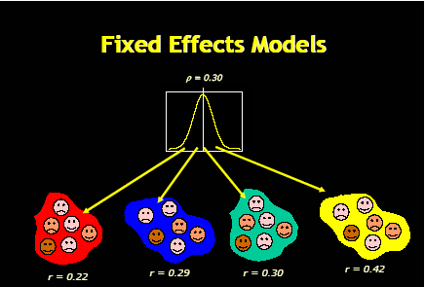
Fixed effects model
T_{i} = θ + ε_{i} ε_{i}~N(0,σ_{i}²)

Slide 17
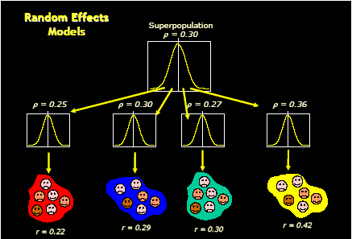
Random effects models
T_{i} = μ_{θ} + η_{i} + ε_{i} η_{i} ~N(0,τ²) ε_{i}~N(0,σ_{i}²) if τ²=0 μ_{θ}=θ fixed effect model if τ²>>σ_{i}² studies will have ~ equal weights

Slide 18
Fixed Effects Model(FE)
Random Effects Model(RE)
Assumes true effect varies among studies, ie older subjects one study
Considers within and between study variability
Assumes that the pooled estimate comes from a normal distribution
Larger studies have less weight in RE then FE
Method: DerSimonian Laird’s method (DSL)
OR=0.78 [0.69,0.88]
Assume underlying true effect is the SAME for all studies
Considers only within study variability
Tighter confidence intervals then random effects model.
OR=0.77 [0.72,0.83]

Slide 19
Heterogeneity

Slide 20
Heterogeneity
Is the fixed effect(FE) model appropriate?
Is the observed scatter of study outcomes consistent with estimating the same underlying effect(FE)?

Slide 21
Cochran’s Q and I² statistics (details)
Measures of consistency vs. heterogeneity among study results
Q = Σ w_{i} [study outcome i - overall effect ]²
Q is a weighted sum of squared differences
between individual study outcomes
and the overall effect across studies
w_{i} is often the individual study inverse variance
Cochran’s Q is distributed as a chi-square statistic
with k-1 degrees of freedom
(where k is number of studies)
The statistic’s p-value relates to the null hypothesis
that individual study estimates are consistent with one another.
Related statistic: I² = 100% x (Q-df)/Q
percentage of variation across study outcomes
due to heterogeneity of studies rather than chance.

Slide 22
Q and I²
I² = 100% x (Q-df)/Q
This measure is preferred to Cochran's Q. If there is no heteogeneity then Q should be approximately equal to the the degrees of freedom. The problem with Cochran's Q, the authors claim, is that it tends to have too little power with a collection of studies with small sample sizes and too much power with a collection of studies with large sample sizes. Values of I-squared equal to 25%, 50%, and 75% representing low, moderate, and high heterogeneity, respectively.
Q
An unusually large value for Q implies substantial heterogeneity,
because you have more variation among the studies than you would
expect just by looking at the individual standard errors.
If there is no heterogeneity, then Q should be approximately
equal to df, which implies that the squared Z-scores are, on average,
just slightly less than 1.
http://www.childrens-mercy.org/stats/training/hand67.asp

Slide 23
Heterogeneity
When event rates are low or trial size is small, the estimates of the standard errors of the effect estimates in the inverse variance methods may be poor
Mantel-Haenszel methods use a different weighting scheme that depends upon which effect measure.
Cochrane Collaboration open learning material for reviewers
V1.1, Nov 2002 (http://www.cochrane-net.org/openlearning/index.htm

Slide 24
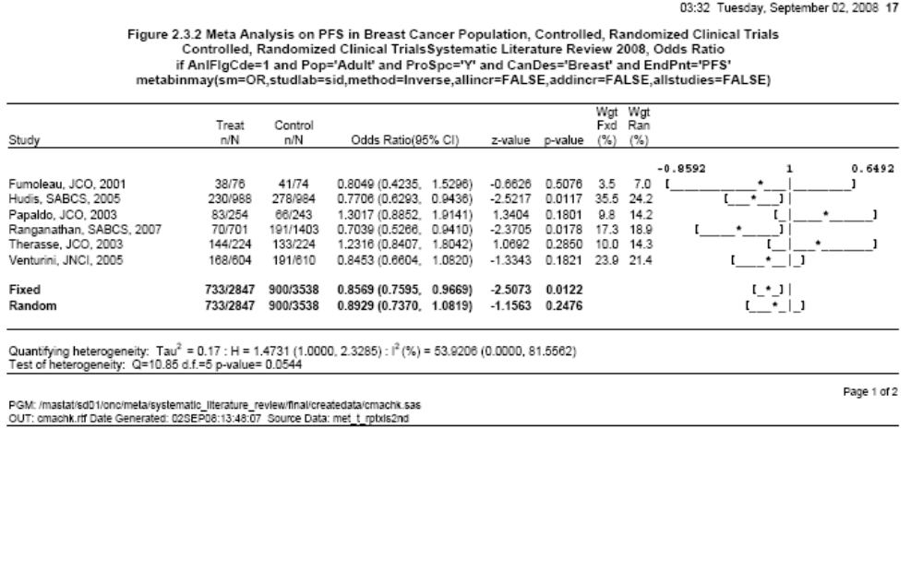
Examples: heterogeniety p-value=.05 made up data

Slide 25
Examples

Slide 26
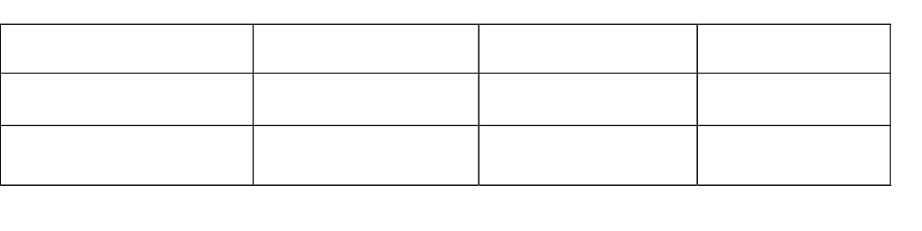
Simple Example of OR, RR, and RD
Odds Ratio = (5/95) / (10/90) = 0.48
Risk Ratio = (5/100) / (10/100) = 0.50
Risk Difference = (5/100) - (10/100) = -0.05
(OR ≈ RR when probability is small. OR is generally more extreme (further from 1) than RR.)

Slide 27
Different Effect Measures
Link | Effect Measure | Formula
identity | Risk difference
log | Log Relative Risk
logit | Log Odds Ratio
Arcsine | Arcsine Difference

Slide 28
Whey we use the log transform of OR and RR
0
1
+∞
OR
-∞
+∞
0
Log(OR)

Slide 29
Arcsine variance stabilizing transformation

Slide 30
SAS - met_arcsin.sas
Simple Inputs
Variance Stabilizing Arcsine Transform
Publication Trt Trt Control Control
Events Total Events Total
Hudis 3 76 0 74
Papaldo 7 988 7 984
Pfreundschuh1 1 254 0 243
Pfreundschuh2 3 349 1 361
Ranganathan 1 341 1 348
Therasse 4 701 4 1403
Venturini 1 224 0 224

Slide 31
met_arcsin.sas
Sample call expects standard directory
%met_arcsin
(
Title = AML/MDS Six Studies
,Input = work.amlmds
,Citation = Publication
,Program = met_arcsincal
,Treatment_Incidence = Trt_Incidence
,Treatment_Total = Trt_Total
,Control_Incidence = Control_Incidence
,Control_Total = Control_Total
);

Slide 32
met_arcsincal_amlmds.sas7bdat
Output Dataset see /doc/met_ddt.xls
Sub = 1 for individual studies, 2 for pooled estimate
SubDes = ‘Individual’ or ‘Combined’ Study Estimates
CytKey = Citation
TrtInc = Treatment Events
TrtTot = Treatment Total
TrtPct = Treatment Percent
ContrlInc = Control Events
ContrlTot = Control Total
ContrlPct = Control Percent
Lwr = Lower CI for VST difference
Upr = Upper CI for VST difference
UprLwr = Formatted Upper and Lower CIs
Var = Variance of the difference
Vst = Variance Staliblizing Arcsine Transformation

Slide 33
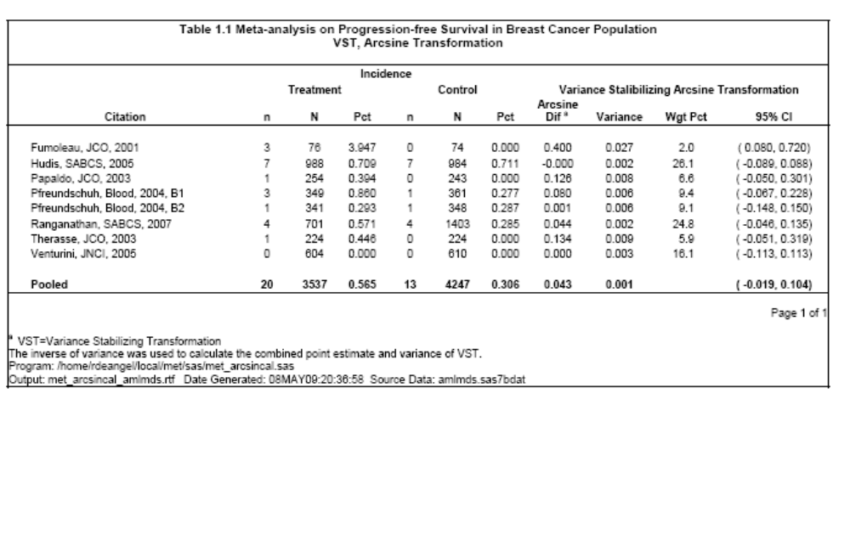
SAS met_arcsin table output

Slide 34
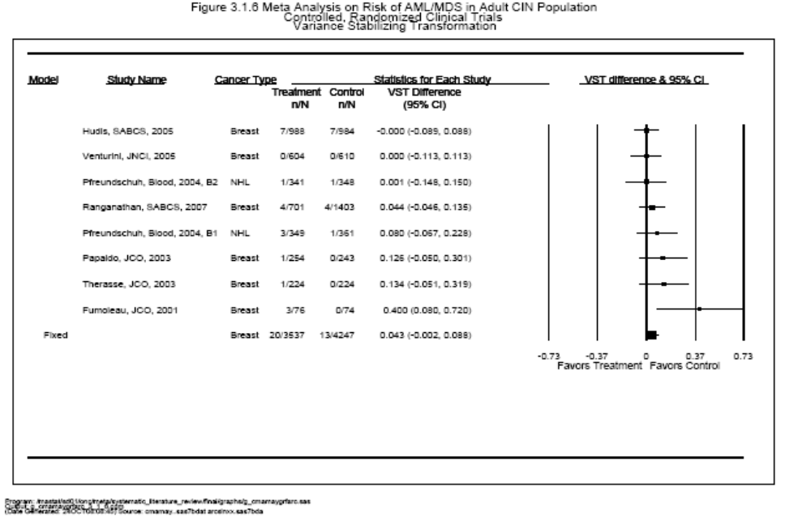
SAS met_forest forest plot

Slide 35
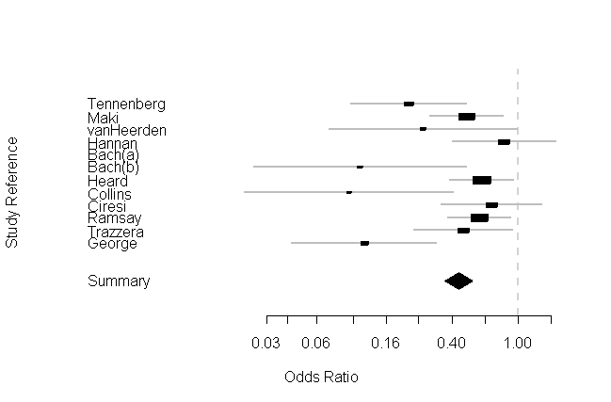
R - meta forest plot – forest.R

Slide 36
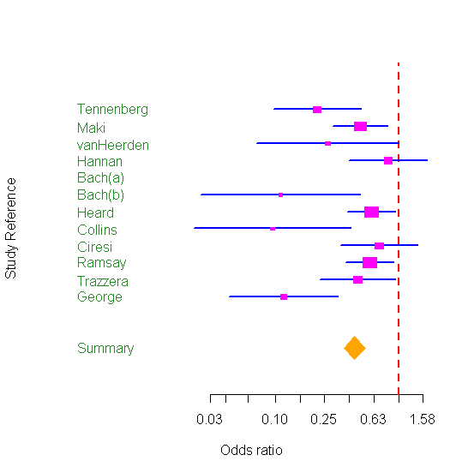
R- rmeta forest plot - metaplot.R
> metaplot(a$logOR, a$selogOR, nn=a$selogOR^-2, a$names,
+ summn=a$logMH, sumse=a$selogMH, sumnn=a$selogMH^-2,
+ logeffect=TRUE, colors=meta.colors(box="magenta",
+ lines="blue", zero="red", summary="orange",
+ text="forestgreen"))
>

Slide 37
Continuity Corrections
Inverse variance-weighted
Cell Continuity Correction 0.5 All
Cell Continuity Correction 0.5 If Needed
Reciprocal opposite arm all
Reciprocal opposite arm if needed
Empirical continuity correction All
Empirical continuity correction If Needed
The Mantel-Haenszel
Cell Continuity Correction 0.5 All
Cell Continuity Correction 0.5 If Needed
Reciprocal opposite arm all
Reciprocal opposite arm if needed
Empirical continuity correction All
Empirical continuity correction If Needed
Peto
Peto's Pooled Odds Ratio

Slide 38
Continuity corrections reciprocal opposite arm(ROA) and empircal
Consider a double 0 study with 0/50 in treatment and 0/150 in control.
ROA
The ratio of patients in control to patients in treatment is 150/50 = 3. The ROA correction would be .25/50.50 for treatment and .75/151.5 for control
Empirical
Suppose the overall odds ratio was 0.5 favoring treatment. The empirical correction for treatment would be .14/50.28 and .86/151.72 for control.

Slide 39
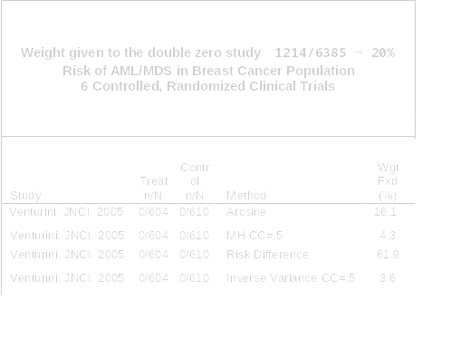
Double 0s and study weights

Slide 40
R-meta, metainf.R, performs influence analysis. Pooled estimates are calculated omitting one study at a time.
> metainf(meta1)
Influential analysis (Fixed effect model)
RR 95%-CI
Omitting MRC-1 0.9183 [0.8696; 0.9698]
Omitting CDP 0.9190 [0.8703; 0.9705]
Omitting MRC-2 0.9185 [0.8691; 0.9706]
Omitting GASP 0.9152 [0.8669; 0.9663]
Omitting PARIS 0.9166 [0.8679; 0.9680]
Omitting AMIS 0.8940 [0.8447; 0.9462]
Omitting ISIS-2 0.9124 [0.8162; 1.0199]
Pooled estimate 0.9137 [0.8658; 0.9643]
Method: Inverse variance method

Slide 41
SAS – met_invwgt.sas

Slide 42
Met_invwgt - continuity corrections
Inverse variance-weighted
Cell Continuity Correction 0.5 All
Cell Continuity Correction 0.5 If Needed
Reciprocal opposite arm all
Reciprocal opposite arm if needed
Empirical continuity correction All
Empirical continuity correction If Needed
The Mantel-Haenszel
Cell Continuity Correction 0.5 All
Cell Continuity Correction 0.5 If Needed
Reciprocal opposite arm all
Reciprocal opposite arm if needed
Empirical continuity correction All
Empirical continuity correction If Needed
Peto
Peto's Pooled Odds Ratio

Slide 43
met_invwgt.sas
Sample Call
%met_invwgt
(pgmnam = met_invwgt
,NonInf = Y
,invinp = metinp.met_rosiglitazone
,Sty = Study
,TrtEvn = Trt_Incidence
,TrtTot = Trt_Total
,CtlEvn = Control_Incidence
,CtlTot = Control_Total
,invout = work.invwgt1
,rtfout = %nrstr(&pgmnam._mi_noninf_48.rtf)
,title1 = %nrbquote(Rosiglitazone and MI Risk)
);

Slide 44
met_invwgt.sas
Output Dataset see /doc/met_ddt.xls
CCM Continuity correction method
InvInp Source data
NonInfCde Y/N Include Non-Informative Studies
NonInf Decode of NonInfCde ie Non-Informative Studies included
Title1 1st tile line of corresponding report
Title2 2nd tile line of corresponding report
NumSty Number of Studies Pooled
PolMth Pooling method
Ref References for the calculations needed to create this dataset
PolMthCCM Pooling method and continuity correction
CIs Character string containing odds ratio, lower and upper 95% CI
LogOdd Log of the odds ratio
LogLwr Log of the lower limit of 95% confidence interval
LogUpr Log of the upper limit of 95% confidence interval
Odd Odds ratio
Lwr Lower limit of 95% confidence interval
Upr Upper limit of 95% confidence interval
Rec Record number for merging with plots

Slide 45
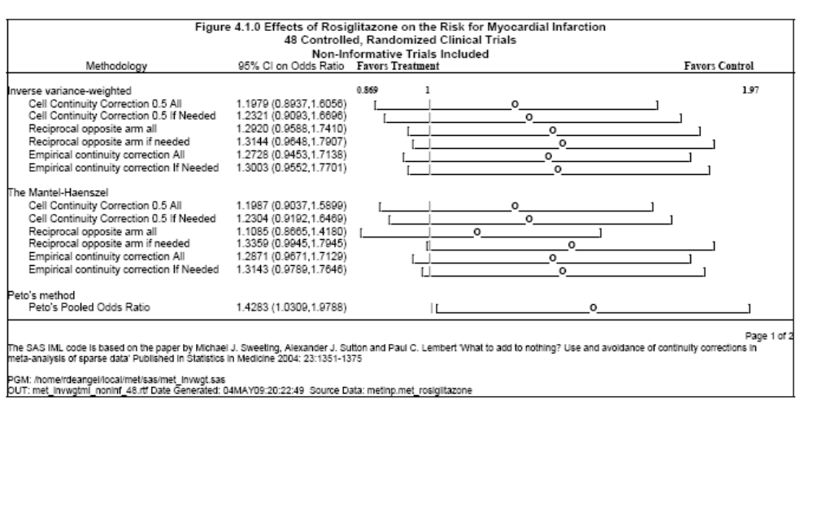
met_invwgt.sas
Sample Table Output Page 1

Slide 46
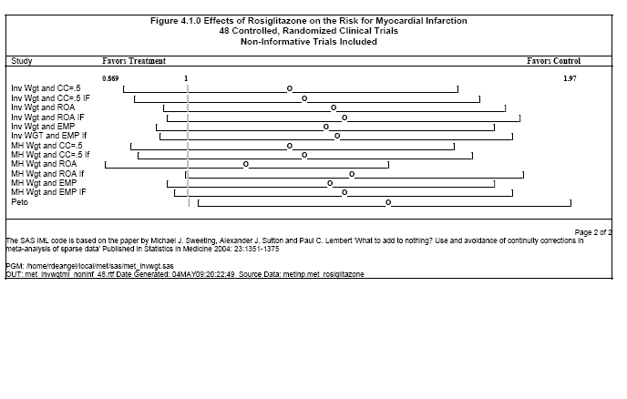
met_invwgt.sas
Sample Table Output Page 2

Slide 47
SAS+R met_cma

Slide 48
met_cma
Simple macro call
Default Method=OR, Pooling Method=Inverse, CC= add .5 to all cells in a study if 0 cell exists
%met_cma(
,cmainp = metinp.met_cma1st
,pgmnam = cmacal
,cmaout = metout.met_cmacal
,rtfout = met_cmacal.rtf
,title1 = %nrbquote(Risk of AML/MDS)
,subset = %nrbquote(if Pop='Adult' and EndPnt='AMLMDS')
,studlab = Study
,event_e = Trt_Incidence
,n_e = Trt_Total
,event_c = Control_Incidence
,n_c = Control_Total
);

Slide 49
met_cma
Key R Options
method – Pooling methods Peto, MH or Inverse
sm – Summary measure RD, OR and RR (AS added?)
Incr – Value to add if cell has 0 count (.5 often)
allstudies – True then include non-informative studies
allincr
If true then incr is added to all studies if at least
one study has a zero cell (ROA recently added?)
if false incr is only added to all cells of the study with 0 count
addincr – add incr to all cells in all studies regardless
mh_exact – For the Mantel-Haenszel method, by default (MH.exact is FALSE), 0.5 is added to all cell frequencies of a study with a zero cell count in the calculation of the pooled estimate. This approach is used in RevMan 4 and the Stata procedure metan.

Slide 50
met_cma
Key Output Options
cmamny – F, I, L, O. First, Intermediate, Last or only One macro call. This allows concatenation of rtf tables and output datasets. For instance if only one macro call is planned the set cmamny=O. This is the default. If four calls are planned then use F in the first call, I on the second and third and L on the last.
Key – user defined unique key for each analysis
addinp – add all variables in the input dataset to the output dataset

Slide 51
met_cma
Output Dataset 118 Variables see /doc/met_ddt.xls
SAS labels contain source R variable information
For example SAS variable H has label
* R-metagen.H.te -> H=(sqrt(Q/(k-1)) square root of the chi-square heterogeneity statistic divided by its degrees of freedom
This means that the source for H is the R variable H.te in the routine metagen Most SAS statistics have R variable sources.

Slide 52
met_cma
SAS List Output
library(meta)
load meta: /home/rdeangel/local/R/R-2.7.1/library ...
> library(foreign)
>metabinmay(event.e,n.e,event.c,n.c,data=rdeangeldat,sm="OR",incr=0.5,studlab=study,
method="Inverse",allincr=FALSE,addincr=FALSE,allstudies=TRUE,MH.exact=FALSE
, RR.cochrane = FALSE, warn = FALSE )
OR 95%-CI %W(fixed) %W(random)
Fumoleau, JCO, 2001 7.0952381 [0.36015121; 139.781298] 6.27 6.27
Hudis, SABCS, 2005 0.9959225 [0.34802903; 2.849939] 50.39 50.39
Papaldo, JCO, 2003 2.8816568 [0.11682589; 71.079673] 5.42 5.42
Ranganathan, SABCS 2.0071736 [0.50049779; 8.049478] 28.88 28.88
Therasse, JCO, 2003 3.0134228 [0.12210366; 74.368917] 5.42 5.42
Venturini, JNCI, 2005 1.0099256 [0.02000718; 50.979186] 3.62 3.62
Number of trials combined: 6
OR 95%-CI z p.value
Fixed effects model 1.551929 [0.7357667; 3.273433] 1.1542 0.2484
Random effects model 1.551929 [0.7357667; 3.273433] 1.1542 0.2484
Quantifying heterogeneity:
tau^2 = 0; H = 1 [1; 1.31]; I^2 = 0% [0%; 41.5%]
Test of heterogeneity:
Q d.f. p.value
2.17 5 0.8254 Method: Inverse variance method

Slide 53
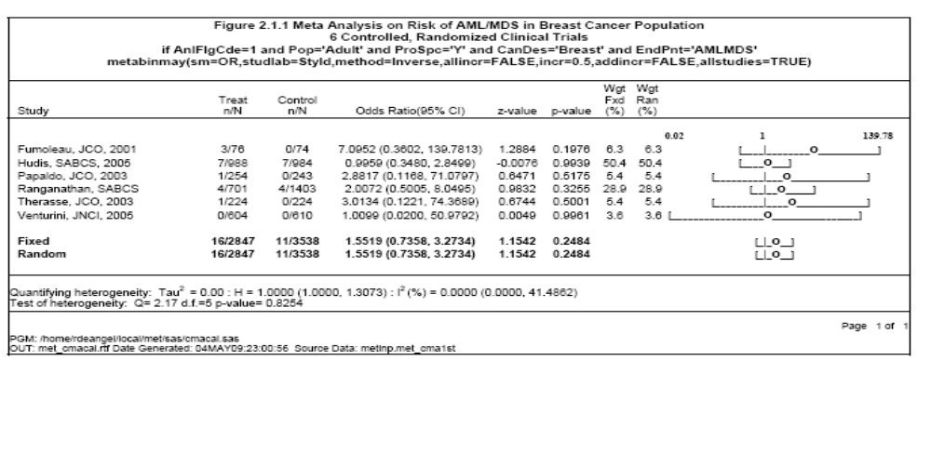
met_cma
SAS Table Output Page 1

Slide 54
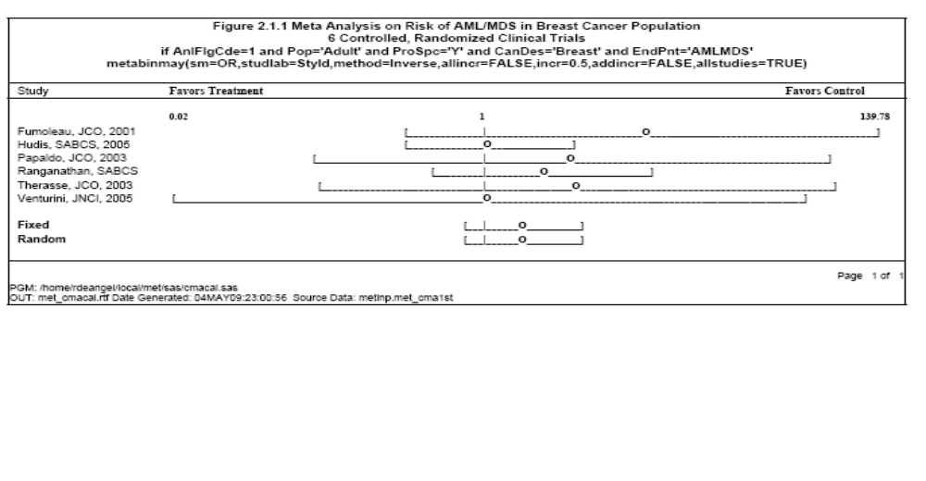
met_cma
SAS Table Output Page 2

Slide 55
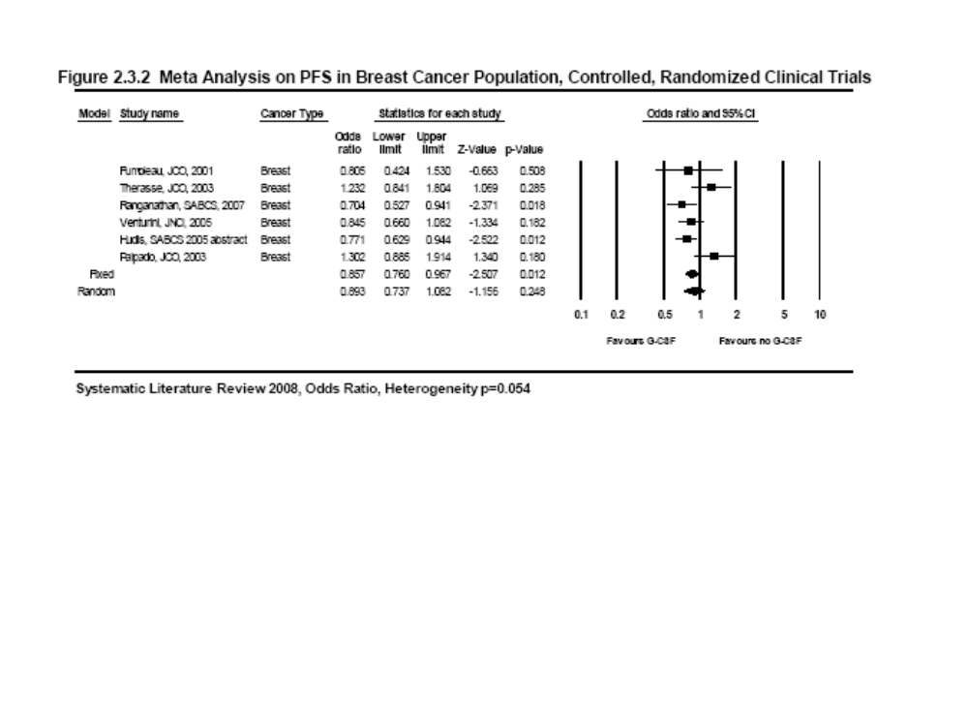
What CMA output looks like

Slide 56
SAS - met_genplt.sas exploratory plotting program
Takes advantage of output datasets created by previous programs
%macro met_genplt(
metinp = metinp.met_cmaamy
,key = 2.1.2
,pgmnam = met_genpltcal
,rtfout = met_genplt_048.rtf
);

Slide 57
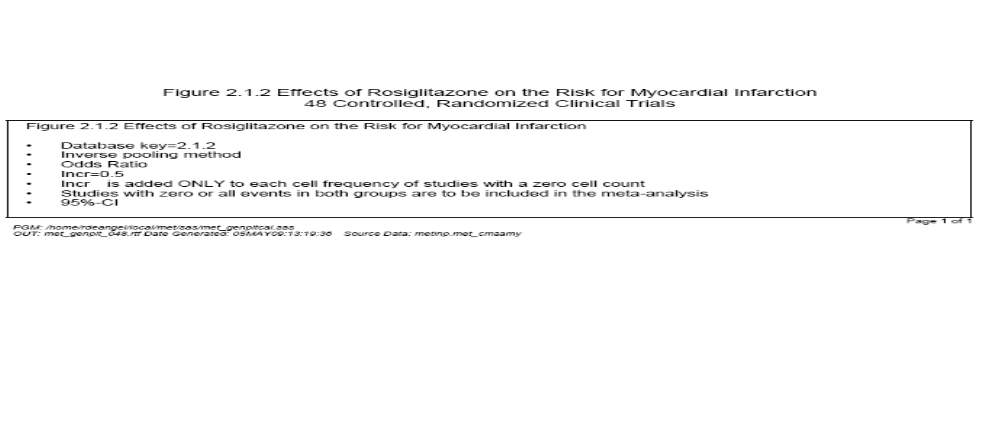
met_genplt summary page

Slide 58
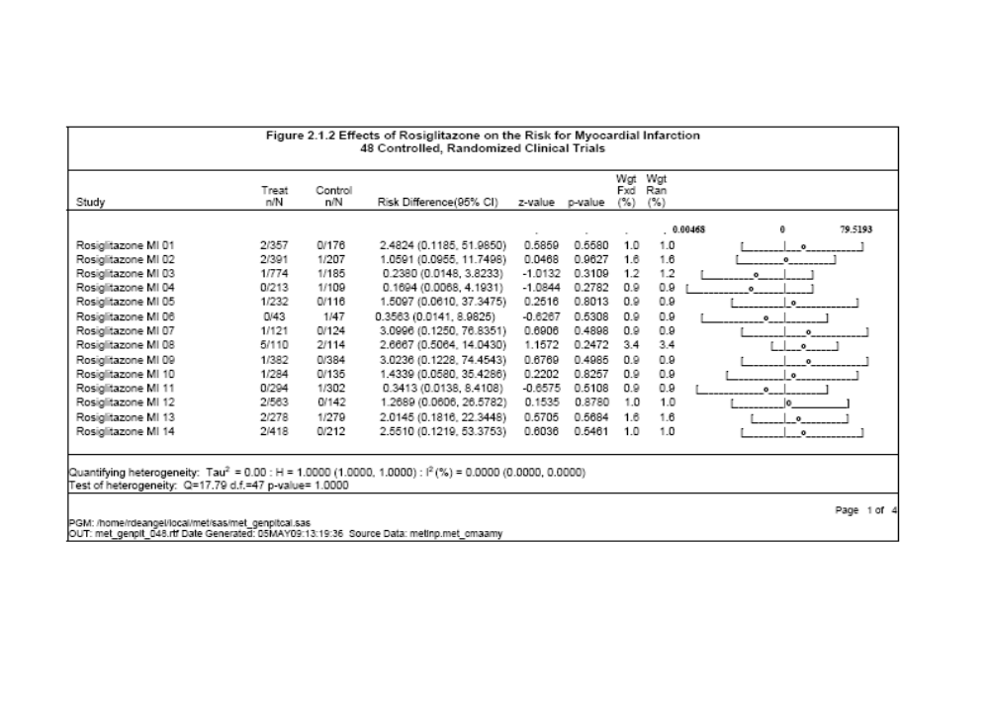
met_genplt Avandia
1st 14 of 48 Studies Page 1

Slide 59
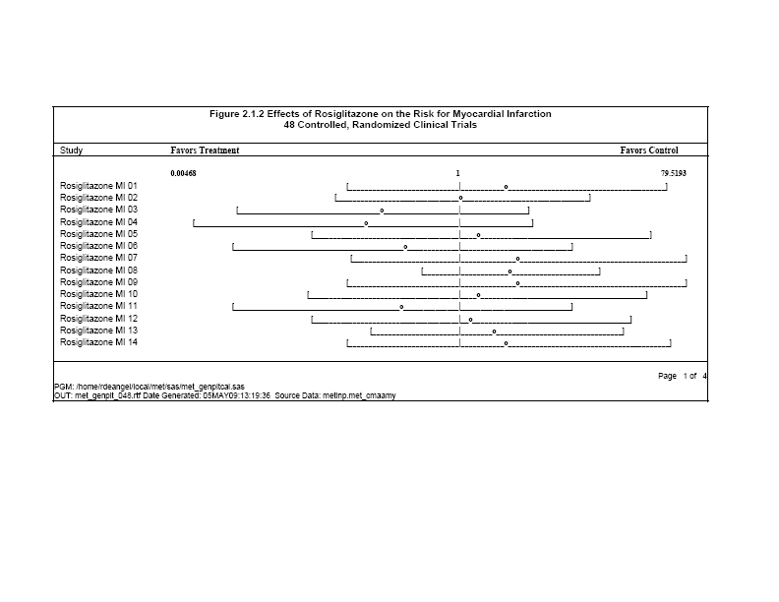
met_cma
Expanded View 1st 14 only

Slide 60
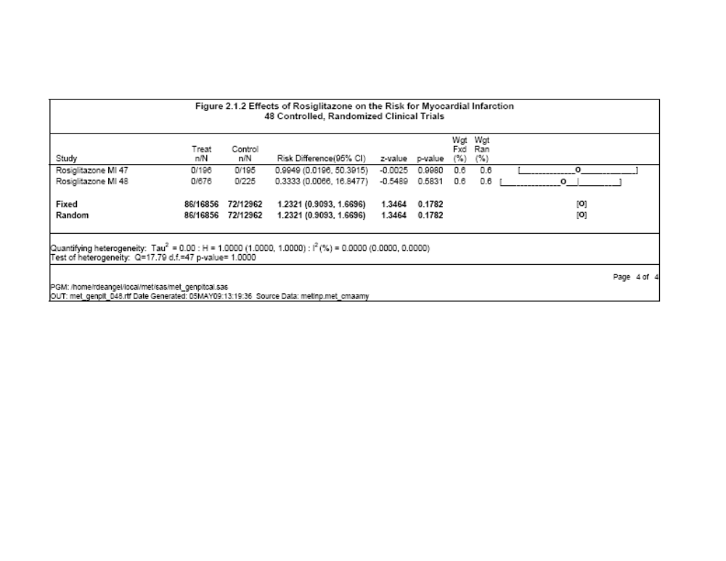
met_cma
Last page narrow view

Slide 61
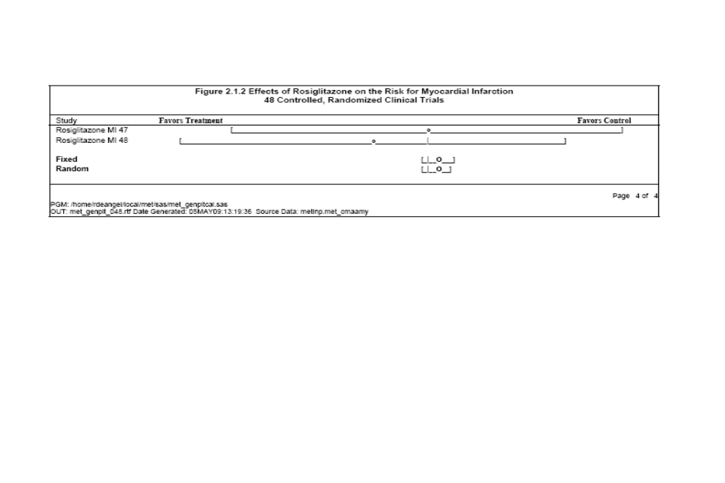
Met_cma
Last page expanded view

Slide 62
Results from the M-H Method with
‘Treat Arm’ Continuity Correction
Crude pooled OR = 0.958
Test for heterogeneity
Q = 4.628, df=8, p-value=0.80
I² = 0%

Slide 63
Results from Various Methods

Slide 64
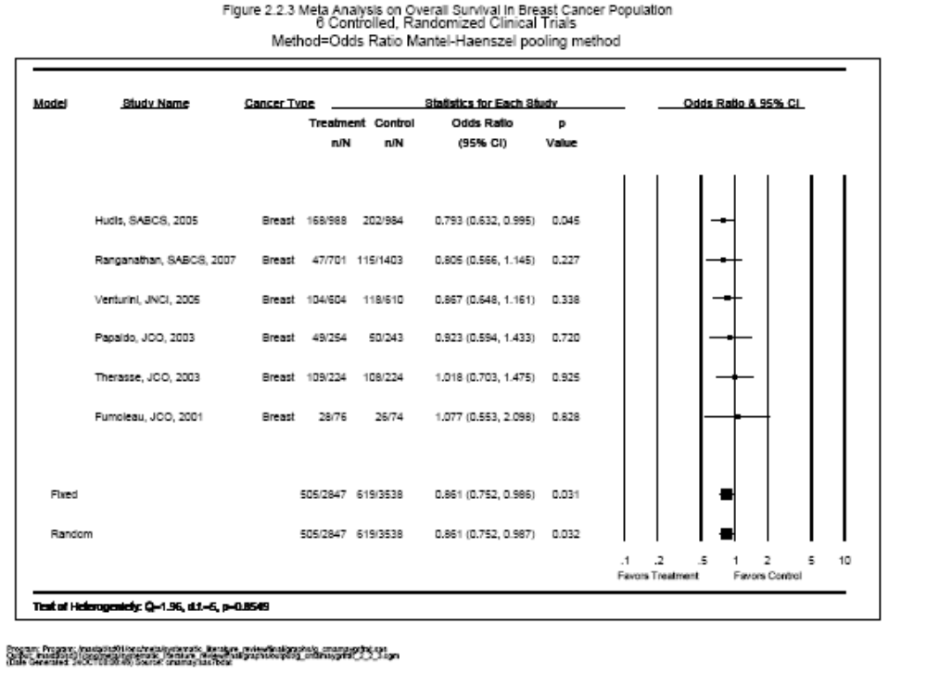
SAS - met_forest
Odds Ratio MH

Slide 65
Five SAS+R Neulasta Tools for Meta Analysis
Meta analysis macro programs
met_cma.sas - SAS and R package
met_invwgt.sas - many CC corrections
met_arcsin.sas - arcsine transform
Reporting tools
met_genplt.sas - general(rtf) exploratory
met_forest - official forest plot GSIB
Sample calls
met_arcsincal.sas
met_invwgtcal.sas
met_cmacal.sas
met_genpltcal.sas

Slide 66
Maintaining 14 significant digits from SAS to R and R to SAS
gendat <- data.frame("metagen.dbf",
TE=TE, seTE=seTE,
studlab=studlab,
w.fixed=w.fixed, w.random=w.random,
TE.fixed=TE.fixed, seTE.fixed=seTE.fixed,
TE.random=TE.random, seTE.random=seTE.random,
k=k, Q=Q, tau=sqrt(tau2),
sm=sm, method="Inverse")
dbf <- Sys.getenv(c("R_DBF"))
outdbf <- paste(dbf,"metagen.dbf",sep="")
write.dbf(gendat,outdbf, factor2char = TRUE)

Slide 67
Treatment effect and CI from R to SAS
14 significant digits
Treatment effect and CI from R to SAS
X_STUDLAB TE LOWTE UPPTE
Fumoleau, JCO, 2001 7.39302550850E+00 7.57160002446E-01 7.21866263310E+01
Hudis, SABCS, 2005 9.95924580421E-01 3.48121802320E-01 2.84919175782E+00
Papaldo, JCO, 2003 7.07588775493E+00 1.40268684885E-01 3.56944870208E+02
Ranganathan, SABCS 2.12420837709E+00 4.87141112960E-01 9.26273950039E+00
Therasse, JCO, 2003 7.38905609893E+00 1.46617522745E-01 3.72384889684E+02

Slide 68
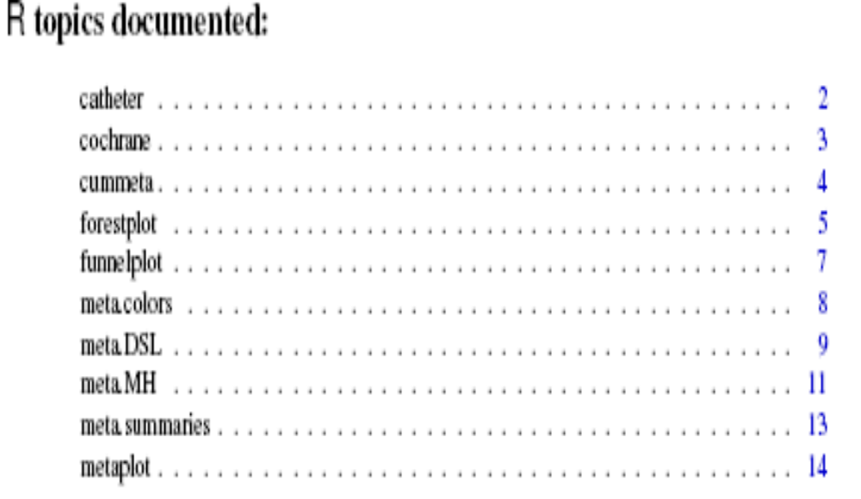
R rmeta package

Slide 69
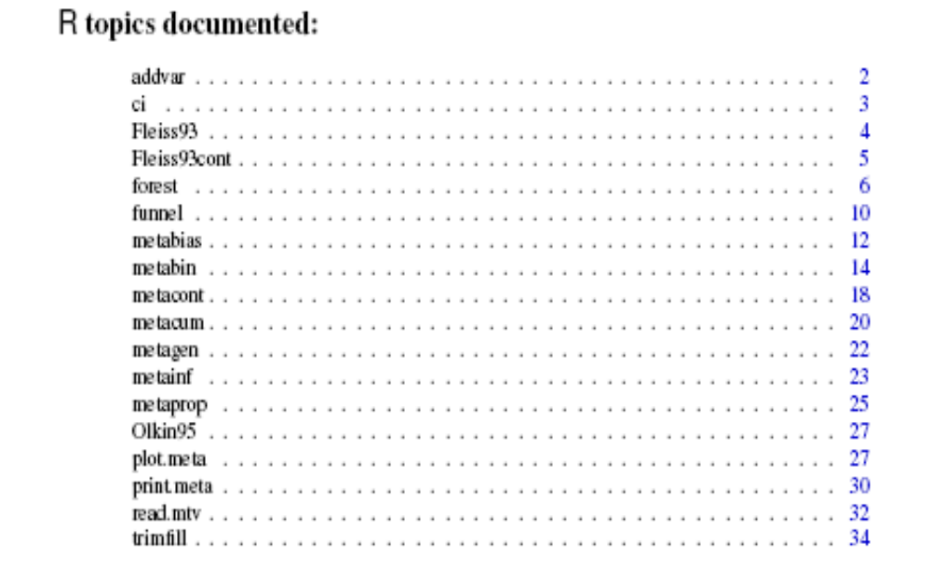
R meta package

Slide 70
Status of Tools
Tools have been tested using the Rosiglitazone 48 study dataset
The results of the 48 studies along with subsets using all logical combinations of methods have been verified against published data and GSLIB S+ program output
Tools were also tested against CMA output using the first Meta Analysis of AML/MDS, OS and PFS.
These tools have not gone through the same level of rigor as the standard macros. Single user testing so far.
These tools will continue to undergo development and testing.

Slide 71
Key References
Bongartz T, et al. (2005) Anti-TNF Antibody Therapy in Rheumatoid Arthritis and the Risk of Serious Infections and Malignancies. Manuscript submitted to JAMA
Bradburn M.J., et (2007) Much ado about nothing: a comparison of the performance of meta-analytical methods with rare events; STATISTICS IN MEDICINE, 26:53–77
DerSimonian R, and Laird N (1986) Meta-analysis in clinical trials. Controlled Clinical Trials; 7:177-188
Fleiss JL (1994) Measures of effect size for categorical data. The Handbook of Research Synthesis; Russell Sage Foundation: New York, 245-260.
Higgins, JPT, et al. (2002) Quantifying heterogeneity in a meta-analysis. Statistics in Medicine; 21:1539-1558
Mantel N, and Haenszel W (1959) Statistical aspects of the analysis of data from retrospective studies of disease. Journal of the National Cancer Institute; 22:719-723

Slide 72
meta and rmeta package
R site : http://cran.r-project.org/
Author of rmeta
: Thomas Lumley tlumley@u.washington.edu
Author of meta
GuidoSchwarzer<sc@imbi.uni-freiburg.de>

Slide 73
Key References (Cont.)
Robins J, et al. (1986) A general estimator for the variance of the Mantel-Haenszel odds ratio. American Journal of Epidemiology; 124:719-723
Smith TC, et al. (1995) Bayesian approaches to random-effects meta-analysis: a comparative study. Statistics in Medicine; 16:2685-2699
Sutton AJ, and Abrams KR (2001) Bayesian methods in meta-analysis and evidence synthesis. Statistical Methods in Medical Research; 10:277-303
Sutton AJ, et al. (2002) Meta-analysis of rare and adverse event data. Expert Review in Pharmacoeconomics Outcomes Research; 2:367-379
Sweeting MJ, et al. (2004) What to add to nothing? Use and avoidance of continuity corrections in meta-analysis of sparse data. Statistics in Medicine; 23:1351-1375
Yusuf S, et al. (1985) Beta blockade during and after myocardial infarction: an overview of the randomized trials. Progress in Cardiovascular Diseases; 27:335-371

Slide 74
Acknowledgement
GSIB: Amy Xia/ George Li /
Haijun Ma / Kefei Zhou
Neulasta team: Roger/May
Others: Springer Li /Paul Peloso / Jim Louie / Sean Zhao
Lizhi Xie / Lifen Zhou

Slide 75
Thank You!

Slide 76
Supporting Slides

Slide 77
Comparing Binary Outcomes Between Two Groups
Group | Event | No Event | Total
Treatment | a | b | a+b
Control | c | d | c+d
Total | a+c | b + d | n
The measure of treatment effect usually takes the form of
with a link function g

Slide 78
Random Model

Slide 79
Mantel-Haenszel (M-H) Method
(Mantel & Haenszel, 1959)
Combining odds ratio from each study (each study forms an individual stratum)
Pooled estimate of the common odds ratio, Variance estimate based on the work by Robins et al. (1986)

Slide 80
Inverse Variance-Weighted (I-V) Method
(Fleiss, 1994)

Slide 81
Peto Method
(Yusuf & Peto, et al, 1985)
Pooled log-odds ratio:

Slide 82
Future Work
Poisson or survival model to account for length of exposure time
Individual patient data
  Gold standard
  Investigate covariates
Further modeling on synthesizing both randomized and observational evidence
The integration of meta-analyses of efficacy and AEs, and even economic decision helps quantify and establish the risk-benefit profile of a pharmaceutical product

