Slide 1
Math Class
by Roger DeAngelis

Slide 2
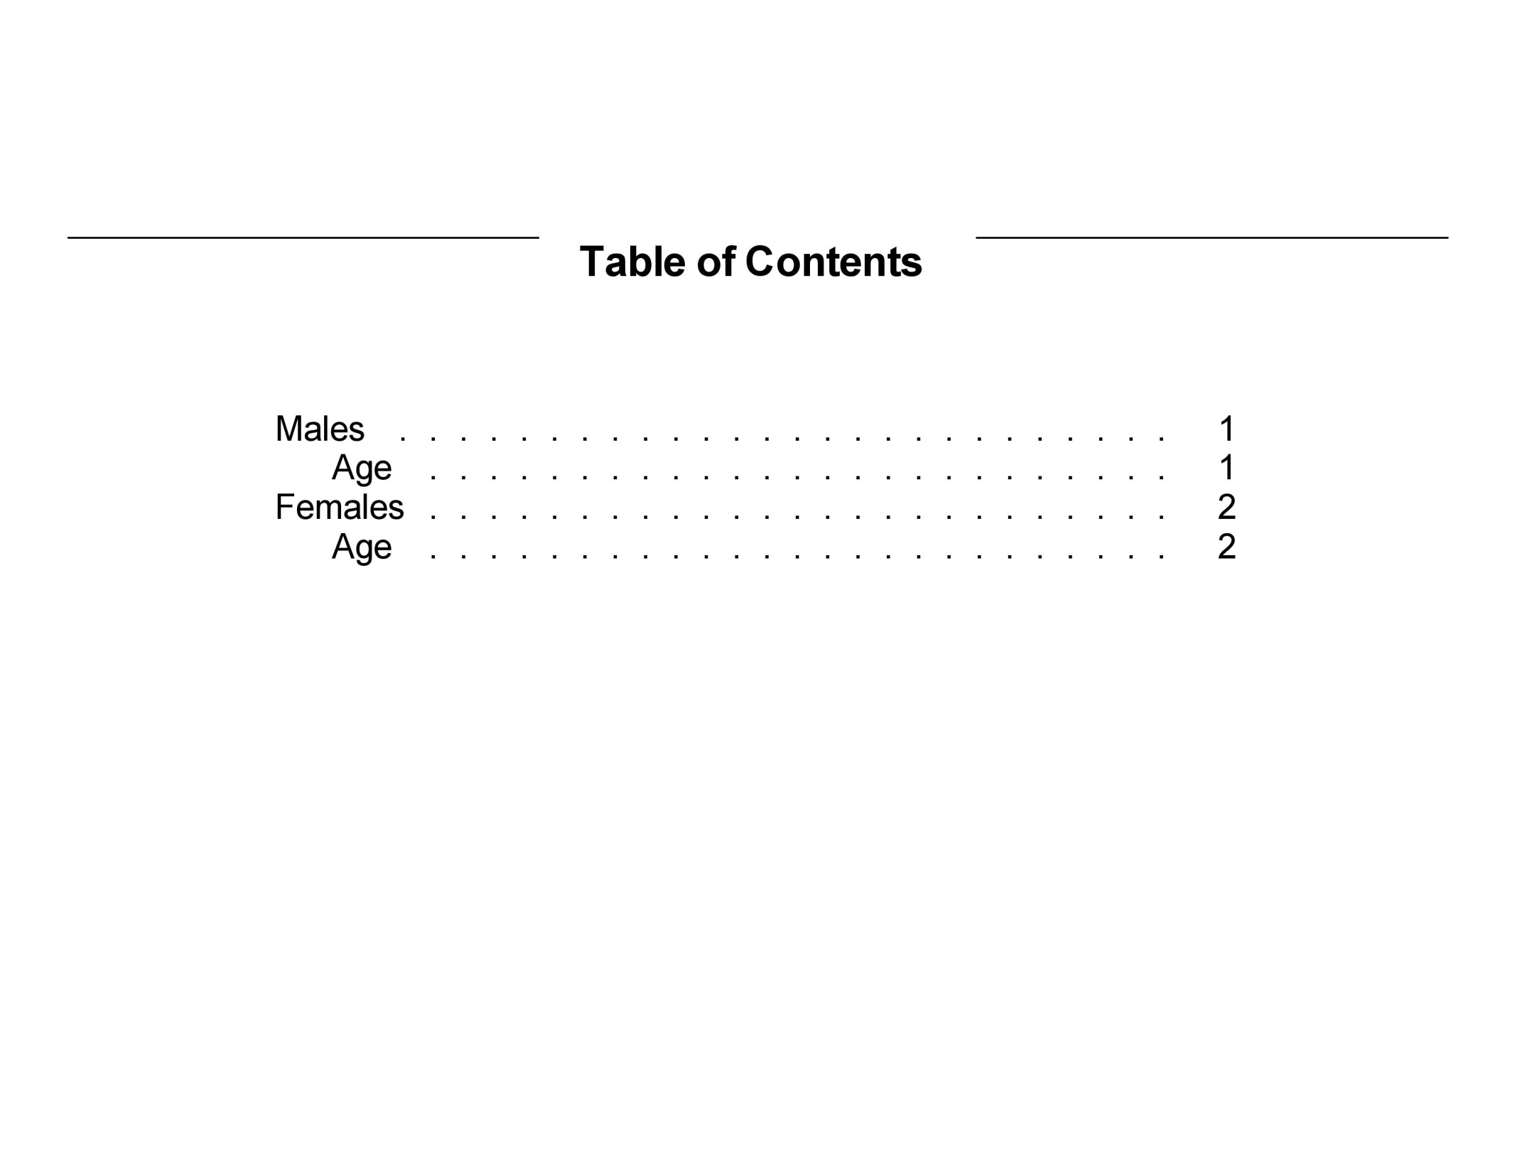

Slide 3
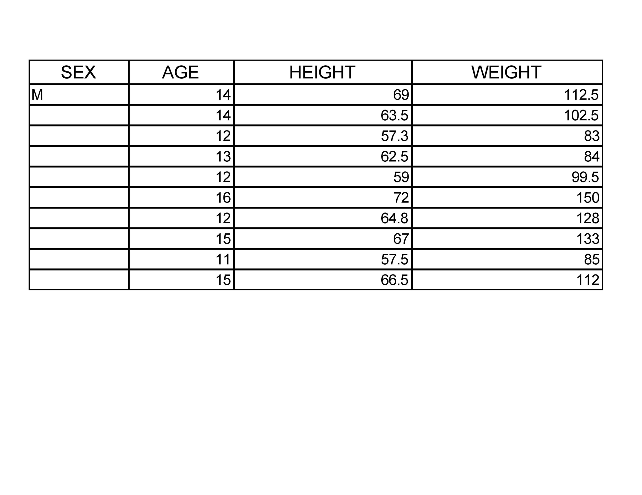

Slide 4
