Slide 1
Accessing Large Table Files
With Dexter
Census Summary Files
and
ACS Base Tables
John Blodgett, Missouri Census Data Center
Notes:
John Blodgett, Missouri Census Data Center. The gist of this presentation was once part of the orginal dexter.ppt presentation available on the mcdc web site. Independent module created 30May2007.

Slide 2
Accessing Summary (Tape) Files
The Census Bureau creates very large table-based summary files. For each census since 1970.
The MCDC has a good collection of such files for ’80, a few for ’90 and many for 2k.
Filetype names begin “stf” or “sf” (the “t” was dropped in 2000.)
E.g. stf803 for 1980 Summary Tape File 3, sf12000 for 2000 Summary File 1.
Follow links off Census section of uexplore home page.

Slide 3
Getting Started with S(T)Fs
If you are new to using Census data and/or summary files we highly recommend that you use the American FactFinder application to become familiar with these files.
From the AFF page:
  Under “Getting Detailed Data” follow the links to “About the Data” and then to “Data Sets”
  Experiment/practice locating and extracting tables for geographic areas of interest.
  Use the Census 2000 Summary File 3 (SF3) data set and specify you want “Detailed Tables”.
  Make use of the “by subject” & “by keyword” tabs to select tables.

Slide 4
Exercise – Use AFF to Access
2000 Summary File 3
With Census 2000-SF3 chosen, use the Select Geography step to choose the state of Missouri and Boone county.
Under Select Tables use “by subject” tab and search for tables related to poverty.
Find a table that has data on # persons below 50% of poverty level.
Display the relevant tables for the 2 geographic areas selected.
Notes:
This criteria can also be stated as: data on # persons where the ratio of income to poverty level is under .50 .

Slide 5

When To Use Uexplore/Dexter Instead
In most cases, for most users, AFF will be the better, easier-to-use tool for accessing SF’s.
Uex/Dex is useful for users who know what they are looking for and may want more control over filtering or output format.
The geographic summary unit may not be available under AFF (e.g. RPC’s in Mo.)
The SF may not be available under AFF (e.g. 1980 STF3).

Slide 6
Summary Files
Set of 4 SF’s for each decade.
Summary Files 1 & 2 based on short form, 3 & 4 based on long form.
Summary Files 1 and 3 most widely used, especially 3.
Within numbered SF’s there are lettered subfiles, e.g. Summary File 3B or Summary File 1C. These are based on geographic coverage. C files, for example, are national files, while A files are for individual states.

Slide 7
MCDC SF Datasets
These are “fat” files with lots of variables.
Rows correspond to geographic entities.
Character-type variables ID the entity
being summarized, numeric variables are primarily the tabulated summary items.
Metadata standards vary over time.
Data dictionaries stored in archive.

Slide 8
SF Tables and Variables
A table consists of multiple cells of data.
Each cell is named <T#>i<cell#>, where
  <T#> is the table name, usually a letter & number.
  i is literally the letter i, standing for “item”.
  <cell#> is the sequential cell # within the table
For example in sf32000 table P5 has 7 cells. The variables are named p5i1, p5i2,…p5i7.

Slide 9
Table Types
In 1980 there were just plain tables, without special prefixes. We used “t” as the prefix to name the table cells, e.g. t12i1 was the name of the first cell in Table 12.
In 1990 there were P and H tables.
In 2000 there are P, H, PCT and HCT tables. (See notes).
Notes:
P and H tables refer to population vs housing subject matter.
The PCT and HCT tables are P and H tables that are only available at the Census Tract (CT) level or above. This is a new complication added for the 2000 census.

Slide 10
Required Reading: Tech Doc
Trying to access a Summary File without first looking at the technical doc is like going on a trip without a map. (Only works if you’ve been there before.)
American FactFinder is the best place to go to find out what tables have what data – if the file you want is included in AFF.
A datadict file in the mcdc data archive or even a paper copy are other options.

Slide 11
What Tables, What Geography
When accessing a Summary File dataset you should know ahead of time what tables you want. (AFF may help).
You need to know what geographic entities are of interest. Many of the SF datasets will have multiple geographic levels (e.g. state, county, place) that you need to specify.
A Summary Level Sequence Chart can be very helpful.
Notes:
Summary Level Sequence Charts are a mainstay of the Census Bureau technical documentation

Slide 12
Access Summary File 3, 2000 Census
Start at uexplore home page and click on Census/2000.
Click on the sf32000 filetype link.
Check out the SumLevs.html page.
Check out the Readme.html page.
On the Readme page look at the Uexplore Access link.
This is hardly typical, having this much metadata & guidance. We wish it were.
Notes:
Notice that a lot of effort is made in the Readme.html page to steer would-be users of these data to other sources, such as AFF or to the demographic profiles and/or standard extract files. The majority of people who come here looking for SF3 data will probably do better elsewhere. But not everybody.

Slide 13
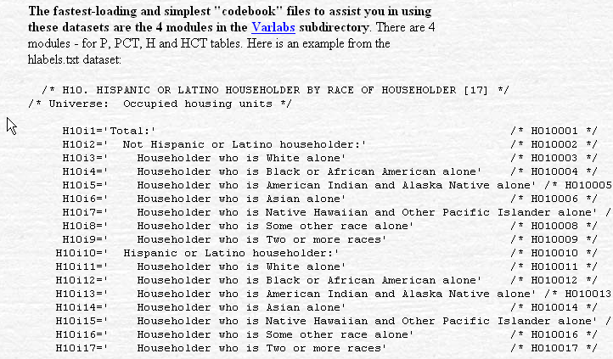
Excerpt From uexplore Section of Readme.html
Notes:
Census data and summary files are just complicated by nature. Lots of fine print and detail to pay attention to. Like what does “alone” mean in all these labels?
Hispanic and Latino mean the same thing in the Census world. It’s just like Black and Africa American.
Notice the use of colons and indentation to indicate subordinate categories – very important.
Roy Williams of the Massachussetts State Data Center provided us with these very useful Varlabs reports, taken directly from the Census Bureau tech doc.

Slide 14
Sf32000 Query Specs
We want to extract data on the number and percentage of minority households at the census tract level for St. Louis City and County.
Ignore any tracts with fewer than 100 total households.
Want data in an Excel spreadsheet.
Hard part is knowing what minority means.
Note: St. Louis City (29510) is also a county (equivalent).

Slide 15
Questions for the Query
What dataset? (We assume we know the directory/filetype.)
What output format?
What geographic areas within the dataset – how to create the filter.
What variables?
What post-processing in Excel will we have to do?
Notes:
We need a dataset that indicates data for the St. Louis, Missouri area. Most or at least many census states have state-based universes. So we probably want a dataset with a name starting with “mo” that indicates Missouri for its universe in the Datasets.html report.
Output format is easy – just take the default, csv. Internet Explore will automatically load this into Excel if you have it. If not, then you cannot do it.
Applying the geographic filter requires knowing what variable on the dataset identifies the county and what values of that variable are codes indicating the City of St. Louis (an independent city – a county equivalent) and St. Louis county.
The variables is the hardest part. Study that earlier slide that shows the variables for table H10. The minority households is not explicitly there, it will have to be derived once we have it in Excel. What we have are the total Occupied units in variable h10i1 and the Non-hispanic White households in h10i3. The latter is the complement of the minority group. So we just need to subtract h10i3 from h10i1. We’ll also have to do the percentage calculation since those figures are not on the SF datasets.

Slide 16
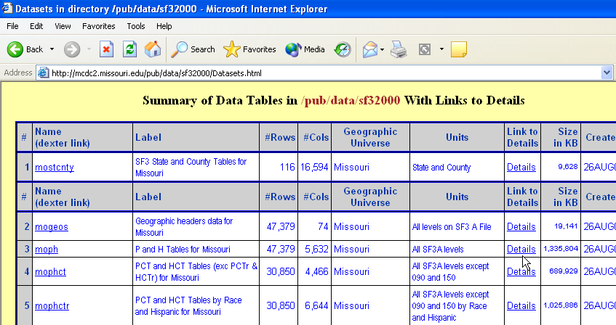
The sf32000 Datasets.html page
Which dataset do we want?

Slide 17
We Want the moph Dataset Because…
The universe is Missouri as needed.
It contains the P and H tables (not PCT or HCT).
It has “All SF3A levels” of geography, including census tract as required.
But now we need to see the details.
Note the size of the dataset – 1.3 Gigabytes!

Slide 18
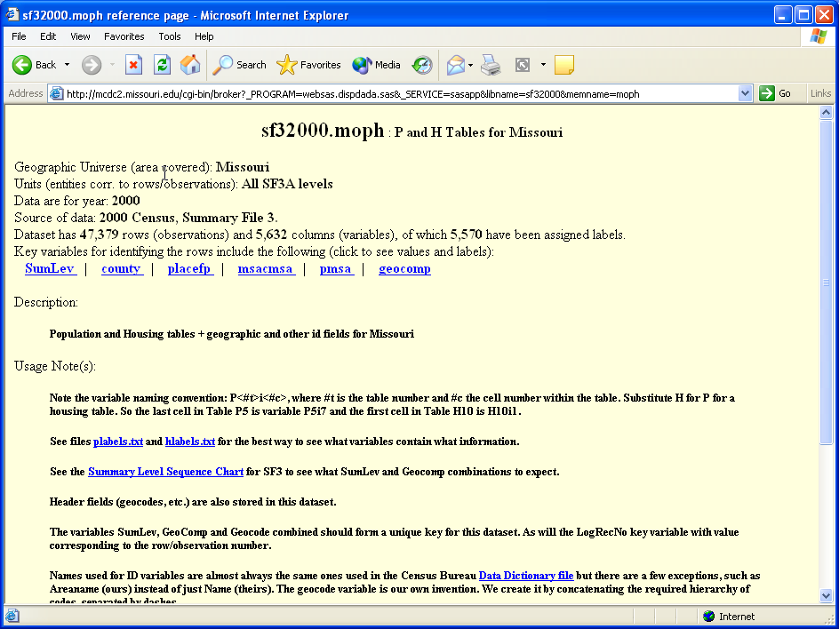
The stf32000.moph Details Page
Notes:
What can we learn from this page? (Next slide tells you, but you might want to figure it out for yourself). And maybe it tells you something different than it tells most people.

Slide 19
What We Learn from Details Page
From the Key variables reports for SumLev and county we know we want the 140 summary level for counties 29189 and 29510.
We get links to the data dictionary files with variable names & labels.
We get a Usage Note explaining the table-cell variable naming conventions.
A link to the Summary Level Sequence chart.
Notes:
We get this and quite a bit more if we take the time to read carefully and follow all the links.
The link to the actual program that created the dataset is available for quite a few datasets, but in most cases you will probably have a hard time deciphering the code. This is primarily a tool for the site developers so we can audit the database and see where things came from.
The link to Hypercon is not particularly recommended. This is a program that we used for many years and some people really got used to it, so we keep it around for them. It basically just lists the variables on the datasets with their labels and some other technical stuff that most users cannot use. Looks real nice though.

Slide 20
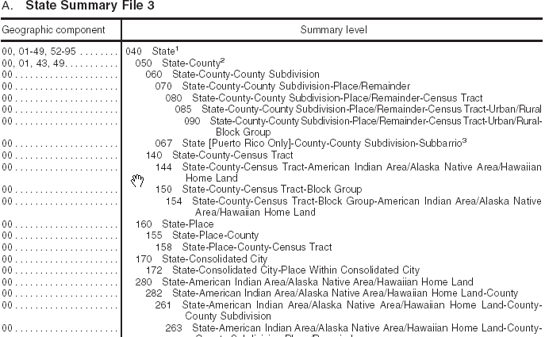
Sample of a Summary Level Sequence Chart (Partial)
Notes:
These take a little getting used to but become quite invaluable once you figure them out.

Slide 21
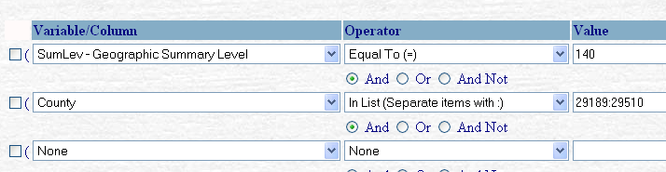
Specify the Filter
First row selects census tract level summaries.
Second row selects the two counties of interest.

Slide 22
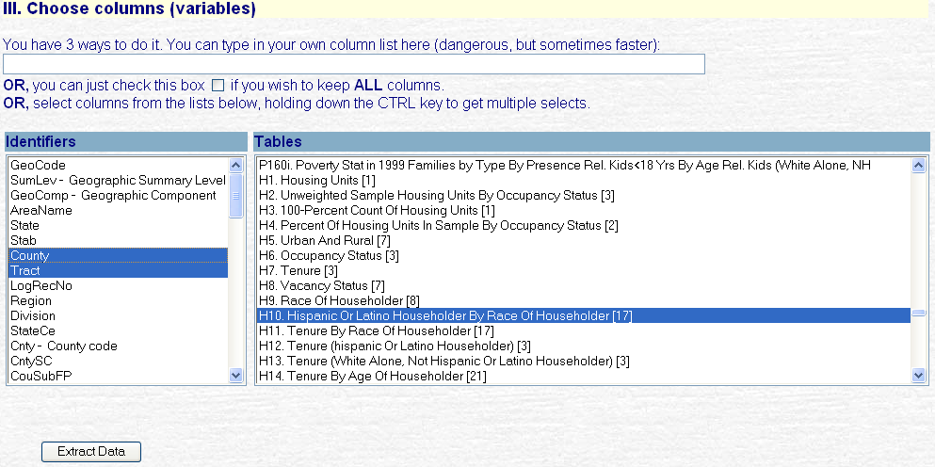
Choose Columns/Tables
Notes:
Note that we now have a Tables select list rather than a Variables select. When you choose a table you get all of the variables associated with that table. Dexter is custom programmed to recognize that just certain filetypes allow selecting at the table rather than the variable level.

Slide 23
Selecting Tables
(instead of variables)
Only for a small number of special filetypes. Mostly SF filetypes.
You choose table H10 and the program translates this into selecting the columns (variables) named h10i1, h10i2,…h10i17.
Note the scrollbar at right side of Tables select list. You may have to scroll horizontally to see this.
Feature was added late in 2004.
Notes:
Ta

Slide 24
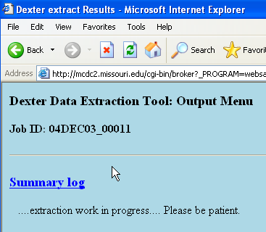
Waiting for Results
We get to see this for about a whole minute. It takes a while for Dexter to slog thru all that data. (A good reason to avoid sf32000 datasets when sf32000x sets will do.)
Wait for it to finish.

Slide 25
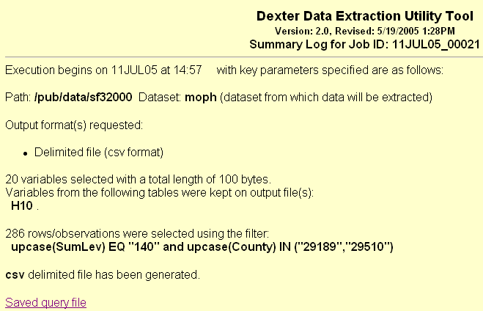
View Results: Summary Log
A brief summary of what you asked for and what you got.
286 rows (tracts) with 20 variables (columns).
Note the upcase functions in the filter. All character values entered are upcased and compared with upcased database values. Of course, when the characters are all digits it doesn’t matter.
Notes:
Of course, there is a little more technical stuff further down this page. But not of interest to most users.

Slide 26
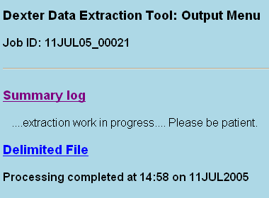

Ready to Access Real Output
Click on Delimited File to access the generated csv file.
The (temporary) URL for the csv file is (for this example): http://mcdc2.missouri.edu/tmpscratch/11JUL05_00021.dexter/xtract.csv
This temporary directory and file lives for 2 days. You can copy and paste the URL into an e-mail note and send it to a colleague or client. Makes it easy to share queries.
Notes:
This ability to e-mail links to the results is extremely useful for data intermediaries. Be sure to tell the person to retrieve and store the results within 48 hours.
Of little interest to most users is that people who work at OSEDA or otherwise have direct access to the MCDC AIX web site, can (and frequently do) copy these temporary files to permanent ones in the public portion of the web site.

Slide 27
Specify Variables by Typing Names
Not generally recommended because it is error-prone but useful for short lists.
Useful in cases like these where you have to select an entire table but all your really want are a few cells.
You have to type the ID variables as well as the numerics. When dexter detects you typed something it ignores any selections from the select lists.

Slide 28
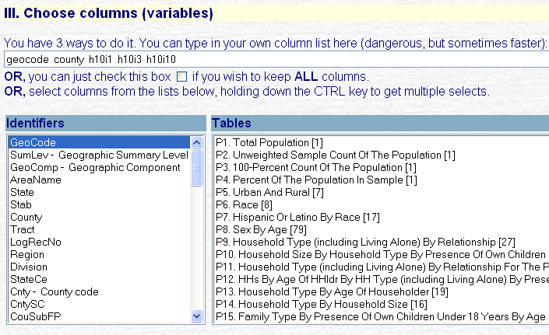
Entering Table Cell Variables
Nothing is selected from Tables list & would not matter if it were.
You can only do this if you understand the table-cell naming conventions. Instead of selecting all 17 data cells in table H10, the program will now select only the 3 specified cells.
The selection of geocode on Identifiers list is irrelevant.
Notes:
This is an old screen shot from when the box for entering your own variable names was located above the pair of variable select lists. It has been relocated in the latest version and now is below the select lists.
When you enter something in the text box for specifying your variables (as we do here) then Dexter will ignore any selections you make from the 2 select lists. Hence the last bullet item: The selection of geocode on Identifiers list is irrelevant.

Slide 29
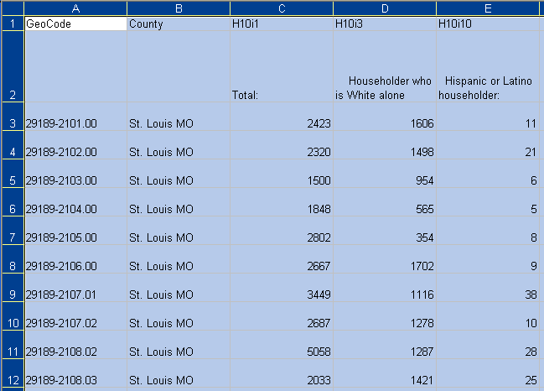
Typical Result of Clicking on Delimited File
Notes:
Excel users will know about the ability to auto-format cells so that they display cell values withut truncation. This has been done here, I.e. we selected all cells and used Format-Column-AutoFit Selection .
Formulae to use to arrive at Pct minority households:
MinHHs= H10i1 – H10i3.
PctMinHHs=100*MinHHs/h10I1 .

Slide 30
What Are “Minority” Households
A household is “minority” if the head of the HH is in a minority category.
Minority for 2000 means you are either:
  Hispanic or Latino, ---or—
  Not white (including multi-racial even if 1 of those races is white).
So h10i1 – h10i3 is the formula to derive mnority households. We do not need h10i10 to derive it.

Slide 31
End of Show
Questions and Comments:
blodgettj@missouri.edu

