Slide 1
The MCDC Data Archive
John Blodgett
Office of Social & Economic Data Analysis
University of Missouri
Rev. May 2007
http://mcdc.missouri.edu/tutorials/mcdc_data_archive.ppt

Slide 2
A Brief History of the Archive
Started by the Urban Information Center (UIC) at UM St. Louis (UMSL), circa 1981.
Accessing census data files (“STF”s – huge sequential summary files on tape) was very tedious and error-prone.
Idea was to standardize the data and make it easier, cheaper and more reliable to access.
SAS® software package was becoming the tool for accessing the data.

Slide 3
Brief History (cont)
Idea was to create an organized collection of datasets with certain standardization.
E.g. A FIPS county code field would always be converted to a SAS variable named County and would be stored as a 3-character field (NOT a numeric) with leading 0’s.
STF’s with thousands of records would be partitioned into smaller datasets based on geographic summary units (counties, tracts, places, etc.)
Notes:
A key to the standardization was to make data fields (“variables”) that appeared on many different data sets be consistent. Same names, same data type and length, etc. So you could access the sets and write code without having to consult tech doc or open the data set to see how the variable containing the County FIPS code or the geographic summary level code was named and stored.

Slide 4
Brief History (cont)
Very informal “database” concept.
Users were 3 SAS programmers at UIC using MVS (IBM mainframe).
No web access and no end-user access to worry about. A database designed for easy and efficient analysis and ad-hoc queries.
The data was almost entirely (decennial) Census data.
We developed SCADS – SAS Census Access and Display System. Sold 8 copies.
Only ran on IBM mainframe systems (MVS) with SAS.
Notes:
MVS was IBM’s biggest and best (well – fastest and most expensive, at least) operating system. A real dinosour by today’s Unix / Linus/ Windows standards.
Key thing to note here is that the archive was really designed for access by programmers, not end users with web browsers.

Slide 5
Brief History: 1988
In 1988 the UIC and OSEDA (UM-Extension at Columbia) team up to become data support for the Missouri Census Data Center.
OSEDA has a wider variety of data that is to be added to the collection (archive).
OSEDA has data analysts who are not SAS programmers. Lotus 1-2-3 is very big.
Storing metadata (documentation) in pendaflex-based system no longer as viable as when it was just “us guys”.
Notes:
OSEDA had no formal data archive. A lot of their data was kept in analyst’s desk drawers at floppy disks.
Some other key datasets were manually entered using FSEDIT with no rigorous editing procedures (and no “audit trails” to trace the source of any possible data problems.)
“Pendaflex-based system” means the docs were on paper kept in hanging folders made by Pendaflex, Inc.

Slide 6
Brief History: 1991-1992
The 1990 Census results are flowing. The UIC is converting all the files to SAS datasets, mostly on tape. Data on disk is very expensive on the MVS system.
The Census Bureau is releasing the data on CD’s along with some extraction software. These are the DOS ages.
To access an STF3 table for Poplar Bluff requires mounting a tape and reading it sequentially to find the relevant data, paying for tape I/O’s required to get there. Slow, expensive and hard to estimate the cost of a query.
Notes:
Querying a dataset on tape was slow, error prone and expensive. The tapes had to be manually mounted and ran sequentially from the beginning. It might take 15 minutes to read a full STF3 tape file. The operating system kept track of the tape I/O’s and the CPU seconds being used and you were billed for the computing services. A wasted query caused by a typo could easily cost you $20 in charges and a wasted hour or two in turnaround time.

Slide 7
Brief History: 1993
Breakthrough year. COIN (Columbia Online Information Network) and Gopher become important elements of the MSCDC.
The UIC’s standard extract reports based on STF3 are turned into very simple but very popular 1 or 2-page demographic profile reports. Delivered via the Internet using the Gopher protocol.
This required copying the report files to a Unix system at OSEDA. But the data and most processing are still on MVS mainframe.
Notes:
MSCDC was the Missouri State Census Data Center, which is what we were called for several years. We dropped the “S” at the request of the Missouri State Data Center, which is a unit of the Missouri state government that provides data processing services to state agencies in Jefferson City.
Gopher was a protocol developed at the U of Minnesota. It had features like the WWW but was entirely text based and worked real well on teletype terminals and my TI Silent 700.

Slide 8
Brief History: 1994-1996
Transition years. (Most) archive data are copied to an AIX (IBM Unix) system. This was the Great Leap Forward for the archive.
The web takes off. Windows 95 appears. Suddenly it seems like everybody has MS-Office with Excel.
First version of Uexplore debuts in 1996 with “sub-applications” xtract, hypercon and tabrgen. It allows users to explore the data archive and do extractions. Targeted for use by the state data center core group & affiliates.
Notes:
The IBM590 RISC machine was purchase by OSEDA in late 1993 for about $80,000. The data center archive was built there and it served as the host machine for both the OSEDA and M(S)CDC web sites for over 10 years. It was finally replace circa 2004 for a faster machine (but not because it ever stopped working).
Moving thousands of data sets and related files from the IBM MVS system over to Unix was extremely tedious, time-consuming and error prone. A few data sets were lost in the transition, but not too many.
Uexplore and xtract were among the 1st apps that we wrote for the web. It was a learning experience.

Slide 9
Brief History: 2001-2003
Archive moves to new hardware system with storage and processing speed to handle 2k decennial census.
Dexter replaces old xtract modules. Hypercon & tabrgen are retired.
Metadata system based on “datasets dataset” developed, with Datasets.html index pages.
Enhancements designed to make archive more “self service” oriented.
Notes:
Not all filetypes have Datasets.html pages, and not all of these have been created with the same degree of effort. The archive now has varying levels of end-user-friendliness based on the quality of the datasets dataset for the filetypes.
Web access stats tell us that few users take advantage of the detailed metadata describing the datasets.

Slide 10
Relevance of History to DA
It was not until the mid-90’s that the data archive was made end-user-accessible via the web. Even then it was for a more sophisticated user, not a casual 1-time user.
The advent of the WWW resulted in much more emphasis on making datasets easier to use and on creating metadata.
The widespread use of Excel led us to concentrate on creating extracts that could be easily loaded into spreadsheets.
There are still “filetypes” in the archive that pre-date the web and these are generally not as accessible as those created after we started worrying about web-access issues.
Notes:
As a practical matter, 95% of what anybody will be interested in within the DA was created in the post-web era. (Although some with better care than others.)

Slide 11
What Is the Data Archive?
A loosely organized collection of data files (data sets, data tables, SAS data sets -- these are all terms for the same thing).
Related supporting files in html, pdf, csv, xls and other standard web formats. Such files may contain metadata, extracts, raw input data, reports, etc.
A reasonably rigorous set of naming and organizational conventions that make accessing the data easier.
A network of MCDC people who will assist you with accessing the data.
Notes:
Network support is in the form of assistance with locating relevant filetypes, data sets, etc. and with the basics of using tools such as Dexter. It does not include support for us doing the extraction and/or analysis of the resulting data. We are here to help you access and understand the data, but not to tell you “what it means”.

Slide 12
Data Archive Directories
The archive is really just a very large Unix directory. It is named /pub/data .
The 1st level subdirectories represent data categories that we call “filetypes”.
All filetypes have a subdirectory named Tools where we keep the SAS programs that created the data sets in the filetype directory.
Occasionally we have subdirectories of filetype directories that contain data files. We do this to avoid having too many data sets in 1 directory.
Notes:
As a user there is no need for you to be concerned with the Tools subdirectories. But it is important for the integrity of the archive that we be able to document exactly how these datasets were created.
To be perfectly correct not ALL filetypes have Tools subdirectories. There are some very old ones that were created on our MVS system where we have not been able to recreated the original progrmas that created them. These are usually not filetypes that we direct users to.

Slide 13
Uexplore and Directories
The Uexplore navigation utility displays the contents of a single directory. It lists subdirectories, data files and other files.
Subdirectories (identified via folder icons) are listed before most files (special files like Datasets.html & Readme.html are the only ones that appear before subdirectories).
Clicking on a subdirectory invokes Uexplore to display the contents of that subdirectory.

Slide 14
Files and Data Files
The directories are simply containers for organizing the content of the DA, which is comprised of files.
“Data Files” is the term we use to reference the special files that can be accessed via the Dexter extraction utility. AKA “data sets” & “SAS data sets”.
Uexplore displays a listing of all the files within a directory in alphabetical order, with the filenames serving as hyperlinks.
In Unix, case matters and uppercase letters sort before lowercase.
Notes:
This is why files that start with uppercase letters are generally special. We made them uppercase so that they would appear first so that users would be less likely to overlook them.

Slide 15
File Naming Conventions
File extensions determine what happens when you select (click on) a file on the uexplore-generated web page.
Extensions sas7bdat and sas7bvew indicate data files. Clicking invokes Dexter to extract from that data set.
Extension sas indicates a SAS code file. It will display as a text file in your browser.
Most other extensions (html, pdf, csv, txt, etc) will be displayed as usual by your browser. E.g. for most users clicking on a file with a “.csv” extension will cause Excel to be invoked.

Slide 16
File Naming Conventions
Many data sets pertain to a specific geographic universe. In these cases we commonly use a filename that identifies this universe such as “mo” (for Missouri) or “us” (for United States).
A file name that ends with 2 digits usually indicates data pertaining to a year. So file mocom06.sas7bdat contains data for 2006.

Slide 17
File Naming Conventions (cont)
We sometimes use geographic levels as part of file names to indicate the level(s) of geography being summarized on the set.
E.g. mostcnty is a file containing summaries for Missouri state and counties.
uszips04 would indicate ZIP code level summaries for the entire U.S. for 2004.

Slide 18
Datasets.html
This is a special file that occurs in most (but not yet all) filetype directories.
Uexplore displays it at the top of the page in bold and uses the Description field to tell you to
Use this custom data directory page to access the database files (only) with greatly enhanced descriptions and metadata.
The MCDC goes to considerable trouble to create these files in order to make it easier to access our data. Take advantage of them.
Notes:
Web usage statistics tell us that Uexplore/Dexter users rarely use the Datasets.html page and those that do rarely call up the Details page for a data set.

Slide 19
SeeAlso.html
This filename is used in several of our filetype directories and we hope to create them for many more.
They provide links to other web sites with related data or information regarding this data directory.
They are usually very short pages with no fancy formatting.

Slide 20
Tools and Queries
These are two specially-named subdirectories.
Tools we have already discussed: it’s where we store the code for creating the data files, as well as (sometimes) examples of sas programs for accessing.
Queries contains saved Dexter queries. We have not fully implemented these yet, but the idea is that users can select these saved queries and re-run them just by clicking on the .txt files in these special subdirectories.
Notes:
In the Tools directories we keep not only the SAS program files that were used to create/access the data sets, but also (in most cases) the SAS-generated log and listing files. Uexplore displays the related files in a special format, all on 1 line.
Only a handful of filetype directories have Queries subdirectories. We hope to devote more resources to these in the future but for now these are not a very viable resource. (as of May, 2007).

Slide 21
Structure of Data Files
The Data Files in the archive are stored as SAS data sets. ( If you do not know or want to know anything about SAS that is OK. Dexter lets you access these without need to know anything about SAS. )
They are rectangular data tables with rows and columns – aka observations and variables.
The rows represent the entities being described or summarized. The columns contain the attributes or the statistics summarizing the entity.
Notes:
Actually, there are a few places in the Advanced features section of Dexter where some knowledge of SAS would let you do some specs a bit more easily. But these can easily be ignored by most users – they are strictly advanced options.

Slide 22
Finding Out About Data Files
The key to using the data archive is understanding what kinds of information about what kinds of entities are stored in the data files.
Within a filetype directory the best place to start trying to figure out what we have is using a Datasets.html page (if available).
Each row of the table displayed on a Datasets.html page tells you about a data file. Not all about, but some basic stuff.
Notes:
Without the help of such a directory page you will have to do a more manual search of the page as displayed by Uexplore. There is often sufficient descriptive text there that you can discern what the datasets are about. But you may have to open some of them up and look to find out more.

Slide 23
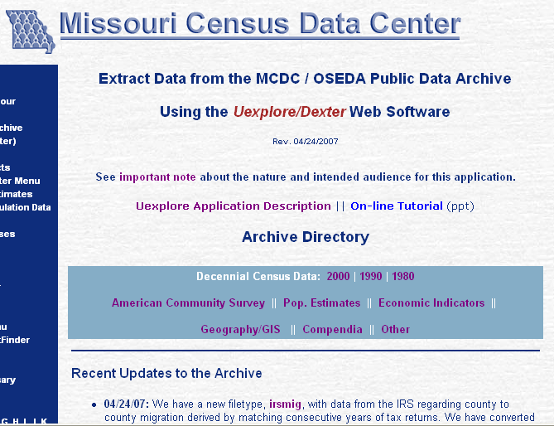
The Uexplore/Dexter Home Page
Notes:
Cropped in both directions. The Archive Directory organizes the data into about 8 major categories, and then within these categories into subcollections which are called filetypes.
Notice all the hyperlinks, starting with important note and the categories within the teal box, and then sf32000x.
Notice the link to the On-line tutorial – this is probably how you got here.

Slide 24
The Archive Directory
(on the Uexplore/Dexter home page)
The teal box contains links to 9 major data categories (2000 Census thru Compendia)
The rest of the page consists mostly of descriptions of, and hyperlinks to, the archive’s data categories (which we refer to as filetypes.)
Filetypes within the major categories are in order of what we think will be user interest.
Sf32000x has been our most popular filetype. Popests and acs2005 are gaining.
Notes:
We sometimes call this the archive index, but that is misleading. An true index would let you search the database by keyword or subject and that is not the case. This is more like the Table of Contents at the front of the book, rather than the index at the back.
By “popularity” we really mean a combination of their containing useful data and having sufficient metadata to make them accessible. We generally regard data that is more current to be more “popular” than data that is of historic interest only.

Slide 25
What’s In the Archive?
Over 20,000 data tables (“datasets”) organized into 60+ major categories. Heavy emphasis on U.S. census data.
Not all filetypes are created equal. We spend 90% of our resources on maybe 10% of our data directories.
Filetypes in bold on the directory page are the MCDC “house specialties”.
Notes:
House specialties meaning the ones we have devoted the most resources on to enhance and document. Also, the ones that we see the most demand for, usually meaning they are more current.

Slide 26
Uexplore & Dexter
Uexplore is the web tool that lets you browse the archive, displaying the contents of one directory at a time.
When Uexplore displays a special data table file it makes the name of the file a hyperlink to invoke Dexter for that table.
Dexter (which is really 2 modules) allows the user to do custom extractions from the data table files.
Notes:
To be perfectly correct the hyperlink does not invoke Dexter itself but rather uex2dex which is a Dexter preprocessor. You fill out the query form generated by uex2dex and when you hit the Extract button on that page Dexter is invoked.

Slide 27
Facts Worth Repeating
The data tables (the things Dexter accesses) are in the same directories with other related files (SeeAlso.html’s, spreadsheets, csv files, Readme files, etc.)
Each filetype directory has a special Tools subdirectory where we keep program code and other tool modules related to the data.
Subdirectories & files starting with capital letters are listed first and are usually worth looking at.
Dexter-accessible table files (“SAS datasets”) have extensions of sas7bdat or sas7bvew.
Notes:
A file with the special name SeeAlso.html contains brief descriptions and links to related web pages, usually not on the mcdc site. E.g. a link to the page at the Census Bureau describing the data or providing an alternate way to access the data.

Slide 28
Exercise
The Bureau of Economic Analysis disseminates its REIS data with key economic indictors for US geography down to the county level.
On the Uexplore home page locate the filetype corresponding to this data collection (what’s the major category?) and navigate to the directory page.

Slide 29
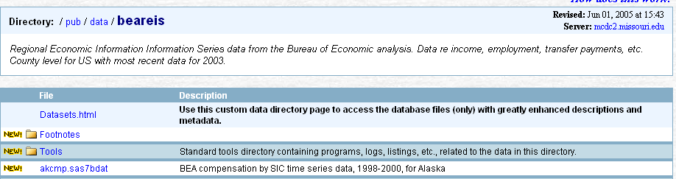
Uexplore Page for beareis
(cropped)
What you see when you click on the beareis link on the Uexplore home page. It displays a list of files within the directory. The “File” column entries are hyperlinks. With a few exceptions the files are displayed in alphabetical order.
Datasets.html is a special file providing enhanced navigation of the data files in this dir. It displays just the data-table files, but in a more logical order and with additional metadata.
Notes:
datasets.sas7bdat is a special data file (SAS data set) that is closely related to the Datasets.html page. Each obs/row in this dataset describes one of the datasets in the directory, I.e. it is metadata.
The Tools directory is rarely of direct interest to the data user. Most of the tools are SAS programs or the log/listing files created by running those programs. They are important, however, because they provide the “audit trail” showing how we created our datasets from the orginal source data. It is also of interest to researchers wanting to adapt our SAS code to create their own datasets.
We can distinguish subdirectories from other files on this page by the trailing slashes in their names.

Slide 30
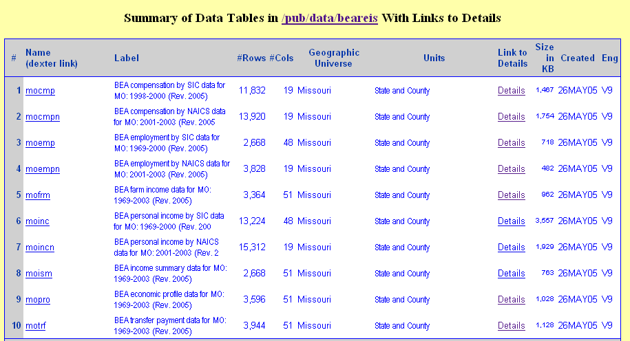
Datasets.html page
Notes:
Datasets.html (note the uppercase “D”) files are special creations. They are index files that provide links to and descriptions of other files.
The only files that appear on these pages are extractable database files – no html, xls, or pdf files will appear here.
The order of the files here is logical instead of alphabetical. You may not understand the logic but there is one.
The first column contains the name of the dataset (without the extension) and is a hyperlink to the dexter preprocessor, uex2dex.)
The Link to Details column is very important. A value of NA says that no detail page is available for the dataset. If you find such a case and feel you really need details send us e-mail and we’ll try to create one.
The ENG column shows the SAS engine for the dataset. Can be used to tell if it’s a view, but most of the time most users could care less. Ignore it.
The datasets dataset is structurally the same in all data directories. Each observation in that dataset corresponds to a dataset within the data directory. The Datasets.html page is a partial listing of this “datasets dataset”.
The column titles are repeated whenever there is a change in the dataset group, a category which is not explicitly shown, or after 12 files, whichever comes first.

Slide 31
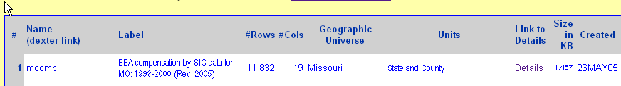
Datasets.html Columns
The Name column is also a link to uex2dex / dexter.
Label is a short description of the dataset.
#Rows (# of observations) and #Cols (# of columns/variables) are taken from the datasets metadata set. As are the Geographic Universe and Units.
Details link provides access to more detailed metadata.
Notes:
There is actual a table file (SAS dataset) named datasets.sas7bdat in any directory that contains a Datasets.html file. This page is really just a formatted display of a subset of the metadata contained in that data table. Each row in the datasets data table describes one data table in the directory and each column/variable contains one item of info about that table.

Slide 32
Universe and Units
The majority of datasets in the archive contain summary data for geographic areas. For example, a dataset in the popests directory might contain the latest estimates for all counties in the state of Missouri. The geographic universe is Missouri, and the units are counties.
When we have many datasets in a directory it’s usually because we have many different combinations of universe and units.

Slide 33
Common Universes
Missouri (the state of) is by far the most common universe for the MCDC archive.
United States is second – we have quite a number of national datasets.
Illinois and Kansas are also very common since we routinely download and convert census files for these key neighbor states.
A common sort order for files on Datasets.html pages is Missouri files first, then US, then IL/KS and then other states.

Slide 34
Rows & Columns
The rows of the data tables typically represent (i.e. contain data about) geographic entities: states, counties, cities (places), etc
Most of the columns in the data tables are summary stats for the entity: e.g. the 2000 pop count, the latest estimated pop, the change and percent change, etc.
Other columns (“variables”) are identifiers with names such as sumlev, geocode and areaname

Slide 35
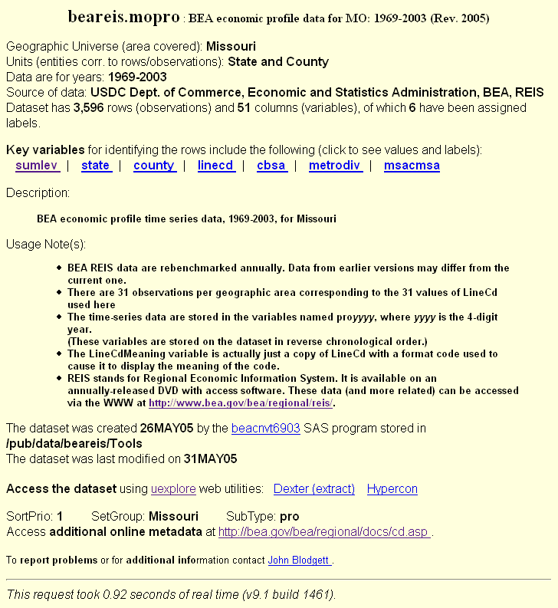
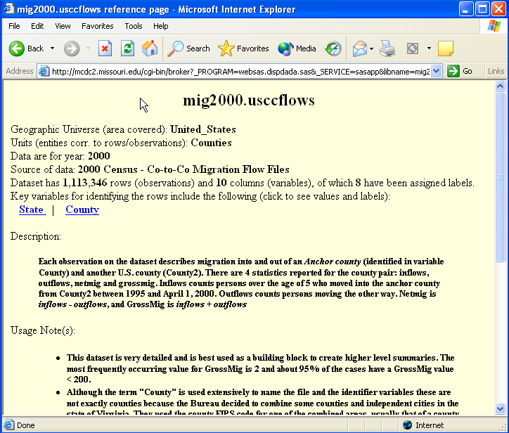

A Details Metadata Page
We get here by clicking on the Details link on Datasets.html page.
Lots of info here – but varies
Key variables is often very useful when doing filters.
Note the direct link to Dexter under Access the dataset near the bottom.
Notes:
This is the best way to find out what we have in a specific dataset. Unfortunately, we only have good Details pages for a small fraction of our datasets. But the good news is that we are more likely to have them for the more current and frequently accessed files.
The information on this page is a combination of program-written data (such as the name, # of obs and cols, creation and modfication dates) and manually entered metadata (such as the Description and Usage Notes).

Slide 36
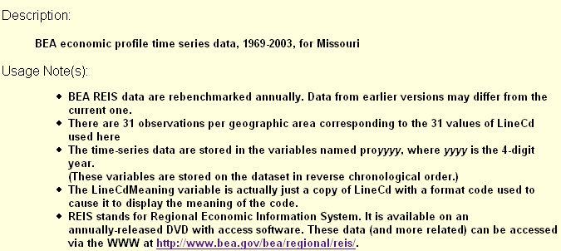
Increase Text Size to Read Fine Print
Notes:
You really need to read this stuff before attempting to do an extract against a dataset for the first time.
Note the hyperlink to the BEA web site where you can easily access related data.

Slide 37
Exercise – Navigate to Dataset
The filetype mig2000 has data regarding migration from 1995 to 2000 as captured in the 2000 census.
Go to the Uexplore home page and navigate to this filetype.
Use the Datasets.html page to display the datasets within the directory.
Find the row for the usccflows data table and click on the Details link for this table.
From the Details page click on the keyvals link for the variable State.

Slide 38
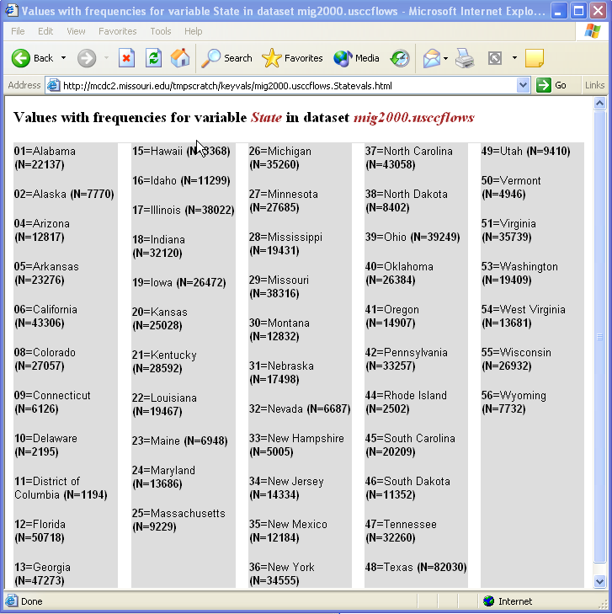
Key Variables Report: State
Tells you that the variable State has a value of 01 (for “Alabama”) in 22137 rows of this dataset.
This can be very helpful when doing a data filter in Dexter.
Notes:
This frequency report may be generated on the fly in which case it is saved to a permanent file. Anyone requesting it again will just see a copy of the page that had to be created the first time.
If this is the first time for a variable/dataset and it has a lot of different values or it’s a very large dataset it may take some time to generate.
Blank (missing) values are not counted.
Data filters will be discussed when we finally get down to Dexter.

Slide 39
General Information About Archive Data Sets and Data Set Variables (Columns)

Slide 40
Dataset Naming Conventions
All filetype names are 8 characters or less.
Dataset names were limited to 8 characters by the software until recently.
The first characters of the dataset name often correspond to the universe – e.g. “mo”, “il”, “us”.
The geo units are often part of the ds-name – e.g. “motracts”, “uszips”.
For time series data the name usually ends with a time indicator – e.g. “uscom05” contains data thru 2005.
The names are cryptic on purpose.
Notes:
The dataset names are rather cryptic because they have to be used by MCDC programmers where they have to be typed in. Programmers, older ones at least, tend to prefer shorter names even if they may not seem as mnemonic as they could be.

Slide 41
Variable Naming Conventions
Not as rigorously applied as we might like, esp. for older datasets (conventions used for 1980 datasets differ a little from 2K and 1990 sets, for example)
Certain names appear on many datasets and are consistent. These are mostly identifier variables, the ones used in creating filters and as keys for merging data from different files.
Notes:
Not only are the names of these common variables the same, but so are the code values associated with them. A variable named State, for example, will always contain a 2-character FIPS state code; a variable named SumLev will always contain a 3-character geographic summary level code as defined by the Census Bureau (if recognized) or by us.

Slide 42
Why Variable Names are Short
Why do we call it medhhinc instead of Median_Household_Income?
Because we are SAS programmers, not COBOL.
Until the late 90’s SAS variable names were limited to 8 characters. We learned to live with this and even to like it.
Notes:
We do try to use variable labels to assist users with understanding what the variables mean.
When using Proc Print long variable names make for wider columns and this can be a problem when trying to get everything on one line.

Slide 43
Numeric vs. Character Variables
SAS© stores data as character strings or as numerics.
We store all identifiers (geographic codes, etc) as character strings even if they are made up of numeric digits.
The value of the state code for California is “06”, not 6. The leading “0” matters.
(Unfortunately, Excel ignores the distinction when importing csv files.)
Notes:
The numerics are stored as signed floating point numerics that can be from 3 to 8 bytes long. Not that you have to understand this or care.

Slide 44
Some Common Identifiers
SumLev: Geographic summary level codes as used in 2K census. (3-char)
State: 2-char state FIPS code.
County: 5-char county FIPS code, incl. the state.
Geocode: A composite code to id a geographic area. E.g. the value for a census tract might be “29019-0010.00”.
AreaName: Name of the area.
Notes:
There are some sumlev codes that are not used in the 2k census but only in other products from the Bureau. Whenever we can find a census code for a level we use it. In some cases we make up codes (such as rpc, dot, lib) to represent levels that we have created locally. Note that our codes are alpha, while the Bureau’s use only digits.

Slide 45
Common ID Variables (cont)
Tract: census tract in tttt.ss format, always 7 characters with leading 0s and 00 suffixes. E.g. “0012.00” .
Esriid: Similar to geocode but intended to use as a key for linking to shape files from ESRI (the ArcInfo people). When geocode=“29019-0010.00” the value of esriid=“29019001000”.

Slide 46
Consistency With Census Bureau Data Dictionary Names
The Bureau often distributes data dictionary files with their data that include suggested names for the fields.
Their name for the field (variable) containing the name of the geographic area being summarized is ANPSADPI. We decided to go with AreaName instead.
But in most cases we try to use the same name as in the data dictionary.

Slide 47
Variable Labels
While variable names tend to be very cryptic we can (and often do) associate descriptive labels to better describe the meaning of the variable.
You see these labels as part of the drop-down variable-select lists in Dexter.
They also occupy the 2nd row (variable names occupy the 1st) of csv files generated by Dexter.
Notes:
You can change or assign the value of a label using the Dexter query form in the Advanced Options section.

Slide 48
Formats
Some variables are codes that have custom formats associated with them. The format causes them to display a value label instead of the stored code value.
E.g. the variable State may have a stored code value of “29” but displays as “Missouri” using the $state format. By default, all Dexter output has the “formatted” value labels.
SAS dataset output is an exception. (See notes).
Click the “View qmeta Metadata report” option at the end of Section II on the Dexter form to see which variables have formats associated with them.
Notes:
1. If you get your dexter output as a SAS dataset they will be stored on output just as they are on the dataset, with the format code associated with them. This can cause problems when you try to access them on your system. You can avoid this by using “options nofmterr;” in your SAS program to tell SAS to ignore the format code and just display the code. Or, you can access the SAS source code for the custom format at http://mcdc2.missouri.edu/cgi-bin/uexplore?/pub/sasfmats – the file name is usually an uppercase “S” and then the format name. E.g. the $county source code is in Scounty.sas . Download this code and use it to run Proc Format.

Slide 49
Tables Within Data Tables
Conventions for Storing SF’s and STF’s

Slide 50
What’s an S(T)F?
STF=Summary Tape File (pre-2000)
SF=Summary File (2000)
The Census Bureau’s terminology for large data files consisting of a large number of tabulated summary tables.
A table might have several “dimensions”

Slide 51
To See Examples
Go American Factfinder on the Census Bureau web site and use the Data Sets option.
Choose “Detailed Tables”.
Complete the query and you’ll see all the hundreds of tables you have to choose from.

Slide 52
Table Cells as Variables
The SF tables have codes consisting of a table-type code, a table number and (sometimes) a table suffix.
E.g. on SF3, 2000 census, there are tables named P5, H11, PCT23, HCT28, and HCT29A. Each table is comprised of multiple cells or “items”.
Each item is a column (variable) in an archive data set in the sf32000 filetype directory.

Slide 53
Table Item Variables
The variables in a sf32000 data table corresponding to table P5 are named p5i1, p5i2, …, p5i7.
P5i1 is the Total Population, p5i2 is the total Urban population, etc.
The variable name is the table ID followed by the letter “i” and the item number within the table.
Notes:
Labels on table-item variables sometimes contain leading ;’s or tab characters to indicate level (inherited characteristics). A label of “: 0-4” would indicate a count of persons aged 0 to 4 of a certain race. The “:” indicates the need to look elsewhere to see how this label needs to be qualified.

Slide 54
Dexter Recognizes Tables
Certain filetype/dataset name combinations are recognized by Dexter as having a table-based structure.
When these are recognized Dexter section III where you normally select numeric variables is modified to let you select entire tables instead.
Notes:
As of 5/07 the filetypes that are recognized as having tables are: sf32000, sf12000, stf903, ctpp2000, stf904,acs2005 and acs2006 (which isn’t even here yet). There are more filetypes than this that could benefit from being recognized but it takes quite a bit of work to set this up.

Slide 55
Regular Data Sets vs. Views
There are 2 kinds of SAS data files used in the archive.
“Regular SAS data sets” are standard data sets created with the default format (“engine”).
A “view” is a pseudo or virtual data set. It does not consist of actual data but instead is a small (usually) program that gets invoked and generates data on the fly.
Notes:
You should probably never need to know this. But in case you were curious. One of the things you’ll notice about views is that in a Datasets.html directory page the number of observations and size of the data set is not filled in. No way to know until you run the view.

Slide 56
Why SAS Data Sets?
Because we want to use SAS.
As compared to a true database (Oracle, et al) they are much easier to create and access, occupy less space, are very good for very large collections, have decent metadata tools. Good Oracle DBA’s are way too expensive.
Have you noticed how it takes a while for the Census Bureau to add new data sets to AFF?
Notes:
We could use SAS for our processing and store the data in some other format such as Oracle so we don’t really have to use SAS data sets just because we want to process our data with SAS. But it makes it simpler and faster.

Slide 57
Why Not More Excel Files?
Creating xls files on a Unix platform is tricky because Excel does not run on Unix.
It is a proprietary format that we do not have much experience with manipulating (to convert from/to other formats).
SAS data sets can be converted to csv files which then load into Excel.
255 and 65,xxx limits (cols and rows)
Notes:
SAS does not have software that runs on Unix to convert to/from SAS data sets to xls files. So we use csv files instead. The latter occupy a lot less space than xls file. And csv files can be read by other spreadsheet programs.
The xls files that appear on our site were uploaded from Windows.

Slide 58
Why Not More Excel Files?
One SAS data set with 100,000 rows and 2000 variables can be rather easily deconstructed (using Dexter) into whatever xls file you need.
Better to let the user decide what rows and columns are of interest than have us decide ahead of time and offer only the results of our guessing at what is wanted.
Notes:
This is kind of the heart of the philosophy of the archive. Let the user decide what they want.

Slide 59
Thank You
Questions, comments, suggestions to:
blodgettj@missouri.edu

