Slide 1

Let’s Talk About Standards
Roger Lew

Slide 2
Definition of “Technical Standard”
A technical standard is an established norm or requirement for a repeatable technical task which is applied to a common and repeated use of rules, conditions, guidelines or characteristics for products or related processes and production methods, and related management systems practices.
https://en.wikipedia.org/wiki/Technical_standard

Slide 3
History of Standards
Ancient Mesopotamia and Egypt: These civilizations had standards for weights and measures as early as 3000 BC to facilitate trade and construction.
Roman Empire: Introduced standards for building roads and military equipment to maintain consistency across the vast empire.
Industrial Revolution (18th and 19th centuries): The need for standardized parts became evident with the rise of machinery and mass production. The concept of interchangeability in manufacturing was a significant milestone.
20th Century: The establishment of national and international standards bodies, such as the International Organization for Standardization (ISO) in 1947, formalized the process of developing and implementing standards. This period saw the development of numerous standards for quality management (ISO 9000 series), environmental management (ISO 14000 series), and many others.
ChatGPT-4

Slide 4
What is a Standard?
It is usually a formal document that establishes uniform engineering or technical criteria, methods, processes, and practices
A technical standard includes:
definition of terms
classification of components
delineation of procedures
specification of dimensions
materials, performance, designs, or operations
measurement of quality and quantity in describing materials, processes, products, systems, services, or practices
test methods and sampling procedures
descriptions of fit and measurements of size or strength
In contrast, a custom, convention, company product, corporate standard, and so forth that becomes generally accepted and dominant is often called a de facto standard.
https://en.wikipedia.org/wiki/Technical_standard

Slide 5
Imagine Life Without Standards
Good examples of standards?
Bad examples of standards?

Slide 6
What Standards are not
Laws are enacted by governmental bodies (local, state, or federal) and are legally binding. Laws are passed by legislative bodies and signed into law by executives (presidents, governors)
Regulations are detailed rules developed by government agencies to implement laws. The process involves political decision-making, public consultation, and legal procedures.
Standards are generally voluntary, though they can be mandated through incorporation into contracts, regulations, or laws.
e.g. National Highway Traffic Safety Administration (NHTSA) self-certification to Federal Motor Vehicle Safety Standards (FMVSS)
Specifications are detailed requirements that could be contained to ensure compliance to a Standard.

Slide 7
Development of Standards
Who develops standards?
private entities such as companies
non-governmental organizations
governmental organizations
private sector multi-stakeholder initiatives
standards bodies that use a consensus-driven process that involves various stakeholders (companies, user groups, and experts)
Quality of Standards?
https://en.wikipedia.org/wiki/Technical_standard

Slide 8
Standard Bodies
International Standards Bodies
International Organization for Standardization (ISO): An independent, non-governmental international organization with a membership of 165 national standards bodies. It develops and publishes a wide range of proprietary, industrial, and commercial standards.
International Electrotechnical Commission (IEC): Develops international standards for all electrical, electronic, and related technologies.
International Telecommunication Union (ITU): A specialized agency of the United Nations that is responsible for issues that concern information and communication technologies.
World Wide Web Consortium (W3C): An international community that develops open standards to ensure the long-term growth of the Web.
Industry-Specific Standards Organizations
Institute of Electrical and Electronics Engineers (IEEE): A professional association dedicated to advancing technological innovation and excellence for the benefit of humanity. It is also a leading standards-developing organization in the field of electrical and electronic engineering and computer science.
Society of Automotive Engineers (SAE International): Develops and publishes standards for the automotive, aerospace, and commercial vehicle industries.
ChatGPT-4

Slide 9

Edison Screw Bulb
Patented by Edison in 1881
Became De-Facto Standard
Codified by IEC 60061 in 1969
https://en.wikipedia.org/wiki/Technical_standard

Slide 10

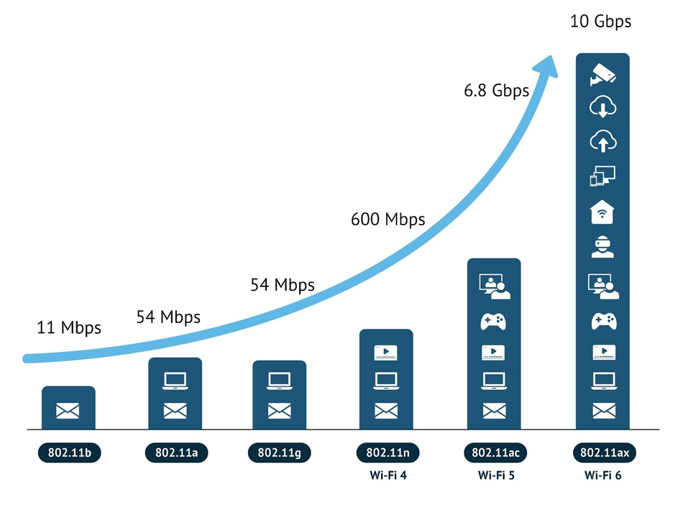
IEEE 802.11x
WiFi Standard developed by World Wide Web Consortium (W3C)
Rigorous process of proposal, discussion, revision, and consensus among IEEE members and stakeholders from academia, industry, and government
This process ensures that the standards are robust, interoperable, and able to meet the evolving needs of wireless communication technology
Enhanced security
Faster data rates
Improved efficiency and reliability

Slide 11
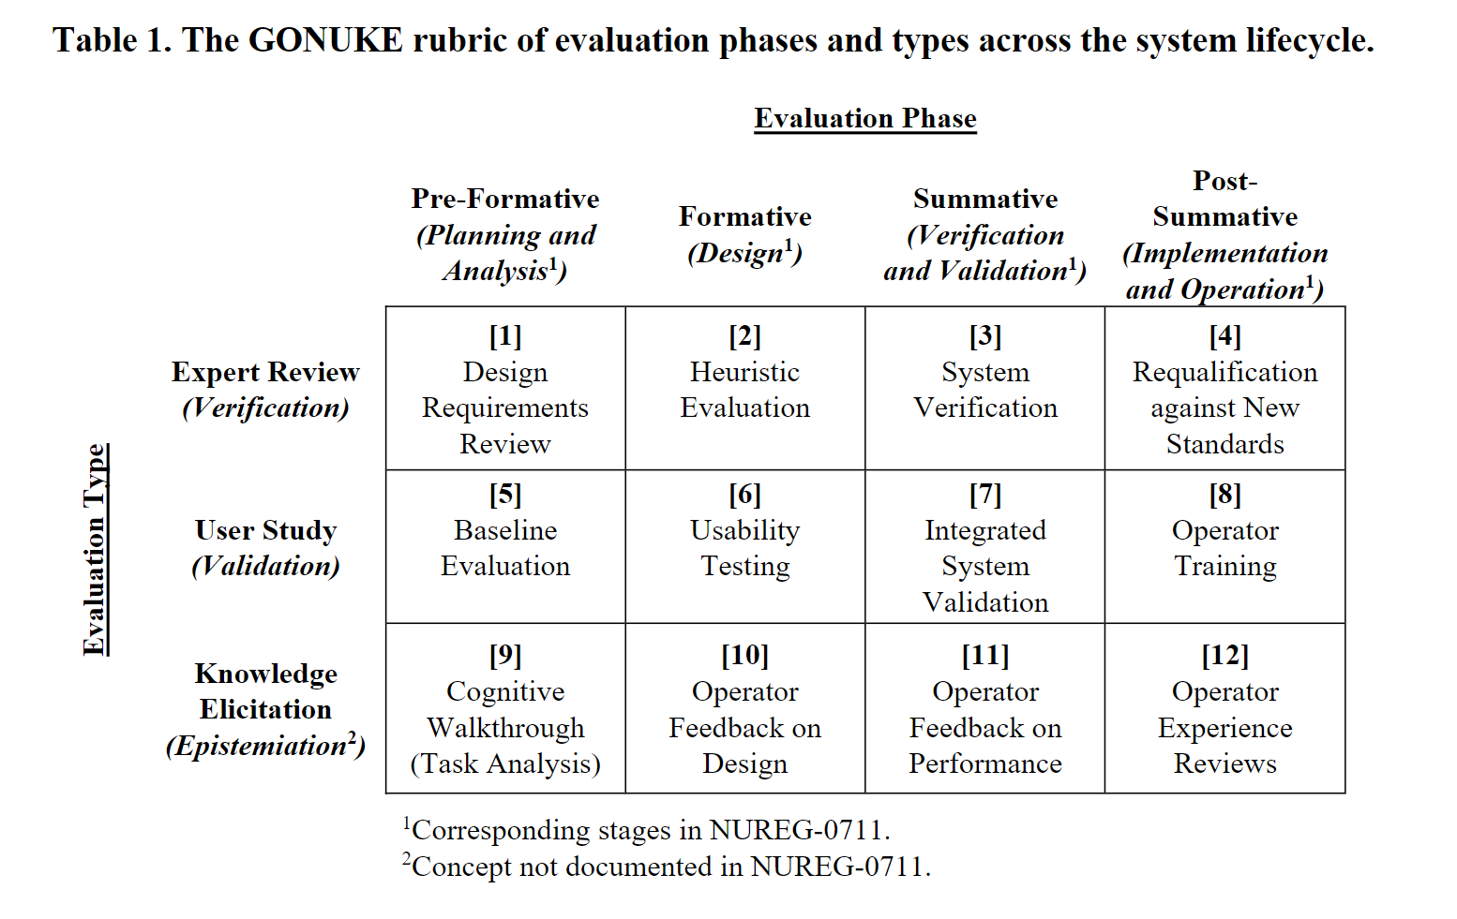
When to Apply Standards? Comprehensiveness of Application?
Boring, R. L., Ulrich, T. A., & Lew, R. (2021). Putting GONUKE into practice: Considerations for human factors evaluations. Proceedings of the Human Factors and Ergonomics Society Annual Meeting, 65(1), 618-622. https://doi.org/10.1177/1071181321651053

Slide 12
Formative Application of Standards
Identify goal(s) of evaluation
Down-select guidelines to apply to product/system/interface
Down-select guidelines that can be assessed
Apply guidelines
Prioritize adherence to standards
Provide actionable guidance where possible

