Slide 1
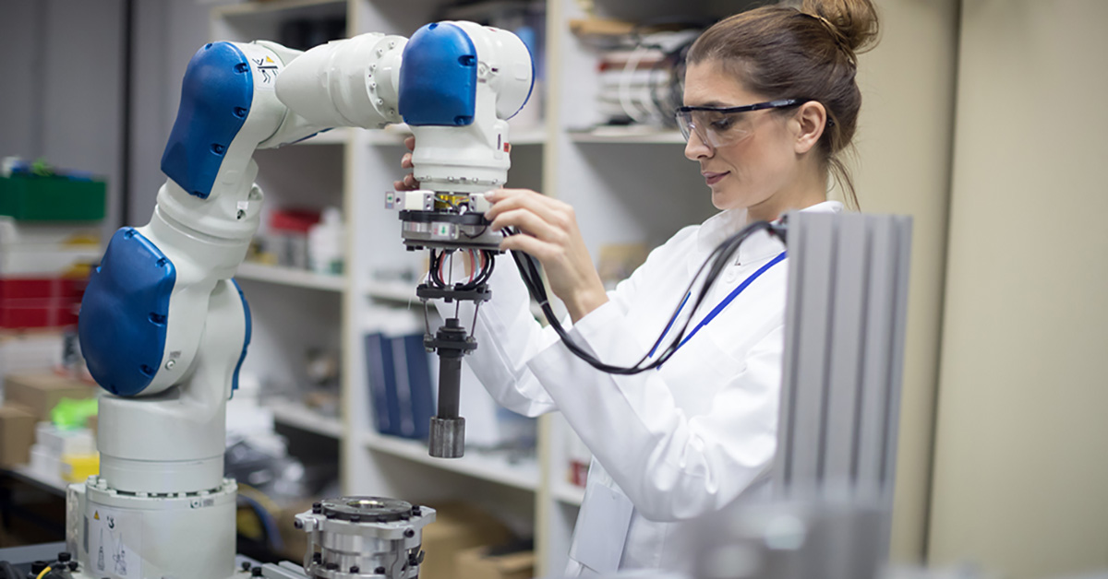
The Ergonomics of Workplace Robotics
Presented by Tanner Hansen
Notes:
Hello Everyone!
Today, I'll be talking about the ergonomics of workplace robotics.
While there will be some similar principles to my discussion on exoskeletons, this topic will cover a more specific set of robots, mainly based on their use in manufacturing instead of a specific type of machine.

Slide 2
Overview
Intro to Workplace Ergonomics
CoBots
Human-Robot Collaboration (HRC)
Assessment Tools and Technologies
Future Research Trends
Lorenzini, M., Lagomarsino, M., Fortini, L., Gholami, S., & Ajoudani, A. (2023). Ergonomic human-robot collaboration in industry: A review. Frontiers in Robotics and AI, 9, 813907. https://doi.org/10.3389/frobt.2022.813907
Notes:
Overview...
Much of the content and research I'll be discussing came from a literature review on "ergonomic human-robot collaboration in industry" from 2023.

Slide 3
Introduction to Workplace Ergonomics
The Problems
Possible Solutions
Key Terms

Slide 4
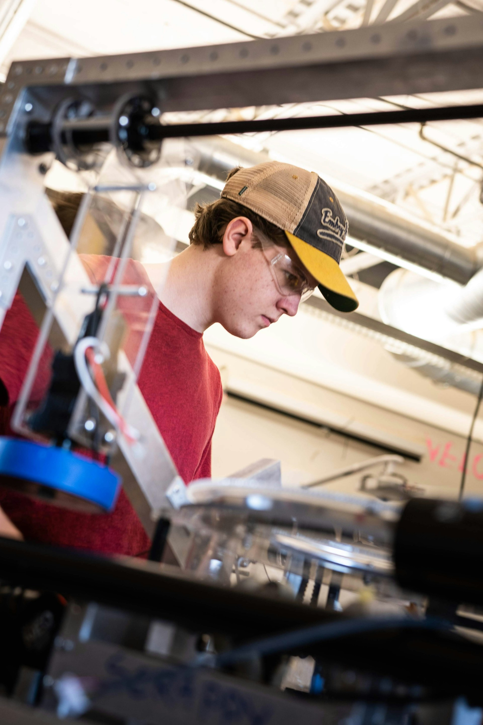
The Problems
Repetitive tasks, heavy loads, bad postures, and stress.
“Three out of five workers suffer from an MSD, among which back-ache and upper limb pain are the most common (de Kok et al., 2019).”
“Results from the sixth European Working Condition Survey (EWCS) claim that 25% of European workers reported that their occupations have negative impacts on their mental and emotional state (Kubicek et al., 2019).”
“Physical and mental health problems may lead to impressive costs to enterprises and society, being one of the most common causes of disability, sick leave, and early retirement (Hassard et al., 2014; James et al., 2018).”
Notes:
A lot of manufacturing jobs suffer from repetive tasks, heavy loads, bad postures, poor environmental conditions, and significant stress. Over time, these can lead to musculoskeletal disorders, or "MSDs."
The article states that...

Slide 5
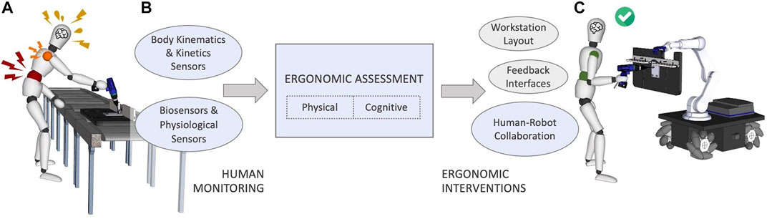
Possible Solutions
“Effective design of comfortable and adjustable workstations”
“Development of intuitive feedback interfaces that warn about risks and hazards”
“Creation of advanced human-robot shared workstations for fruitful and ergonomic collaboration in hybrid environments”
Possible solutions being researched in the field:
"A conceptual illustration of a worker accomplishing an industrial task without (A) and with (C) a collaborative robotic solution. The structure of this article is also described in the schema (B), highlighting (blue) the research themes that we focus on."
Notes:
Some possible solutions being researched in the field include effective design of workstations, development of intuitive feedback interfaces that warn about risks and hazards, and the creation of advanced human-robot shared workstations for fruitful and ergonomic collaboration in hybrid environments.
This diagram from the article shows a worker in poor working conditions on the left, and then in a hypothetical improved workstation in collaboration with a robot on the right. The middle section shows the research tools that could be equipped to perform the ergonomic intervention.

Slide 6
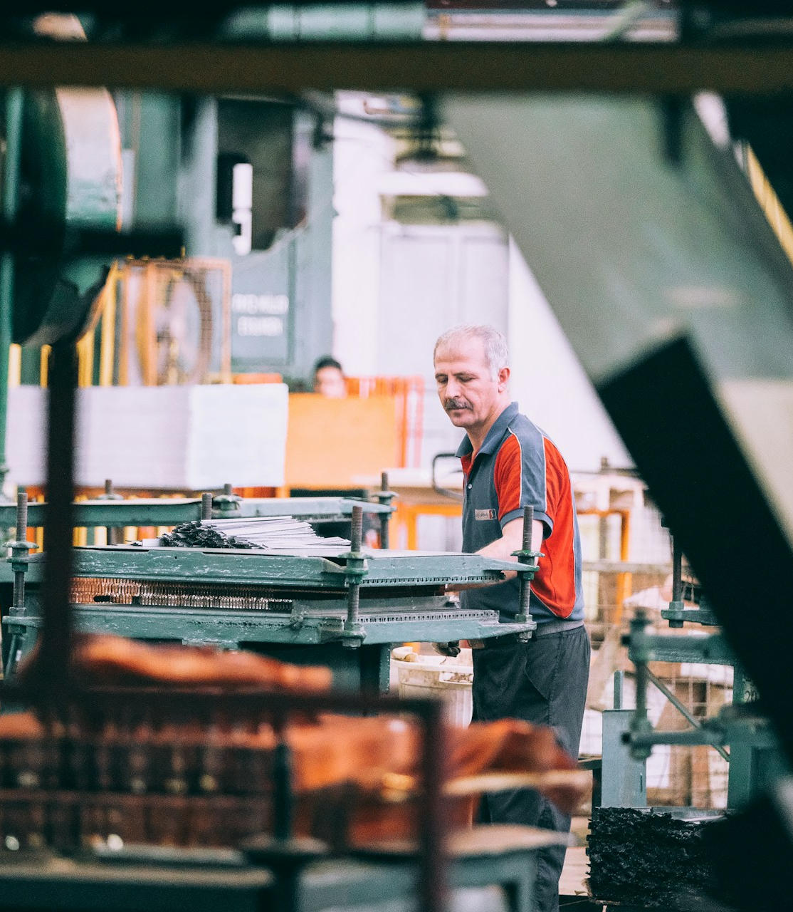
Key Terms
Microergonomics: Worker postures, workplace productivity, work physiology, and biomechanics
Macroergonomics: Resource allocation, shift/turn planning, and outline of the working environment
Environmental ergonomics: Lighting, noise, temperatures, air quality, etc.
Mechanical exposure: Ergonomic factors that do not include the environment; Physical forces
External exposure: Working methods, postures, movements, and forces that workers perform
Internal exposure: Corresponding moments and forces within the human body
Notes:
First, let me cover some key terms before we jump in. Is everyone familiar with micro- and macro-ergonomics?
Environmental factors include things like lighting, noise, temperature, air quality, etc.
Mechanical exposure refers to ergonomic factors that do not include the environment. This primarily includes physical forces, movements, and postures.
Mechanical exposure can be further broken down into external exposure (which refers to methods, postures, and movements that the workers perform) and internal exposure (which refers to the corresponding moments and forces that occur within the human body as a result of the external exposure).

Slide 7
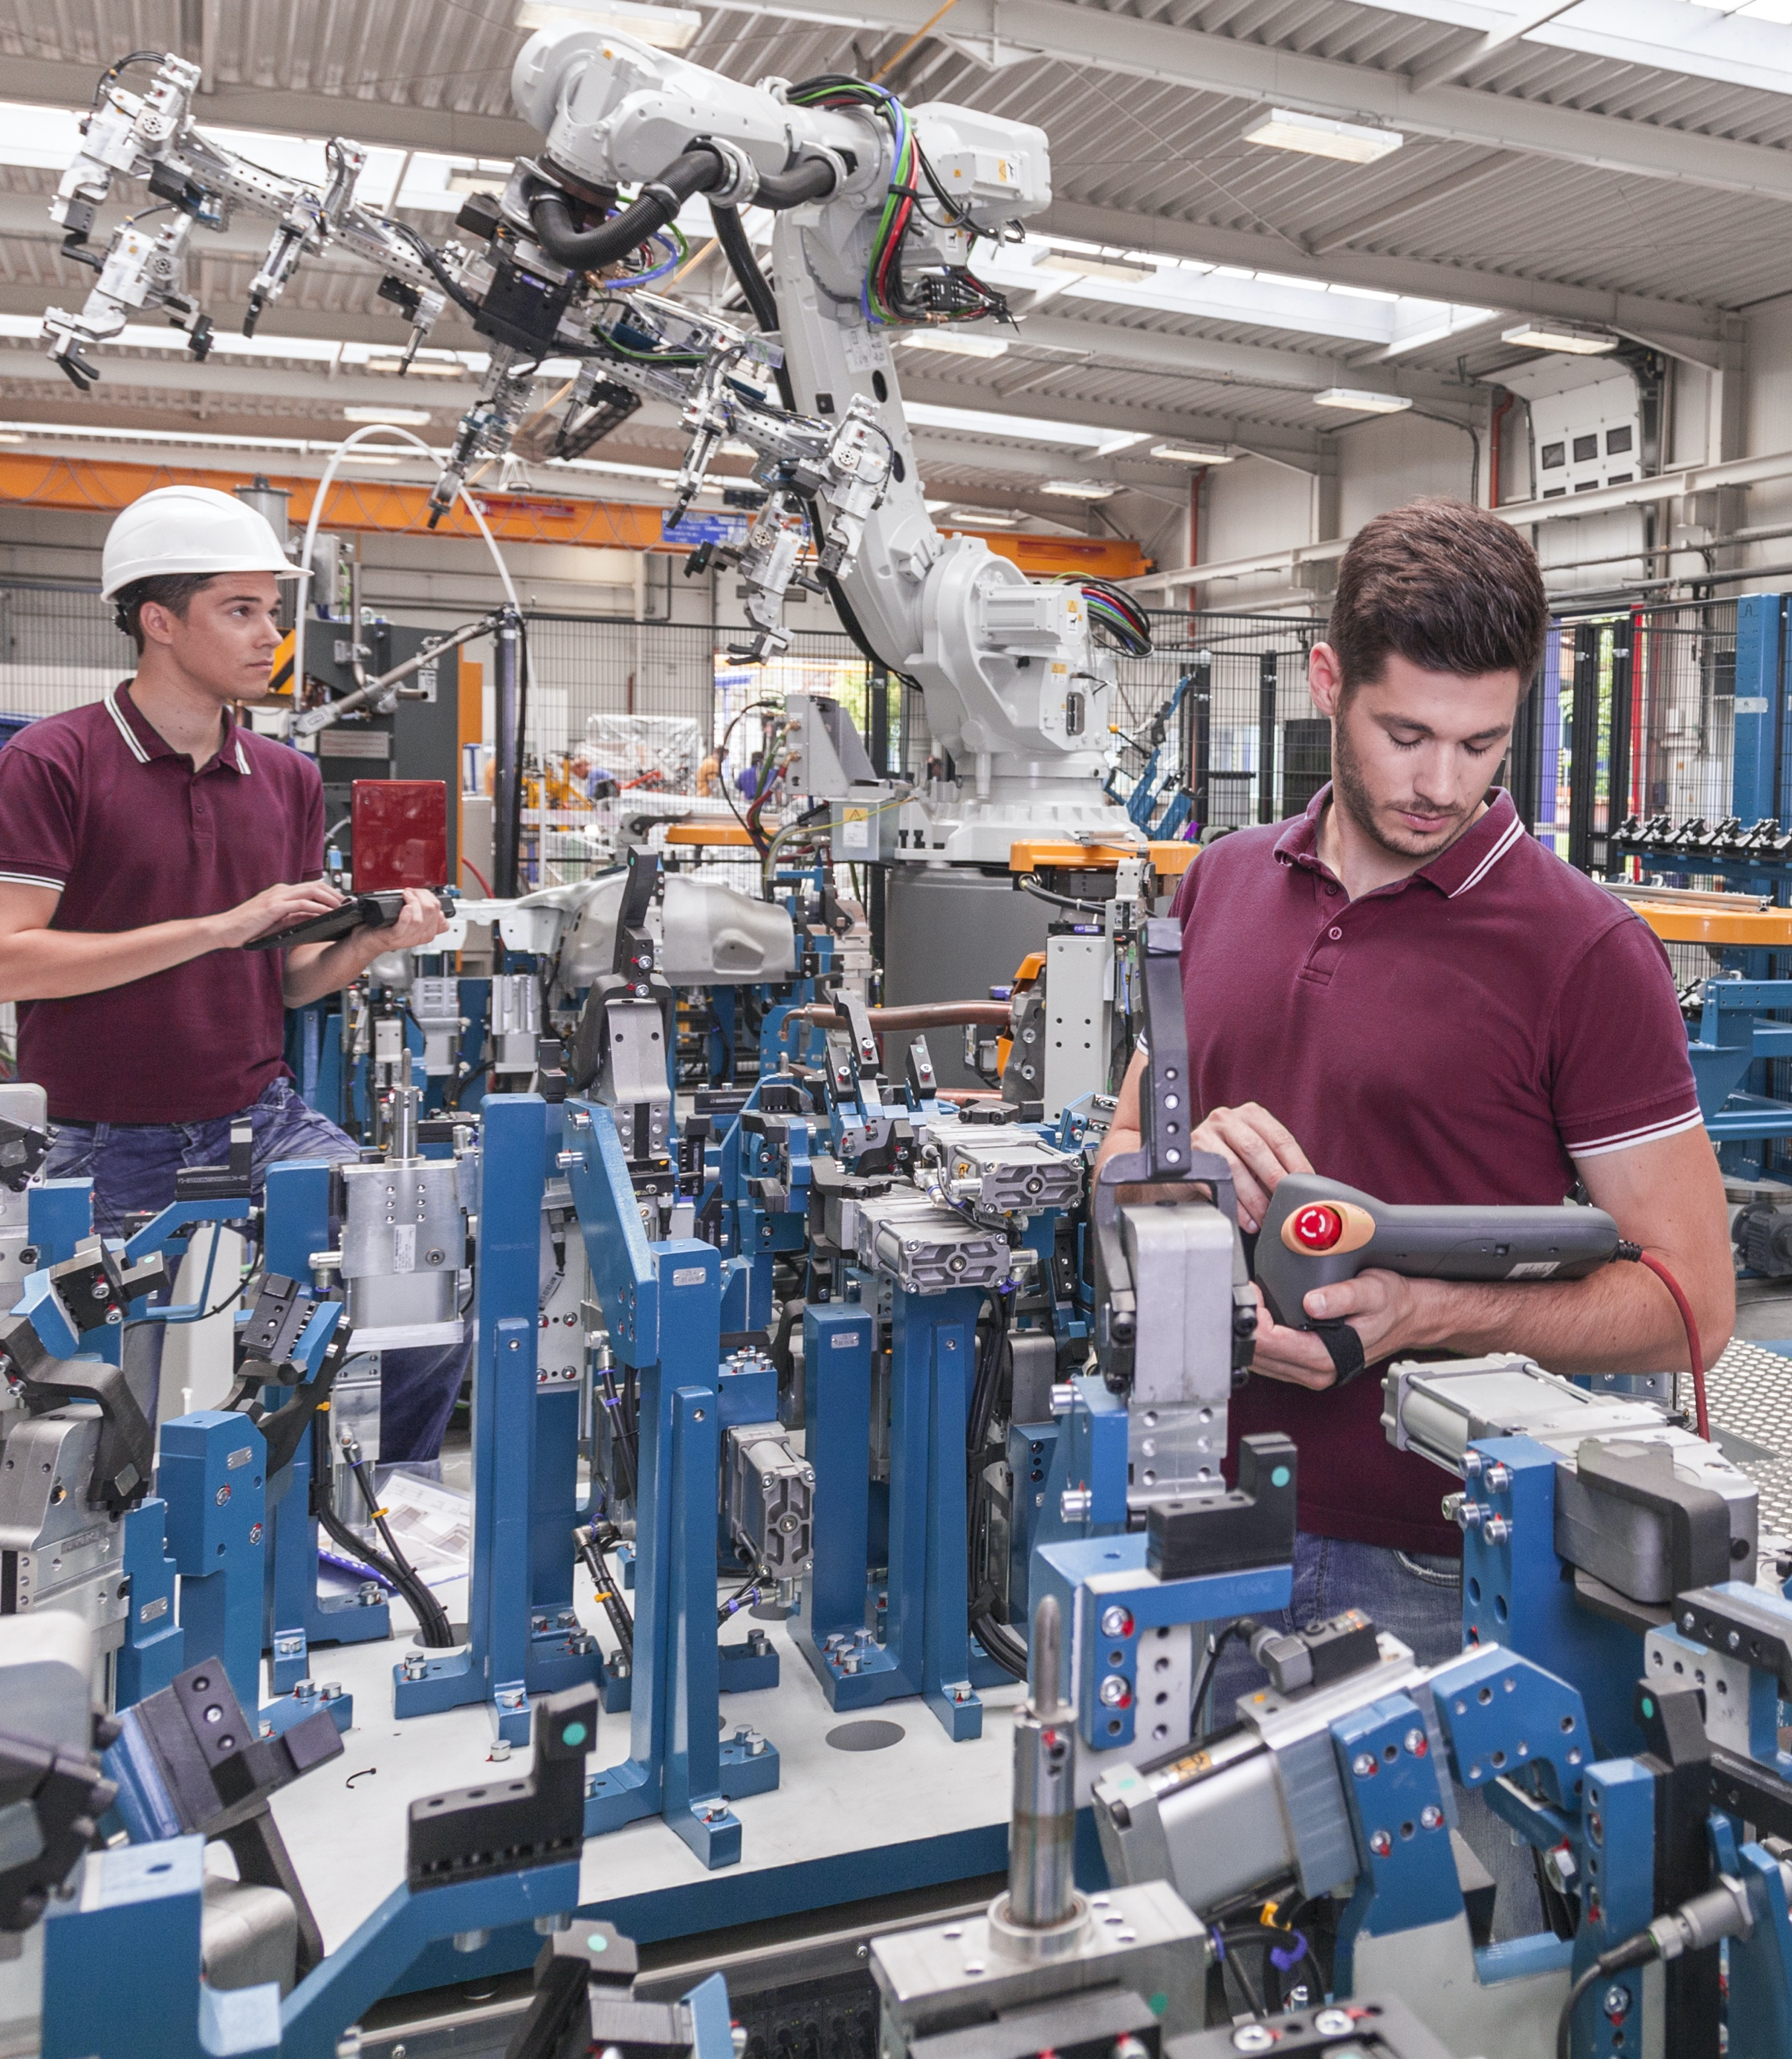
Key Terms (continued)
Human-Robot Interaction (HRI): HRI refers to any interaction between a human and a robot
Human Robot Collaboration (HRC): HRC refers more specifically to a human and a robot collaborating on a shared task as a team.
Humans and machines have different strengths, but these can complement each other if implemented effectively.
Notes:
The article made a distinction between human-robot interaction, which it defined as any interaction between a human and a robot, and human-robot collaboration, which it defined as being more about a team-based collaboration between a human and a robot with the same goals.
The key principle here is that humans and machines have different strengths, but these can complement each other if implemented effectively.

Slide 8
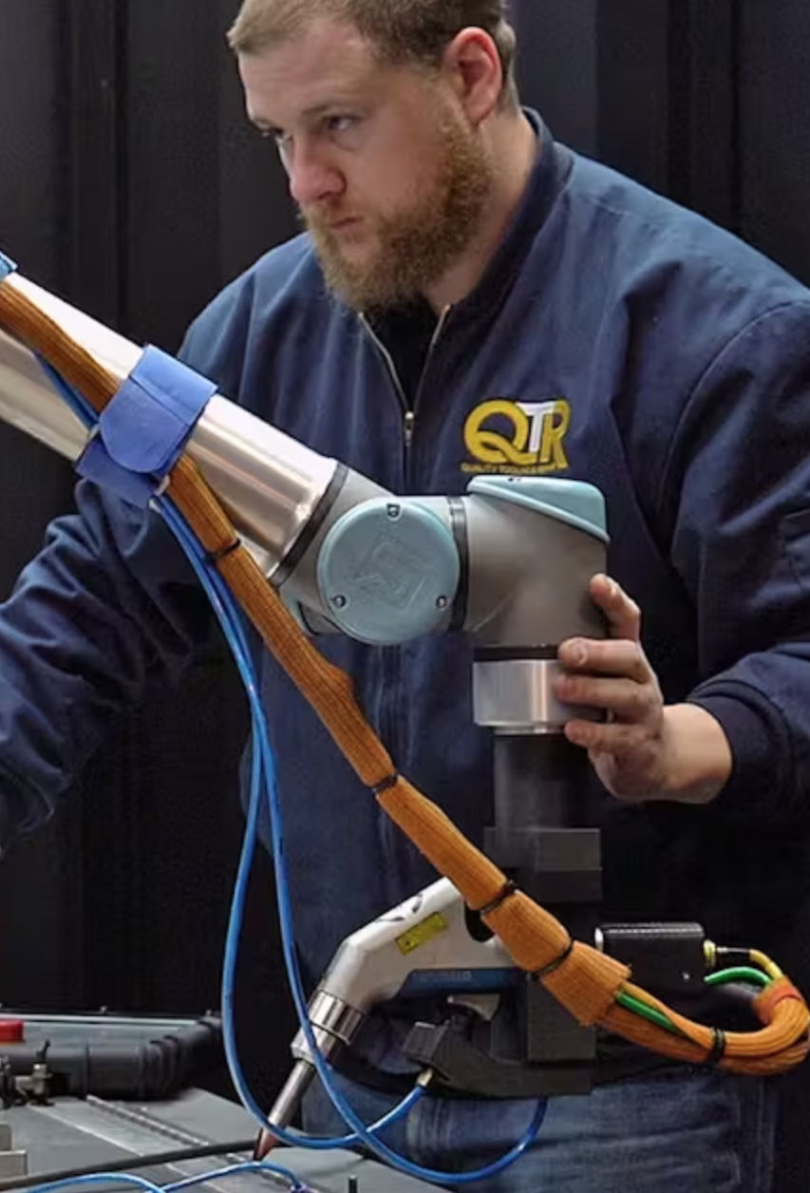
CoBots
(Collaborative Robots)
Notes:
CoBots.
Now I'll talk more specifically about these collaborative robots, which are given the nickname of CoBots.
Engineers seem to really like giving their various industries a lot of nicknames.

Slide 9
CoBots
Collaborative robots (CoBots) can support humans' operations:
Physical operations: handling and lifting heavy loads, adjusting positions of objects in completing a task
Cognitive operations: visualizing alternative behaviors to reduce operators' mental stress
Hazardous operations: handling chemical or heated materials
"This relationship positively impacts productivity, flexibility, and the creation of new jobs instead of replacing workers"
The article covers "frameworks in which a CoBot interacts with the human to accomplish a shared task, by adapting online its behavior to address the counterpart’s demands." It does not cover teleoperation systems and exoskeletons.
Notes:
According to the article, CoBots are built to support humans' physical operations (by handling and lifting heavy loads into more helpful positions), cognitive operations (by visualizing alternative behaviors to reduce operators' mental stress), and hazardous operations (by handling chemical or heated materials so the humans don't have to).
The article stated that "this relationship positively impacts productivity, flexibility, and the creation of new jobs instead of replacing workers." They didn't expand on this much, but I think this is a more human-friendly and effective approach.
The article also covered frameworks in which a CoBot interacts with the human to accomplish shared tasks by adapting its behavior in real-time to the human counterpart's demands.

Slide 10
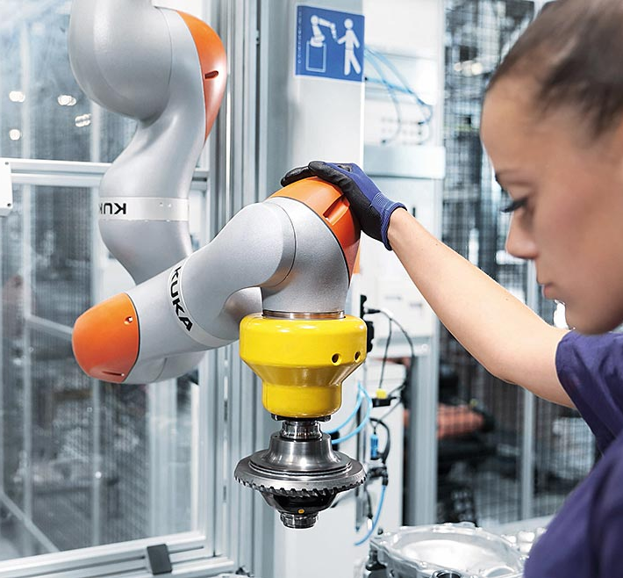
CoBots (continued)
Adaptive Automation
CoBots should assess their human collaborators' physical and cognitive ergonomic state in real-time:
"Thanks to the introduction of ergonomics assessment in the control loop, the robot behaviour could be adapted to workers’ physical condition and characteristics (e.g., age, gender, dominant and vulnerable limb, disabilities, fatigue) and enhance specific skills, mitigate risks, fulfil required capabilities, and fight inequalities."
Notes:
This ability to adapt to the human in real-time is called adaptive automation.
The article stated that CoBots should be able to assess their human collaborators' physical and cognitive ergonomic state in real-time.
"Thanks to the introduction of... "
One of the many things I find really cool about this is the possibility of adapting to different people. This can level the playing field for a lot of people, especially when many industrial jobs have physical strength requirements.

Slide 11
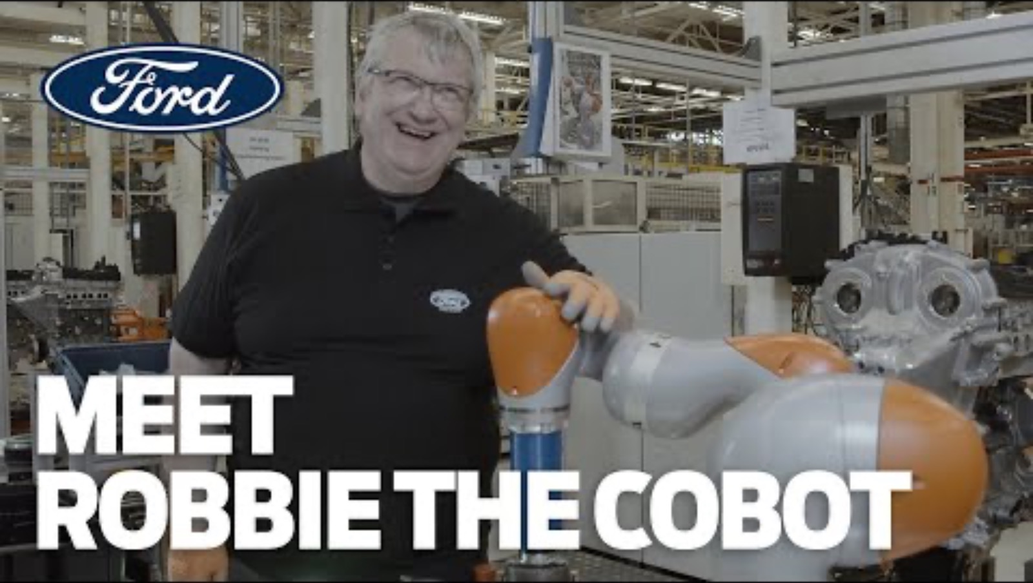
Example: Ford installs Robbie the CoBot
Notes:
This video is a good example of the potential CoBots have to improve workers’ tasks.
After video: Disappointing: they only had the robot do one of the tasks. The worker still had to do most of the work; the robot just slowly took care of the task that required a lot of force.

Slide 12
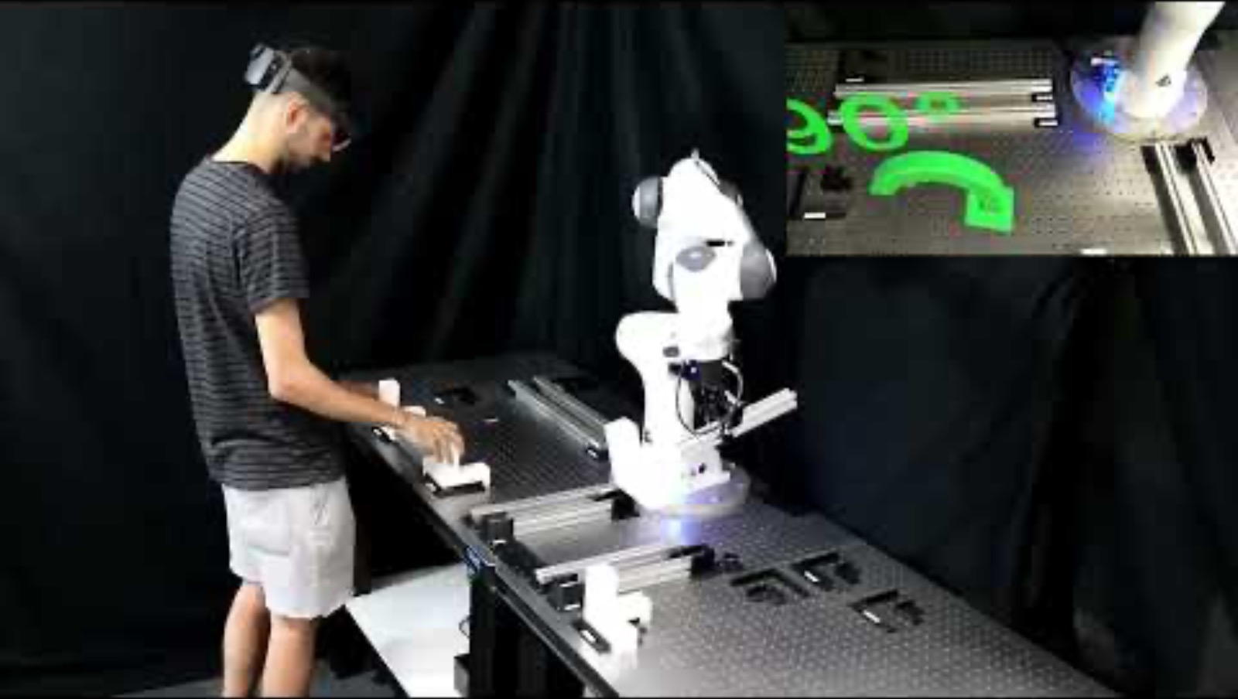
Example: SOPHIA Project
Notes:
Thoughts?
This video has some more advanced applications.
Details:
"In a video , researchers show some examples of the use of SOPHIA technologies. In the industrial shopfloor at Hankamp premises, the CoBot carries heavy loads while the human moves it through a user-friendly interface, without any need of pre-programming. In HIDRIA, the CoBot helps the operator to carry some mechanical components, replanning the trajectory based on the operator level of attention and their psycho-physical stress. At the University of Twente (one of project partners) the exoskeleton supports the operator to carry heavy loads. In IIT in Genova, the operator teaches the robot the trajectories to be executed and the forces to be exerted on the table; then the operator manually guides the CoBot to perform overhead tasks such as drilling, relieving the human from carrying up to 16 kg of payload. In IIT, the operator also uses an Augmented Reality interface to get instructed about the task carried out alongside the CoBot; the robot responds to the flexibility needs of common industrial tasks such as box-filling and item sorting."

Slide 13
Ergonomics of Human-Robot Collaboration
Physical Ergonomics
Cognitive Ergonomics
User Acceptance
Automation Bias
Notes:
Now that we've seen those examples, let's go more in-depth on the ergonomic factors involved in HRC.
First, we'll talk about...

Slide 14
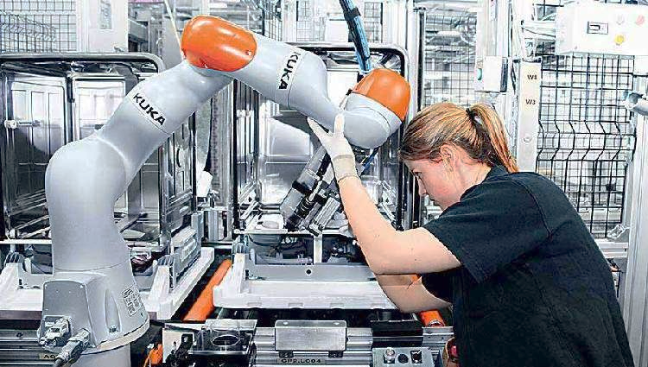
Physical Ergonomics in HRC
Tools
REBA and RULA
Allow the CoBot to adjust its motion
WISHA index, OWAS, and Task Analyses
Identify ergonomic costs and risks
Determine which tasks should be performed by which party
The "medium joint angle index" and "joint torque model"
Model arm comfort
Generate ergonomic robot paths toward the object transfer point (OTP)
NIOSH Index, quality, and productivity measures
Simulations
Safety protocols
Hazard identification and mitigation
Fail-safe mechanisms
Safety standards (ISO 10218, ANSI/RIA R15.06)
Notes:
Here's where a lot of the adaptive automation comes in.
Tools like REBA and RULA allow collaborative robots to assess the human worker and adjust according to their most healthy postures. Did you guys learn about the REBA and RULA in your Ergonomics class?
These have also been used to change the robot's motion to become more human-like, appearing safer and more interpretable to the human operators.
The WISHA index, OWAS, and Task Analyses are used to identify ergonomic costs and risks, which are then used to determine which tasks should be performed by which party (human/robot).
The "medium joint angle index" and "joint torque model" can be used to model arm comfort, which could be used to generate ergonomic robot paths toward the object transfer point (OTP) for handover.
The NIOSH Index, quality, and productivity measures were used to assess methods and collaboration techniques.
Additionally, simulations can be used for these assessments.
Safety protocols include:
Hazard identification and mitigation
Fail-safe mechanisms
Safety standards (ISO 10218, ANSI/RIA R15.06)

Slide 15
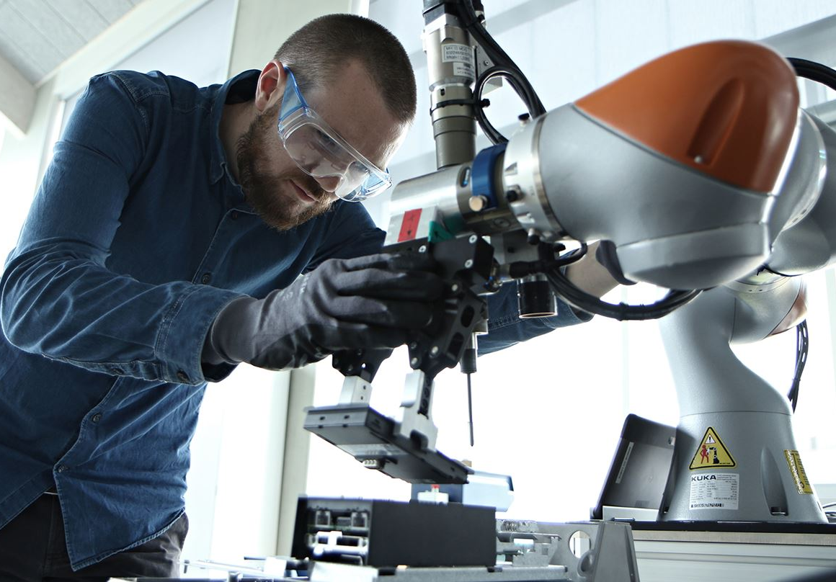
Cognitive Ergonomics in HRC
Cognitive Load Theory (CLT)
Includes factors such as instantaneous load, peak load, accumulated load, average load, and overall load
Investigates how cognitive load changes over time
Investigates what loads are imposed on the subject from activities and/or environmental conditions
Cognitive Performance
Based on questionnaires and secondary-task performance measures, "when a more significant percentage of primary task time was automated, operator perceptual resources were freed up and monitoring performance on the secondary task improved."
"The degree of robot’s transparency and observability provided to the human worker had an influence on the development of cognitive workload. Moreover, changes in experienced mental effort between human and automated assistance were mainly correlated to the operator’s familiarity with the technology."
Affective Robotics: mostly in research on social or service robots.
Difficulties from social desirability influences
Machine learning techniques, especially the Support Vector Machine (SVM) can be fairly accurate in classifying cognitive ergonomic risk.
"Cognitive resources demand and mental stress induced by the close interaction with a CoBot should not be overlooked."
Notes:
"Cognitive resources demand and mental stress induced by the close interaction with a CoBot should not be overlooked."
Cognitive Load Theory (CLT)
Includes factors such as instantaneous load, peak load, accumulated load, average load, and overall load
Investigates how cognitive load changes over time
Investigates what loads are imposed on the subject from activities and/or environmental conditions
Cognitive Performance
Based on questionnaires and secondary-task performance measures, "when a more significant percentage of primary task time was automated, operator perceptual resources were freed up and monitoring performance on the secondary task improved.”
This seems like a no-brainer to me, but still interesting – especially when we talk about automation bias later.
The article also stated that "The degree of robot’s transparency and observability provided to the human worker had an influence on the development of cognitive workload. Moreover, changes in experienced mental effort between human and automated assistance were mainly correlated to the operator’s familiarity with the technology."
Research following this principle of monitoring the human state and adapting accordingly is often referred to as "affective robotics." Most applications of this are devoted to social or service robots.
"Researchers are encountering difficulties due to the multidimensional construct and high subjectivity of cognitive processing and the typical human attitude of being ashamed and concealing about psychological state."
Machine learning techniques, especially the Support Vector Machine (SVM) can be fairly accurate in classifying cognitive ergonomic risk.

Slide 16
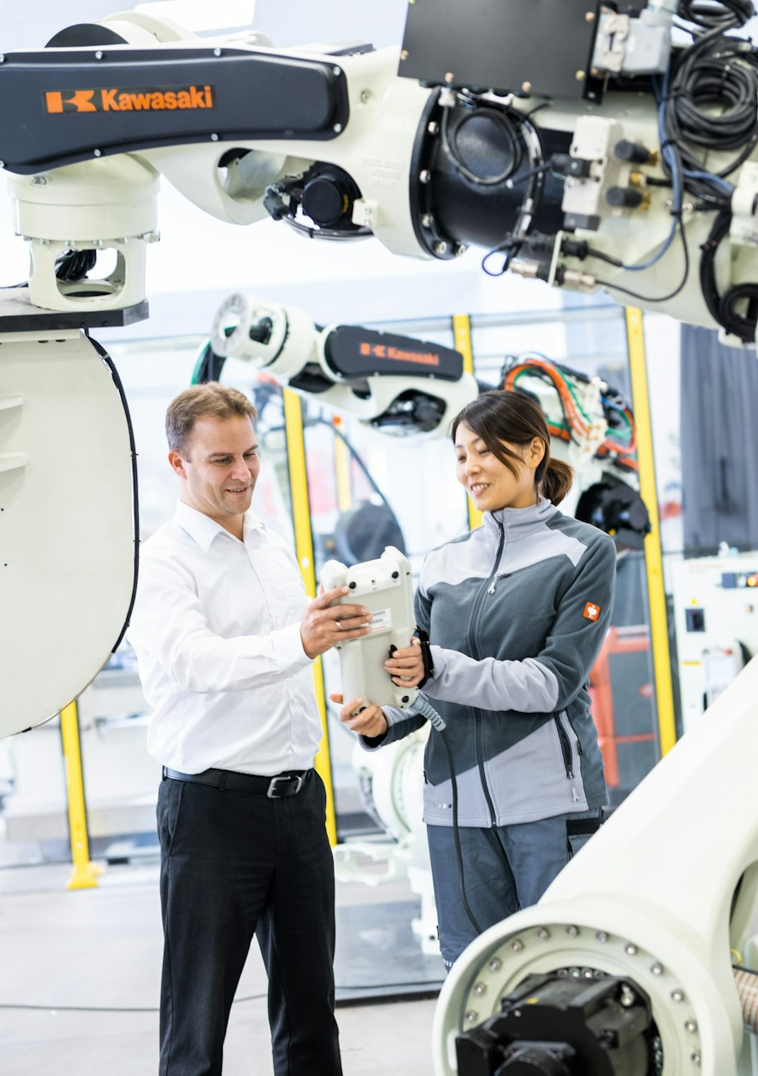
User Acceptance
"Early interviews with the potential future users (i.e., actual industrial workers) of these robots revealed controversial attitudes and social cues."
“Even the most efficient and ergonomic equipment, without users’ approval, becomes meaningless.”
Using questionnaires and biosensors, researchers found that "An increase in psychophysiological conditions was found when a robot moved closer to a worker, with high approaching speed and without notifying its motion in advance."
Researchers also found that “the feeling of perceived safety was enhanced when the robot's motion was fluent and predictable.” Recent research has focused on providing “smooth trajectories to generate psychologically acceptable motions without adding disturbances or uncomfortable sensations to the worker."
"Since they will firsthand use and experience the proposed technologies, their approval is fundamental for an effective integration. Hence, parallel to the development of HRC strategies, their evaluation with real workers in real factories is a key requirement."
Notes:
Similar to our discussion on exoskeletons, user acceptance is a big factor here.
"early interviews..."
...
Are there other factors you think should be considered here?
What about management mandates? Could these pose a threat and some internal conflict?
Management will need to be informed clearly that these robots are not meant to replace their workers, but support them.

Slide 17
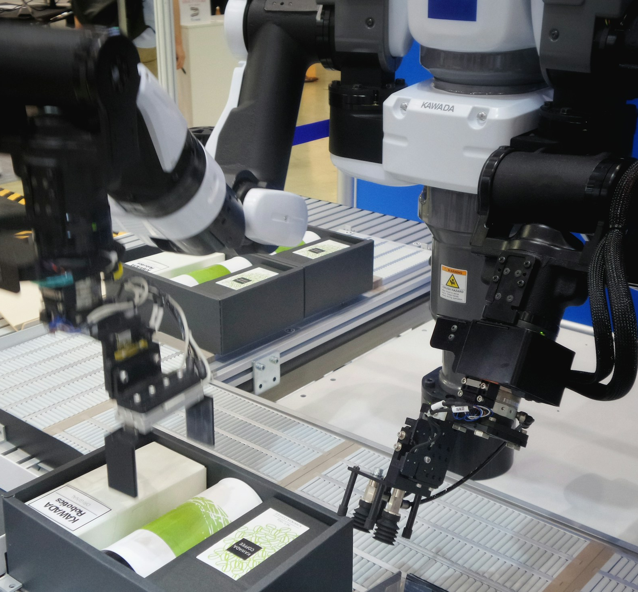
Automation Bias
From CoPilot: Automation bias is “the tendency of humans to over-rely on automated systems, trusting their outputs and decisions even when the automation is flawed or incorrect. This cognitive bias can manifest when people prioritize automated information over their own judgment or critical thinking, assuming that systems are infallible.”
Discuss:
What role do you think automation bias could play in this kind of situation?
Adaptive automation: These CoBots are being designed to assess the worker's physical and cognitive state. What could go wrong here? What might those consequences be?
Notes:
Automation bias wasn't covered by the article at all, but I think it's an important factor for us to consider. As a refresher, here's a definition of automation bias from Microsoft's CoPilot: "..."

Slide 18
Assessment Tools
Types of Tools
Physical Assessment Tools
Cognitive Assessment Tools

Slide 19
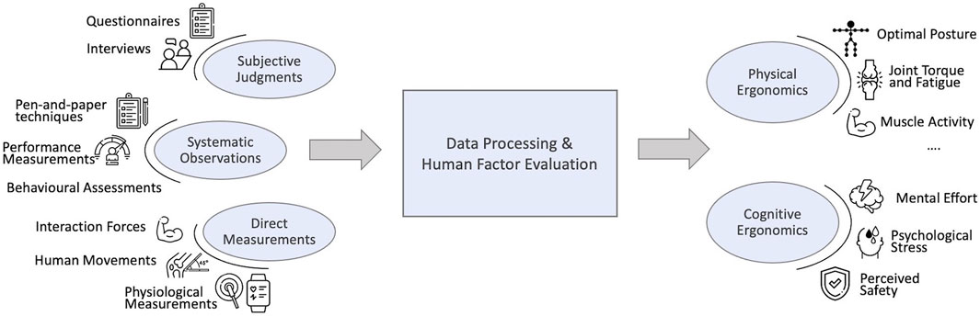
Human-Monitoring Assessments
Notes:
This diagram covers the most common assessment tools used for evaluating CoBots and their interactions with people. Most of these are performed by researchers, but some can be performed by the CoBots to support their human counterparts.

Slide 20
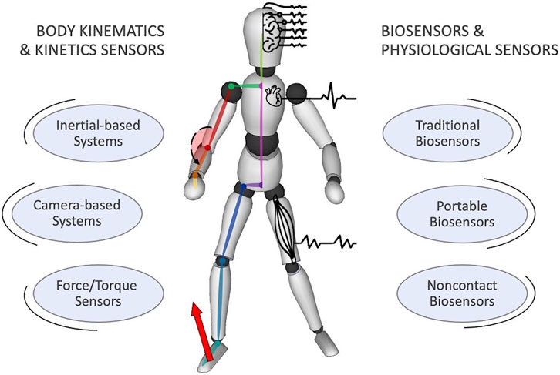
Human Monitoring Technologies
Notes:
These technologies can be used to assess both the person’s physical and cognitive states.

Slide 21
Summary of Available Assessment Tools
 | Physical Assessments | Cognitive Assessments
Subjective Assessments Self-questionnaires and Expert Interviews | NASA-TLX | Subjective self-reports: Cognitive Load Assessment for Manufacturing (CLAM)
Systematic Observations Worksheets filled by skilled observers | RULA, REBA, Ergonomic Assessment Worksheet (EAWS), NIOSH Lifting Equation, SI | Performance measures on primary and secondary tasks, cameras with emotion-recognition software*
Direct Measures Performed on-site or during simulations | OpenSim, Anybody, Virtual Interactive Musculoskeletal System (VIMS), EMG, Biosensors (especially eye-tracking, motion capture, force gloves, and force boots) | EEG, Galvanic Skin Response (GSR or EDA), respiratory activity, eye activity, cortisol level, speech measures
Notes:
There’s a lot here, but I want to highlight a few things.
RULA, REBA
Biosensors
Cognitive, systematic:
Cameras and emotion-recognition software
Can assess attentional distribution, decision making, mental overload, frustration, stress, and errors.
Relatively new, but promising; especially for assessing actual shop floors, not just workers in a lab.

Slide 22
Future Research Trends
Increasing Adoptability
Improving Assessments
Discussion

Slide 23
Increasing Adopt-ability
More accessible tools are needed so CoBots can be adopted by more industries and audiences.
“...the study of human ergonomics in collaborative robotic workstations is relatively a new topic, still looking for practical solutions. ... The actual research tends to rely on elaborate and time-consuming data post-processing. Consequently, available tools can be used almost exclusively by experts or merely provide subjective and offline insights about human ergonomics, inhibiting their applicability in real-world environments.”
“One of the main current challenges is being able to perform assessments on the actual manufacturing floor instead of in a lab. As such, the present researchers advocate for adopting wearable sensor technologies to maximize user comfort without hindering workers' daily activity.”
Notes:
One of the biggest factors the article discussed was making it easier for companies and researchers to use CoBots.
“...”

Slide 24
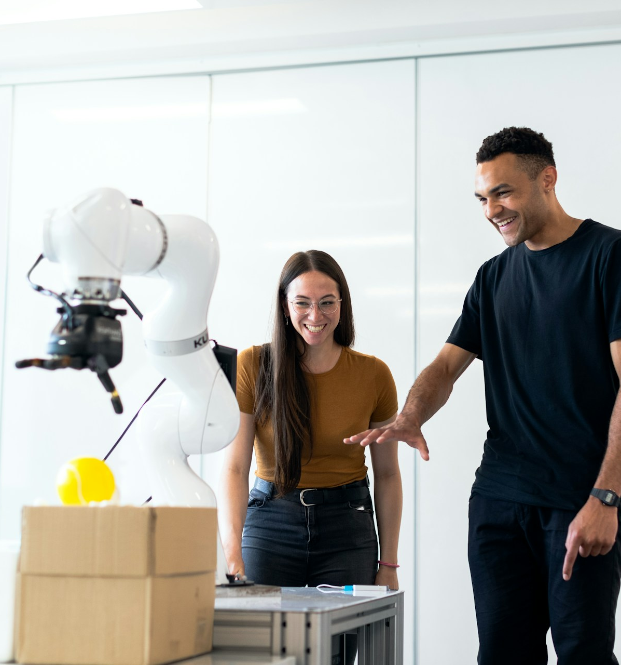
Improving Assessments
Cognitive ergonomics, user acceptance, and reliable mental load measures will be required to ensure safe and effective adoption of CoBots in real-world industrial environments.
Tools like the NASA-TLX should be updated.
"When the technologies for ergonomics monitoring and HRC ... reach a more mature level, the challenges to be addressed include the cost-effectiveness, the level of expertise needed to implement and maintain them, and the multi-person examination capacity. These challenges are not only limited to the technical aspects but also to the regulatory ones, such as privacy issues when it comes to monitoring of humans."

Slide 25
Discussion
What do you think could get in the way of CoBots being adopted more widely?
Are there other factors that need to be considered?
What other applications do you see for these devices?
What advantages do these machines have over Exoskeletons?

Slide 26
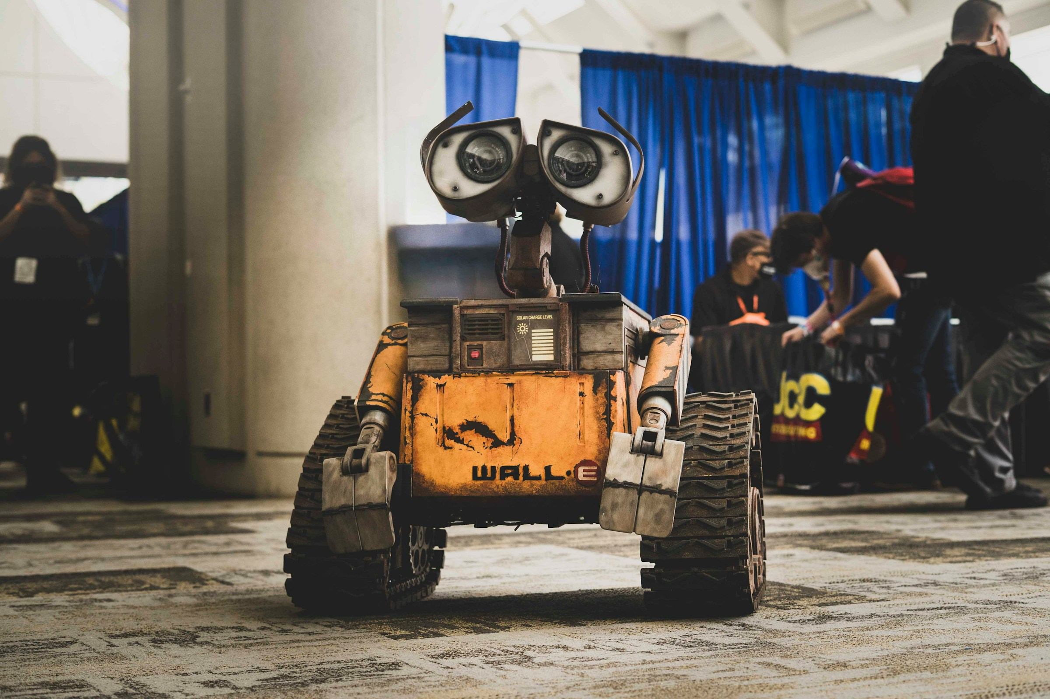
Thank you!
Any questions?

