Slide 1
Uni-Game: One platform to rule them all
Maxwell Light
&
Roger Lorelli

Slide 2





Problem domain?
What is the problem?
Today there exist numerous platforms to purchase digital rights to games
Why is this a problem?
This leads to disconnected libraries where a person might not remember what is in each library

Slide 3
Problem Domain cont.
What is your solution?
A centralized database that players can add games to which will consolidate their libraries.
Why is it a solution?
By doing this, players will be able to better see what games they currently own, have access to the installed executables, and be able to see what games their friends have, plus the marketplace from which they were purchased.

Slide 4
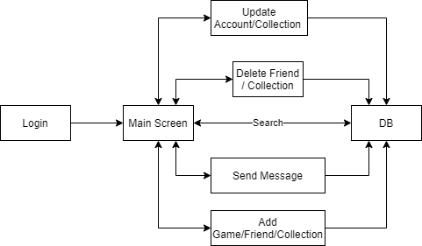
Application
Features
Comprehensive collection of games that exist within multiple online marketplaces.
Personal libraries that track games owned across the same marketplaces.
Customized collections
Able to add other users as friends, being able to see their alias’ across the other marketplaces they use as well as the games they own
Able to send messages to other users.

Slide 5

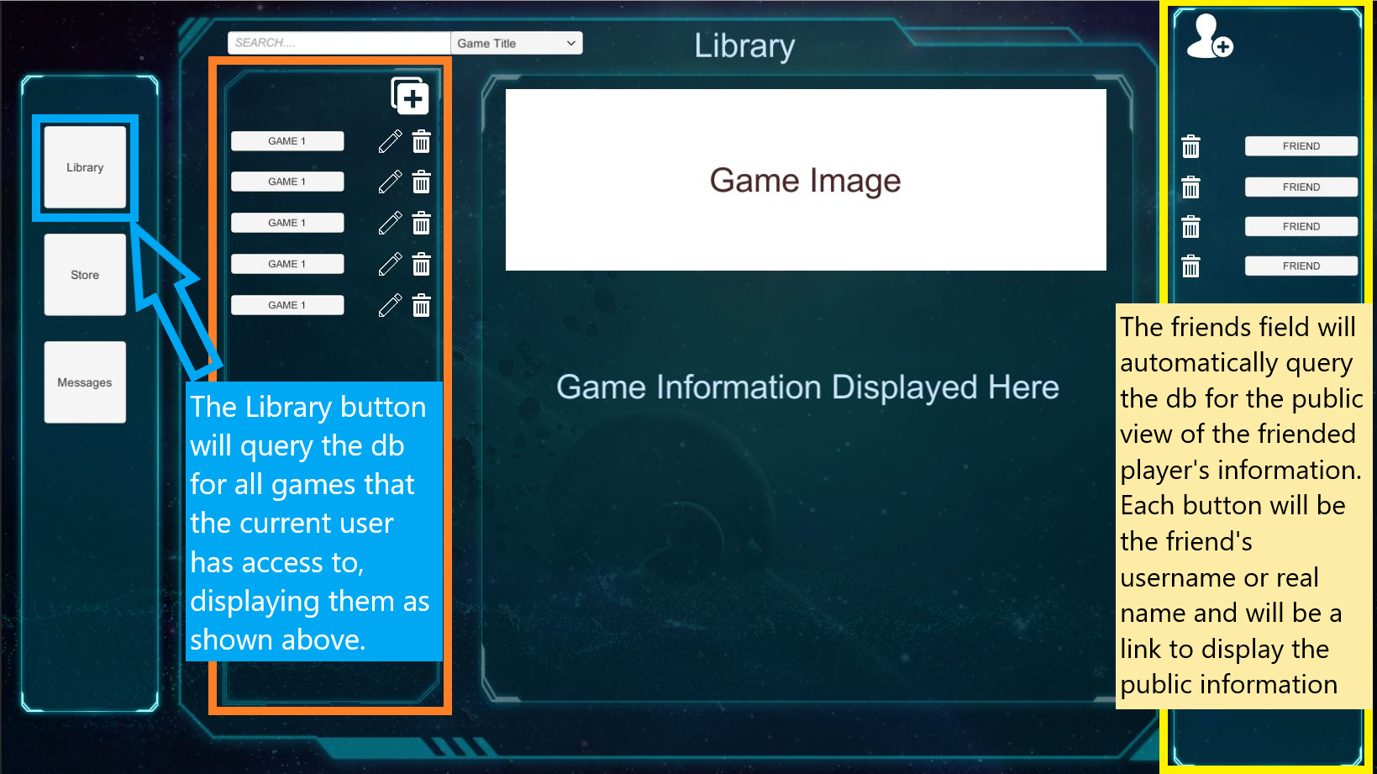
Application - Interaction
The main page will be split into 3 vertically divided sections with the left dedicated to the user’s game library, middle as a main display with a search bar at the top, and the right as a display for a friends list.
Each entry in the library, search results, and friends list will be a button that when clicked will display the information about the game/friend in the middle section.

Slide 6



Technology

Slide 7
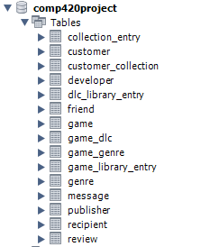
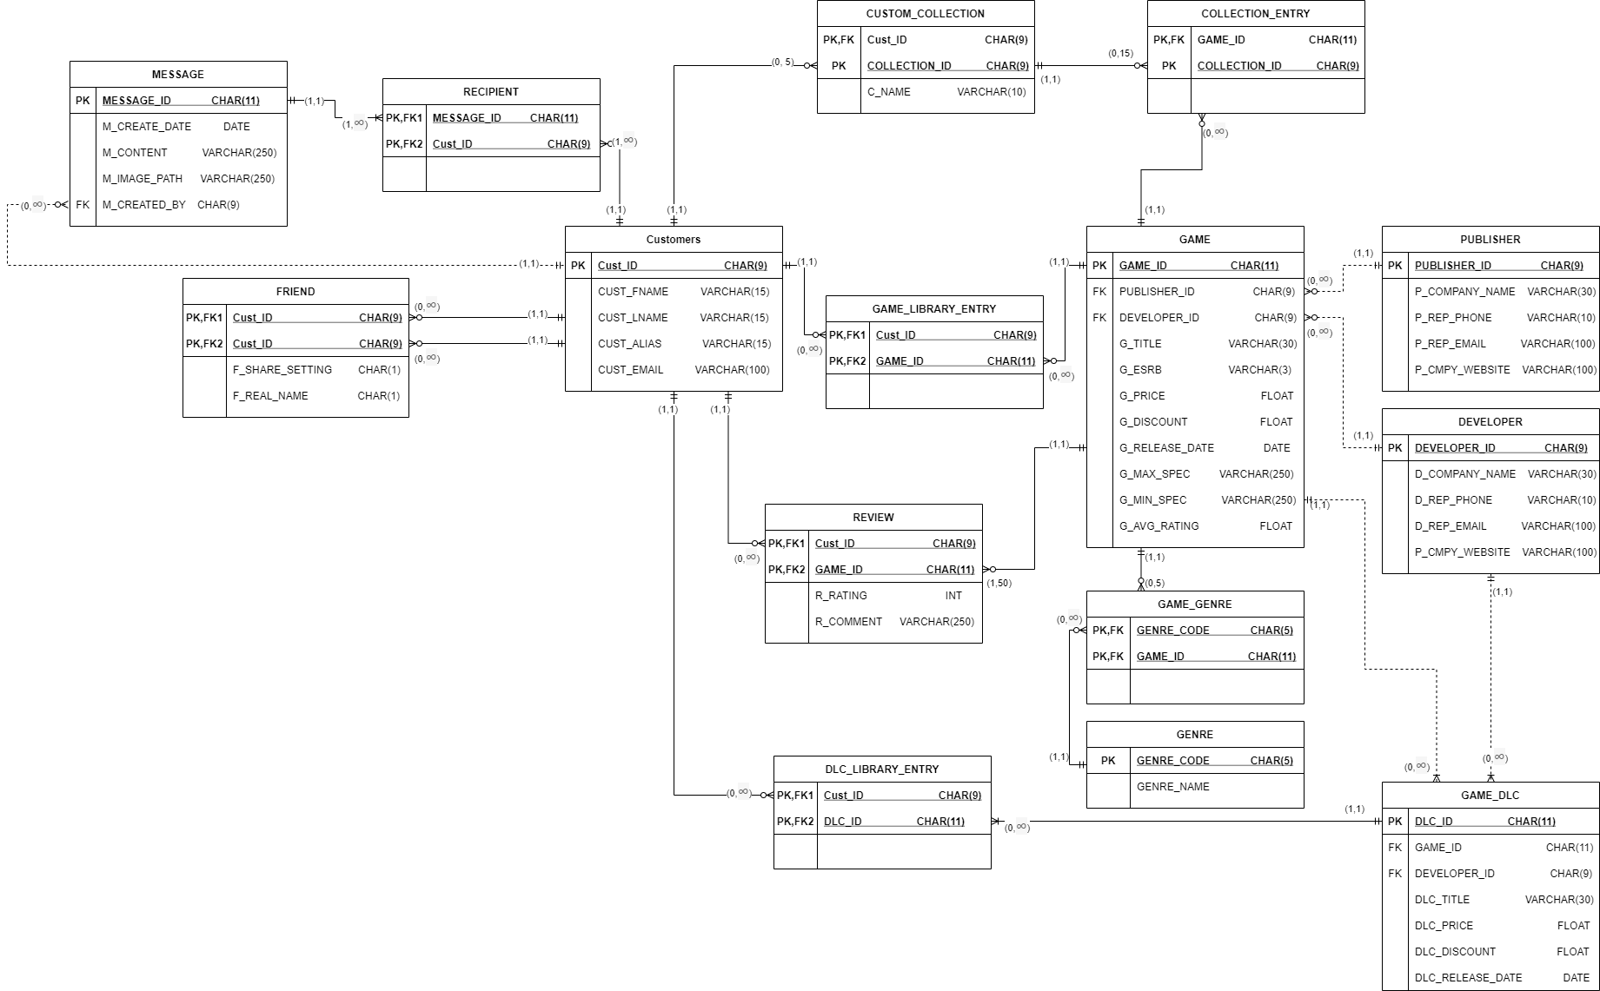
ERD/Schema

Slide 8
Views
Restricted view of customer entity which will only show ID and alias. This removes personal information from being accessible.
Friend view allows for users to view their friends alias’ from the most popular gaming marketplaces.
A display of each game, with basic information about the game as well as each of its descriptor tags.
A report that shows all the lifetime sales for developers and publishers.
A report that shows how many accounts have each game in their library.

Slide 9
Triggers
Queries
After a new game review is made, the game’s avg rating is updated within the game entity.
Counters within game, developer and publisher are incremented after a game is added to the database that is connected to the companies (developer & publisher) or when the game is added to someone’s library (game).
Users are limited to the number of collections they can create, before a new one can be created the database is checked to see that the user has not reached the limit.
Search for games/DLC by title, rating, tags, developer, publisher, price, discount and/or if a friend owns it.
Search for other users by alias.
Search for developers/publishers by name or average rating based on all their games in the database.

