Slide 1


Gold price forecast
Roger Loya

Slide 2
About The Data
Yahoo Finance
Gold
US Dollar Index
Dow Jones Index
Euro/USD Forex Price

Slide 3
Chosen Machine Learning Model
FB Prophet
RMSE GOLD = 56.32
SARIMA
Gold RMSE = 77.32

Slide 4
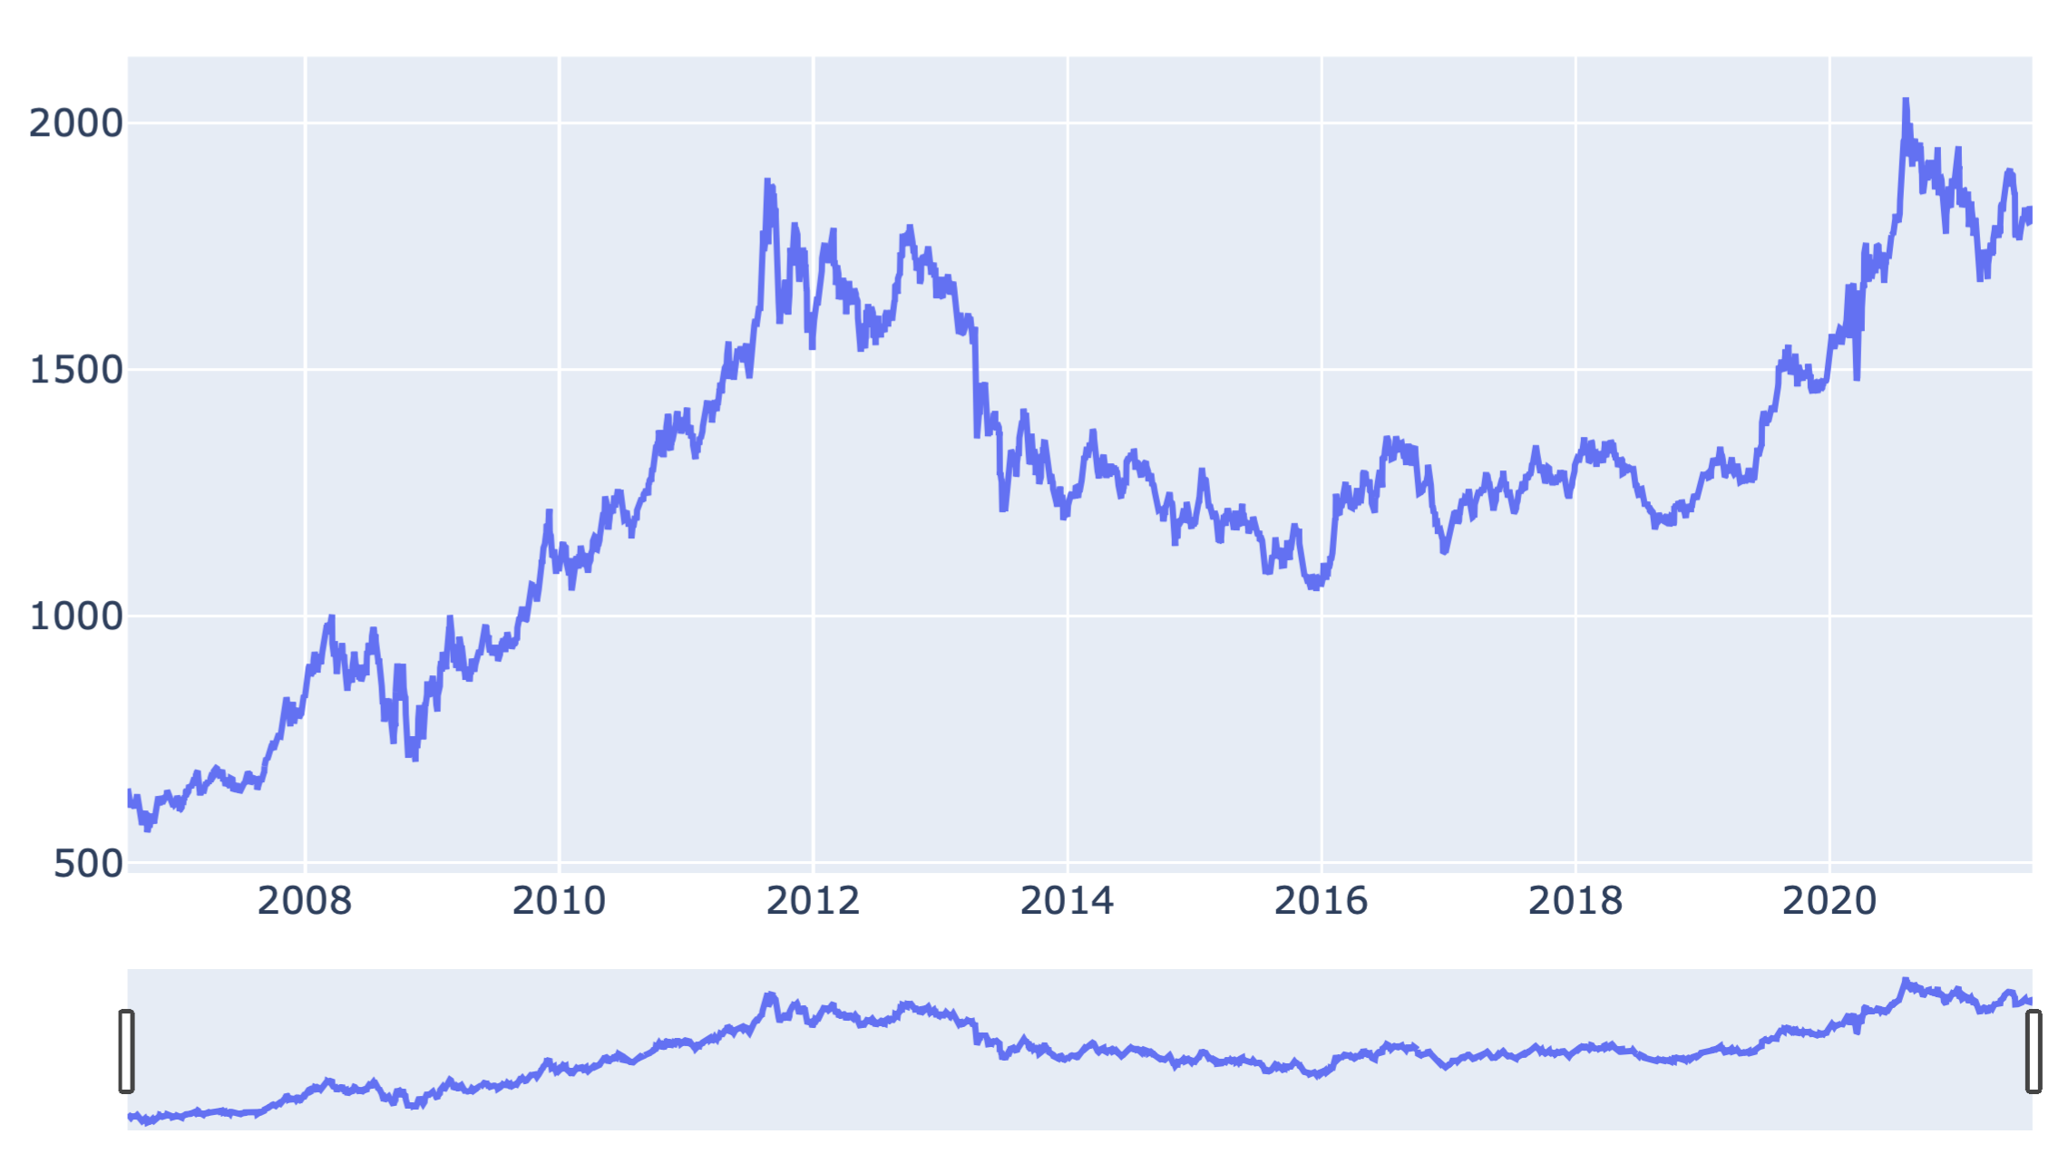
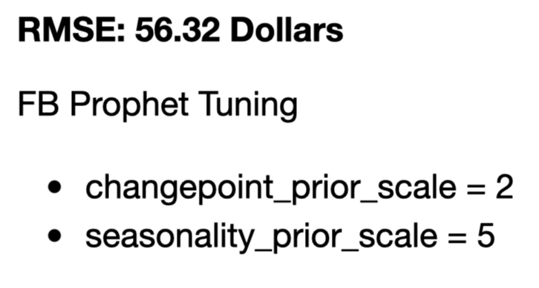
Gold/Dollar Price
Correlation:
0.507 – Dow Jones
0.177 – US DOLLAR
- 0.286 – EUR/USD

Slide 5
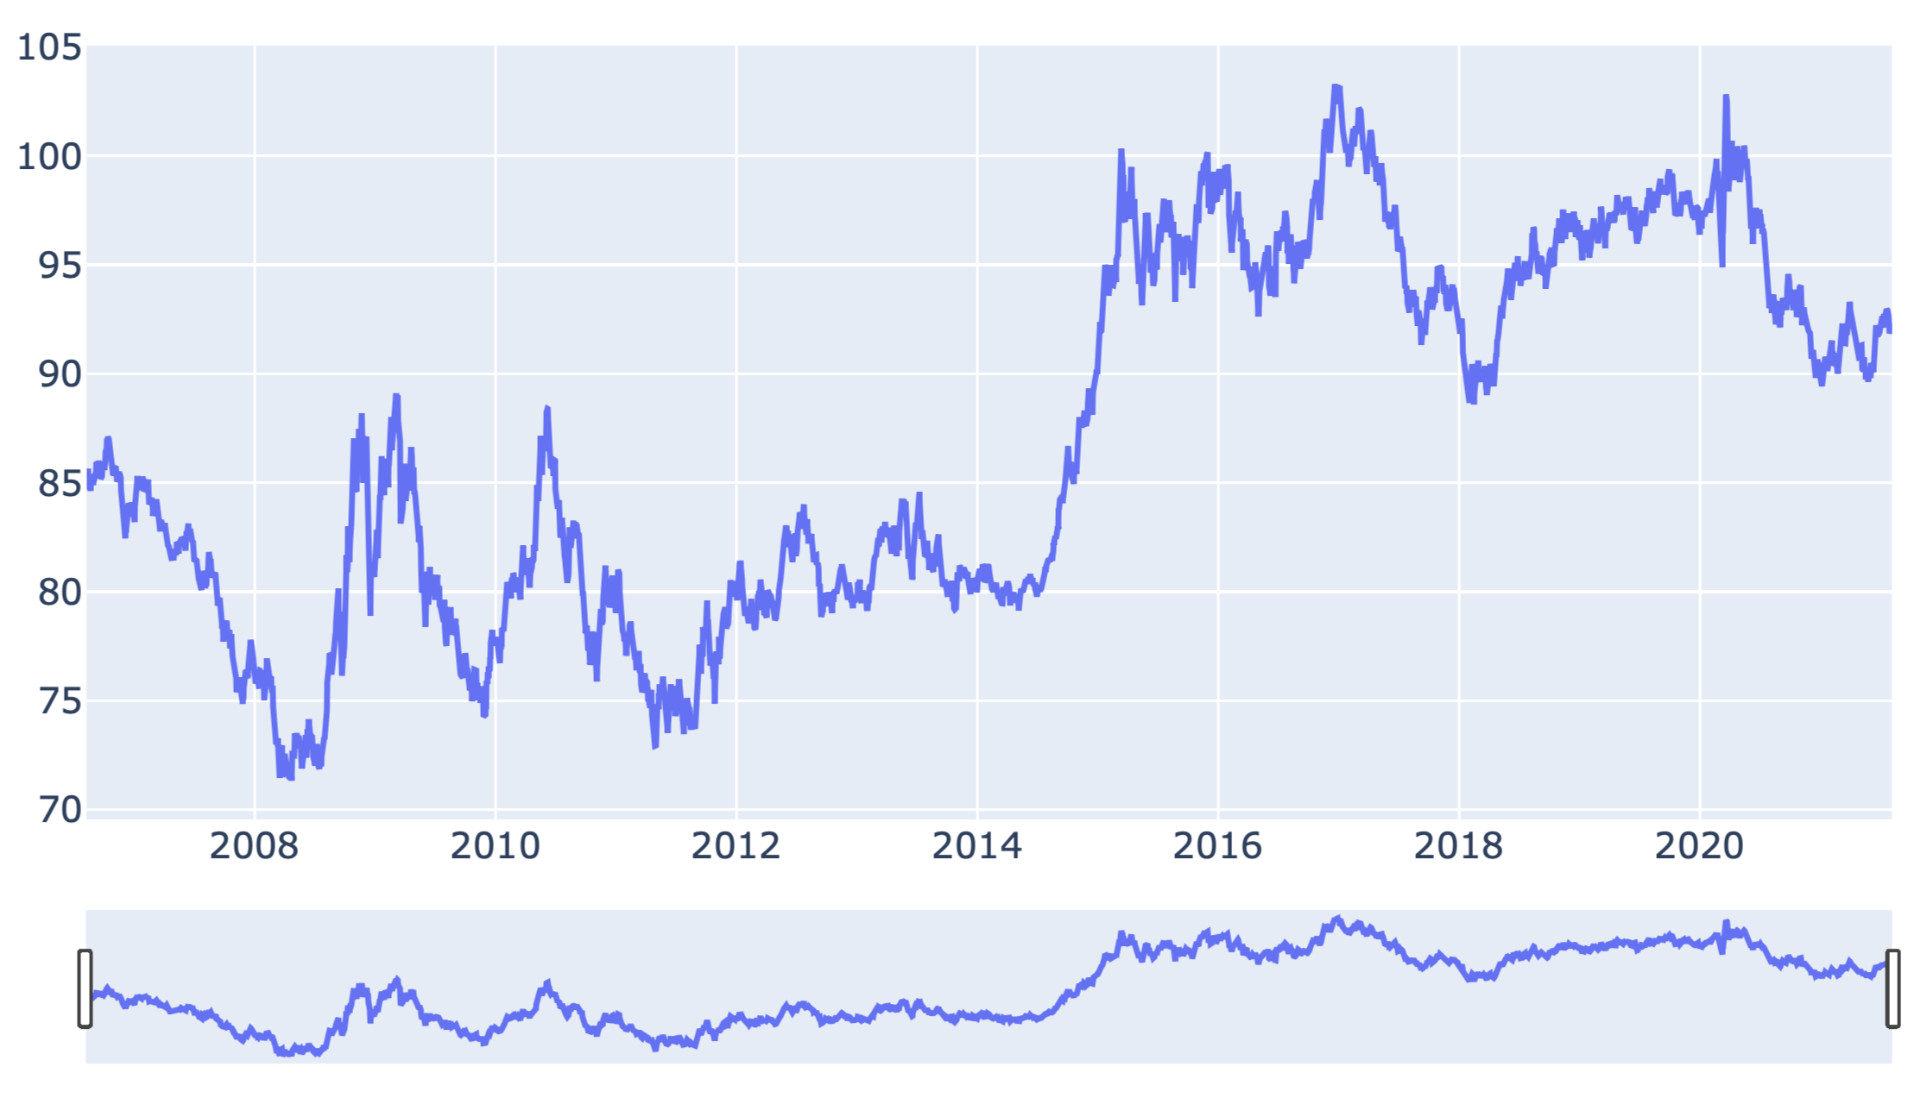
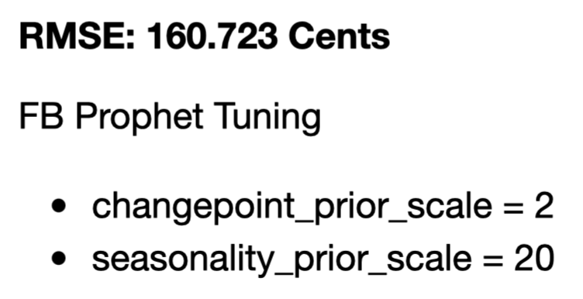
US Dollar Index
Correlation:
0.70 - Dow Jones
0.17 – Gold
-0.97 – EUR/USD

Slide 6
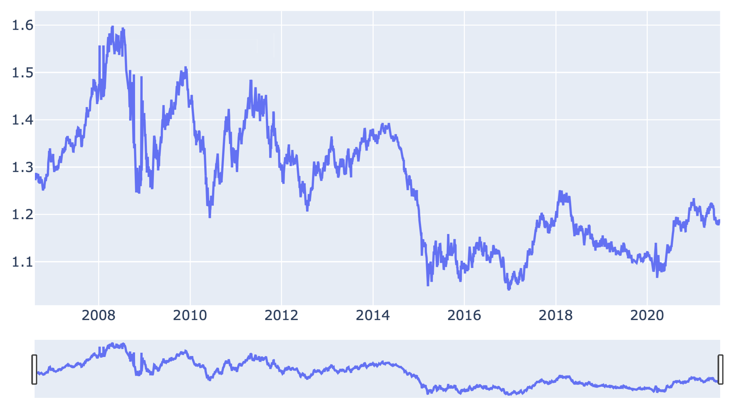
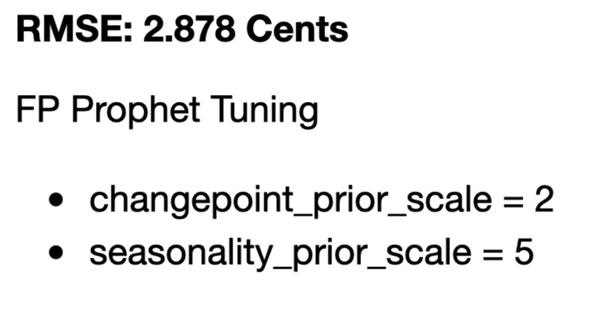
EUR/USD Price
Correlation:
- 0.286 – Gold
- 0.648 – Dow Jones
- 0.967 – US Dollar

Slide 7
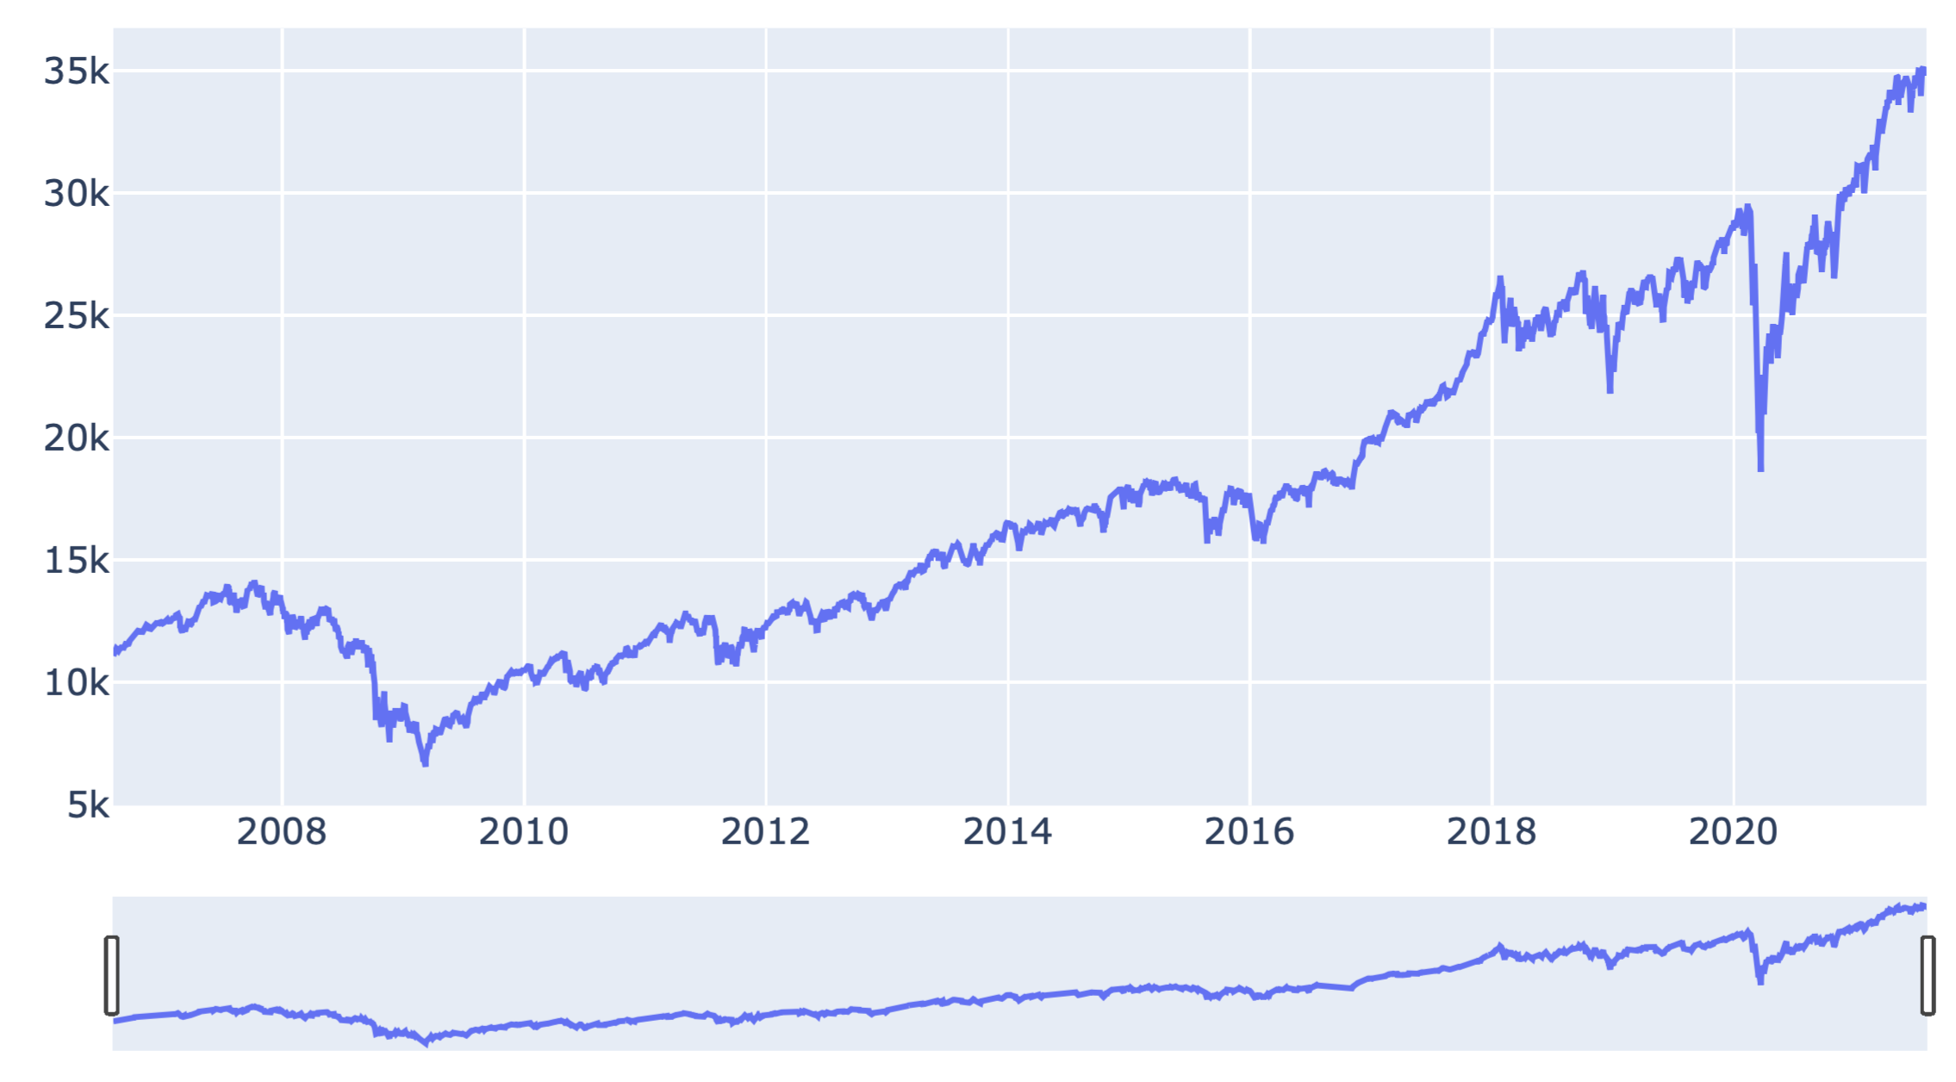
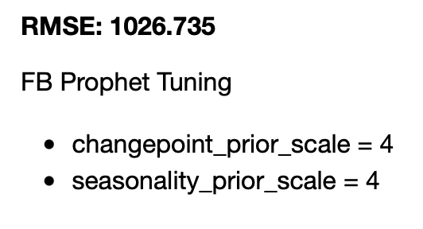
Dow Jones Index
Correlation:
0.701 – DOLLAR
0.507 – Gold
- 0.648 – EUR/USD

Slide 8
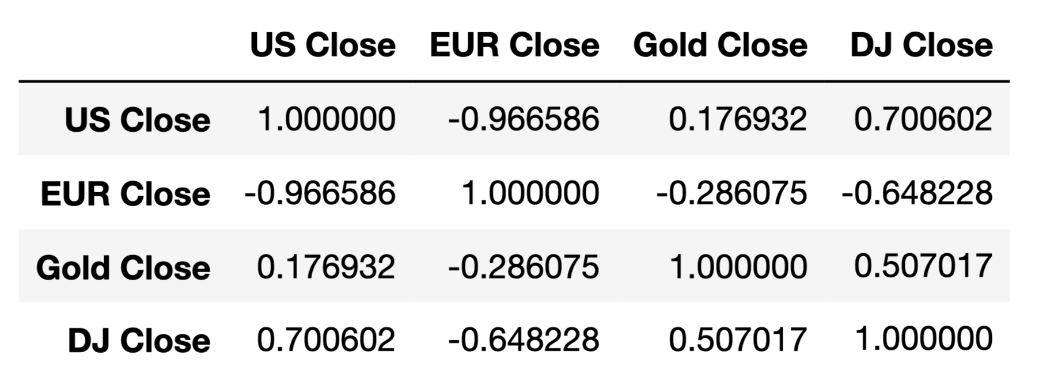
Correlation

Slide 9
Moving Forward
Finding Appropriate eXogenous Data
- CPI Inflation
- GDP Projections
- Poverty Rate
- Federal Fund Rate
- National Debt

