Slide 1
Galvanize Data Science
Clustering
Land Belenky

Slide 2
Supervised vs. Unsupervised
Two Types of Clustering:
K-Means
Hierarchical
Methods:
Distances
Scaling
Initialization
Stopping
Measurements
Selecting the Right K
Combining Clustering and Regression
Overview

Slide 3
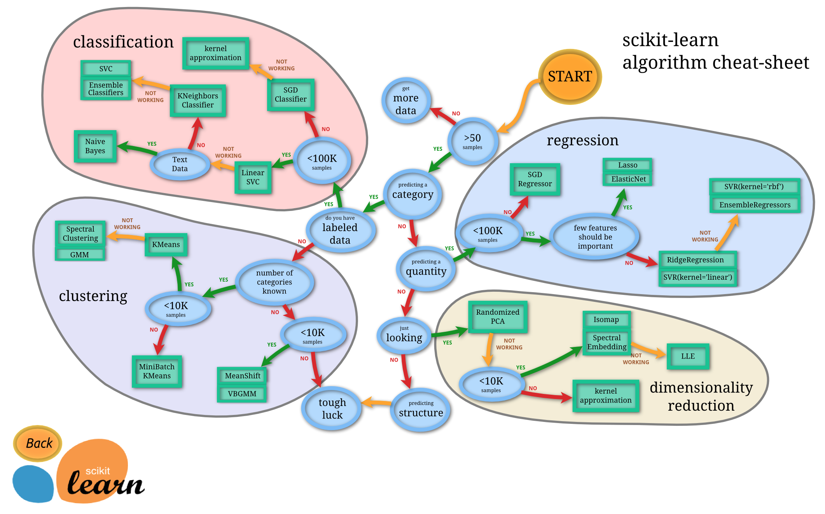
Supervised vs. Unsupervised

Slide 4
Supervised vs. Unsupervised

Slide 5
Supervised vs. Unsupervised

Slide 6
Real World Use Cases
Customer Segmentation
Product Segmentation
Image Segmentation
Anomaly Detection
Social Network Analysis
As a complement to supervised learning

Slide 7
Classifying the Modern NBA Player
All players exist on a spectrum (offense, defense, passing, assists, rebounding, blocking, etc)
Historically, 3 positions
  Guard, forward, center
In the 1980s, the game evolved and 5 positions were identified
  Point guard, shooting guard, small forward, power forward, center
Some Non-standard and hybrid positions:
  Point forward, swingman, big, stretch four
Some systems:
  Running guard, combo guard, stationary guard
Understanding positions helps with coaching, in-game decisions, player development, recruiting and trading strategy

Slide 8
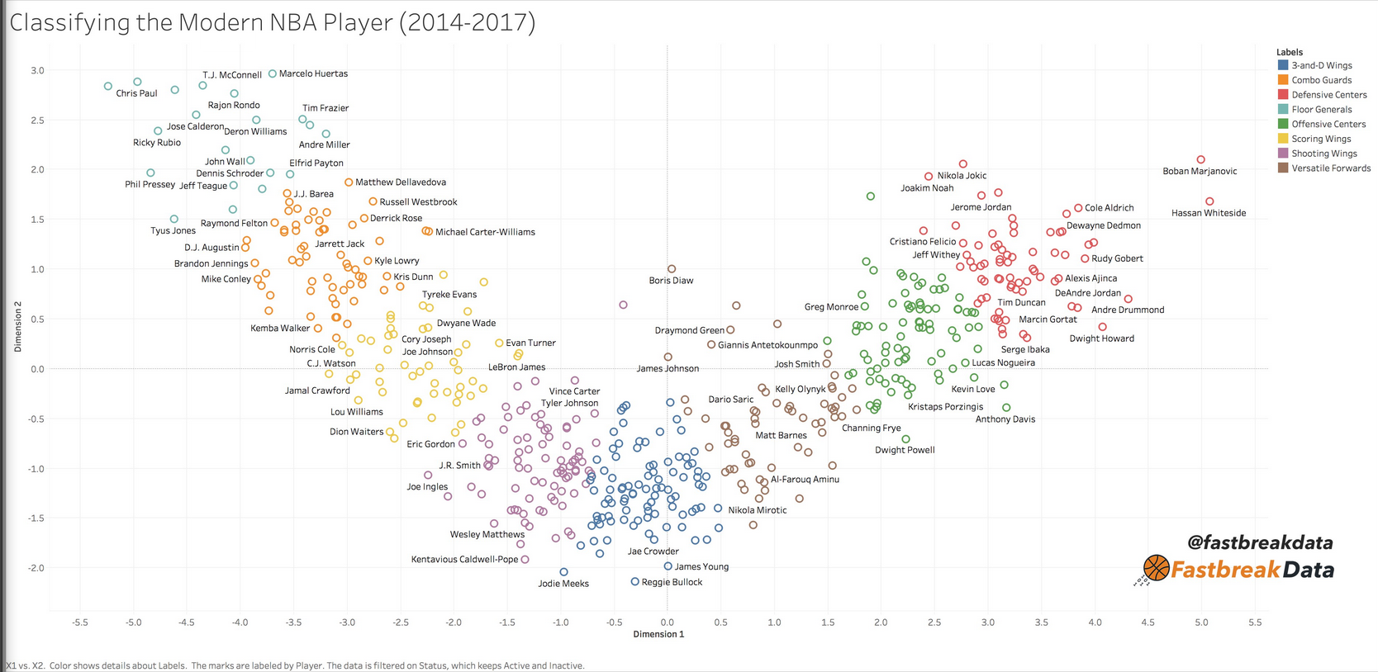
Modern Players: 8 semi-distinct types

Slide 9
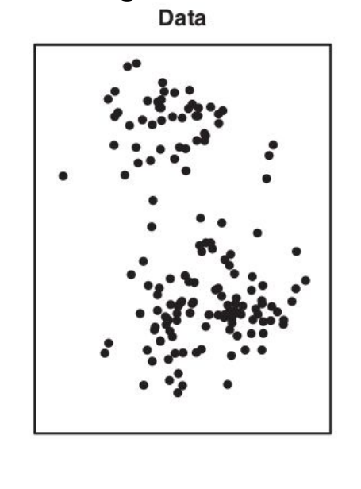
Clustering
Data Exists
Distributed Across Multiple Dimensions
Reason to believe (or suspect) that difference exist in the data that have not been explicitly labeled
Reason to believe (or suspect) that knowing these differences helps make decisions, or improve outcomes

Slide 10
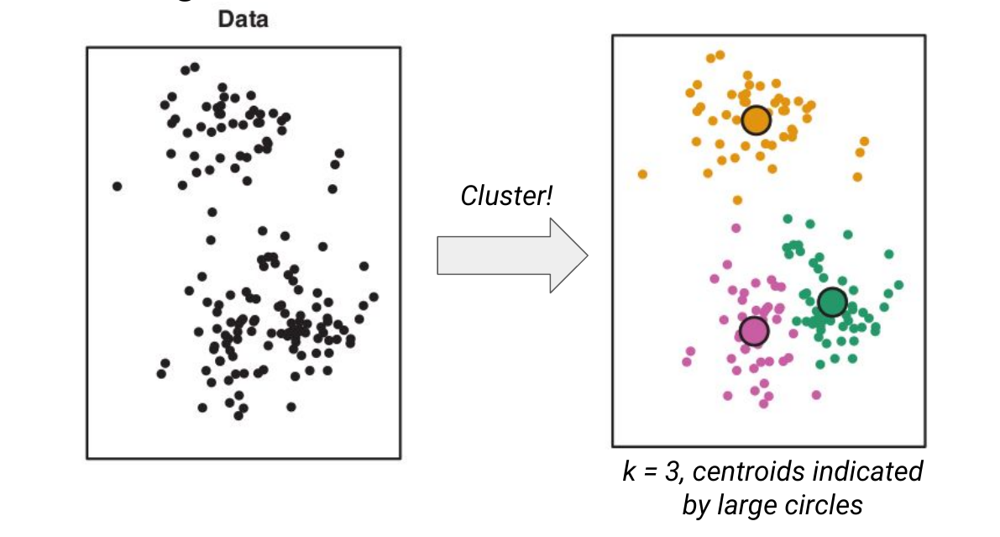
Hypothesis:
There is an unseen label that helps to explain the distribution of data.
This label can be deduced from the distributions of features

Slide 11
Objectives
Given unlabeled data, how can we infer labels?
How can we measure the integrity of these clusters?
How can we determine the appropriate number of clusters?
How can we use this new information to drive decisions?

Slide 12
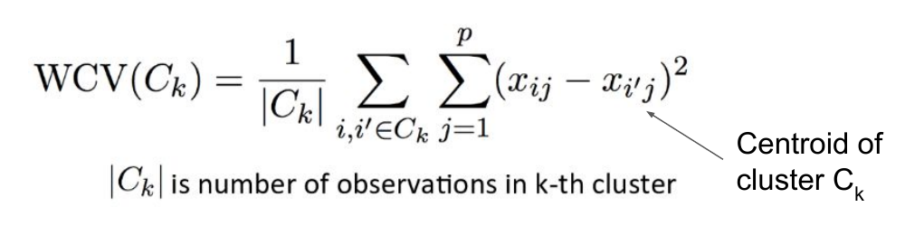
Measurement
A cluster is good when the points in the cluster are near to each other and far away from points outside of the cluster
Minimize “Within Cluster Variation”: WCV

Slide 13
WCV
The average distance from each point to the center of the cluster that contains that point
Extreme Case:
  If there is one point in every cluster, each point is the center of its own cluster. Therefore all distances are zero and WCV is minimized

Slide 14
K-Means Clustering
(Not to be confused with K-Nearest Neighbors)
Pick a value for k (number of clusters)
Randomly initialize k points (centroids)
Tentatively assign each observation point to the nearest centroid
Iterate:
  Move centroid points to the average position of all points that have been assigned to that cluster
  Re-assign observations to nearest centroid
Repeat until convergence

Slide 15
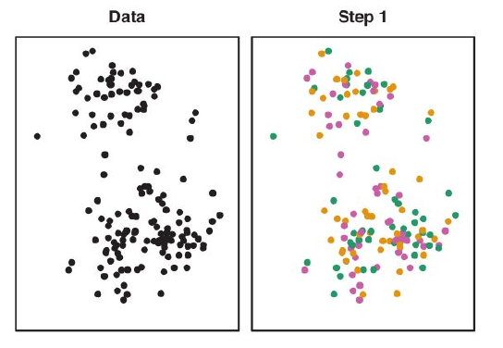
Step 1: Random Initialization
k = 3
  Green
  Orange
  Pink
All points randomly assigned to clusters
This ensure that centroids are within the range of data (but results in broad, overlapping clusters)

Slide 16
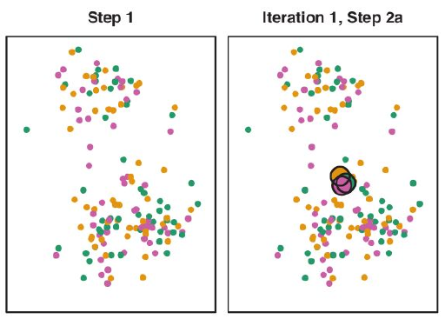
Step 2: Create Centroids
Compute the centroid of each cluster as the average position of all points of that cluster
Due to random initialization, each centroid will be near to the center of all data

Slide 17
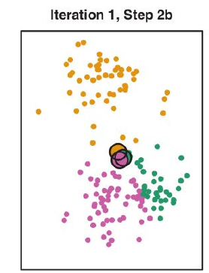
Step 3: Reassign Points according to nearest centroid
Discard information about how observation points were originally assigned to clusters
For each observation:
  Measure distance to each centroid
  Determine closest centroid
  (tentatively) Re-assign point to cluster with closest centroid

Slide 18
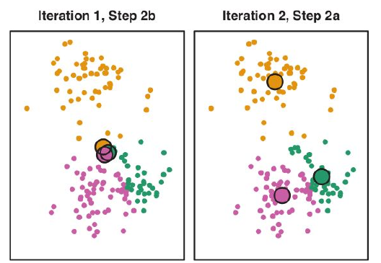
Step 4: Relocate Centroids
For each cluster:
  Identify the average position of all points in that cluster
  Discard previous information about centroid of that cluster
  Create new centroid at average position

Slide 19
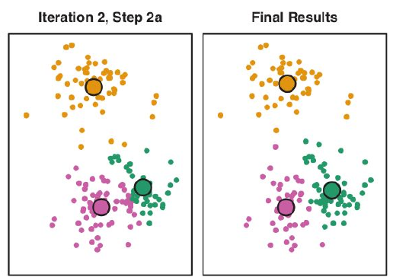
Iterate
Since centroids have just moved, some points may now lay closer to other centroids than their own.
Iterate:
  Reassign points to cluster with nearest centroid
  Relocate centroid to center of observations

Slide 20
Different Approaches to Initialization
Simplest: randomly choose k points from observations to serve as initial centroids
Randomly assign points to clusters (as shown above)
k-means++:
  Chooses well-spread initial centroids.
  First centroid chosen randomly.
  Subsequent centroids chosen with probability proportional to the squared distance to the closes existing centroid. (i.e, “fill in the gaps”)
  Default initialization in sklearn

Slide 21
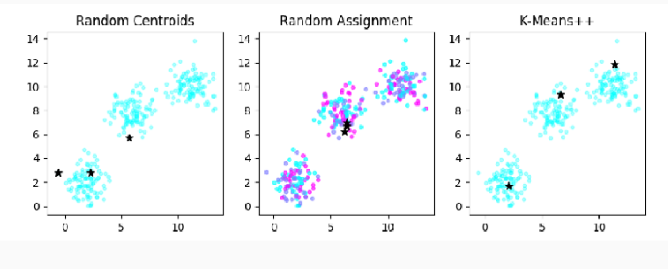
Initialization

Slide 22
Stopping Criteria
Repeat iteration process until:
  Specified number of iterations
    sklearn default: max_iter = 1000
  Centroids don’t change at all / No points change clusters
  Until centroids don’t move by very much
    Sklearn default: tol = 0.0001

Slide 23
Non-Deterministic
Due to random initialization, it is not assured that points will always be assigned to the same cluster
Especially if clusters are not well separated or wrong value of k is chosen
May be necessary to repeat clustering multiple times

Slide 24
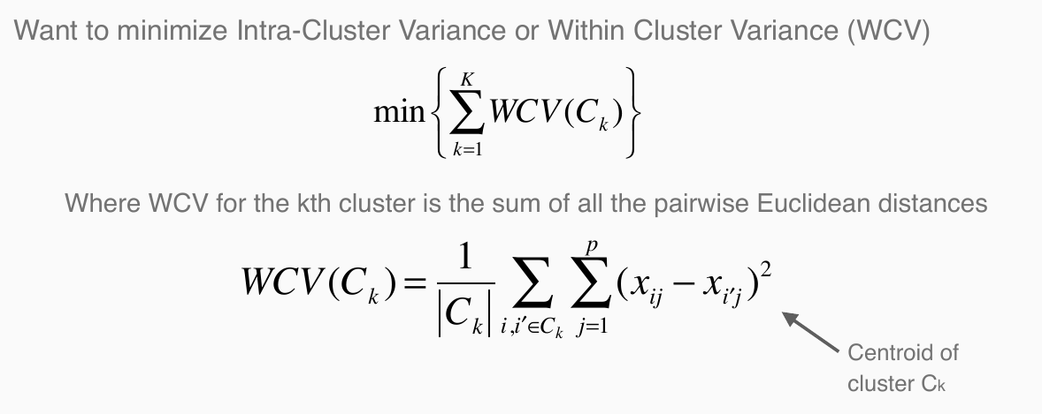
Evaluating Clustering

Slide 25
Picking the right value for k
No precise method: requires judgment call
Elbow Plot
Silhouette Score
GAP Statistic
Domain Knowledge

Slide 26
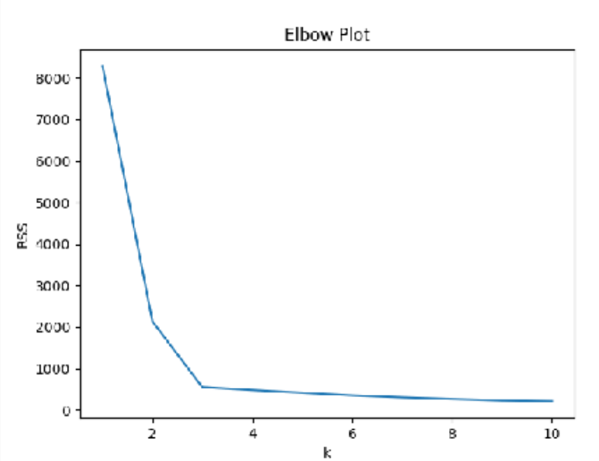
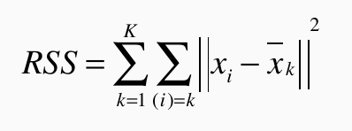
Elbow Plot
Increasing k will always result in lower RSS, with diminishing returns
Identify “elbow” where improvements become less significant
Preference for simpler models (lower k)

Slide 27
Silhouette Score
Good clusters should have:
  Low average intra-cluster distance (a)
  High average nearest-cluster distance (b)
  Silhouette = (b-a)/max(a,b)
  Best: 1: (a=0, S = b/b)
  Worst: -1: (b=0, S = -a/a)
  S = 0: indicates b=a, or intra-cluster equal nearest=cluster distance

Slide 28
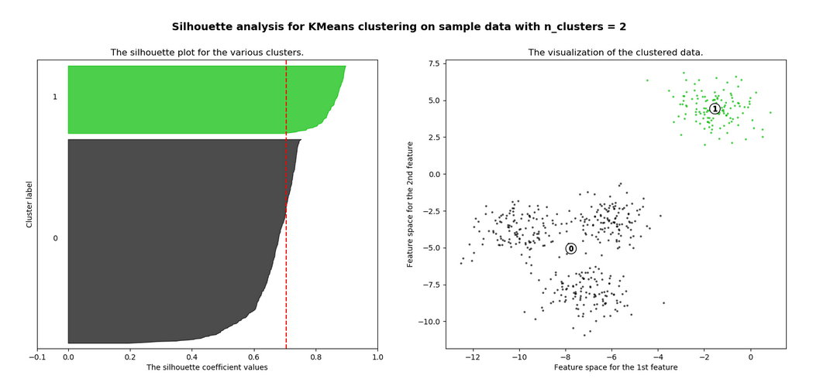
Silhouette Plots (k=2)

Slide 29
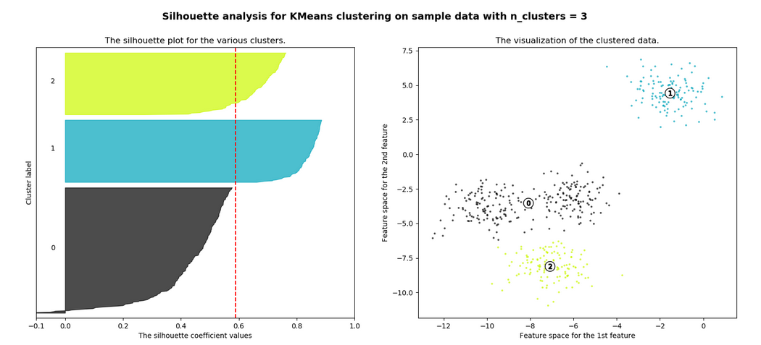
K = 3

Slide 30
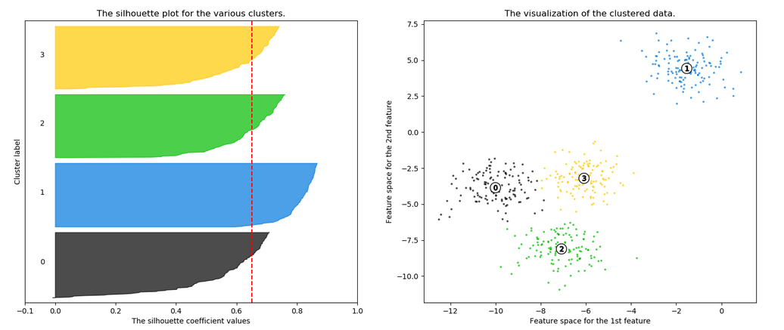
K = 4 (ideal)

Slide 31
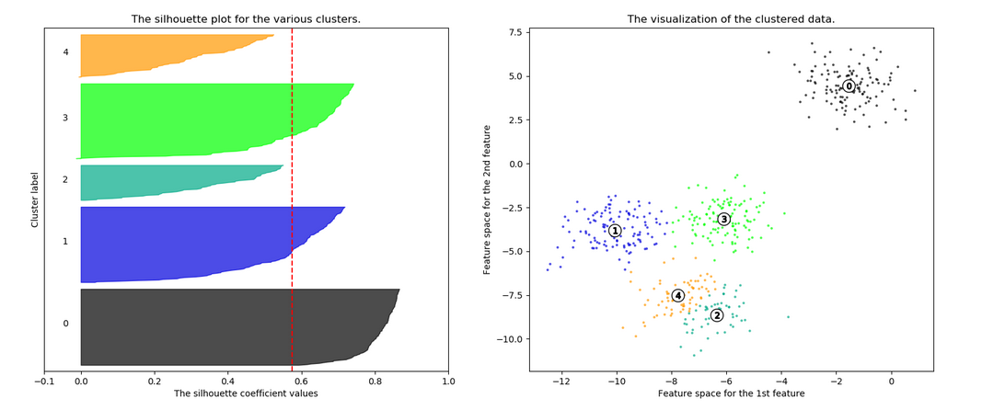
K = 5 (too many)

Slide 32
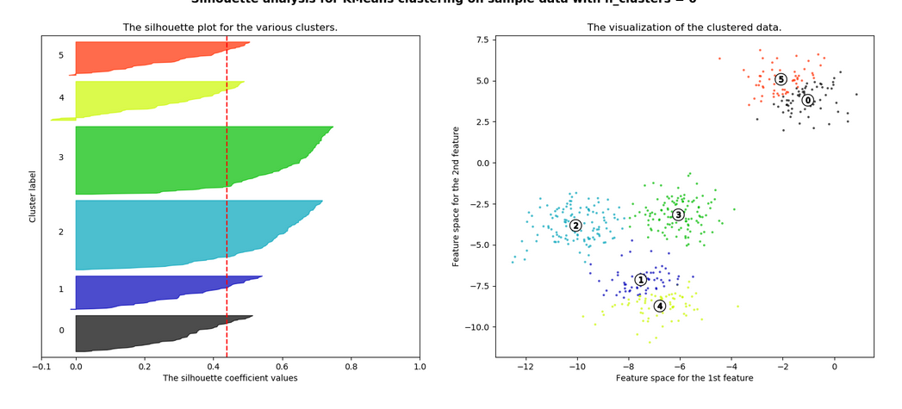
K = 6

Slide 33
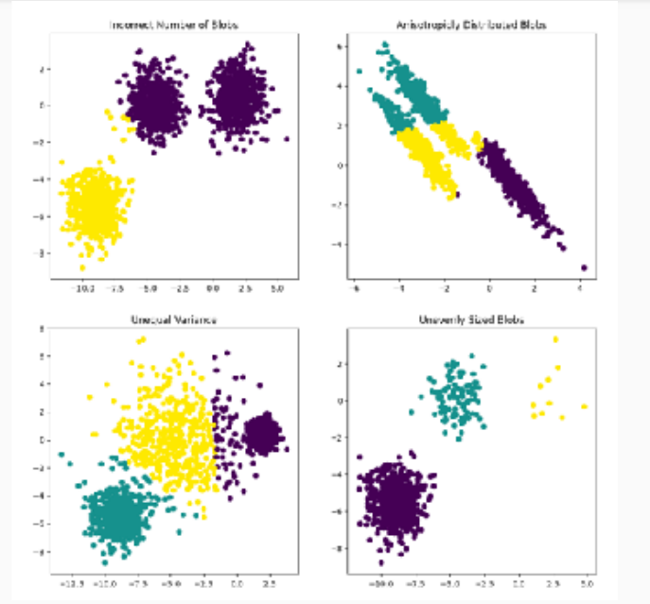
Assumptions
Correct k
Equal Variance
Isotropic Shape
Clusters do not need same number of points

Slide 34
Hierarchical Clustering
Do not pick k value in advance
Effectively scan through a range of k
Deterministic: no random initialization. Always same results
Not limited to Euclidean distance

Slide 35
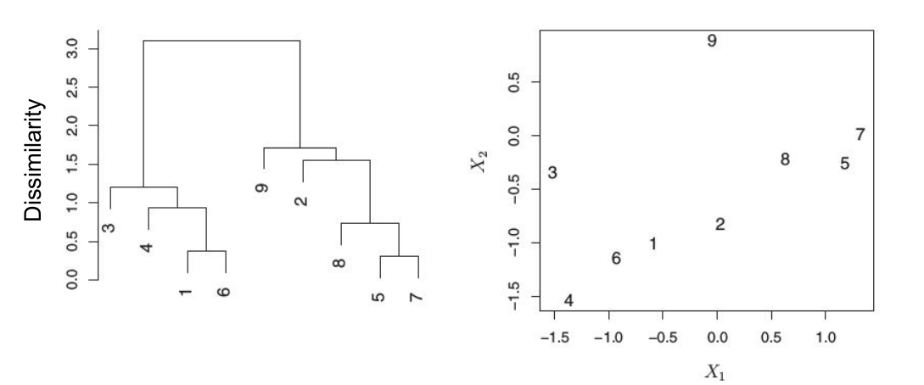
Dendrogram
X-axis arbitrary
Y-axis: distance at which a connection can be made
Points connected low are most similar
Points connected high are most distant

Slide 36
Hierarchical Clustering Algorithm
For each observation, measure distance to all other observations.
Distance may be euclidean, cosine, etc
Identify closest points
Chart closest points on dendrogram at height = distance
Fuse into a new cluster
Recalculate distances between all points/clusters
Continue until all points/clusters have been fused

Slide 37
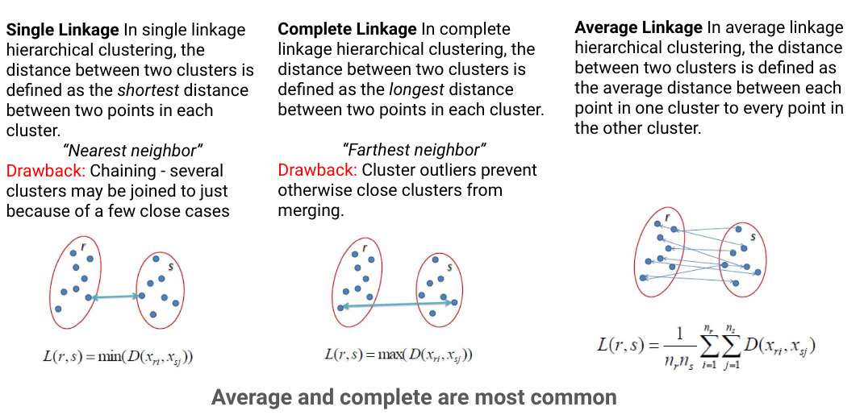
Fusing

Slide 38
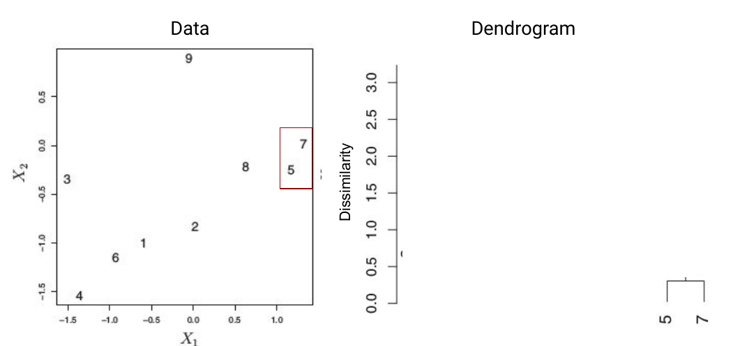

Slide 39
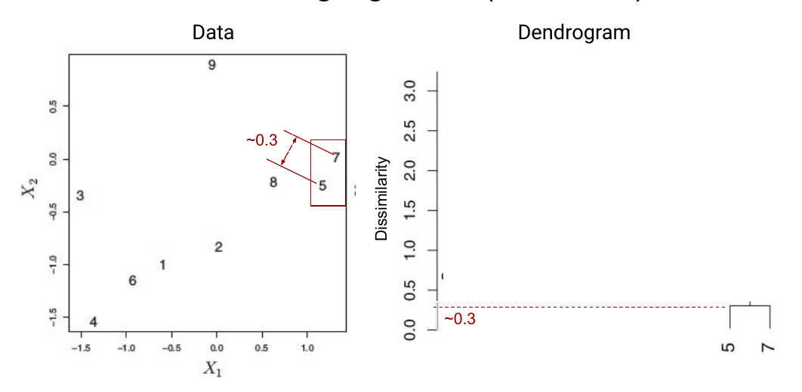

Slide 40
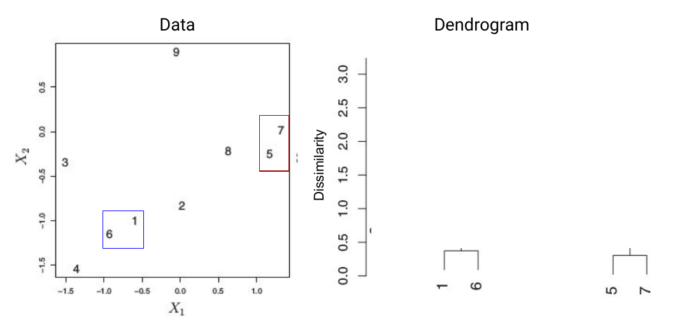

Slide 41
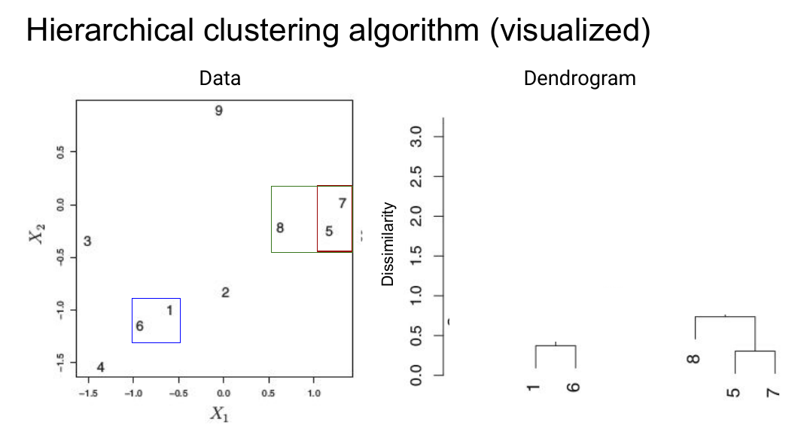

Slide 42
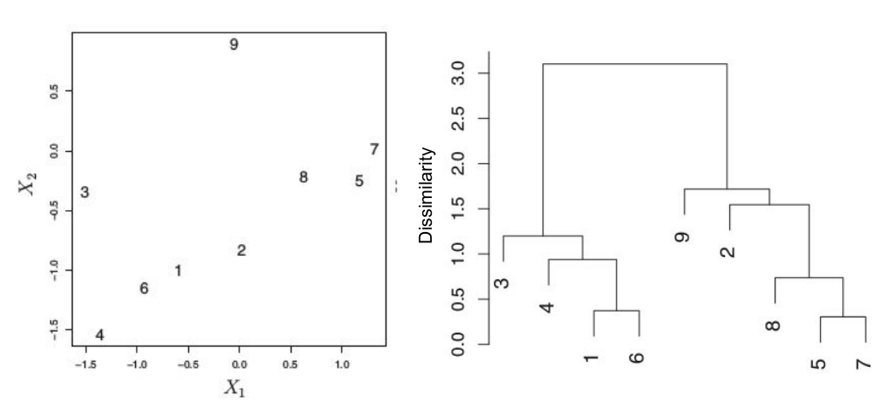

Slide 43
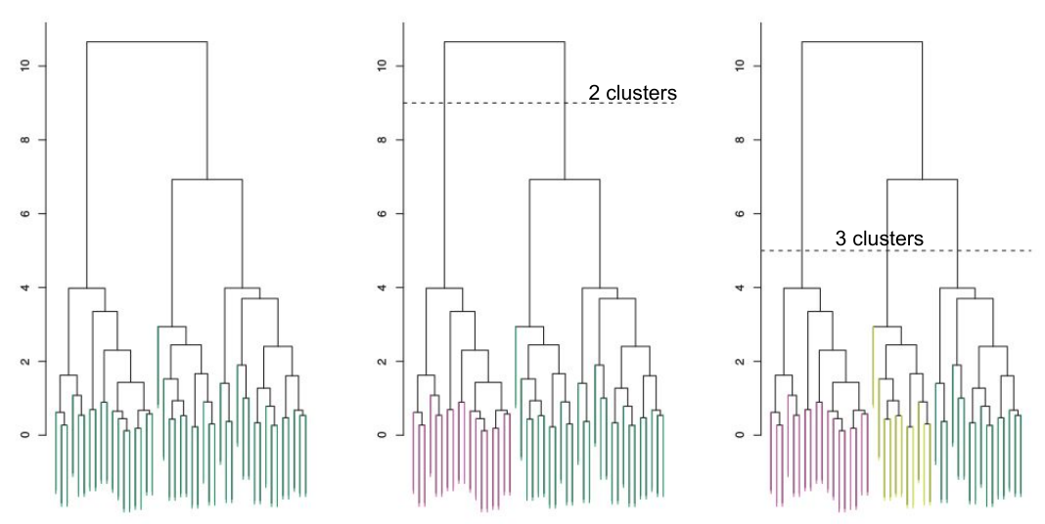
Selecting k

Slide 44
Summary Questions
When do you choose k in each method?
What methods help pick k?
What is a stopping criteria?
What is the stopping criteria for hierarchical clustering?
How do we initialize centroids in k-Means?
What’s a good cluster?

