Slide 1
Budget Forecast Roads – Rail – Ponds
2026 April 22
PM Roger Campbell

Slide 2
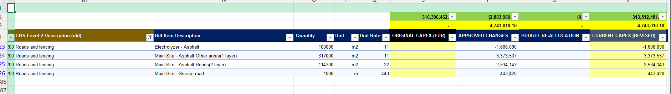
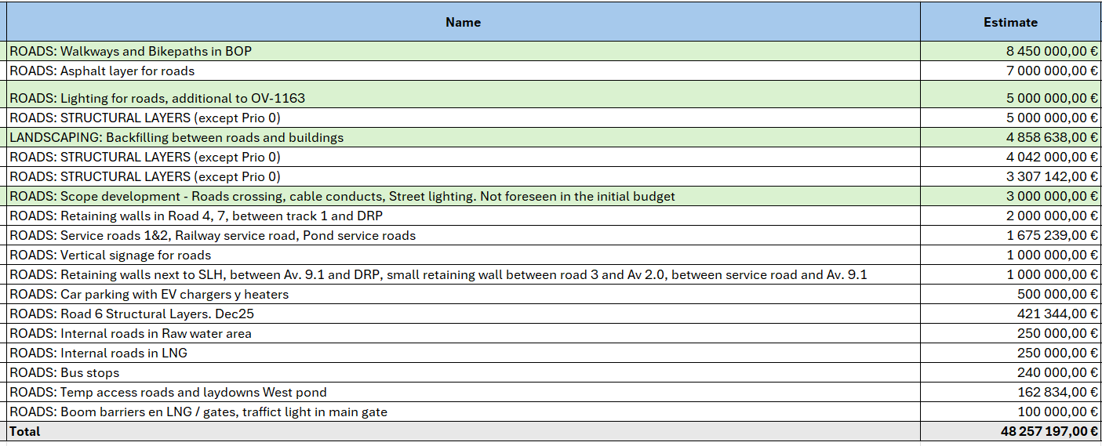
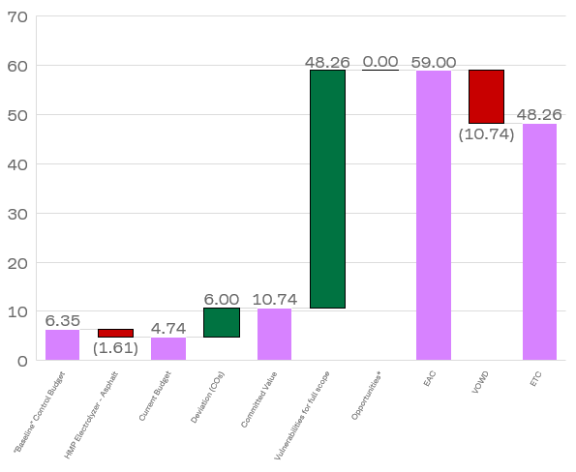
Roads
Only asphalt considered in the budget
Budget Forecast
Budget
Vulnerabilities
SoW
Length ≈16 km (load classes BK4, IHT180, IHT330)
Structural layers ≈300k m³
Concrete roads ≈12k m²
Walkpaths + Bikepaths + Lightning + Signals + EV chargers + Bus stops + Parking lot
* Value Engineering ongoing
Source: BOP Monthly cost report March 2026

Slide 3
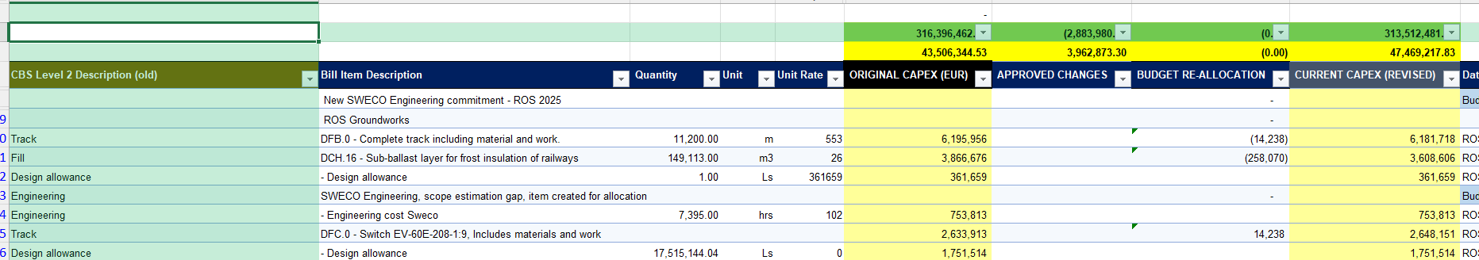
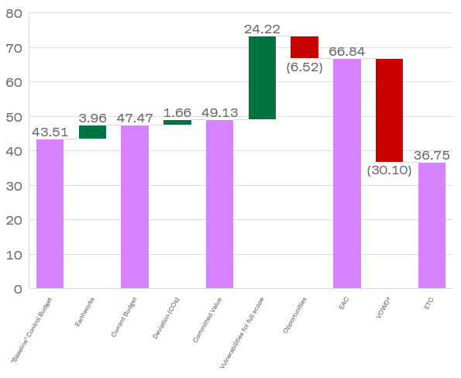
Rail
Budget Forecast
Budget
Vulnerabilities & Opportunities
* 18m€ GWs legacy work without information
Source: BOP Monthly cost report March 2026

Slide 4
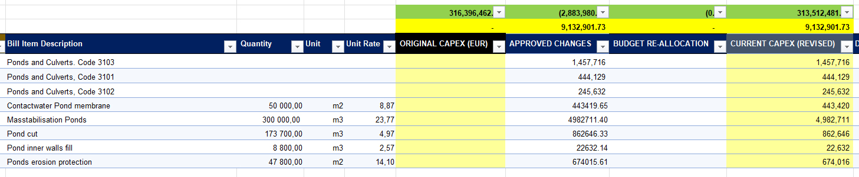
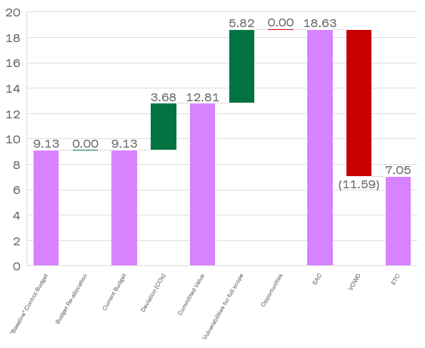
Ponds
Budget Forecast
Budget
Vulnerabilities
Source: BOP Monthly cost report March 2026

